Slide 1
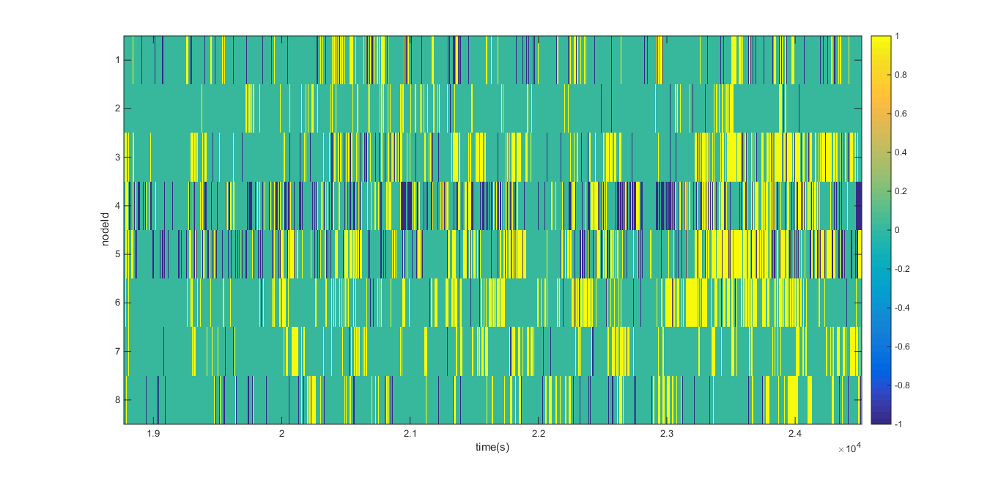
% packet lost
7.66
1.015
5.656
23.6678
14.0574
1.4888
0.966
4.5416

Slide 2
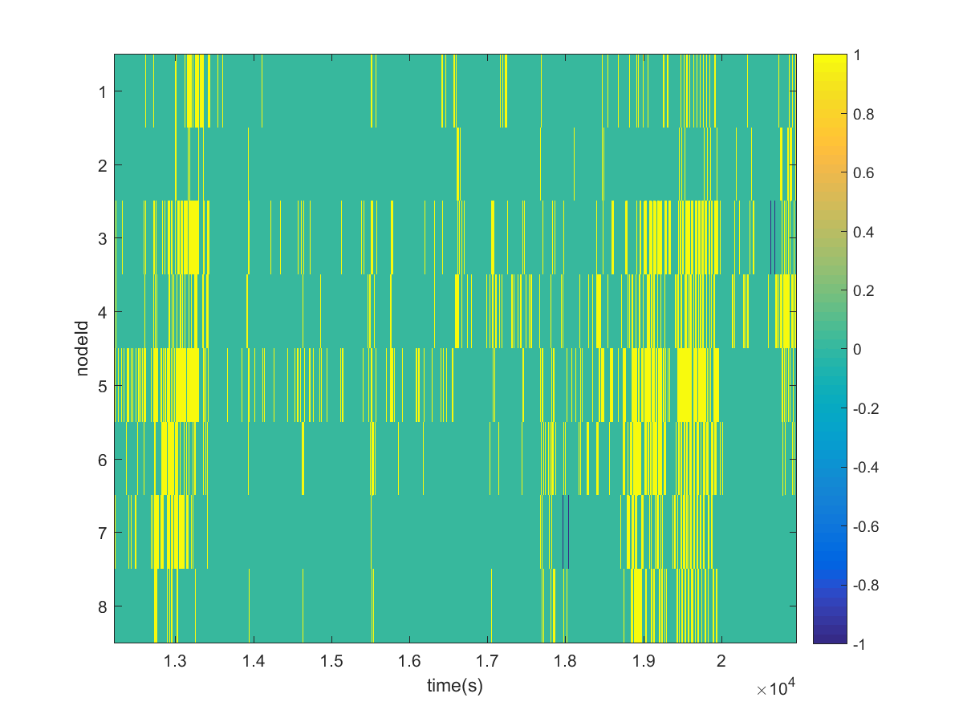
Packet lost % | num packet lost
0 | 0
0 | 0
0.0007 | 2
0 | 0
0 | 0
0 | 0
0.0017 | 5
0 | 0

Slide 3
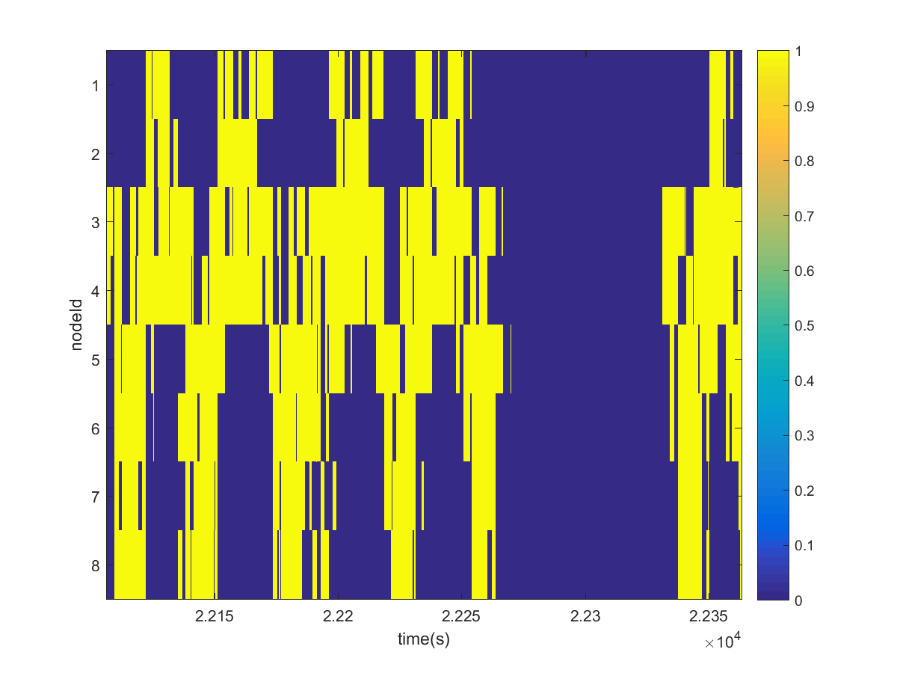
Test the correlation between the nodes
Walking back and forth 4 times from 8 to 1.
Went out
Came back in
Walking from 3-5-7-1.

Slide 4
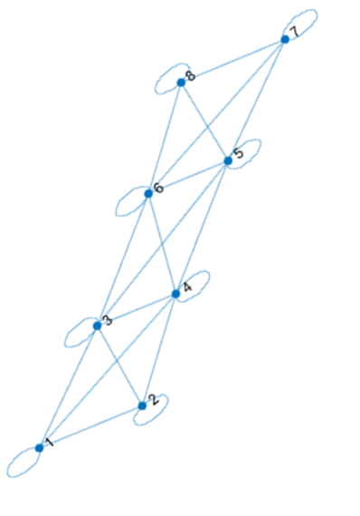
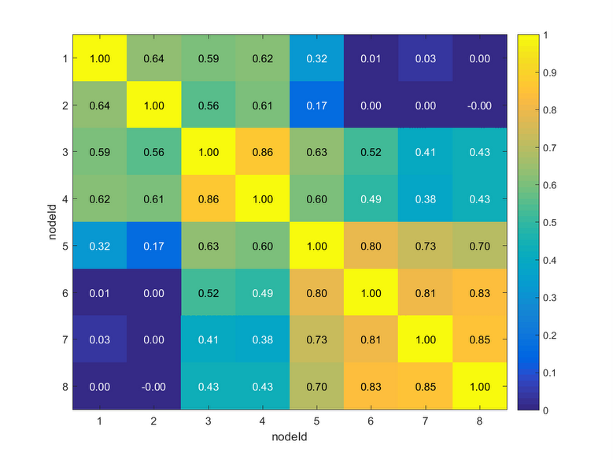
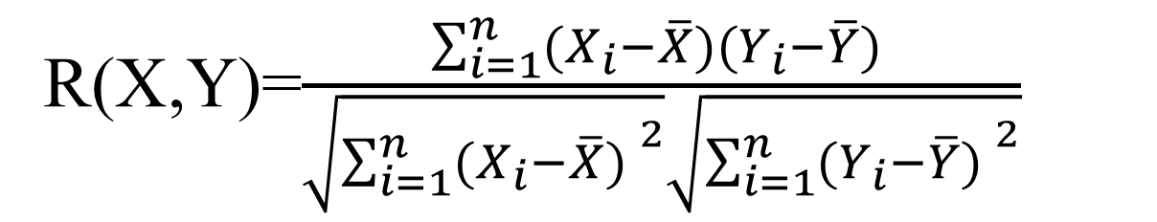
R(X,Y)=$\frac{\sum_{i=1}^{n}{(X_{i}−\overline{X})(Y_{i}−\overline{Y}) }}{\sqrt{{\sum_{i=1}^{n}{(X_{i}−\overline{X}) }}^{2}}\sqrt{{\sum_{i=1}^{n}{(Y_{i}−\overline{Y}) }}^{2}}}$
Threshold of 0.48
Connectivity graph

Slide 6
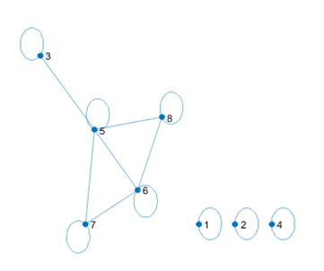
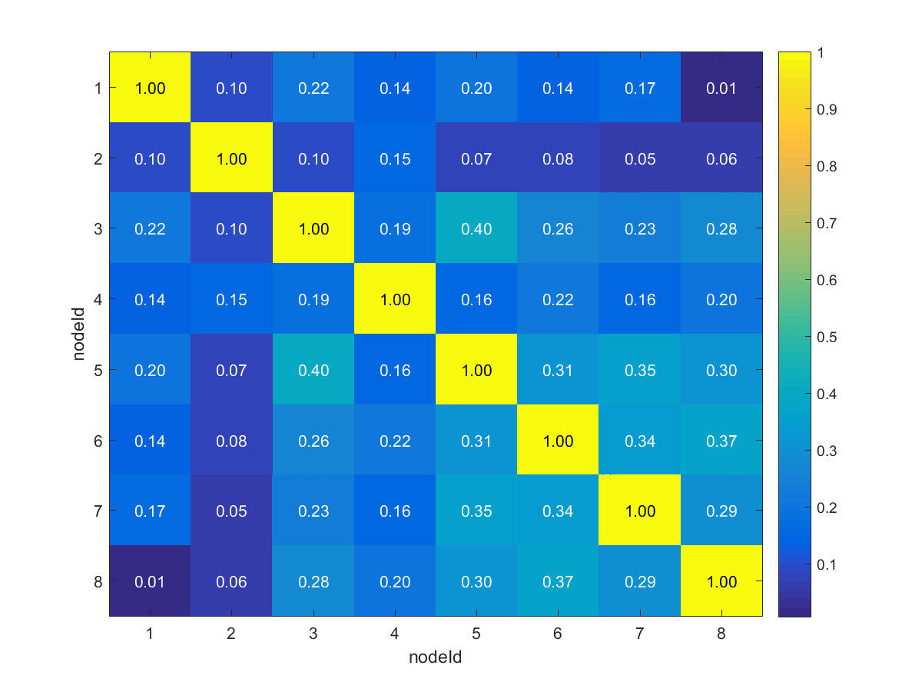
Connectivity graph threshold of 0.30

Slide 7
Calculate the transition
Steps
Divide the

Slide 8
Is it possible to separate the PIR output caused due to a person sitting in his workplace and moving around.
If it is possible then filter out the portion of the pir output caused due to a person sitting in his workplace from that caused due to walking around.
Then apply the correlation to check for the neighboring nodes.

