Slide 1
Agreed Goals last week
Improve packet reception.
Data analysis- EMD, correlation.
Summary of work done
Improve packet reception in TI and Memsic sensors.
Correlation between PIR sensor data.
Correlation for Light sensor data.
Correlation of IMF obtained by calculating EMD for light sensor data.

Slide 2
Improving packet reception.
Measures taken:
Increase in the transmission power.
Changing batteries.
Removing few obstacles.
For memsic sensor data time slot of 50ms with 5 retransmission and 6ms delay.
Result for memsic sensor : packet lost 2% and 7%.

Slide 3
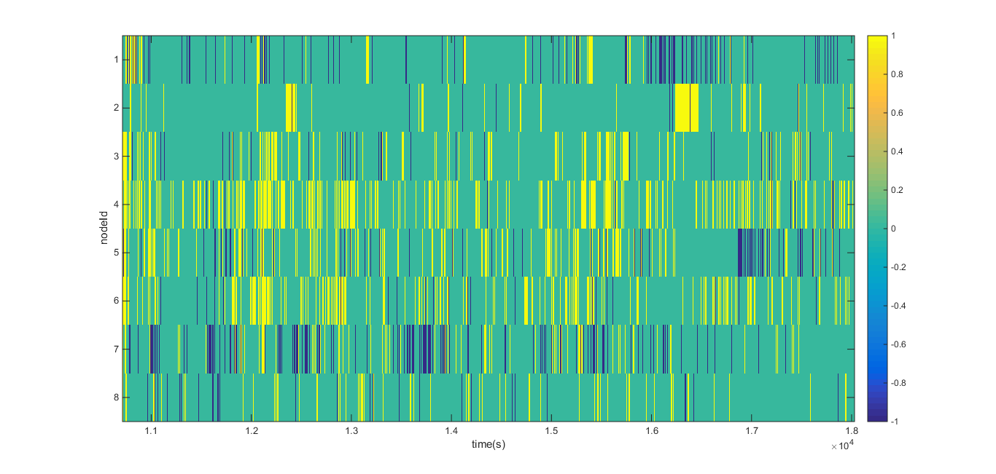
% packet lost
9.9452
2.1413
2.6574
1.168
7.9882
1.8345
11.3063
3.5065

Slide 4
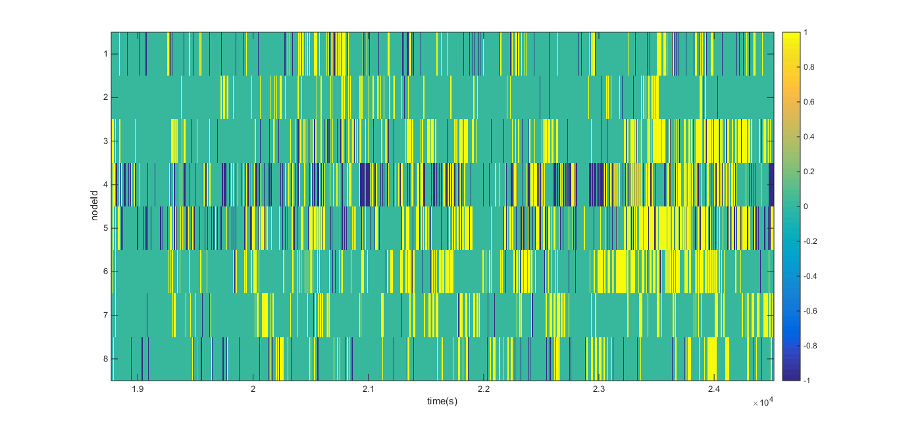
% packet lost
7.66
1.015
5.656
23.6678
14.0574
1.4888
0.966
4.5416

Slide 5
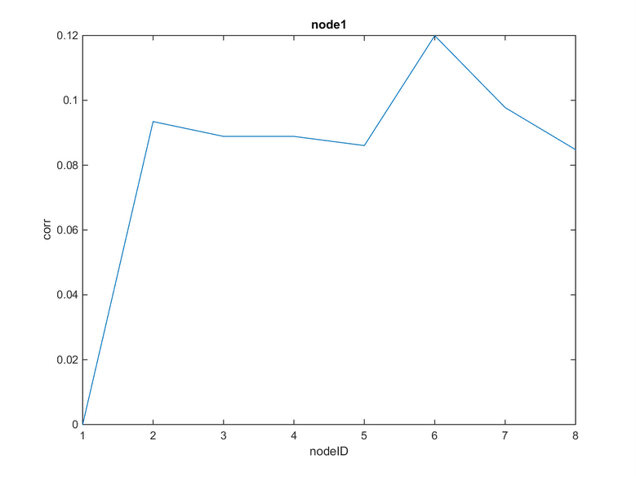
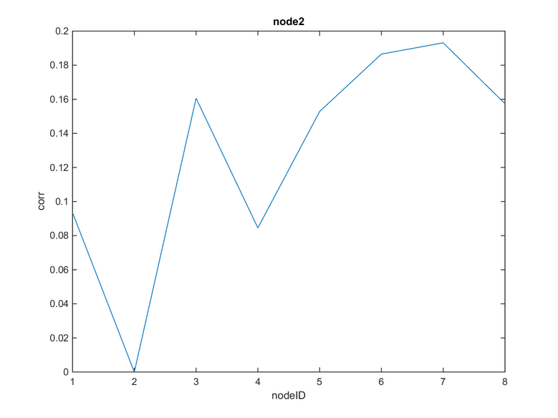
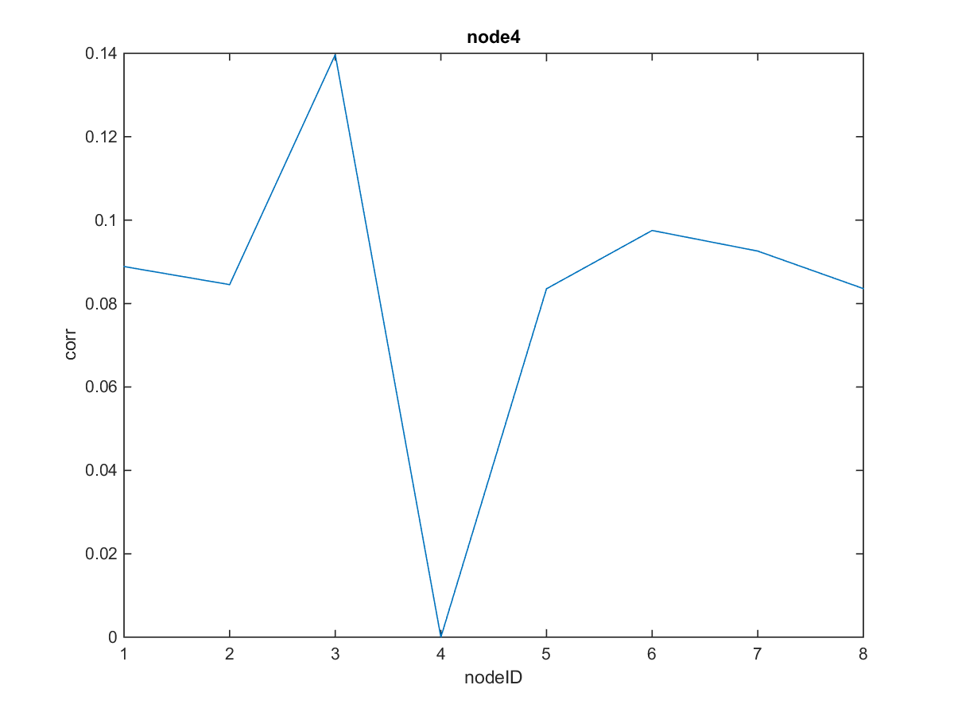
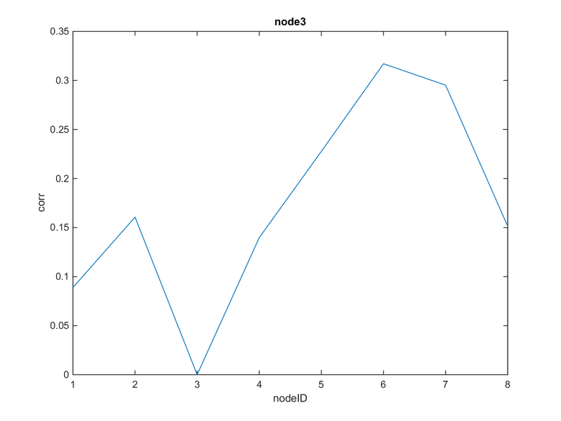
Correlation coefficient for PIR
Correlation analysis for : Afterlunch_12_02_17_28

Slide 6
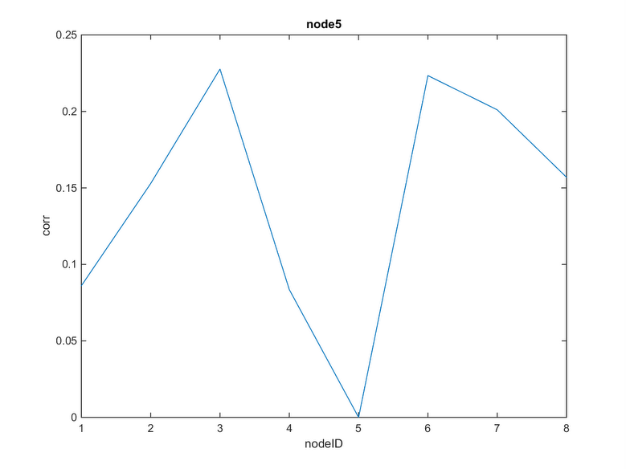
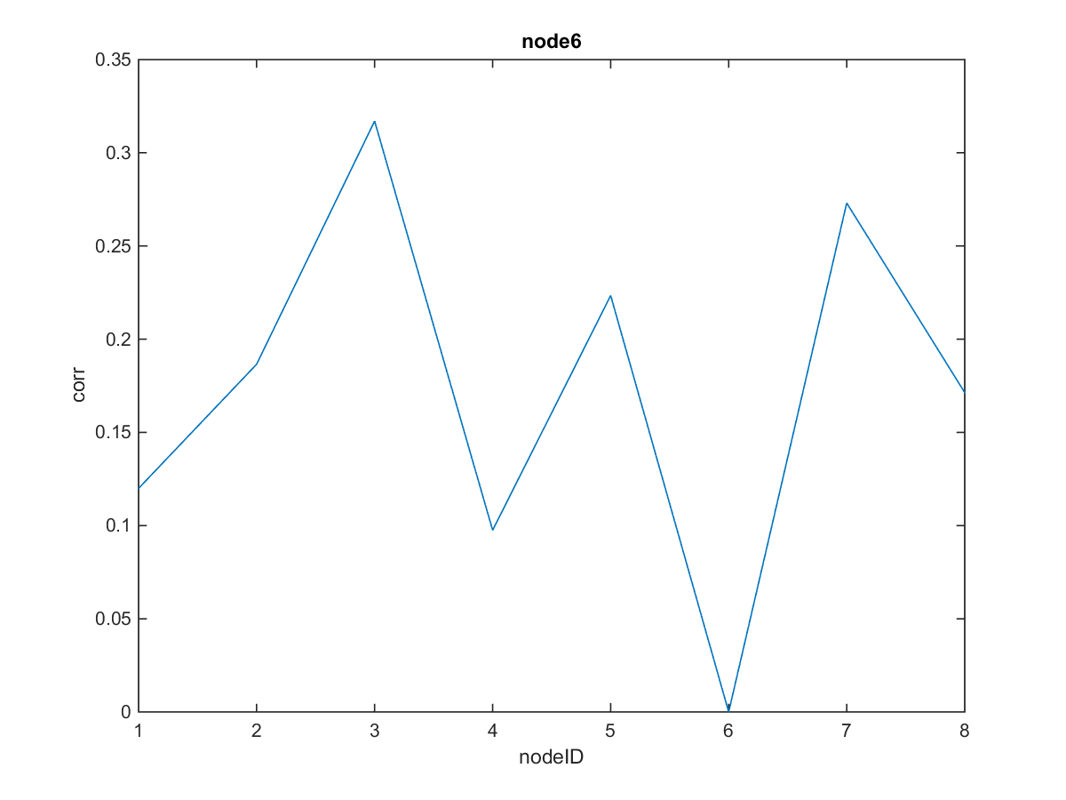
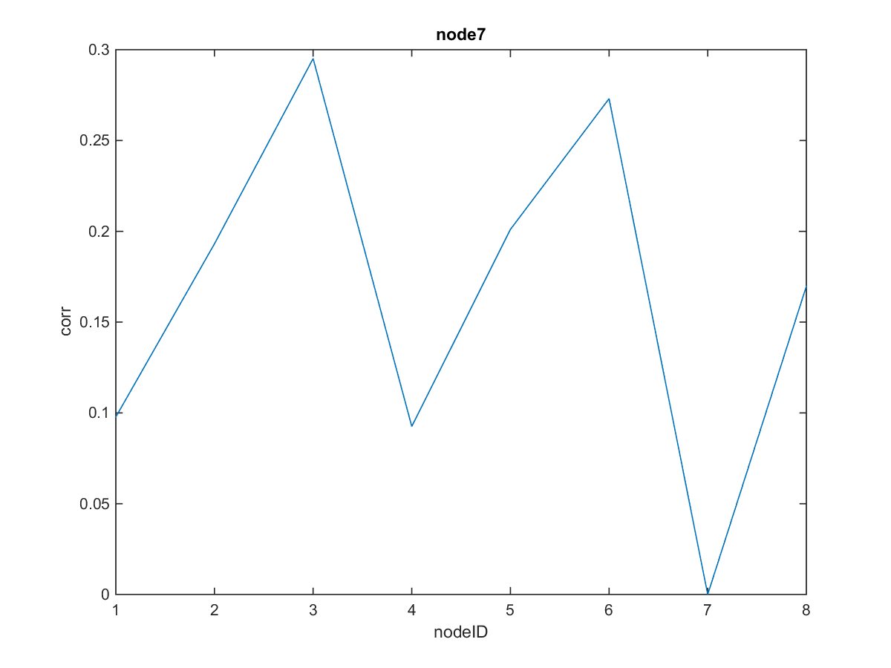
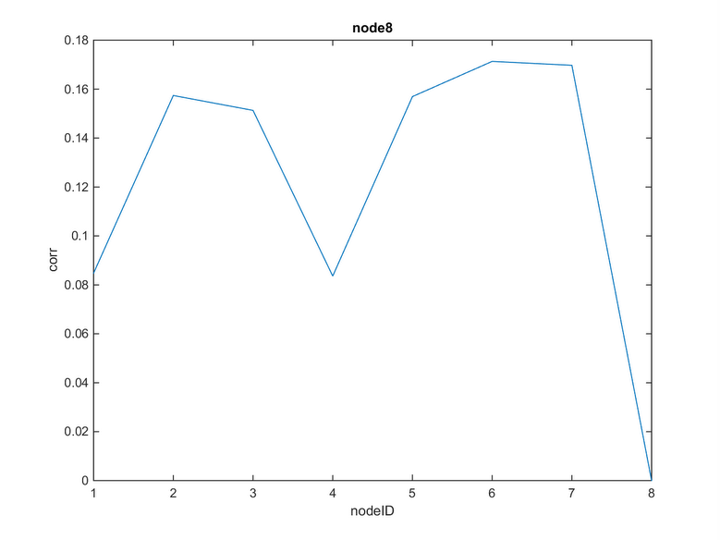

Slide 7
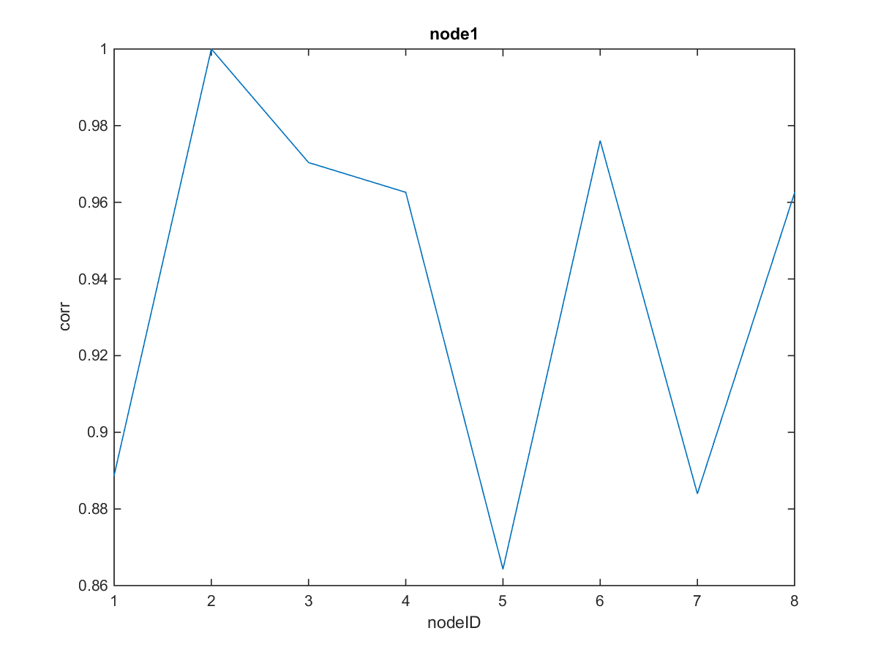
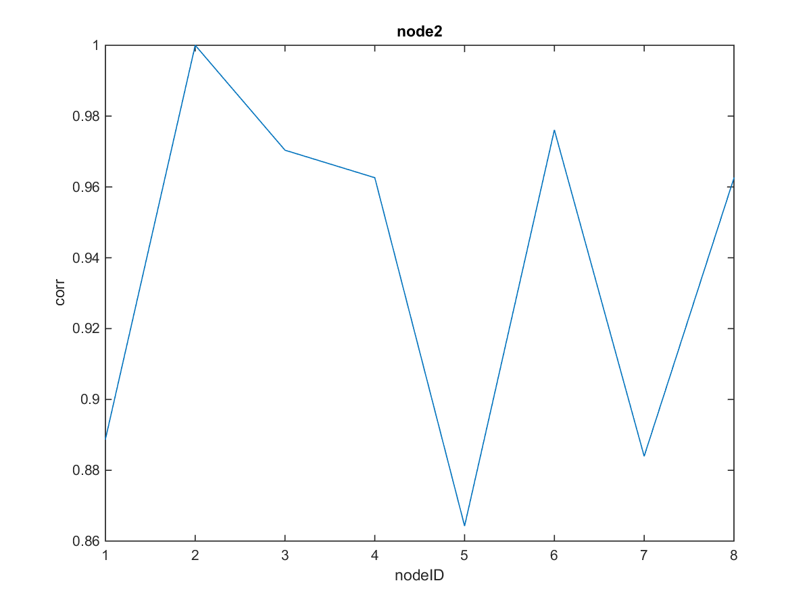
Correlation for light sensor data.

Slide 8
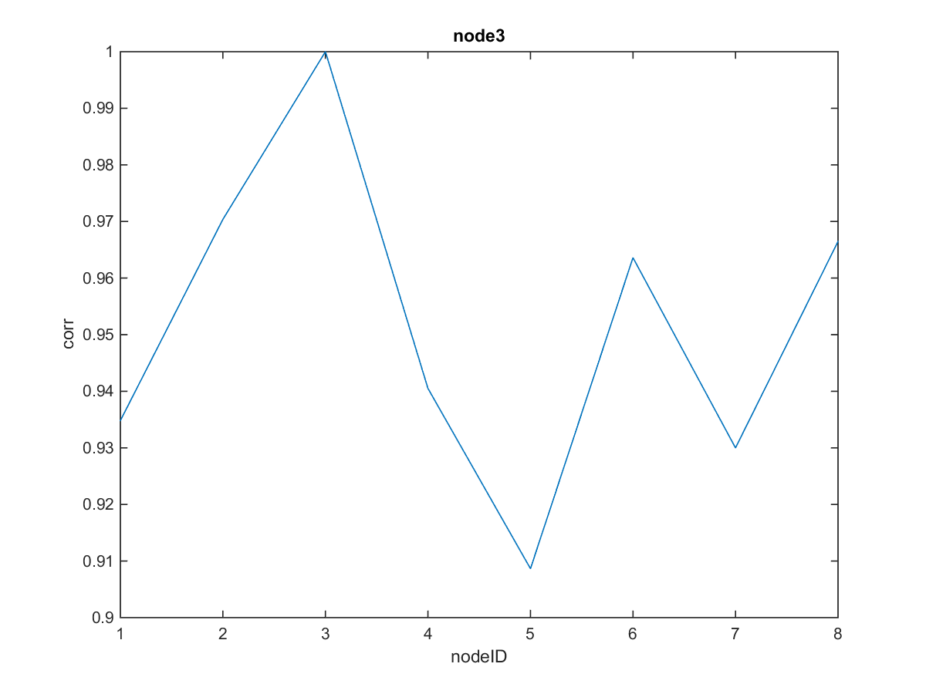
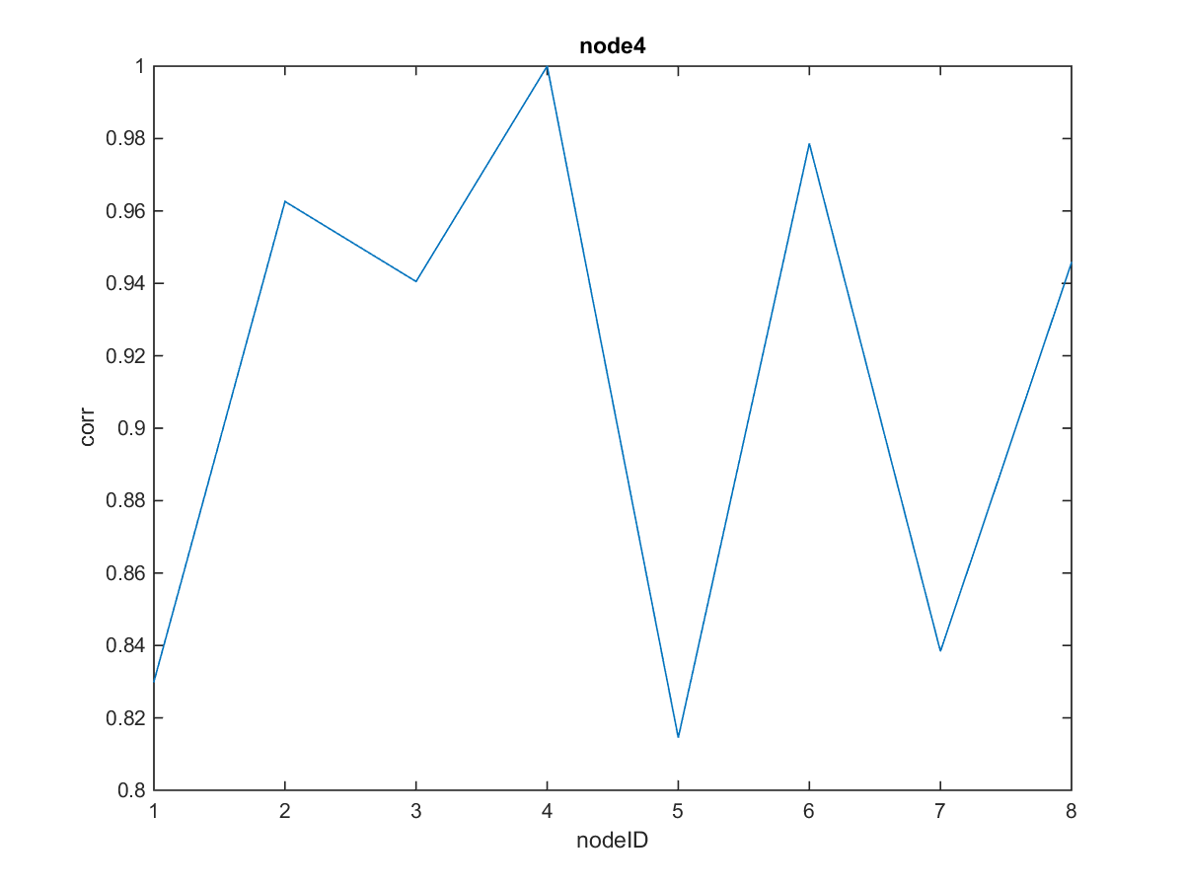

Slide 9
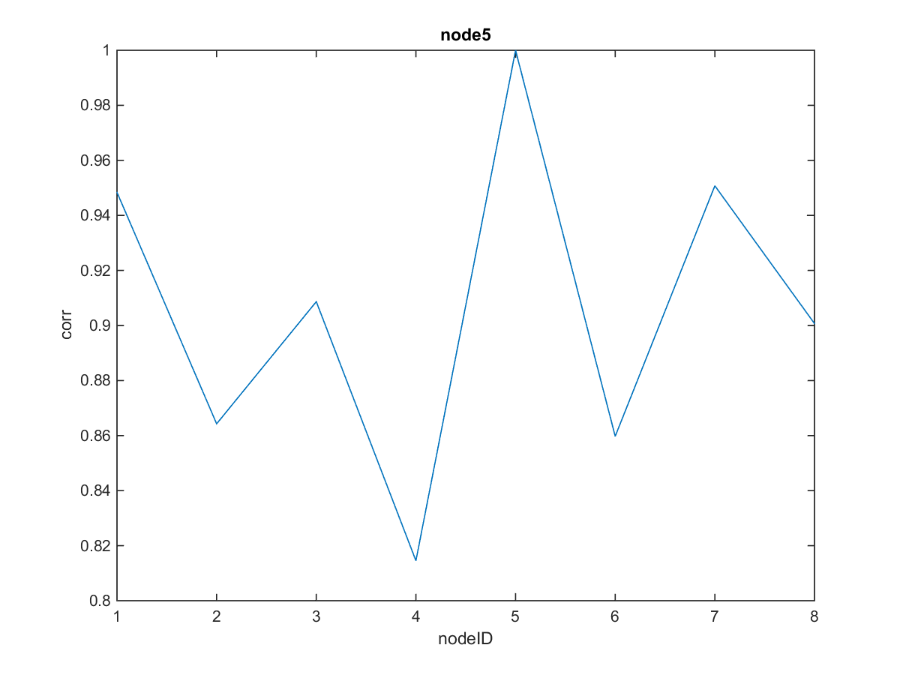
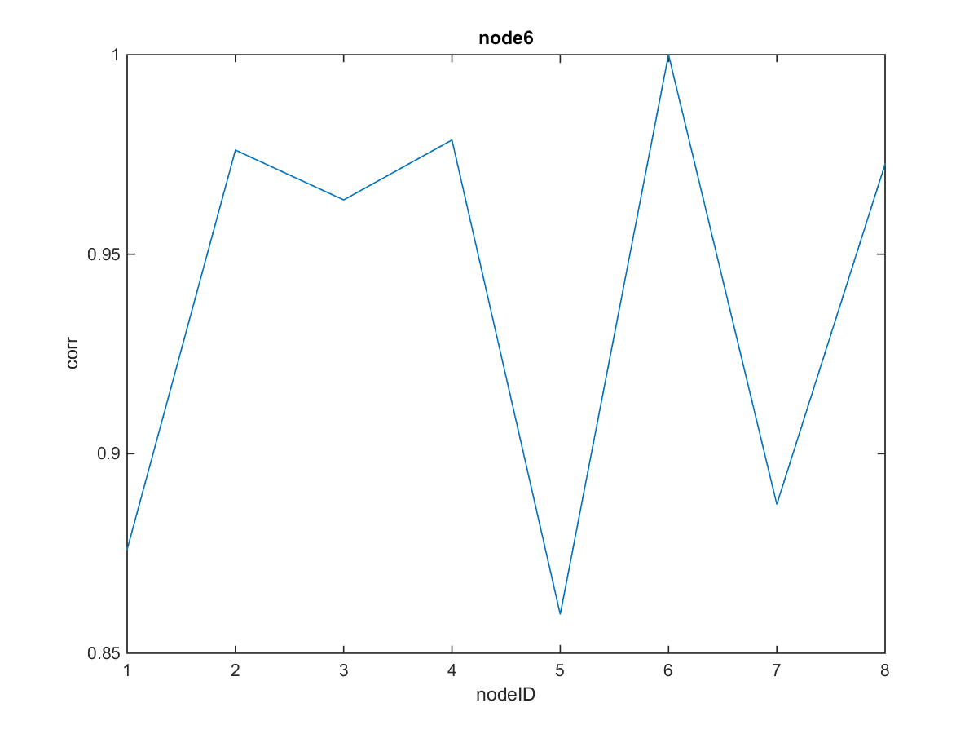

Slide 10
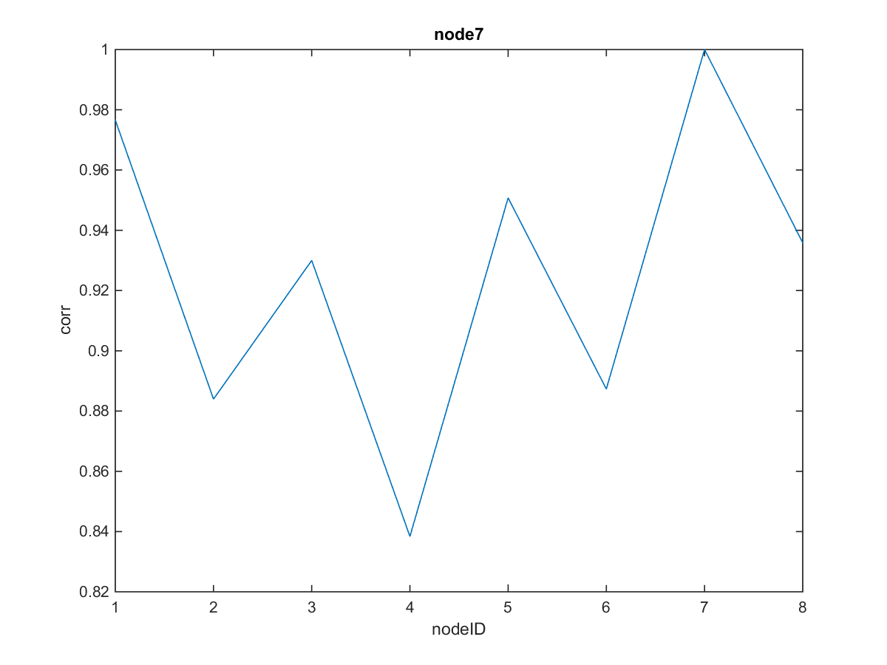
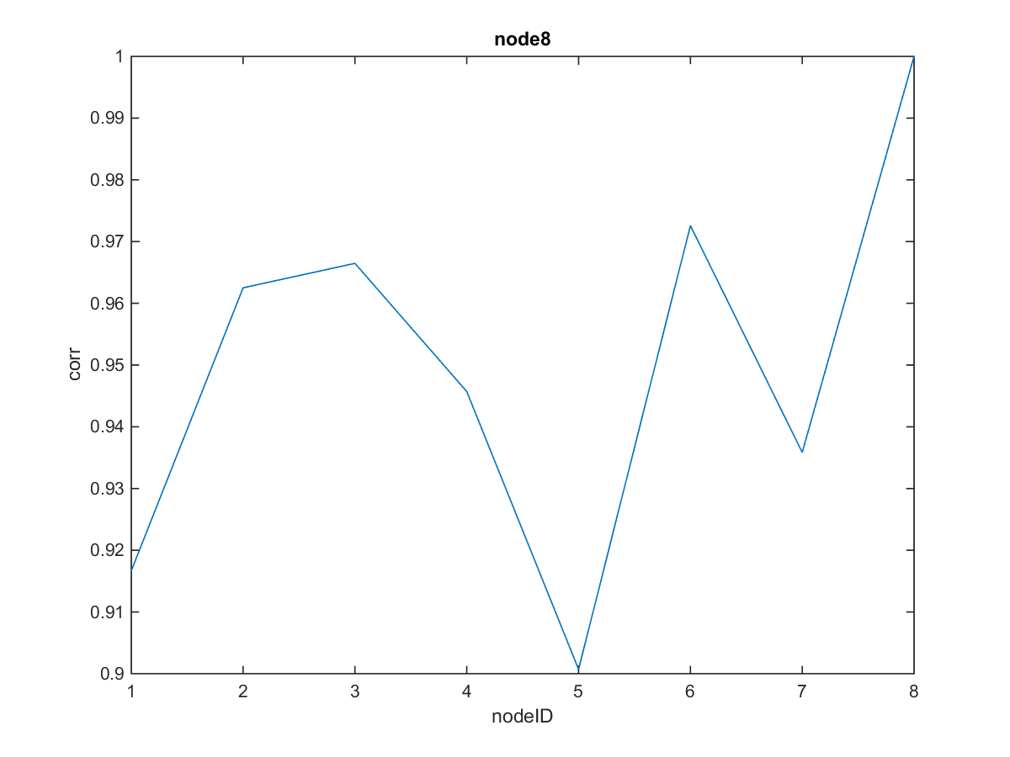

Slide 11
Empirical Mode Decomposition(EMD)
EMD is a process, not a theoretical tool.
EMD calculation:
compute lower and upper envelopes from interpolations between extrema
substract mean envelope from signal
iterate until mean envelope = 0 and #{extrema} = #{zero-crossings} ± 1
substract the obtained Intrinsic Mode Function (IMF) from signal and iterate on residual
EMD removes the low frequency trends in the traces and compare the readings at high frequencies.
Occupancy and room activities occur at random times during the day and change at a higher frequency than weather patterns.

Slide 12
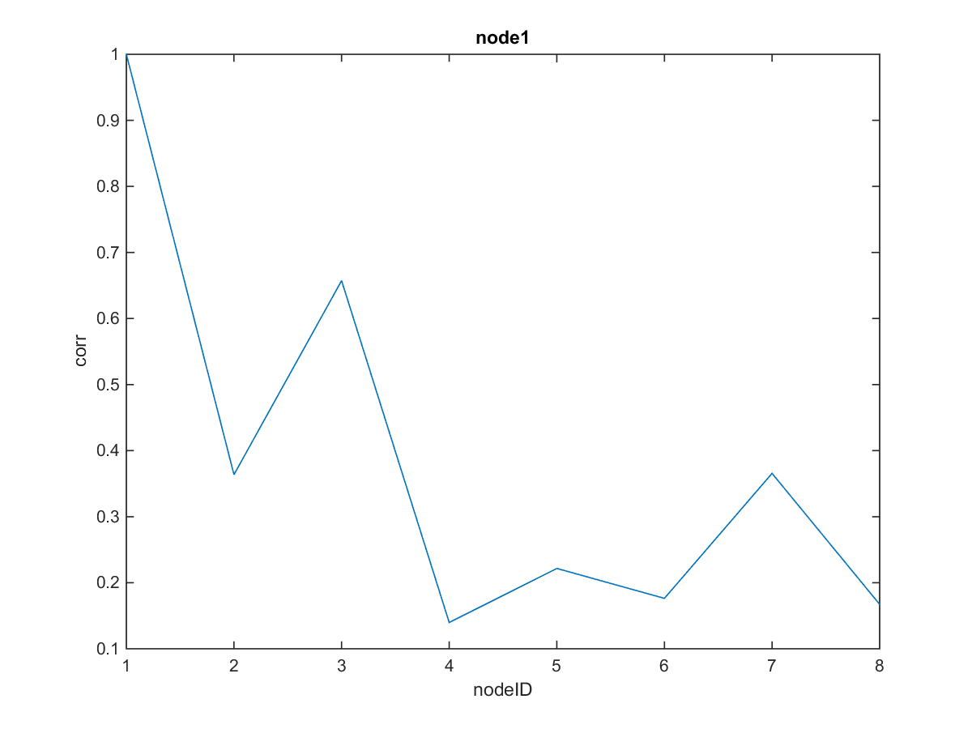
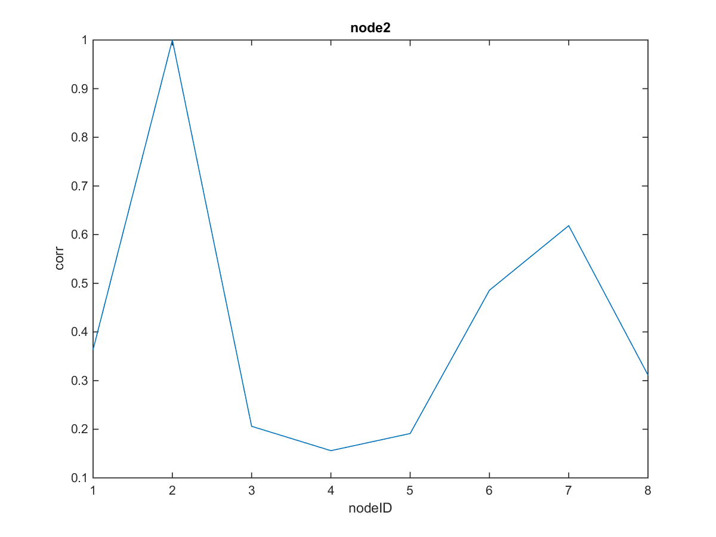

Slide 13
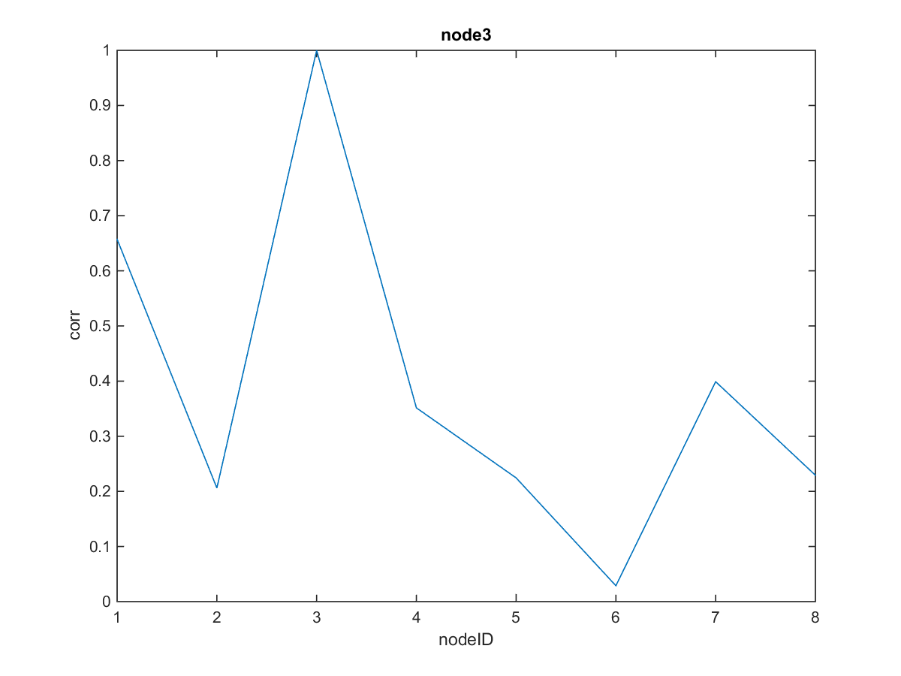
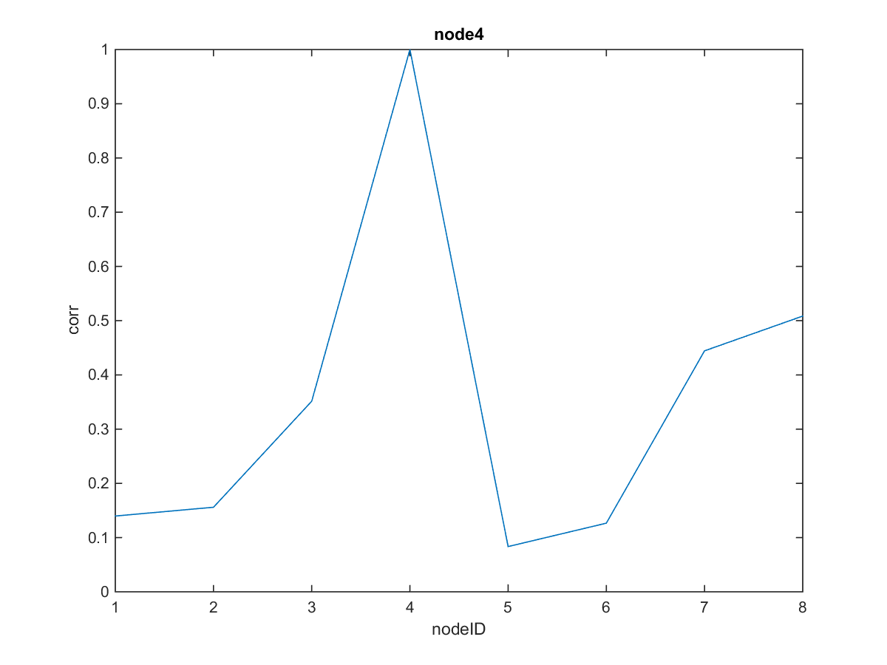

Slide 14
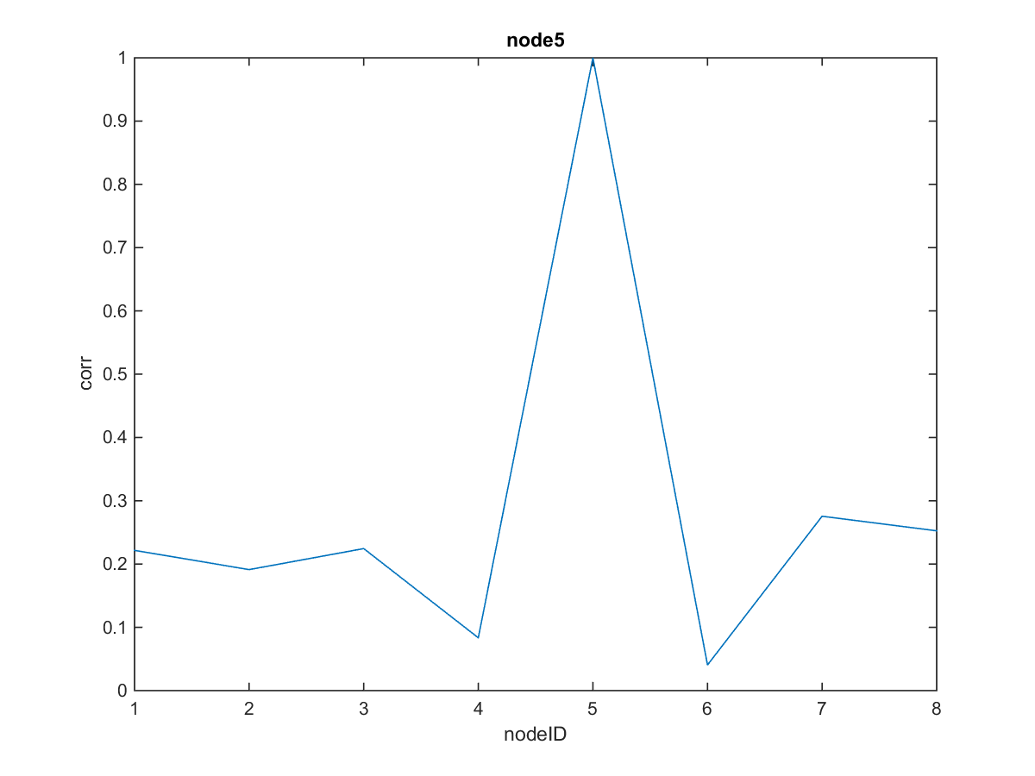
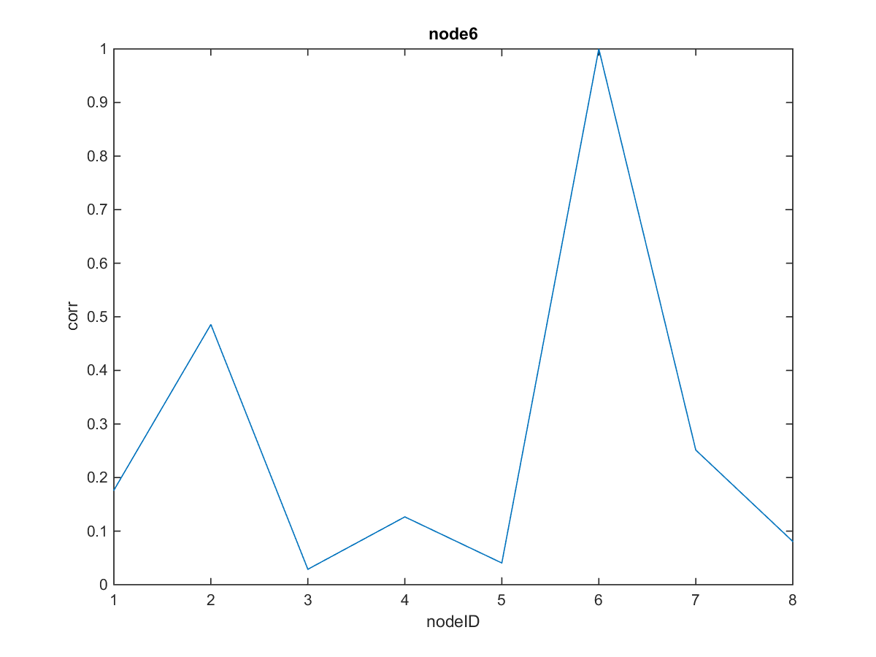

Slide 15
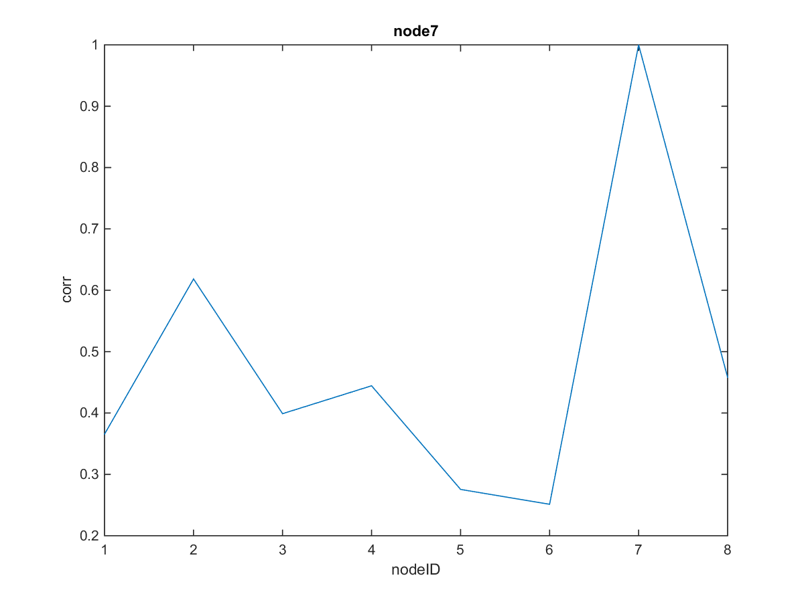
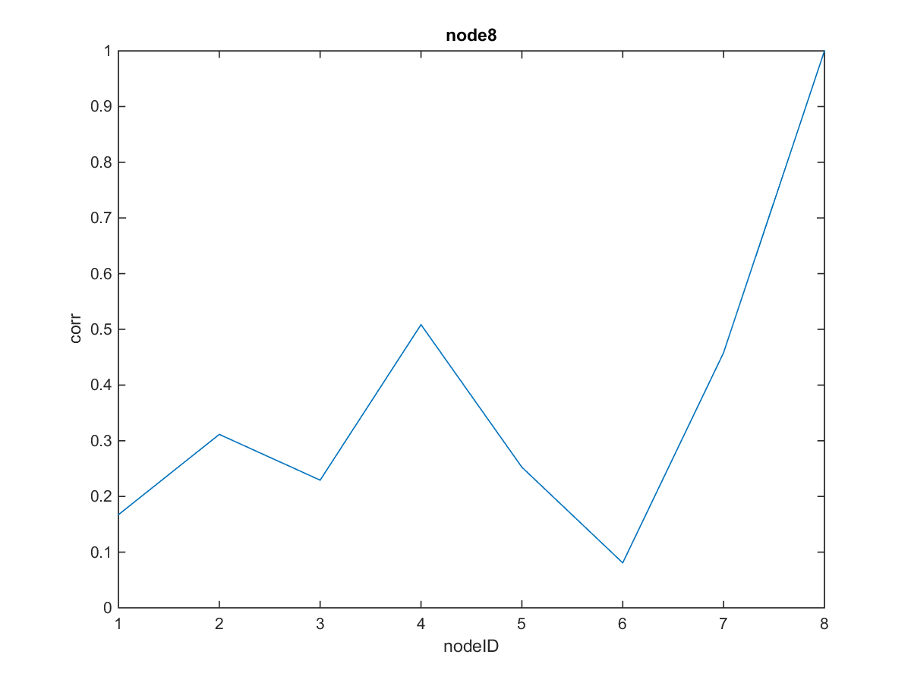
According to Fontugne to get accurate results data of atleast 24hr is required.

Slide 16
Goals for the week.
Improve packet reception for PIR sensors. Increase the time slot duration.
connected map with transitions in the PIR sensor data.
Start with 1 person data and then extend it for data with multiple people.
Validate EMD with larger amount of data.

