Slide 1
Agreed Goals last week
Improve packet reception for PIR sensors. Increase the time slot duration.
connected map with transitions in the PIR sensor data.
Start with 1 person data and then extend it for data with multiple people.
Validate EMD with larger amount of data.
Summary of Work done
Packet reception improved with ack.
Connected map with correlation for the PIR sensor data with 1 person in the room.
Calculation of transition.

Slide 2
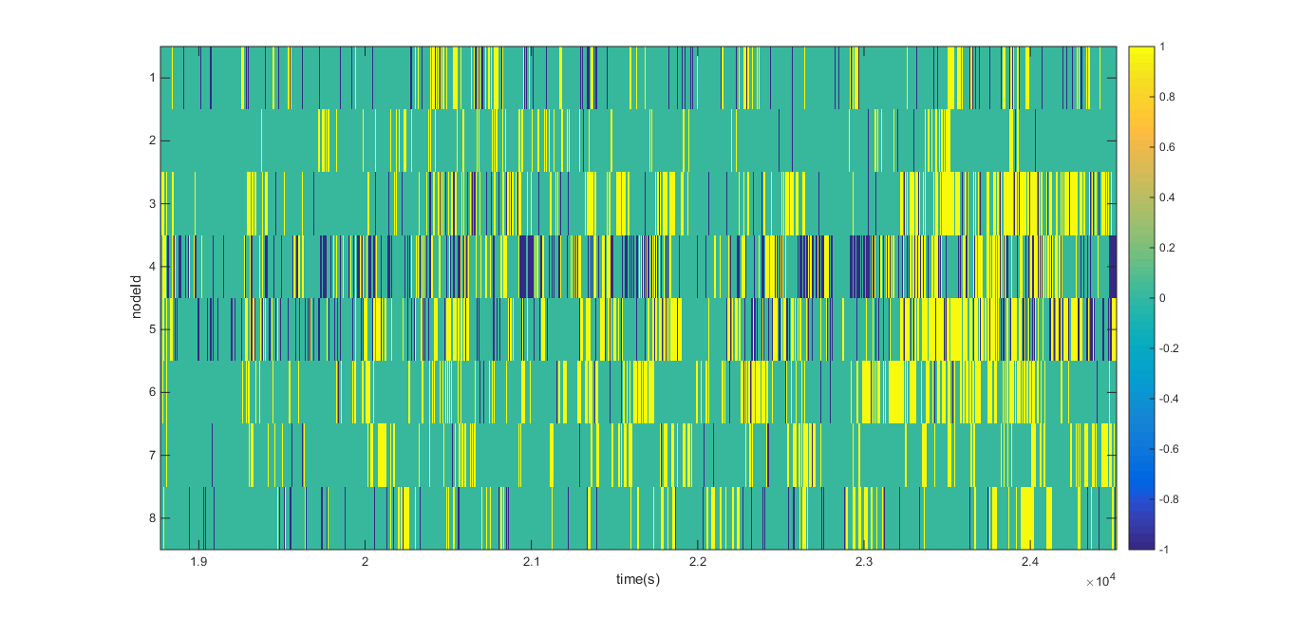
% packet lost
Data from previous week
7.66
1.015
5.656
23.6678
14.0574
1.4888
0.966
4.5416

Slide 3
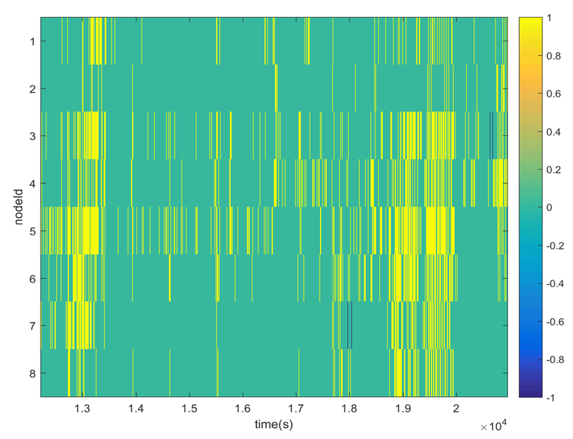
Packet lost % | num packet lost
0 | 0
0 | 0
0.0007 | 2
0 | 0
0 | 0
0 | 0
0.0017 | 5
0 | 0
Data with improvised packet reception

Slide 4
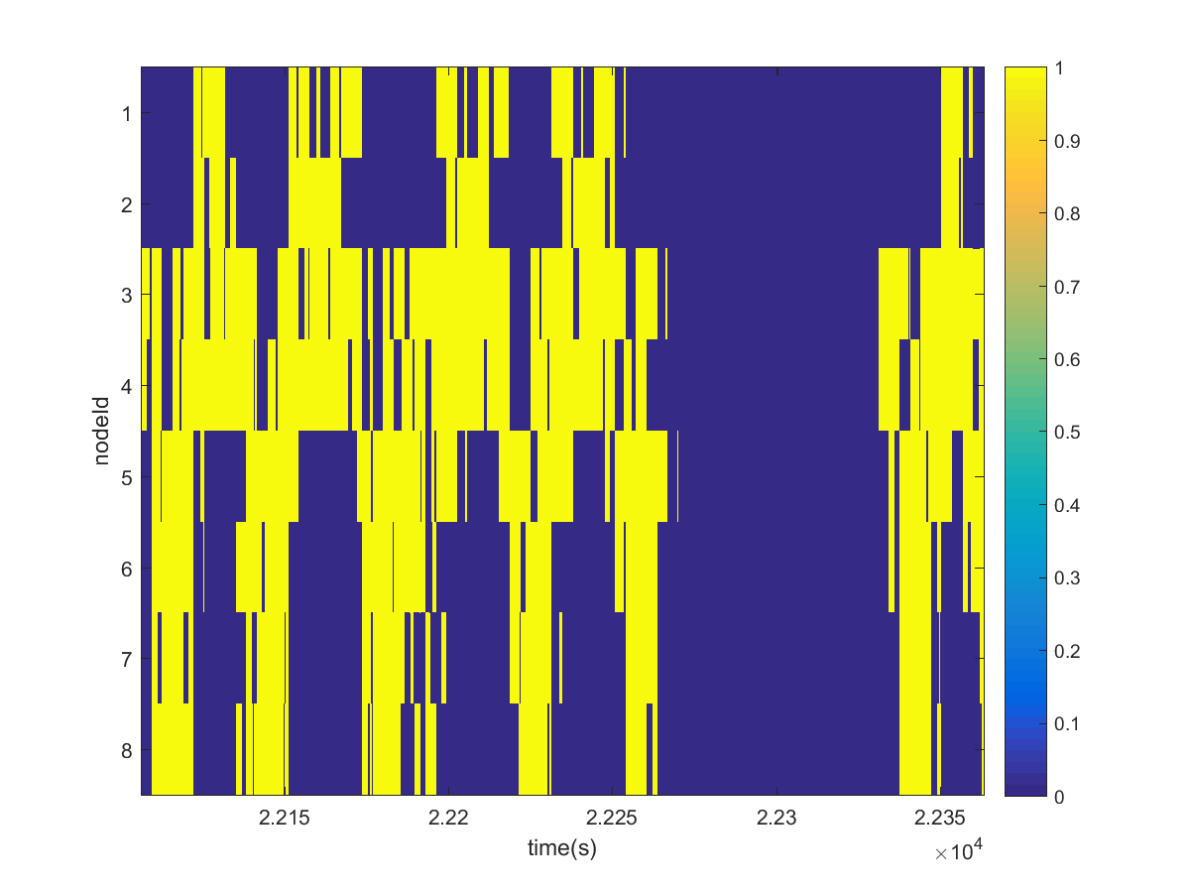
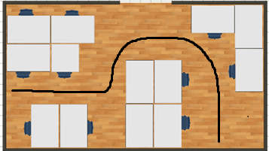
Test the correlation between the nodes
Single person in the room.
Walking back and forth 4 times from 8 to 1.
Went out
Came back in
Walking from 3-5-7-1.

Slide 5
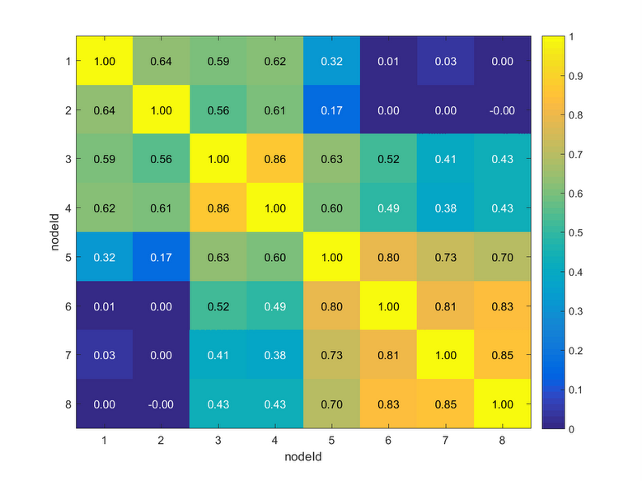
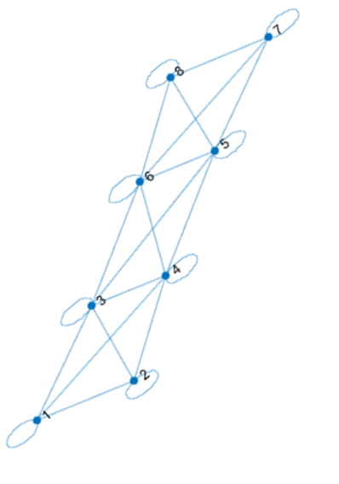
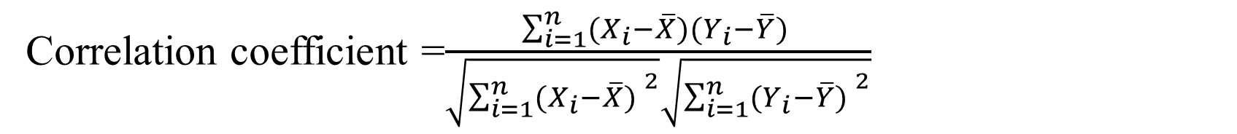
Correlation coefficient =$\frac{\sum_{i=1}^{n}{(X_{i}−\overline{X})(Y_{i}−\overline{Y}) }}{\sqrt{{\sum_{i=1}^{n}{(X_{i}−\overline{X}) }}^{2}}\sqrt{{\sum_{i=1}^{n}{(Y_{i}−\overline{Y}) }}^{2}}}$
Connectivity graph Threshold of 0.48
Correlation between sensor nodes

Slide 6
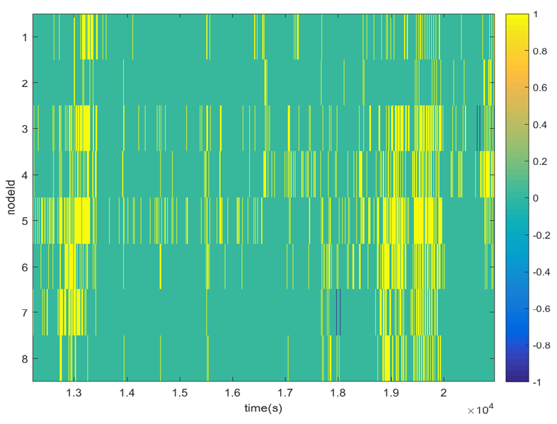
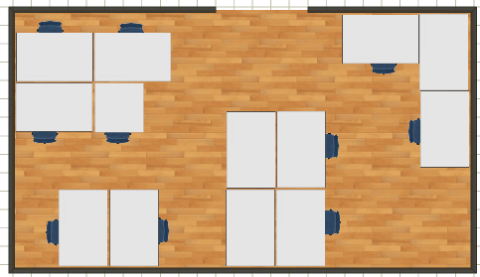
Scenario 2
Initial 15mins 4 people + Me and Fei.
Fei sitting near the desktop.
I am sitting between 3 and 5 initially.
After an hour one person sitting between 2 and 4. More close to 2.

Slide 7
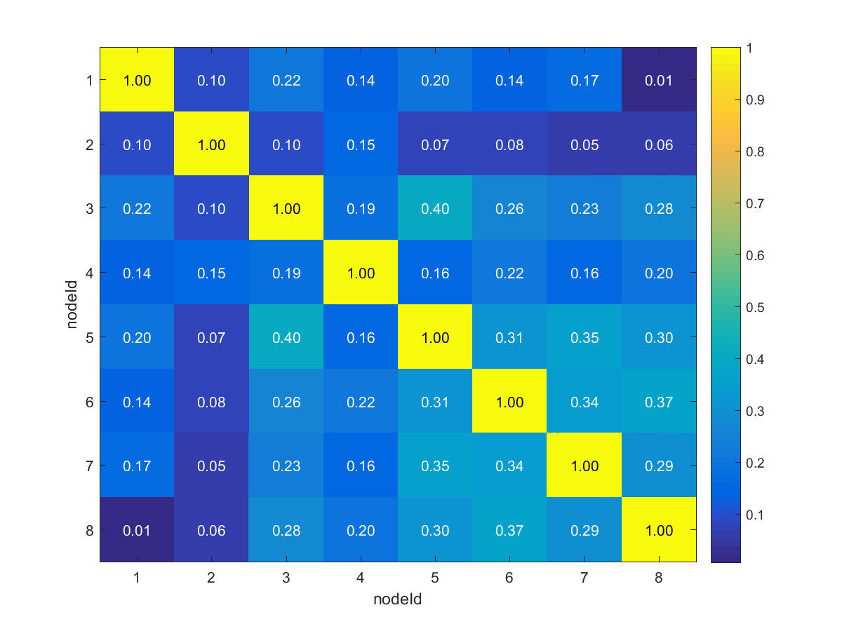
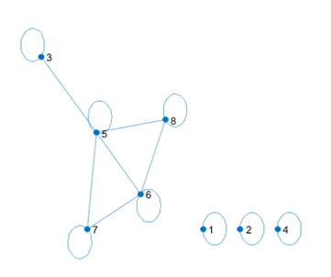
Connectivity graph threshold of 0.30
Correlation between sensor node for scenario-2

Slide 8
Inference that can be drawn
Correlation works well when a person is moving around or when the person is sitting in a region where is there is a overlap between 2 sensors.
Is it possible to separate the PIR output caused due to a person sitting in his workplace and moving around.
If it is possible then filter out the portion of the pir output caused due to a person sitting in his workplace from that caused due to walking around.
Then apply the correlation to check for the neighboring nodes.

Slide 9
Detecting the transition.
Primitive method still needs to be improved.
Create a moving window of 32 samples each with 50% overlap.
Calculate the sum of all the elements in that window.
As the window moves we can observe gradual increase in the amplitude when the person is moving towards the sensor and decreases when the person moves away.

Slide 10
Goals for the week
Check ways of performing analysis in the frequency domain and see if the frequency for walking is different from that when a person is working in his workplace.
Collect data throughout the week when there are at least 4 people in the room.
Frequency aggregation method for EMD.
Bug fix for Packet transmission stopping randomly.

