Slide 1
Agreed Goals last week
Collect more sensor data with large duration.
Check for time synchronization after the implementation of the Ack.
Fix the bug which causes the the PIR sensor to stop transmission randomly.
Analyzing data from the audio sensor on the memsic motes.
Summary of work done
Collection of data.
Time synchronization checked, synchronization error is still within 100ms.
Bug fixed.
Binary correlation for the pir data.

Slide 2
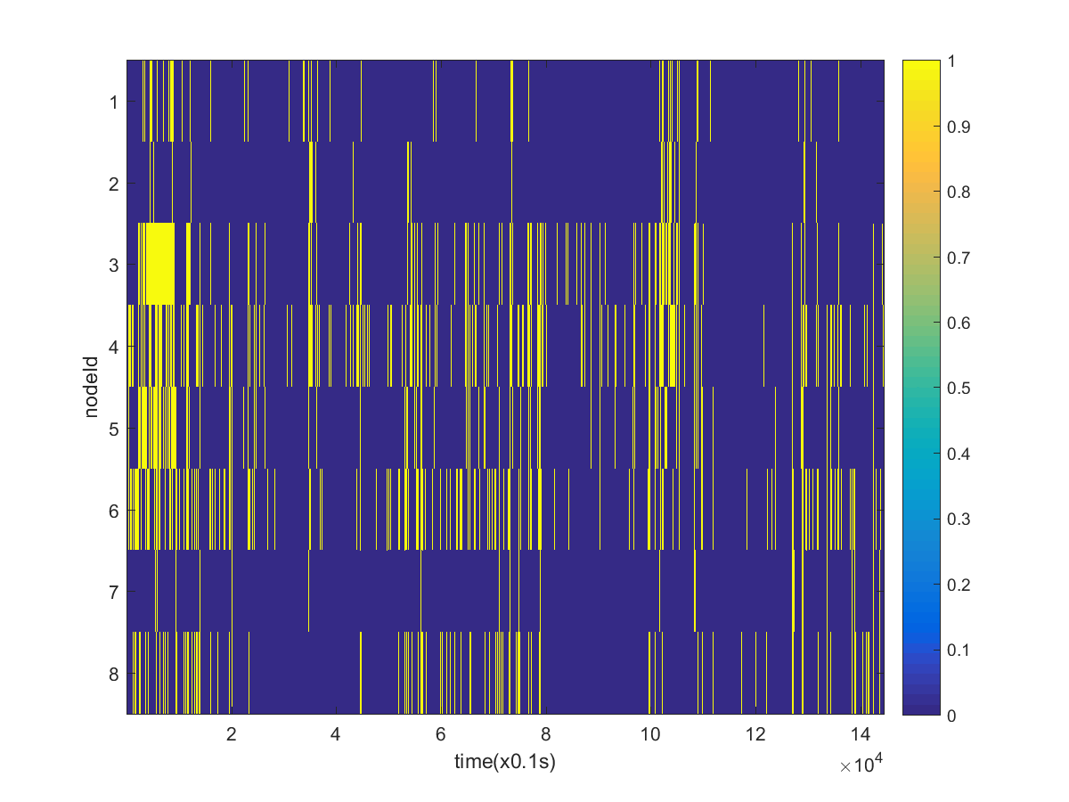
PIR Data (~4hrs)

Slide 3
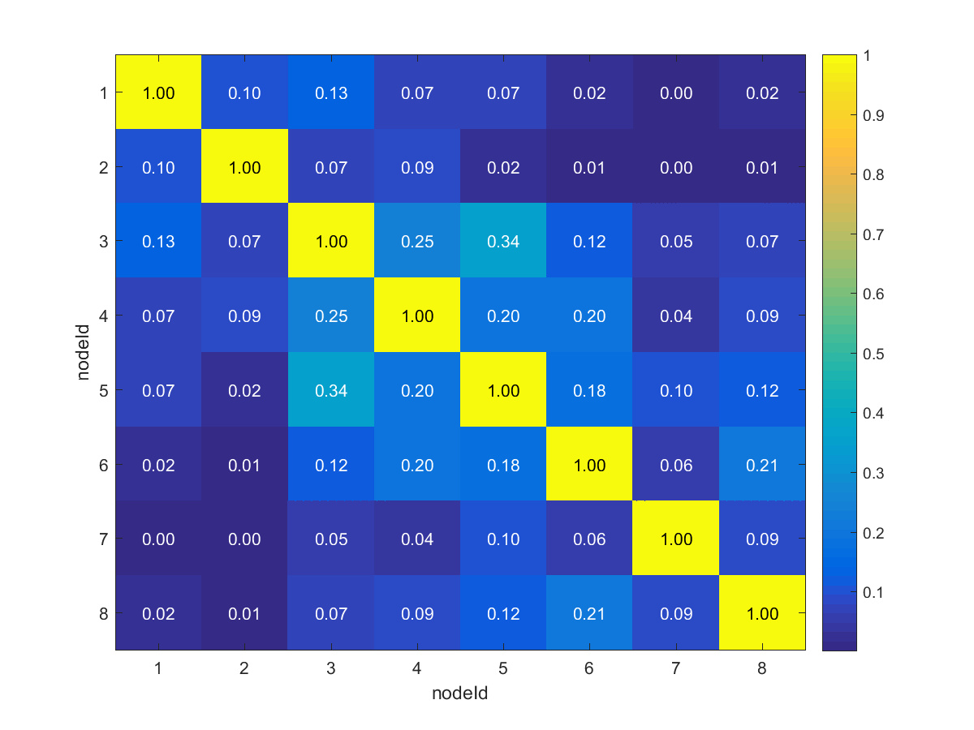
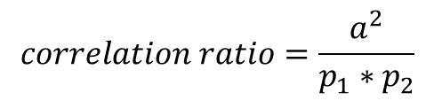
$$correlation ratio=\frac{a^{2}}{p_{1}∗p_{2}}$$
a : number of 1’s in the same position in both the data.
P1: number of 1’s in data set 1.
P2:number of 1’s in dataset 2.

Slide 4
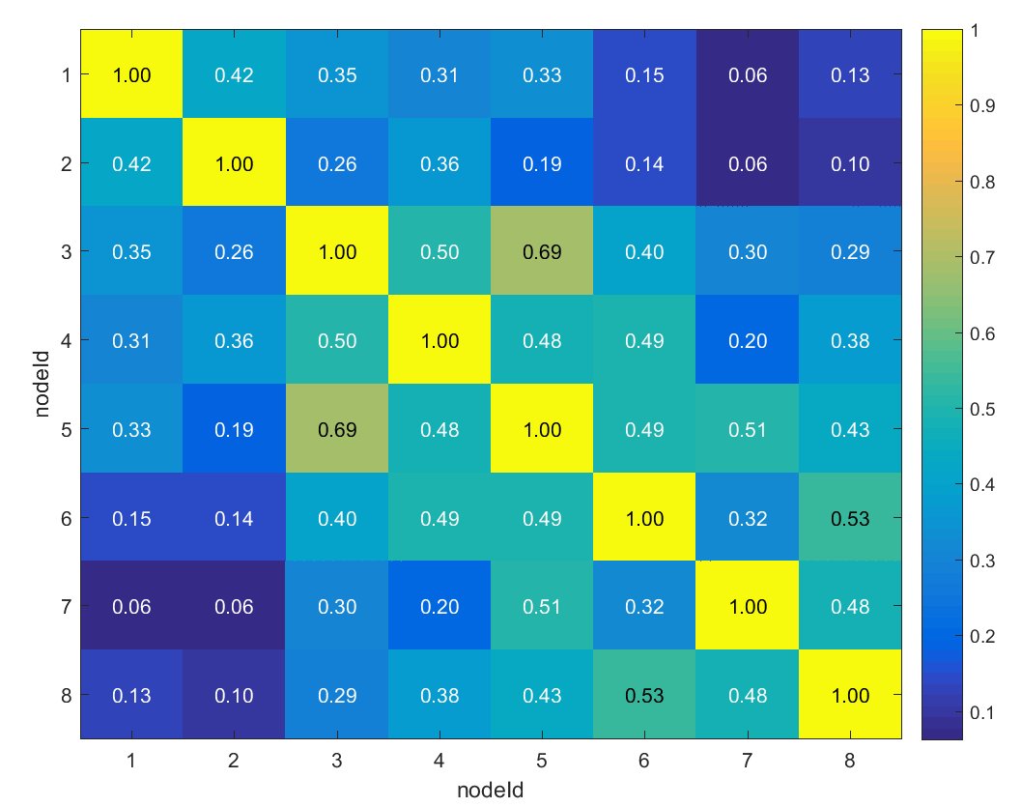
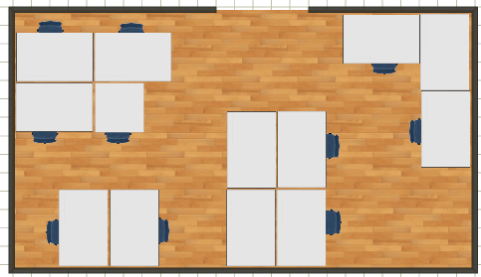
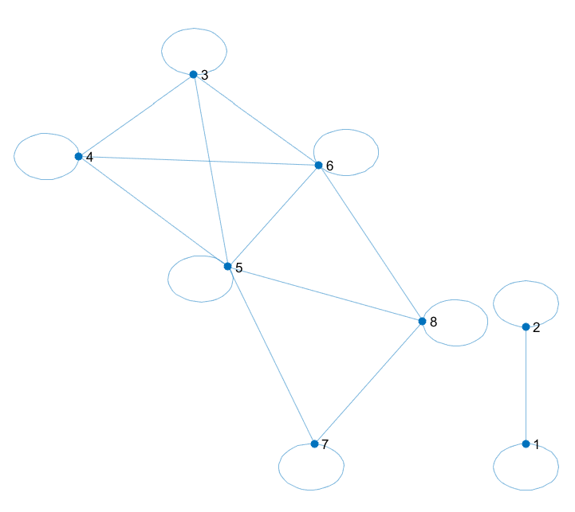
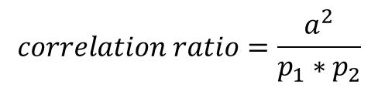
7
5
3
1
8
6
4
2
$$correlation ratio=\frac{a^{2}}{p_{1}∗p_{2}}$$
Window of 8mins; Threshold of 0.38

Slide 5
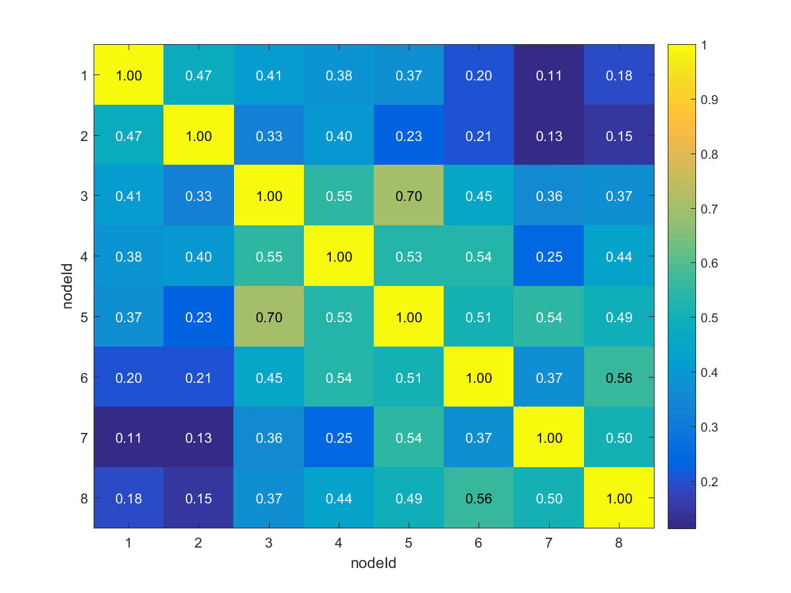
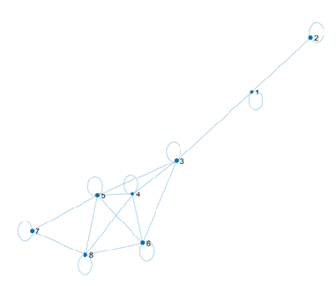
7
5
3
1
8
6
4
2
Window of 6mins; Threshold of 0.40
Jaccard $\frac{a}{a+b+c} b: number of 1s in the first dataset and 0s in the second data set in the same position$
C: number of 0s in the first data set and 1s in the second dataset in the same position.

Slide 6
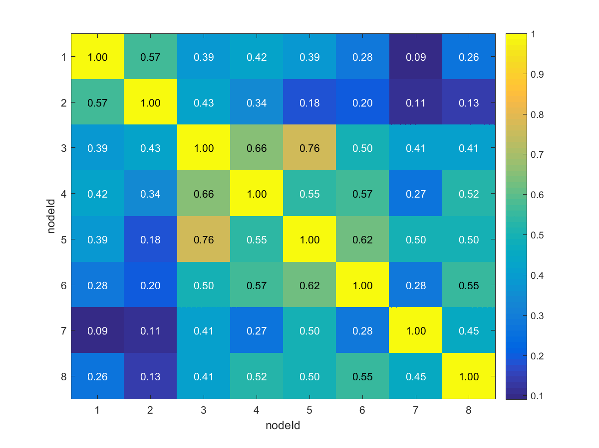
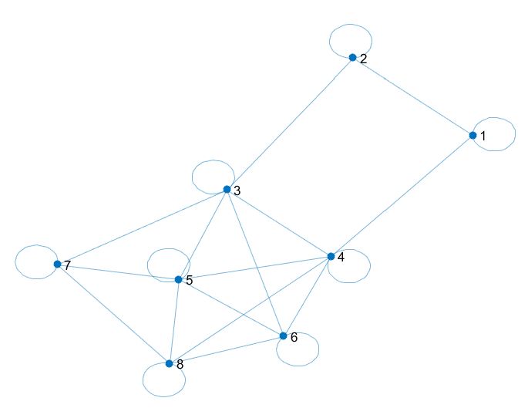
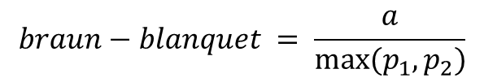
$$braun−blanquet = \frac{a}{max⁡(p_{1},p_{2})}$$
7
5
3
1
8
6
4
2
Window =12min, threshold = 0.42.

Slide 7
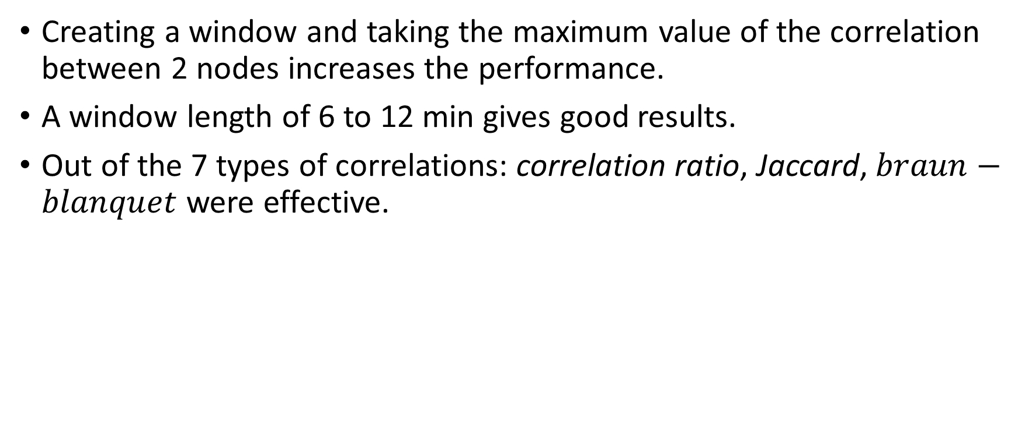
Inferences
Creating a window and taking the maximum value of the correlation between 2 nodes increases the performance.
A window length of 6 to 12 min gives good results.
Out of the 7 types of correlations: correlation ratio, Jaccard, $braun−blanquet$ were effective.

Slide 8
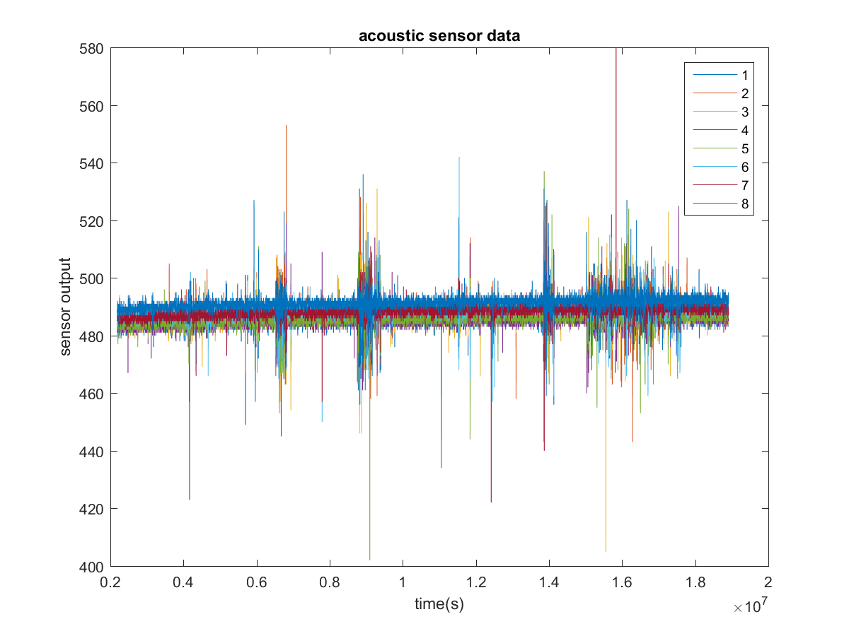

Slide 9
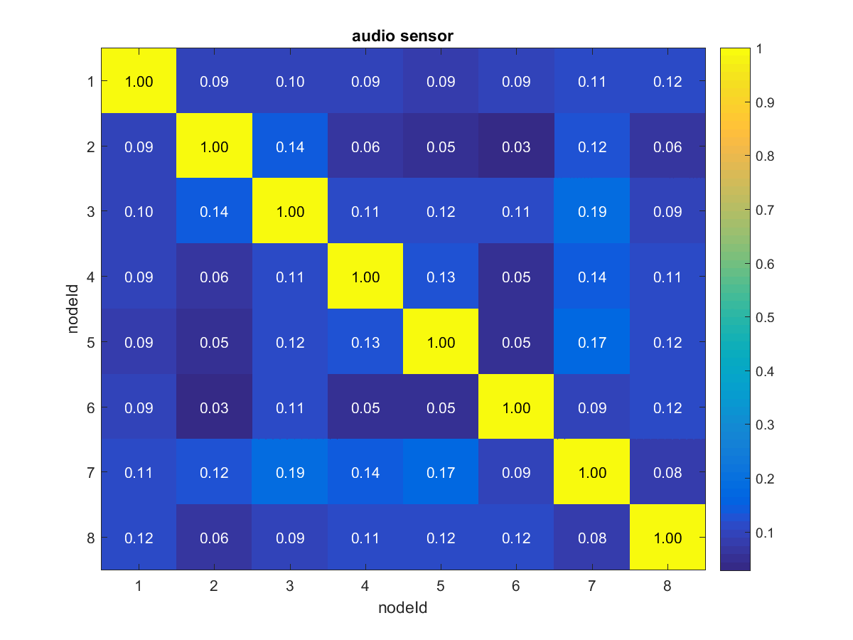

Slide 10
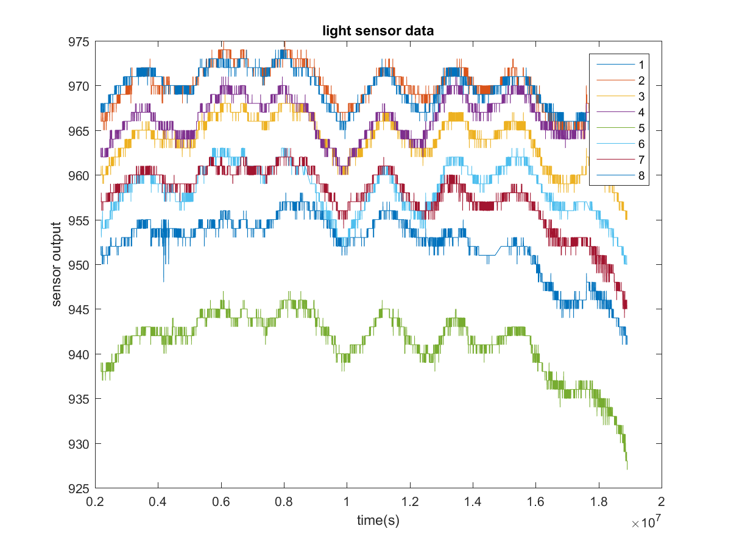

Slide 11
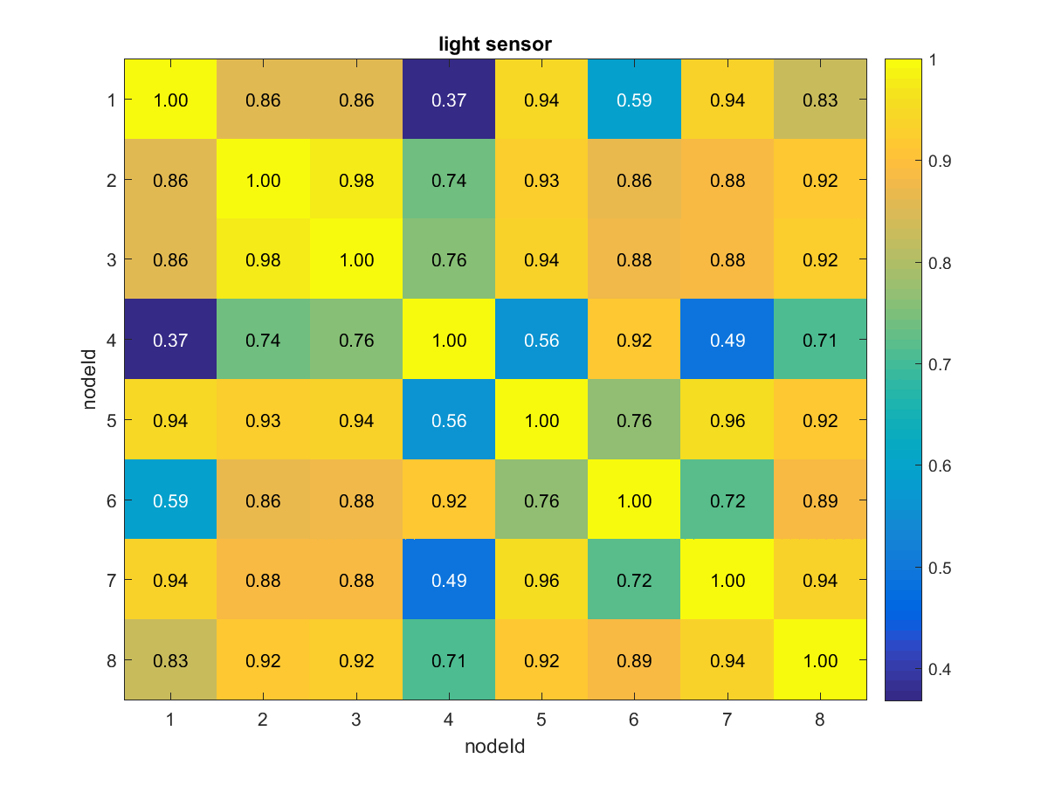
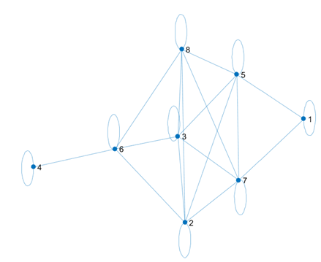
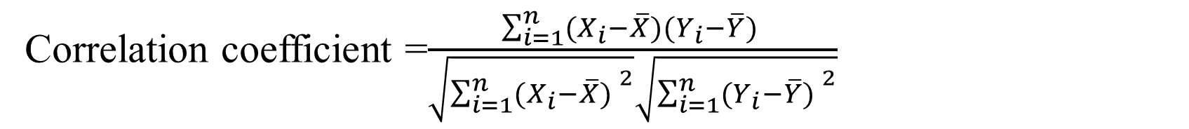
Correlation coefficient =$\frac{\sum_{i=1}^{n}{(X_{i}−\overline{X})(Y_{i}−\overline{Y}) }}{\sqrt{{\sum_{i=1}^{n}{(X_{i}−\overline{X}) }}^{2}}\sqrt{{\sum_{i=1}^{n}{(Y_{i}−\overline{Y}) }}^{2}}}$
7
5
3
1
8
6
4
2
Threshold > 0.86

Slide 12
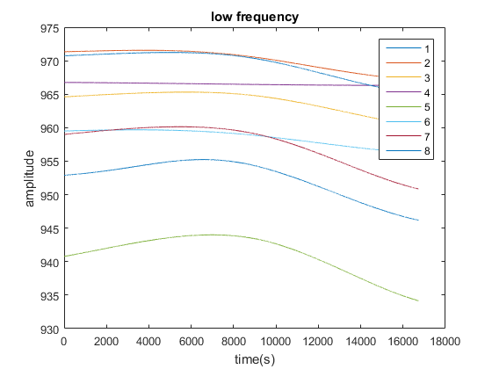
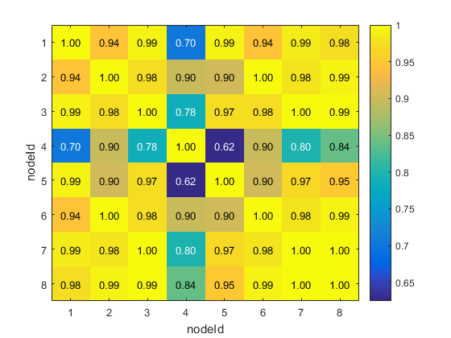

Slide 13
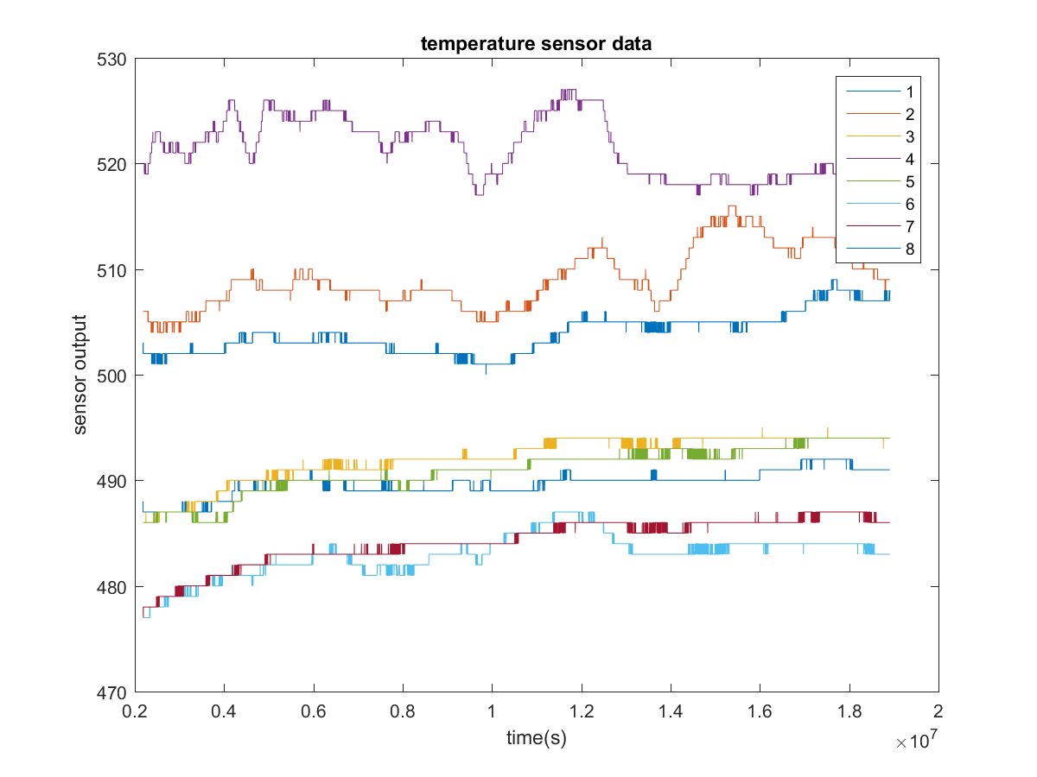

Slide 14
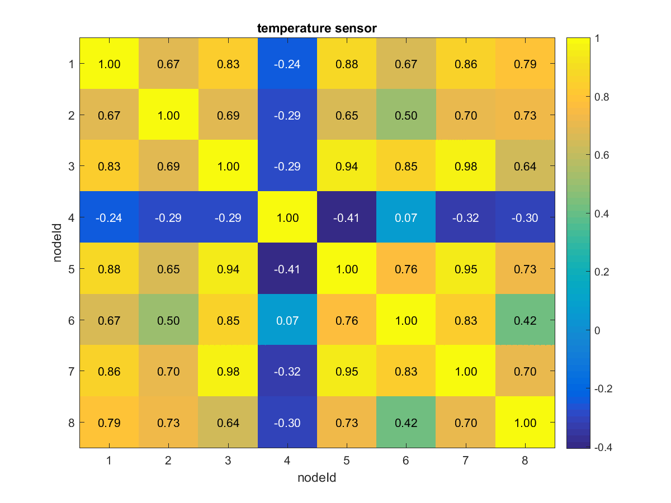
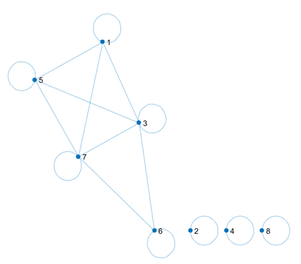
7
5
3
1
8
6
4
2
Threshold > 0.82

Slide 15
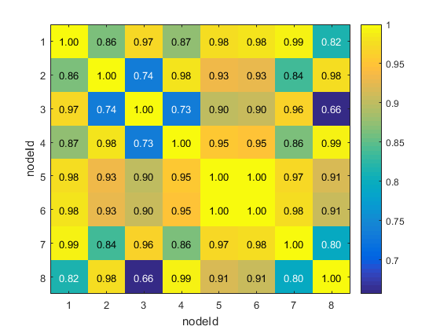
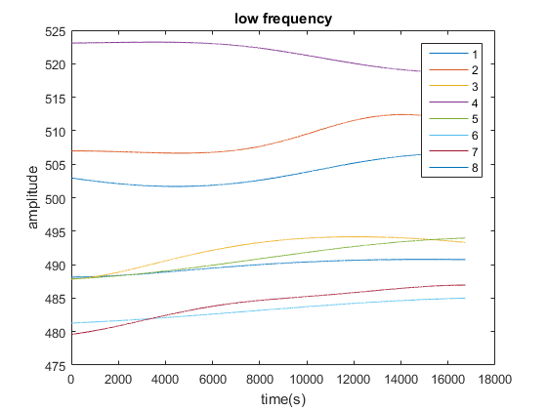

Slide 16
Goals for the week
Transition analysis in the pir data(prev week) integrate it with the correlation and try to find the topology of the sensor network.
Memsic sensor data: find out the frequency range that gives a good correlation boundary for the sensor data.
Sensor collect continuous data throughout the week. (hopefully the room will be occupied).

