Slide 1
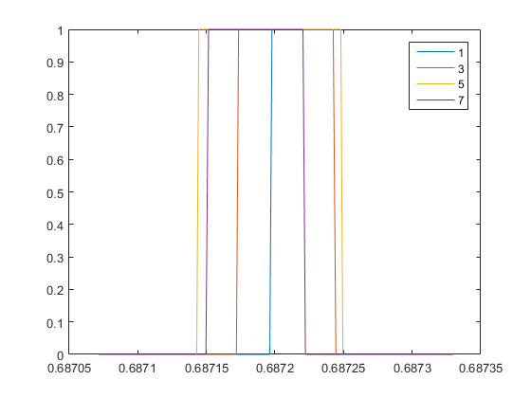
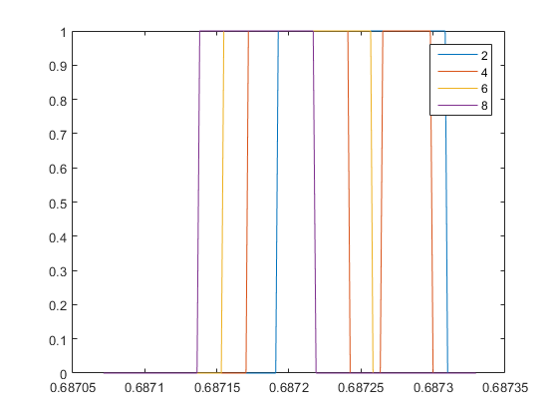
7 | 8 | 4
5 | 6 | 3
3 | 4 | 2
1 | 2 | 1
Walking from section 4 to 1

Slide 2
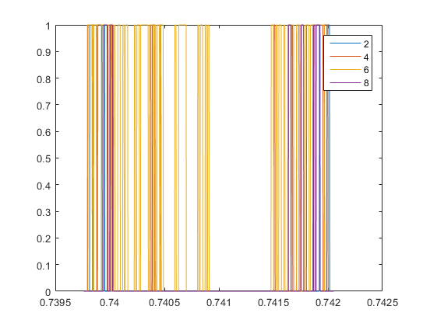
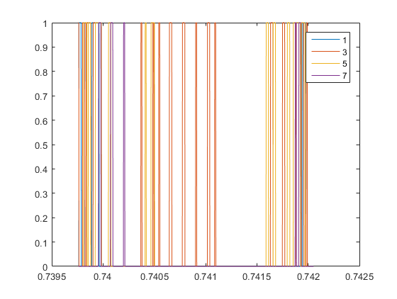
Sitting in section 3
7 | 8 | 4
5 | 6 | 3
3 | 4 | 2
1 | 2 | 1

Slide 3
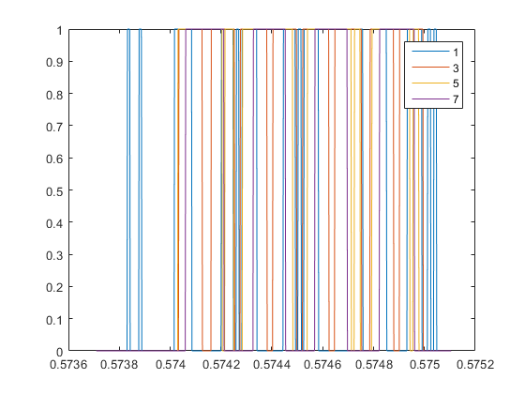
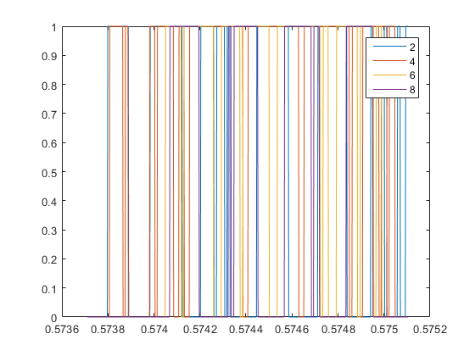
Walking back and forth
7 | 8 | 4
5 | 6 | 3
3 | 4 | 2
1 | 2 | 1

