Slide 1
Previous Meeting
It could be seen that the synchronization error was between 100ms to 1s.
The goal was to achieve synchronization accuracy within ~ 10ms.

Slide 2
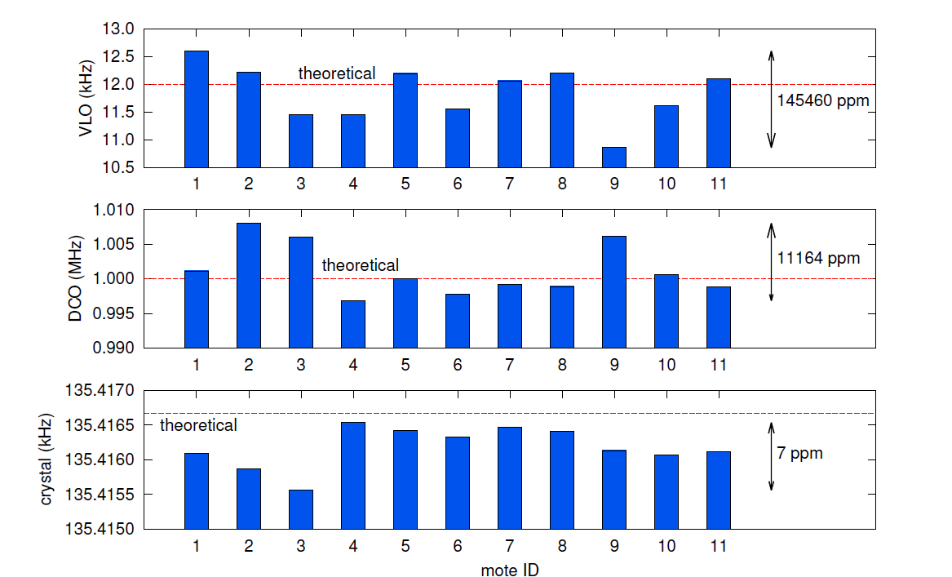
Work by Branko Kerkez of UC Berkeley.
Variation from 11khz to 12.5 khz
Variation from 995khz to 1005khz
Variation of clock frequencies over a set of different nodes at constant temp and voltage

Slide 3
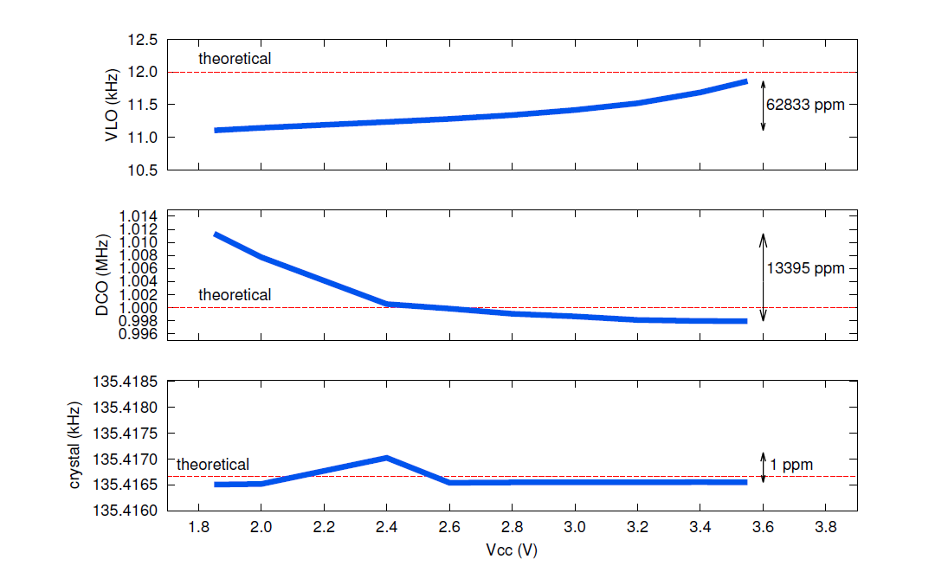
Clock frequency Variation of motes with voltage

Slide 4
According to the author one way synchronization can give an accuracy between 10ms – 100ms.
To achieve accurate synchronization one of the time synchronization protocol has to be implemented.
Synchronizing every 2s not ideal when there are 8 nodes.
Timestamp the packet at AP. If the transmission time doesn’t differ too much(optional)

