Slide 1
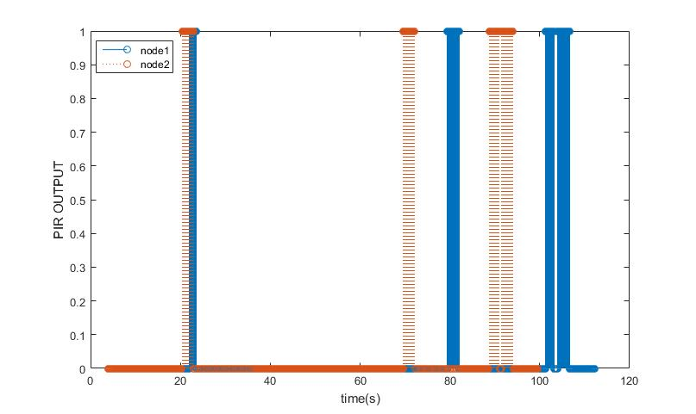
Time Synchronization

Slide 2
Synchronization process
AP sends out a start signal.
AP starts its own local clock.
Once every 2mins local clocks of the all the sensor nodes are synchronized with the clock of the AP.
The minimum error observed is 100ms. This is because 1 clock tick is equal to 100ms.
change clock tick to a lesser value (10ms).

Slide 3
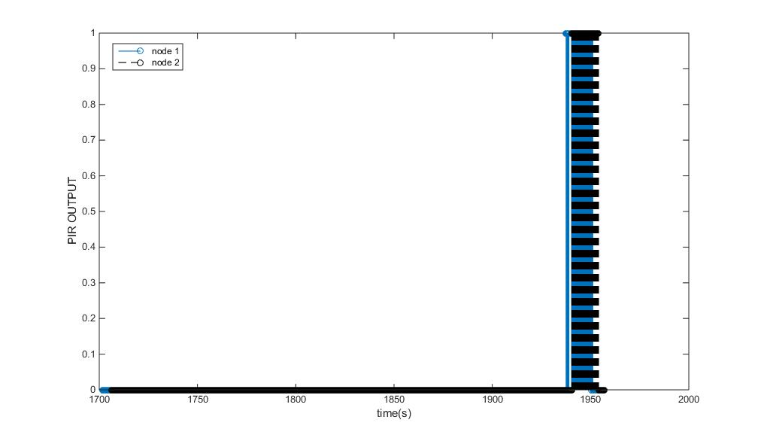
Time synchronization

Slide 4
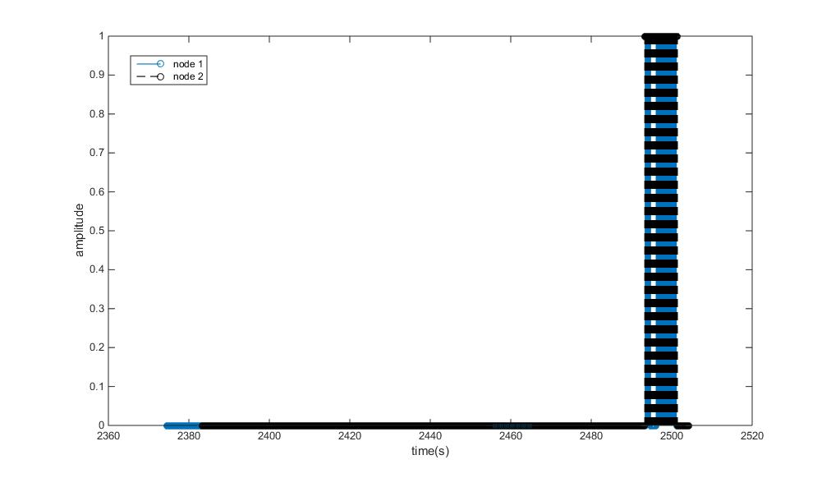

Slide 5
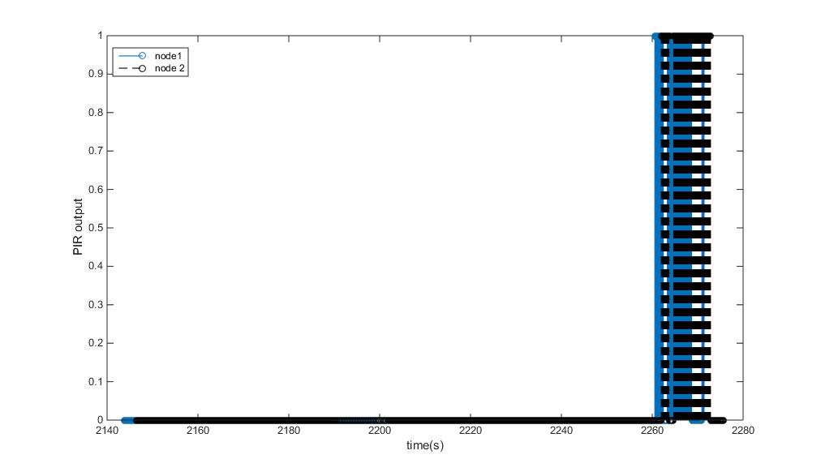

Slide 6
High level overview of the Thesis
Case 1 : Develop an algorithm to determine the arrangement of the sensor nodes in the given wireless sensor network from the data obtained by the network of PIR sensors.
Correct the sensor location error .
Case 2 : Develop an algorithm to look at the transitions in the PIR output of different nodes determine the movement in the room.
Determine the maximum synchronization error that can be allowed in both the cases.
Develop time synchronization method suitable for different use cases.
Look at other possible use cases.
Prior information available are the position of entry and exit, Workstation location.

Slide 7
Road map
January – Finish setting up the test bench and collect data. Start with analysis of data.
February – Literature survey and develop algorithm to extract information from the PIR sensor data.
March and April – Development of algorithm continued. Introduce artificial delay to the collected sensor data or collect unsynchronized data from the sensor. Check the efficiency of the algorithm and see the effects of having unsynchronized data.
April and May- Time synchronization: literature survey and implementing it on the sensor nodes.
June and July(15 days)- Testing and Evaluating the performance of the proposed solution. Improving the algorithm if required.
July(15 days) – Buffer period if the deadlines are not met.
August – Writing thesis (writing also done simultaneously every month)

Slide 8
Memsic Sensors
10 sensor
2.4 GHz IEEE 802.15.4 for communication.

