Slide 1
Agreed Goals last week
It could be seen that the synchronization error was between 100ms to 1s. So the goal was to achieve synchronization accuracy of around ~ 10ms.
Summary of work done
Change in the clock tick resolution.
Increasing the sampling rate.
Limiting the field of view of the pir sensor using a paper shield.
Preparing Memsic Sensor for data acquisition.

Slide 2
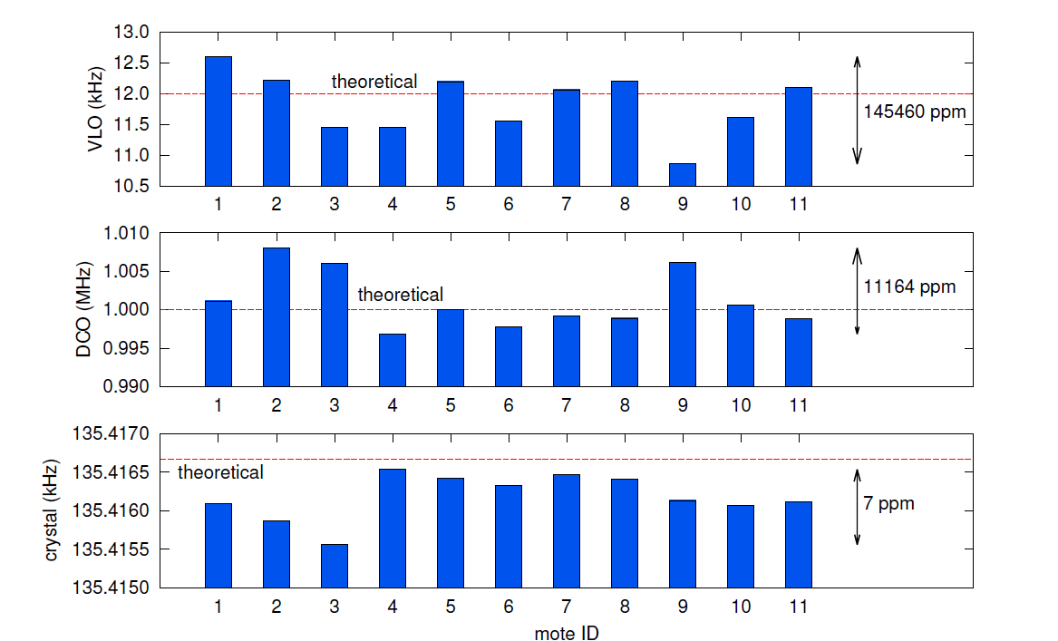
Reasons for clock drift
Variation from 11khz to 12.5 khz
Variation from 995khz to 1005khz

Slide 3
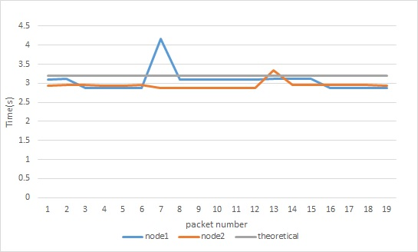
Comparison of the Time taken to collect 32 samples pir data between two motes.

Slide 4
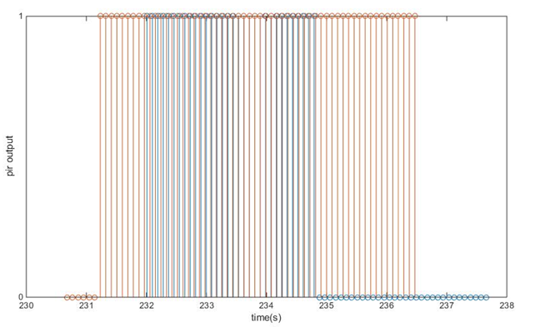
Results:
Reasons might be noise or sensors not triggering.
Steps taken to mitigate noise: Limit the field of view of the sensor.
Unequal number of trigger

Slide 5
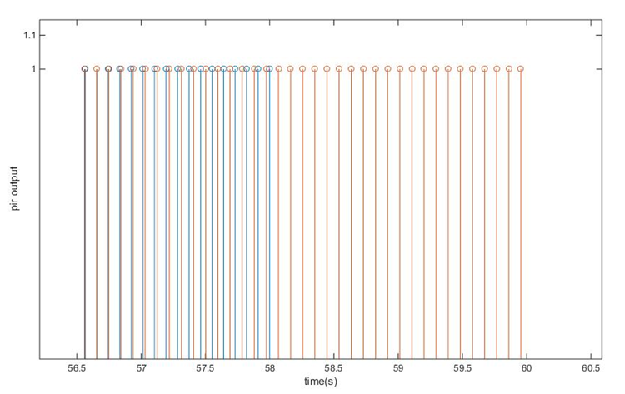
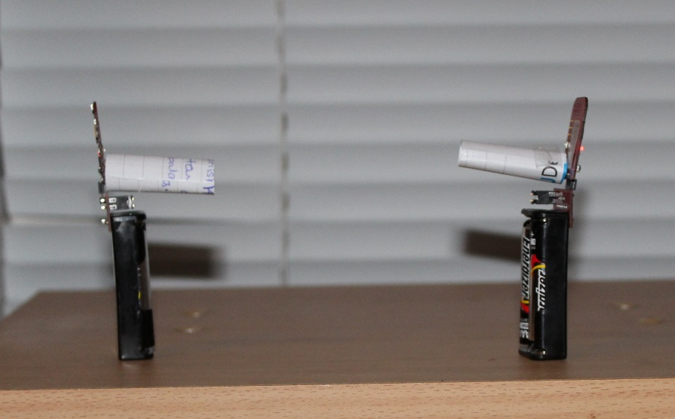
Test setup and results
Altered test setup
Best case Result: showing Perfect synchronization

Slide 6
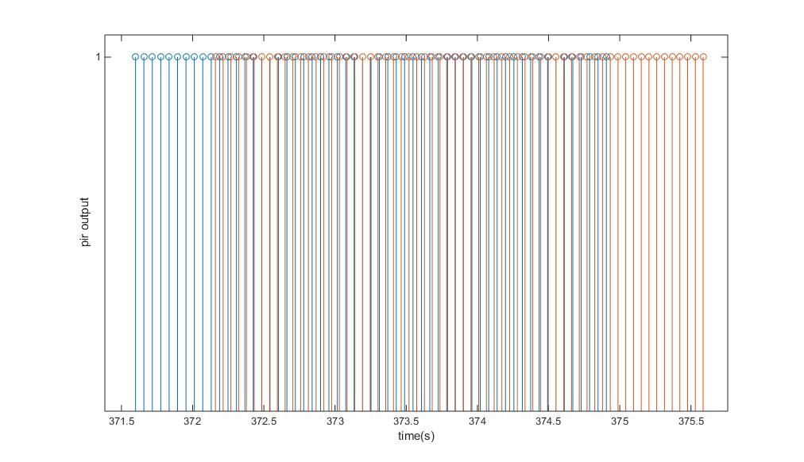
Worst case: Synchronizations error of 450ms.

Slide 7
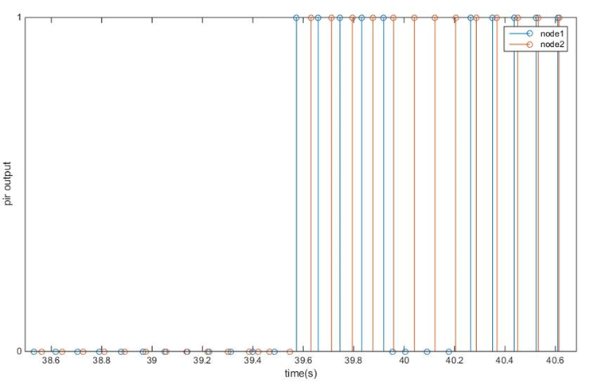
Decrease in clock tick to 1ms.
Best case : Clock Synchronization error of approximately 10ms.

Slide 8
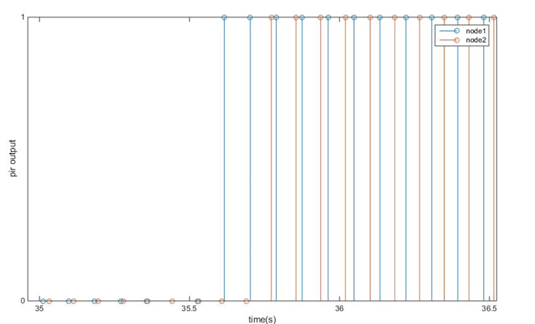
Worst case: Synchronizations error of 200ms.

Slide 9
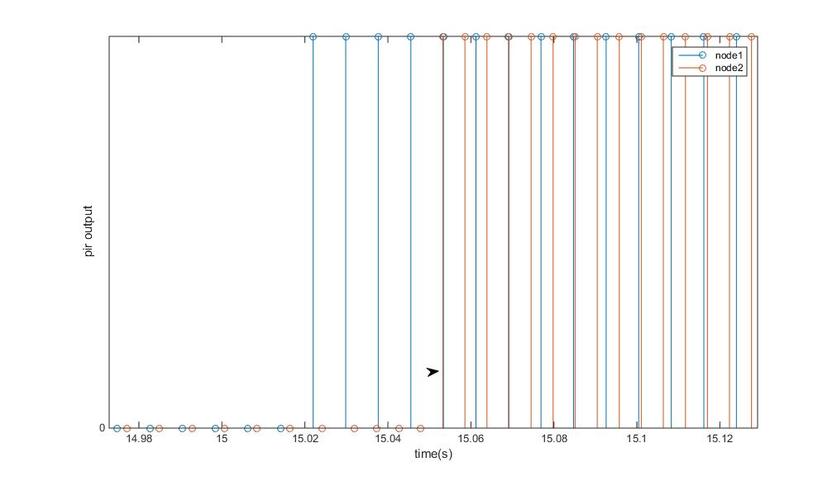
Decrease the sampling period to 10ms
Best case : synchronization error of 40ms

Slide 10
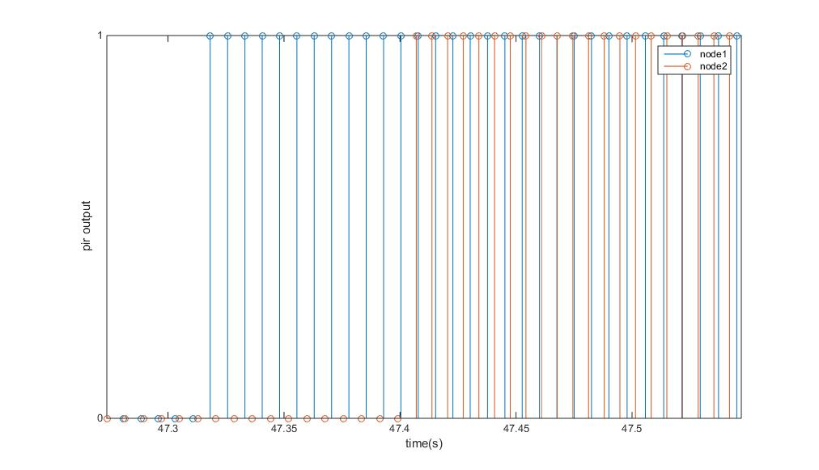
Worst case: Synchronizations error < 100ms.

Slide 11
Points to discuss
Better testing method.
Goals for the week.
Complete the implementation on the memsic sensor.
Check which channels motes communicate in TI sensor and memsic sensor.
Testing for the synchronization error.
Setting up the test bed.

