Slide 1
Agreed Goals last week
Complete the implementation on the memsic sensor.
Check on which channels motes communicate in TI sensor(13) and memsic sensor(16).
Setting up the test bed(Test bed with TI sensors has been completed,
memsic sensors need to be installed).

Slide 2
Summary of work done
Setting up of test bed with TI sensor and collecting data.
Memsic sensor: Time synchronization, sensor data acquisition.
Flooding time synchronization protocol provided by Miklos Maroti et al has been used for memsic sensors.

Slide 3
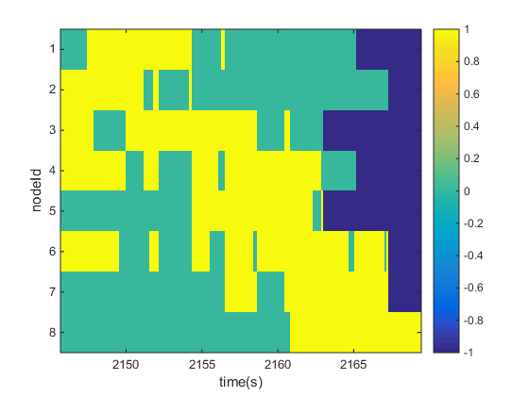
Walking from node 1 to node 8
Results
1 | 2
3 | 4
5 | 6
7 | 8
Room layout
0-1 PIR output
-1 Packet loss

Slide 4
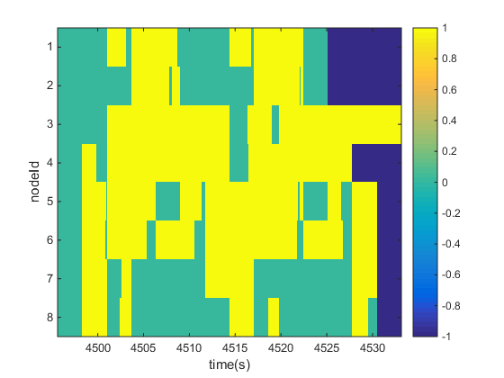
1 | 2
3 | 4
5 | 6
7 | 8
Room layout
0-1 PIR output
-1 Packet lost
Scenario: Walking from node 8 to node 1 and then back from 1 to 8. This is repeated twice.

Slide 5
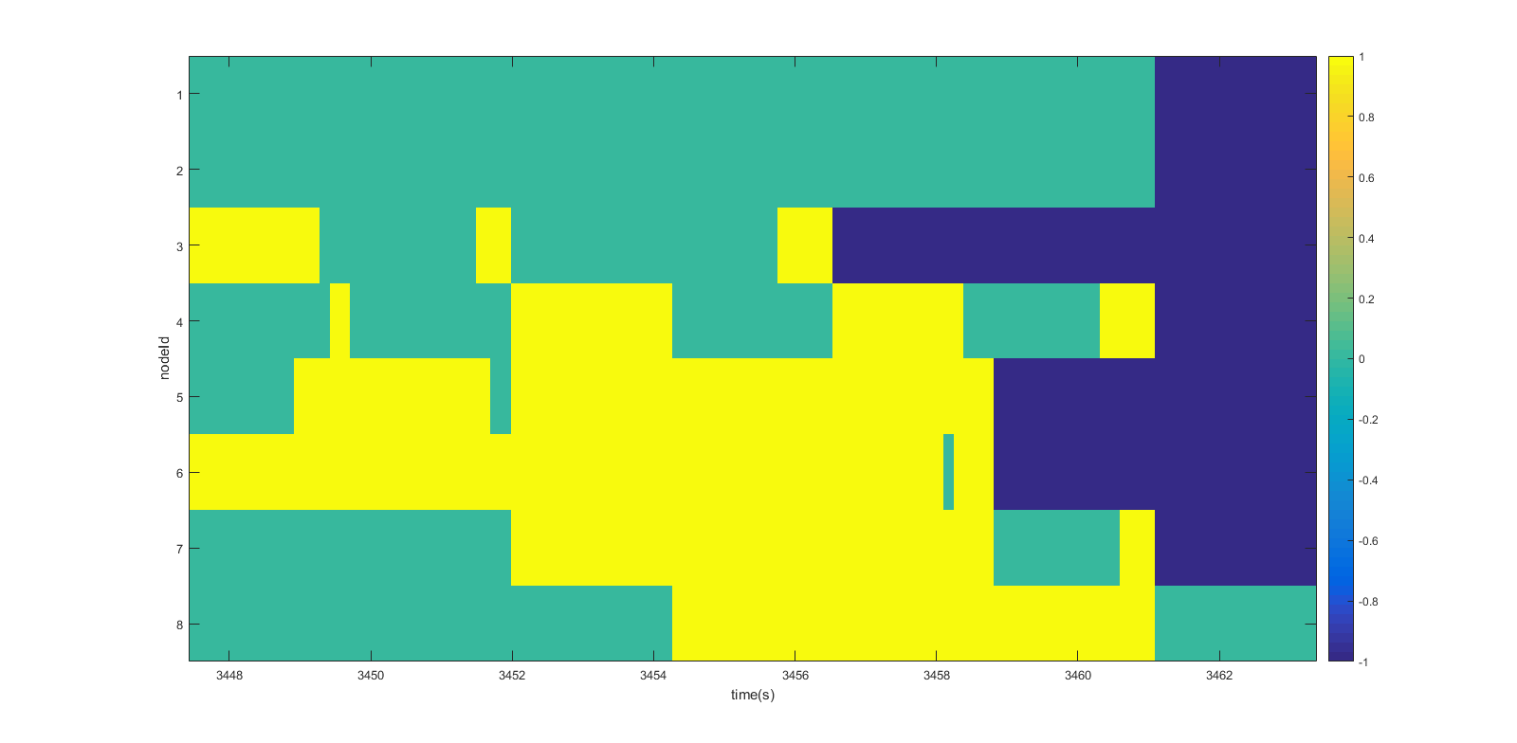
1 | 2
3 | 4
5 | 6
7 | 8
Room layout
Entered from door which is at node3 and move towards node 8.

Slide 6
Points to discuss
Use cases for collecting data.
Paper suggestions for data analysis.
Goals for the week.
Collect data from both TI and Memsic sensor.
Literature review.
Start with data analysis.

