Slide 1
Agreed Goals last week
Collect data from both TI and Memsic sensor.
Literature survey.
Start With data analysis.
Summary of work done
Installation of Memsic sensors.
Collection of data from TI and Memsic sensor.
Started with literature study.

Slide 2
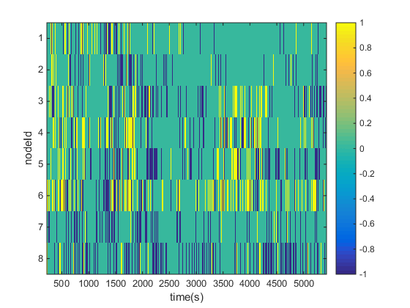
Results
Thursday afternoon. Data collected for approximately 1.5hrs

Slide 3
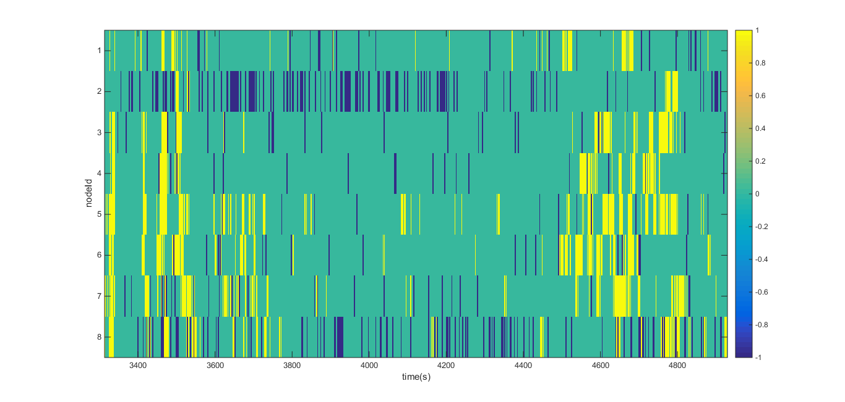
Friday after lunch.

Slide 4
Goals for the week.
Collect data with at least 4 people in the room.
Data analysis and literature survey.

