Slide 1
Last week minutes.
List down events that can help in detecting the neighboring sensor nodes and give a thought about capturing the events in the acquired pir sensors data.
First try and answer the question of verifying the sensor placement order given the topology and then look at generalizing it to find out the topology of the sensors.
See what sort of pre-processing of the pir data can be done.
Give a thought about porting the sensor data to a database.
Collect controlled data if the room is not occupied.

Slide 2
Work done during the week
Pre processing of the data. Removing noise and calculating features like fft, mean,and standard deviation of fft and energy.
Correlation analysis for the feature.
Transition analysis.
Calculating the last and the first triggers to determine the nodes near the door.

Slide 3
Events aiding our analysis
Walking and sitting in the overlapping region of the sensors field of view.
The last trigger before the room becomes completely unoccupied or the first trigger when the room is in an unoccupied state. These triggers helps in determining the nodes closer to the door.
Transition analysis after the first trigger is observed will help in search for the neighboring nodes.
The number of triggers are more, when someone is walking compared to that when someone is just working on their work desk.

Slide 4
Events that can mislead the analysis
2 people working in a region where the sensors do not share the field of view might result in similar triggers, which might lead to false correlation.
Triggers caused due to presence of people in a region which is covered by only single sensor.
2 people enter the room almost simultaneously and walk in different direction.

Slide 5
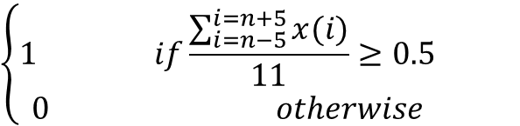
Filtering the PIR output
Removes false triggers.
x(n)=
$$\left\{\begin{aligned}1 if\frac{\sum_{i=n−5}^{i=n+5}{x(i)}}{11}≥0.5 \\ 0 otherwise\end{aligned}\right.$$

Slide 6
Calculate Energy
Steps involved:
Create a moving window of 128 samples with 50% overlap.
Calculate the F=FFT(pir_signal) in each window.
Calculate the corresponding energy in each window :
energy = sum(F*conj(F)).
Physically energy signifies the number of 1’s present in the signal in the current window.
Window size of 128 is chosen as the trigger caused due to a person working on his desk are captured in 64 samples and the triggers due to a person walking around will be present in minimum 96 samples(Was observed from the data collected).

Slide 7
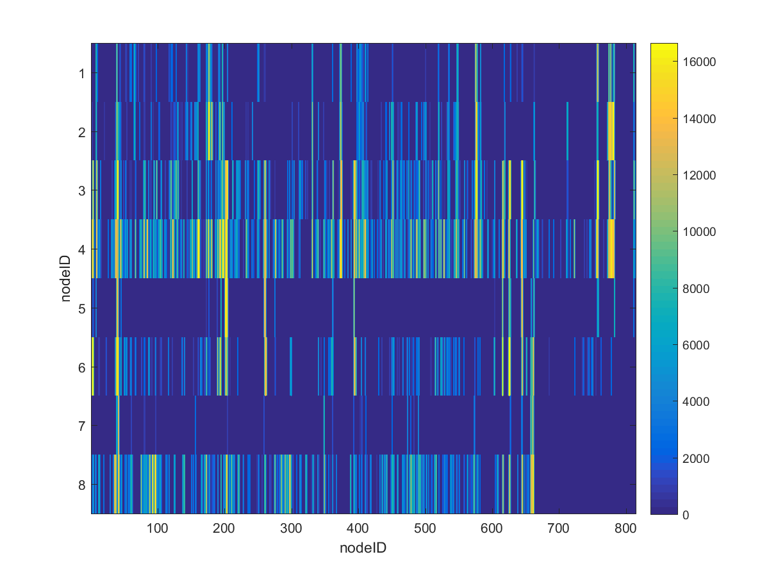
energy data

Slide 8
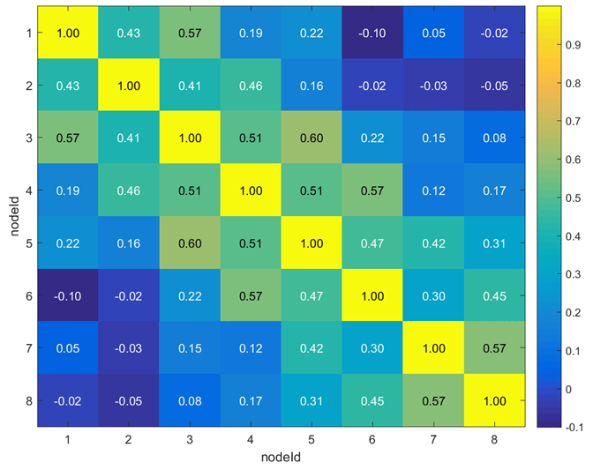
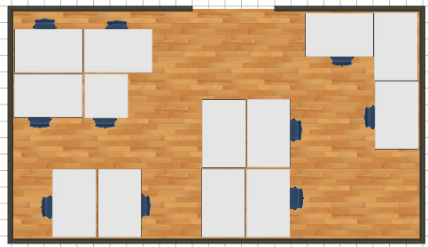
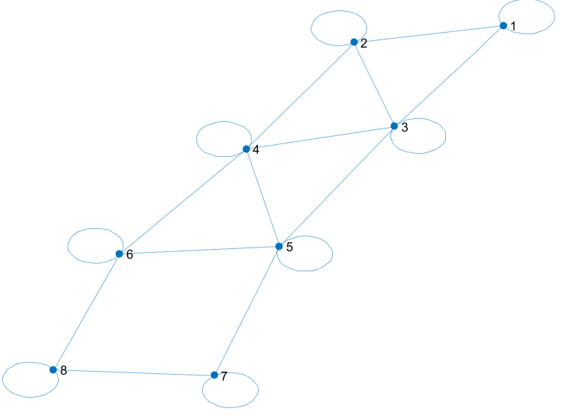
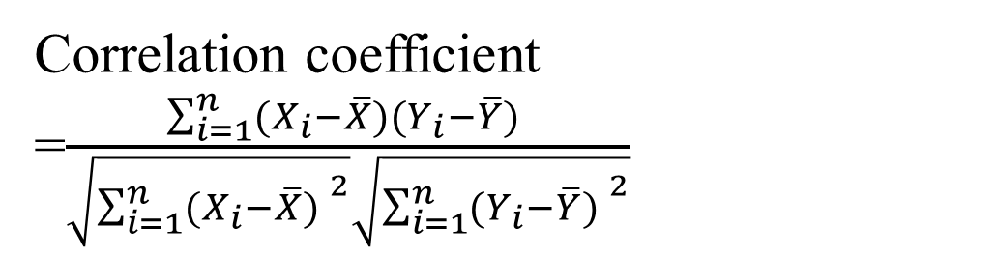
7
5
3
1
8
6
4
2
Correlation coefficient =$\frac{\sum_{i=1}^{n}{(X_{i}−\overline{X})(Y_{i}−\overline{Y}) }}{\sqrt{{\sum_{i=1}^{n}{(X_{i}−\overline{X}) }}^{2}}\sqrt{{\sum_{i=1}^{n}{(Y_{i}−\overline{Y}) }}^{2}}}$

Slide 9
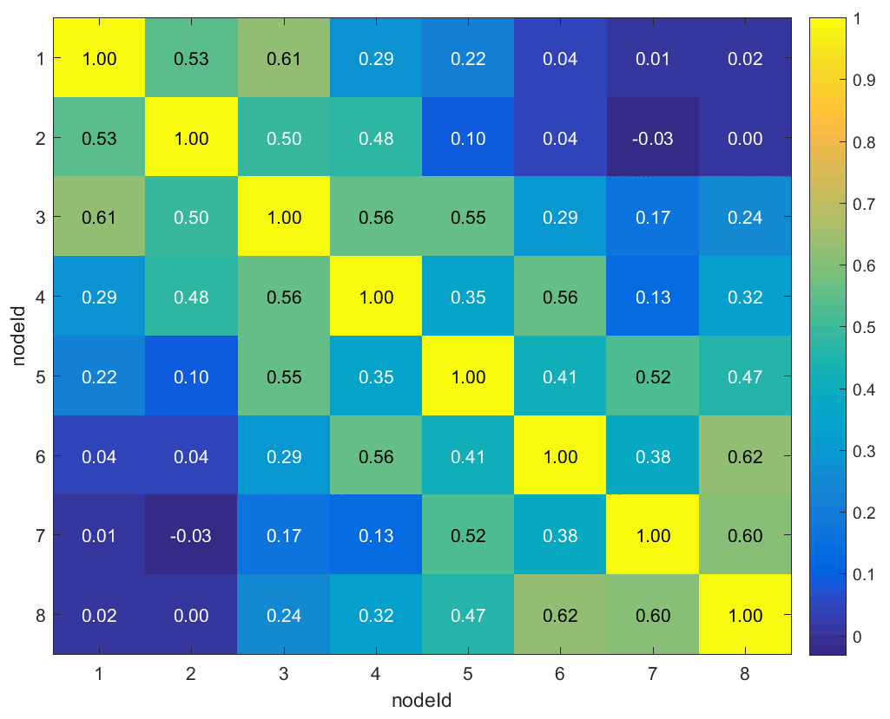
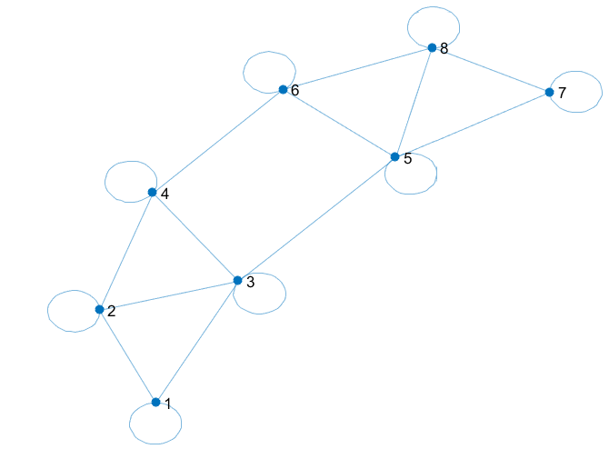
7
5
3
1
8
6
4
2

Slide 10
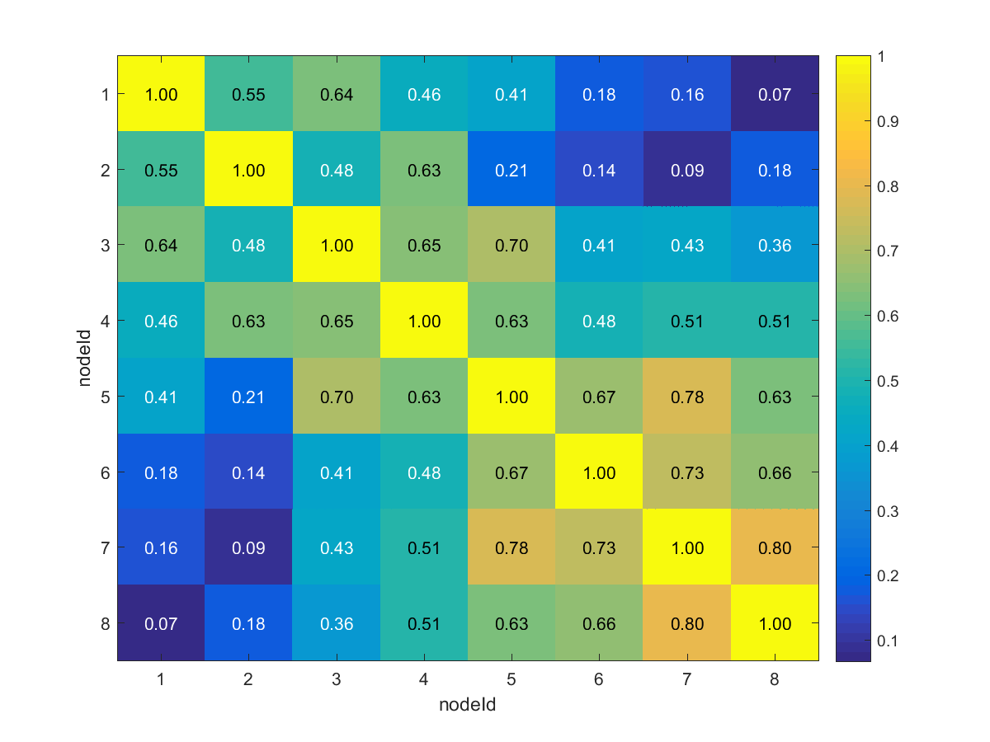
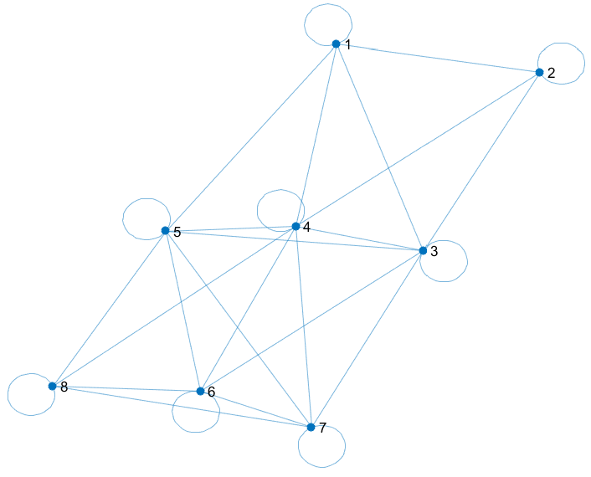
7
5
3
1
8
6
4
2
False positive (1,5),(4,8),(4,7),(3,7).

Slide 11
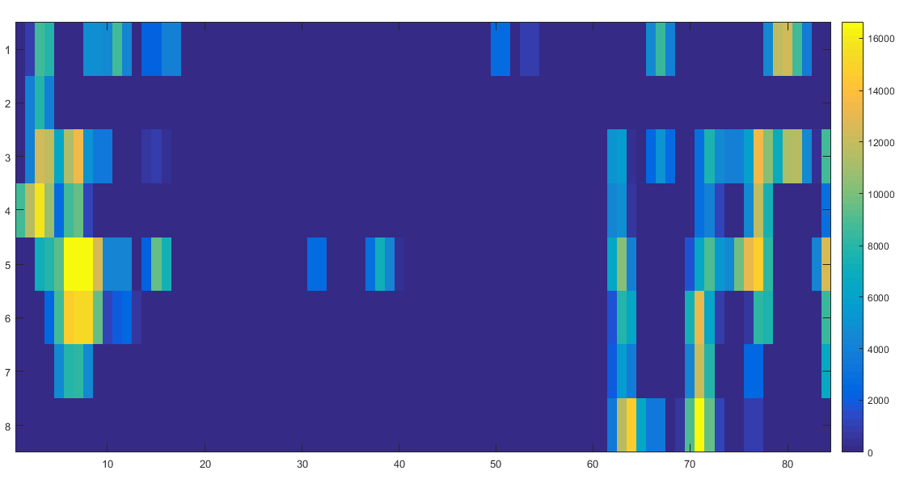
Scenario: 1 person already in the room. Near the desktop. 1 person enters the room and sits under 5 and 6 region. After a while one more person enters the room goes to the workplace below 8, and leaves the room after approximately a min.
7
5
3
1
8
6
4
2

Slide 12
Inferences
Correlation of energy of a signal is a useful feature to look at in determining the topology.
energy values can help distinguish walking around in the work place from that of working on the desk.(Need to be verified with more data).
From the correlation values topology can be verified.

Slide 13
Transition Analysis
Steps of calculation
Assign +1 value when there is a change from 0 to 1 in the sensor data.
Assign a value 0f -1 when it changes from 1 to 0.
Assign a value of 0 when x(n-1)=x(n).
Calculate the correlation delay of the transitions between two sensors.
The results were poor with maximum correlation of 0.2.

Slide 14
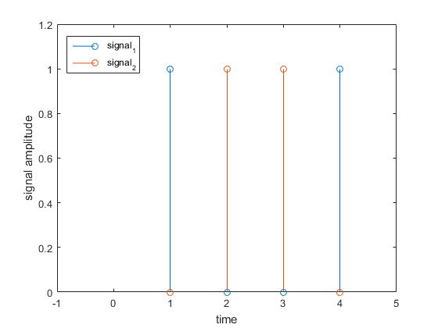
The reason for the bad performance for the correlation is that the transition are 2 ways.

Slide 15
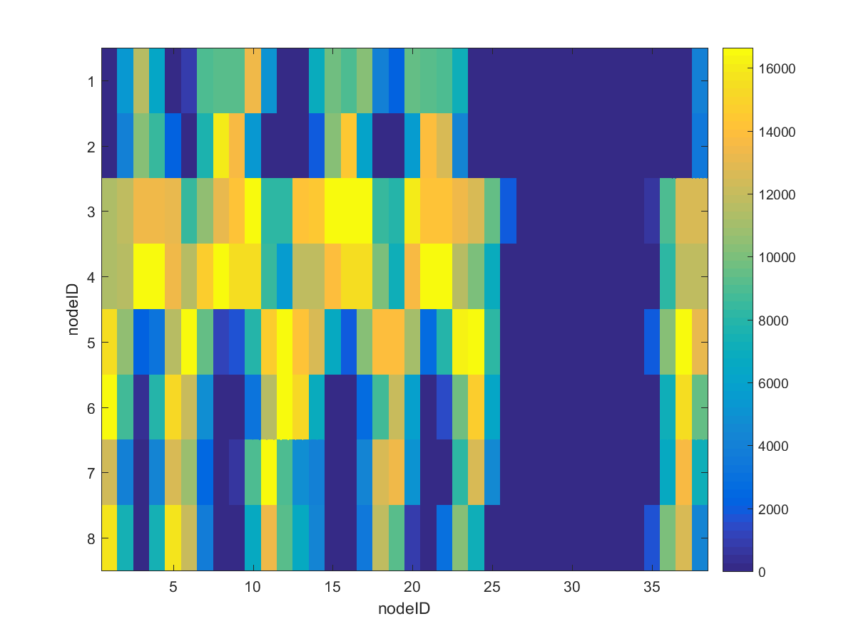
Goals for the week
Perform transition analysis, with energy data. Identifying the transition of energy will be more accurate than raw signal.
Look for more features that can be extracted from the raw signal.

