Slide 2


SARVAJANIK COLLEGE OF ENGINEERING & TECHNOLOGY
INFORMATION TECHNOLOGY DEPARTMENT
subject: python programming(2180711)
TOPIC: python graphics using turtle
prepared by.: ashish chovatiya (160420116011)

Slide 3
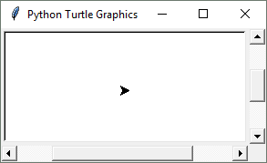
Introduction to Turtle Graphics
Python's turtle graphics system displays a small cursor known as a turtle.
You can use Python statements to move the turtle around the screen, drawing lines and shapes.

Slide 4
Introduction to Turtle Graphics
To use the turtle graphics system, you must import the turtle module with this statement: import turtle This loads the turtle module into memory

Slide 5
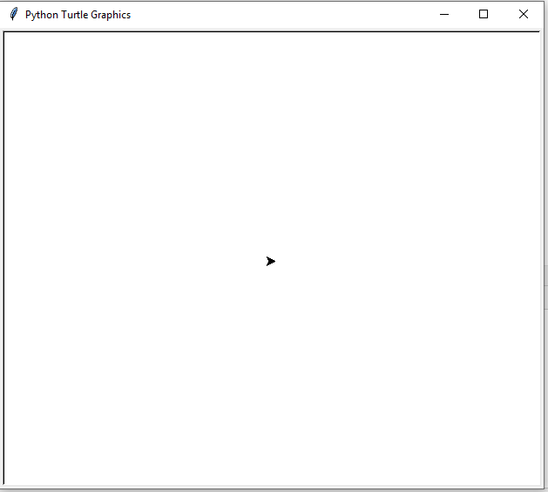
Showing Turtle Graphics Window
turtle.showturtle()

Slide 6
Shape of turtle
We can change the shape of turtle using turtle.shape(“ shape ”) method
i.e. turtle.shape(“ turtle ”)
The available shapes are arrow, turtle, circle, square, triangle, classic.
The default is “classic”.

Slide 7
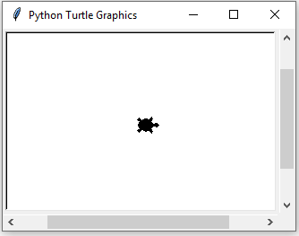
Shape of turtle
import turtle turtle.shape("turtle") turtle.showturtle() turtle.exitonclick()

Slide 8
End of turtle code
After the coding Is done we must put turtle.done() or turtle.exitonclick() , otherwise drawing won’t stay on screen after drawing is done.
If we use turtle.done() then, if we want to close the drawing window then we can do it by clickling on the close button.
And if we use turtle.exitonclick() then, by just clicking screen can be closed.

Slide 9
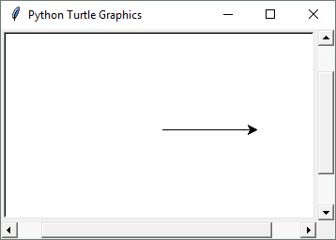
Moving the Turtle Forward
Use the turtle.forward(n) statement to move the turtle forward n pixels.
import turtle
turtle.forward(100)

Slide 10
Turning the Turtle
The turtle's initial heading is 0 degrees (east)
Use the turtle.right(angle) statement to turn the turtle right by angle degrees.
Use the turtle.left(angle) statement to turn the turtle left by angle degrees.

Slide 11
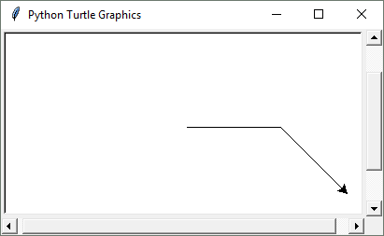
Turning the Turtle
import turtle
turtle.forward(100)
turtle.right(45)
turtle.forward(100)

Slide 12
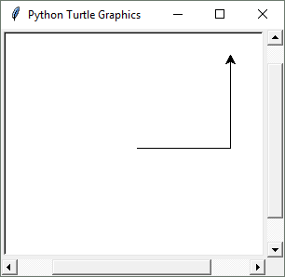
Turning the Turtle
import turtle
turtle.forward(100)
turtle.left(90)
turtle.forward(100)

Slide 13
Setting the Turtle's Heading
Use the turtle.setheading(angle) statement to set the turtle's heading to a specific angle.
i.e : turtle.setheading(90)

Slide 14
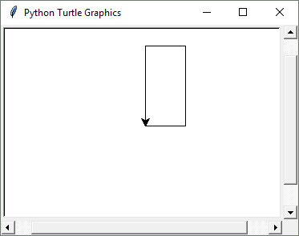
import turtle
turtle.forward(50)
turtle.setheading(90)
turtle.forward(100)
turtle.setheading(180)
turtle.forward(50)
turtle.setheading(270)
turtle.forward(100)

Slide 15
Setting the Pen Up or Down
When the turtle's pen is down, the turtle draws a line as it moves. By default, the pen is down.
When the turtle's pen is up, the turtle does not draw as it moves.
Use the turtle.penup() statement to raise the pen.
Use the turtle.pendown() statement to lower the pen.

Slide 16
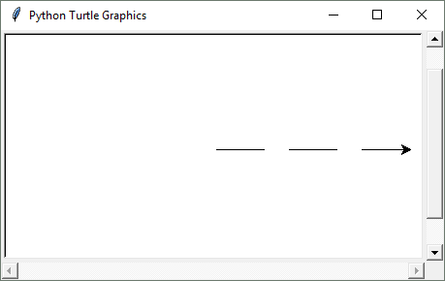
Setting the Pen Up or Down
import turtle
turtle.forward(50)
turtle.penup()
turtle.forward(25)
turtle.pendown()
turtle.forward(50)
turtle.penup()
turtle.forward(25)
turtle.pendown()
turtle.forward(50)

Slide 17
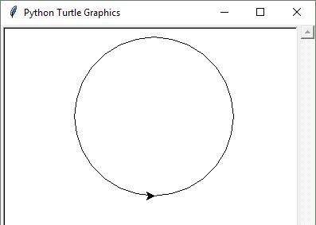
Drawing Circles
Use the turtle.circle(radius) statement to draw a circle with a specified radius.
import turtle
turtle.circle(100)

Slide 18
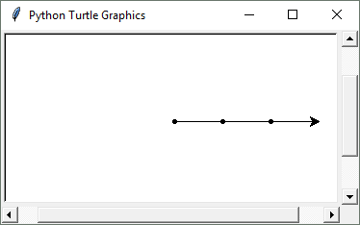
Drawing Dots
Use the turtle.dot() statement to draw a simple dot at the turtle's current location.
import turtle
turtle.dot()
turtle.forward(50)
turtle.dot()
turtle.forward(50)
turtle.dot()
turtle.forward(50)

Slide 19
Changing the Pen Size and Drawing Color
Use the turtle.pensize(width) statement to change the width of the turtle's pen, in pixels.
Use the turtle.pencolor(color) statement to change the turtle's drawing color.

Slide 20
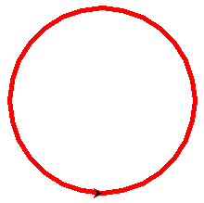
import turtle
turtle.pensize(5)
turtle.pencolor('red')
turtle.circle(100)

Slide 21
Working with the Turtle's Window
Use the turtle.bgcolor(color) statement to set the window's background color.
Use the turtle.setup(width, height) statement to set the size of the turtle's window, in pixels.
The width and height arguments are the width and height, in pixels.
For example, the following interactive session creates a graphics window that is 640 pixels wide and 480 pixels high:
import turtle
turtle.setup(640, 480)

Slide 22
Resetting the Turtle's Window
The turtle.reset() statement:
Erases all drawings that currently appear in the graphics window.
Resets the drawing color to black.
Resets the turtle to its original position in the center of the screen.
Does not reset the graphics window’s background color.

Slide 23
Resetting the Turtle's Window
The turtle.clearscreen() statement:
Erases all drawings that currently appear in the graphics window.
Resets the drawing color to black.
Resets the turtle to its original position in the center of the screen.
Resets the graphics window’s background color to white.

Slide 24
Resetting the Turtle's Window
The turtle.clear() statement:
Erases all drawings that currently appear in the graphics window.
Does not change the turtle's position.
Does not change the drawing color.
Does not change the graphics window’s background color.

Slide 25
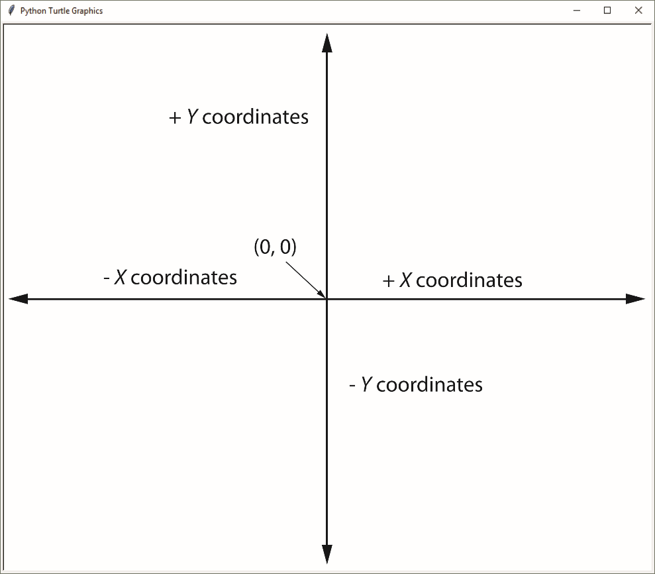
Working with Coordinates
The turtle uses Cartesian Coordinates

Slide 26
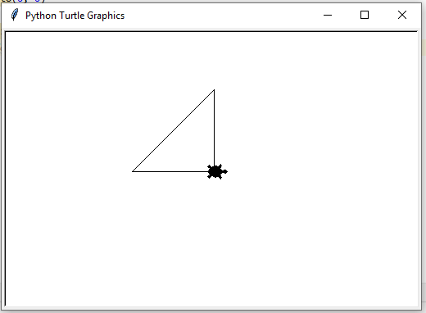
Moving the Turtle to a Specific Location
Use the turtle.goto(x, y) statement to move the turtle to a specific location.
import turtle turtle.shape("turtle") turtle.speed(1) turtle.showturtle() turtle.goto(0, 100) turtle.goto(-100, 0) turtle.goto(0, 0) turtle.exitonclick()

Slide 27
The turtle.pos() statement displays the turtle's current X,Y coordinates.
The turtle.xcor() statement displays the turtle's current X coordinate and the turtle.ycor() statement displays the turtle's current Y coordinate.

Slide 28
Animation Speed
Use the turtle.speed(speed) command to change the speed at which the turtle moves.
The speed argument is a number in the range of 0 through 10.
10 is the fastest, 1 is the slowest
If you specify 0, then the turtle will make all of its moves instantly (animation is disabled).

Slide 29
Hiding and Displaying the Turtle
Use the turtle.hideturtle() command to hide the turtle.
This command does not change the way graphics are drawn, it simply hides the turtle icon.
Use the turtle.showturtle() command to display the turtle.

Slide 30
Displaying Text
Use the turtle.write(text) statement to display text in the turtle's graphics window.
The text argument is a string that you want to display.
The lower-left corner of the first character will be positioned at the turtle’s X and Y coordinates
To change font and font size use
turtle.write (‘Any Text', font = (‘font style’, size, ‘design'))

Slide 31
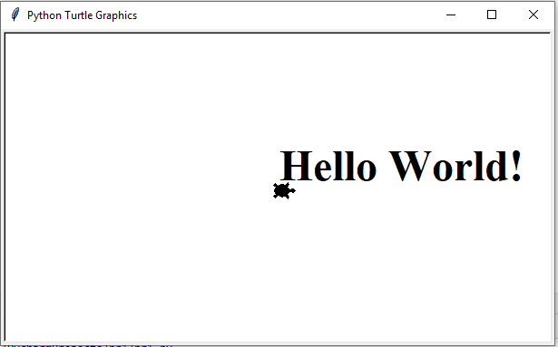
Displaying Text
import turtle turtle.shape("turtle") turtle.speed(0) turtle.showturtle() turtle.write ('Hello World!', font = ('Times New Roman', 36, 'bold')) turtle.exitonclick()

Slide 32
Filling Shapes
To fill a shape with a color:
Use the turtle.begin_fill() command before drawing the shape
Then use the turtle.end_fill() command after the shape is drawn.
When the turtle.end_fill() command executes, the shape will be filled with the current fill color

Slide 33
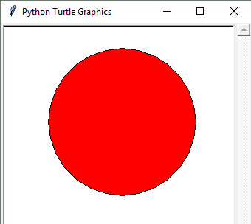
Filling Shapes
import turtle
turtle.hideturtle()
turtle.fillcolor('red')
turtle.begin_fill()
turtle.circle(100)
turtle.end_fill()

