Slide 1
DS 530 Project
By Arpan Patel

Slide 2
Resources
PostgreSQL
PgAdmin
Pycharm
Aws
Aws redshift
Aws S3

Slide 3
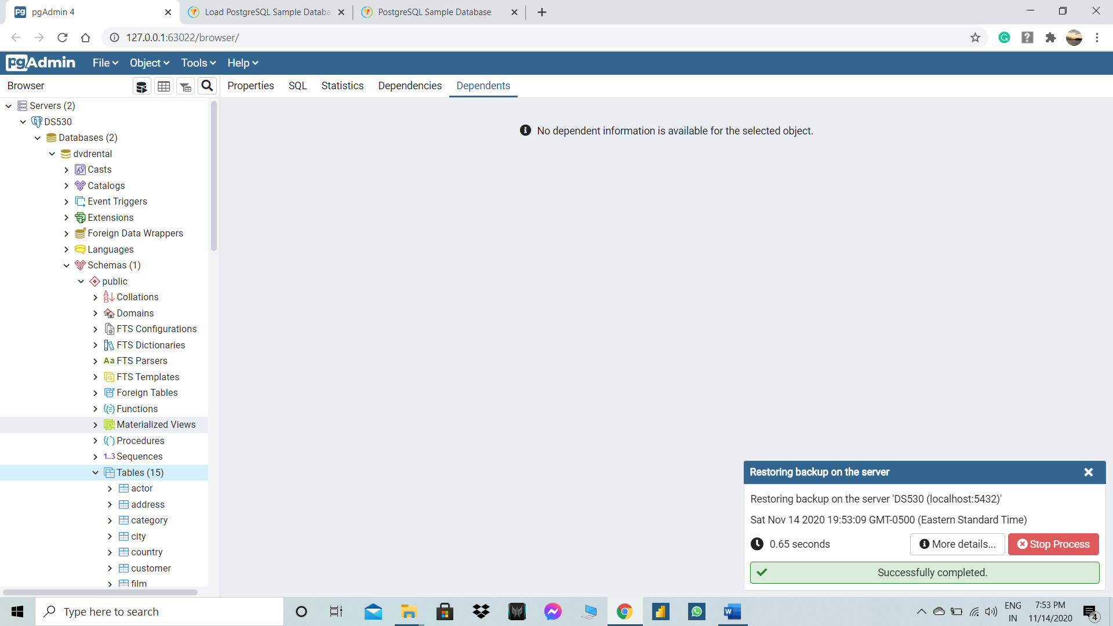
PostgreSQL pgadmin4

Slide 4
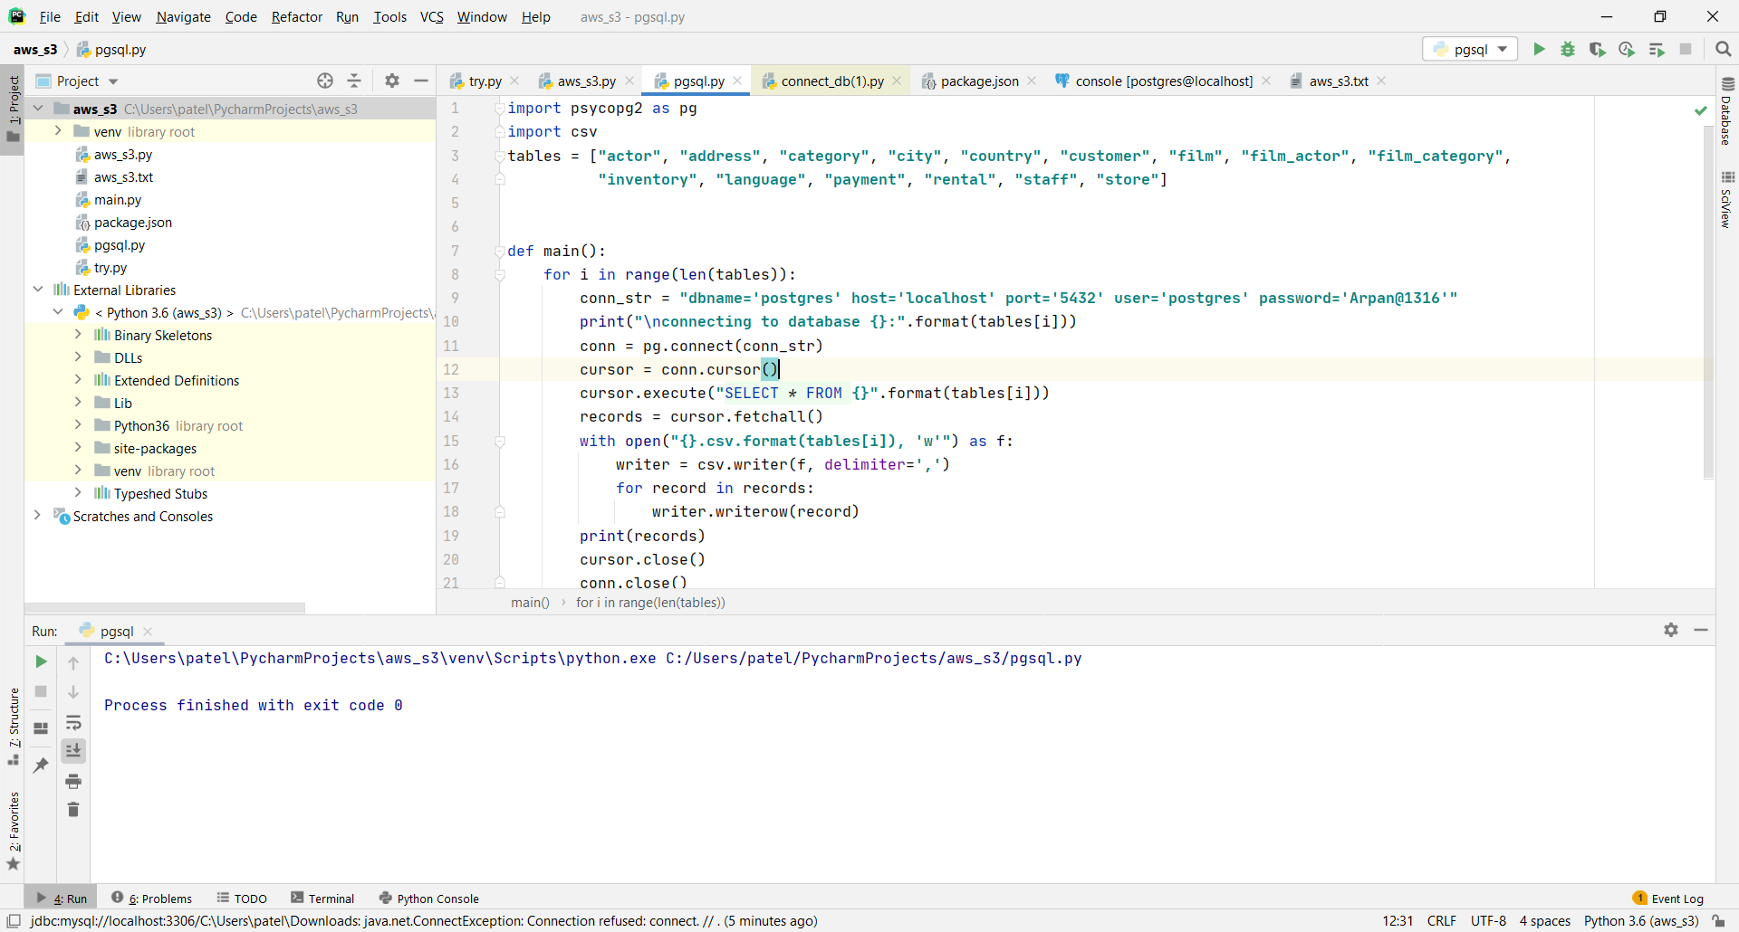
Pycharm code to convert tables to .csv

Slide 5
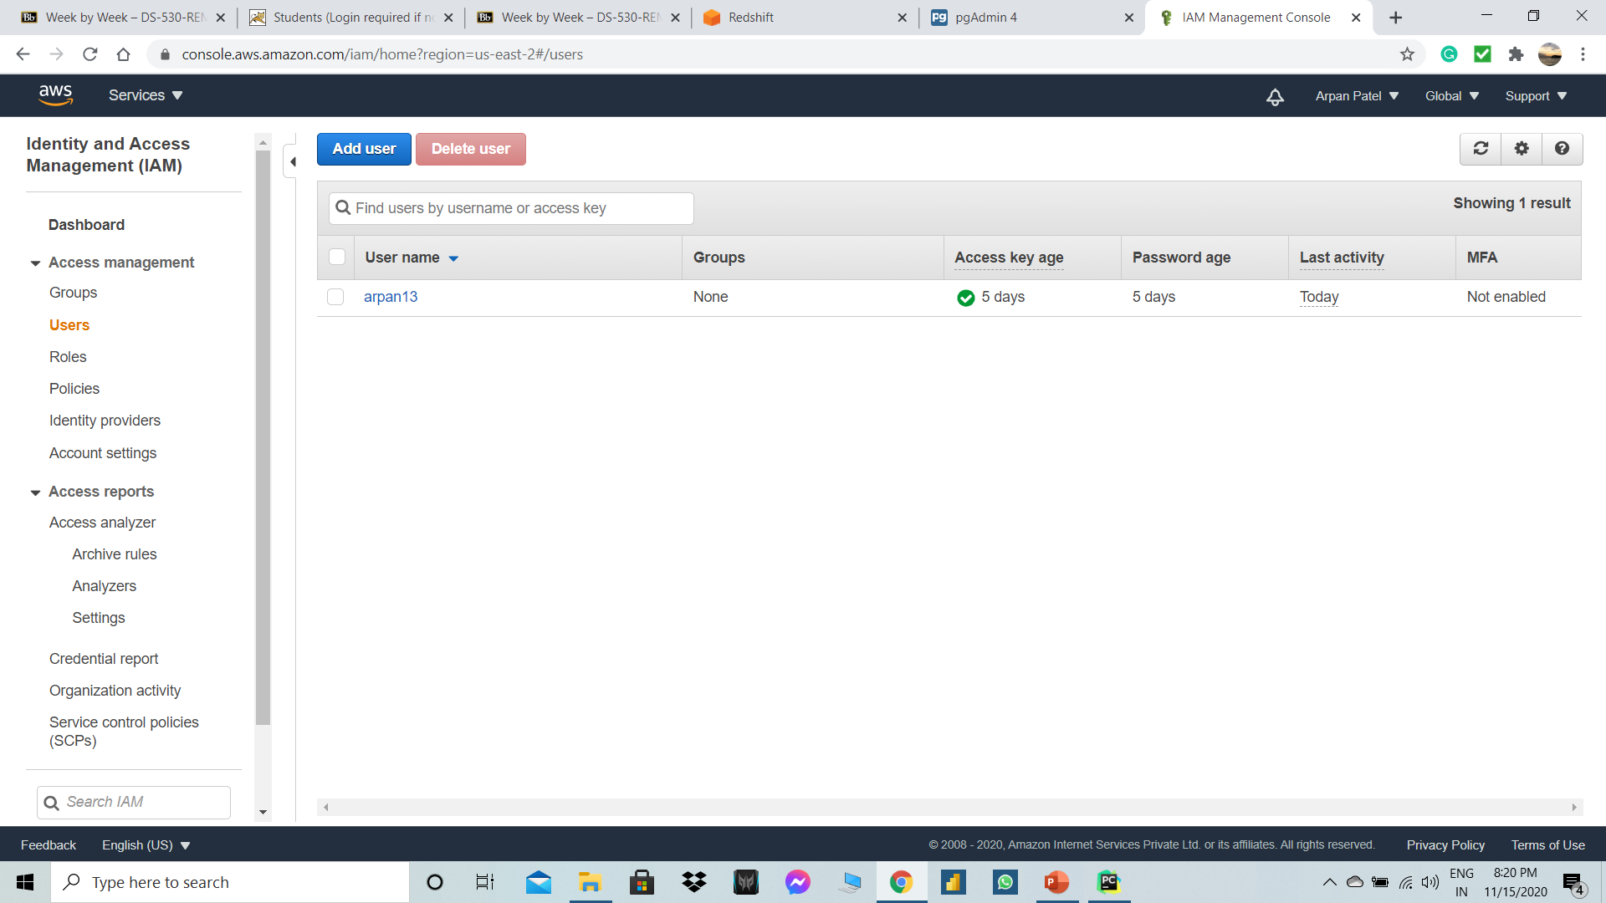
Create IAM user and assign access to s3 Bucket

Slide 6
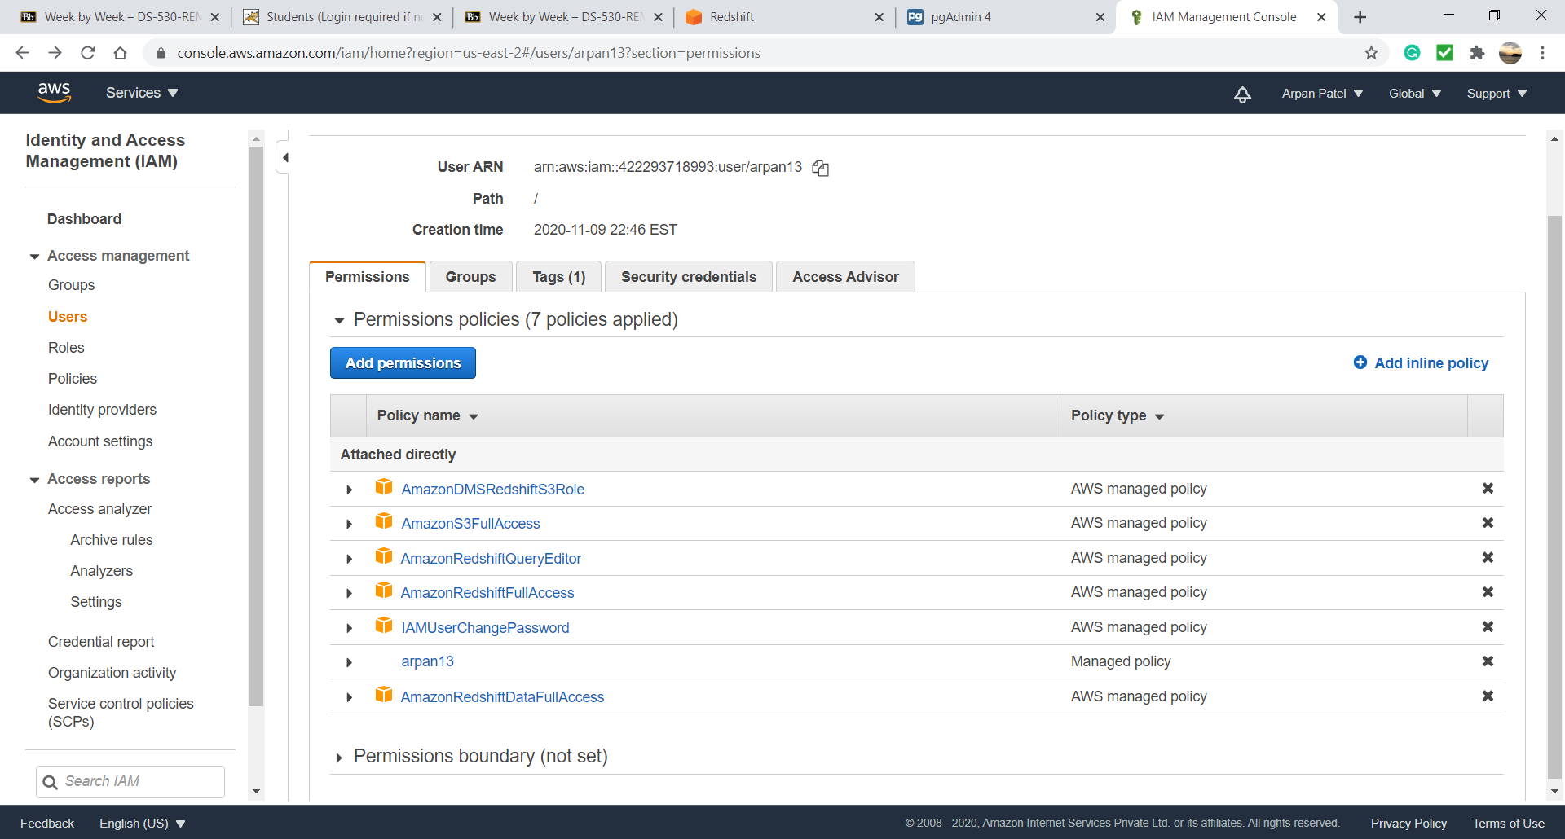
Assign full access to user

Slide 7
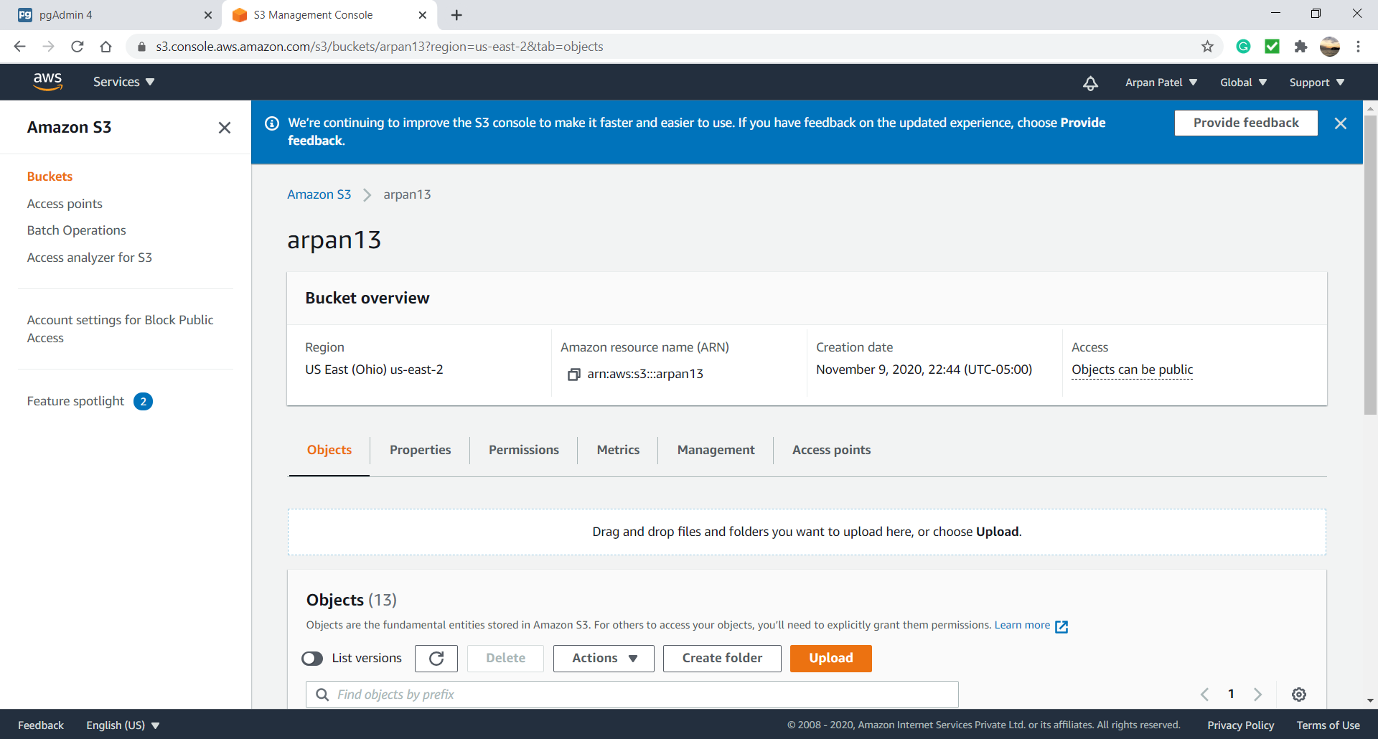
S3 Bucket

Slide 8
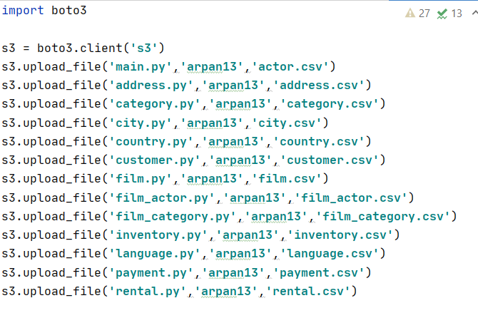
Pycharm code to upload files into s3 bucket

Slide 9
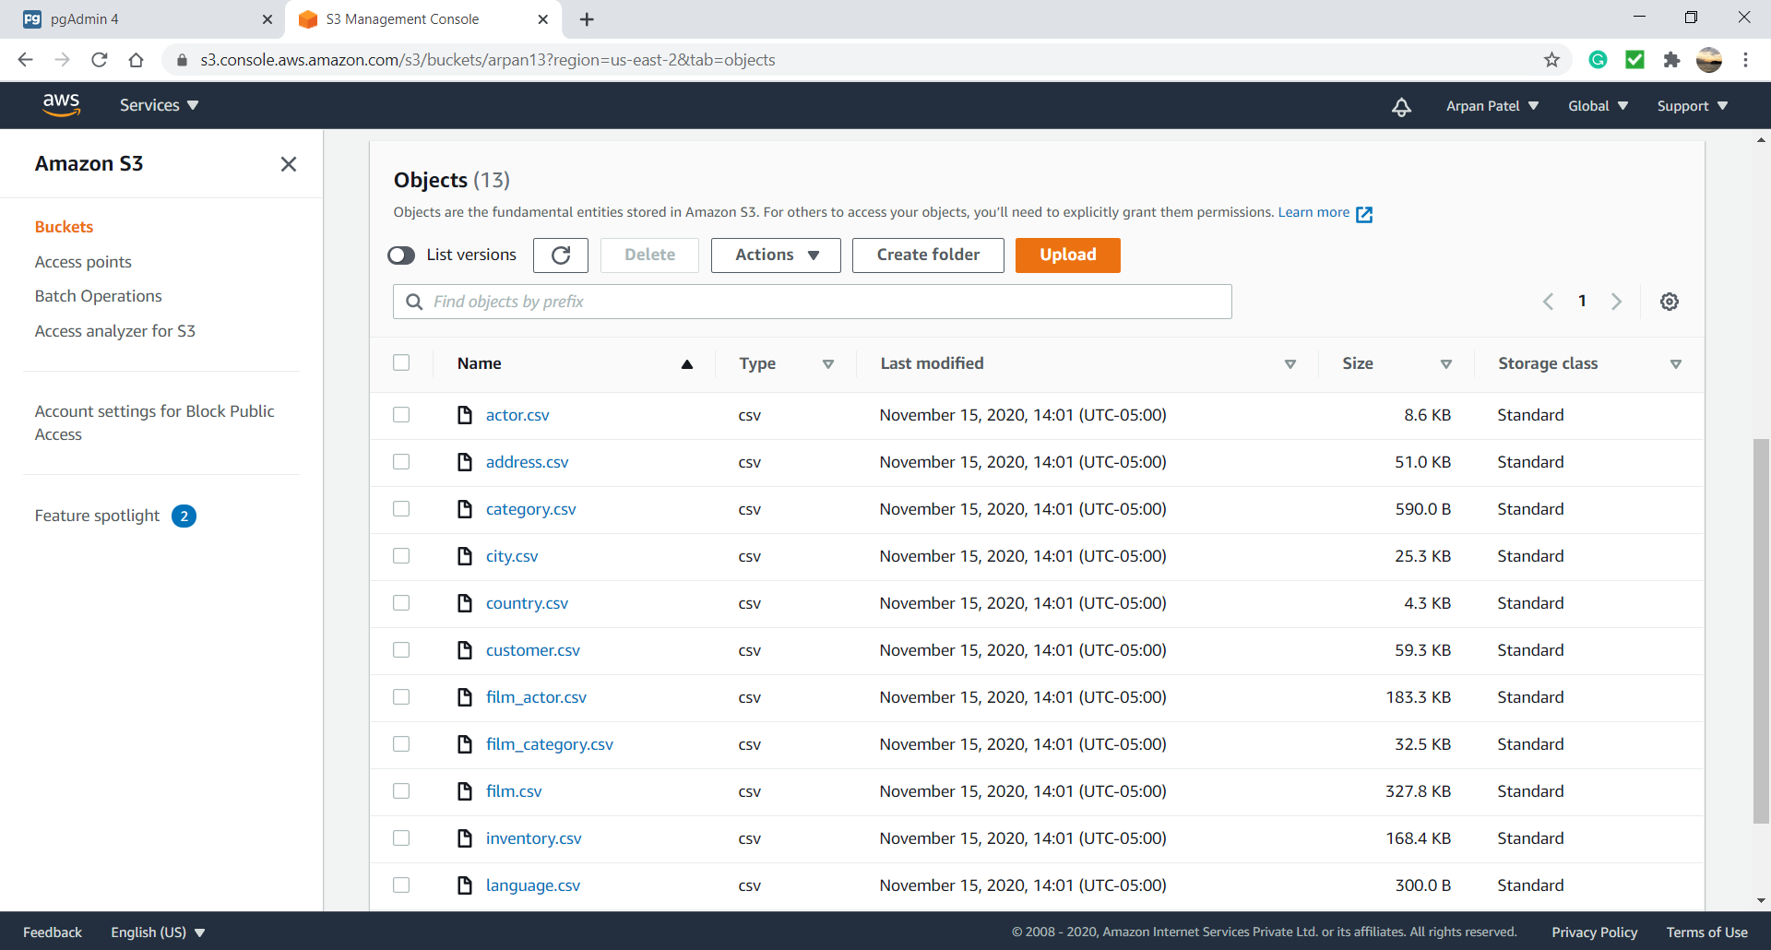
Csv files in S3 Bucket

Slide 10
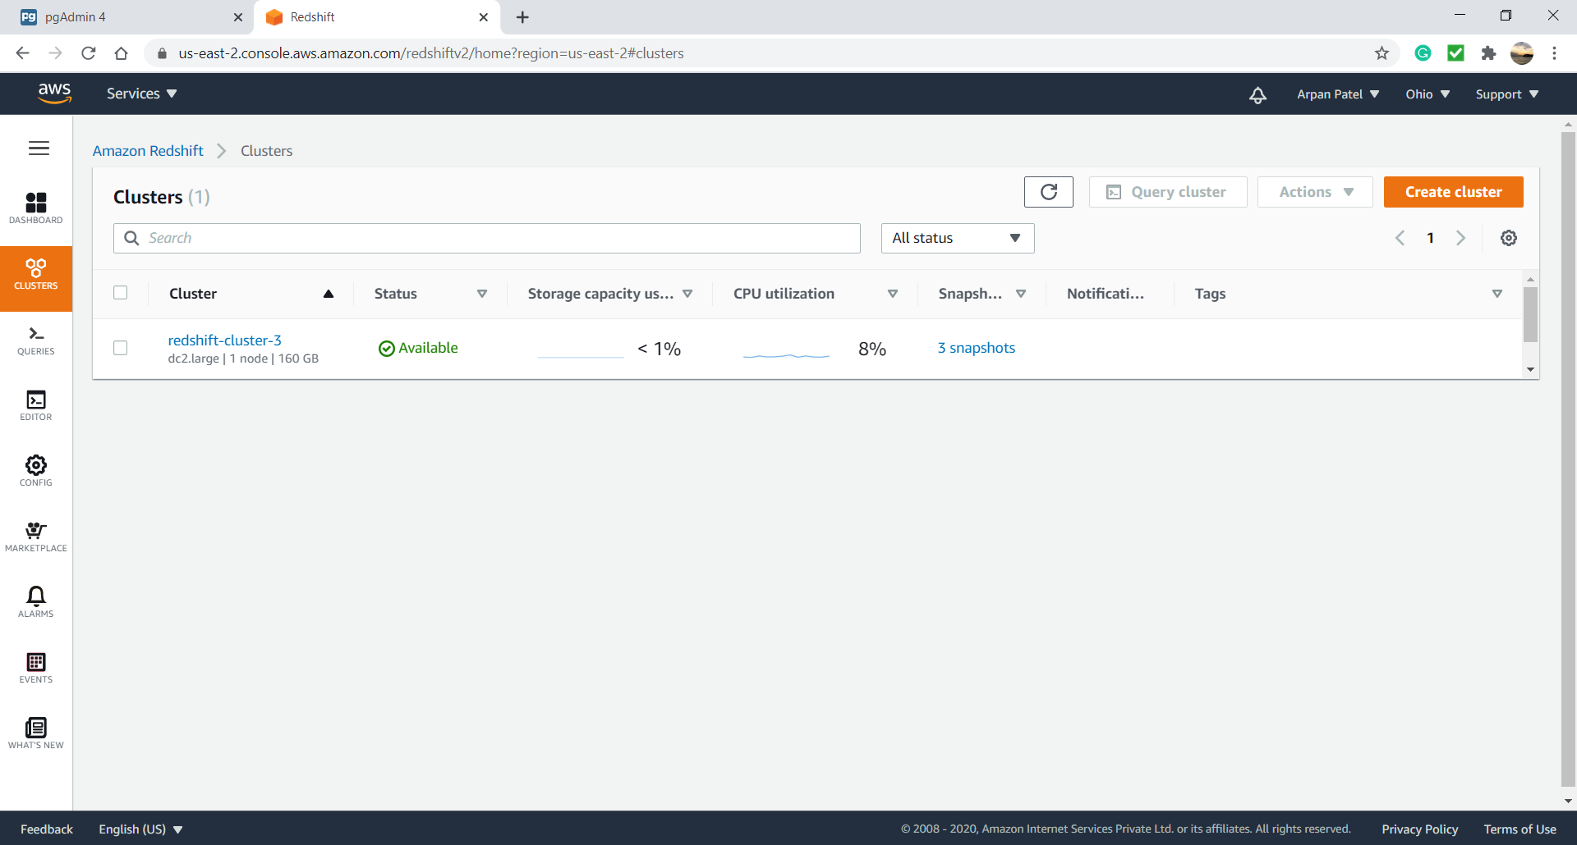
Amazon Redshift Cluster

Slide 11
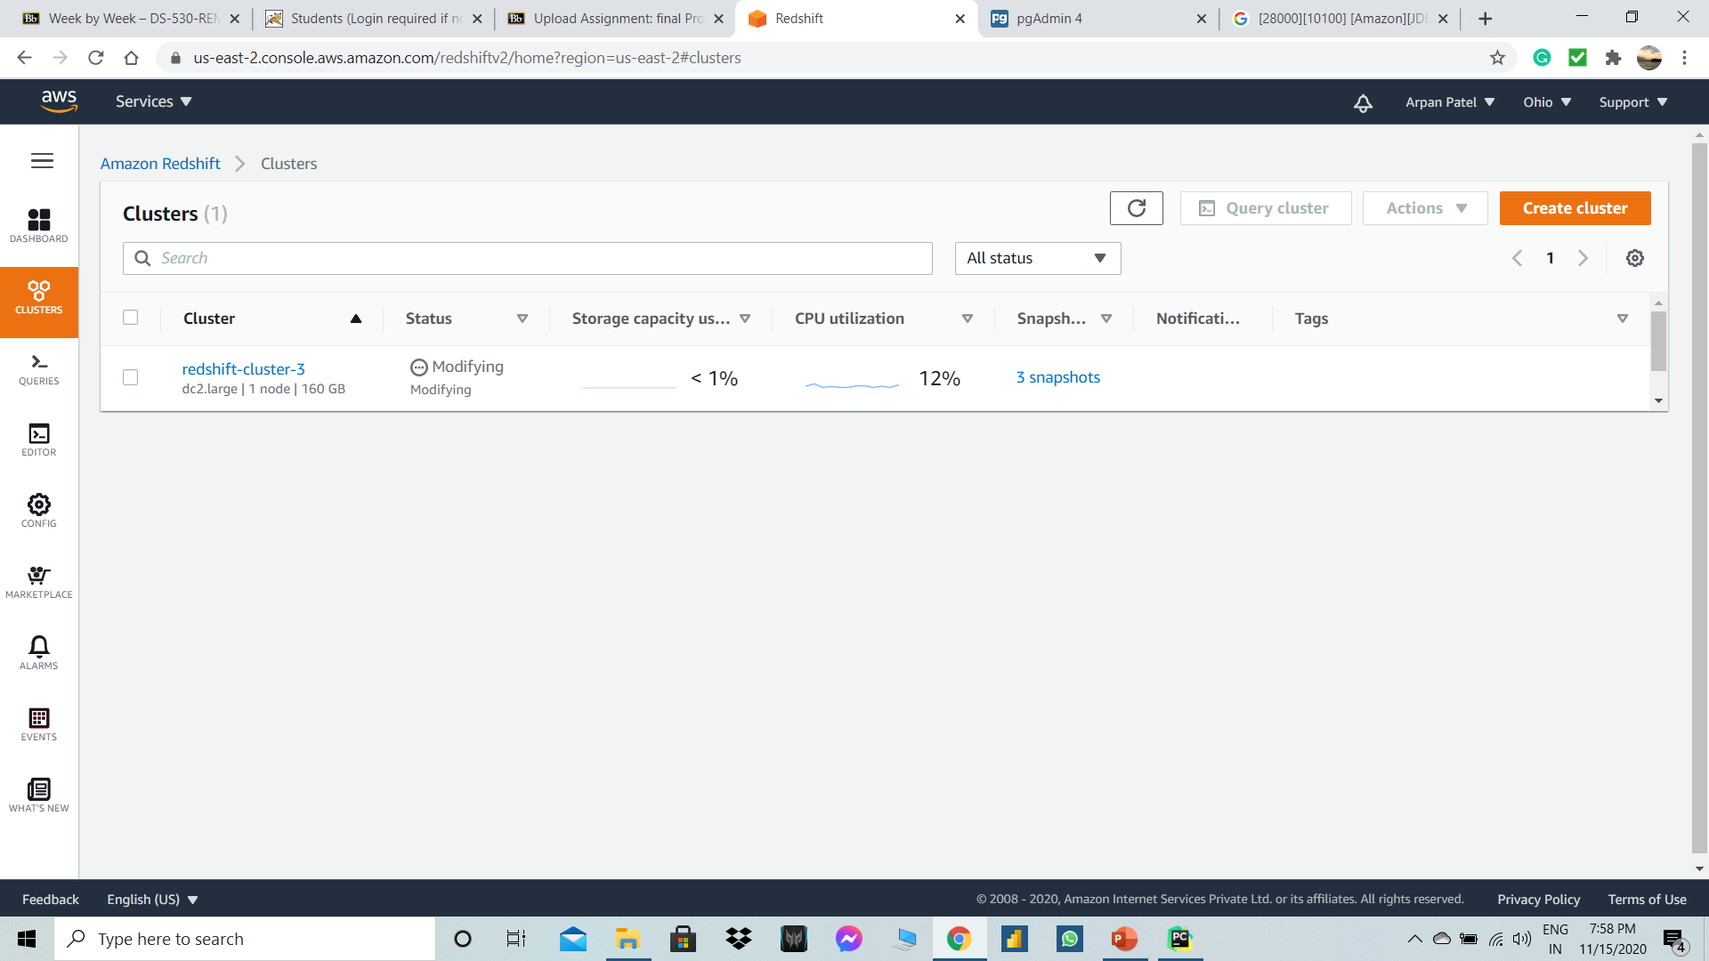
Modifying cluster for public access to yes

Slide 12
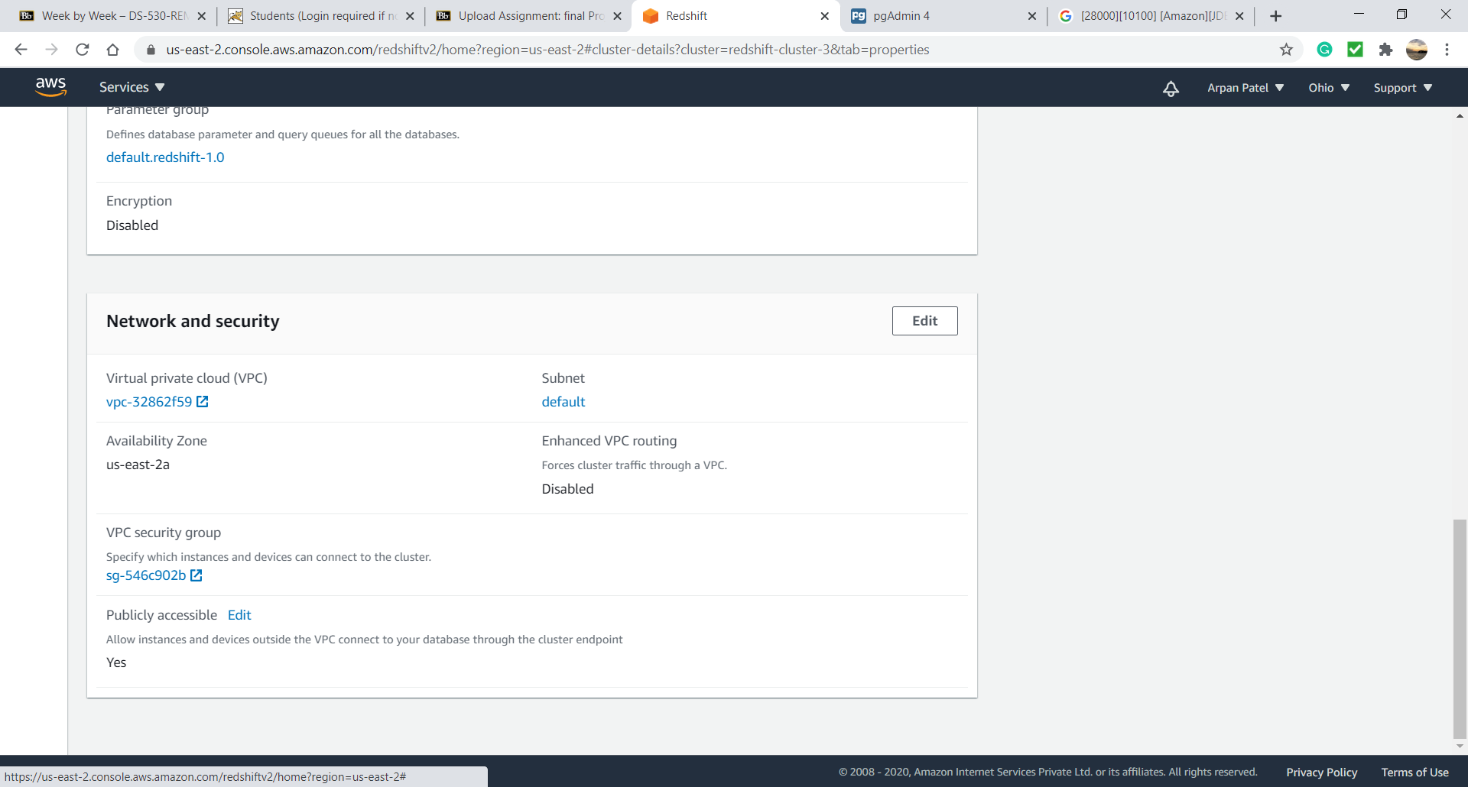
Now publicly accessible to yes if you need to access from internet gateway

Slide 13
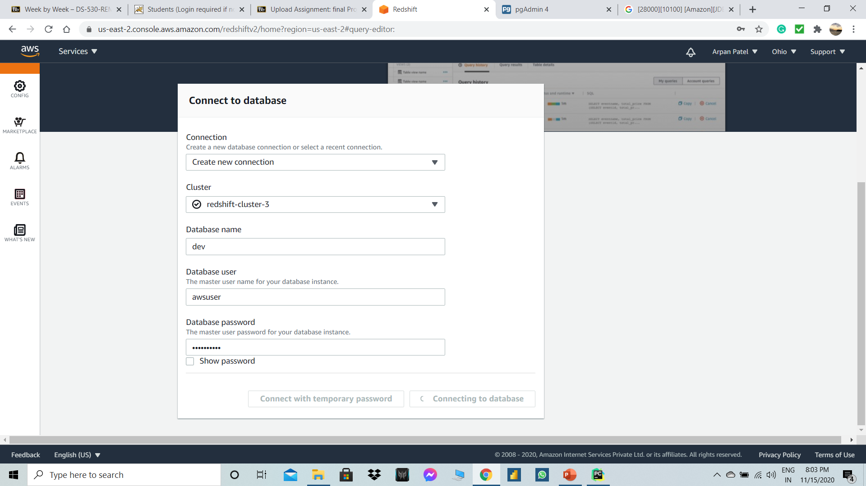
Connect to database user in aws redshift for query editor

Slide 14
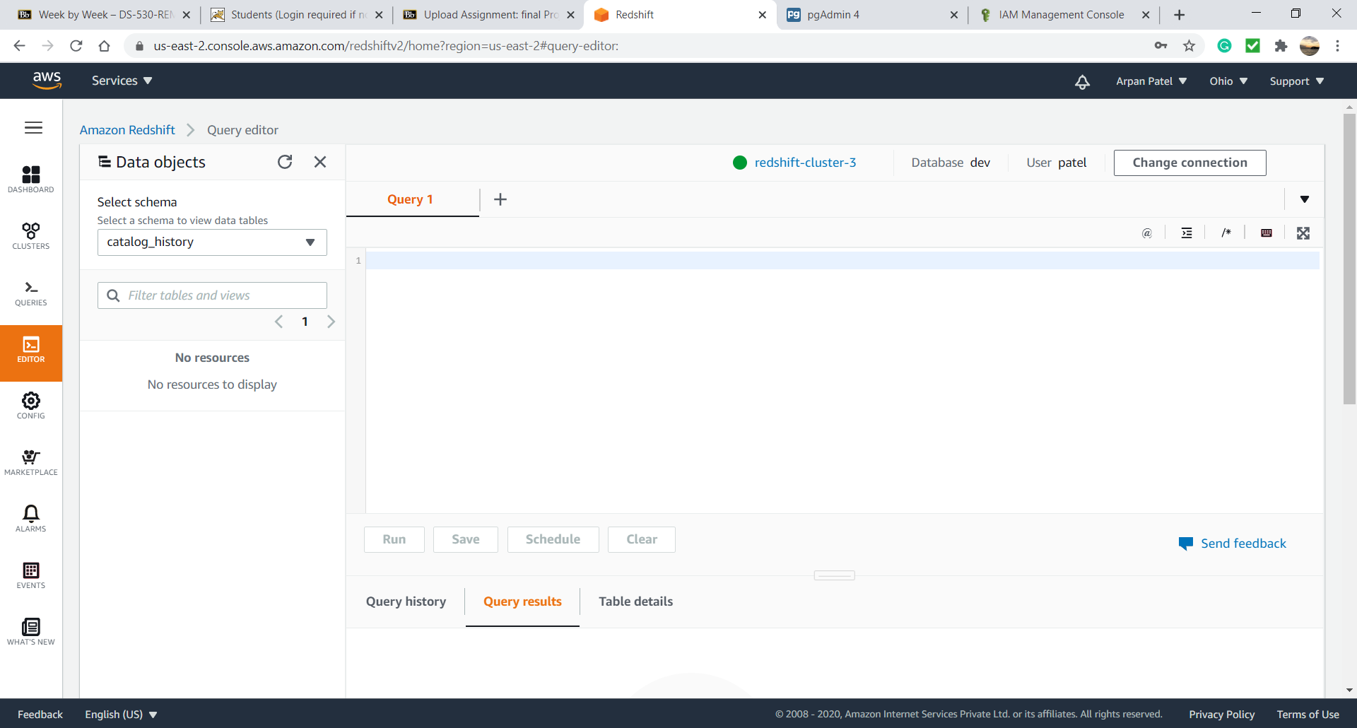
Redshift query editor

Slide 15
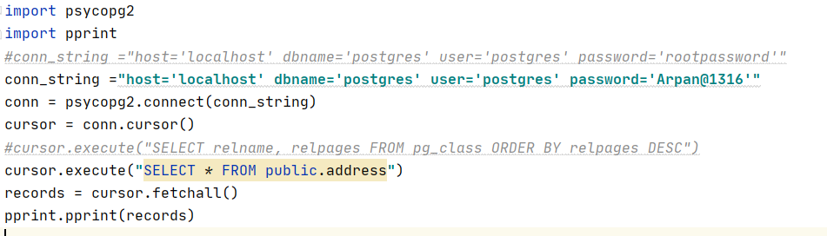
Query pycharm

Slide 16
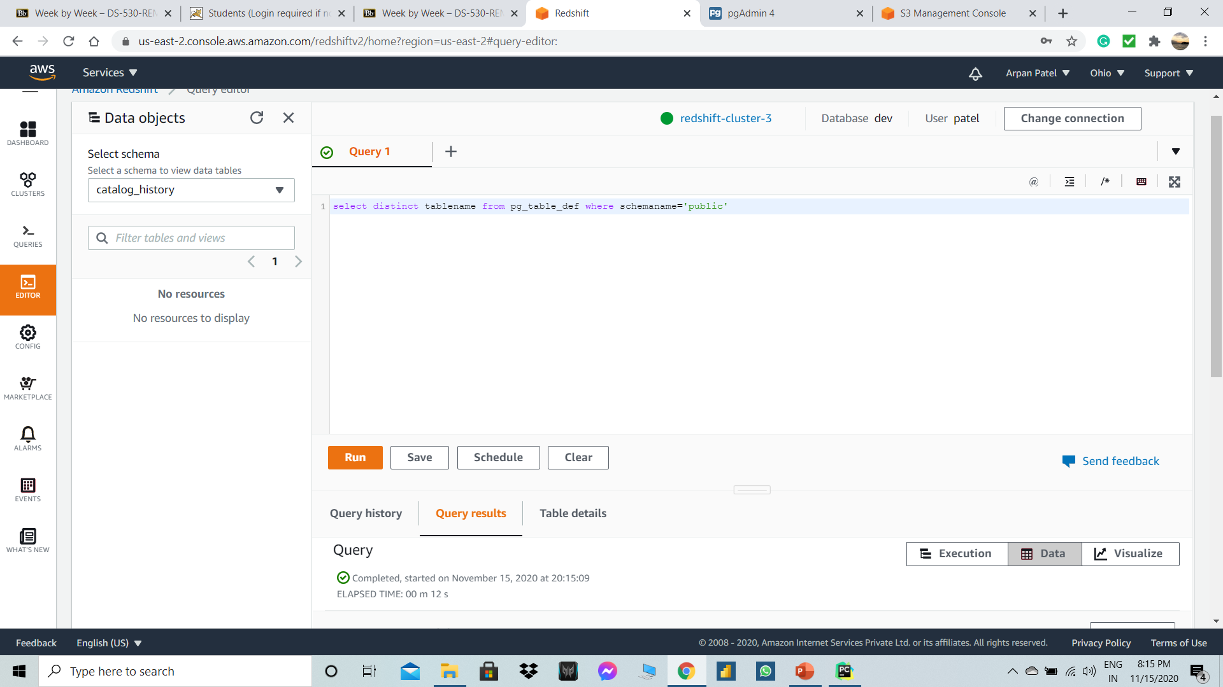
Sample Queries in redshift

Slide 17
THANK YOU

