Slide 1

Note: The data and information in this document is reflective of a hypothetical situation and client. This document is to be used for KPMG Virtual Internship purposes only.
Sprocket Central Pty Ltd
Data analytics approach
[Division Name] - [Engagement Manager], [Senior Consultant], [Junior Consultant]

Slide 2
Note: The data and information in this document is reflective of a hypothetical situation and client. This document is to be used for KPMG Virtual Internship purposes only.
Agenda
Introduction
Data Exploration
Model Development
Interpretation

Slide 3

Note: The data and information in this document is reflective of a hypothetical situation and client. This document is to be used for KPMG Virtual Internship purposes only.
Introduction
Approach to Recommendation: Creating a Comprehensive Strategy
To proceed with our recommendation, we'll outline a comprehensive strategy in a PowerPoint presentation. We'll cover three phases: Data Exploration, Model Development, and Interpretation

Slide 4

Note: The data and information in this document is reflective of a hypothetical situation and client. This document is to be used for KPMG Virtual Internship purposes only.
Data Exploration
Data Distribution Analysis
We'll deeply analyze data distributions to uncover patterns and gain insights that drive decision-making.
Feature Engineering
Through creative feature engineering techniques, we'll transform raw data into meaningful predictors for our models.
Data Transformations
Applying advanced data manipulation techniques, we'll preprocess and normalize the data to enhance model performance.

Slide 5
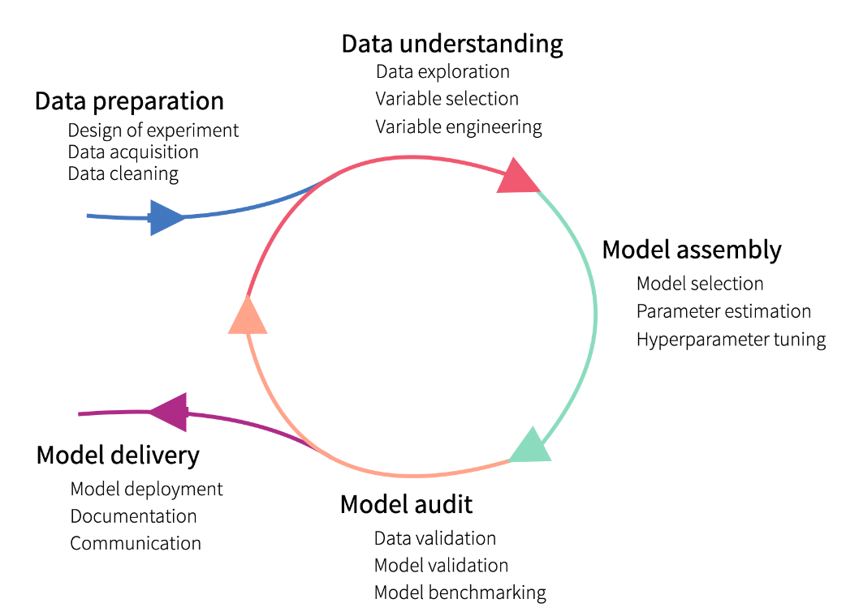
Note: The data and information in this document is reflective of a hypothetical situation and client. This document is to be used for KPMG Virtual Internship purposes only.
Model Development
Step 1: Determine Hypothesis
First, we need to formulate a hypothesis that relates to our business question and can be tested with the available data. We will then perform statistical testing to determine the validity of the hypothesis.
Step 2: Create Calculated Fields
Next, we will create calculated fields based on the existing data. For example, we can convert the date of birth (D.O.B) into age brackets to better analyze the data.
Step 3: Model Performance Testing
We will evaluate the performance of the model using various factors such as residual deviance, AIC, ROC curves, and R-squared. This analysis will help us assess the accuracy and effectiveness of the model, considering its assumptions and limitations.

Slide 6
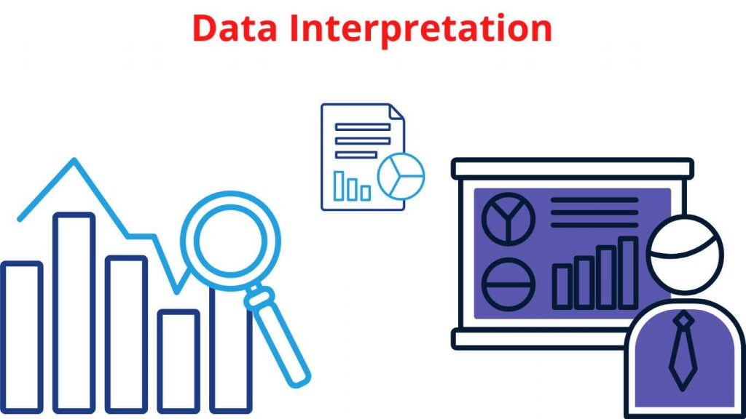
Note: The data and information in this document is reflective of a hypothetical situation and client. This document is to be used for KPMG Virtual Internship purposes only.
Interpretation
Results Interpretation
We'll interpret the model results, translating complex data, and presenting the findings in a clear and actionable manner.
Reporting
Our comprehensive reports will provide detailed insights, recommendations, and strategies for the client to implement effectively.

