Slide 1
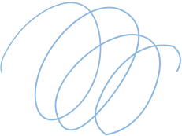


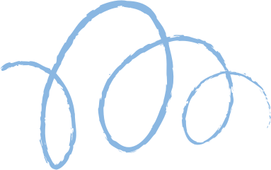









Polyalphabetic
Vigenere Ciphere
Arpan Kumar (2021020)
Pranav Tanwar (2022368)

Slide 2

What is the Vigenere Cipher?
Vigenere Cipher is a polyalphabetic substitution cipher that uses a secret word as its key, and uses it to encrypt and decrypt the plaintext.

Slide 3
Given plaintext P, and key K, perform encryption to generate the ciphertext C such that,
C(i)=(P(i)+K(i)) mod 26
where X(i) represents the i-th character in the sequence.
Encryption and Decryption using Vigenere Cipher
01.
Transfer of the ciphertext from the sender to the receiver, assuming that the key had already been exchanged through a secure channel.
02.
Here we assume that all letters have been assigned a numerical value based on their index. So, A=0, B=1, C=2 and so on until Z=25.
The receiver decrypts the ciphertext C using the key K to obtain the plaintext P back in the following manner.
P(i)=(C(i)-K(i)) mod 26
03.

Slide 4
Brute Force Attack
The brute force attack on the Vigenere Cipher involves trying out all the possible values of the key, given that its length is known. For example, if we know that our key has a length of seven, we can cycle through all the possible values from a given set at a particular position, which, in the case of the English alphabet being used as the set, will take 26^7 iterations.

Slide 5
Vigenere Cipher Implementation
01
02
03
04
Using the set of lowercase English alphabet {a,b,c,...,y,z} for the plaintext, ciphertext, and key.
Creating 5 random plaintext strings, and encrypting them with a predefined key of size 4.
Decrypting the generated strings using the same key as used for encryption, as well as creating a hash function for verification.
Using a brute force attack with complexity of 26^4 to generate the key and break the cipher.

Slide 6
Thank you very much!

