Slide 1

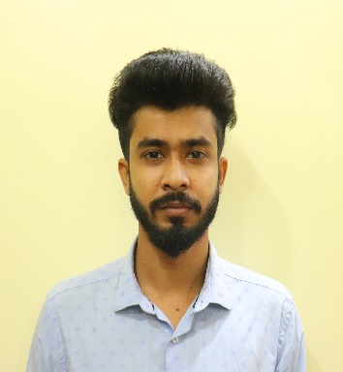





ARPAN GHOSH
Education and certificates Bachelor of Technology Computer Science Engineering : 2018 - 2022
Skills
Analyst/A4
Base Location: Mumbai
Email ID:
***********.*******@gmail.com
Java 8 /J2EE | Java Basics, OOPS, Generics, Collections, Arrays, Loops, Lambda Exp, Stream API Junit, Mockito, Servlets
Spring core | IOC & Dependency Injection, Autowire
Spring REST | REST controllers, Implementation of GET, POST, PUT & DELETE, Bean Validation & Exception Handling, Testing Services, Controller & Repository layer
Spring Data JPA | Implement DAO layer using spring Data repositories, Transaction Management
Spring Boot Microservi ces | Spring Boot Starters, annotations, Messaging Service, Sync/Async comms, Swagger API documents
Spring Cloud | Eureka, Netflix Ribbon, Feign Client, Netflix Hystrix, Netflix Zuul & Config Server
React | Components, Hooks, Event handling, Redux, Reducers, Testing
Database | MongoDB No Sql Basics My SQL RDS Basics
UI Tech | HTML 5 & CSS 3,JavaScript, Optimized UI Designed
Tools | Git, Postman, Maven, IDE
Add On skills | Communications, Team management. Peer learning
Mobile No: Grade: A4
+91 xxxxxxxxxxxx
Strengths
Full Stack Developer
Achievement
Hands on experience in creating microservices with Spring Boot, Spring Security, Spring Cloud API Gateway, Eureka server, load balancing, Swagger,
Online Car wash booking application
Completed end to end case development of Car Wash Booking Application in JAVA Spring boot along with JWT authentication, Swagger, Spring Cloud, API Gateway, RabbitMQ and payment gateway using Paytm. React Js is used as the front-end interface. Bootstrap 5 and Material UI is used for extra styling apart from CSS. MongoDB is used as the Database in the whole application.
Proficient in creating Single Page Web Application in React, React routing, HTML5, CSS3, Bootstrap5, ReactStrap, Validators, React UI Kit, MDBBootstrap.
Student Management System
Hands on experience in implementing Mongo dB Atlas & PostgreSQL.
Completed end to end development of Student Management System in Java Spring Boot. React Js is used as the front-end interface. Bootstrap 5 is used for extra styling apart from CSS. H2 Database and PostgreSQL is used as the database in the whole application.
Development experience in frontend development using MDB Bootstrap
Completed a three months Training for A4 Analyst of
Capgemini India.
LinkedIn www.linkedin.com/in/arpan-ghosh-36b344214/
Check out my work on GitHub & Video Profile
Presentation Title | Author | Date © Capgemini 2017. All rights reserved | 1

