Slide 1
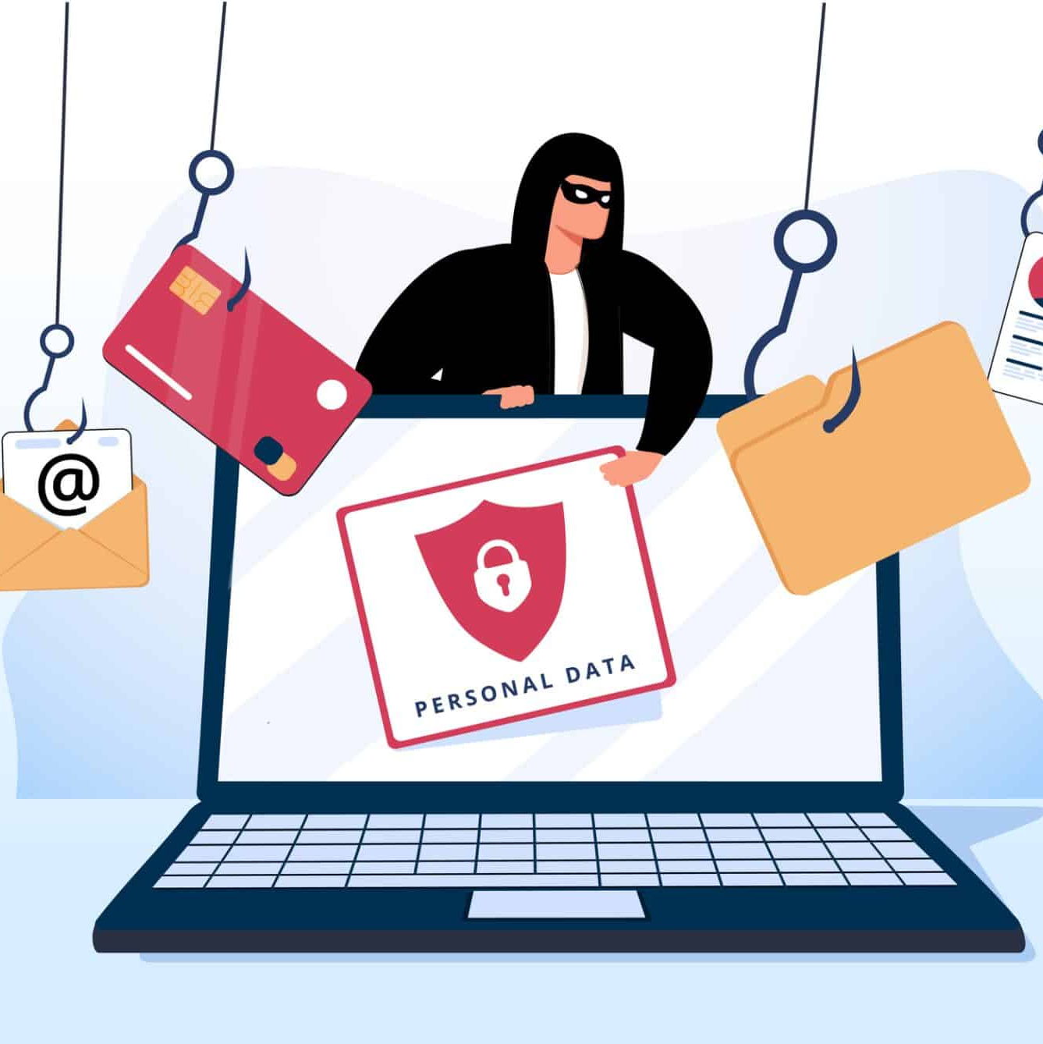
Social Engineering
Social engineering refers to a wide range of cyberattacks that use psychological tactics to manipulate people into taking a desired action, such as giving up confidential information. These attacks exploit human error or weakness rather than technical vulnerabilities .Social engineering attacks happen in one or more steps. A perpetrator first investigates the intended victim to gather necessary background information, such as potential points of entry and weak security protocols, needed to proceed with the attack. Then, the attacker uses a form of pretexting such as impersonation to gain the victim’s trust and provide stimuli for subsequent actions that break security practices, such as revealing sensitive information or granting access to critical resources.

Slide 2
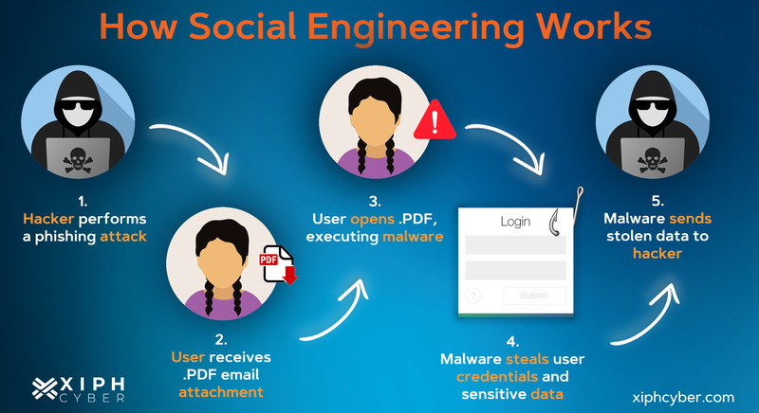

Slide 3
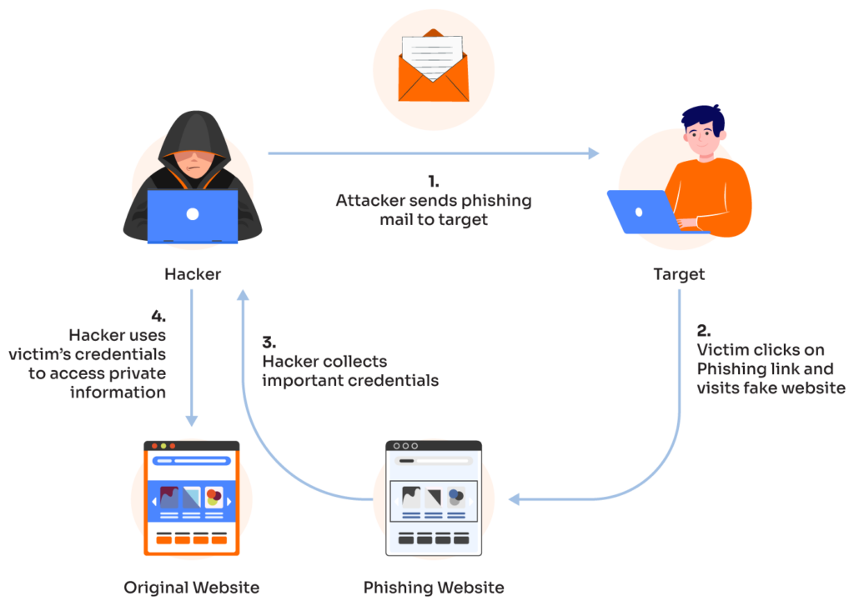
Some Common Type
Phishing: The process of attempting to acquire sensitive information such as usernames, passwords, and credit card details by masquerading as a trustworthy entity using bulk email, SMS text messaging, or by phone. Phishing messages create a sense of urgency, curiosity, or fear in the recipients of the message. The message will prod victims into revealing sensitive information, clicking on links to malicious websites, or opening attachments that contain malware

Slide 4
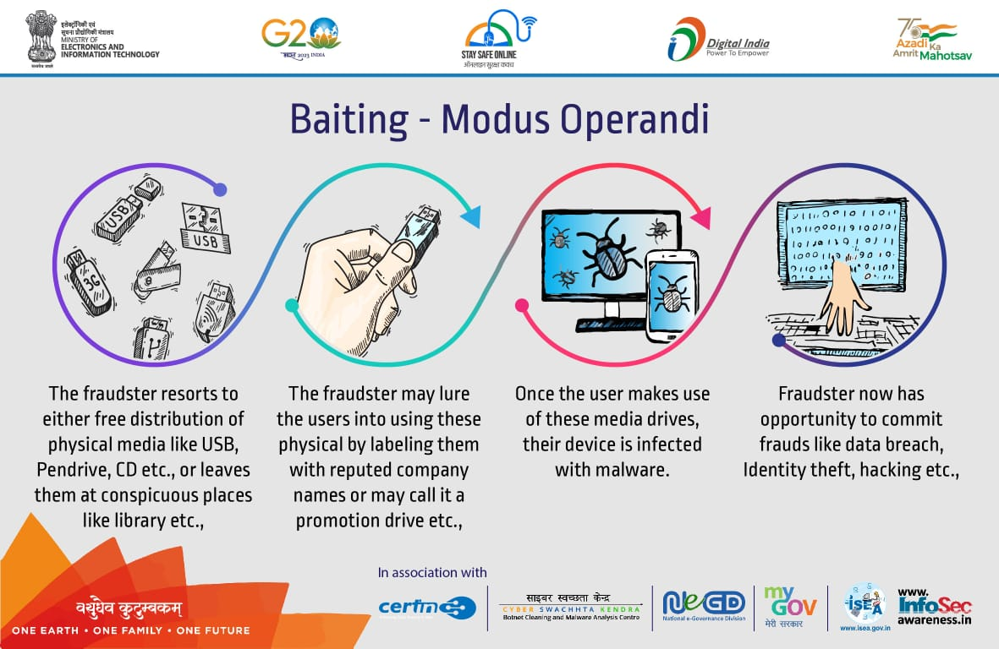
Baiting: A type of social engineering attack where a scammer uses a false promise to lure a victim into a trap which may steal personal and financial information or inflict the system with malware. The trap could be in the form of a malicious attachment with an enticing name.
The most common form of baiting uses physical media to disperse malware. For example, attackers leave the bait of a malware-infected flash drives in conspicuous areas where potential victims are certain to see them. When the victim inserts the flash drive into a work or home computer, the malware is automatically installed on the system. Baiting scams are also online in the form of tempting ads that lead to malicious sites or encourage users to download a malware-infected application.

Slide 5
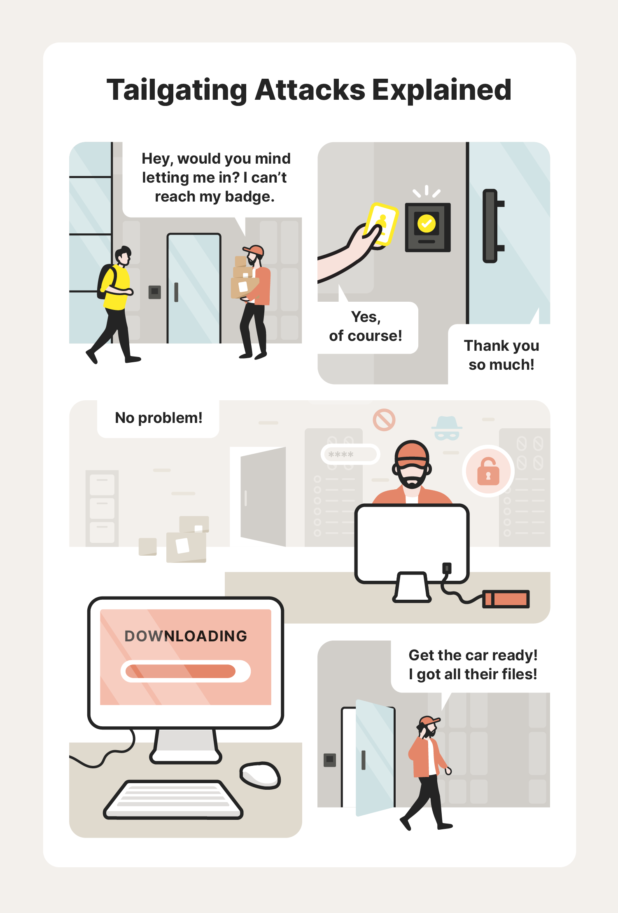
Tailgating: Also known as "piggybacking". A physical breach where an unauthorized person manipulates their way into a restricted or employee only authorized area through the use of social engineering tactics. The attacker might impersonate a delivery driver, or custodian worker. Once the employee opens the door, the attacker asks the employee to hold the door, thereby gaining access to the building.

Slide 6
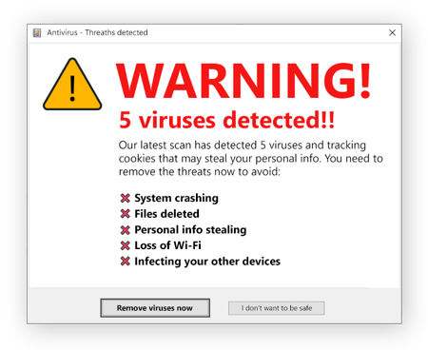
Scareware: Scareware involves victims being bombarded with false alarms and fictitious threats. Users are deceived to think their system is infected with malware, prompting them to install software that grants remote access for the criminal or to pay the criminal in a form of bitcoin in order to preserve sensitive video that the criminal claims to have.

Slide 7
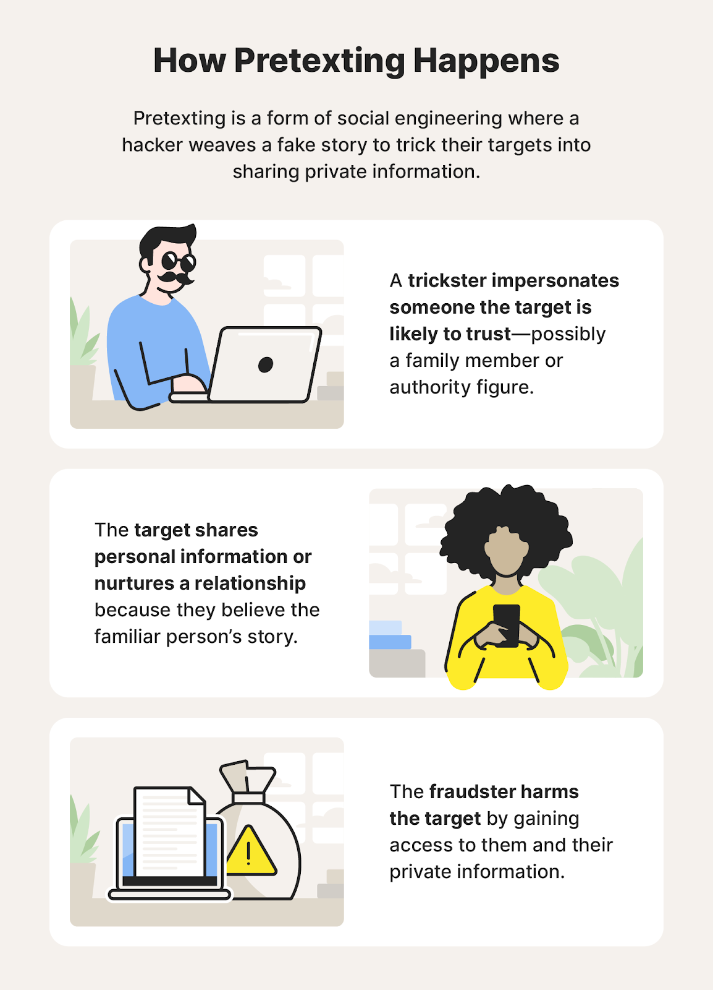
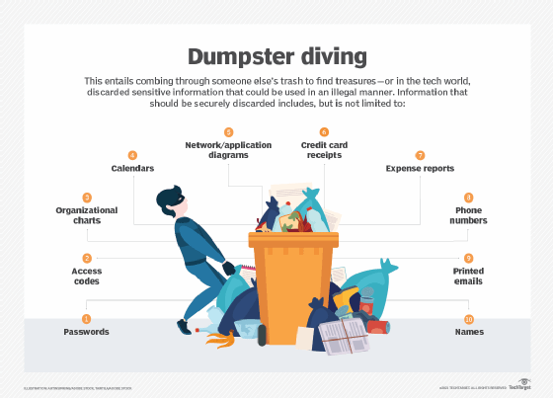
Pretexting: Creating a fabricated scenario to extract information (e.g., posing as a co-worker to gain access).
Dumpster Diving: A scammer will search for sensitive information e.g., bank statements, pre-approved credit cards, student loans, other account information, in the garbage when it hasn’t been properly sanitized or destroyed.

Slide 8


Honeytrap: Using romantic or sexual lures to compromise targets.
Quid Pro Quo: Quid pro quo involves a criminal requesting the exchange of some type of sensitive information such as critical data, login credentials, or monetary value in exchange for a service. For example, a computer user might receive a phone call from the criminal who, posed as a technology expert, offers free IT assistance or technology improvements in exchange for login credentials. If an offer sounds too good to be true, it most likely a scam and not legitimate.

Slide 9
Ways to Prevention of social engineering
Don't open email attachments from suspicious sources. Even if you do know the sender and the message seems suspicious, it's best to contact that person directly to confirm the authenticity of the message.
Use Multi-Factor Authentication (MFA). One of the most valuable pieces of information attackers seeks are user credentials. Using MFA helps to ensure your account's protection in the event of an account compromise. Follow Computing Services instructions for downloading DUO two-factor authentication to add another layer of protection for your Andrew account.
Be wary of tempting offers. If an offer seems too good to be true, it's probably because it is. Use a search engine to look up the topic which can help you quickly determine whether you're dealing with a legitimate offer or a trap.
Clean up your social media. Social engineers scour the Internet searching for any kind of information they can find on a person. The more information you have posted about yourself, the more likely it is that a criminal can send you a targeted spear phishing attack.

Slide 10
Install and update antivirus and other software. Make sure automatic updates are turned on. Periodically check to make sure that the updates have been applied and scan your system daily for possible infections. Visit Secure Your Computer on the Computing Services website for more instructions on using and updating antivirus software.
Back up your data regularly. If you were to fall victim to a social engineering attack in which your entire hard drive was corrupted, it is essential that you have a backup on an external hard drive or saved in the cloud.
Avoid plugging an unknown USB into your computer. When a USB drive is found unattended, please give it to a cluster consultant, the Computer Services Help Center, a residence assistant (RA), or to Carnegie Mellon campus police.

