Slide 1
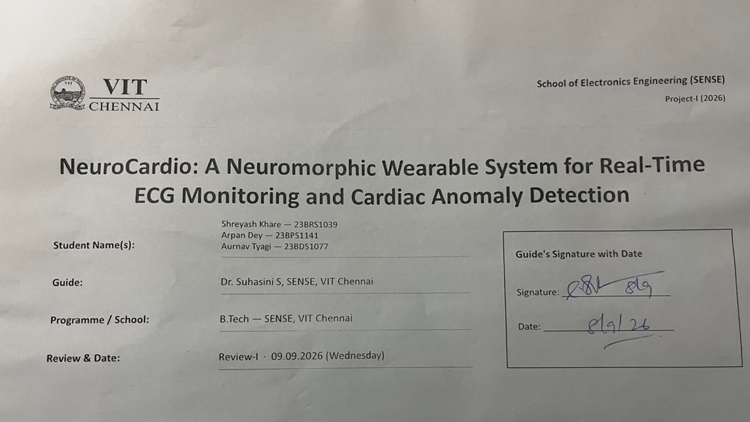

Slide 2

Problem Statement & Background
Problem Statement:
  Cardiovascular disease is the leading cause of death worldwide, yet ECG analysis is still slow, manual, and largely unavailable in remote or low-resource settings.
  Accurate deep-learning models are too power- and memory-hungry for always-on, battery-powered wearables.
Background & Significance:
  Continuous on-device cardiac monitoring enables early detection of arrhythmias and timely intervention outside the hospital.
  Neuromorphic computing (event-driven Spiking Neural Networks) promises ultra-low-power classification by computing only when the signal changes.
Existing Solutions:
  Most recent works use frame-based CNN / LSTM models, often on cloud servers, Jetson, or Raspberry Pi hardware.
Limitations / Research Gap:
  They sample at the Nyquist rate (no event-driven acquisition), depend on high-power or cloud hardware, and are rarely self-contained.
  No surveyed system combines level-crossing (LC) sampling with an on-device SNN for ultra-low-power ECG anomaly detection — the gap NeuroCardio targets.
4

Slide 3
Literature Survey (1 / 2)
No. | Author(s) & Year | Title / Source | Method / Approach | Findings & Research Gap
1 | O. M. Machidon, 2026 | Privacy-preserving adaptive arrhythmia monitoring with wearable ECG+PPG; Frontiers in Digital Health | Federated on-device learning; ECG+PPG personalization | No spiking/event-driven; leans on smartphone compute; not self-contained
2 | S. Sheeba Rani et al., 2025 | IoT embedded wearable for continuous cardiovascular monitoring; Biomed. Signal Process. Control | 1D-DSC + Attention-GRU on ARM Cortex-M (TF-Lite) | Frame-based, not event-driven; no LC sampling; higher power
3 | M. Hizem et al., 2025 | Reliable ECG Anomaly Detection on Edge Devices for IoMT; Sensors | TinyML + Edge AI; pruned/quantized 2-D CNN | Nyquist-rate quantized CNN, not spike-driven; few anomaly classes
4 | Y. Wang et al., 2025 | Hybrid CNN-LSTM for ECG arrhythmia detection in IoMT; Discover IoT | CNN-LSTM on MIT-BIH; NVIDIA Jetson Nano | Power-hungry for wearables; no LC/SNN; weak on minority classes
5 | E. M. Priya, K. S. Krishnan, 2025 | LIFE-CARE: IoT–Cloud heart-disease prediction; Int. J. Distrib. Sensor Networks | IoT + EHR; edge server + multicloud deep learning | Cloud-dependent (latency, privacy); not on-device waveform classification
6 | Z. Alimbayeva et al., 2024 | Wearable ECG Device and Machine Learning for Heart Monitoring; Sensors | Single-lead; PQRST segmentation; ML web module | Conventional ML; no neuromorphic path; PC/web-based prediction
7 | X. An et al., 2024 | Lightweight Arrhythmia Model via Knowledge Distillation; Sensors | Teacher→student distillation on STM32 MCU | Still frame-based CNN/LSTM; not event-driven; needs heavy teacher
References [1]–[13], 2022–2026. The recurring gap: none combine level-crossing sampling with an on-device SNN — our target.
5

Slide 4
Literature Survey (2 / 2)
No. | Author(s) & Year | Title / Source | Method / Approach | Findings & Research Gap
8 | A. S. Almasoud et al., 2023 | Automated Arrhythmia Classification with Farmland Fertility Algorithm; Sensors | Metaheuristic + hybrid deep learning on IoT | Heavy optimization; server/cloud-oriented; no wearable hardware
9 | Y. M. Obeidat, A. M. Alqudah, 2023 | Embedded System on Raspberry Pi for ECG Monitoring; Applied Sciences | Raspberry Pi ECG acquisition + monitoring | Pi is high-power; mostly visualization; little auto-classification
10 | N. Raheja, A. K. Manocha, 2022 | IoT ECG Monitoring with Encryption + Authentication; Biomed. Signal Process. Control | SG/MOWPT filtering; encryption + OTP; DL classifier | Security overhead; cloud dependence; no on-device neuromorphic inference
11 | A. A. Nancy et al., 2022 | IoT-Cloud Smart Healthcare for Heart-Disease Prediction; Electronics | Bi-directional LSTM; IoT sensors + cloud | Cloud-dependent; not real-time on-device; no event-driven acquisition
12 | P. Wang et al., 2022 | Wearable ECG Monitor for Deep-Learning CVD Detection; arXiv:2201.10083 | ECG patch; CNN+LSTM+ResNet; semi-supervised | Confuses SVPB vs AF (~58% acc.); cloud AI-engine; not neuromorphic
13 | H. Chu et al., 2022 | Neuromorphic Spike-Driven SNN Processor for Wearable ECG; IEEE T-BioCAS (base method) | LC sampling + SNN trained with STBP; 40 nm ASIC | 98.22% on MIT-BIH at 0.75 uJ/classification; custom silicon (we adapt on Arduino)
References [1]–[13], 2022–2026. The recurring gap: none combine level-crossing sampling with an on-device SNN — our target.
6

Slide 5
Proposed Solution & Methodology
Proposed Solution:
  A wearable belt that acquires single-lead ECG and classifies it as Normal / Abnormal on-device. Goal model: an event-driven Spiking Neural Network (SNN) [13].
  Level-crossing (LC) sampling turns the ECG into a sparse single-bit spike train, so computation happens only when the signal changes — the source of the power saving.
  Current baseline: a Random Forest classifier on P/Q/R features validates the full acquisition → classification → display pipeline while the SNN is developed.
Methodology / Approach:
  ECG electrodes (belt) → ECG sensor module (+5V, analog) → Arduino UNO (A0) → on-device processing → 16×2 LCD + buzzer alert; results also viewable on a web app.
  Target pipeline: raw ECG → LC sampling → SNN (STBP), trained and validated on the MIT-BIH Arrhythmia dataset (PyTorch + snnTorch).
Project Scope:
  In scope: single-lead acquisition, on-device Normal/Abnormal classification, LCD/buzzer feedback and a web dashboard.
  Out of scope (this stage): multi-lead clinical diagnosis, custom neuromorphic ASIC, and medical/regulatory certification.
7

Slide 6
Work Completed (50%), Timeline & Tools
Work completed so far (≈50%) — hardware & acquisition:
  Wearable hardware assembled and working: Arduino UNO, ECG sensor module (+5V, analog out), 3-lead electrodes on the wearable belt, 16×2 LCD, and buzzer.
  Live ECG acquired from the belt electrodes; heartbeat activity shown on the LCD, with the buzzer signalling abnormal beats.
  Baseline ML pipeline built as a proof of concept: a web app classifies P/Q/R values as Normal / Abnormal (Random Forest) — validates the end-to-end flow.
  Literature survey (13 works) and full system architecture finalised.
Timeline & milestones up to Review-III:
  Review-I (now, ≈50%): hardware acquisition + baseline classifier working. Review-II: real ECG → digital P/Q/R, MIT-BIH dataset, begin LC sampling + SNN.
  Review-III: SNN (STBP) integrated on-device, accuracy & power benchmarking, final validation and demo.
Tools & technologies:
  Hardware: Arduino UNO, ECG sensor module, 3-lead electrodes, 16×2 LCD, buzzer, wearable belt, USB power.
  Software: Python, scikit-learn (RF baseline), Git/GitHub. Target ML: PyTorch + snnTorch (SNN/STBP), MIT-BIH Arrhythmia dataset.
8

Slide 7
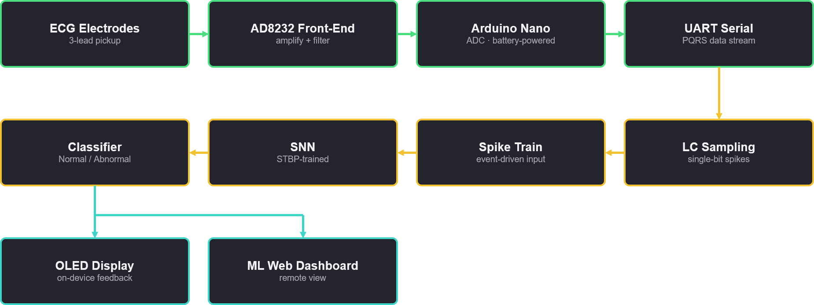
Architecture Diagram

Slide 8
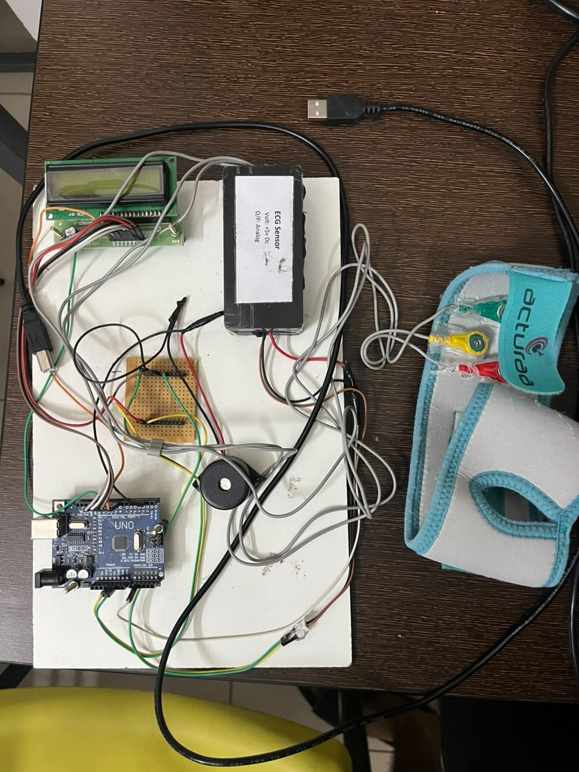
Hardware Implementation & Connections
Signal chain:
  3-lead electrodes (RA / LA / RL — red, yellow, green) snap onto the wearable belt and cable into the ECG sensor module.
  ECG sensor module: powered at +5V DC; its analog output feeds the Arduino UNO analog input (A0).
  Arduino UNO reads and processes the ECG signal, then drives the 16×2 LCD (heart activity / status) and the buzzer (audible alert on an abnormal beat).
  USB links the Arduino to the PC — for power and for the Serial Monitor / Serial Plotter used to view the live waveform.
  The perfboard carries the supporting connections between the sensor, LCD, and buzzer.
Verified working:
  Live ECG waveform tracks a real heartbeat on the Serial Plotter; the LCD updates in real time; the buzzer fires on an abnormal input.
Assembled prototype: belt electrodes → ECG sensor → Arduino UNO → LCD + buzzer.
9
Notes:
Add your results here — graphs, tables, screenshots or outputs.

Slide 9
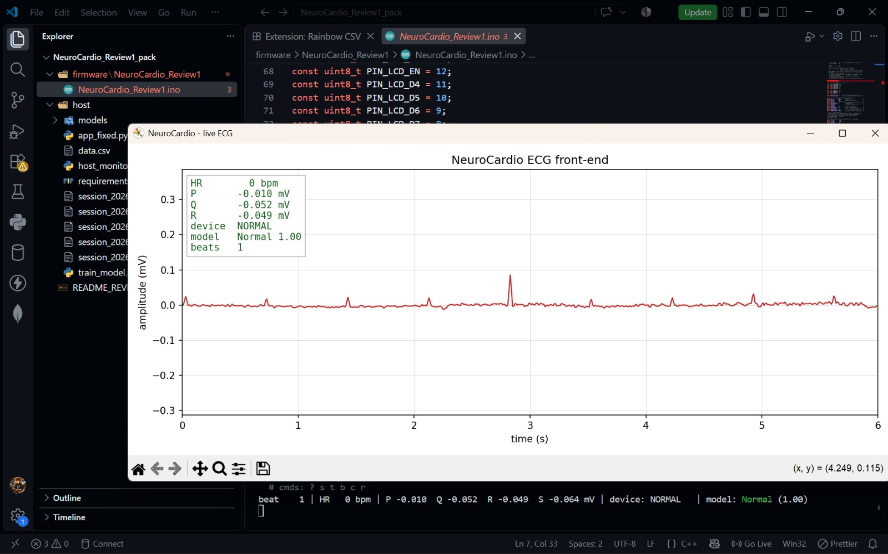
Observations & Current Outcomes
Architecture — Current Setup (Review 1)
ECG Electrodes
(3-lead belt)
ECG Sensor
(AD8232 · analog)
5V Power
(USB)
Buzzer
(alarm)
LCD Display
P
Q
R
Arduino UNO
filter → R-peak
→ P/Q/R → BPM
ML Prediction
(PC · Random Forest)

Slide 10
Current Baseline & Road to Neuromorphic
Baseline classifier (done, proof of concept):
  A Flask web app takes P/Q/R inputs and predicts Normal / Abnormal using a Random Forest (also tried Logistic Regression, Gradient Boosting, SVC).
  Trained on a small synthetic dataset (100 samples, 50 Normal / 50 Abnormal). It is cleanly separable, so accuracy is ~100% — this validates the software pipeline, not clinical performance.
  What this proves: the acquisition → feature → classification → display flow works end to end.
Remaining 50% (Review-II → III):
  Capture real ECG and extract P/Q/R (or raw beats) automatically on-device instead of manual entry.
  Train and validate on the real MIT-BIH Arrhythmia Database for honest, reportable accuracy.
  Implement the target neuromorphic model: level-crossing sampling + SNN trained with STBP; benchmark accuracy and power vs. the RF baseline.
  Integrate the SNN back onto the wearable for on-device, low-power inference.
10
Notes:
Add your results here — graphs, tables, screenshots or outputs.

Slide 11
References
[1] O. M. Machidon, "Privacy-preserving adaptive arrhythmia monitoring with wearable ECG, smartphone PPG, and federated on-device learning," Frontiers in Digital Health, vol. 8, 2026.
[2] S. Sheeba Rani, D. Gopal, S. Vignesh, and P. S. Ramesh, "Advanced IoT-enabled embedded wearable system for continuous cardiovascular health monitoring using edge intelligence," Biomed. Signal Process. Control, 2025.
[3] M. Hizem, L. Bousbia, Y. Ben Dhiab, M. Ould-Elhassen Aoueileyine, and R. Bouallegue, "Reliable ECG anomaly detection on edge devices for IoMT applications," Sensors, vol. 25, no. 8, 2496, 2025.
[4] Y. Wang et al., "Hybrid CNN-LSTM model for ECG-based arrhythmia detection in internet of medical things," Discover Internet of Things (Springer), 2025.
[5] E. M. Priya and K. Sundara Krishnan, "LIFE-CARE: IoT–cloud-enabled smart heart disease prediction system," Int. J. Distributed Sensor Networks (Wiley), 2025.
[6] Z. Alimbayeva et al., "Wearable ECG device and machine learning for heart monitoring," Sensors, vol. 24, no. 13, 4201, 2024.
[7] X. An et al., "Lightweight arrhythmia classification via knowledge distillation for wearable single-lead ECG," Sensors, vol. 24, no. 24, 7896, 2024.
[8] A. S. Almasoud et al., "Automated arrhythmia classification using Farmland Fertility Algorithm with hybrid deep learning on IoT," Sensors, vol. 23, no. 19, 8265, 2023.
[9] Y. M. Obeidat and A. M. Alqudah, "An embedded system based on Raspberry Pi for effective ECG monitoring," Applied Sciences, vol. 13, no. 14, 8273, 2023.
[10] N. Raheja and A. K. Manocha, "IoT-based ECG monitoring system with encryption and authentication," Biomed. Signal Process. Control, vol. 74, 2022.
[11] A. A. Nancy et al., "IoT-cloud-based smart healthcare monitoring system for heart disease prediction via deep learning," Electronics, vol. 11, no. 15, 2292, 2022.
[12] P. Wang et al., "A wearable ECG monitor for deep learning based real-time cardiovascular disease detection," arXiv:2201.10083, 2022.
[13] H. Chu et al., "A neuromorphic processing system with spike-driven SNN processor for wearable ECG classification," IEEE Trans. Biomed. Circuits Syst., vol. 16, no. 4, pp. 511–523, 2022.
[14] S. Alinsaif, "Neuromorphic computing for long-term cardiac health: a review of spiking neural networks in low-power wearable electronics," Electronics, vol. 15, no. 6, 1179, 2026.
[15] O. Banjo and B. Ghoraani, "A cascaded quantized spiking neural network for real-time ECG arrhythmia detection on edge hardware," Sensors, vol. 26, no. 12, 3723, 2026.
11

Slide 12
Thank You
12

