Slide 1

MOSQUITO SPECIES DETECTION
USING DEEP-LEARNING COMPUTER VISION
TEAM NAME :VisionTek
TEAM LEADER NAME : Arpan Guria
Department : Electronics and Telecommuication Engineering

Slide 2
Motivation
Nations with tropical climate have major health problem wit mosquitoes brone disease.
Tropical climate is boon for survival of mosquitoes
The classification of mosquitoes species is done manually using microscope.
Requirement of expensive eqiupment like microcope and specialised domaain knowledge.
Mosquitoes have very little details on their body and are very small in size.
Providing a simple solution to researcher and common people to easily classify between mosquitoes.

Slide 3
Approach details
According to problem statement website capable of doing onboard image classification using Intel chipsets and tensor flow .
Selection of mosquito species.
Image Data collection using google image search and fatkun downloader.
Data preparation : Image resizing , Image scaling and removing unwanted images.
Data augmentation : Sampling images to generate 1,000 images for image dataset of 2 classes.
Selecting deep learning algorithms.
Selected Mobilenet v2 deep learning architecture.
Creating label for each images.
Creating data pipeline.
Training the inception deep learning architecture till 13,000 steps with learning rate 0.01.
Visualizing learning graphs on tensor board.
Generating model and converting into frozen graphs.
Converting frozen graphs into protobuff(.pb).
Quantization of protobuff graph to deploy on website using flask.
Creating Web application template on visual studio code IDE.
Deploying trained model in website to classify and detect real time images according to their classes.

Slide 4
TECHNOLOGY STACK:
Python interpreter/IDE
Tensor flow API
Tensor board API
Mobilenet V2 model
Keras API
Visual studio code
XML
Fatkun bulk image downloader
Internet browser
Flask

Slide 5
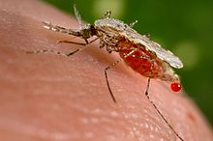
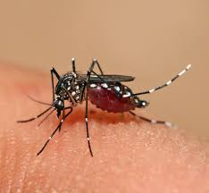
DATA PREPARATION
SELECTION OF species:
Anopheles
Aedes Aegyati
Features
wing spots,
head anatomy,
larval and pupal anatomy
Features
white markings on its legs
marking in the form of a lyre
on the upper surface of its thorax

Slide 6

TENSOR FLOW AND KERAS API
Tensor flow deep learning library is developed and maintained by Google.
Keras is the library from which we design deep neural networks.
Tensor flow is a wrapper of C++ API’s of keras.
It can be deployed in mobile web services and mobile.
Keras API is used mostly for image classification problems.
It also performs image augmentation.Image augmentation increases the data set as we know more the data set,more the accuracy of the model.

Slide 7
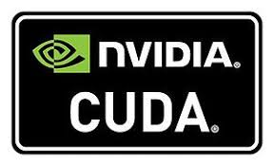
Accelerated GPU training
NVIDIA CUDA is developed by NVIDIA corporation.
It utilizes tensor cores of GPU of computer system to accelerate training of deep learning models.
It reduces training time and increases accuracy of deep learning models.
It has faster processing power than CPU.

Slide 8
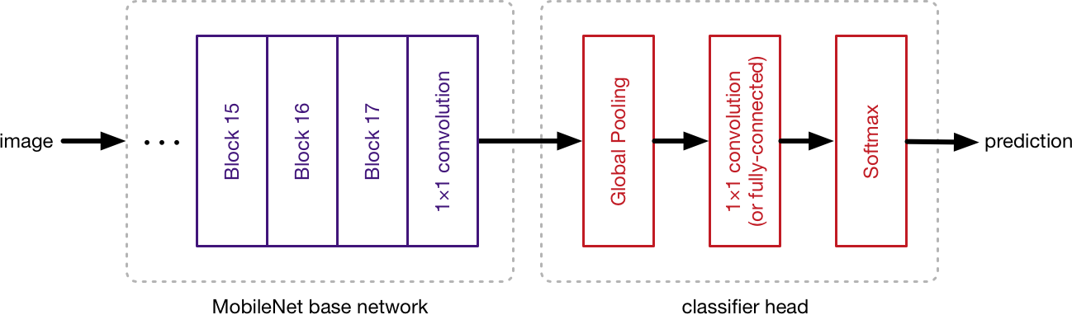
MOBILENET V2 MODEL ARCHITECHTURE
Mobilenet v2 is a widely-used image recognition model.
The model itself is made up of symmetric and asymmetric building blocks, including convolutions, Global pooling, max pooling, concats, Softmax dropouts, and fully connected layers.
Batch norm is used extensively throughout the model and applied to activation inputs. Loss is computed via Softmax.
It uses technique to increase accuracy.
Its gives better performance than sequential models.
MobileNetV2 provides a very efficient mobile-oriented model that can be used as a base for many visual recognition tasks
It can be optimized and easily deployed on edge computing devices and mobile devices.

Slide 9
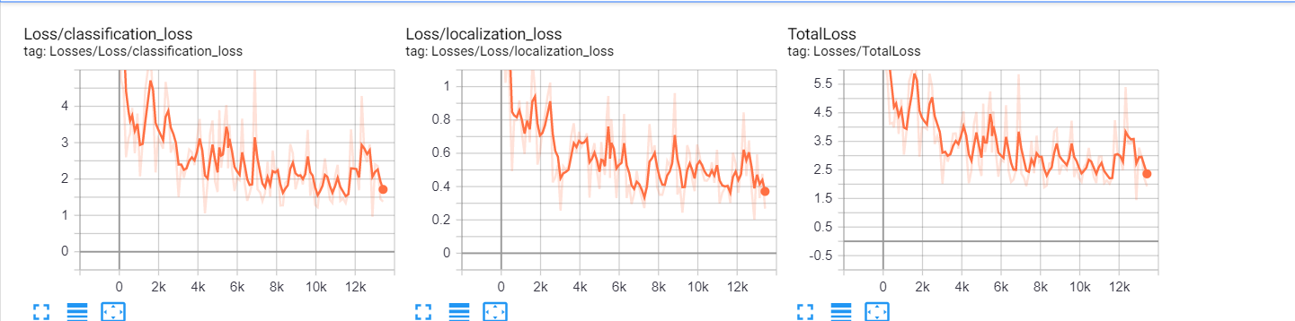
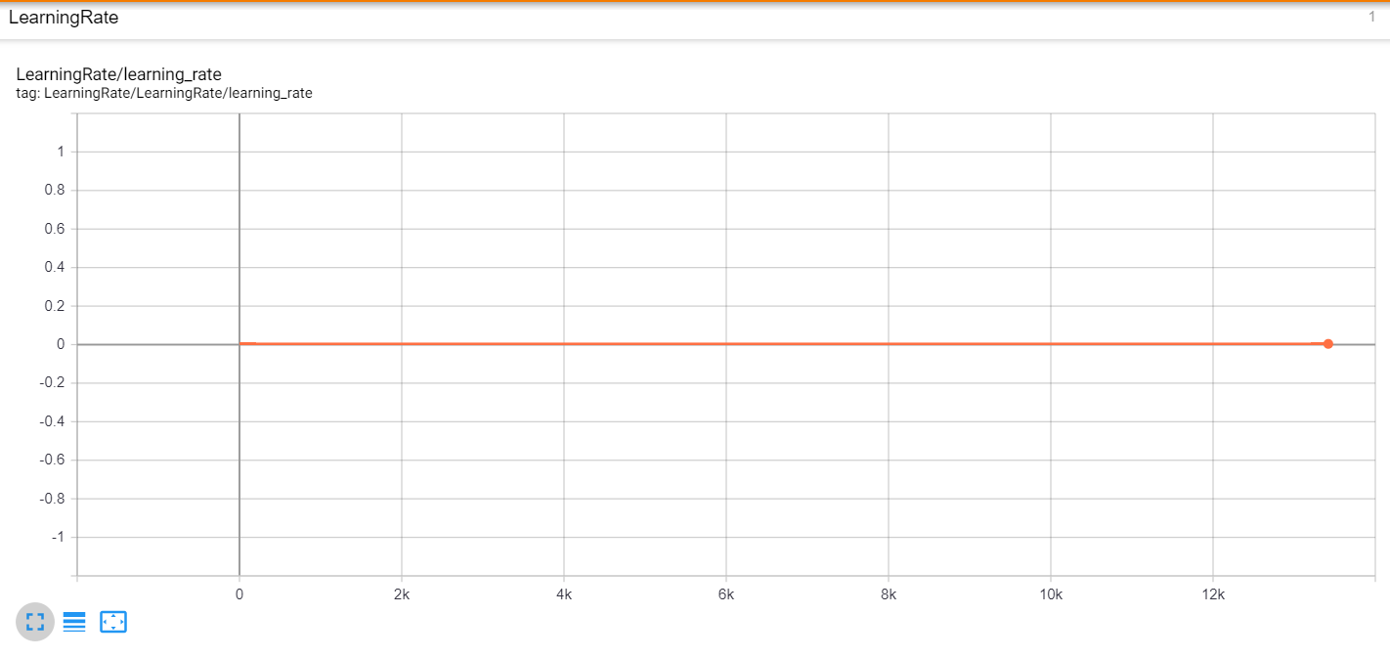
Tensorboard Training Visualization
Training Losses
Training Accuracy

Slide 10
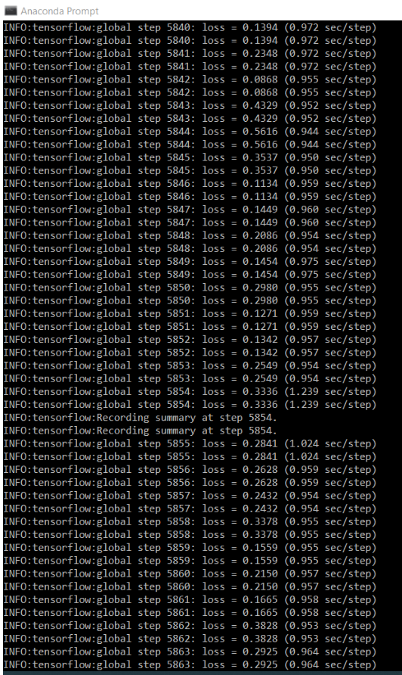
Model Description
Accuracy :- 99.73%
Losses:- 1.5
Global Steps :- 13000 steps
mAP():- 63.54%
Training Time:- 7 hours

Slide 11
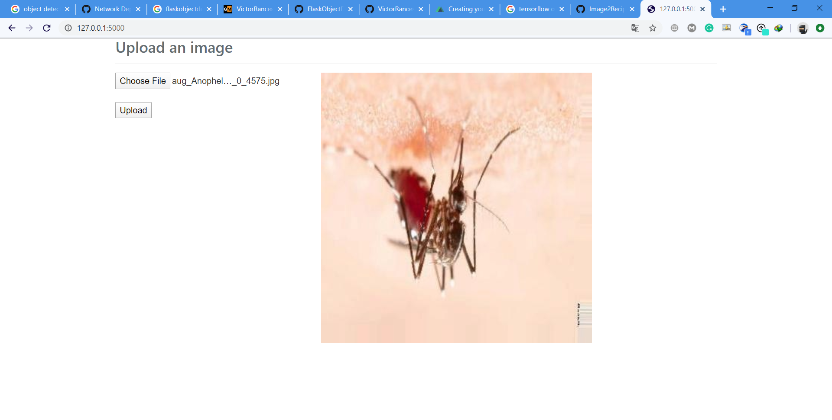
Web Interface of Deployed Model

Slide 12
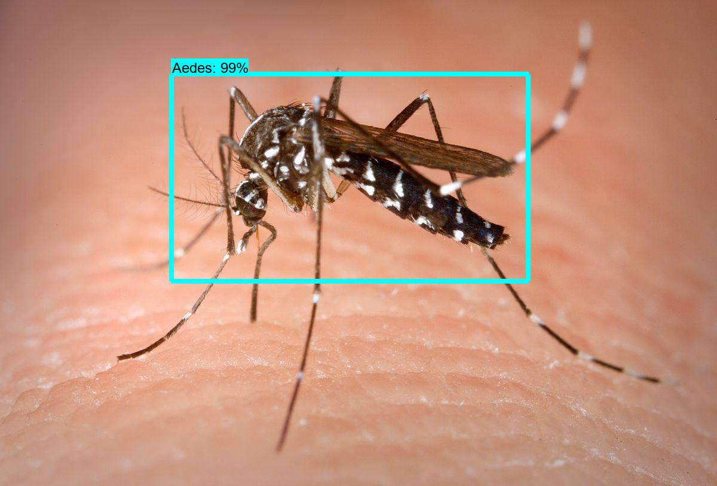
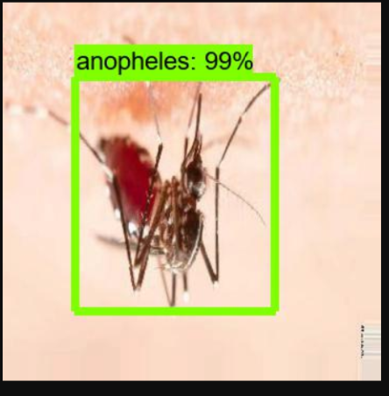
Results

Slide 13
Advantages
It is very efficient and accurate in operation
It have capability to match the nearby manual accuracy.
One model trained can easily be deployed over different platorm.

