Slide 1
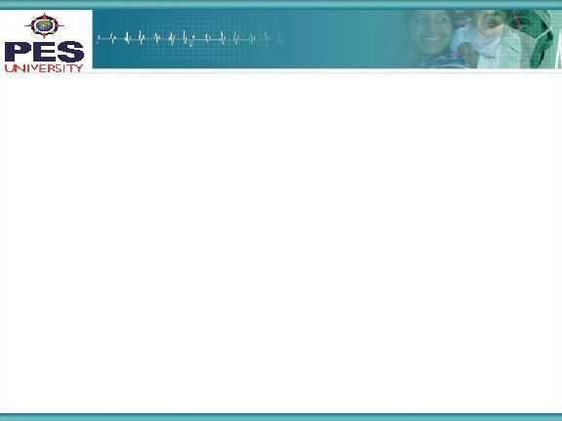

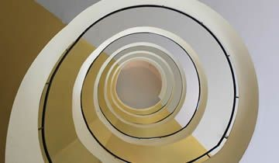
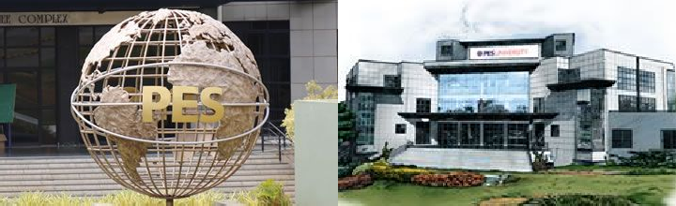
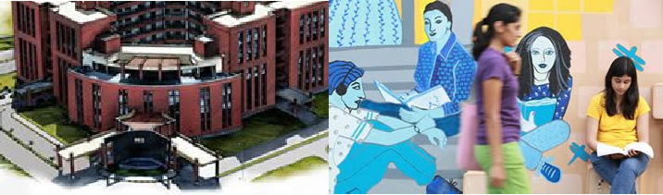

Project Presentation
(Final - ESA)
Project Title
: Automatic Image Captioning
Project Team : Abhinandan Singla PES1201701128
Arpan Ghoshal PES1201700240
Abhijeet Murthy PES1201700139
‹#›

Slide 2
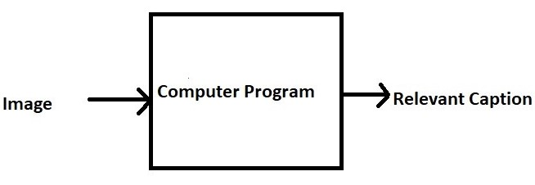
Project Abstract and Scope
=> Image Captioning is the process of generating a textual description of an image.
=> It can be divided into two modules logically:
Image-based model – which extracts the features and nuances out of our image.
Language-based model – which translates the features and objects given by our image-based model to a natural sentence.
‹#›

Slide 3
Project Scope -2
=> It can be used for aid to the blind, CCTV cameras, in self-driving cars and in reverse image search.
=> This problem was well researched by Andrej Karapathy in his PhD thesis. We tried to implement methods described in the paper with some other references combined for better results.
3

Slide 4
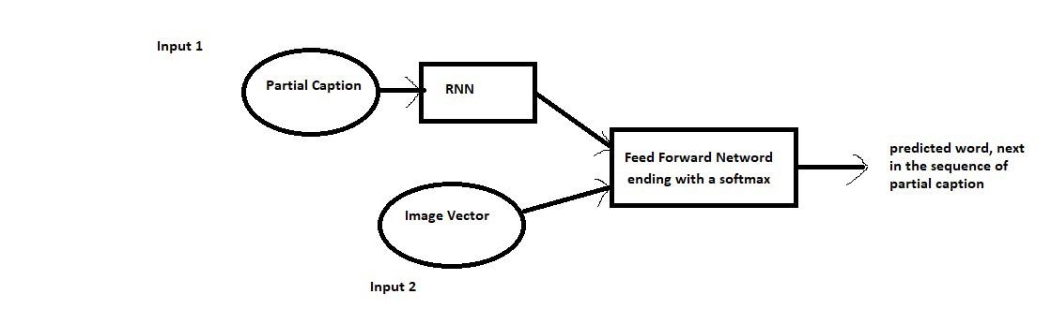
Solution Architecture
Input_1 -> Partial Caption
Input_2 -> Image feature vector
Output -> An appropriate word, next in the sequence of partial caption provided in the input_1 (or in probability terms we say conditioned on image vector and the partial caption)
‹#›

Slide 5
Solution-1
=> Converted the training images as a feature vector which will further feed to our neural network. Used the InceptionV3 model to get fixed length information of each image for automatic feature extraction.
=> Built vocabulary with respective tokens and modified the captions.
=> For the first time, we provide the image vector and the first word as input and try to predict the second word and this process is continued till we get the end_seq.

Slide 6
Solution-2
=> No. of data points = No. of the actual image training dataset * Each having 5 captions * Words in each caption (avg) = 6000 * 5000 * 7 = 210000
=> Length of each data point = Length of image vector(2048) + Length of partial caption (34 indices * 200 glove vector) = 2048 + 6800 = 8848
=> Finally, size of data matrix= 210000 * 8848= 1858080000 blocks.
So Stochastic Gradient Descent was used. And updation was done in batch of data points.

Slide 7
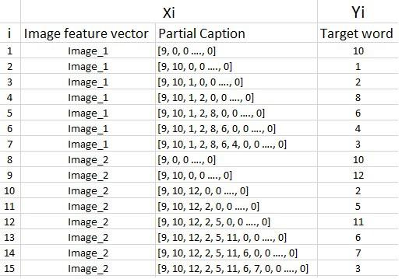
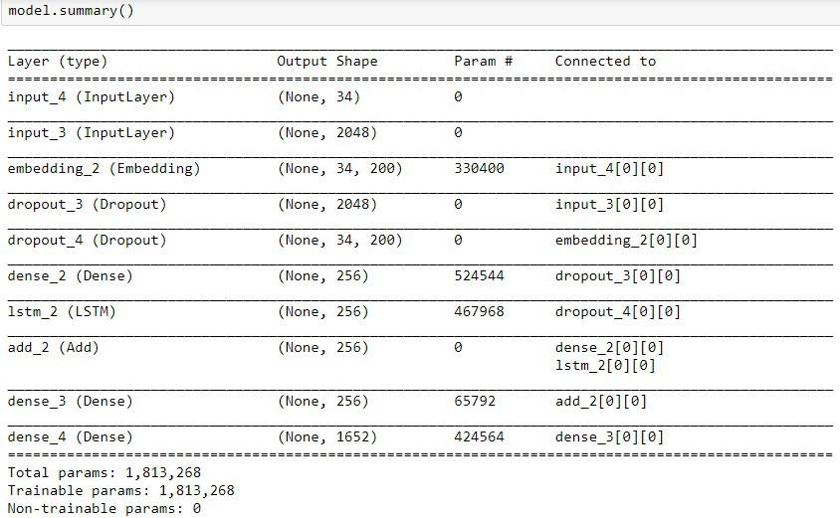
Solution-3
=>Framed it as a supervised learning problem where we have a set of data points D = {Xi, Yi}, where Xi is the feature vector of data point ‘i’ and Yi is the corresponding target variable.
=> Where the inputs are Partial Caption and Image feature vector and output is an appropriate word, next in the sequence of partial caption provided in the inputs.

Slide 8
Constraints, Assumptions & Dependencies
We must understand that the images used for testing must be semantically related to those used for training the model. For example, if we train our model on the images of cats, dogs, etc. we must not test it on images of aeroplanes, waterfalls, etc. If the distribution of train and test sets are different the model will not give the desired performance.
‹#›

Slide 9
Future work plan
Using a larger dataset.
Changing the model architecture, e.g. include an attention module.
Doing more hyperparameter tuning (learning rate, batch size, number of layers, number of units, dropout rate, batch normalization etc.).
Use the cross-validation set to understand overfitting.
Using Beam Search instead of Greedy Search during Inference.
Using BLEU Score to evaluate and measure the performance of the model.
‹#›

Slide 10
References
[1] A. Karpathy and L. Fei-Fei, "Deep Visual-Semantic Alignments for Generating Image Descriptions," in IEEE Transactions on Pattern Analysis and Machine Intelligence, vol. 39, no. 4, pp. 664-676, 1 April 2017.
[2] Tanti, Marc & Gatt, Albert & Camilleri, Kenneth. (2017). What is the Role of Recurrent Neural Networks (RNNs) in an Image Caption Generator?. 10.18653/v1/W17-3506.
[3] TANTI, M., GATT, A., & CAMILLERI, K, “Where to put the image in an image caption generator,” in Natural Language Engineering, 467-489, 12 March 2018
[4] O. Vinyals, A. Toshev, S. Bengio and D. Erhan, "Show and tell: A neural image caption generator," 2015 IEEE Conference on Computer Vision and Pattern Recognition (CVPR), Boston, MA, 2015, pp. 3156-3164.

Slide 11
Thank You

