Slide 1
Book Recommendation System
Submitted by: Arpan Kumar Sasmal

Slide 2
OVERVIEW
Book Discovery Challenge: With the growing number of books published annually, it becomes difficult for readers to find books that match their interests.
Solution - Book Recommendation System: A recommendation system provides personalized book suggestions by analyzing features like title, author, genre, subgenre, and publisher.
Techniques Used: The system leverages machine learning and Natural Language Processing (NLP) techniques to process book features and generate recommendations.
Goal: The main objective is to offer users tailored book recommendations based on their preferences, improving their reading experience.

Slide 3
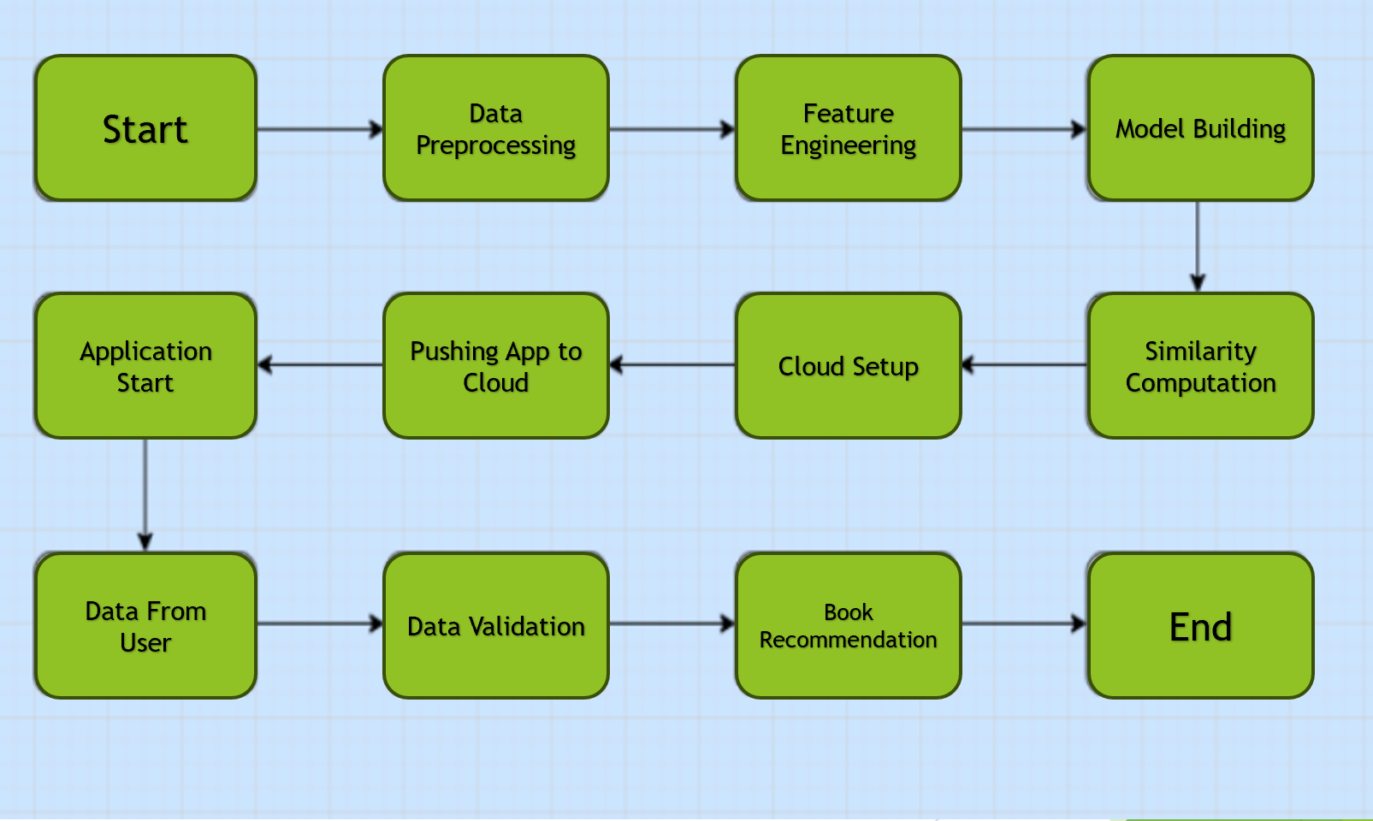
ARCHITECTURE

Slide 4
DATA PREPROCESSING
The dataset was cleaned by handling missing values and removing unnecessary characters from book titles.
The 'Title' column was rearranged to bring articles like 'The' or 'A' to the beginning of the title.
The 'Height' column was scaled as a numerical feature, and combined features were created by merging other columns (except 'Title') for further analysis.
No null values remained after preprocessing, and the dataset was ready for feature transformation.

Slide 5
DATA ANALYSIS
Conducted an Exploratory Data Analysis (EDA) to gain insights into the structure and distribution of the dataset.
Visualized the distribution of different book genres to understand the dominant categories within the dataset.
Analyzed the distribution of authors, identifying the most frequent authors and their contributions to the dataset.
Explored the publishers to see how the publishing trends vary across the dataset.
Generated a Word Cloud to highlight the most commonly occurring words in book titles, revealing trends in popular title structures.
Investigated the distribution of book heights to explore any relationships between physical dimensions and other book attributes.

Slide 6
MODEL SELECTION & PREDICTION
In the Book Recommendation System, TF-IDF (Term Frequency-Inverse Document Frequency) was utilized to convert combined book features (title, author, genre, etc.) into numerical data, capturing the importance of each feature. To reduce dimensionality, Singular Value Decomposition (SVD) was applied, enabling the system to handle large feature spaces more efficiently.
Cosine similarity was then computed to determine the similarity between books based on their numerical representations. The recommendation engine leverages these similarity scores, enabling the system to provide book suggestions by identifying the most similar books to the user's input or preferences.

Slide 7
CONCLUSION
The Book Recommendation System efficiently analyzes various book features to generate personalized recommendations.
Data preprocessing and feature engineering played a crucial role in structuring the dataset for optimal performance.
TF-IDF, SVD, and cosine similarity were used to identify and rank relevant book suggestions based on user preferences.
The system is deployed using Streamlit, making it accessible to users in a cloud-based environment for real-time recommendations.
Overall, the system improves book discovery by offering tailored suggestions, enhancing the user experience with minimal effort.

Slide 8
Thank You

