Slide 1

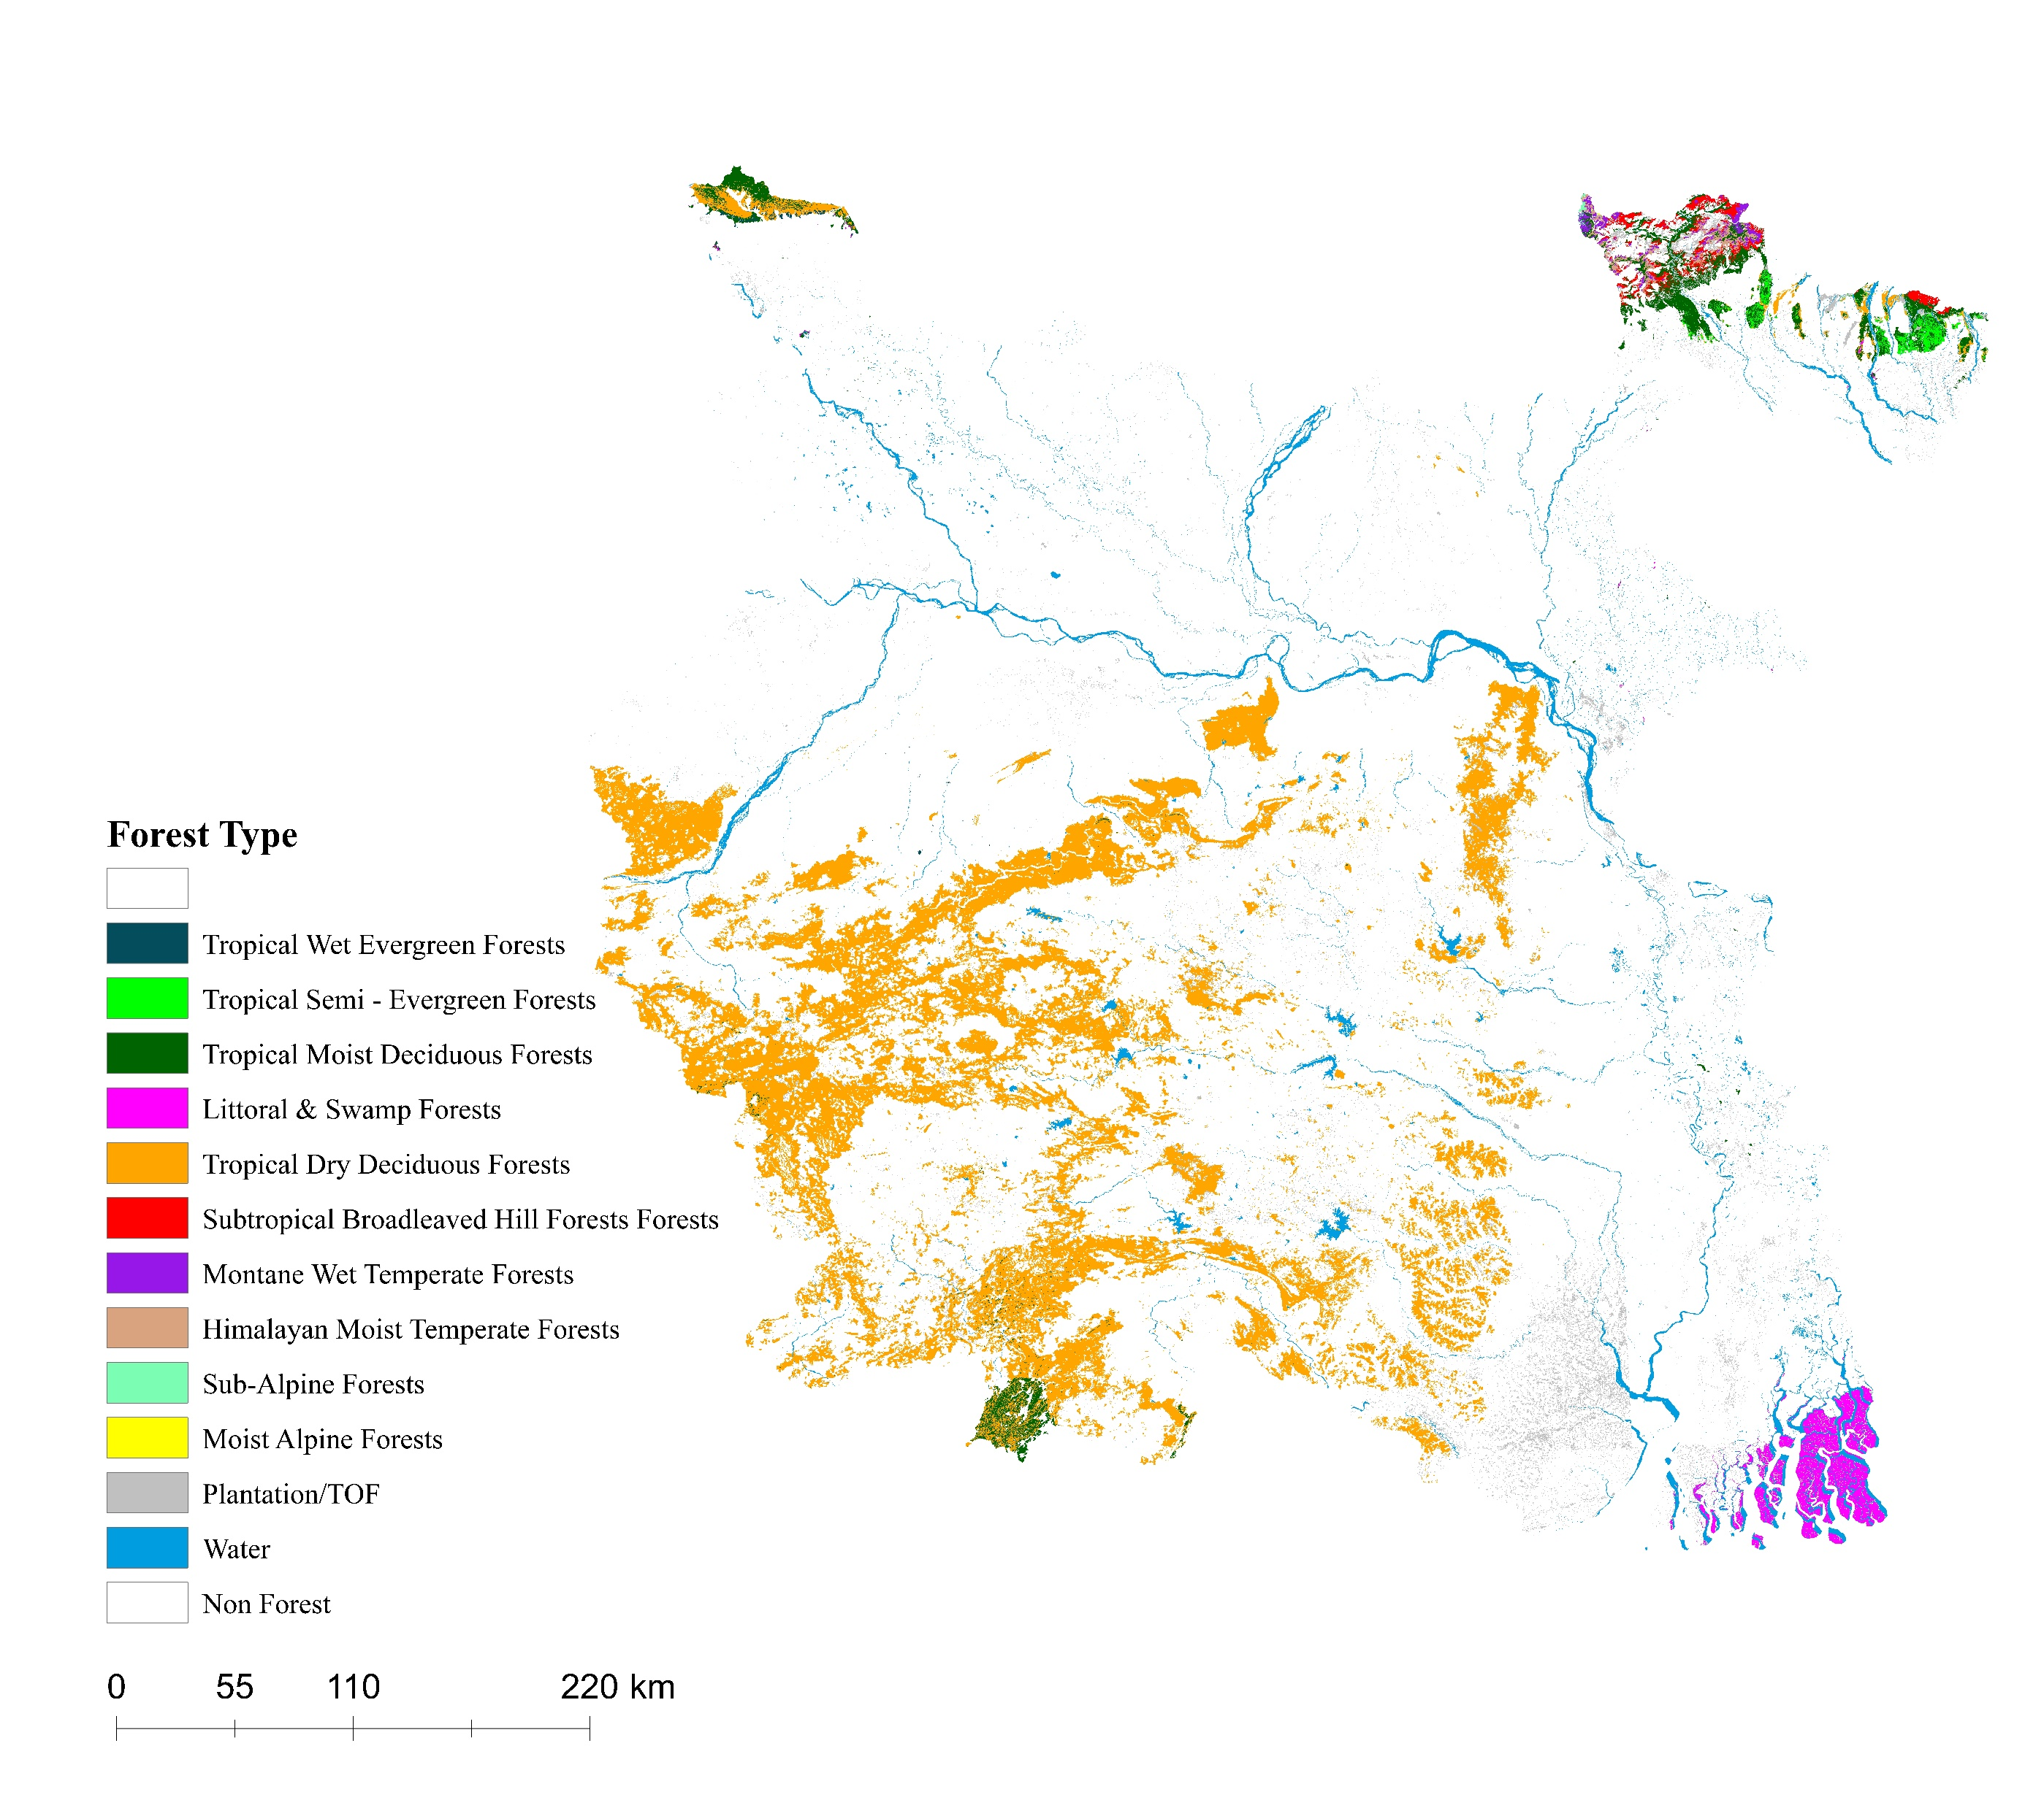
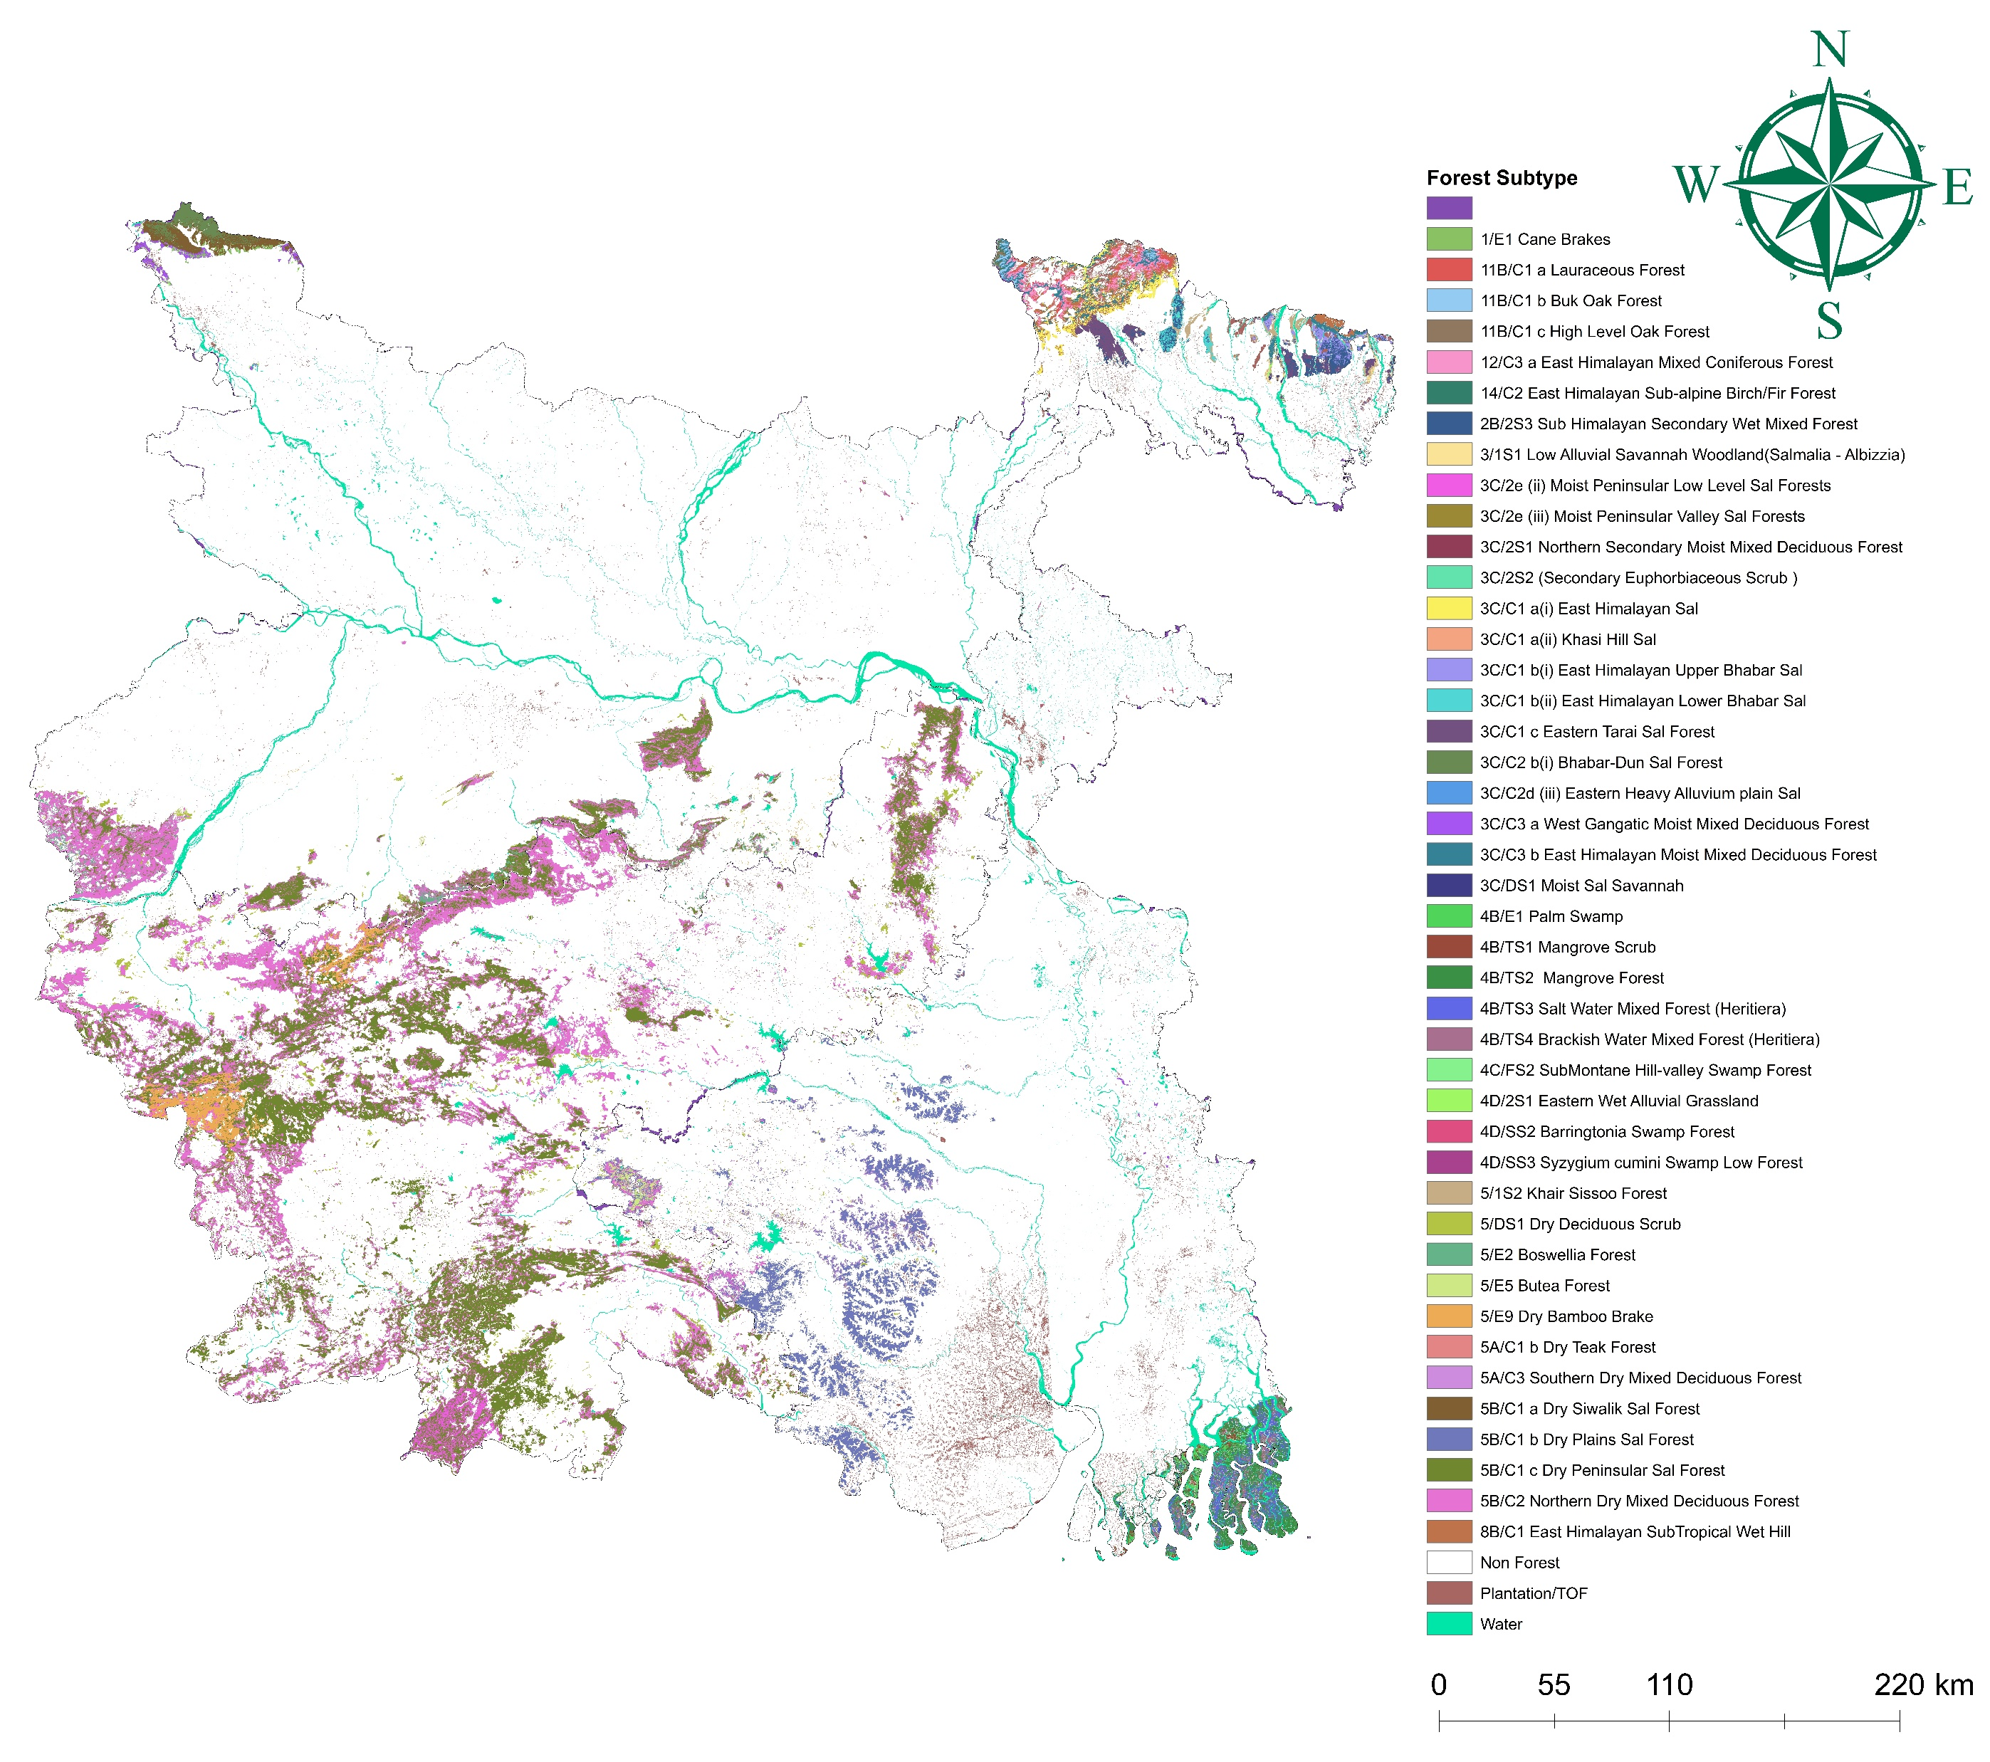
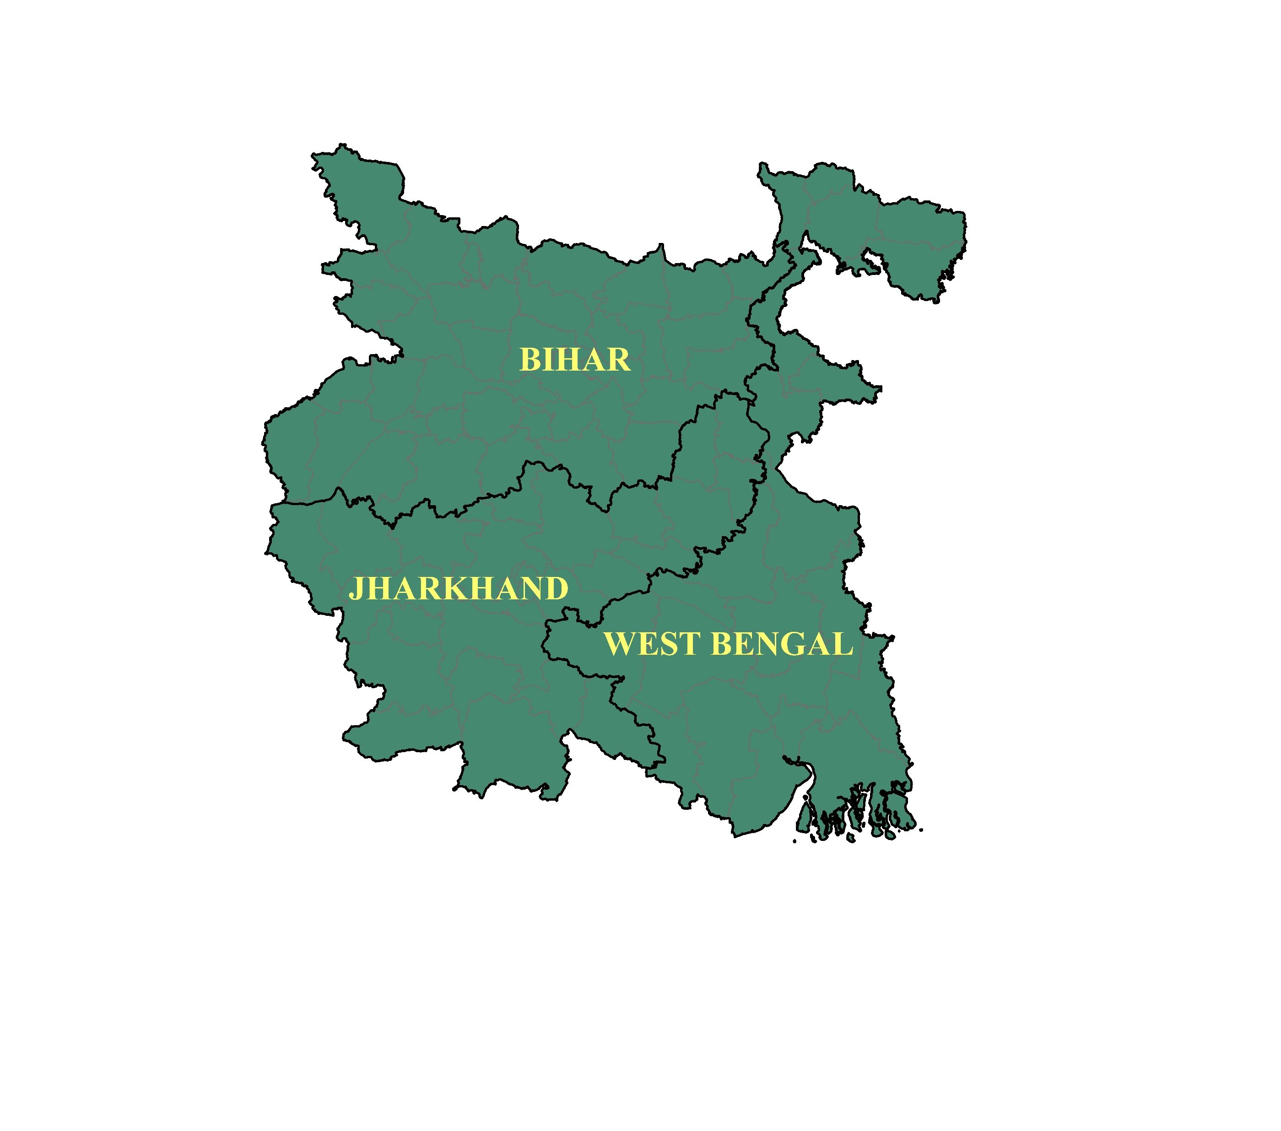
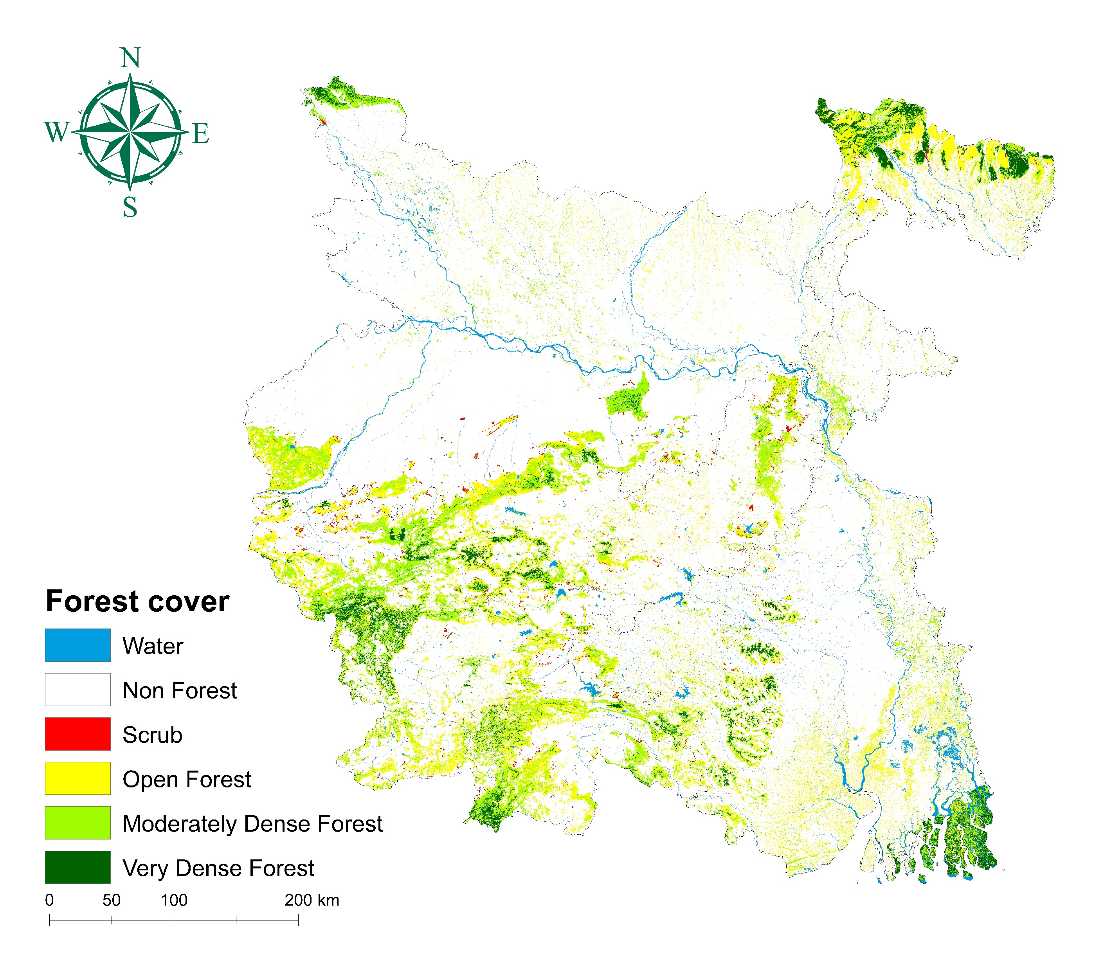
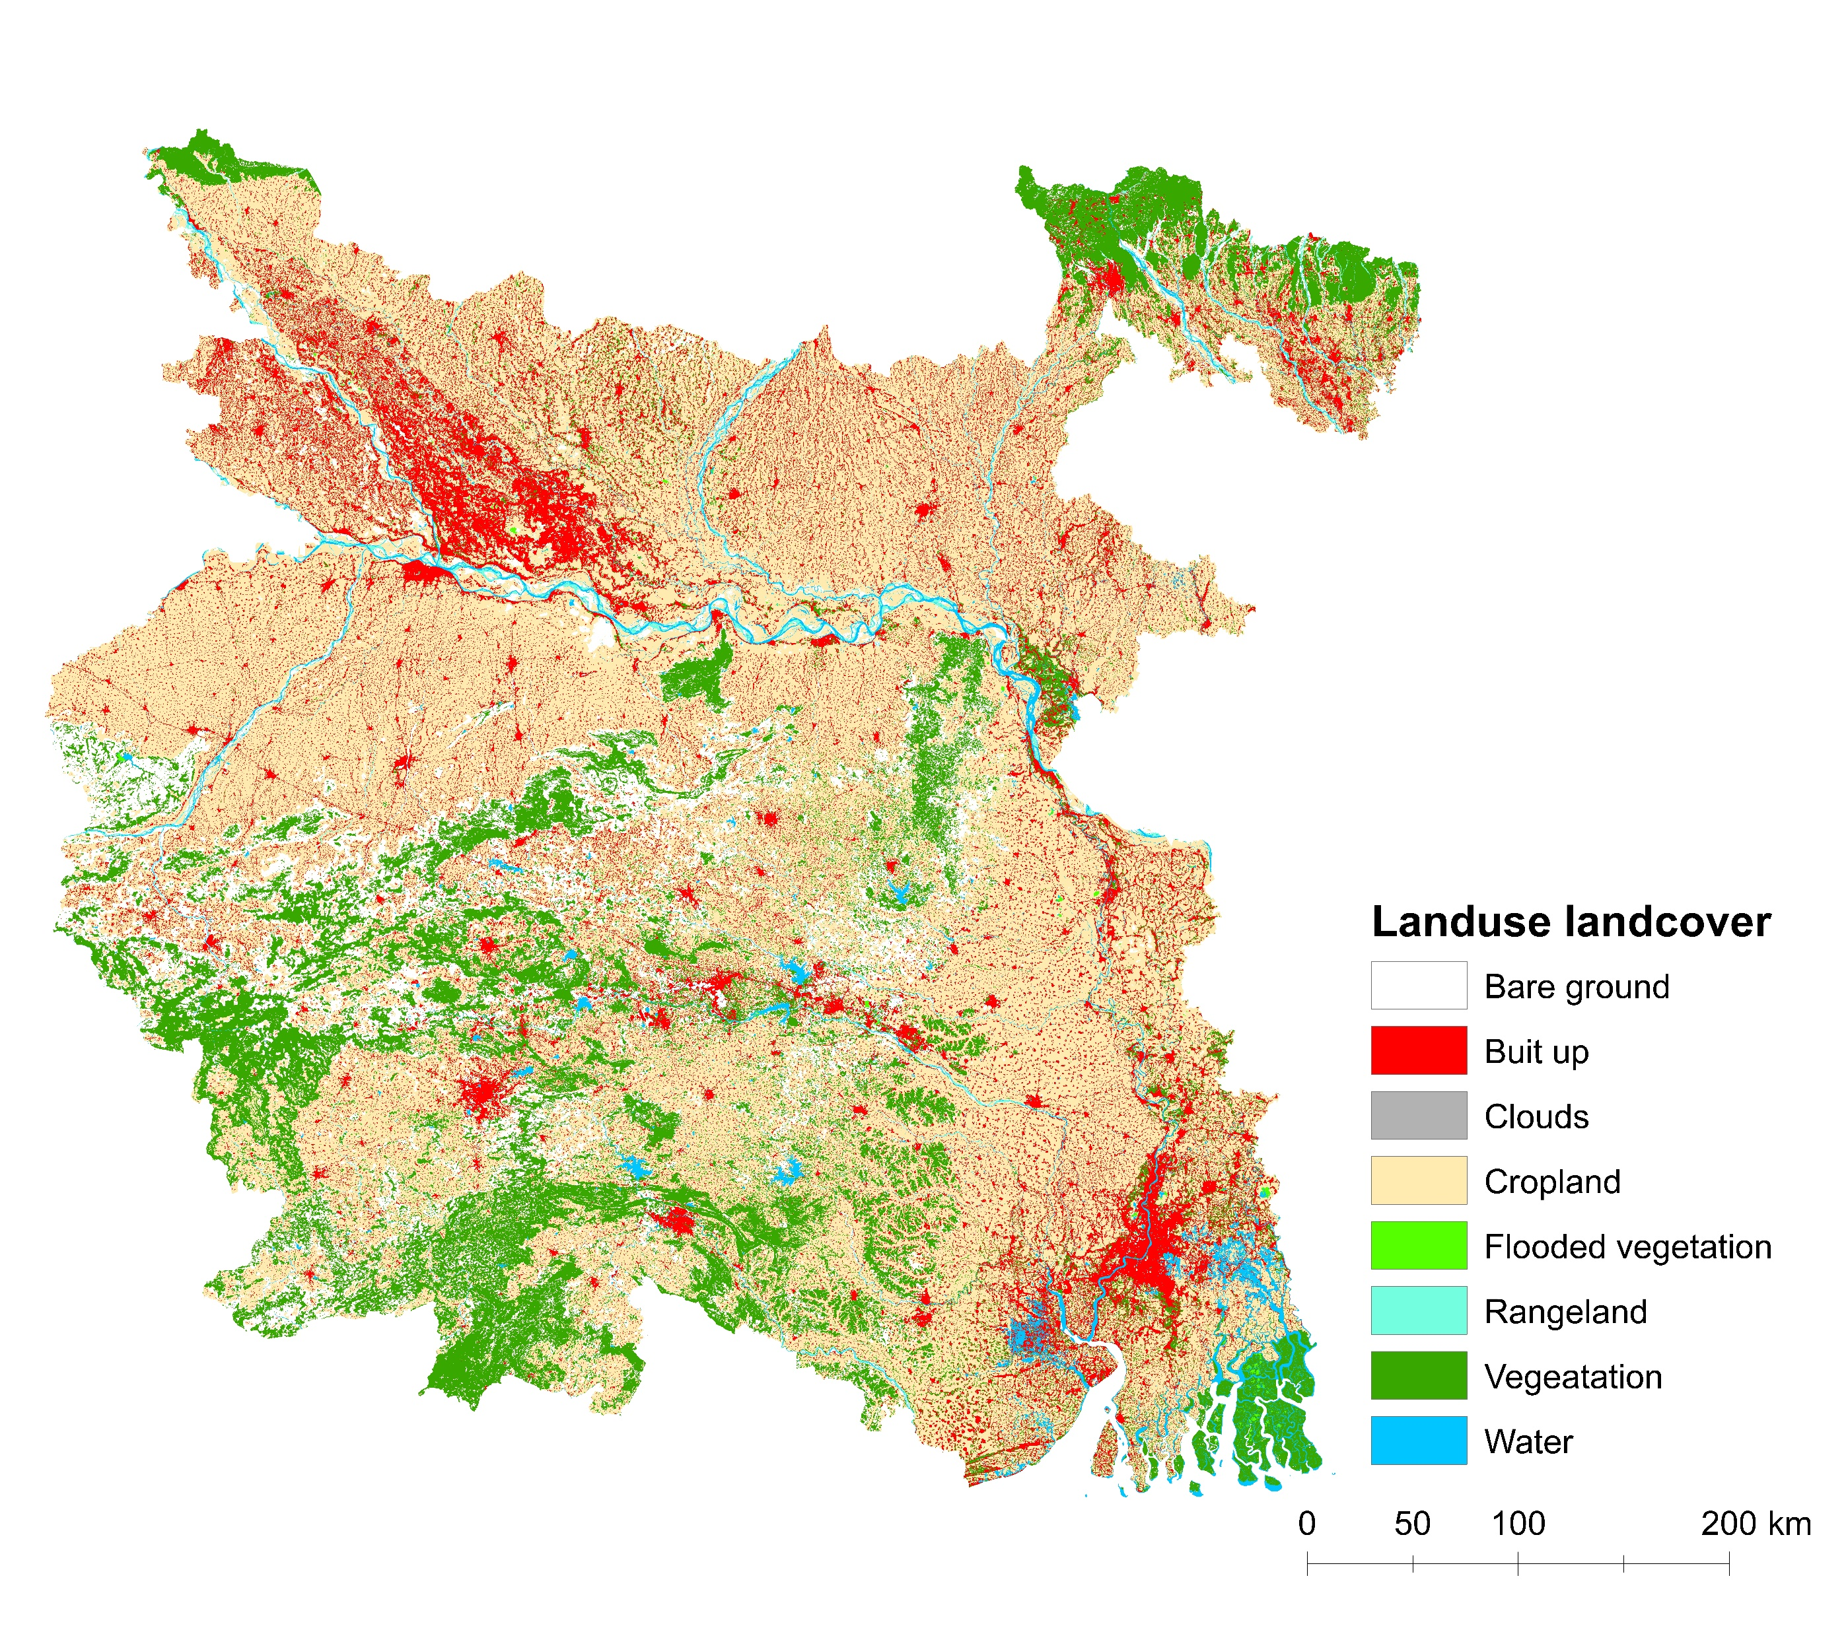
Forest Type
Forest Sub Type
(FSI, 2021)
(FSI, 2021)
Forest Cover
Land Use Land Cover
(FSI, 2021)
(ESRI, 2021)

