Slide 1
Aircraft azimuth detection using swerling model on random gaussian noise
Arpan Ojha
Presentation for HAL, aircraft division .

Slide 2
Radars
Radar is an acronym of Radar detection and ranging, wherein guided radio waves are used to detect a particular target and properties such as range , velocity , map terrain etc.
Properties like range , angle , velocity, size and image can be prepared using a radar .
There are types of radar based on element spacing and number of antenna.
Examples are: Mechanical radar , Phased array radar ,monostatic radar .

Slide 3
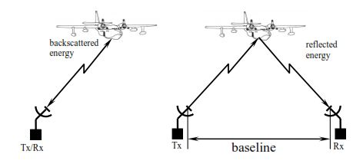
Monostatic and bistatic radar

Slide 4
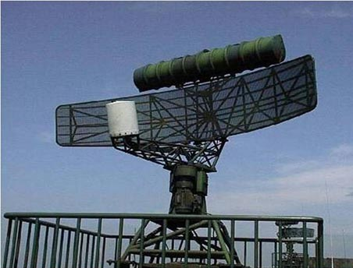
Mechanical and Phased array radar
Mechanical - The scan direction is controlled mechanically by turning the radar physically using servos .
Phased array- The scan direction is controlled by adjusting phase difference of adjacent elements in the antenna .

Slide 5
The range
v=d/tand d=vt
The range is displacement
Since radio waves travel at the speed of light (v = c = 300,000 km/sec ) range = c*time/2

Slide 6
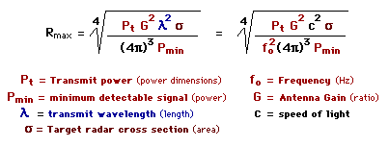
Range Equation
The radar range equation is a relation between range, signal to noise ratio , power transmitted, gain etc.

Slide 7
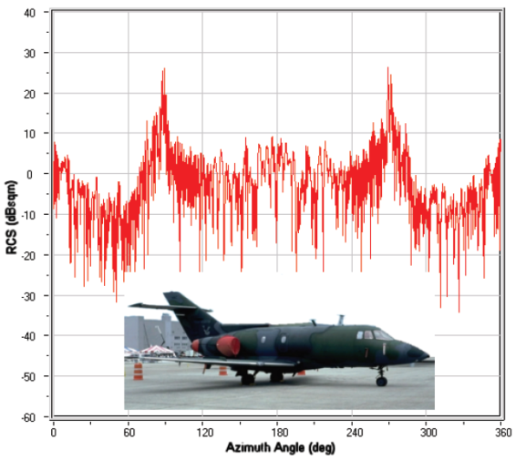
Radar Cross Section
The radar cross section is a parameter of the target where the ratio of power transmitted over power received per unit area .
RCS of aircraft f35 (0-360) .
RCS is directly related to :
Physical geometry
Direction of radar signal
Material of the target

Slide 8
Factors affecting RCS
Size – increases with effective normal size increase
Material
Shape , orientation ,Directivity

Slide 9
RCS of simple shapes
Frustum
Cylinder
Circular plate
Triangular plate

Slide 10
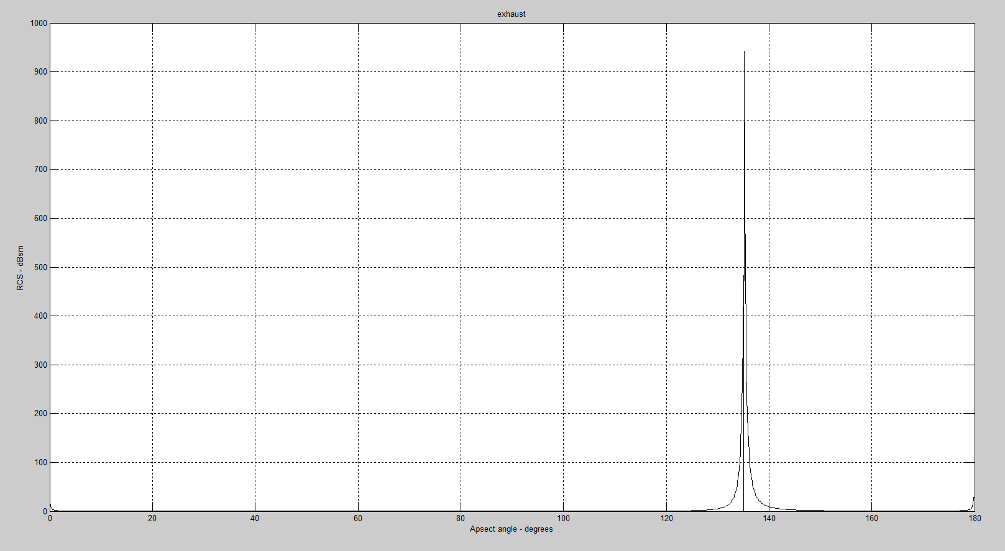
Frustum

Slide 11
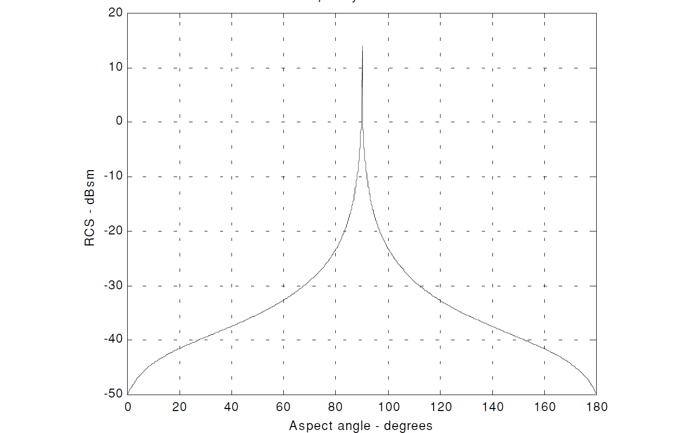
Cylinder

Slide 12
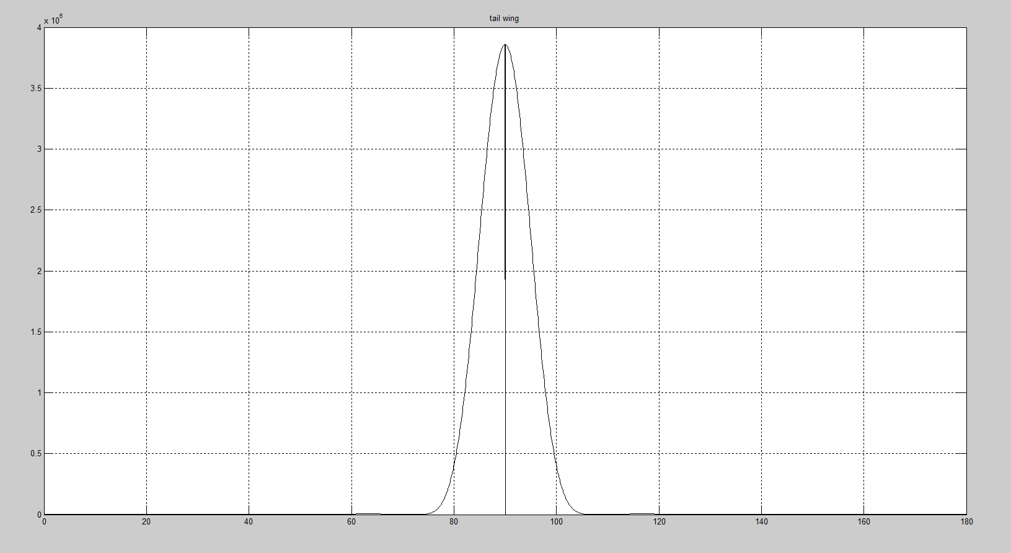
Triangular flatplate

Slide 13
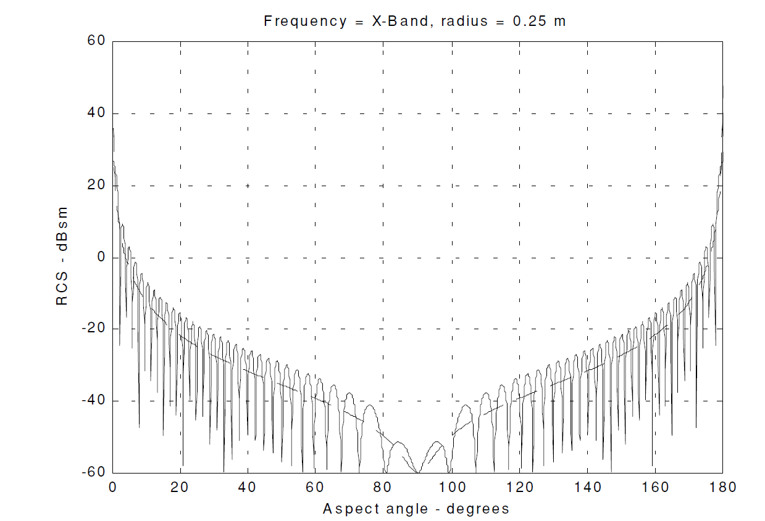
Circular flatplate

Slide 14
Target model
Wings – triangular flatplate
Nose - Cone
Tail wing – triangular flatplate
Body - cylinder
Exhaust - frustum

Slide 15
Statistical models
Gamma function
Incomplete function
Chi squared distribution
Rayleigh
Marcum Q
Error function

Slide 16
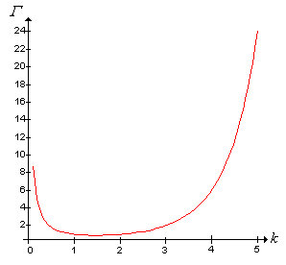
Gamma Distribution
Matlab – gamma()

Slide 17
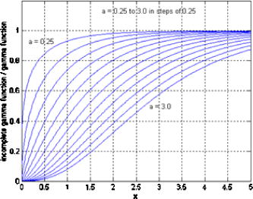
Incomplete gamma function
Gammainc is given by
Matlab – gammainc()

Slide 18
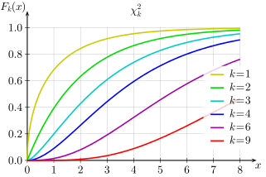
Chi squared distribution
Matlab – chi2cdf()

Slide 19
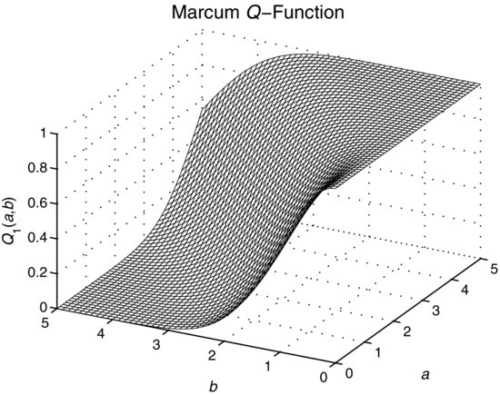
Marcums Q
Matlab – marcum()

Slide 20
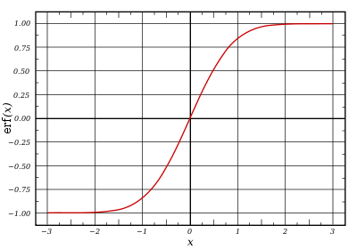
Error Function
Error function is primarily used in gram charlier series

Slide 21
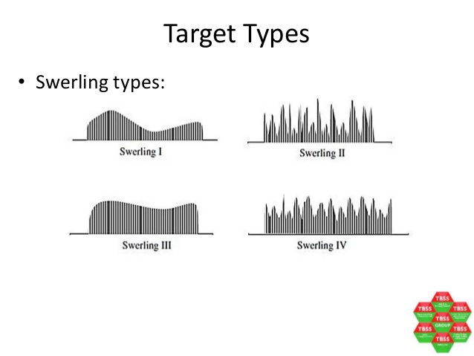
Swerling models
Swerling 1
Swerling 2
Swerling 3
Swerling 4
Swerling 5/0 .

Slide 22
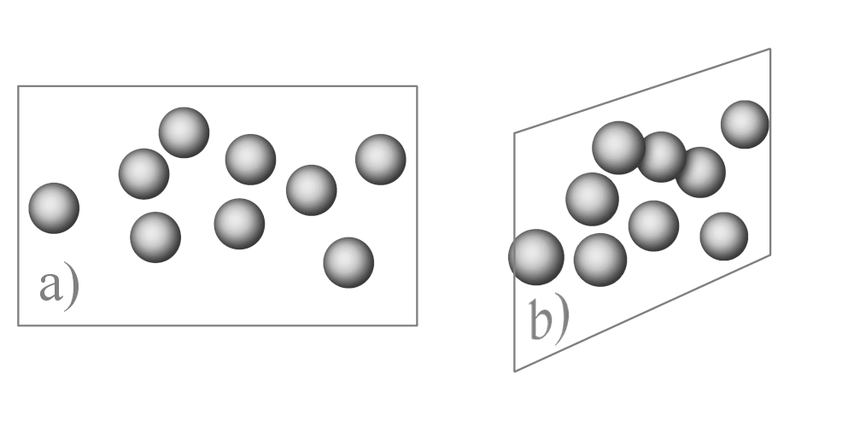

Swerling 1
Scan to scan decorrelation
Multiple scatterers

Slide 23
Swerling 2
Pulse to pulse decorrelation
Multiple scatterers

Slide 24
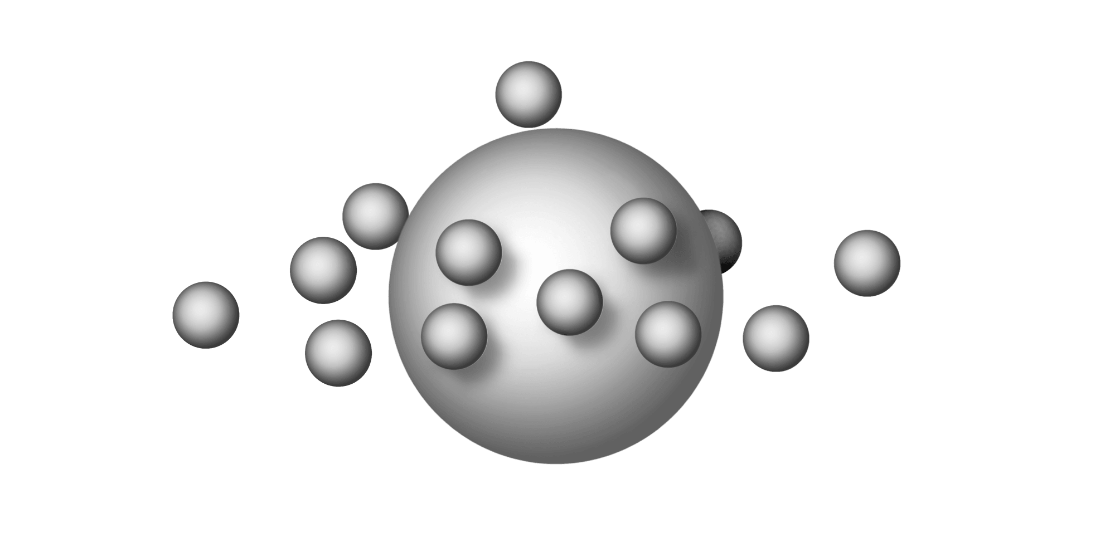
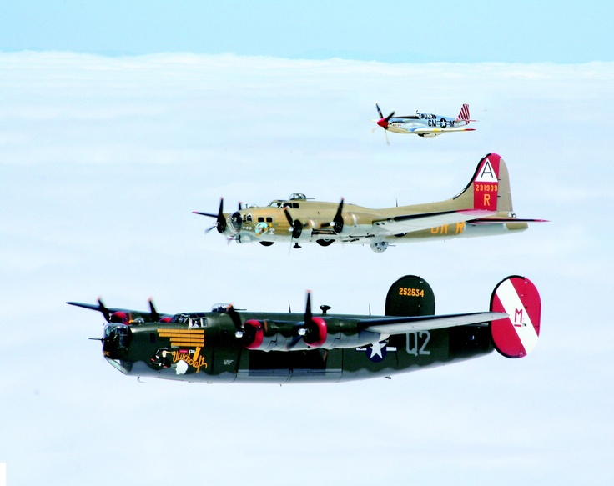
Swerling 3
Scan to scan decorrelation
Single dominant scatterer

Slide 25
Swerling 4
Pulse to pulse decorrelation
Single dominant scatterer

Slide 26
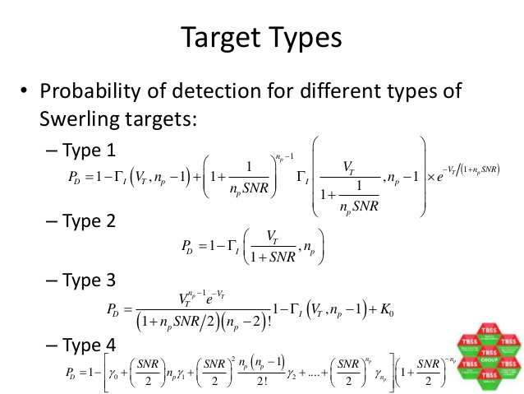
Swerling model(formula apprach)

Slide 27
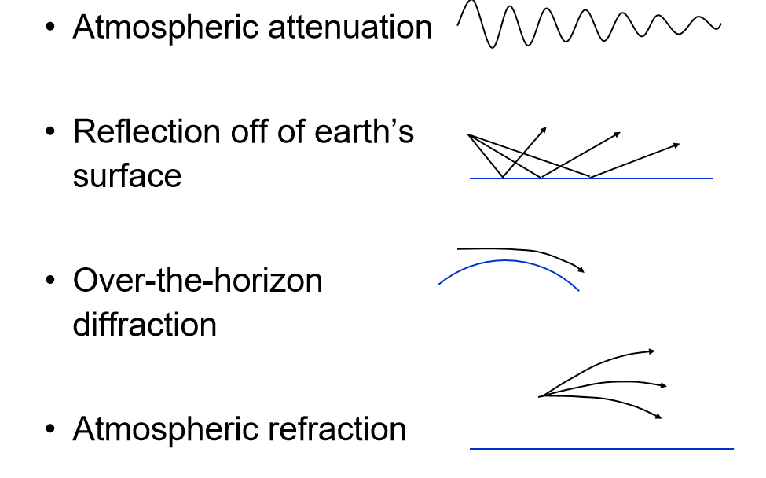
Noise

Slide 28
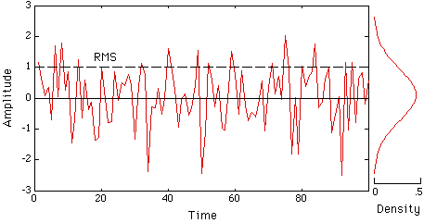
Gaussian noise

Slide 29
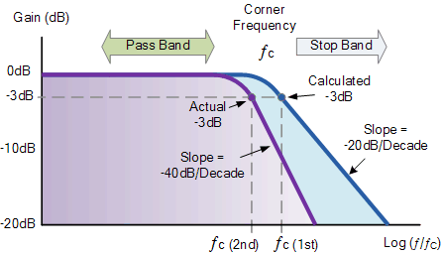
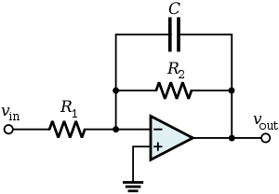
Filters
Low pass filter

Slide 30
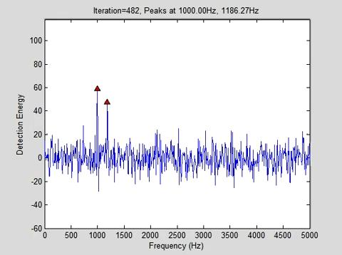
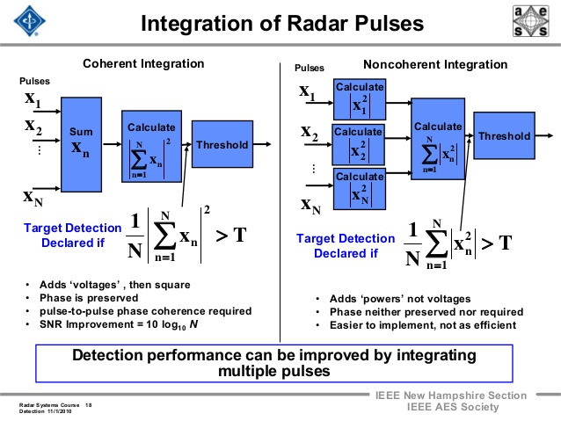
Non coherent Integration

Slide 31
Approximations
Long range approximation – The ranges involved in the equation are much larger than the aircraft dimension hence the RCS of individual parts can be just added to give the net RCS .
Dynamic range – Taking analogy from dynamic resistance, we find that the SNR to RCS to Range relation is a 3d equation whose plot is smooth with no minima or maxima. Thus we can take a dynamically static range and equate SNR to RCS. This curve can be extrapolated to other ranges without loss of generality .

Slide 32
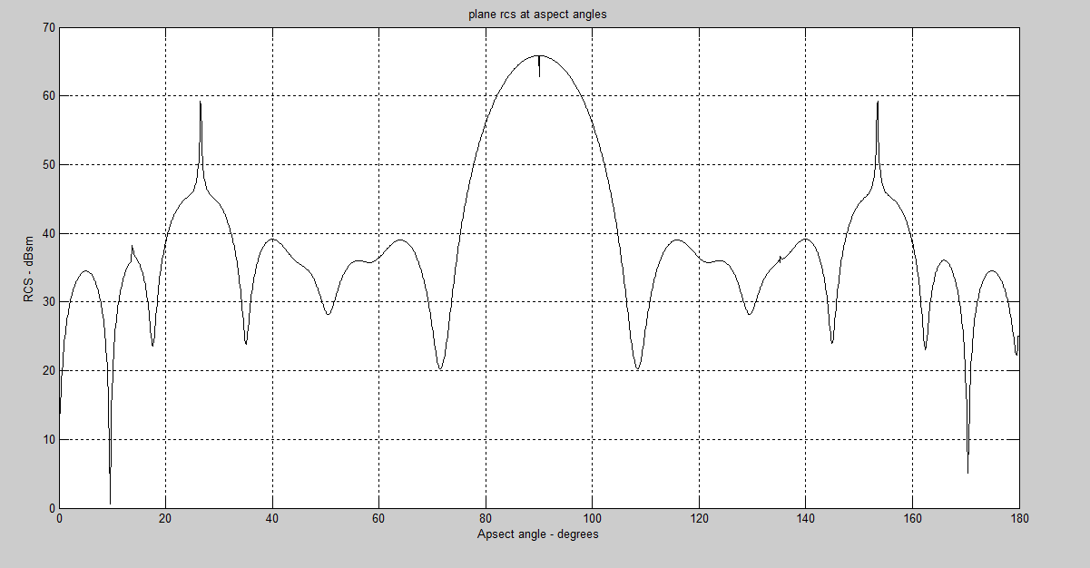
Target model vs real time data

Slide 33
Thank you :)

