Slide 1
Arpan_book
File created on: 4/1/23 4:58:44 PM EDT

Slide 2
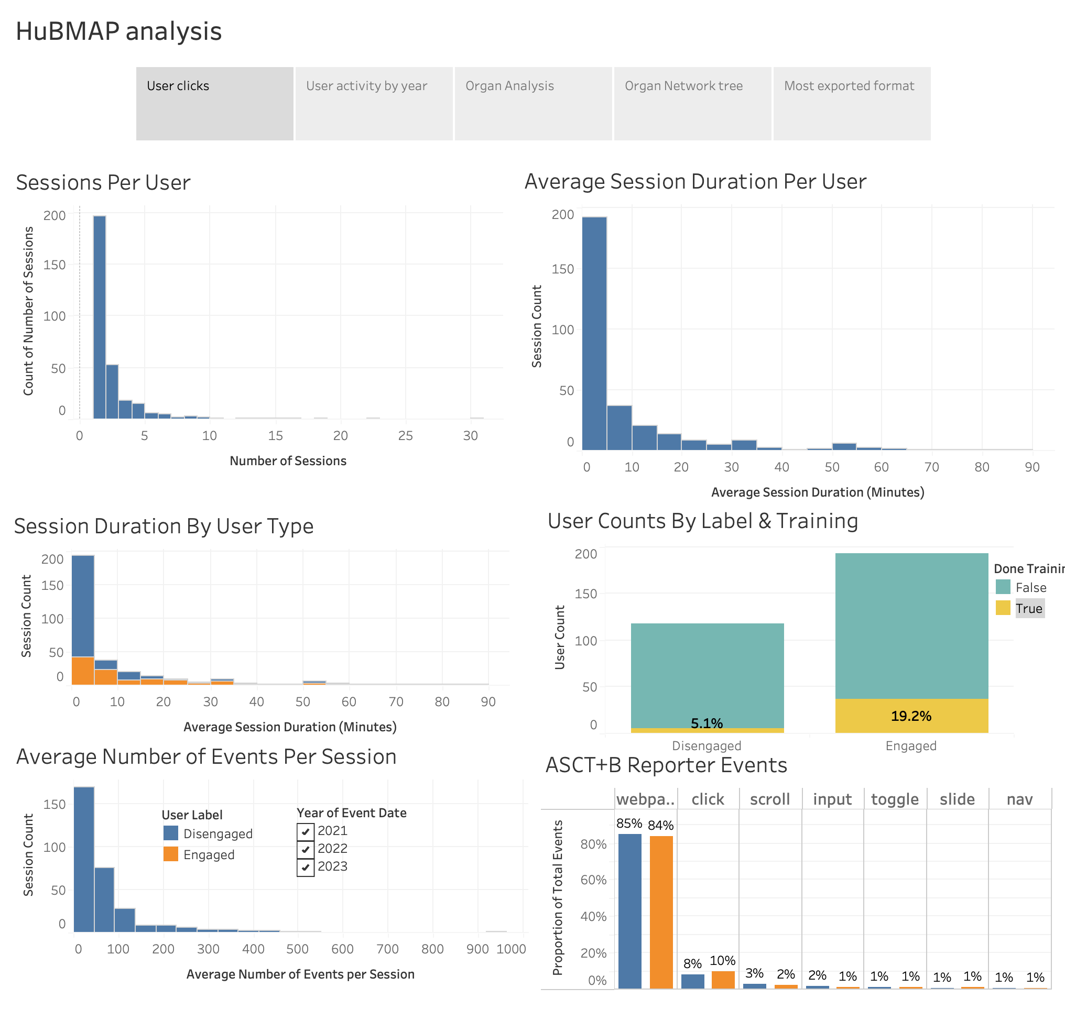

Slide 3
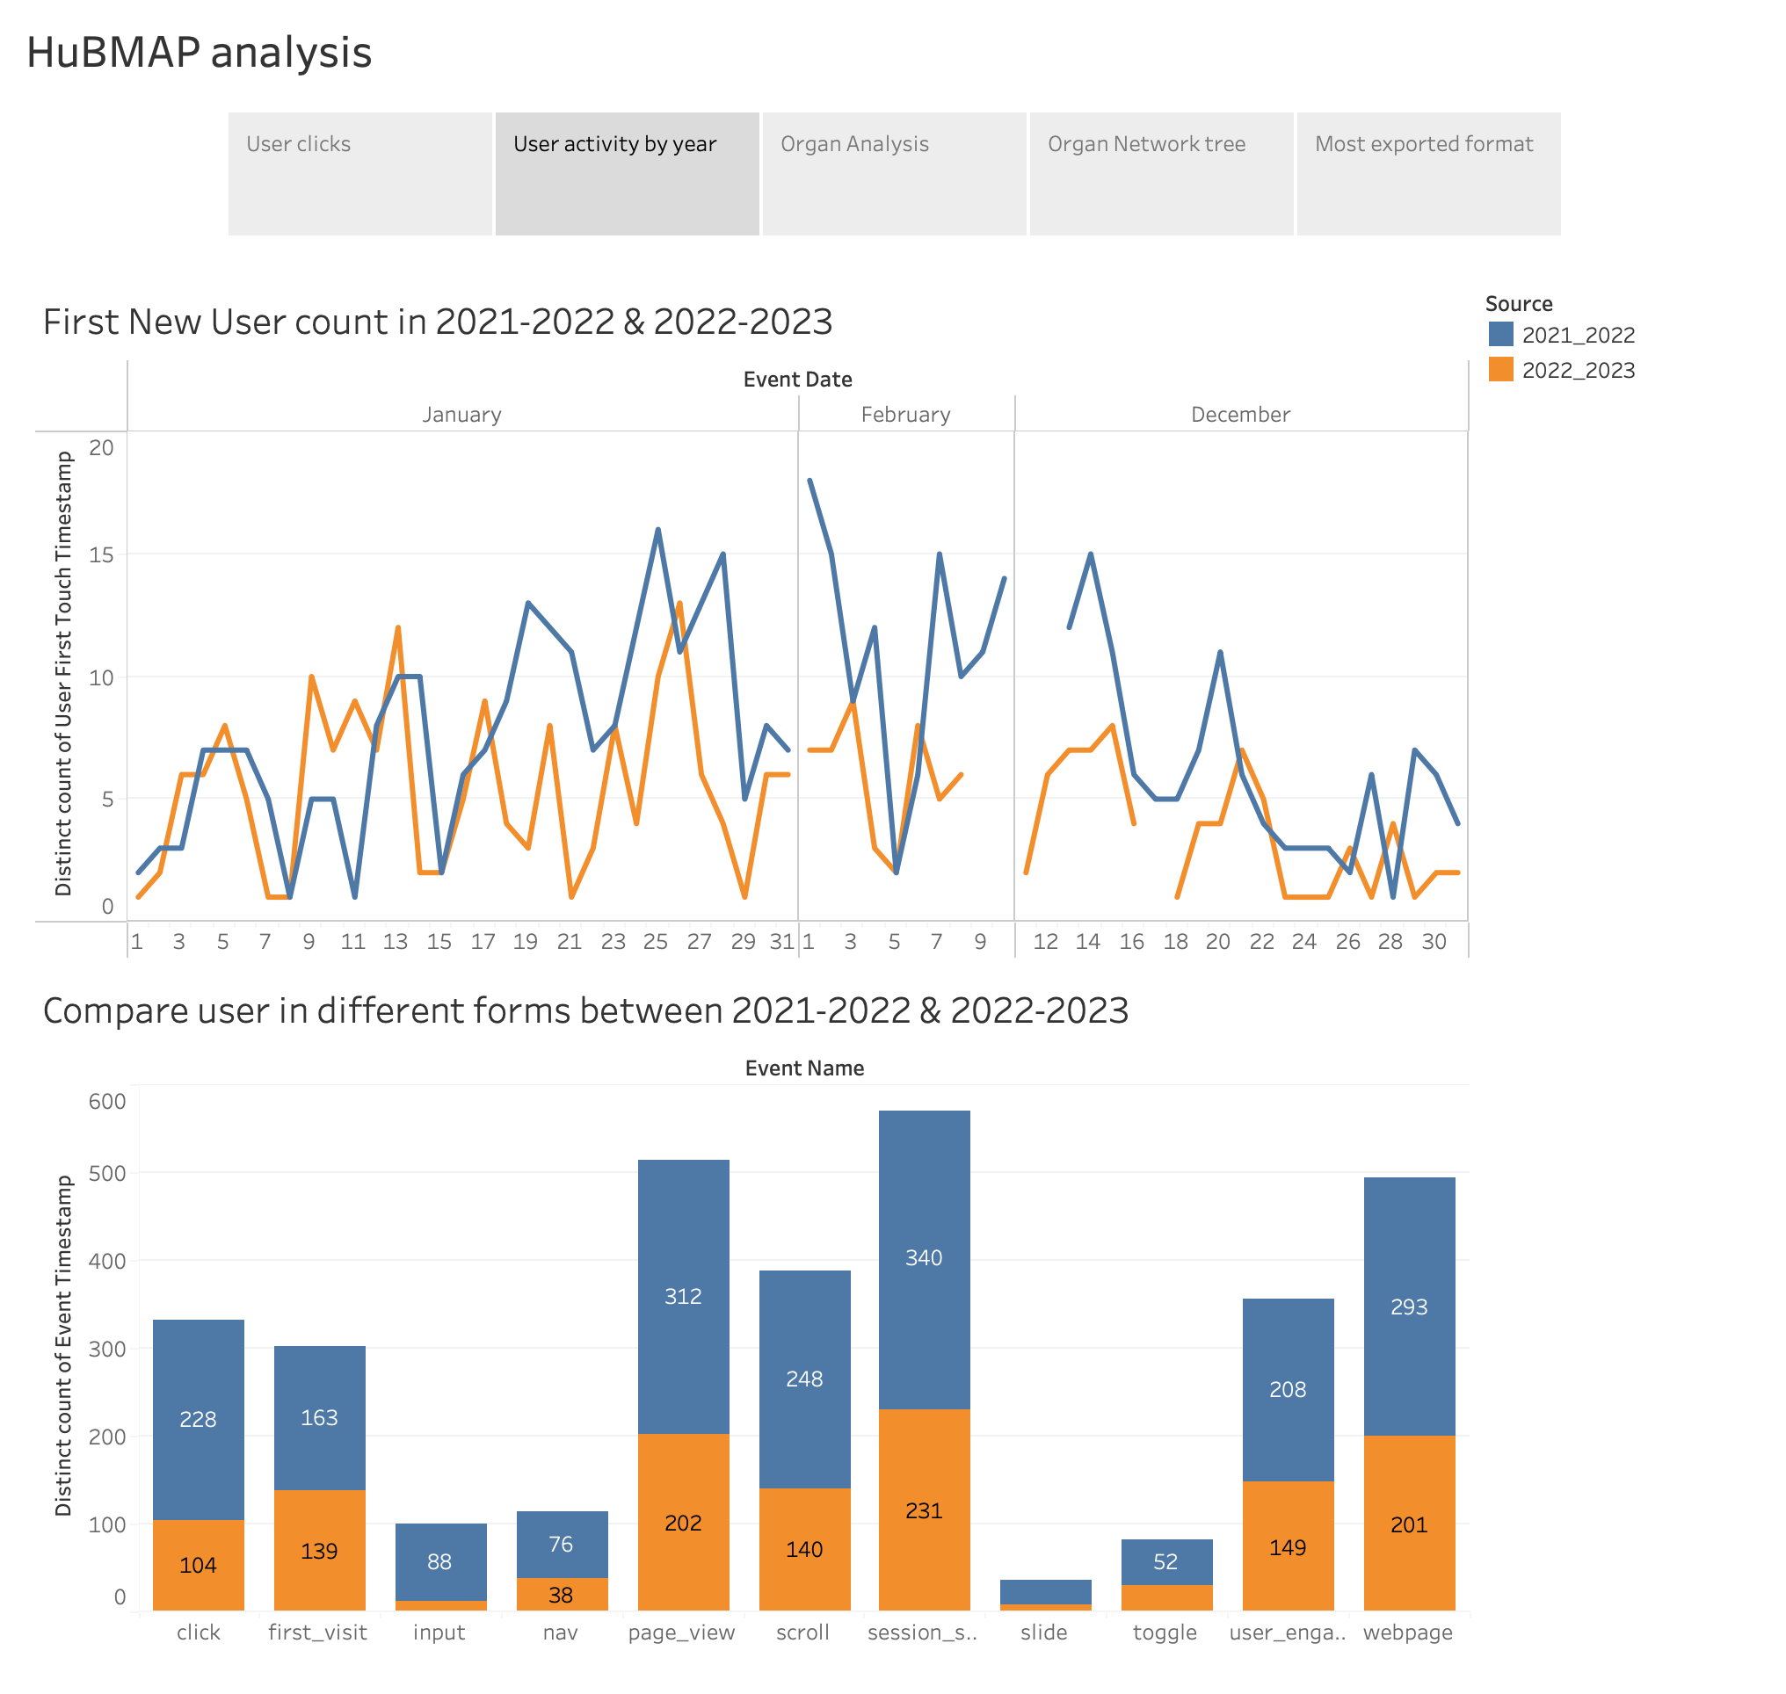

Slide 4
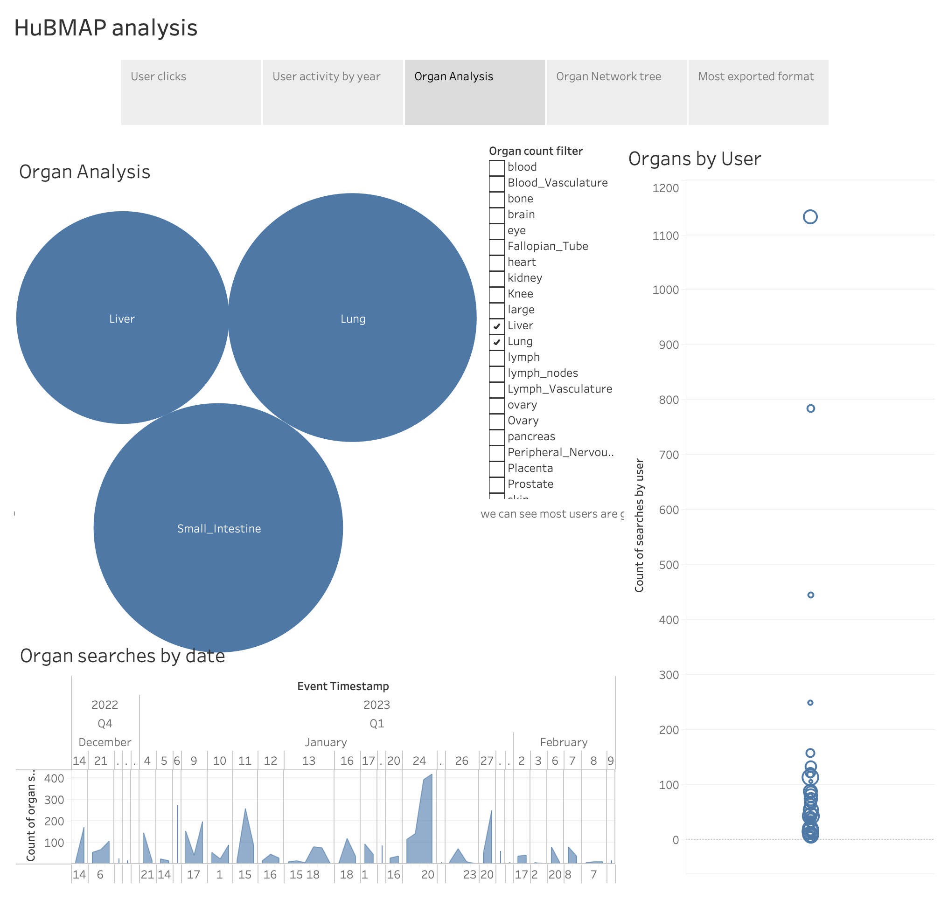

Slide 5
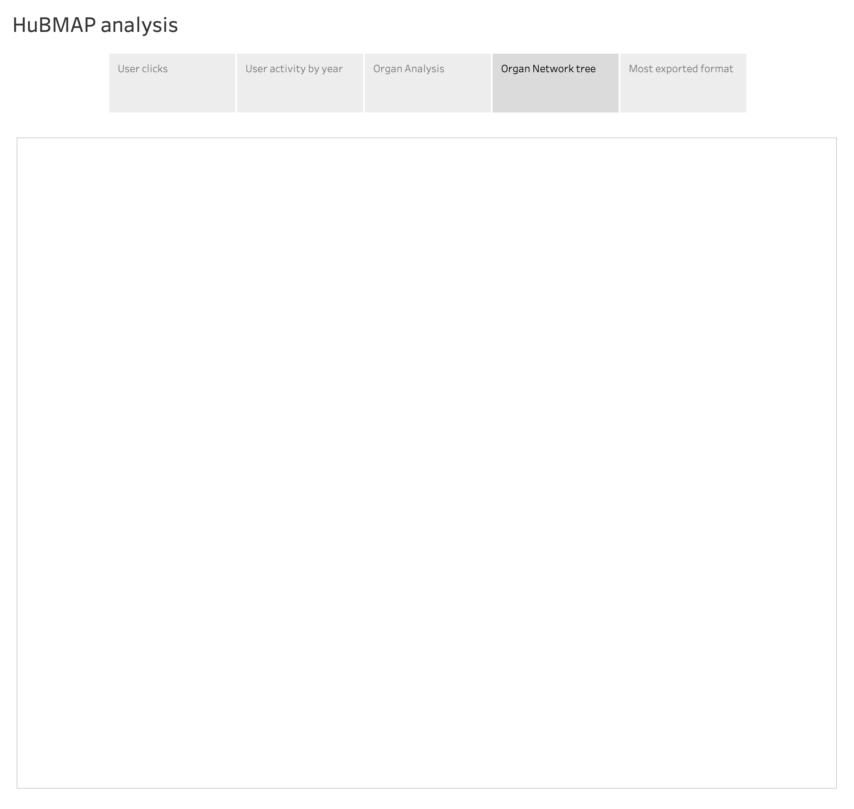

Slide 6
