Slide 1

CEE546
Assignment 3 Desk Review

Slide 2
Part 1 – Geiger Dome

Slide 3
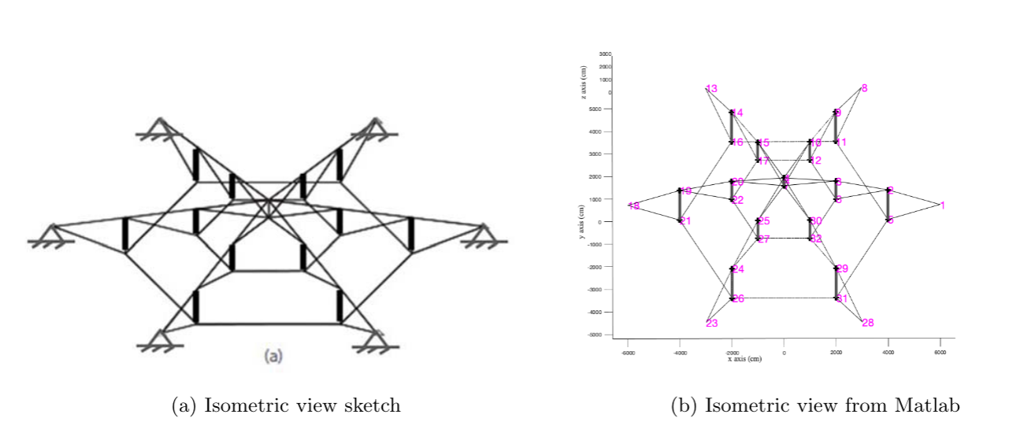

Slide 4
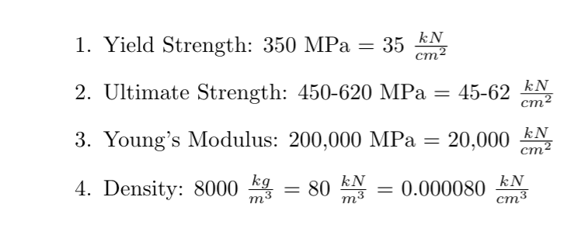
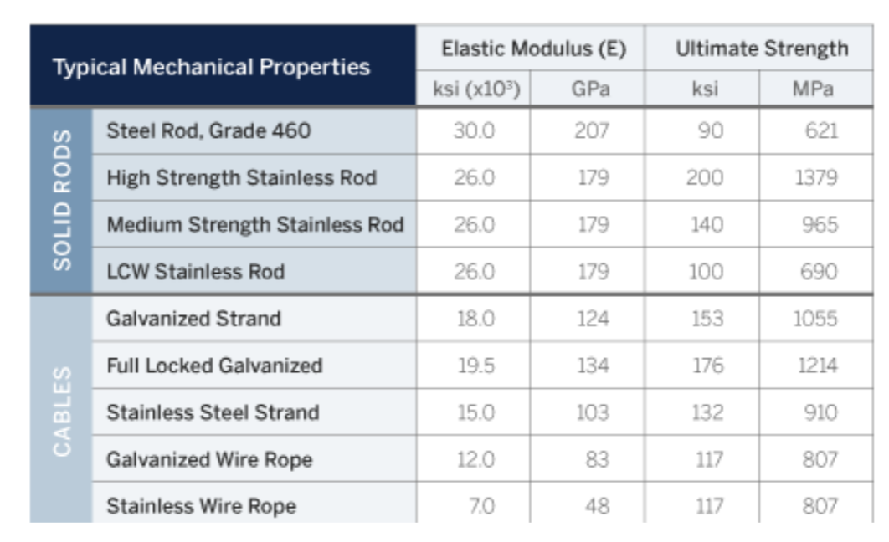
Structural Assumptions
MATERIALS

Slide 5
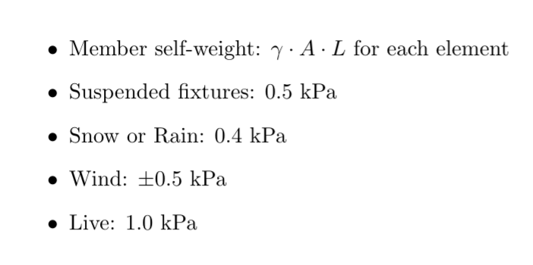
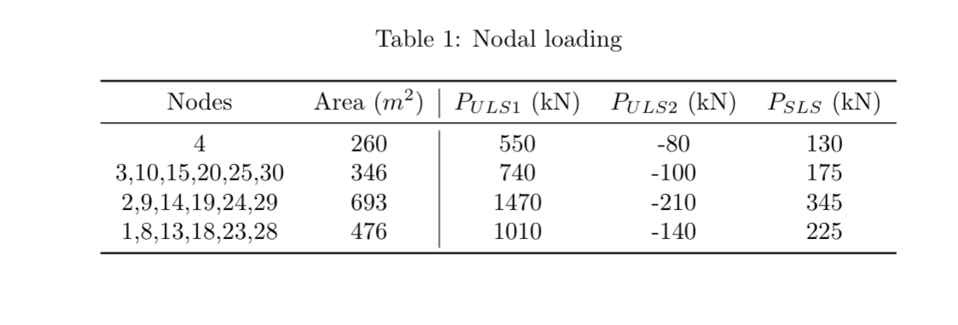
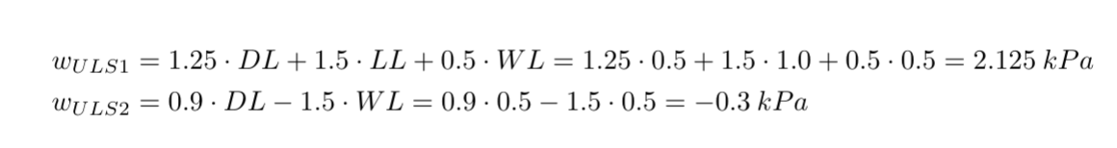
Structural Assumptions
LOADING

Slide 6
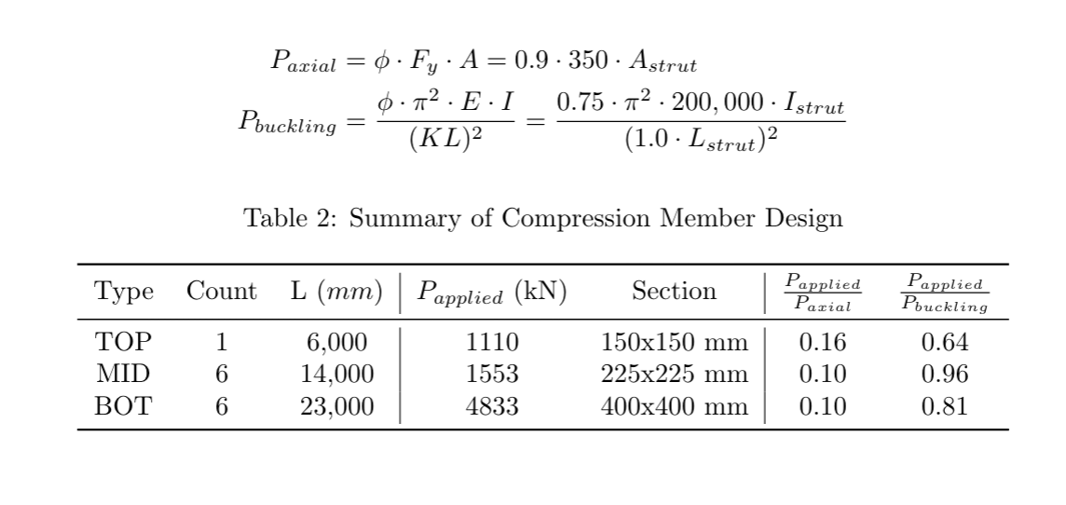
Structural Design – Compression Struts

Slide 7
Structural Design – Prestress and Deflection
0.01% strain → prestress of 5% of yield
Necessary to avoid tension cables/rods going into compression
Reduced maximum deflection
0.89m at top, reasonable for 120m span.

Slide 8
Part 2 – Equad Courtyard

Slide 9


Slide 10
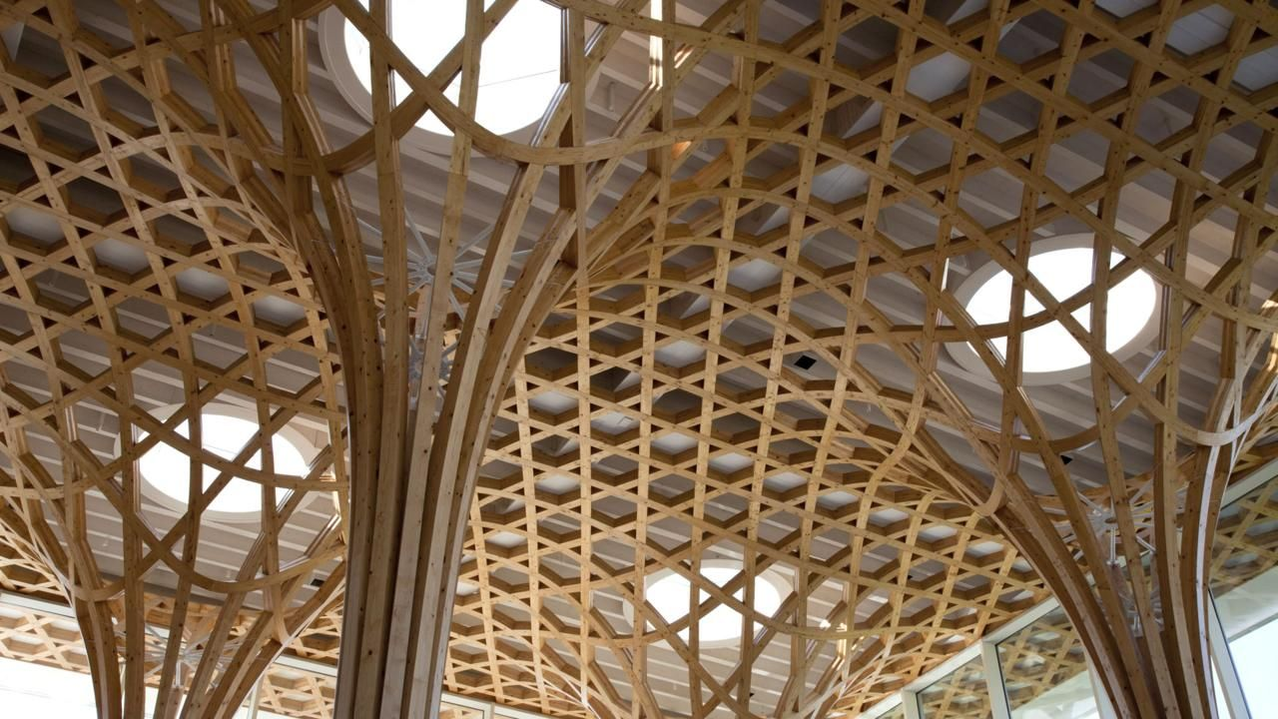

Slide 11
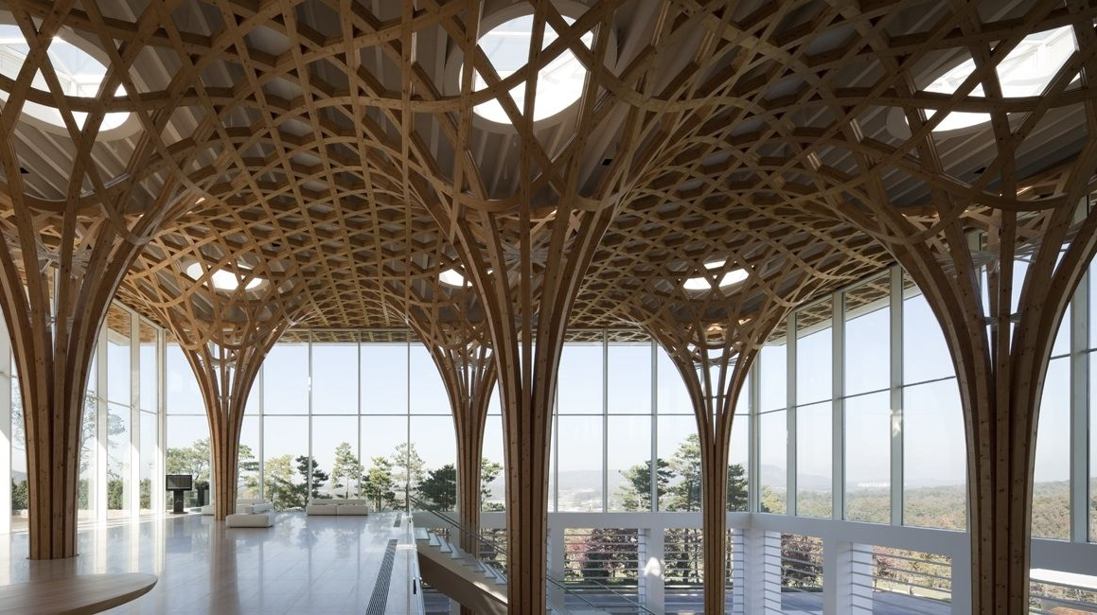

Slide 12
