Slide 1

Presented by Sabrina Highfield MA in Design | University of Texas at Austin

Slide 2
Mission | Vision | Beliefs
Mission: Deliver affordable, accessible, and human-centered primary care to America's workforce. Vision: A future where healthcare happens where people live and work—not where insurers dictate. Beliefs:
Everyone deserves timely, dignity-centered care
Prevention is the most powerful medicine
Healthier employees build healthier organizations

Slide 3



Imagine..
You’re working in one of these industries:
Manufacturing
Logistics
Public Service
Notes:
You work in one of these three industries: manufacturing, logistics, or public service.
What comes to mind? For those outside these sectors, it may be hard to imagine the day-to-day realities.
Manufacturing often demands intense physical labor. Logistics can mean long, unpredictable hours.
And while public service may offer a better work-life balance, compensation tends to be lower.

Slide 4
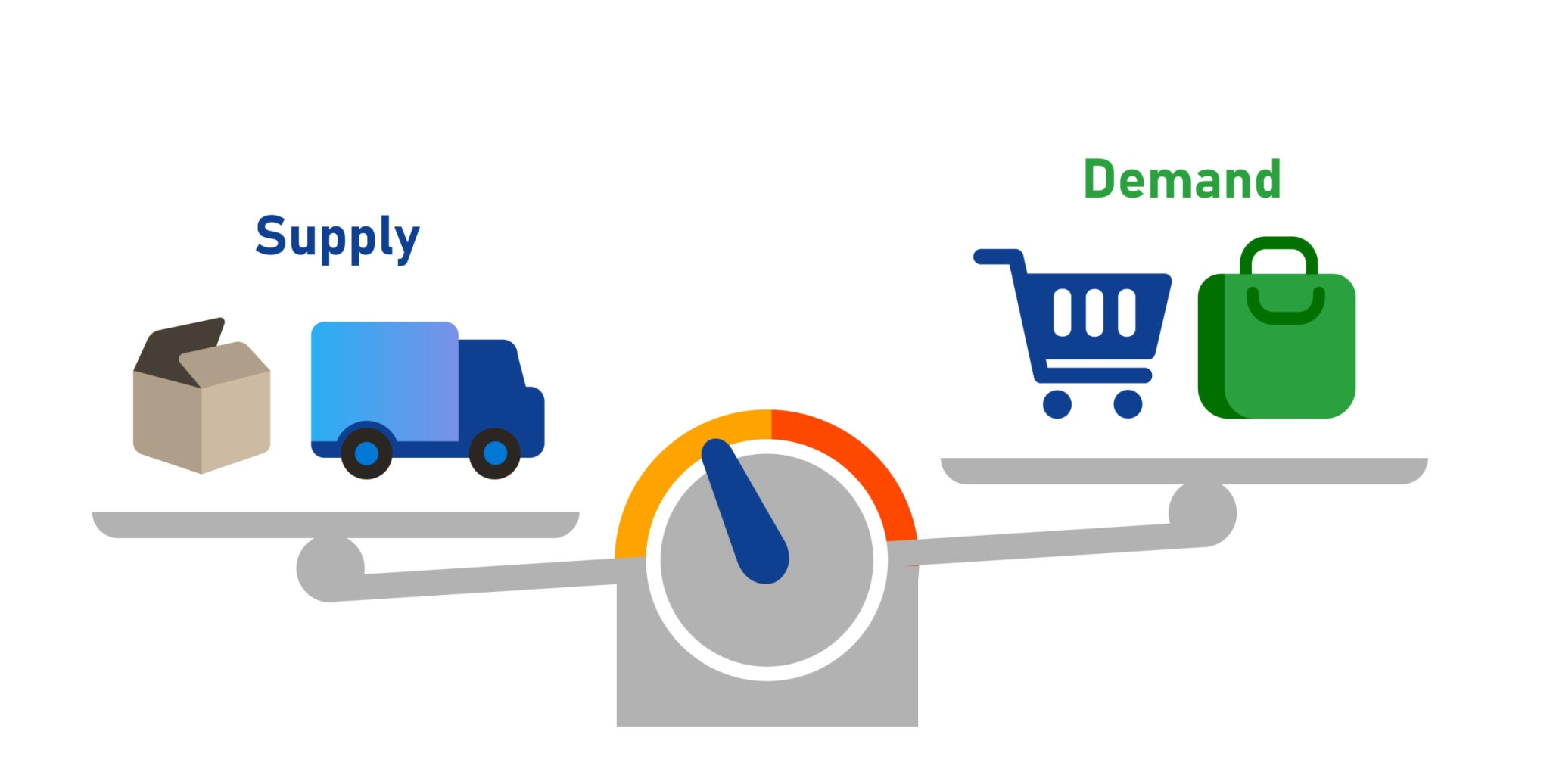
The Problem
Burnout and increasing barriers to accessing timely, affordable primary care.
Access Delays
Care Avoidance
Employer Burden
Notes:
Despite their differences, these industries share a troubling commonality: high rates of burnout and increasing barriers to accessing timely, affordable primary care.

Slide 5
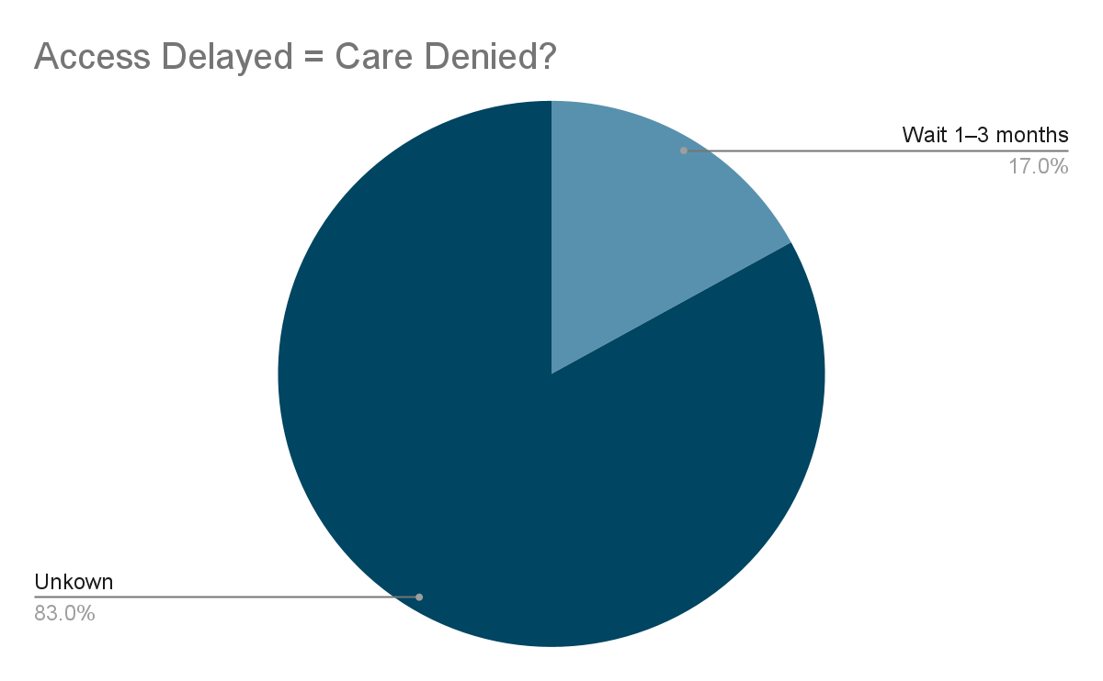
The Problem - Access Delays
38 days average wait time
40% of Americans say wait times are ‘longer than reasonable’
Notes:
38 days — average wait time for a primary care appointment in the U.S., exceeding the industry benchmark of 14 days.
17% of patients wait 1–3 months for a doctor's appointment.
Over 40% of Americans report experiencing "longer than reasonable" wait times for healthcare.
https://healthjournalism.org/blog/2024/08/in-the-u-s-wait-times-to-see-a-doctor-can-be-agonizingly-long/
https://www.axios.com/2024/09/03/health-shrinkflation-patients-wait-more-for-less
https://www.aanp.org/news-feed/two-in-five-americans-report-unreasonable-health-care-wait-times

Slide 6
The Problem - Care Avoidance
Nonfinancial
21.7%
61%
Uninsured Adults
28%
Financial
Notes:
21.7% of adults delayed or did not receive medical care in the past year due to nonfinancial access barriers, such as being too busy or unable to get to a provider when open.
28% of adults delayed or did not get health or dental care due to cost.
61% of uninsured adults have skipped or postponed needed healthcare due to cost.
https://www.healthsystemtracker.org/indicator/access-affordability/delay-needed-care/?utm_source=chatgpt.com#Percent%20of%20adults%20who%20reported%20delaying%20or%20going%20without%20medical%20care%20due%20to%20COVID-19,%202021
https://www.kff.org/health-costs/issue-brief/americans-challenges-with-health-care-costs/

Slide 7
The Problem - Employer Burden
$1.3 trillion
$8,435 for coverage
Projected spend on health benefits in 2024 by U.S. employers.
The average annual premium for employer-sponsored health insurance.
The Bottom Line
Despite this investment, many employers lack insight into the quality of care purchased, leading to potential overspending on low-quality healthcare services.
Notes:
U.S. employers are projected to spend $1.3 trillion on health benefits in 2024.
The average annual premium for employer-sponsored health insurance in 2023 is $8,435 for single coverage and $23,968 for family coverage.
Despite this investment, many employers lack insight into the quality of care purchased, leading to potential overspending on low-quality healthcare services.
https://www.benefitspro.com/2024/06/13/cms-u-s-employers-to-spend-1-3t-on-health-benefits-this-year/
https://www.kff.org/report-section/ehbs-2023-summary-of-findings/
https://www.axios.com/2023/08/30/employer-health-costs-quality

Slide 8
Common Obstacles of Traditional PCPs
Obstacle | What Patients/Employers Experience
Limited Access | Long wait times (7–30+ days), short visits (7–12 mins)
Insurance Complexity | Surprise bills, denials, co-pays, paperwork
Fragmented Care | No coordination between providers or employer insight
Overworked Providers | Burnout, low availability, high turnover
Low Utilization | Many employees don’t even use their PCP benefits

Slide 9


Why This Problem Demands Attention
Looking at the past
Looking into the future
Notes:
The COVID-19 pandemic highlighted something: workers in manufacturing, logistics, and public service are the backbone of our society. While the world paused, they kept supply chains running, maintained public safety, and upheld critical infrastructure.
And even as AI reshapes these industries, these roles remain deeply human. They involve real-world complexity, decision-making, and care—things automation can support, but not replace

Slide 10
The Solution
Notes:
ThriveClinic brings Direct Primary Care (DPC) into workplaces through modular clinics and onsite care teams.
It will provide:
Unlimited access to primary care, wellness coaching, and virtual visits
No insurance, no co-pays, no barriers
Transparent pricing for employers, with real-time ROI tracking

Slide 11

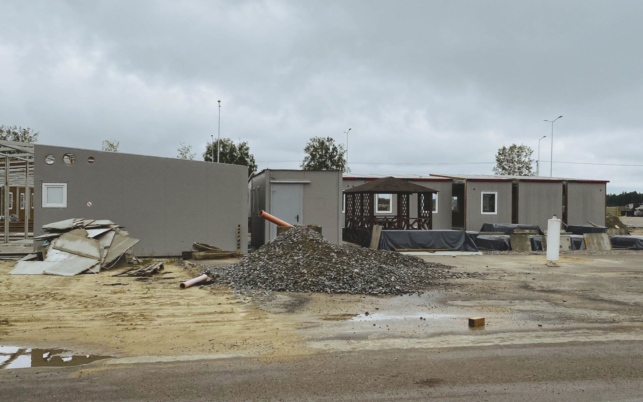
Industry Specific Direct Primary Care (DPC) Model
Onsite Care Teams
Modular Clinics
Notes:
ThriveClinic brings Direct Primary Care (DPC) into workplaces through modular clinics for and onsite care teams.
It will provide:
Unlimited access to primary care, wellness coaching, and virtual visits
No insurance, no co-pays, no barriers
Transparent pricing for employers, with real-time ROI tracking

Slide 12
How does a DPC model differ?
Traditional PCP | ThriveClinic Solution
Wait times (avg. 19 days) | Same-day / next-day visits at work
Short appointments | 30–45 minute visits = deeper care
Billing stress | Flat-fee, no co-pays, no surprise bills
Limited hours / access | Modular, onsite, AND virtual care
No employer insight | Real-time employer dashboards (aggregated + de-identified)
Burnout-prone model | Smaller patient panels (max ~350), no billing admin for providers
Underused benefits | Proactive outreach, wellness integration, high trust via access

Slide 13
How ThriveClinic brings Value
For Employees = Higher Satisfaction
Fast, reliable access to high-quality primary care—on-site, near-site, or virtual—without the wait times or financial barriers typical of traditional healthcare.
Services are aligned with work demands and shift schedules, ensuring care is convenient, relevant, and impactful.
For Employers = Lower Cost
A predictable, cost-effective healthcare solution that improves workforce health, reduces absenteeism, and delivers measurable ROI.
Tailored specifically to the needs of essential industries like manufacturing, logistics, and public service.
Notes:
A predictable, cost-effective healthcare solution that improves workforce health, reduces absenteeism, and delivers measurable ROI.
Tailored specifically to the needs of essential industries like manufacturing, logistics, and public service.
Fast, reliable access to high-quality primary care—on-site, near-site, or virtual—without the wait times or financial barriers typical of traditional healthcare.
Services are aligned with work demands and shift schedules, ensuring care is convenient, relevant, and impactful.

Slide 14



Competitive Landscape
Company | Model | Insurance-Free | Modular Clinics | Data ROI | DEI Lens
OneMedical | Fee-for-service | No | No | Limited | Limited
Crossover Health | Employer-based | No | Partial | Yes | Medium
Forward Health | Tech-focused | Yes | No | Yes | Limited
ThriveClinic | Onsite DPC | Yes | Yes | Yes | Strong
Insurance Free | Yes | No | No | Yes
Modular Clinics | Yes | No | No | No
Data ROI | Yes | Limited | Yes | Yes
Industry Specific | Yes | No | No | No
Notes:
One Medical: New business initiative through amazon
Cross Over
ForwardHealth: startup that shut down
Urgent Care clinic as comp?

Slide 15
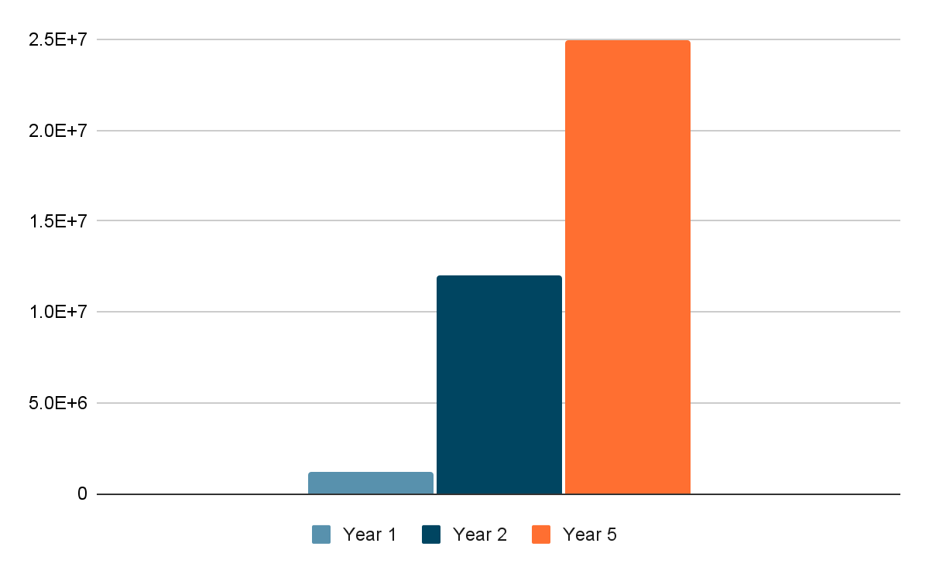
Path to Profitability
Notes:
Year 1: 5 contracts → $1.2M revenue
Year 2: 50 contracts → $6.5M revenue
Year 5: 25 million

Slide 16

Year 1 Projections
10 employer contracts @ 125 employees each
Yearly revenue: 10 x 125 x $80 x 12 = $1,200,000
$70,000 Operating Income
Notes:
Category
Estimated Annual Cost
Clinician Salary (NP or PA)
$100,000
Medical Assistant / Admin
$65,000
Virtual MD Pool (part-time coverage)
$15,000
Software & Platform Subscriptions
$10,000
Supplies, Labs, Equipment
$10,000
Rent + Utilities (modular or small site)
$30,000
Marketing & Employer Education
$5,000
Insurance & Legal / Liability
$5,000
Total Annual Operating Costs
$240,000

Slide 17
Offerings and Costs Break Down
Annual Revenue | $ 1,200,000.00
Cost of Care Team & Staffing |  | $ 700,000.00
Clinic Infrastructure & Mobile Units |  | $ 250,000.00
Tech Platform & EMR |  | $ 120,000.00
Outreach, Onboarding, Education |  | $ 60,000.00
Total Expenses | $ (1,130,000.00)
Operating Income | $ 70,000.00

Slide 18
Staffing Breakdown Cost Per Year
Role | Count | Estimated Salary | Total Cost
Nurse Practitioners | 2 | $120,000 | $240,000
Physician Assistants | 1 | $130,000 | $130,000
Medical Assistants | 2 | $60,000 | $120,000
Care Coordinators | 1 | $70,000 | $70,000
Subtotal |  |  | $560,000*
*Overhead (25% of $560,000) = $140,000 (700,000)

Slide 19
Clinic Breakdown Cost Per Year
Mobile Clinic Units (2 units) | $160,000 | $80,000 each for converted mobile health vans with exam rooms, HVAC, ADA access
Medical Equipment & Furnishings | $40,000 | Exam tables, diagnostic equipment, refrigeration (for vaccines/labs), supplies
Initial Build-Out & Customization | $25,000 | Plumbing, interior layout, branding, telehealth setup
Licensing, Permits, Inspections | $10,000 | Local/state health permits, fire safety, vehicle licensing
Logistics & Setup Costs | $15,000 | Delivery, setup, utility hookups, signage, storage
Contingency Reserve (5–10%) | $10,000 | To accommodate scope creep or rising material costs

Slide 20

Year 2 Projections
50 contracts (~12,500 employees)
Expansion into mental health, and reporting tools ($100 per employer)
Annual revenue: $12M–$15M
Notes:
20 a month add on

Slide 21
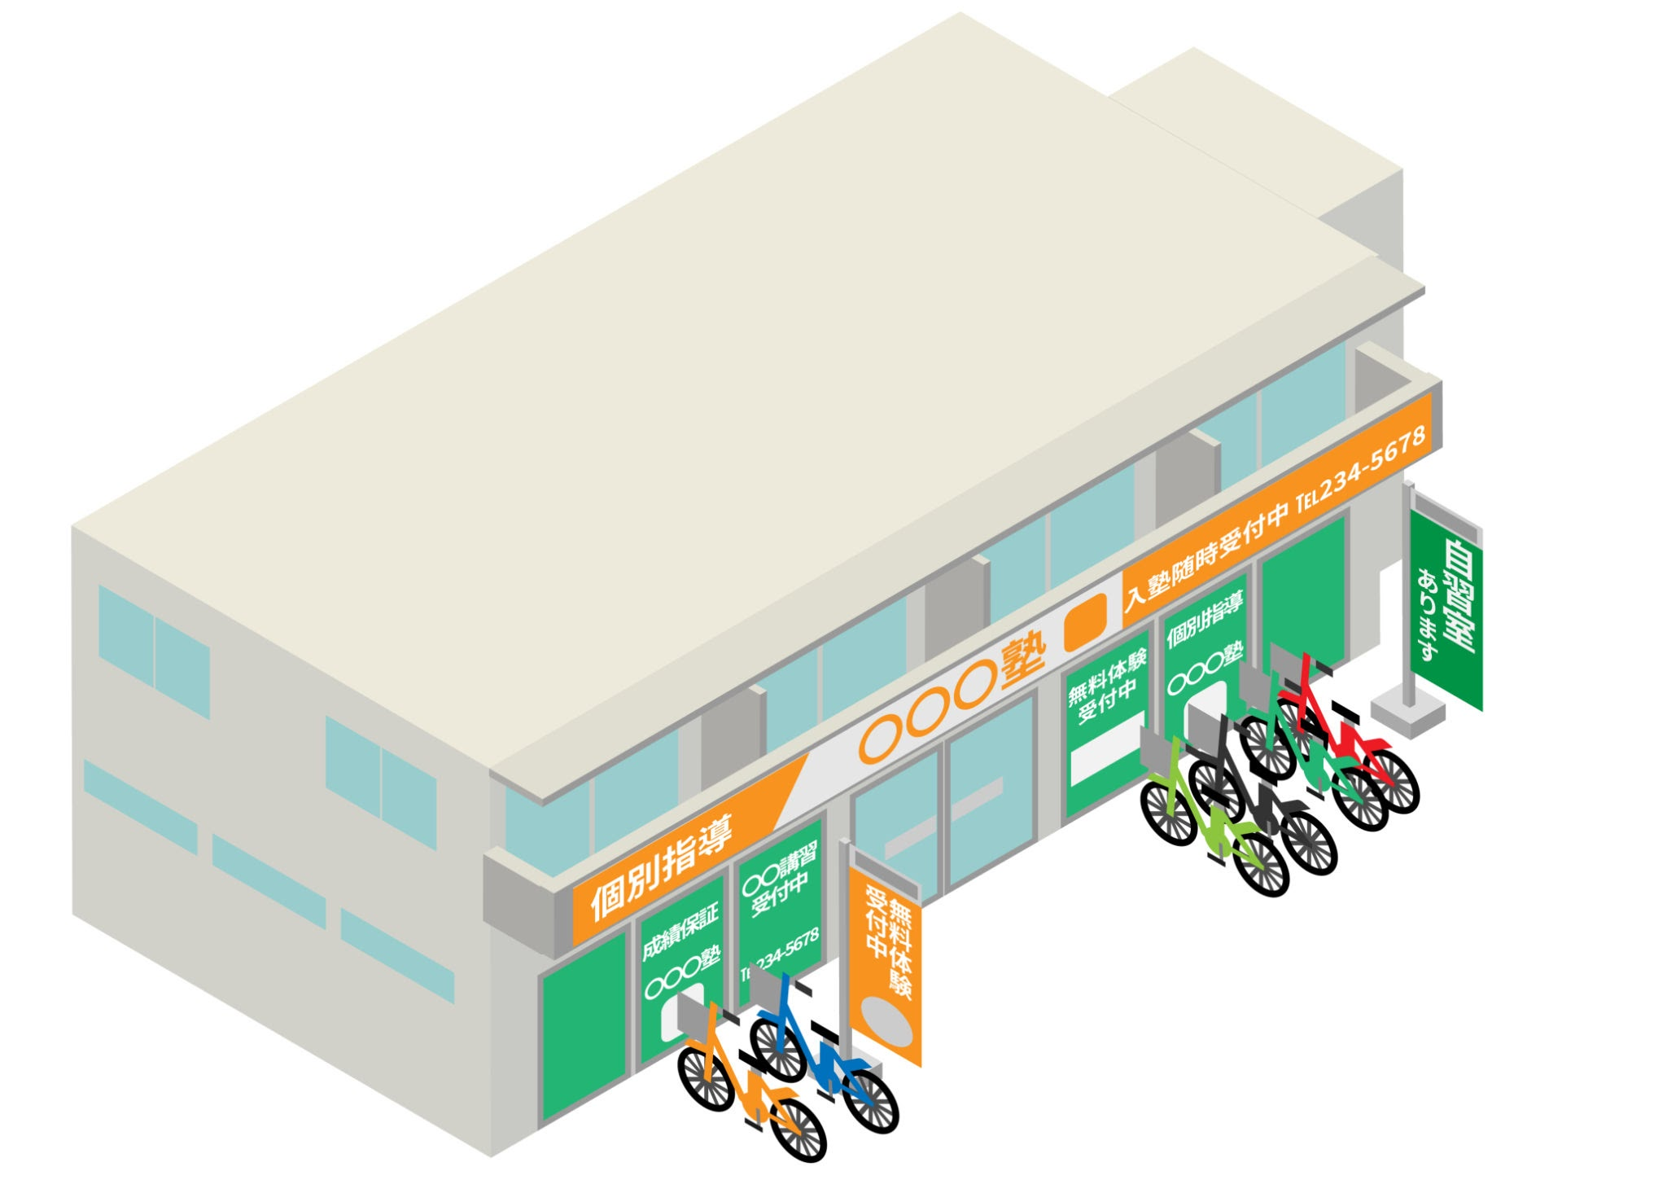
Year 5 Projections
Multi-year city and school district deals (increased predictability)
Optional SaaS-style reporting products (increased profitability)
Scaled to other industrial hubs (increased scale)

Slide 22

Future Growth Strategy
Integrate behavioral health and occupational therapy by Y3
Launch AI-driven member app for personalized prevention plans
Expand to other industries after Y5

Slide 23
Call to Action
ThriveClinic is how we make work healthier—together. Join me in transforming how America’s essential workers receive care. Invest | Refer | Partner

Slide 24
Research & Class Resources
Business Model Generation — Canvas model structuring and iteration
The Real Value of Design (McKinsey) — Design-led orgs double ROI
Scenario Planning (Shell) — Future-proofing through adaptive pathways
Living in the Futures — Health as a continuous, contextualized ecosystem
Economics of Healthcare — Flawed incentives in reactive fee-for-service models

Slide 25
Traditional PCPs are stuck in a fee-for-service model:
PCPs Are Built for Volume—Not Value
Get paid per visit → Incentivized to see more patients in less time
More admin than care → ~50% of time spent on charting/billing
Limited to “what insurance will cover” → not true prevention or education
ThriveClinic is Designed for Value-Based Care:
No insurance = no “minimum billing code” care
Care team is paid to build health, not process volume
Supports employers’ goals: productivity, retention, health equity

Slide 26
Target Market
Mid-sized employers (50–500 employees) These employers often struggle with rising premiums and absenteeism but lack the scale for in-house health services.
School districts and municipalities These are ideal partners due to fixed budgets, a focus on public well-being, and predictable workforce sizes.
Industries with high physical/mental strain Such as education, manufacturing, logistics, or public service—where absenteeism, burnout, and underutilized PCP benefits are common.

Slide 27
Value Proposition
Customer Jobs: Lower healthcare costs, retain talent, reduce absenteeism Pains: Rising premiums, poor employee health metrics, insurance complexity Gains: Predictable spending, healthier workforce, streamlined employee benefits
ThriveClinic Provides:
Accessible care without billing friction
In-house visibility into workforce health trends
A recruiting and retention differentiator

Slide 28
Business Model Canvas Highlights
Customer Segments: Mid-size employers (50–500), school districts, municipalities
Value Proposition: Modular, subscription-based primary care with no insurance markup
Channels: Direct outreach to HR leaders, school boards, municipalities; regional employer roundtables
Customer Relationships: Dedicated client managers, biannual health impact reports
Revenue Streams: Monthly per-employee fees ($70–$90); add-ons for wellness, labs, and diagnostics
Key Resources: NP/PA care teams, mobile clinic units, EMR platform, employer onboarding playbook
Key Activities: Clinic set-up, ongoing care delivery, employer engagement, data reporting
Key Partners: Local labs, fitness centers, mental health providers, occupational health orgs
Cost Structure: Staffing, clinic infrastructure, tech platform, outreach/education

