Slide 1
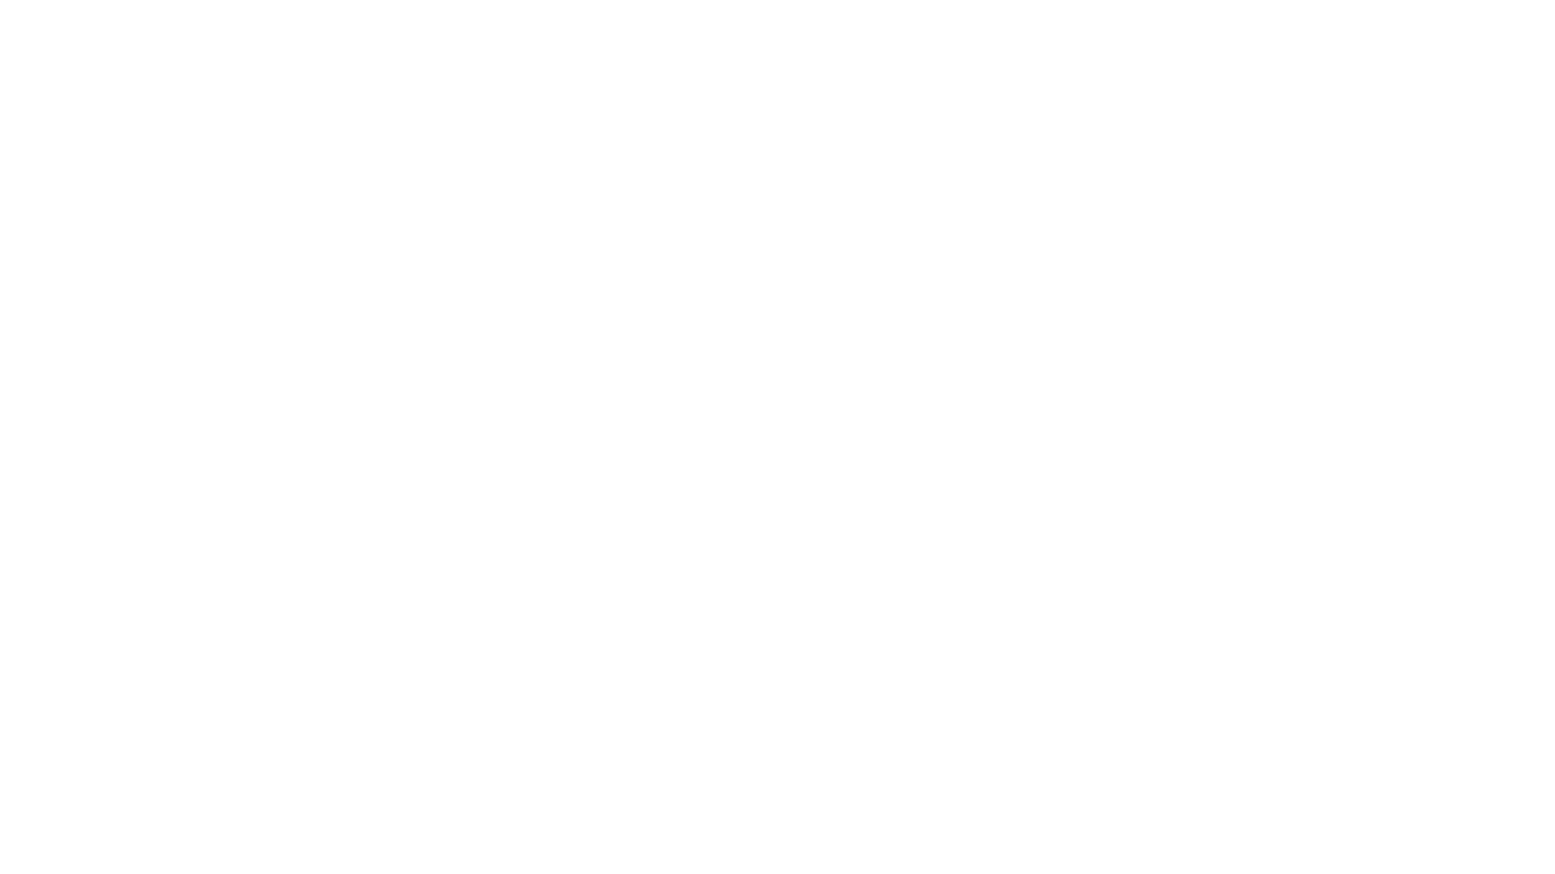
Customer Segmentation Model
-Diksha Patil(17it1072)
-ankita pawar (17IT1003)
-Arpeet rasal(18It5018)

Slide 2
Problem Statement
Customer segmentation is the process of dividing your shoppers/customers into segments based on similar characteristics.
Companies aim to gain a deeper approach to, what customer are targeting.
through the data collected, companies can gain a deeper understanding of customer preferences as well as the requirements for discovering valuable segments that would make them maximum profit.

Slide 3
Objective
In this project, we designed customer segmentation model.
Used K-mean Clustering algorithm to build our model .
Analyze and visualize the data and then proceed to implement our algorithm using R.

Slide 4
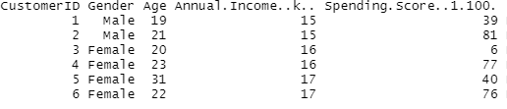
Dataset
The dataset consists of 5 columns namely Customer ID, Gender, Age, Annual Income and Spending Score.

Slide 5
Algorithm Used
K-means Clustering :
It is one of the simplest and popular unsupervised machine learning algorithms.
Unsupervised algorithms make inferences from datasets using only input vectors without referring to known, or labelled, outcomes.
It is a method of vector quantization, originally from signal processing, that aims to partition n observations into k clusters in which each observation belongs to the cluster with the nearest mean (cluster centroid), serving as a prototype of the cluster.

Slide 6
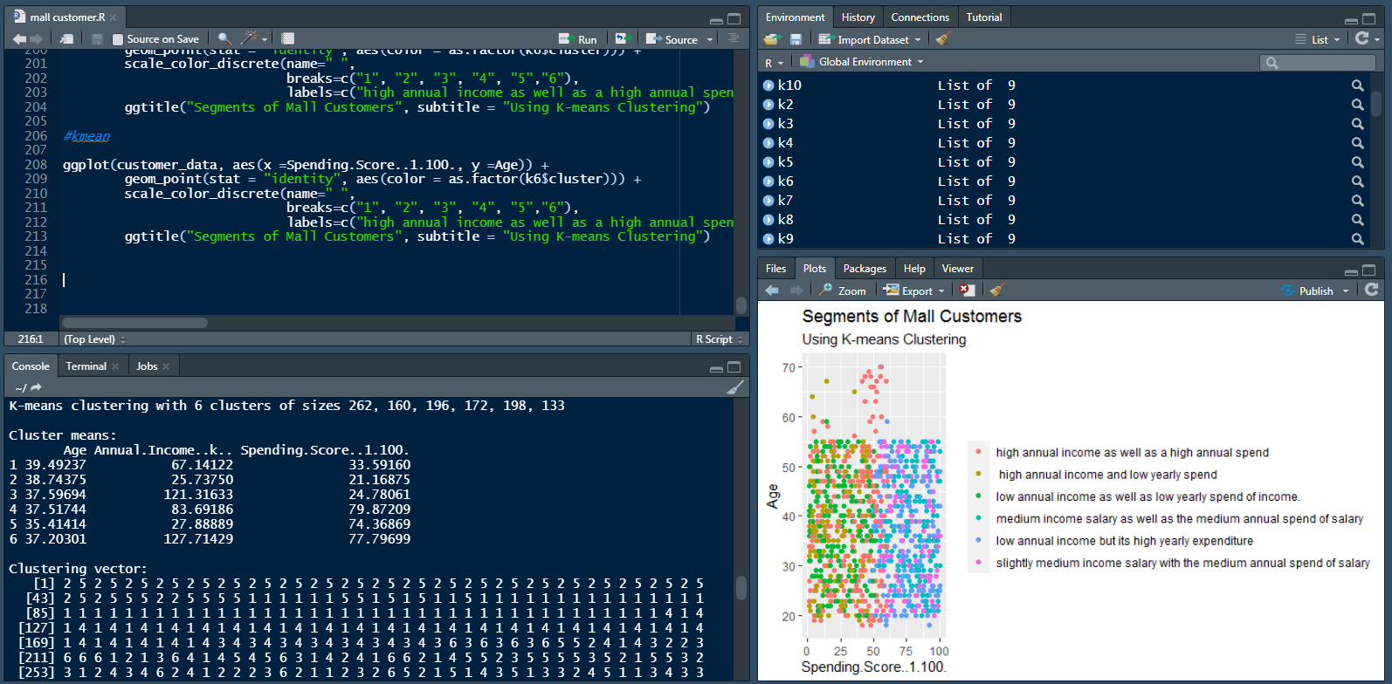
Implementation

Slide 7
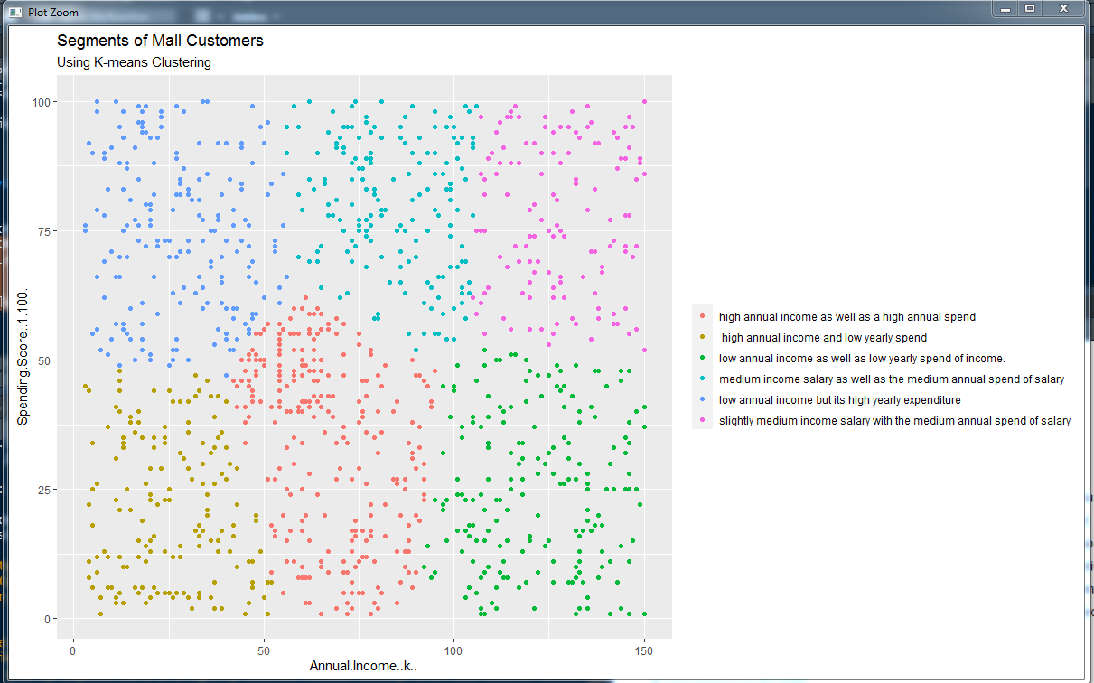
Result

Slide 8
Conclusion

Slide 9

Thank YOU

