Slide 1
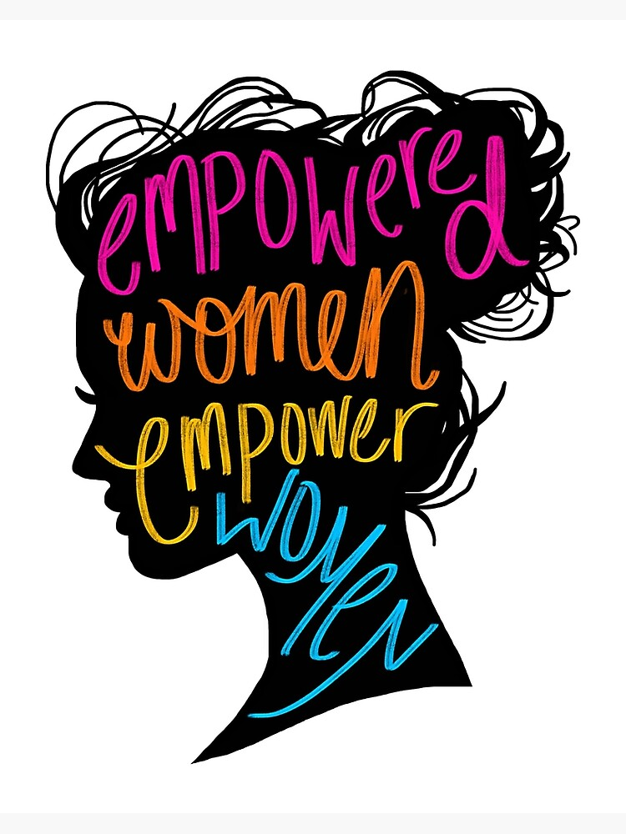
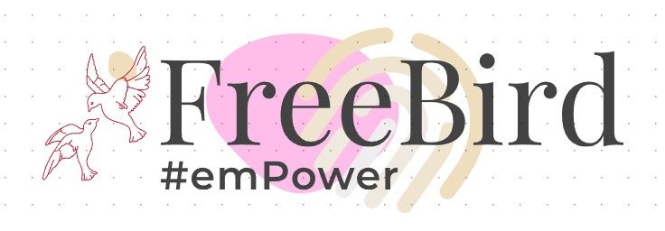
Dreams will come true if you know the right path to reach your goal.
By –
Arpeeta Halder

Slide 2
Introduction
Indian women play a crucial part in society, most women have also established themselves in different fields. But only 18.6% of working-age women in India participate in the labor force, three times lower than men, says the Periodic Labour Force Survey (PLFS) 2020. According to the World Bank, Indian women's participation in the formal economy is among the lowest in the world.
Women make up 13.76 percent of entrepreneurs in India; own 20.37 percent of MSMEs.
Many women dream big and have ideas that are not only beneficial for our society but also for the growth of their country. But the right platform and right opportunities are not available to them both rural and urban women. Most of these women become housewives at a young age, and their skills are not enhanced and certified. And, after daily house chores, they get very less time to enhance themselves.
And many don’t know the right path to reach the desired goals.
FreeBird will give them a social network platform of women where empowered women will empower other women in need.
They can enhance their skills, get them certified and will also get counseling from others in need for any problem they face in life.

Slide 3

WHY FreeBird?
Most women in India (mostly in rural areas) don’t get higher education. The education gap and year gap become a hurdle in their career growth.
Many get married at a young age. But afterward, if they want to pursue their dream, they don’t know where to start? Or whom to contact?
Most women don’t have enough money for higher education and skill assessment or to start a business.
Most Indian women are mothers at a very young age and are always busy with family. Many times suffer from postpartum depression but don’t have any idea about it.
Depression, counselling, and sex education are taboo in society in India.
There are many online study materials, but they don’t give the proper certifications required.

Slide 4
An online platform that will create a social network of women, where empowered women will guide other women on:
How to start when everything seems to be blocking you?
How to set short-term and long-term career goals?
Provide a platform to enhance their skills?
Take help privately, anonymously, or publicly for their mental health.
Guiding them with proper sex education.
Motivate them to give priority to their dreams.
Helping them to get Industrial Training when required.
Getting them enough fund to start small scale business.

Slide 5
Supporting Women
Initially the steps will be taken to help Indian women, lately, we can expand our social network and help women across the globe in need.
Our women play a vital role to nurture our future generation, with their help helping them to grow and guiding them properly we can create a better future.
Working and guiding them with sustainable development and providing them opportunities will be the main moto of FreeBird.
Getting funds for medical camps in rural areas to encourage women to maintain better hygiene and health.

Slide 6

Feminism is not about power in gender role, but to develop one’s personality so that equal opportunities are given to them also.

Slide 7
Thank you all to support women and taking the initiative to empower women.

