Slide 1

Arrays and Variables
LECTURE 05
Storing many values in a single name.
Spark 010 Spring 2024

Slide 2
Week 1
Announcements!
Make sure you can access JupyterHub
If not, email Jordan, Adrien, or Suzanne
Office hours start today
(Suzanne) Mondays 430 - 520PM in ACS 366
(Adrien) Wednesdays 430 - 520PM in ACS 330B
(Jordan) Thursdays 10-12am
Homework 2 will be released today and due on Wednesday Feb 07 @ 3PM

Slide 3
Today’s Roadmap
NoneType
print()
Display vs. Output
Arrays
Array Operations
Lecture 05, Spark 010 Spring 2024
Notes:
Heads up: today’s lecture will feel more like a lecture from Week 2 – lots of syntax. Don’t memorize!
And if you’re still iffy on iteration – don’t worry! It will not be heavily emphasized on the quiz, and we will get a lot more practice with it in coming lectures.

Slide 4
print()
➤
1. Print
2. NoneType
3. Arrays

Slide 5
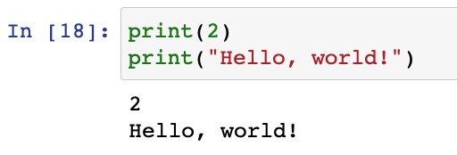
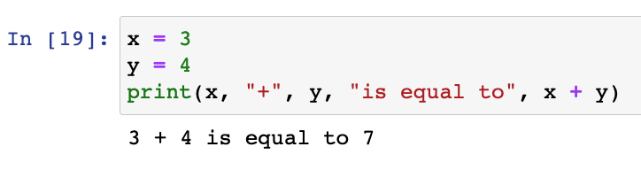
A very useful function for human display: print()
The print() function displays values.
Works even if it’s not the last line of a cell!
Strings are displayed without quotes
Can take multiple arguments of different types
Sub-expressions are evaluated before display

Slide 6
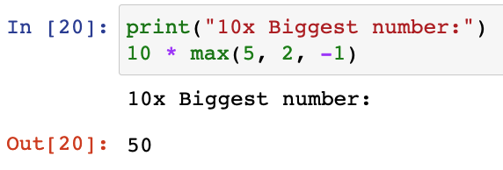
A very useful function for human display: print()
The print() function displays values.
Works even if it’s not the last line of a cell!
Strings are displayed without quotes
Can take multiple arguments of different types
Sub-expressions are evaluated before display
⚠️ Note ⚠️
Print displays values. It does not produce cell output!
Terminology going forward:
Print means display
Output means cell output

Slide 7
Quick Check 1
What happens when we run the cell below?
print(15)
x = 3 + 4
x
print(14)
-3

Slide 8
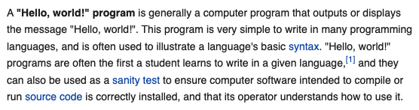
“Hello, World!”
This is a common “first” program to test that a programming language works as expected.
Now you understand it!!!
print("Hello, World!")
https://en.wikipedia.org/wiki/%22Hello,_World!%22_program#Python

Slide 9
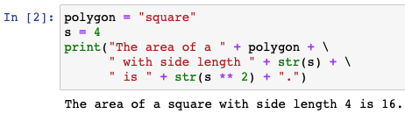
Review of print() and Typecasting
There are two common ways to print strings:
Multiple arguments
String concatenation
Python inserts a space character for display
Arguments can be different data types
Programmer must insert space character for display
One string argument, so all values must be cast to string
If your lines of code are too long, use the \ character to break code into multiple lines.

Slide 10
NoneType
1. Print
2. NoneType
3. Arrays
➤

Slide 11
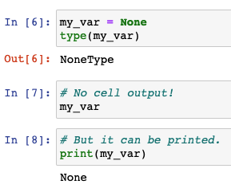
NoneType
There are infinitely* many integers, floating point numbers, and strings.
However, for the NoneType data type, there is only one value: None.
None is strange:
Cells will not output expressions that evaluate to None.
None can be displayed (i.e., printed).
None is also referred to as the “null value.”
*Actually a finite number because of how computers store information; take CS61C to learn more!

Slide 12
NoneType
There are infinitely* many integers, floating point numbers, and strings.
However, for the NoneType data type, there is only one value: None.
output
None is strange:
Cells will not output expressions that evaluate to None.
None can be displayed (i.e., printed).
None is also referred to as the “null value.”
display
print() returns None, therefore when evaluated as the last line in a cell:
Print displays the value of the evaluated argument
But the cell does not output anything!
*Actually a finite number because of how computers store information; take CS61C to learn more!

Slide 13
Quick Check 2
What is output and/or displayed when we run the cell below?
In [ ]:
print("This value is", print(1))

Slide 14
Python Data Types: Summary
Data Type | Category | Example Value(s)
int | Numeric | 3, -1
float | Numeric | 3.4, -1.3,
str | Text Sequence | “”, “Hello, World!”, ‘234’
NoneType | Special | None
bool | Numeric | True, False
so far
coming up
array | NumPy Sequence | array([1, 2, 3]), array([])
DataFrames | Pandas | pd.DataFrame()
… | … | …
our next topics

Slide 15
Arrays
1. Print
2. NoneType
3. Arrays
➤

Slide 16
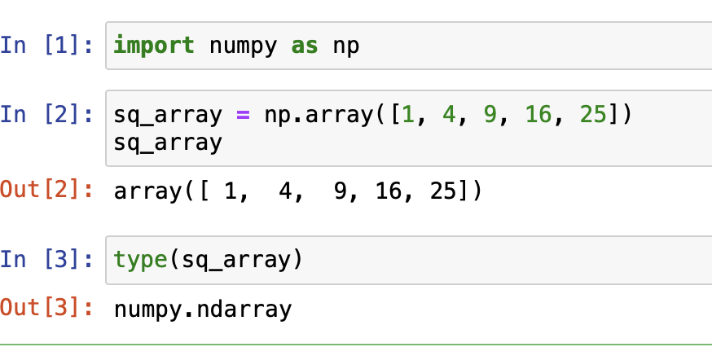
The numpy Package
The numpy Python package is a fundamental package..
We generally put the import statement in a cell at the top of our notebook.
After running the import statement, we can then call package functions by prepending with “np.”
The np.array() function is from this package!
import numpy as np
“Import the numpy package”

Slide 17
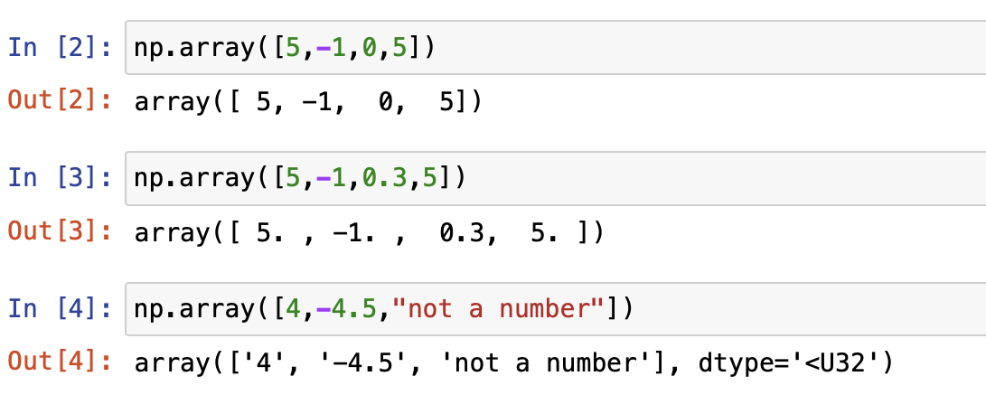
An Array Is a Sequential Collection of Values
arranged like a line/queue
multiple values organized together
Use np.array() to create arrays.
Values in an array must all be of the same data type, and Python will cast appropriately.
Array with 4 ints
Array with 4 floats
Array with 3 strs

Slide 18
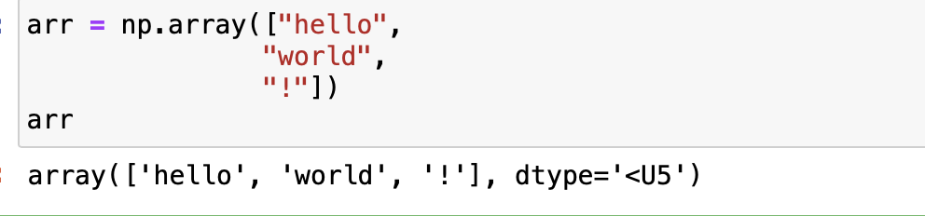
An Array Is a Sequential Collection of Values
arranged like a line/queue
multiple values organized together
Use np.array() to create arrays.
Values in an array must all be of the same data type, and Python will cast appropriately.
Array with 4 ints
Array with 4 floats
Python can assign an entire array of values to a single name.
The order of a list is fixed (i.e., they will be arranged in the order specified when building the array), and values can be repeated.
Array with 3 strs
Arrays allow us to write code that performs computation on many pieces of data at once.

Slide 19
Array Operations
1. Print
2. NoneType
3. Arrays
➤

Slide 20
American Community Survey (ACS) 2020
The following table is drawn from the American Community Survey (ACS) of 2020. It shows education levels of adults 25 years or higher by state.
We show AL, CA, FL, NY, TX.
 | Estimated total state population | Estimated high school graduate or higher (%) | Estimated bachelor's degree or higher (%)
Alabama | 3,344,006 | 86.9 | 26.2
California | 26,665,143 | 83.9 | 34.7
Florida | 15,255,326 | 88.5 | 30.5
New York | 13,649,157 | 87.2 | 37.5
Texas | 18,449,851 | 84.4 | 30.7
(Now) How can we use arrays to analyze this data?
(Later) How is this data presented, and in what societal context was it analyzed?
Notes:
https://data.census.gov/cedsci/table?q=2020%20education&t=Age%20and%20Sex%3AEducational%20Attainment&g=0100000US%240400000

Slide 21
Compute % of Non-HS Graduates by State
 | Estimated total state population | Estimated high school graduate or higher (%) | Estimated bachelor's degree or higher (%)
Alabama | 3,344,006 | 86.9 | 26.2
California | 26,665,143 | 83.9 | 34.7
Florida | 15,255,326 | 88.5 | 30.5
New York | 13,649,157 | 87.2 | 37.5
Texas | 18,449,851 | 84.4 | 30.7
hs_or_higher = np.array([86.9, 83.9, 88.5, 87.2, 84.4])

Slide 22
Compute % of Non-HS Graduates by State
 | Estimated total state population | Estimated high school graduate or higher (%) | Estimated bachelor's degree or higher (%)
Alabama | 3,344,006 | 86.9 | 26.2
California | 26,665,143 | 83.9 | 34.7
Florida | 15,255,326 | 88.5 | 30.5
New York | 13,649,157 | 87.2 | 37.5
Texas | 18,449,851 | 84.4 | 30.7
hs_or_higher = np.array([86.9, 83.9, 88.5, 87.2, 84.4])
below_hs =

Slide 23
Compute % of Non-HS Graduates by State
 | Estimated total state population | Estimated high school graduate or higher (%) | Estimated bachelor's degree or higher (%)
Alabama | 3,344,006 | 86.9 | 26.2
California | 26,665,143 | 83.9 | 34.7
Florida | 15,255,326 | 88.5 | 30.5
New York | 13,649,157 | 87.2 | 37.5
Texas | 18,449,851 | 84.4 | 30.7
hs_or_higher = np.array([86.9, 83.9, 88.5, 87.2, 84.4])
below_hs = 100 - hs_or_higher
below_hs

Slide 24
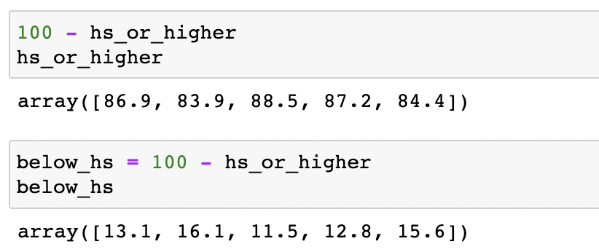
Arithmetic on Arrays:
Evaluation Returns a New Array
⚠️ Evaluating array expressions returns a new array; it does not change the original array.

Slide 25
Arithmetic on Arrays:
Evaluation Returns a New Array
Array Arithmetic is Element-Wise
⚠️ Evaluating array expressions returns a new array; it does not change the original array.
1) Arithmetic with an array and a numeric value

Slide 26
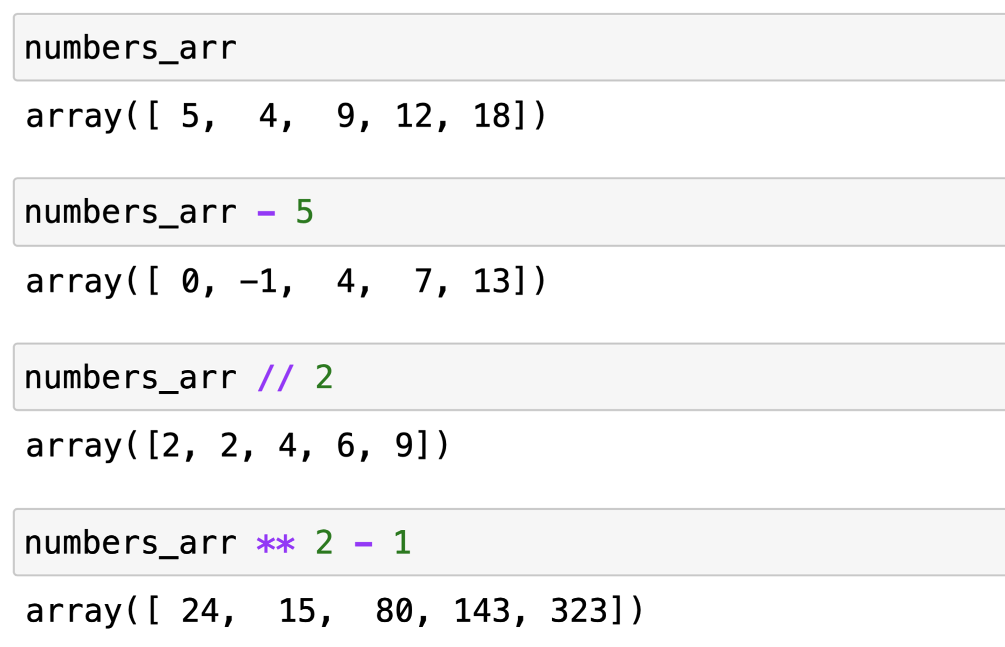
Element-Wise Arithmetic
This element-wise behavior works with all of the arithmetic operations you expect!

Slide 27
Estimate # Bachelor Degrees by State
 | Estimated total state population | Estimated high school graduate or higher (%) | Estimated bachelor's degree or higher (%)
Alabama | 3,344,006 | 86.9 | 26.2
California | 26,665,143 | 83.9 | 34.7
Florida | 15,255,326 | 88.5 | 30.5
New York | 13,649,157 | 87.2 | 37.5
Texas | 18,449,851 | 84.4 | 30.7
bs_or_higher =
state_pop =
num_bs_per_state =

Slide 28
Estimate # Bachelor Degrees by State
 | Estimated total state population | Estimated high school graduate or higher (%) | Estimated bachelor's degree or higher (%)
Alabama | 3,344,006 | 86.9 | 26.2
California | 26,665,143 | 83.9 | 34.7
Florida | 15,255,326 | 88.5 | 30.5
New York | 13,649,157 | 87.2 | 37.5
Texas | 18,449,851 | 84.4 | 30.7
bs_or_higher = np.array([26.2, 34.7, 30.5, 37.5, 30.7])
state_pop =
num_bs_per_state =

Slide 29
Estimate # Bachelor Degrees by State
 | Estimated total state population | Estimated high school graduate or higher (%) | Estimated bachelor's degree or higher (%)
Alabama | 3,344,006 | 86.9 | 26.2
California | 26,665,143 | 83.9 | 34.7
Florida | 15,255,326 | 88.5 | 30.5
New York | 13,649,157 | 87.2 | 37.5
Texas | 18,449,851 | 84.4 | 30.7
bs_or_higher = np.array([26.2, 34.7, 30.5, 37.5, 30.7])
state_pop = np.array([3344006, . . . , 13649157])
num_bs_per_state =

Slide 30
Estimate # Bachelor Degrees by State
 | Estimated total state population | Estimated high school graduate or higher (%) | Estimated bachelor's degree or higher (%)
Alabama | 3,344,006 | 86.9 | 26.2
California | 26,665,143 | 83.9 | 34.7
Florida | 15,255,326 | 88.5 | 30.5
New York | 13,649,157 | 87.2 | 37.5
Texas | 18,449,851 | 84.4 | 30.7
bs_or_higher = np.array([26.2, 34.7, 30.5, 37.5, 30.7])
state_pop = np.array([3344006, . . . , 13649157])
num_bs_per_state = bs_or_higher / 100 * state_pop

Slide 31
Arithmetic on Arrays:
Evaluation Returns a New Array
Array Arithmetic is Element-Wise
⚠️ Evaluating array expressions returns a new array; it does not change the original array.
1) Arithmetic with an array and a numeric value
2) Arithmetic with two arrays of equal length (same number of values).

Slide 32
Quick Check 3
Assign f_temps to the result of converting all celsius temperatures in the array c_temps to fahrenheit.
How many elements are in empty_array?
c_temps = np.array([30, 18, -4.5, 0, 3])
f_temps = ...
Hint: Fahrenheit is Celsius * 9/5 + 32
empty_array = np.array([])

Slide 33
In Conclusion…

Slide 34
Summary
The print() function is used to display things, but does have an output itself
The Python NoneType indicates a “null” value — It represents the absence of a value.
None can be printed, but is not outputted
We use arrays to store and work with multiple values at once
We can perform (element-wise) arithmetic operations and other functions on arrays

Slide 35
Recap
Next Time
Print
NoneType
Arrays
Numpy
More Numpy
Array Indexing
Working with Data

