Slide 1

Boolean Arrays and Indexing
LECTURE 06
Ways of filtering data
Spark 010 Spring 2024

Slide 2
Week 4
Announcements!
Make sure you can access JupyterHub
If not, email Jordan, Adrien, or Suzanne
Office hours
(Suzanne) Mondays 4:30 - 5:20PM in ACS 366
(Adrien) Wednesdays 4:30 - 5:20PM in ACS 3:30B
(Jordan) Tuesdays + Thursdays 10-12am
Homework 2 due on Wednesday @ 3PM

Slide 3
Icebreaker & Check-In

Slide 4
Today’s Roadmap
Array Functions
Indexing
Bools
Comparisons
Boolean Indexing
Lecture 06, Spark 010 Spring 2024

Slide 5
Warmup
 | 2019 pop (in millions) | 2020 pop (in millions)
.Alabama | 5.025 | 5.040
.Alaska | 0.732 | 0.733
.Arizona | 7.178 | 7.276
.Arkansas | 3.012 | 3.026
.California | 39.500 | 39.238
Suppose we have two arrays containing the resident populations of several states in 2020 and 2021. Assume each array contains information about the same states in the same order.
How would you compute the percentage change in state populations from 2020 to 2021?
In [ ]:
pop_2020 = np.array([5.025, .732, 7.178, 3.012, 39.500])
pop_2021 = np.array([5.040, .733, 7.276, 3.026, 39.238])
In [ ]:
...

Slide 6
Warmup
 | 2019 pop (in millions) | 2020 pop (in millions)
.Alabama | 5.025 | 5.040
.Alaska | 0.732 | 0.733
.Arizona | 7.178 | 7.276
.Arkansas | 3.012 | 3.026
.California | 39.500 | 39.238
Suppose we have two arrays containing the resident populations of several states in 2020 and 2021. Assume each array contains information about the same states in the same order.
How would you compute the percentage change in state populations from 2020 to 2021?
In [ ]:
pop_2020 = np.array([5.025, .732, 7.178, 3.012, 39.500])
pop_2021 = np.array([5.040, .733, 7.276, 3.026, 39.238])
In [3]:
(final - initial) / initial
In [ ]:
100 * (pop_2021 - pop_2020) / pop_2020
...
Out [3]:
array([ 0.29850746, 0.13661202, 1.36528281, 0.46480744, -0.66329114])

Slide 7
Array Functions
➤
1. Array Functions
2. Indexing
3. Bools
4. Comparisons
5. Boolean Indexing

Slide 8
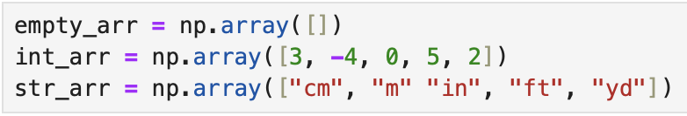
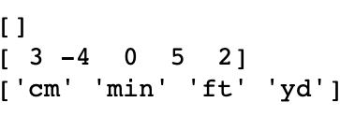
Standard Functions
Call expression format | Example(s)
len(arr) | len(str_arr) # 5 len(empty_arr) # 0
max(arr) | min(int_arr) # -4
min(arr) | max(str_arr) # 'yd'
sum(arr) | sum(int_arr) # 6 sum(str_arr) # TypeError

Slide 9
Standard Functions
Call expression format | Example(s)
len(arr) | len(str_arr) # 5 len(empty_arr) # 0
max(arr) | min(int_arr) # -4
min(arr) | max(str_arr) # 'yd'
sum(arr) | sum(int_arr) # 6 sum(str_arr) # TypeError
While the function names are identical to what we saw for int/float/strs, the call expressions evaluate differently with our new array data type.

Slide 10
Quick Check 1
Recall the definition of an average:
The average, or mean, of a collection of numbers is the sum of all the elements of the collection, divided by the number of elements in the collection.
How would you compute the average of an array arr?
In [ ]:
arr = np.array([30, -40, -4.5, 0, 35])
avg = ...
avg

Slide 11
Indexing
1. Array Functions
2. Indexing
3. Bools
4. Comparisons
5. Boolean Indexing
➤

Slide 12
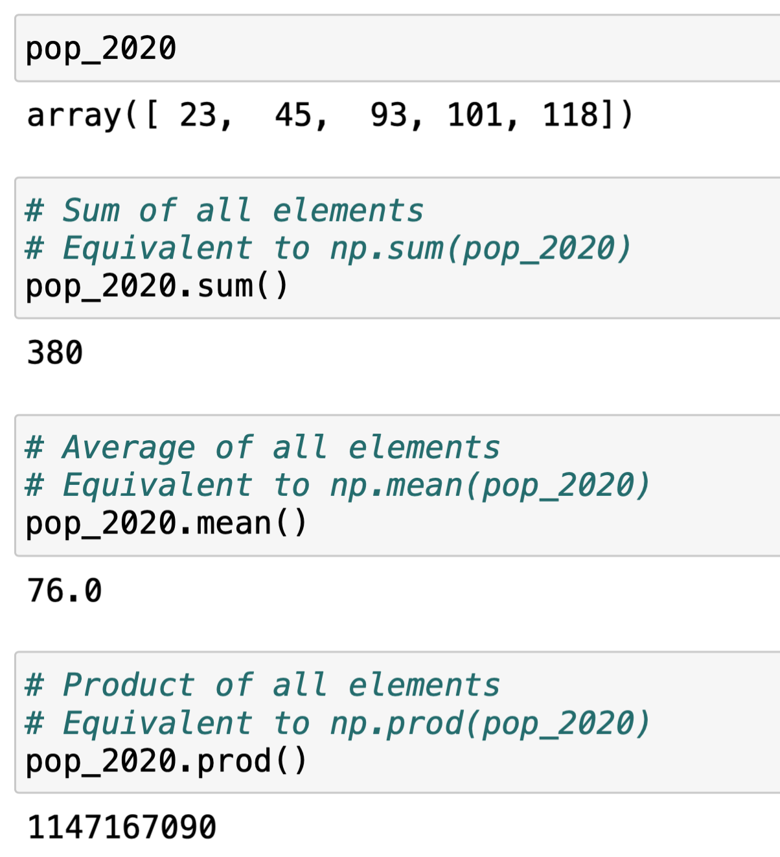
Array Methods
Methods are functions that we call with “dot” syntax. There are several array methods that make it easy to calculate values of interest.
Terminology note: Method calls are where the function operates directly on the array arr.
In these examples, method calls are equivalent to the NumPy package functions.
The most common array method is item(), which is used for array indexing.

Slide 13

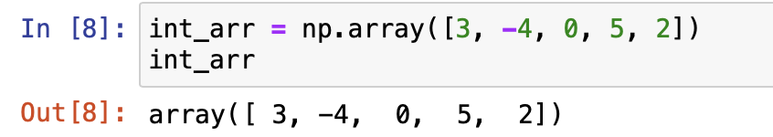
An Element’s Index Is Its Position in an Array
When people stand in a line, each person has a position.
Similarly, each element (i.e., value) of an array has a position – called its index.
Person 1
Index 0
Python, like most programming languages, is 0-indexed. This means that in an array, the first element has index 0, not 1.
Person 7
For a length-5 array:
Index 6
Indices
0 1 2 3 4

Slide 14
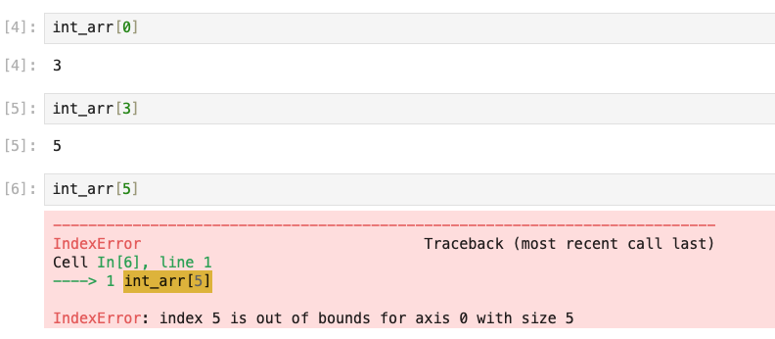
Array Indexing
We can access an element in an array by using bracket notation:
arr[index]
Indices
0 1 2 3 4
Though int_arr has 5 elements, the largest valid index is 4.
Notes:
Use brackets

Slide 15
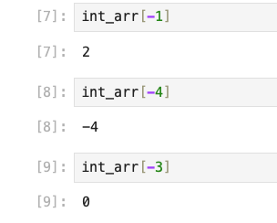
Negative Indexing
We can also “count backwards” using negative indexes.
-1 corresponds to the last element in a list.
-2 corresponds to the second last element in a list.
And so on...
Indices
0 1 2 3 4
-5 -4 -3-2 -1

Slide 16
Questions?

Slide 17

Quick Check 2
What is the value of five after running this code?
Notes:
CHANGE THIS

Slide 18
Bools
1. Array Functions
2. Indexing
3. Bools
4. Comparisons
5. Boolean Indexing
➤

Slide 19
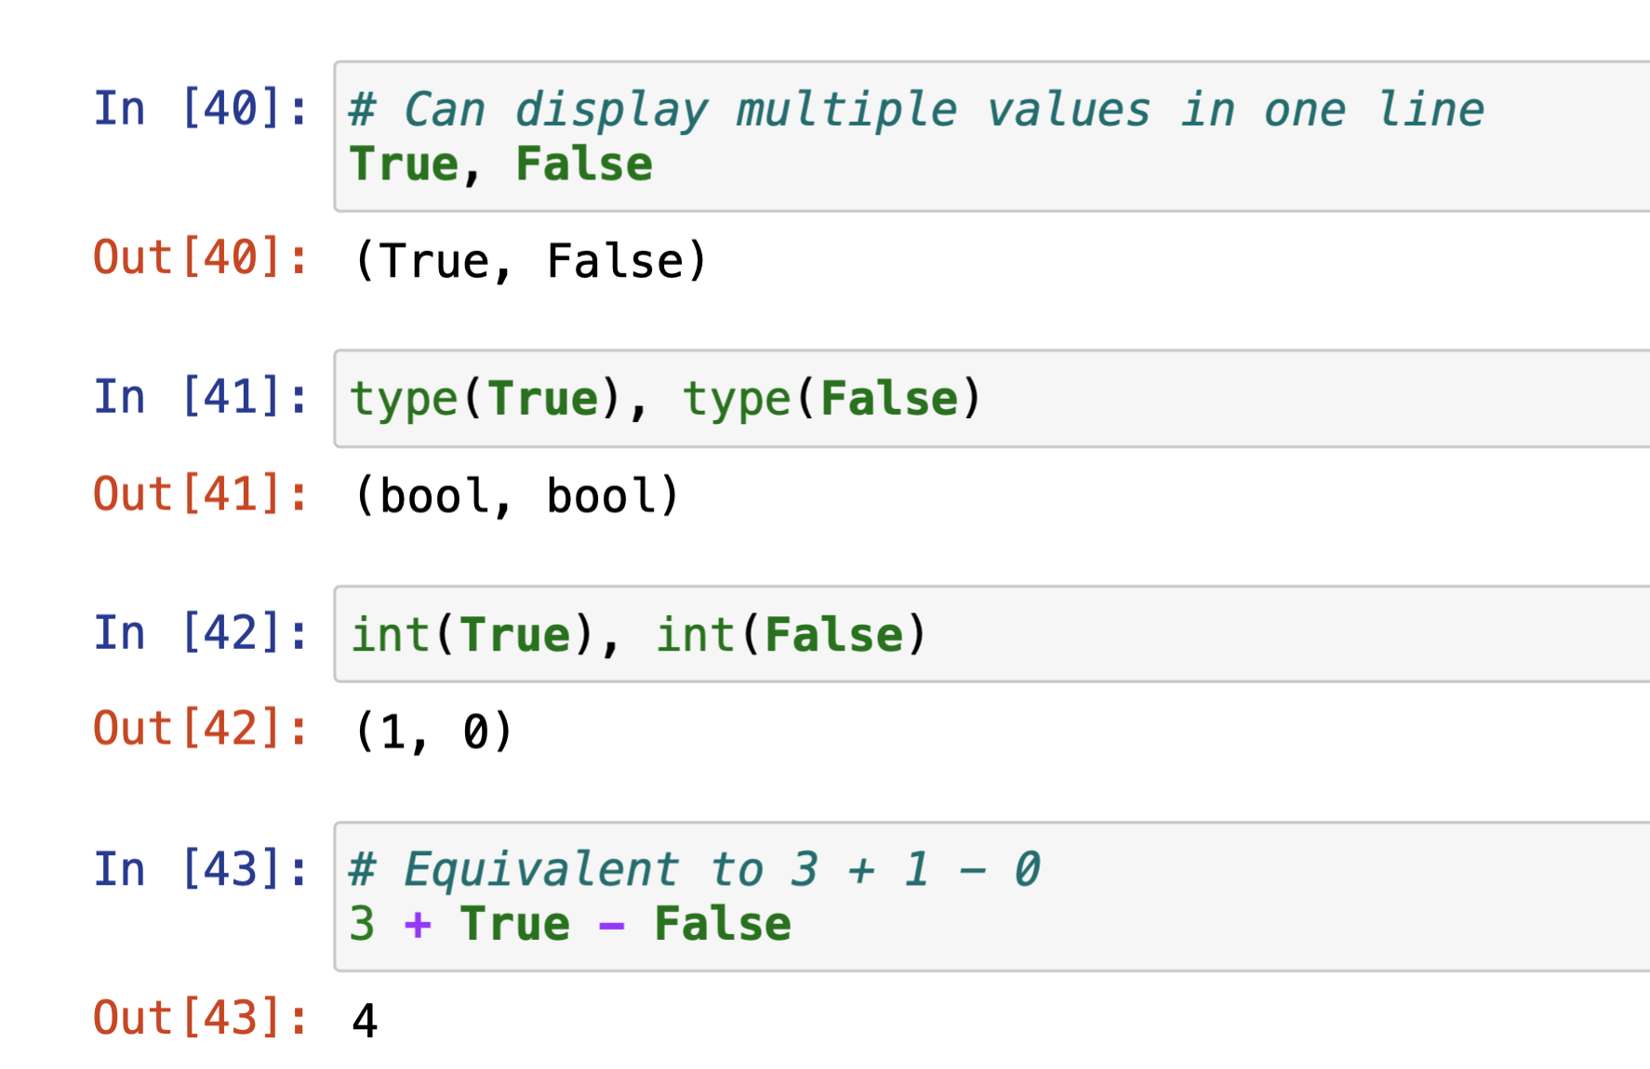
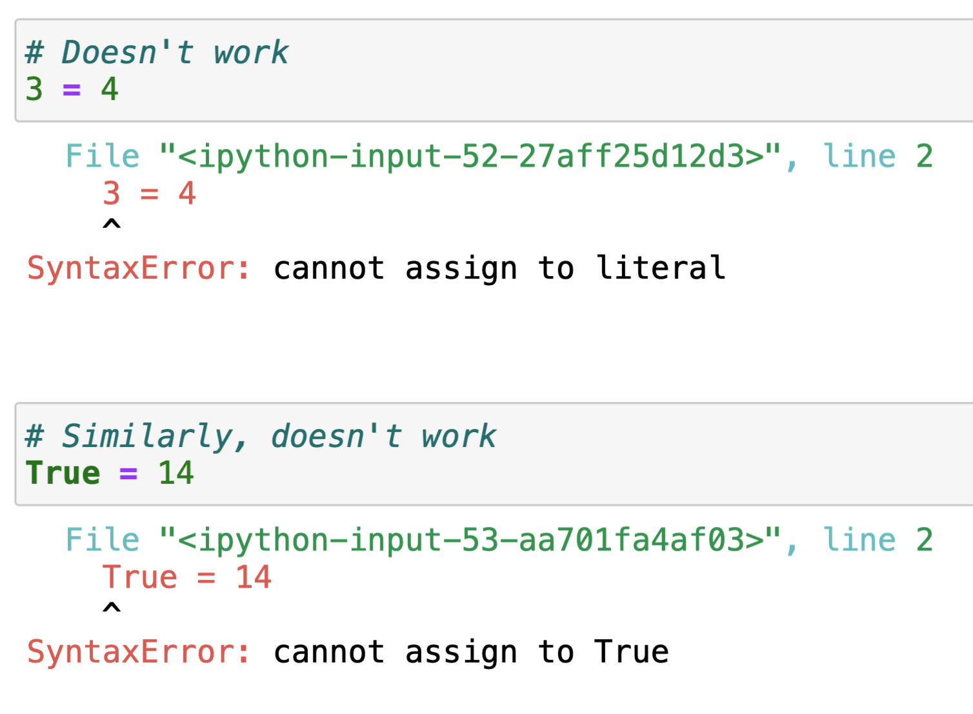
bool
The bool, or Boolean type, has only two values: True and False. No other values have this type.
True, and False are Python keywords.
They have special meanings and cannot be
used as names.
In this regard, they’re similar to values 3, -15.2, and "zebra".

Slide 20
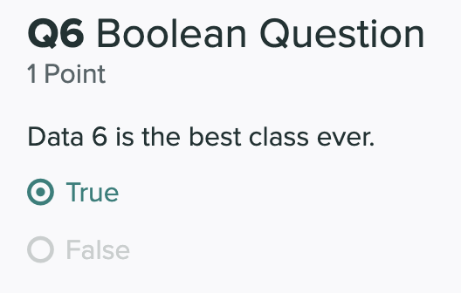
Boolean Data
In data science, boolean values can be used represent a binary variable:
yes/no, on/off, high/low, etc.
Notes:
Another screenshot

Slide 21
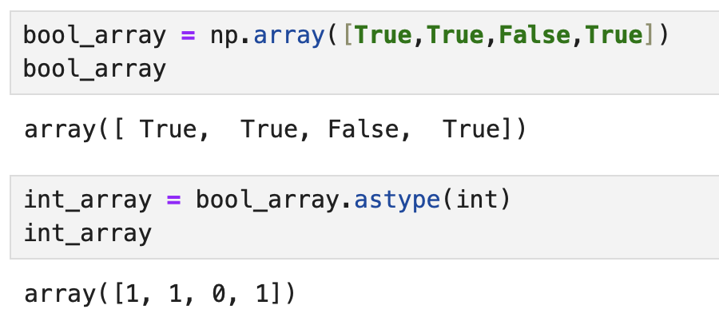
Using Boolean Values
True and False are technically numeric values: you can cast them to integers and floats, and use them in arithmetic expressions.
True is equivalent to 1.
False is equivalent to 0.
Like other data types, it can be stored in arrays.

Slide 22
Comparisons
1. Array Functions
2. Indexing
3. Bools
4. Comparisons
5. Boolean Indexing
➤

Slide 23
Comparisons
Naturally, we will want to compare values in our code.
# is age at least age_limit?
age_limit = 21
age = 17
# is password_guess equal to true_password?
true_password = 'qwerty1093x!'
password_guess = 'QWERTY1093x!'

Slide 24
Comparisons
Naturally, we will want to compare values in our code.
# is age at least age_limit?
age_limit = 21
age = 17
age >= age_limit # False
# is password_guess equal to true_password?
true_password = 'qwerty1093x!'
password_guess = 'QWERTY1093x!'
true_password == password_guess # False

Slide 25
Comparison Operators
Each of these comparisons evaluate to True if the statement holds, and False if it doesn’t.
Name | Symbol | Usage
Equal | == | x == y
Not equal | != | x != y
Greater than | > | x > y
Greater than or equal to | >= | x >= y
Less than | < | x < y
Less than or equal to | <= | x <= y

Slide 26
Examples
3 == 3 # True
'hello' != 'howdy' # True
-3 > -2 # False
-3 < -2 # True
'alpha' >= 'beta' # False

Slide 27
Equality
= and == have very different meanings in Python. This is unlike algebra, where we use the same equals sign for different purposes.
x = 5 # set x equal to 5
x == 5 # is x equal to 5?
y = x == 5 # valid, common code!

Slide 28
Comparing Different Types
You can check for equality (== and !=) with values of any type.
17 == '17' # False
'zebra' != True # True
True == 1.0 # True
But you can only check for inequality between values of the same “category”:
5 > True # True
'alpha' >= 'beta' # False
'alpha' >= 5 # TypeError!

Slide 29
Be Careful...
Remember floating point issues from a three weeks ago?
0.1 * 2 == 0.2 # True
0.1 * 6 == 0.6 # False, because 0.1 * 6 = 0.60000000001
Using == to see if two floats are equal is generally not reliable. Instead, check if the difference is negligible using abs:
abs(0.1 * 6 - 0.6) < 0.0001 # True

Slide 30
String Containment
The in keyword allows us to check if one string is a substring of another.
'berkeley' in 'uc berkeley' # True
'stanford' in 'uc berkeley' # False
'berkeley' in 'UC BERKELEY' # False

Slide 31
American Community Survey (ACS) 2020
The following table is drawn from the American Community Survey (ACS) of 2020. It shows education levels of adults 25 years or higher by state.
We show AL, CA, FL, NY, TX.
 | Estimated total state population | Estimated high school graduate or higher (%) | Estimated bachelor's degree or higher (%)
Alabama | 3,344,006 | 86.9 | 26.2
California | 26,665,143 | 83.9 | 34.7
Florida | 15,255,326 | 88.5 | 30.5
New York | 13,649,157 | 87.2 | 37.5
Texas | 18,449,851 | 84.4 | 30.7
(Now) How can we use arrays to filter this data?
(Later) How is this data presented, and in what societal context was it analyzed?
Notes:
https://data.census.gov/cedsci/table?q=2020%20education&t=Age%20and%20Sex%3AEducational%20Attainment&g=0100000US%240400000

Slide 32
Compute % of Non-HS Graduates by State
 | Estimated total state population | Estimated high school graduate or higher (%) | Estimated bachelor's degree or higher (%)
Alabama | 3,344,006 | 86.9 | 26.2
California | 26,665,143 | 83.9 | 34.7
Florida | 15,255,326 | 88.5 | 30.5
New York | 13,649,157 | 87.2 | 37.5
Texas | 18,449,851 | 84.4 | 30.7
hs_or_higher = np.array([86.9, 83.9, 88.5, 87.2, 84.4])

Slide 33
Compute % of Non-HS Graduates by State
 | Estimated total state population | Estimated high school graduate or higher (%) | Estimated bachelor's degree or higher (%)
Alabama | 3,344,006 | 86.9 | 26.2
California | 26,665,143 | 83.9 | 34.7
Florida | 15,255,326 | 88.5 | 30.5
New York | 13,649,157 | 87.2 | 37.5
Texas | 18,449,851 | 84.4 | 30.7
hs_or_higher = np.array([86.9, 83.9, 88.5, 87.2, 84.4])
above_85_hs = hs_or_higher > 85

Slide 34
Compute % of Non-HS Graduates by State
 | Estimated total state population | Estimated high school graduate or higher (%) | Estimated bachelor's degree or higher (%)
Alabama | 3,344,006 | 86.9 | 26.2
California | 26,665,143 | 83.9 | 34.7
Florida | 15,255,326 | 88.5 | 30.5
New York | 13,649,157 | 87.2 | 37.5
Texas | 18,449,851 | 84.4 | 30.7
hs_or_higher = np.array([86.9, 83.9, 88.5, 87.2, 84.4])
above_85_hs = hs_or_higher > 85
above_85_hs

Slide 35
Boolean Indexing
1. Array Functions
2. Indexing
3. Bools
4. Comparisons
5. Boolean Indexing
➤

Slide 36
Boolean Arrays
When we do a comparison operation on an array:
we get in return, an array of bools, i.e. a Boolean array.
Why is this important?
This will be a very useful method for filtering data that meets certain criteria.
hs_or_higher = np.array([86.9, 83.9, 88.5, 87.2, 84.4])
above_85_hs = hs_or_higher > 85
above_85_hs

Slide 37
Can we keep or drop only the rows with less than 85% high school graduation rates?
 | Estimated total state population | Estimated high school graduate or higher (%) | Estimated bachelor's degree or higher (%)
Alabama | 3,344,006 | 86.9 | 26.2
California | 26,665,143 | 83.9 | 34.7
Florida | 15,255,326 | 88.5 | 30.5
New York | 13,649,157 | 87.2 | 37.5
Texas | 18,449,851 | 84.4 | 30.7
hs_or_higher = np.array([86.9, 83.9, 88.5, 87.2, 84.4])
above_85_hs = hs_or_higher > 85
above_85_hs
array([True, False, True, True, False])

Slide 38
Boolean Indexing
We can now use this Boolean array to index the entries in the original array where the condition specified returned True.
Or we can index the entries which returned False.
hs_or_higher = np.array([86.9, 83.9, 88.5, 87.2, 84.4])
above_85_hs = hs_or_higher > 85
hs_or_higher[above_85_hs]
array([86.9, 88.5, 87.2])
hs_or_higher[~above_85_hs]
array([83.9, 84.4])

Slide 39
In Conclusion…

Slide 40
Summary
Array functions allow us to operate on and aggregate data in arrays
To retrieve a specific element/item in an array, you use the element’s index
Remember that indices start at 0, not 1
Boolean data types only take two values: True/1 or False/0.
Indexing using Boolean arrays can be used to filter out irrelevant data.

Slide 41
Recap
Next Time
Array Functions
Indexing
Bools
Comparisons
Boolean indexing
Tables!
Columns and Variables
Table Methods

