Slide 1

Table Fundamentals
LECTURE 07
Learning how to work with tabular data in Python.
Spark 010, Spring 2024
Variation of content developed by students and faculty at UC Berkeley and Tuskegee University
data6.org/su23/syllabus/#acknowledgements-
Notes:
Not using “datascience” but instead “pandas”

Slide 2
Ice Breaker
Would you rather fight:
1 horse-sized duck
OR
100 duck-sized horses

Slide 3
Week 4
Announcements!
Office Hours take place
(Suzanne) Mondays 4:30 - 5:20PM in ACS 366
(Adrien) Wednesdays 4:30 - 5:20PM in ACS 330B
(Jordan) Thursdays 10-12am
Homework 2 is now due at FRIIDAY at 3pm
No New Homework this week!
Mid-Semester Project
Stay Tuned!

Slide 4
Today’s Roadmap
Jupyter Hub Housekeeping!
Boolean Indexing
Pandas: the “dataframe” type
Slicing and dropping
Adding Columns
Lecture 07, Spark 010, Spring 2024

Slide 5
Today’s Roadmap
Table Structure
Pandas: the “dataframe” type
select and drop
Adding Columns
Filtering with where
Additional Methods
Demo
Lecture 07, Spark 010, Spring 2024

Slide 6


Data 6 Content
Module 1
Introduction to Python and Jupyter Notebooks
Module 2
Data Visualization
Module 3
Working with Tables
Module 4
Simulation and Randomness

Slide 7
JupyterHub
Shut Down Your Code!
➤
Jupyter Hub Housekeeping!
Boolean Indexing
DataFrames
Slicing and dropping
Adding Columns

Slide 8
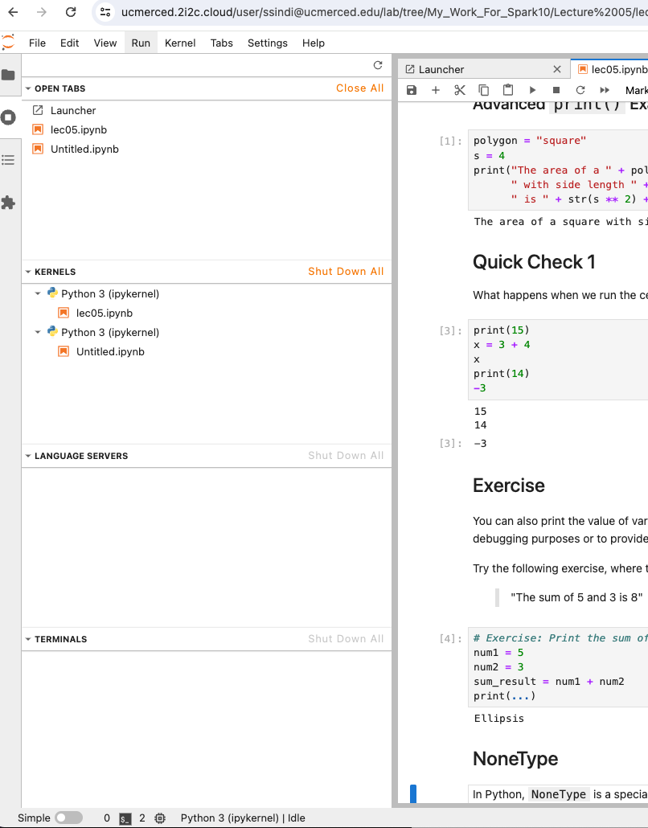
The JupyterHub Keeps Your Notebooks in Memory
Part of what is awesome about a JupyterHub, you can access your code from anywhere and don’t need to install anything.
There are a few housekeeping things you have to do including making sure that you’re in the right directory.
Today I want you to make sure you don’t have any running/active sessions.

Slide 9
Review

Slide 10
Comparing Different Types
You can check for equality (== and !=) with values of any type.
17 == '17' # False
'zebra' != True # True
True == 1.0 # True
But you can only check for inequality between values of the same “category”:
5 > True # True
'alpha' >= 'beta' # False
'alpha' >= 5 # TypeError!

Slide 11
Be Careful...
Remember floating point issues from a three weeks ago?
0.1 * 2 == 0.2 # True
0.1 * 6 == 0.6 # False, because 0.1 * 6 = 0.60000000001
Using == to see if two floats are equal is generally not reliable. Instead, check if the difference is negligible using abs:
abs(0.1 * 6 - 0.6) < 0.0001 # True

Slide 12
String Containment
The in keyword allows us to check if one string is a substring of another.
'berkeley' in 'uc berkeley' # True
'stanford' in 'uc berkeley' # False
'berkeley' in 'UC BERKELEY' # False

Slide 13
Boolean Indexing
Jupyter Hub Housekeeping!
Boolean Indexing
DataFrames
Slicing and dropping
Adding Columns
➤

Slide 14
American Community Survey (ACS) 2020
The following table is drawn from the American Community Survey (ACS) of 2020. It shows education levels of adults 25 years or higher by state.
We show AL, CA, FL, NY, TX.
 | Estimated total state population | Estimated high school graduate or higher (%) | Estimated bachelor's degree or higher (%)
Alabama | 3,344,006 | 86.9 | 26.2
California | 26,665,143 | 83.9 | 34.7
Florida | 15,255,326 | 88.5 | 30.5
New York | 13,649,157 | 87.2 | 37.5
Texas | 18,449,851 | 84.4 | 30.7
(Now) How can we use arrays to filter this data?
(Later) How is this data presented, and in what societal context was it analyzed?
Notes:
https://data.census.gov/cedsci/table?q=2020%20education&t=Age%20and%20Sex%3AEducational%20Attainment&g=0100000US%240400000

Slide 15
Compute % of Non-HS Graduates by State
 | Estimated total state population | Estimated high school graduate or higher (%) | Estimated bachelor's degree or higher (%)
Alabama | 3,344,006 | 86.9 | 26.2
California | 26,665,143 | 83.9 | 34.7
Florida | 15,255,326 | 88.5 | 30.5
New York | 13,649,157 | 87.2 | 37.5
Texas | 18,449,851 | 84.4 | 30.7
hs_or_higher = np.array([86.9, 83.9, 88.5, 87.2, 84.4])

Slide 16
Compute % of Non-HS Graduates by State
 | Estimated total state population | Estimated high school graduate or higher (%) | Estimated bachelor's degree or higher (%)
Alabama | 3,344,006 | 86.9 | 26.2
California | 26,665,143 | 83.9 | 34.7
Florida | 15,255,326 | 88.5 | 30.5
New York | 13,649,157 | 87.2 | 37.5
Texas | 18,449,851 | 84.4 | 30.7
hs_or_higher = np.array([86.9, 83.9, 88.5, 87.2, 84.4])
above_85_hs = hs_or_higher > 85

Slide 17
Compute % of Non-HS Graduates by State
 | Estimated total state population | Estimated high school graduate or higher (%) | Estimated bachelor's degree or higher (%)
Alabama | 3,344,006 | 86.9 | 26.2
California | 26,665,143 | 83.9 | 34.7
Florida | 15,255,326 | 88.5 | 30.5
New York | 13,649,157 | 87.2 | 37.5
Texas | 18,449,851 | 84.4 | 30.7
hs_or_higher = np.array([86.9, 83.9, 88.5, 87.2, 84.4])
above_85_hs = hs_or_higher > 85
above_85_hs

Slide 18
Boolean Arrays
When we do a comparison operation on an array:
we get in return, an array of bools, i.e. a Boolean array.
Why is this important?
This will be a very useful method for filtering data that meets certain criteria.
hs_or_higher = np.array([86.9, 83.9, 88.5, 87.2, 84.4])
above_85_hs = hs_or_higher > 85
above_85_hs

Slide 19
Can we keep or drop only the rows with less than 85% high school graduation rates?
 | Estimated total state population | Estimated high school graduate or higher (%) | Estimated bachelor's degree or higher (%)
Alabama | 3,344,006 | 86.9 | 26.2
California | 26,665,143 | 83.9 | 34.7
Florida | 15,255,326 | 88.5 | 30.5
New York | 13,649,157 | 87.2 | 37.5
Texas | 18,449,851 | 84.4 | 30.7
hs_or_higher = np.array([86.9, 83.9, 88.5, 87.2, 84.4])
above_85_hs = hs_or_higher > 85
above_85_hs
array([True, False, True, True, False])

Slide 20
Boolean Indexing
We can now use this Boolean array to index the entries in the original array where the condition specified returned True.
Or we can index the entries which returned False.
hs_or_higher = np.array([86.9, 83.9, 88.5, 87.2, 84.4])
above_85_hs = hs_or_higher > 85
hs_or_higher[above_85_hs]
array([86.9, 88.5, 87.2])
hs_or_higher[~above_85_hs]
array([83.9, 84.4])

Slide 21
DataFrames
Jupyter Hub Housekeeping!
Boolean Indexing
DataFrames
Slicing and dropping
Adding Columns
➤

Slide 22
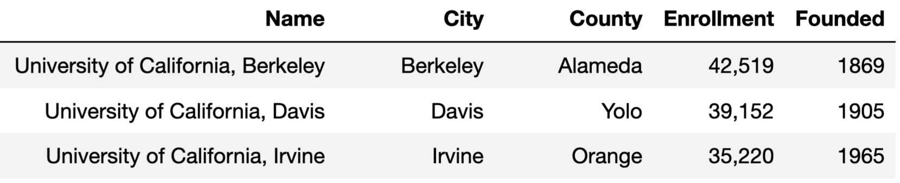
The Structure of a DataFrame
A pandas DataFrame is a sequence of labeled columns.
Each row represents one observation or individual – also known as a “data point”.
Each column represents one attribute.
This lecture we will return to the dataset of public four-year colleges and universities in California (source):
label
row
column
value

Slide 23
Reading CSV files using pandas
To interact with DataFrames, we first need to import the pandas module.
import pandas as pd
Then, to load a table from a CSV, we call the function pd.read_csv(file_path), where file_path is a string containing the name and location of the CSV file.
schools = pd.read_csv('data/cal_unis.csv')
Always assign your DataFrame to a name!

Slide 24
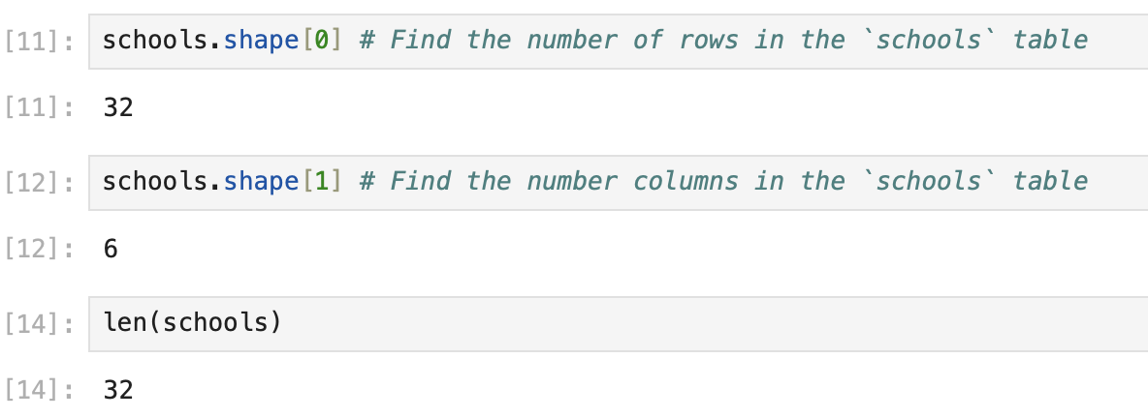
len and .shape
How big is our DataFrame?
One of the first things we may want to do when loading in a table is to determine the number of rows and columns. Assuming df is a DataFrame:
df.shape[0] evaluates to the number of rows in the table.
df.shape[1] evaluates to the number of columns in the table.
len(df) also returns the number of rows in the table.
Example
Why is it important to know the size of our table?

Slide 25
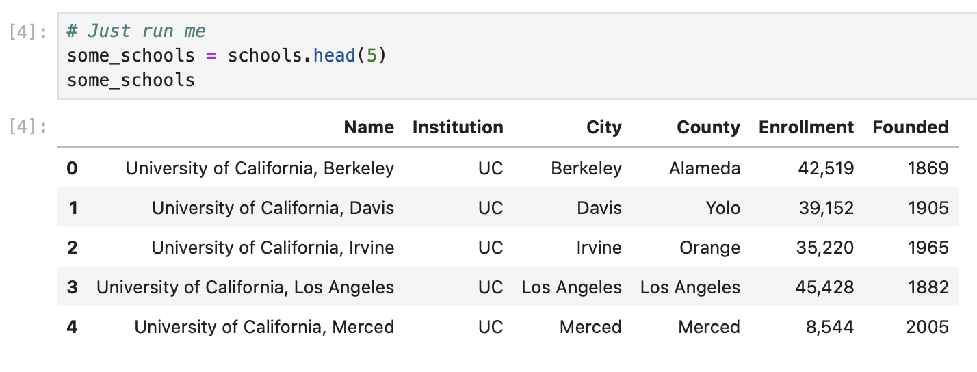
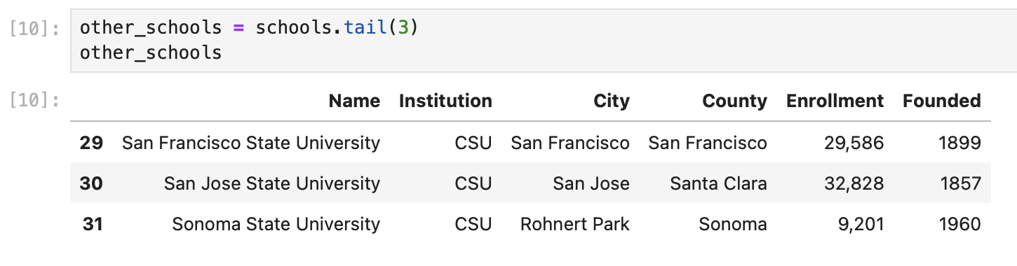
.head and .tail
df.head(num) allows us to extract a specified number of rows starting from the top.
df.tail(num)allows us to extract a specified number of rows starting from the bottom.
By default, num is set to 5.
Access the bottom 3 rows of the table

Slide 26
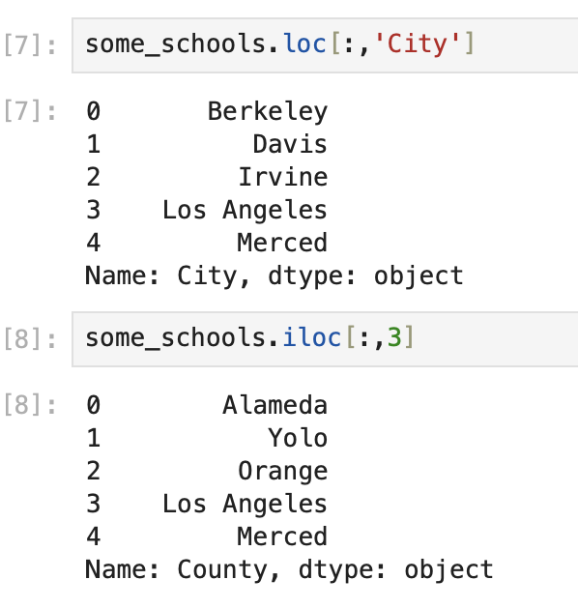
Columns
df.loc[:,label] allows us to extract a single column from a DataFrame using the column’s label.
df.iloc[:,index] allows us to extract a single column from a DataFrame using the column’s index.
The “County” column is at index 3

Slide 27
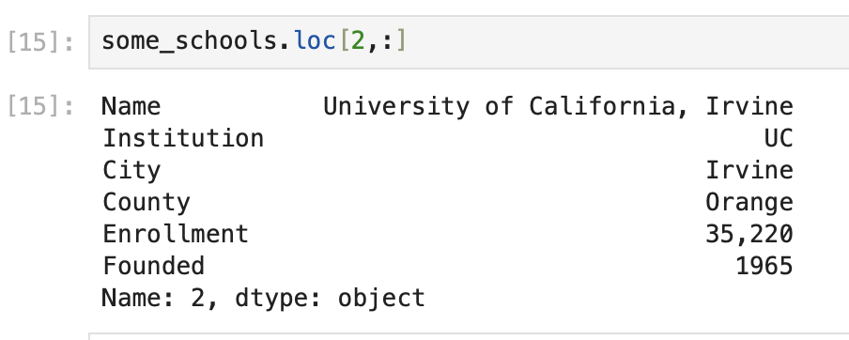
Rows
df.loc[label,:] allows us to extract a single row from a DataFrame using the row’s label.
df.iloc[index,:] allows us to extract a single row from a DataFrame using the column’s index.
The row at index 2 is UC Irvine

Slide 28
Questions?

Slide 29
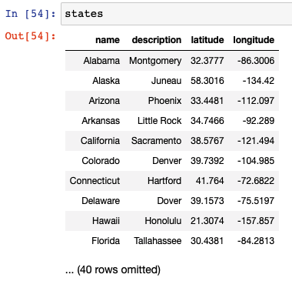
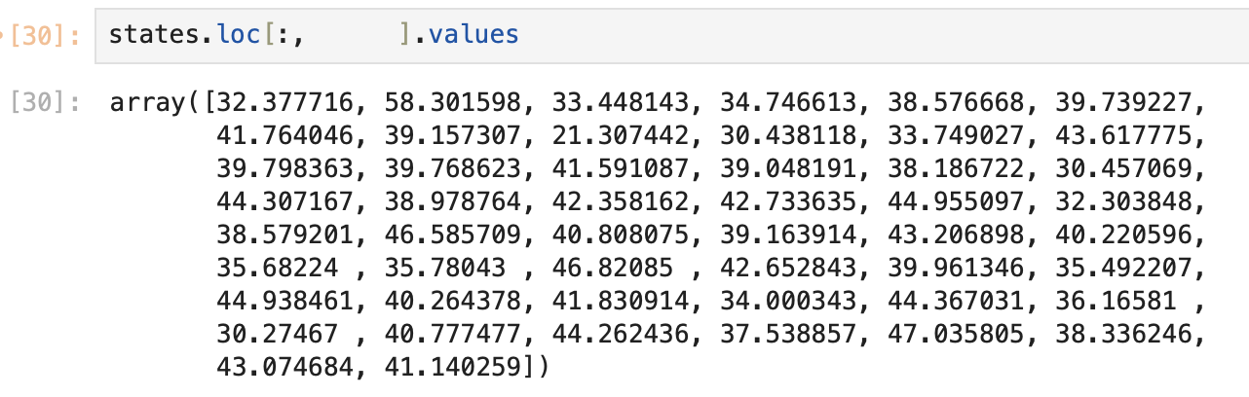
Quick Check 1
Fill in the blank so that the correct array is returned. Select all that apply.
'name'
'description'
'latitude'
'longitude'

Slide 30
slicing and dropping
Jupyter Hub Housekeeping!
Boolean Indexing
DataFrames
Slicing and dropping
Adding Columns
➤

Slide 31
A Common Workflow
Load in table with many columns
Identify which columns are relevant
Make a new table with the relevant columns
Next up!

Slide 32
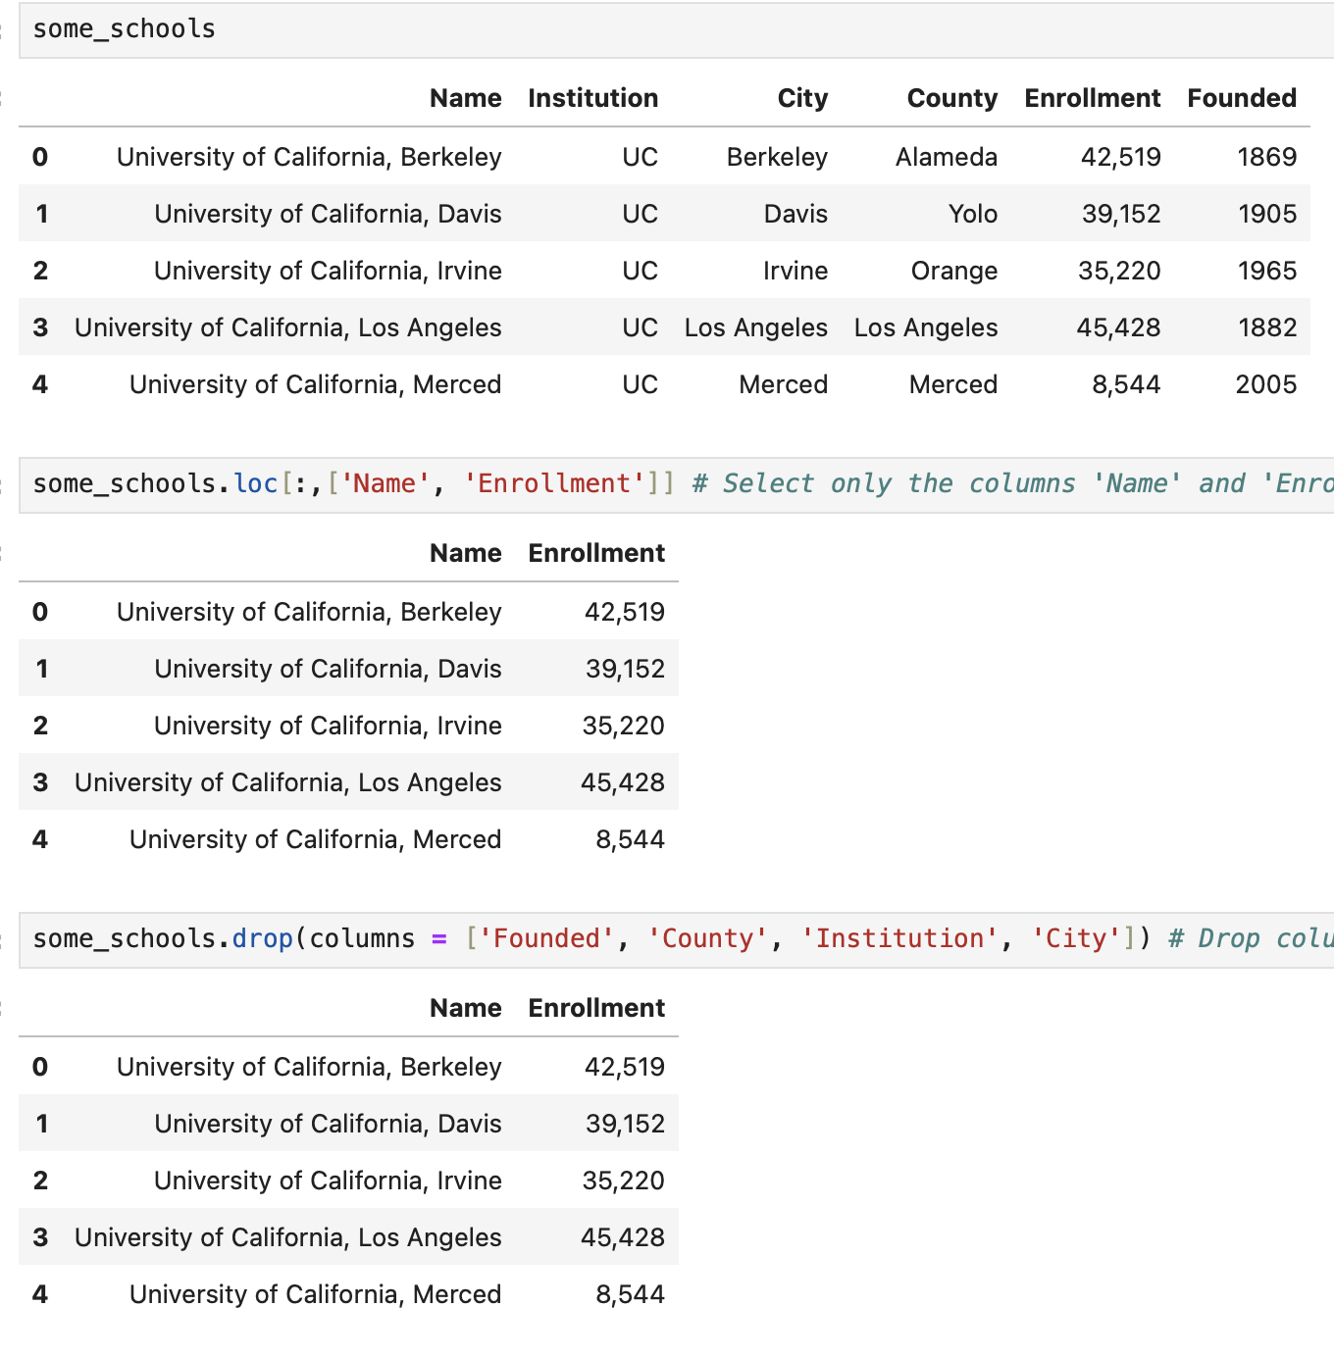
.loc[] and .drop()
After we identify which columns are relevant, we may want to work with only those columns. We can narrow down our table by slicing the columns we want or dropping the columns we don’t want:
df.loc[:,[c1, c2, ...]] takes in a list of one or more column labels (or indices) and returns a new table with just those columns
df.drop(columns = [c1, c2, ...]) returns a new table without the specified columns
We can assign this new table to a variable
Both methods return new tables. The original table df is not changed!

Slide 33
Adding Columns
Jupyter Hub Housekeeping!
Boolean Indexing
DataFrames
Slicing and dropping
Adding Columns
➤

Slide 34
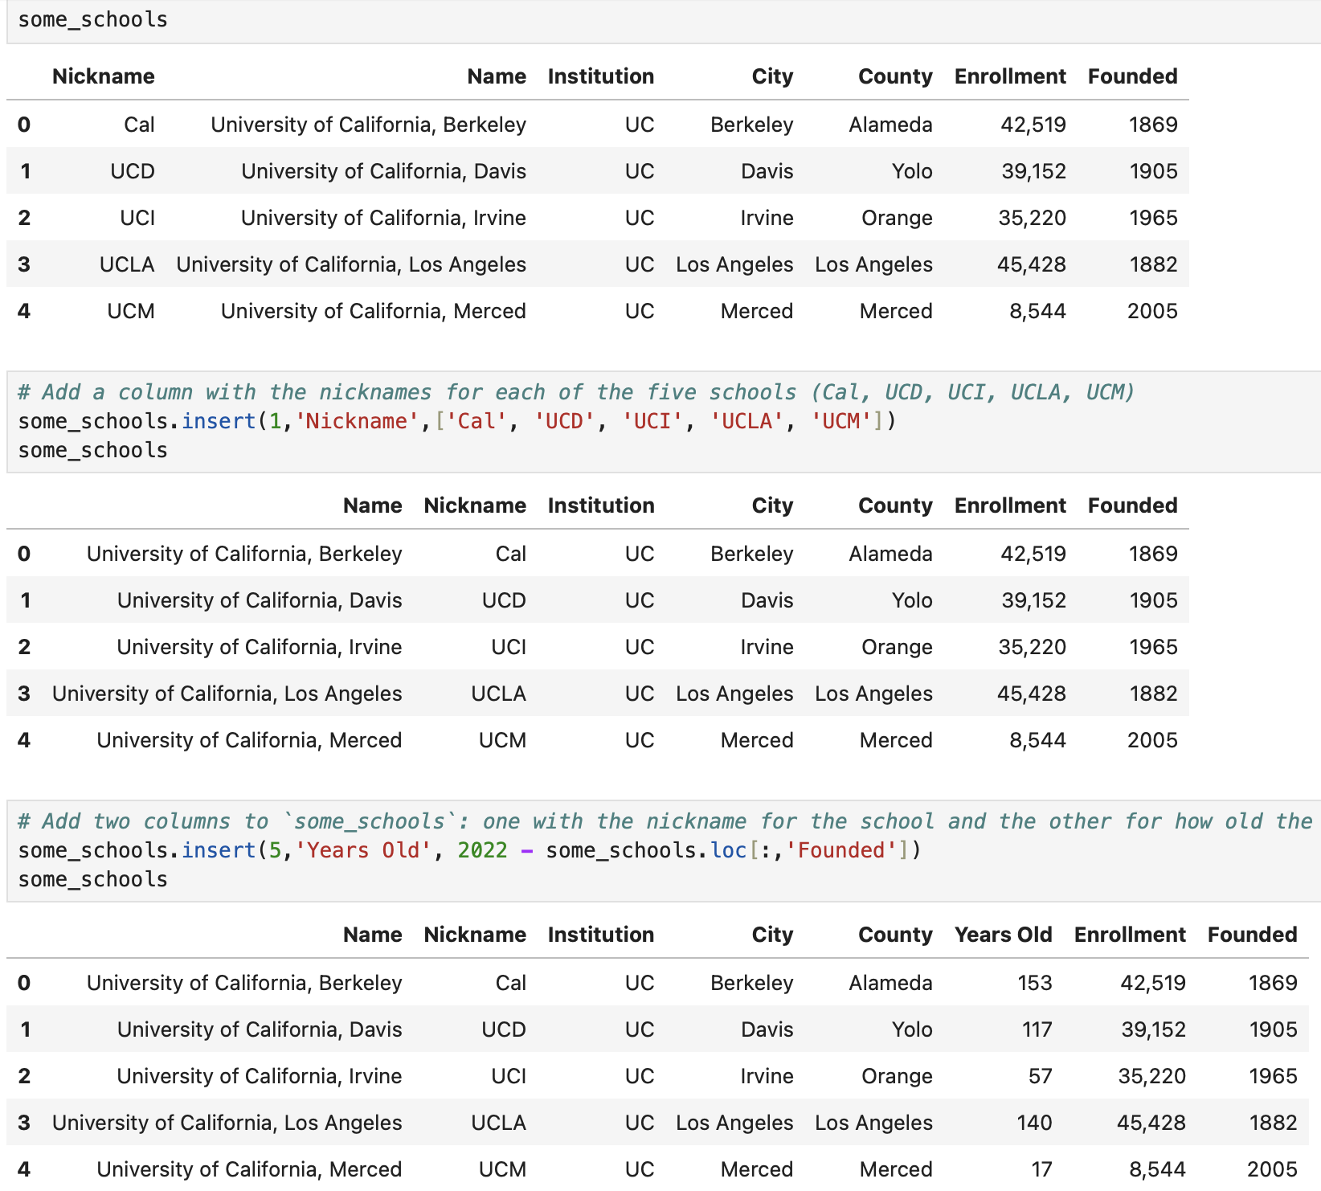
Adding Columns
The method df.insert(...) returns a new DataFrame with additional column(s).
df.insert(i,name,values), where index ‘i’ specifies the location to insert the new column, name is the new column name, and values is a list of new data points.
Caution: Unlike drop and loc, the insert method does change the original df!

Slide 35
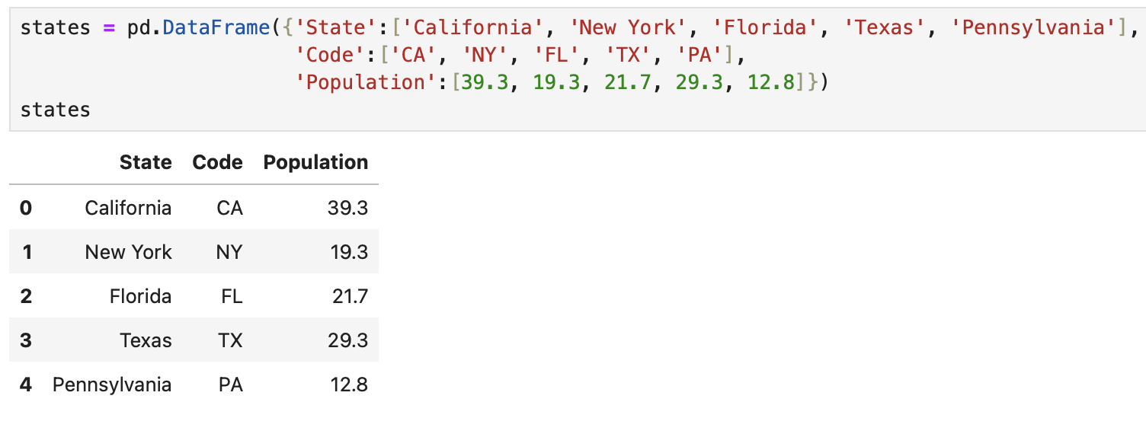
Creating Tables from Scratch
While we mostly will load in tables from CSV files, we could also create tables from scratch.
The function pd.DataFrame() creates an empty table.
We insert data using an array or a dictionary.

Slide 36
Questions?

Slide 37
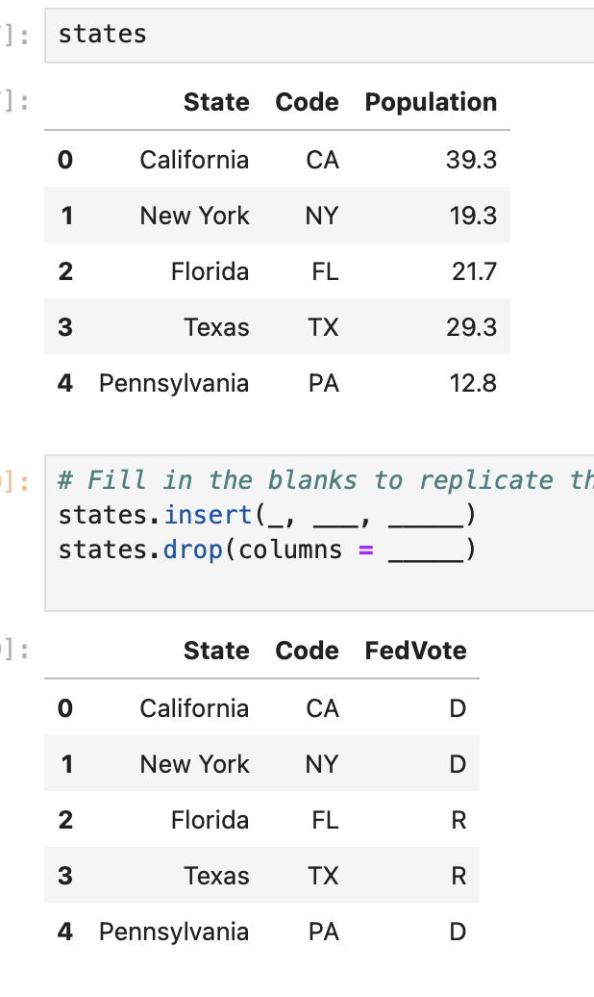
Quick Check 2
Fill in the three blanks so that the correct table is returned.

Slide 38
Demo: WNBA Data

Slide 39
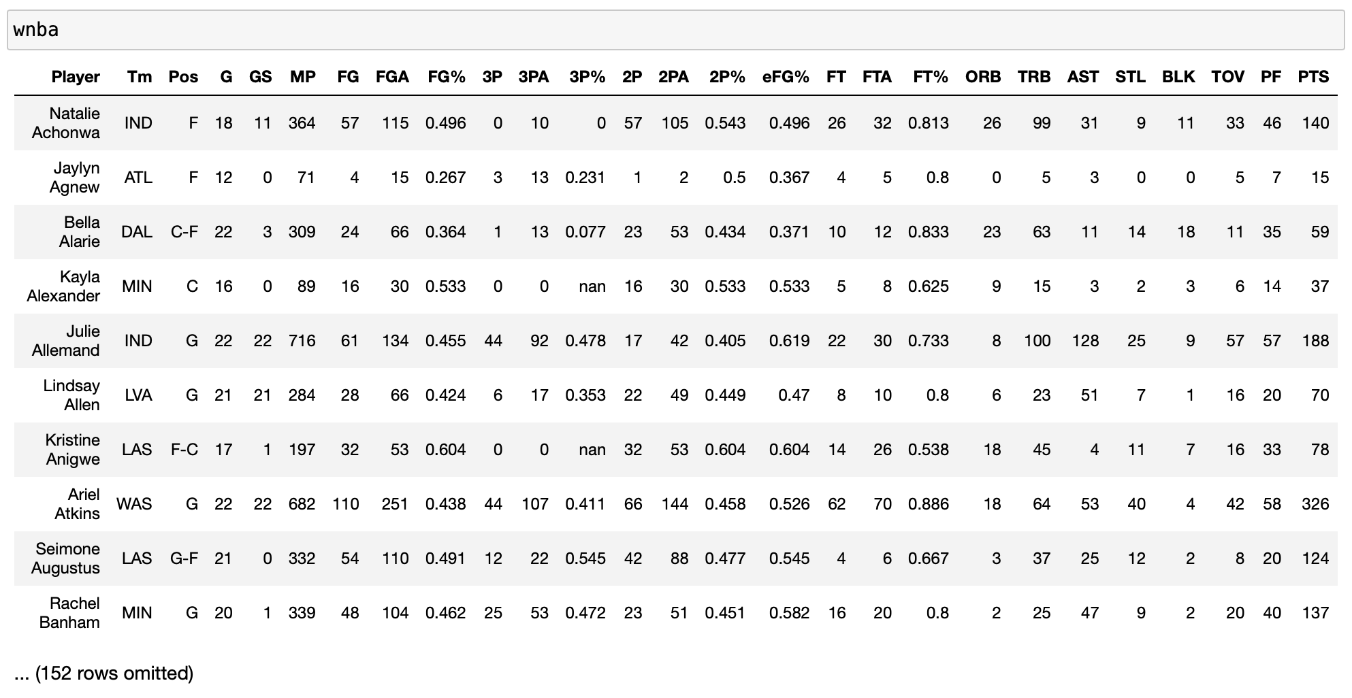
WNBA Data
Let’s apply the methods we just learned about to a dataset of WNBA statistics from the 2020 season. The data was downloaded from here.

Slide 40
In Conclusion…

Slide 41
Summary
Method or Property | Behavior
pd.read_csv(file_path) | Loads in a table from data.
df.shape | Returns a tuple containing the number of rows and columns in df.
df.head(n) | Displays the first n rows of df.
df.tail(n) | Displays the last n rows of df.
df.loc[:,label] | Returns only the corresponding column of df.
df.loc[:,[c1, c2, … ] ] | Returns a copy of df with only the specified columns.
df.drop(columns=[c1, c2, …]) | Returns a copy of df without the specified columns.
df.insert(i, name, values) | Returns a copy of df with a single additional column located at index i.
pd.DataFrame(data) | Used to create a DataFrame from scratch

Slide 42
Recap
Next Time
Introduction to Visualization
Boolean Indexing
pandas DataFrames!
Columns and Rows
Creating and Slicing DataFrames

