Slide 1

Visualizing Categorical Variables
LECTURE 11
Learning how to create bar charts.
Spark 10, Spring 2024
Developed by students and faculty at UC Berkeley and Tuskegee University
data6.org/su23/syllabus/#acknowledgements-

Slide 2
Week ?
Announcements!
No Homework Due this week!
Mid-Semester Project will be announced soon/this week.
Will be similar to Homework #3
Will be due March 22
Office Hours take place
(Suzanne) Mondays 4:30 - 5:20PM in ACS 366
(Adrien) Wednesdays 4:30 - 5:20PM in ACS 330B
(Jordan) Tuesdays & Thursdays 10-12am

Slide 3
Overall Plan
Recap
Thus far, learned basics of
JuypterHub
Python (some variables, some tables, some plotting)
Done some exploring with data on populations, internet usage
This week we will, focus on creating visualizations of data and using these visualizations to help us understand what stories data has to tell us.
Next week/Mid-semester project you will, use these skills to study two different data sets.

Slide 4
Today’s Roadmap
Categorical Distributions
Bar Charts
Grouped Bar Charts
Lecture 11, Spark 10, Spring 2024

Slide 5
Categorical Distributions
➤
1. Categorical Distributions
2. Bar Charts
3. Grouped Bar Charts
4. Customization

Slide 6
Variable Type
Numerical
aka Quantitative
Categorical
aka Qualitative
Discrete
Whole numbers; can be counted.
Continuous
Numbers with decimals; often measured.
Ordinal
Categories with some inherent ordering.
Nominal
Categories with no inherent ordering.
e.g number of cars, number of Cal students
e.g price, temperature, GPA, weight
e.g highest degree attained, Yelp stars
e.g colors, political affiliation
Can do arithmetic with.
Cannot do arithmetic with.

Slide 7
Distributions of Categorical Variables
In a distribution, each individual belongs to exactly one category and thus has exactly one value.
A distribution table (aka frequency table) shows all the values of a categorical variable along with the frequency of each one (i.e., number of occurrences).
The table on the right is a distribution table of data on 55 cookies. The values of the categorical variable Cookie are sugar cookies, chocolate chip, red velvet, oatmeal raisin, and peanut butter.
Cookie | Count
chocolate chip | 15
red velvet | 15
oatmeal raisin | 10
sugar cookies | 10
peanut butter | 5

Slide 8
Bar Charts
1. Categorical Distributions
2. Bar Charts
3. Grouped Bar Charts
➤

Slide 9
Bar Charts
Bar charts are often used to display the relationship between a categorical variable and a numerical variable:
Average GPAs of Data Science, History, and Biology majors.
The number of streams by the top 10 songs on Spotify yesterday.

Slide 10
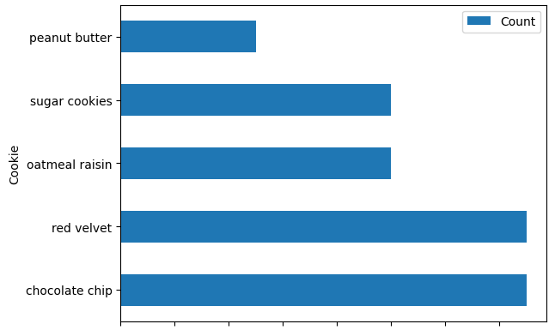
Bar Charts and Categorical Distributions
Bar charts are often used to display the relationship between a categorical variable and a numerical variable:
Average GPAs of Data Science, History, and Biology majors.
The number of streams by the top 10 songs on Spotify yesterday.
Cookie | Count
chocolate chip | 15
red velvet | 15
oatmeal raisin | 10
sugar cookies | 10
peanut butter | 5
Bar charts are often used to visualize a categorical distribution:
The proportion of adults in upper, middle, and lower class.
The number of public vs private institutions in the top 100 universities
The numerical variable here is Count.
Lengths encode values. Widths encode nothing.
Colors can encode sub-categories! (more soon)

Slide 11
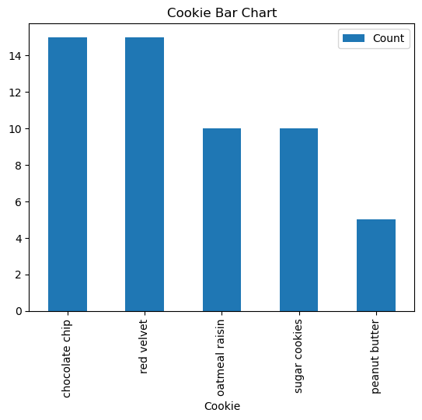
.bar( ) for Vertical Bar Charts
ax=cookieData.plot.bar(x='Cookie',y='Count'
,title='Cookie Bar Chart')
The method
pd.plot.bar(x=...,y=...,title=...)
creates a bar chart with:
The values rows are the x values (should be categories. This column should contain a categorical variable, and values should be unique.
Bars are on the y-axis and should be the numerical variables.

Slide 12
.barh( ) for Horizontal Bar Charts
ax=cookieData.plot.barh(x='Cookie',y='Count'
,title='Cookie Bar Chart')
Cookie | Count
chocolate chip | 15
red velvet | 15
oatmeal raisin | 10
sugar cookies | 10
peanut butter | 5
The method
plot.barh(x=...,y=...,title=...)
creates a bar chart with:
The reverse orientation!
X should still be the categorical variable, and values should be unique.
Y is still the Bars and will have your numerical variables.

Slide 13
Example: Spotify Daily Top 10 Songs
For the rest of this Lecture (and probably on Wednesday), we will work with a very cool data set.
Spotify makes public the top streams in a variety of different ways:
Daily/Weekly Top Songs
Daily/Weekly Top Artists
Top Albums
Check out http://charts.spotify.com
Spotify Charts

Slide 14
Example: Spotify Daily Top 10 Songs
We will work with the global top daily streams from Feb 29.
Here’s the different attributes that come with the top 200 songs on Spotify!
rank: what the rank is from 1 - 200.
uri: the digital spotify identifier.
artist_names: the listed performers.
track-name: the name of the track
source: the record/production company
peak_rank: the top rank achieved by the song.
previous_rank: the rank the song had yesterday (-1 if it wasn't in the top 200)
days_on_chart: how many days it's been in the top 200.
streams: the number of streams per day globally
Spotify Charts

Slide 15
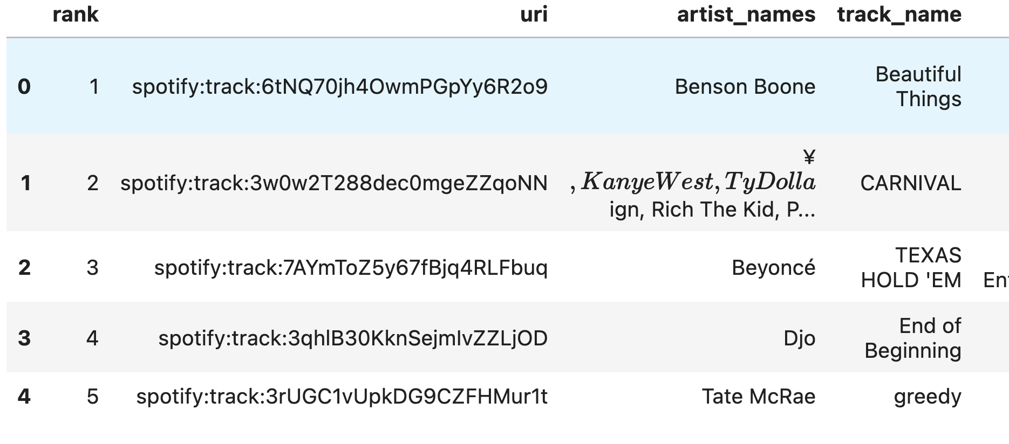
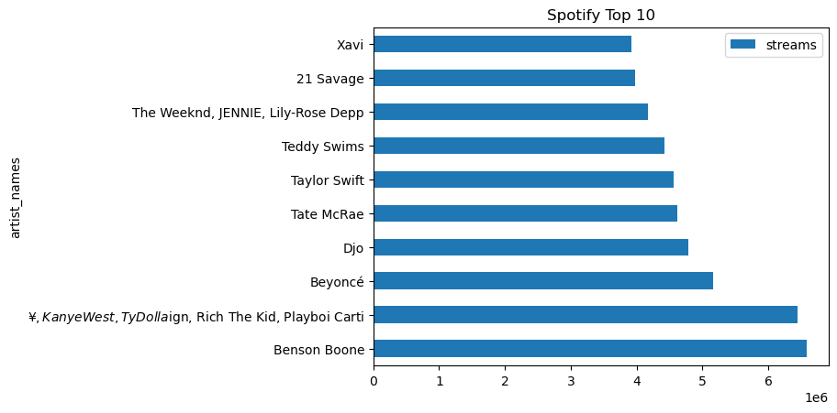
Example: Spotify Daily Top 10 Songs
Spotify Charts

Slide 16
Example: Spotify Daily Top 10 Songs
spotifyStreams = pd.read_csv("regional-global-daily-2024-02-29.csv")
top10 = spotifyStreams.head(10)
#Horizontal Bar Chart.
ax=top10.plot.barh(x='artist_names',y='streams',title='Spotify Top 10')
Spotify Charts

Slide 17
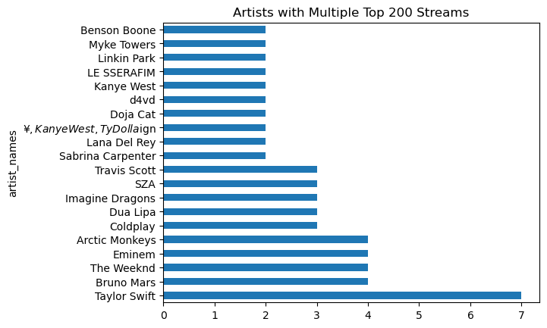
Pre-Process the Table Before Plotting
#Use .value_counts() to determine the unique artists
artistsAndCounts = spotifyStreams['artist_names'].value_counts()
top20ArtistsAndCounts = artistsAndCounts.head(20);
ax=top20ArtistsAndCounts.plot.barh(x='artist_names', y='count',title='Artists with Multiple Top 200 Streams')
It’s important to first create a table with only the information you want, sorted in the order you want, before trying to visualize.
If you call barh on your original table without any additional selection, the results you get back might not make any sense.
Let’s look at an example using value_counts().
In a categorical distribution, each category should only appear once.

Slide 18
Three-Step Process for Visualization
This process will apply to all visualizations we create in this class, not just today’s bar charts:
Pre-Process
Create a table with only the columns necessary to create the visualization
Choose the Plot Type
Call the correct visualization (depending on variable type)
Customize the Plot
Provide the correct arguments for visual customization
Next up!
✅

Slide 19
Questions?

Slide 20
.sort_values()
1. Categorical Distributions
2. Bar Charts
3. Grouped Bar Charts
➤

Slide 21
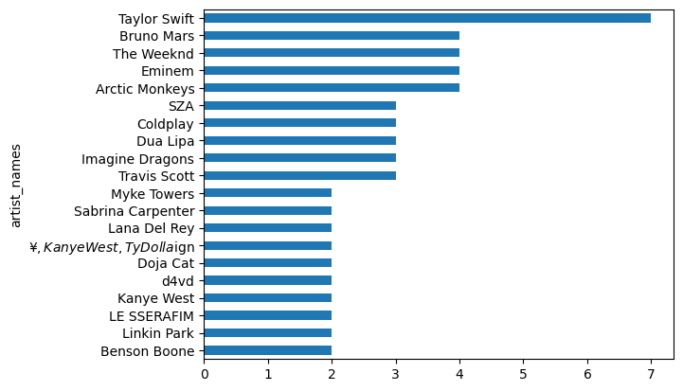
Sorting by the Value (# Songs in Top 200)
ax = top20ArtistsAndCounts.sort_values().plot.barh()
Now we have the #1 number of Songs listed first.

Slide 22
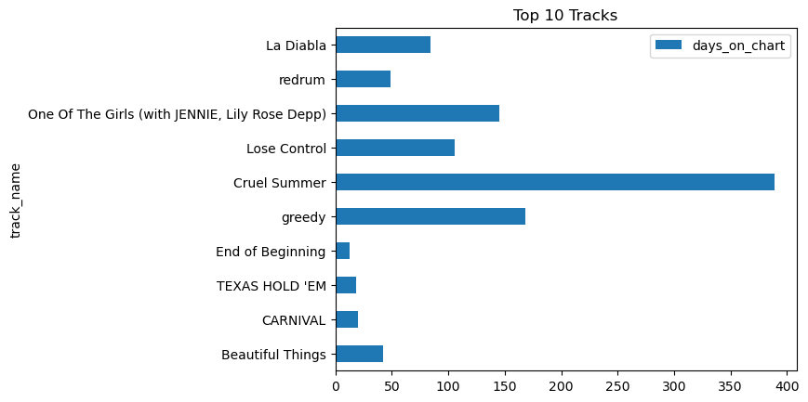
Adjusting the Order of Categories
top10TracksByDaysOnChart = top10[['track_name','days_on_chart']]
ax = top10TracksByDaysOnChart.plot.barh(x='track_name',title='Artists with Multiple Top 200 Streams')
In order to reorder our categories we must reorder the rows of our table by sorting.

Slide 23
sort_values()
The method t.sort_values(...) returns a new table with the rows sorted according to the values in some column. There are two ways we can call it:
t.sort_values(column_or_label)
Sorts rows according to the specified column, in ascending order.
t.sort_values(column_or_label, ascending = False)
Sorts rows according to the specified column, in descending order.
ascending is an optional parameter. If it is not provided, then Python supplies a default. In this case, the default is ascending, i.e., Approach 1.
True is a boolean value. We will learn more about booleans next week; just remember the sort() syntax for now.
We’ll most often specify columns by their label (i.e., variable name), though we could also specify by index (0, 1, 2, etc.)

Slide 24
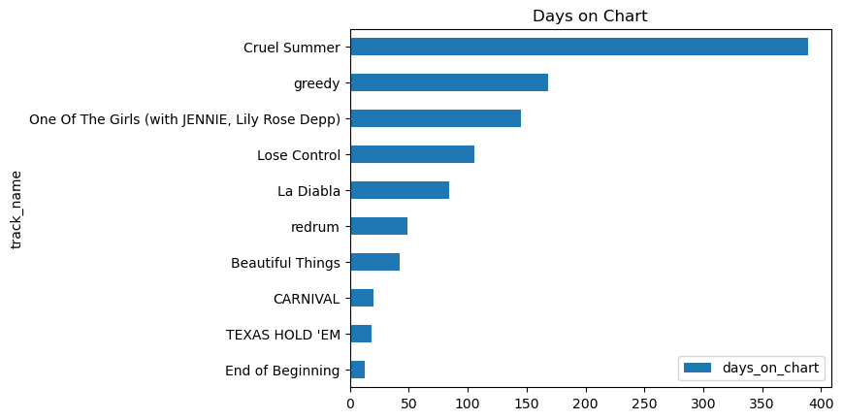
Sorting by Number of Days on Chart
top10TracksByDaysOnChart.sort_values('days_on_chart').plot.barh(x='track_name',title='Days on Chart')
With method chaining, Python evaluates method calls left-to-right.
The new table returned by sort_values() is the one that is then plotted by barh().

Slide 25
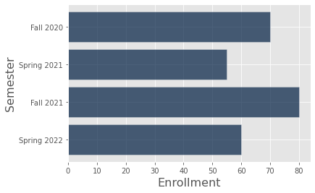
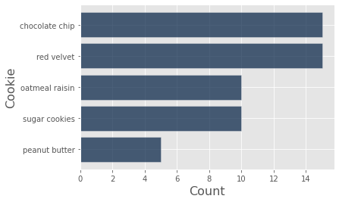
Visualization Note: Bar Order
Depending on the type of categorical variable we’re displaying, we may want to sort the bars of our bar charts differently.
Sort by category: e.g., if categorical variable has an inherent ordering like alphabetical, numerical, etc.
Semester | Enrollment
Fall 2020 | 70
Spring 2021 | 55
Fall 2021 | 80
Spring 2022 | 60
Sort by bar length: e.g., if categorical variable has no natural order to the categories.
Cookie | Count
chocolate chip | 15
red velvet | 15
oatmeal raisin | 10
sugar cookies | 10
peanut butter | 5
The bar order depends on what you want to express through your visualization.

Slide 26
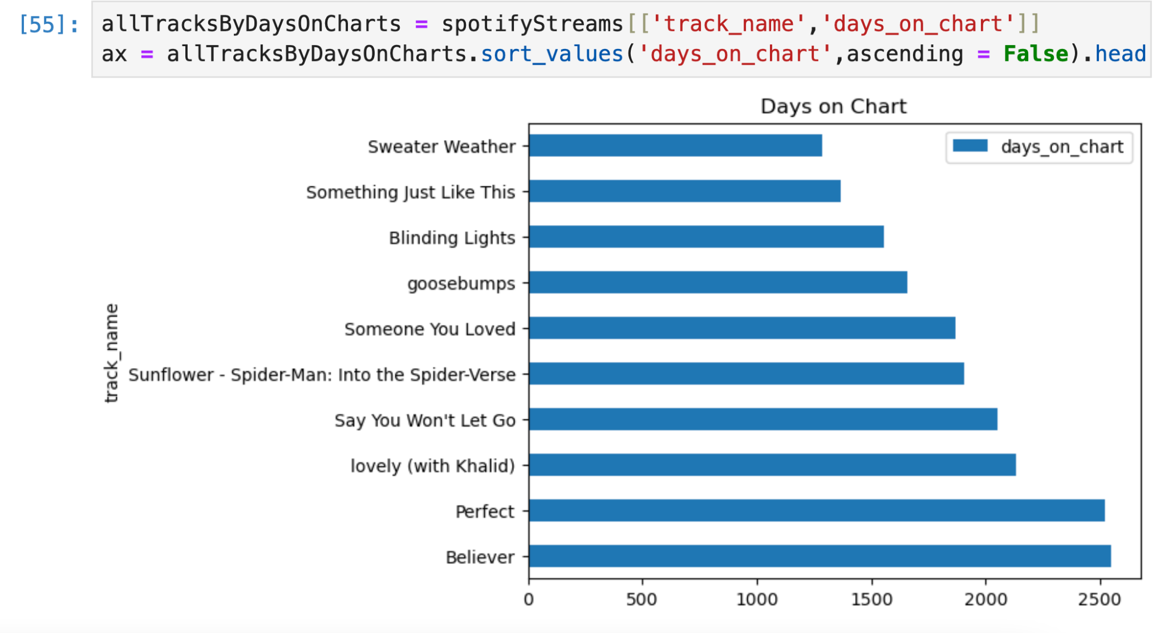
Quick Check 1
top10 = spotifyStreams.head(10)
Our previous examples used only the top 10 songs by daily stream. But we have 200 songs in total. Go back to the original data frame and use .sort_values() to find the songs on our list with the greatest number of days on the charts.
Fill in blank to create chart of the top 10 songs by days on chart.
Notes:
allTracksByDaysOnCharts = spotifyStreams[['track_name','days_on_chart']]
ax = allTracksByDaysOnCharts.sort_values('days_on_chart',ascending = False).head(10).plot.barh(x='track_name',title='Days on Chart')

Slide 27
.take()
1. Categorical Distributions
2. Bar Charts
3. Grouped Bar Charts
➤

Slide 28
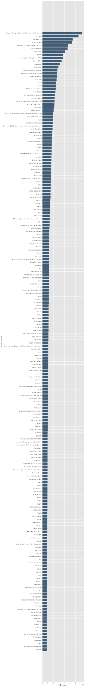
From the Top 200 to Relevant Subsets
The Spotify Daily Chart dataset actually contains the Top 200 songs from each day. This would be pretty tedious to plot.
200 bars!

Slide 29
From the Top 200 to Relevant Subsets
We want conceivably different ways to select different kinds of subsets.
head(n)and tail(n) give us the top/bottom n values
Binary filtering gives us rows which satisfy different criteria.
take()is more general than head because it can select different combinations of rows.
We have already seen head, so we will review binary filtering and see take.
200 bars!

Slide 30
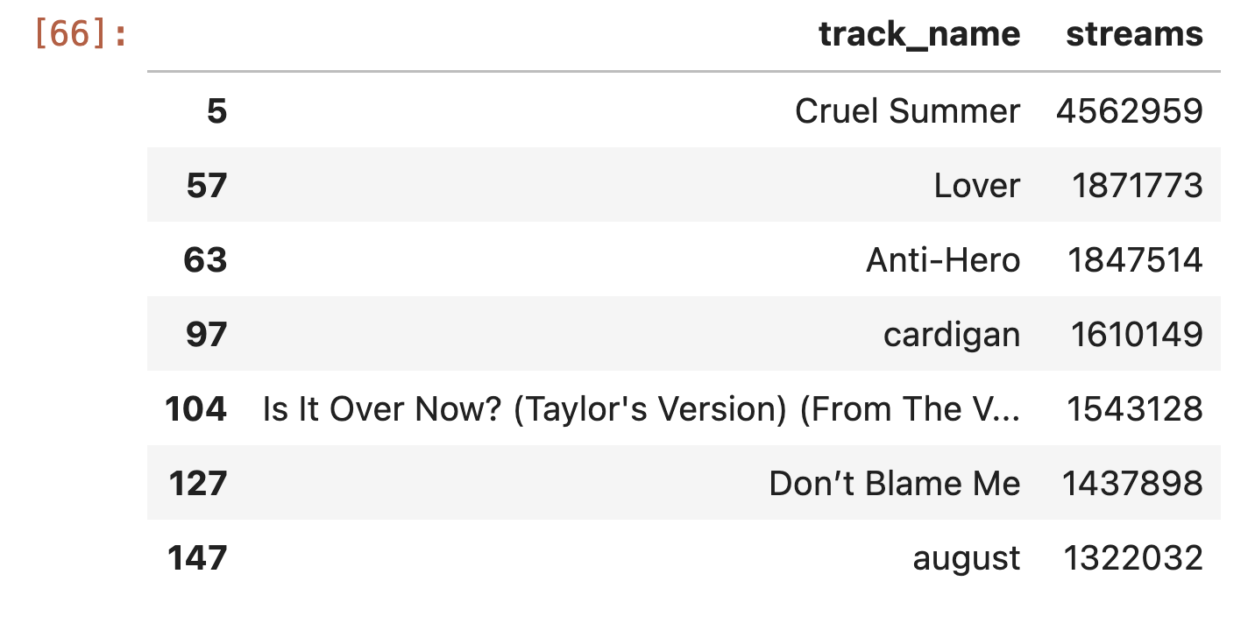
From the Top 200 to only Taylor Swift
filter = spotifyStreams['artist_names']=='Taylor Swift'; onlyTaylorStreams = spotifyStreams[filter]
onlyTaylorStreams[['track_name','streams']]
200 bars!

Slide 31
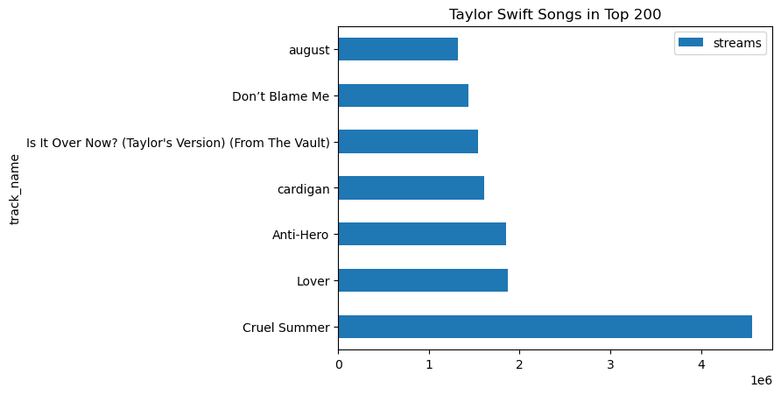
From the Top 200 to only Taylor Swift
onlyTaylorStreams[['track_name','streams']].plot.barh(x='track_name',title='Taylor Swift Songs in Top 200')

Slide 32
From the Top 200 to Relevant Subsets
We want conceivably different ways to select different kinds of subsets.
head(n)and tail(n) give us the top/bottom n values
Binary filtering gives us rows which satisfy different criteria.
take()is more general than head because it can select different combinations of rows.
We have already seen head, so we will review binary filtering and see take.
200 bars!

Slide 33
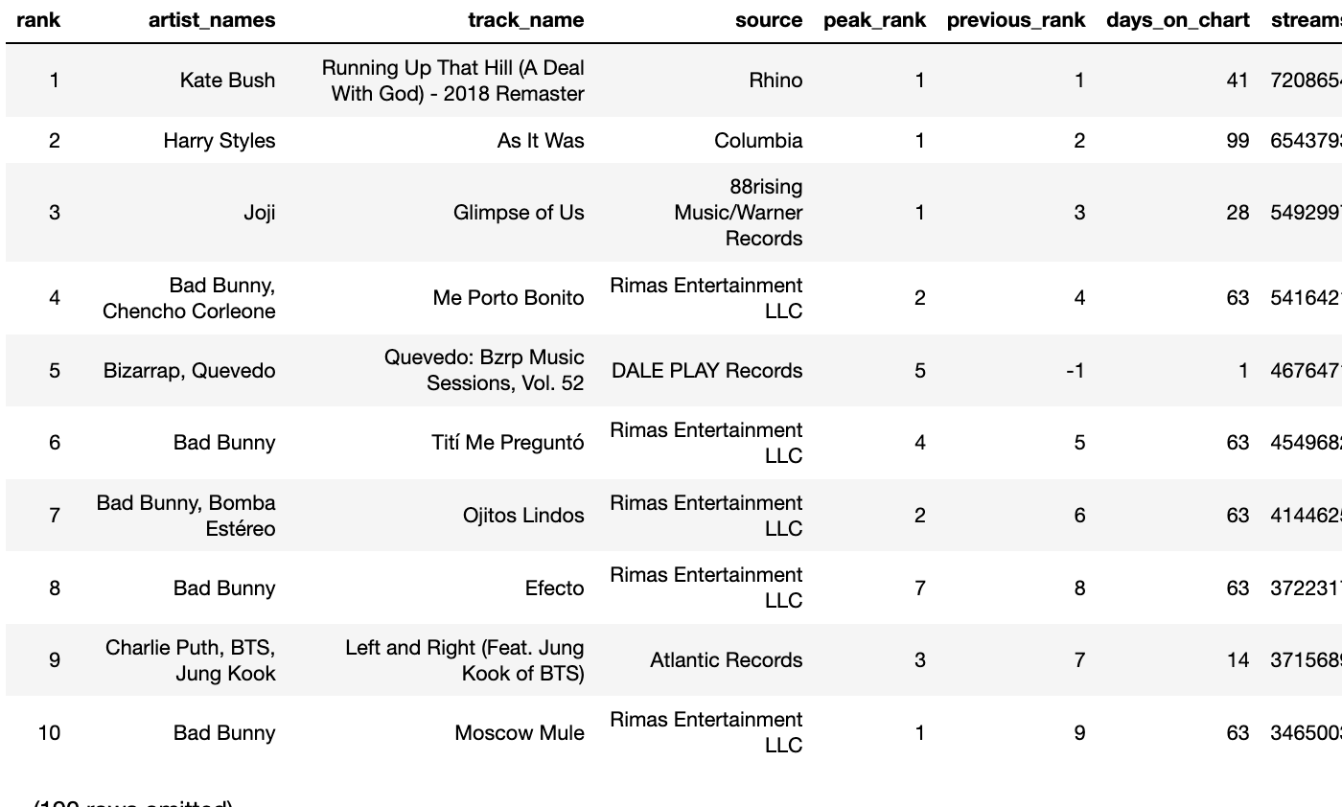
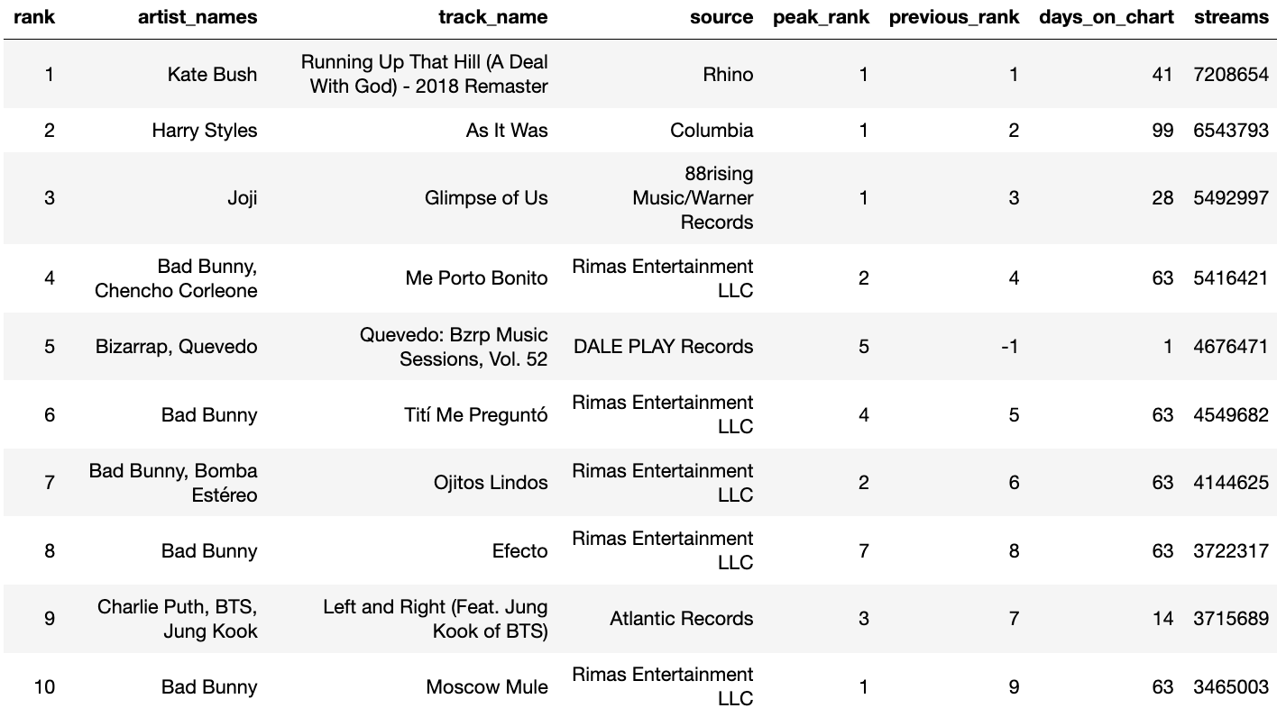
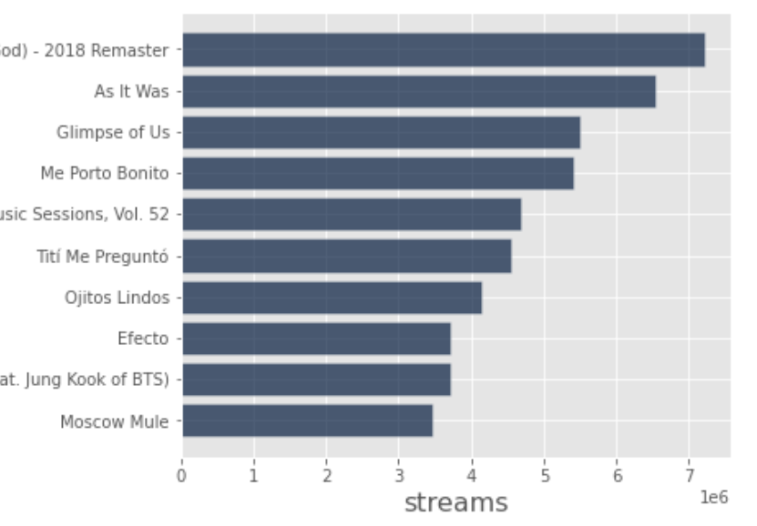
From the Top 200 to the Top 10 with take()
The Spotify Daily Chart dataset actually contains the Top 200 songs from each day. This would be pretty tedious to plot.
200 bars!
Instead, we make a new table that limits the number of rows to 10, then we plot that table:
top_10
10 rows
streams
200 rows
take()

Slide 34
take(np.arange(n))
The method call t.take(np.arange(n)) returns a new table with only the first n rows.
We will cover all components of this method call in detail over the next few days.
“From this table…”
“...take the first 10 rows.”
top_10 = spotifyStreams.take(np.arange(10))
top_10
10 rows
streams
200 rows
take()

Slide 35
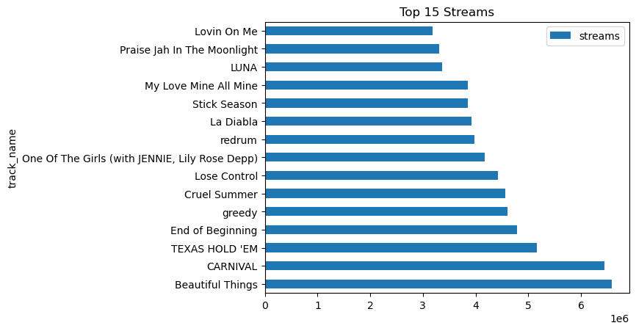
Quick Check 2
Fill in the blank to generate a bar chart of the top 15 streamed songs showing how many streams each artist has
Make the bar chart sorted by the number of streams.
Notes:
top15 = spotifyStreams.take(np.arange(15))[['track_name','streams']];
ax = top15.sort_values('streams',ascending = False).plot.barh(x='track_name',title='Top 15 Streams')

Slide 36
Questions?

Slide 37
Grouped Bar Charts
1. Categorical Distributions
2. Bar Charts
3. Grouped Bar Charts
➤

Slide 38
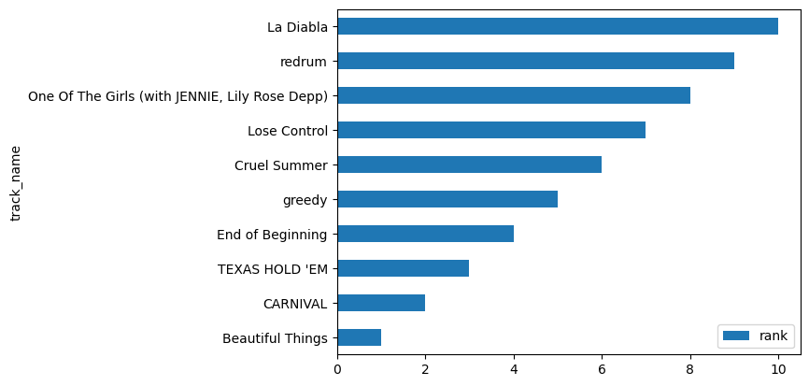
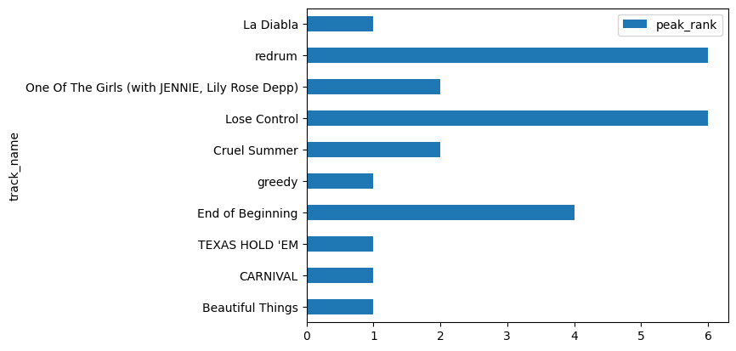
Separate Bar Charts
Spotify keeps track of each song’s “peak rank,” which is a song’s lowest rank since its release on the platform.
With our current tools, we’d likely make two different plots, which are difficult to compare:
top10.plot.barh(x='track_name',y='rank')
top10.plot.barh(x='track_name',y='peak_rank')

Slide 39
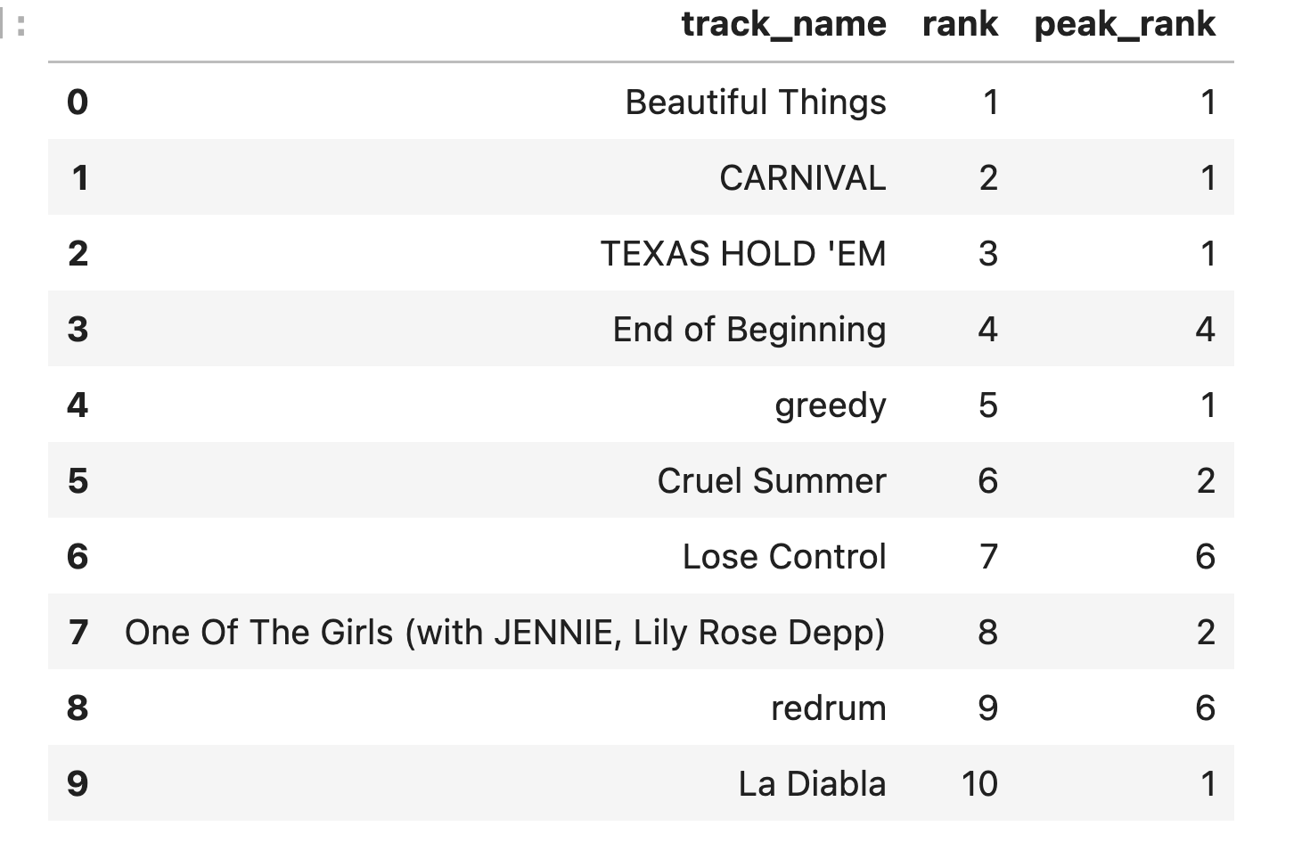
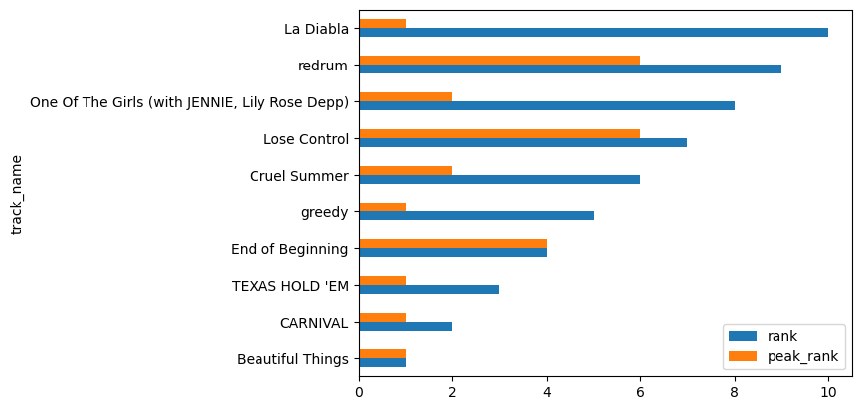
Grouped Bar Charts
We first select only the columns we have with one categorical variable (track name) and the two numerical values.
If the table we call barh on has multiple numerical columns, it will draw bars for each of them, and each column will get its own color!
top10[['track_name','rank','peak_rank']].plot.barh(x='track_name')

Slide 40
Questions?

Slide 41
In Conclusion…

Slide 42
Three-Step Process for Visualization
This process will apply to all visualizations we create in this class, not just today’s bar charts:
Pre-Process
Create a table with only the columns necessary to create the visualization
Choose the Plot Type
Call the correct visualization (depending on variable type)
Customize the Plot
Provide the correct arguments for visual customization
✅
✅

Slide 43
Summary
Bar charts are used to display the distribution of a categorical variable, or the relationship between a categorical variable and one or more numerical variables.
The method t.plot.barh(column_for_categories) creates a bar chart with:
The values of the column column_for_categories as the categories on the y-axis. This column should contain a categorical variable, and values should be unique.
Bars for every other column in t. These columns should contain numerical variables.
Multiple other columns → grouped bar chart.
Bars should be sorted depending on the type of the categorical variable.

Slide 44
Recap
Next Time
Bar Charts
Distributions
Customizing Visualizations
Numerical Distributions
Histograms
Bins
Overlaid Plots

