Slide 1

Visualizing Two Numerical Variables
LECTURE 13
Scatter plots and line plots.
Spark 10 Spring 2024
Developed by students and faculty at UC Berkeley and Tuskegee University
data6.org/su23/syllabus/#acknowledgements-

Slide 2
Week ?
Announcements!
No Homework Due this week!
Mid-Semester Project will be announced Wednesday.
Will be similar to Homework #3
Will be due March 22
Office Hours take place
(Suzanne) Mondays 4:30 - 5:20PM in ACS 366
(Adrien) Wednesdays 4:30 - 5:20PM in ACS 330B
(Jordan) Tuesdays & Thursdays 10-12am

Slide 3
Today’s Roadmap
Review: Histograms
Scatter Plots
Customizing Scatter Plots
Line Plots
Multiple Line Plots
Lecture 13, Spark 10 Spring 2024

Slide 4
Review: Histograms
➤
1. Review: Histograms
2. Scatter Plots
3. Customizing Scatter Plots
4. Line Plots
5. Multiple Line Plots

Slide 5
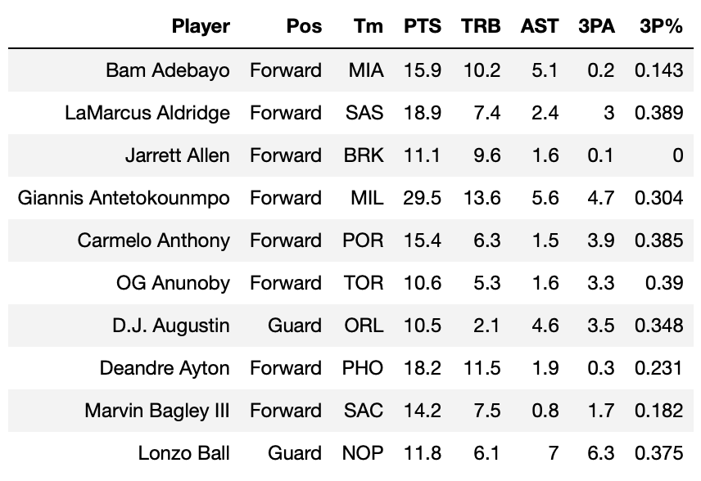
Today’s Data
Our first dataset today comes from Basketball Reference. It contains per-game averages of players in the 2019-2020 NBA season.
'Player': name.
'Pos': general position.
'Tm': abbreviated team.
'PTS': average number of points scored per game.
'TRB': average number of rebounds per game.
'AST': average number of assists per game.
'3PA'`: average number of three-point shots attempted per game.
'3P%': average proportion of three-point shots that go in.

Slide 6
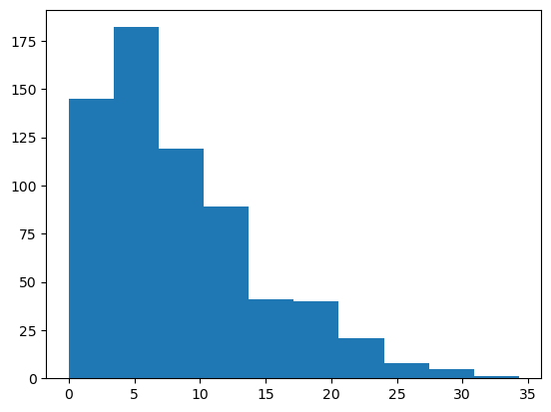
Histograms
pointsScored = NBA_2019_2020_PlayerData['PTS']
plt.hist(pointsScored)
A histogram visualizes the distribution of a numerical variable by binning. The method
plt.hist(column)
creates a histogram of the column column of t. This column must contain numerical values.
It automatically chooses bins for us. We can change them.

Slide 7
Scatter Plots
1. Review: Histograms
2. Scatter Plots
3. Customizing Scatter Plots
4. Line Plots
5. Multiple Line Plots
➤

Slide 8
Question
So far, we’ve visualized the following combinations of variables:
Bar Chart: One categorical variable, one numerical variable
Top songs on Spotify
Histogram: One numerical variable
Distribution of tips
Frequency of cookies
What if we want to visualize two numerical variables at once?
Height vs. weight
Tip vs. total bill
Number of rebounds vs. number of points

Slide 9
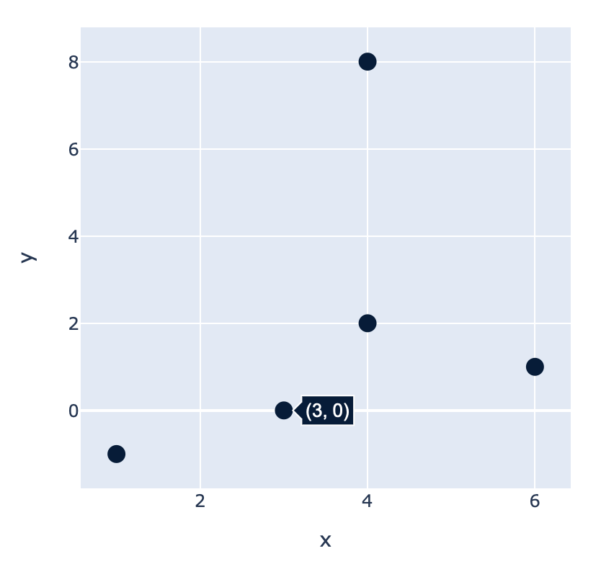
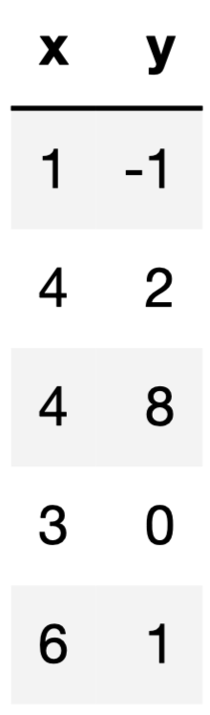
Scatter Plots
Scatter plots are used to visualize two numerical variables at once. To create a scatter plot from a table, you need two columns:
A numerical column for the x-axis.
A numerical column for the y-axis.
The resulting graph has one point for every row in your table.
We call this a graph of “y vs. x”.

Slide 10
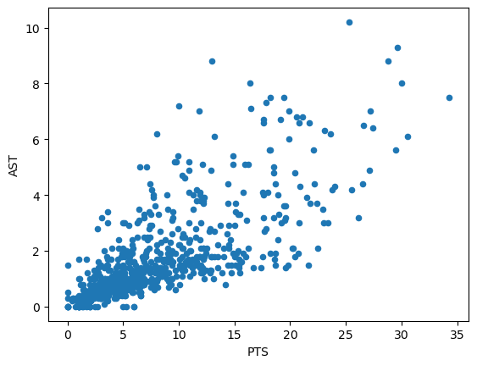

.scatter()
nba.plot.scatter(x='PTS', y='AST')
The method
DataFrame.plot.scatter(column_for_x, column_for_y)
creates a scatter plot using the specified columns. Both columns must contain numerical values.
If only column_for_x is provided, a separate scatter plot is drawn for every other column in t (similar to the behavior of barh).
“On average, as the number of points a player averages increases, the number of assists they average also increases.”

Slide 11
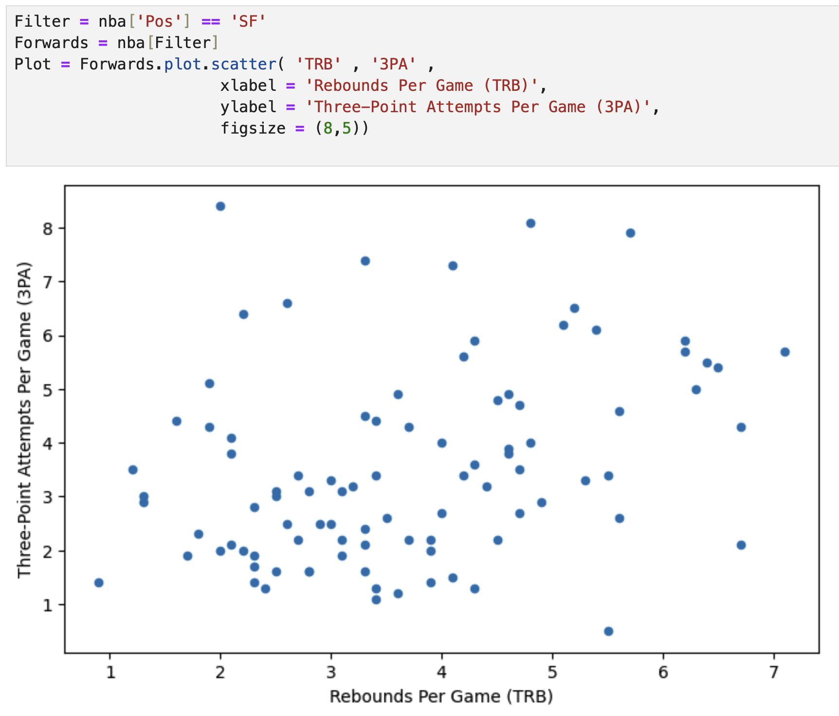
Example
“On average, as the number of rebounds a player averages per game increases, the number of three point attempts they average per game decreases.”

Slide 12
Quick Check 1
Answer on Ed!
Fill in the blanks to create the scatter plot showing three point attempts (“3PA”) vs. rebounds (“TRB”) for small forwards.
Forwards.plot.scatter( ..., ... ,

Slide 13
Customizing Scatter Plots
in Seaborn
1. Review: Histograms
2. Scatter Plots
3. Customizing Scatter Plots
4. Line Plots
5. Multiple Line Plots
➤

Slide 14
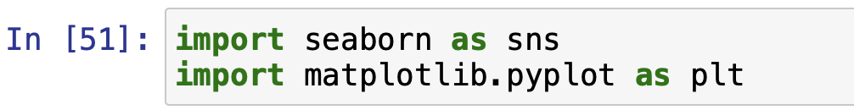
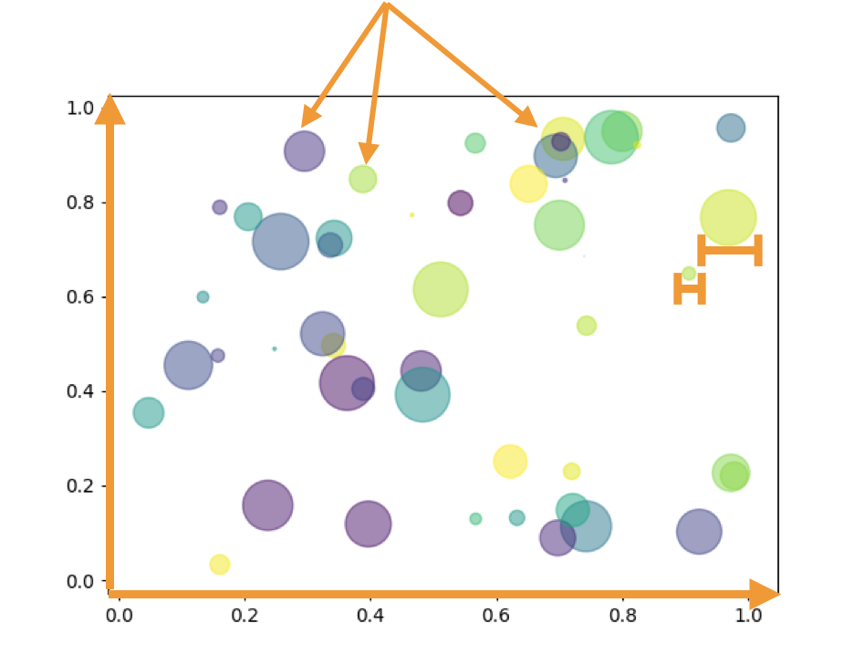
Encoding
Using the seaborn package, we can use s and size to tweak scatter plots.
We can also take things a step further, by changing the following properties for each point:
s – make all points bigger, or make size proportional to some other numerical variable (e.g. older players have larger points).
Color – different colors for different categories (e.g. one color for forwards, one color for guards).
Labels – labeling each point according to a category (name, position, team, etc.).
Remember me?

Slide 15
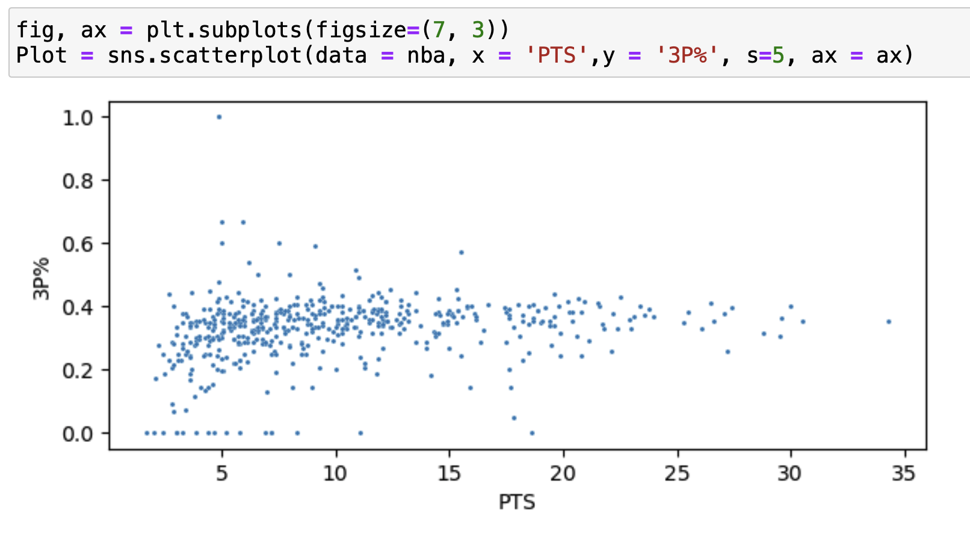
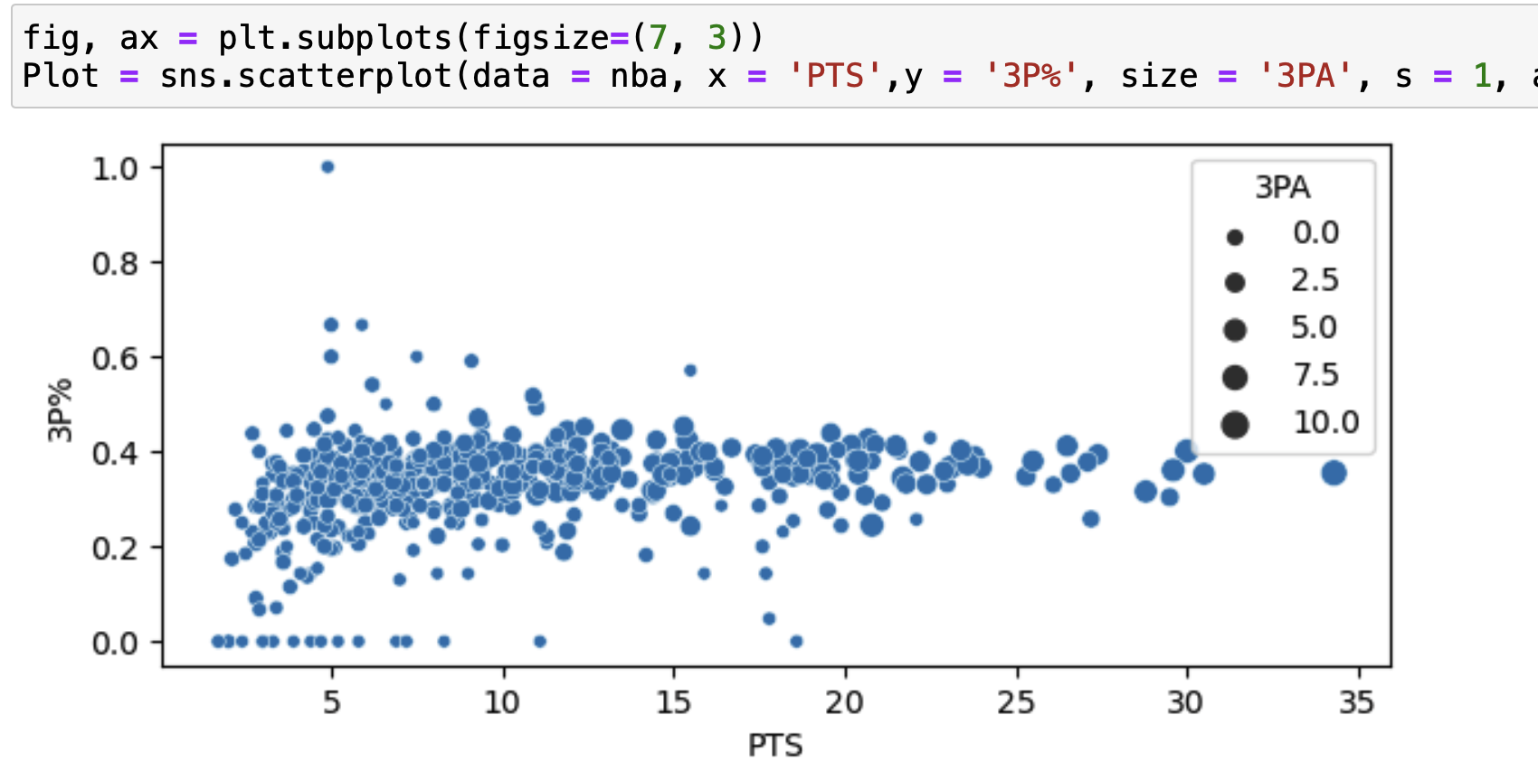
Point Size
There are two relevant arguments:
s (int): assign this to change the default size of all points.
size (str): assign this to the name of a numerical column in your table; point sizes will be proportional to the values in this column.
As 3PA increases, point size increases.

Slide 16
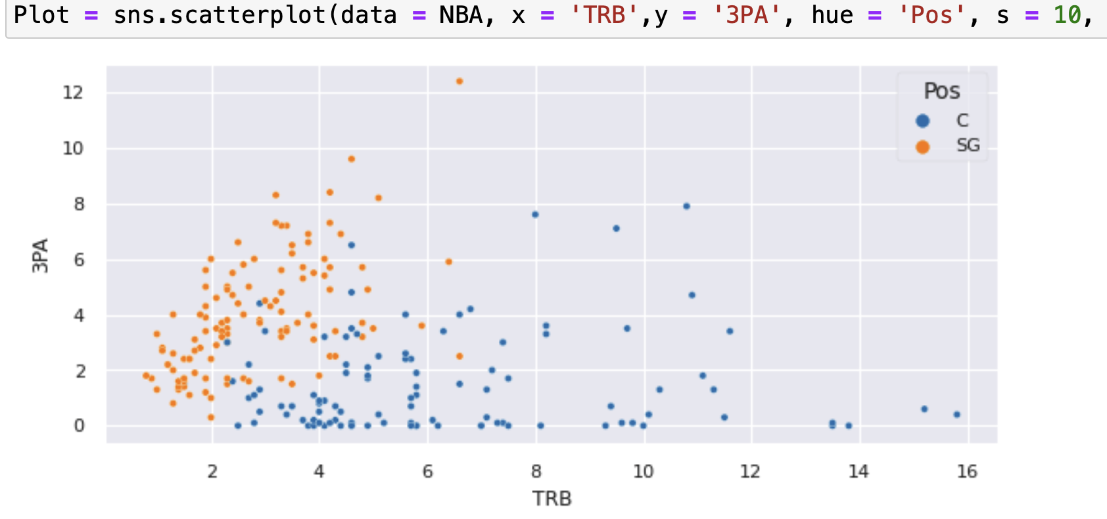
Point Color
hue (str): assign this to the name of a categorical column in your table.
Point colors will be determined according to the category.
Effectively two separate scatter plots sharing the same axis.
“Shooting Guards tend to have fewer rebounds and more three-point attempts than centers.”

Slide 17
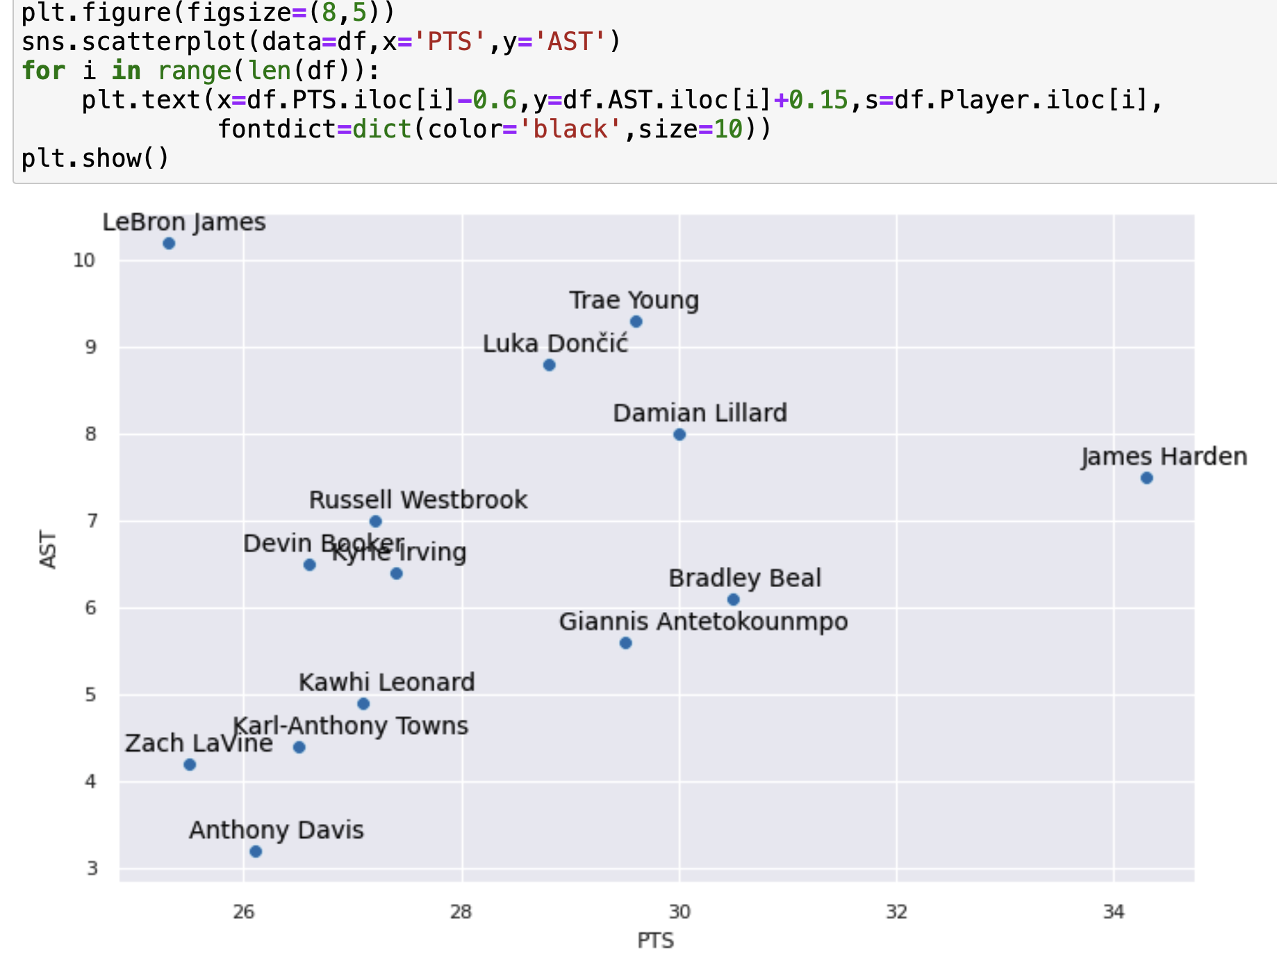
Labels
Assign text to points using plt.text (str)
The more points you have, the harder the labels will be to read.
Pros: Very customizable
Cons: A little complicated using seaborn and matplotlib, uses a for-loop to label each point individually

Slide 18
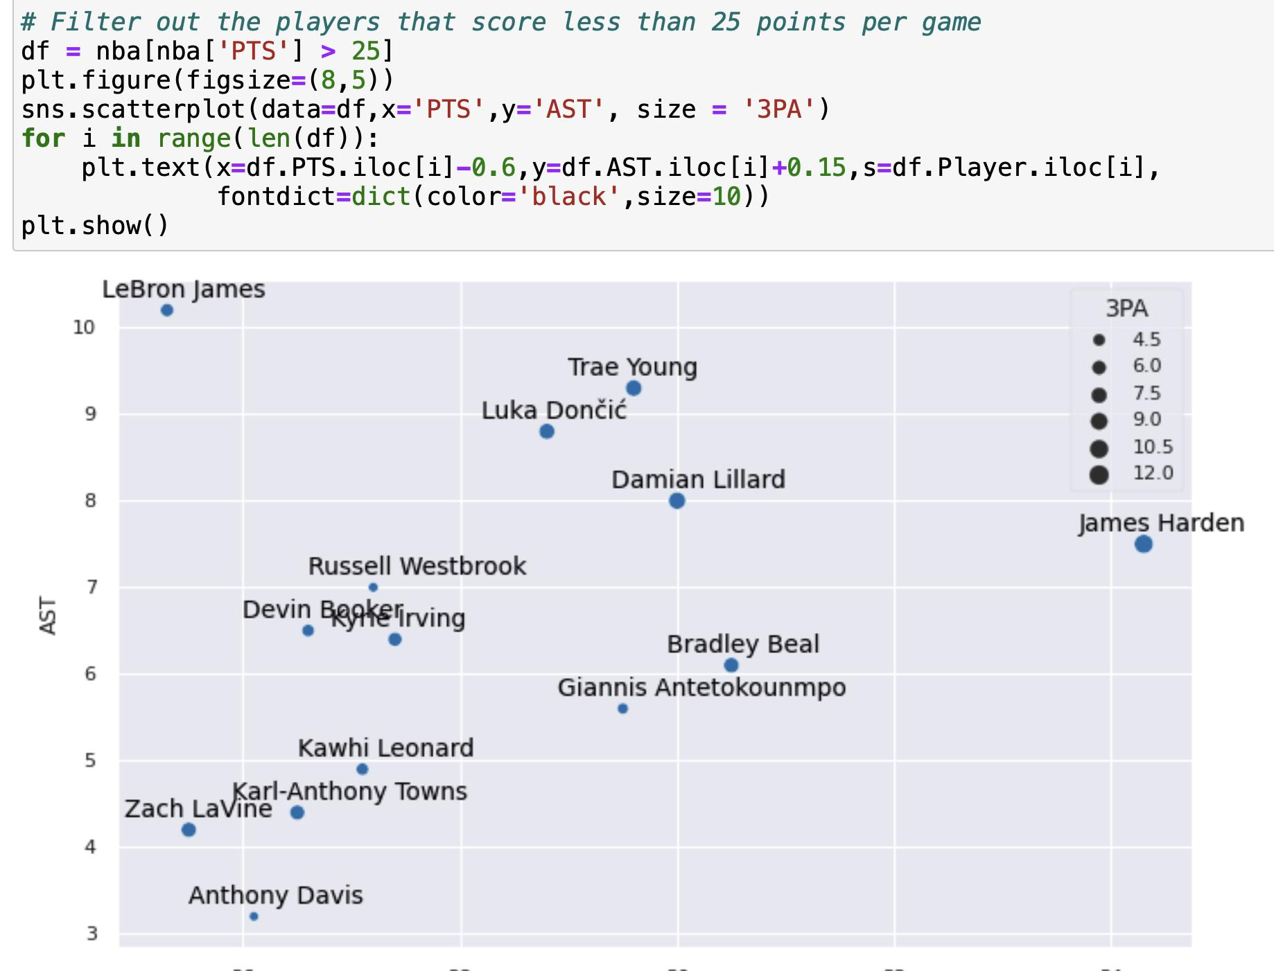
Four variables are being encoded here:
PTS (x).
AST (y).
Name (label).
3PA (size).

Slide 19
Line Plots
1. Review: Histograms
2. Scatter Plots
3. Customizing Scatter Plots
4. Line Plots
5. Multiple Line Plots
➤

Slide 20
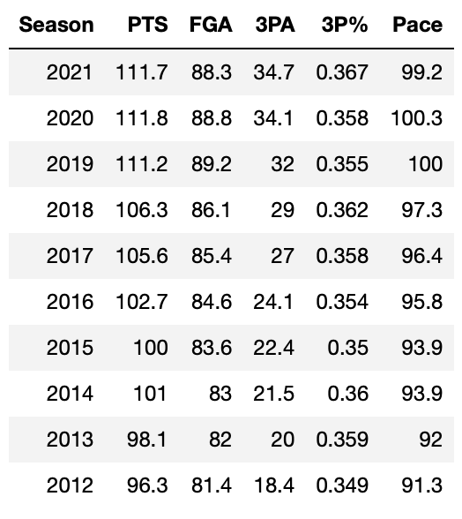
New dataset
Our second dataset also comes from Basketball Reference. This dataset contains team-based average statistics for each year.
A little bit about our new dataset:
'Season': the second calendar year for each season (e.g. `2018` refers to the 2017-18 season).
'FGA': the average number of field goal attempts (shot attempts) per game.
'Pace': the average number of times a team had possession of the ball per game.

Slide 21
Motivating Line Plots
What if we want to visualize two numerical variables, but one of them is time?
COVID cases per day in Alameda County.
Average rainfall for each month of the year in San Diego.
While a scatter plot would theoretically work in such a scenario, there are some key differences that lead us to another type of plot.
There’s only one y for every x.
There’s only one number of COVID cases per day.
There can be many people with the same height when graphing weight vs. height.
We want to emphasize a trend by “connecting the dots”.
🤔

Slide 22
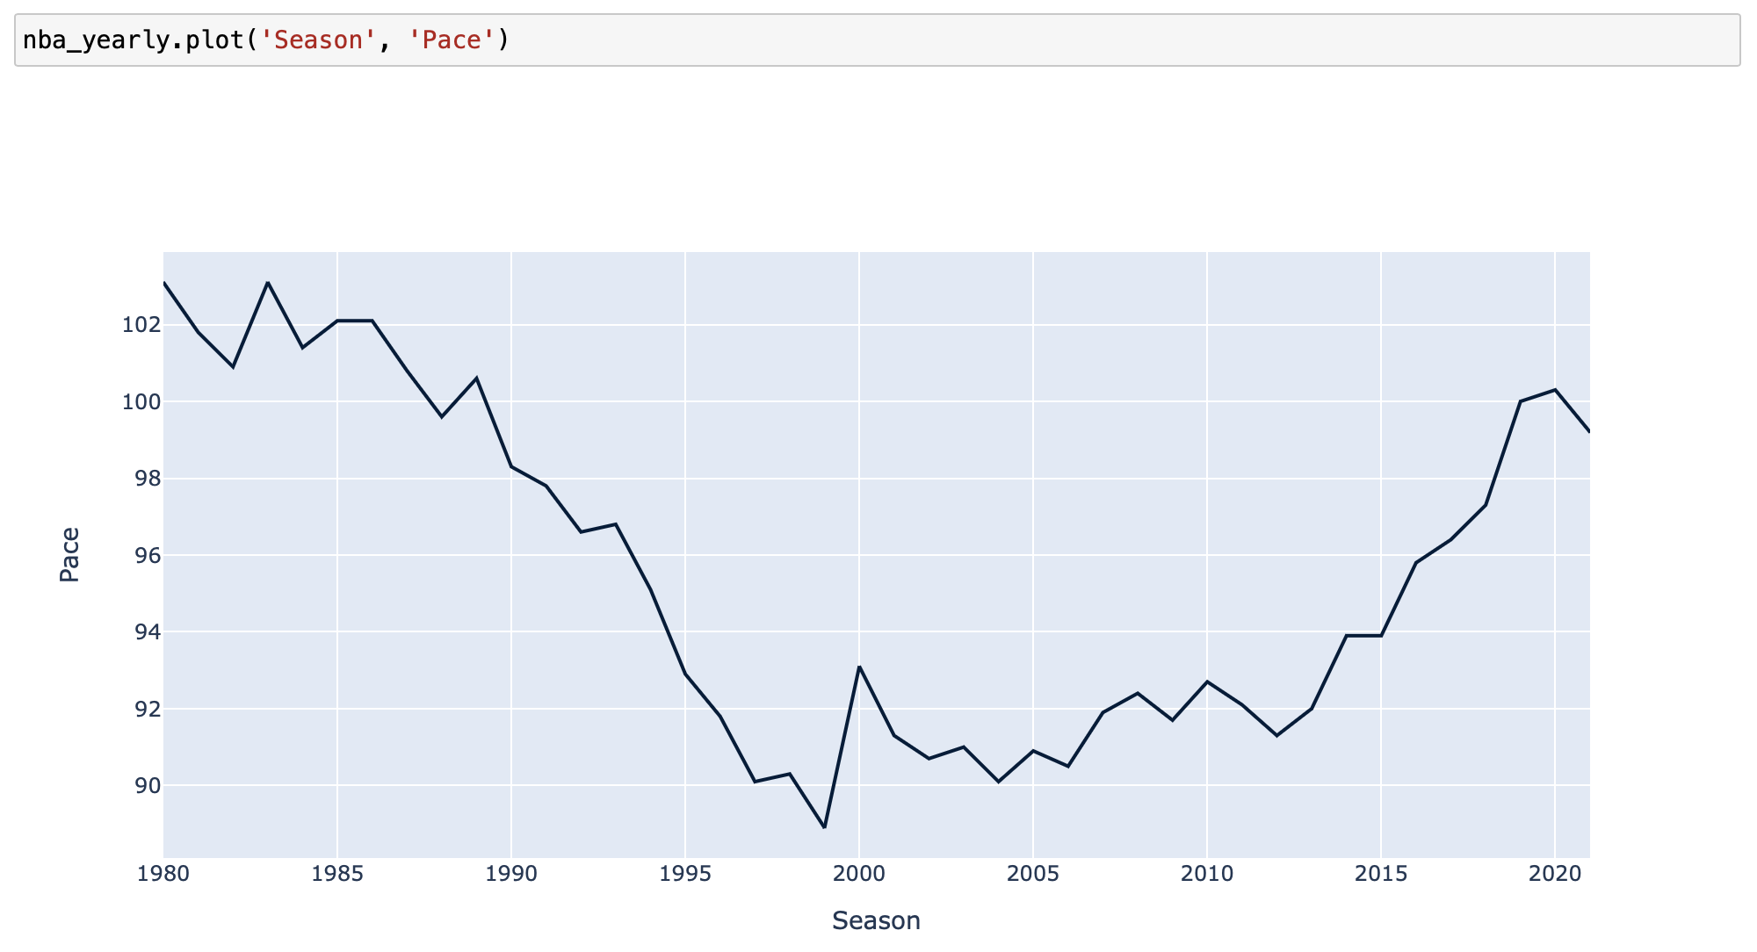
.plot()
The method
t.plot(column_for_x, column_for_y)
creates a line plot using the specified columns. Both columns must contain numerical values.
column_for_x should contain some time-based variable.
If only column_for_x is provided, a separate line plot is drawn for every other column in t (similar to the behavior of barh and scatter).
“The league slowed down in the late 90s and early 2000s, but is speeding back up.”

Slide 23
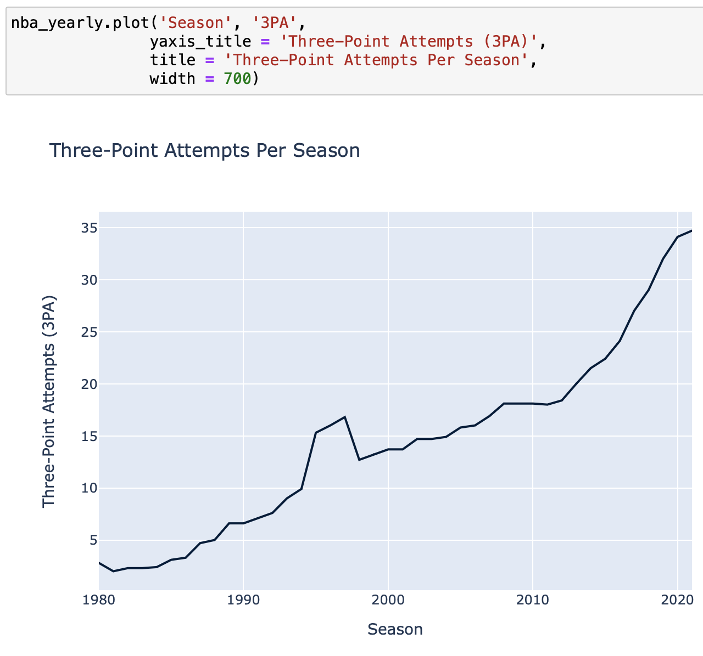
Examples
“The three-point shot has rapidly increased in popularity over the past decade.”

Slide 24
Multiple Line Plots
1. Review: Histograms
2. Scatter Plots
3. Customizing Scatter Plots
4. Line Plots
5. Multiple Line Plots
➤

Slide 25
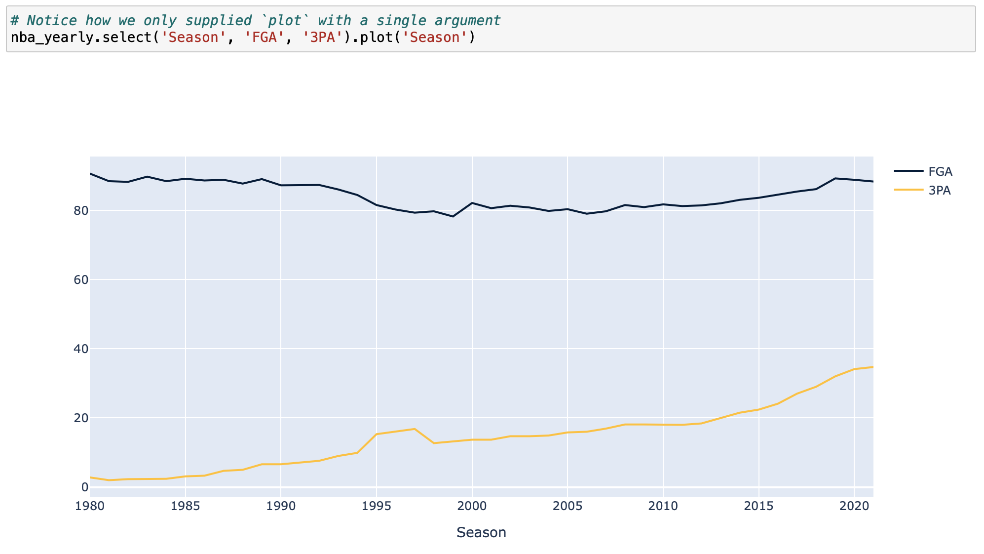
Multiple line plots
If we provide plot with only a single column name, it will draw lines for every other column in your table.
If you want to do this, make sure to select columns first!

Slide 26
In Conclusion…

Slide 27
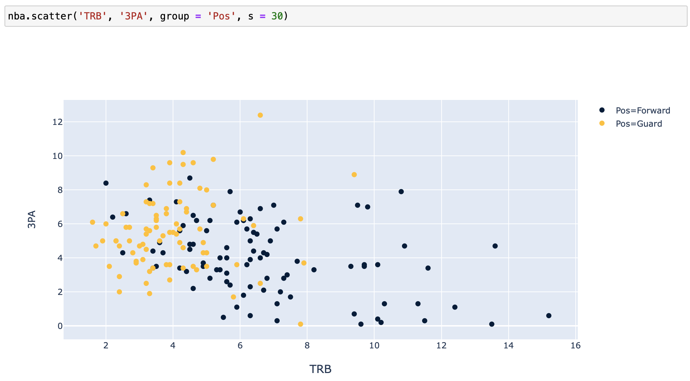
Scatter Plots vs. Line Plots
Scatter plots visualize the relationship between any two numerical variables.
No need to have unique x (or y) values.
Useful for identifying patterns between variables
Line plots visualize the relationship between two numerical variables — one of them is ordered.
x-axis generally represents time or distance.
There should only be one y value for every x value.
Useful for identifying trends over time

Slide 28
Summary: scatter
The method
df.plot.scatter(column_for_x, column_for_y)
creates a scatter plot using the specified columns. Both columns must contain numerical values.
Optional arguments, in addition to xlabel, etc:
s (int): changes default size of all points.
size (str): point sizes will be proportional to the values in this numerical column.
Using df.groupby to plot separate histograms colored according to category in this categorical column.
In seaborn, using sns.scatterplot to make more advanced plots and visualize several different variables all at once.

Slide 29
Summary: plot
The method
dt.plot(column_for_x, column_for_y)
creates a line plot using the specified columns. Both columns must contain numerical values.
column_for_x should contain some time-based variable.

Slide 30
Recap
Next Time
Visualizing Multiple Variables
Scatter Plots
Line Plots
Customizing Visualizations
Mid Semester Project

Slide 31
Week 2
Announcements!
Mid-Semester Project on Wednesday
Office Hours take place
(Suzanne) Mondays 4:30 - 5:20PM in ACS 366
(Adrien) Wednesdays 4:30 - 5:20PM in ACS 330B
(Jordan) Tuesdays & Thursdays 10-12am

