Slide 1
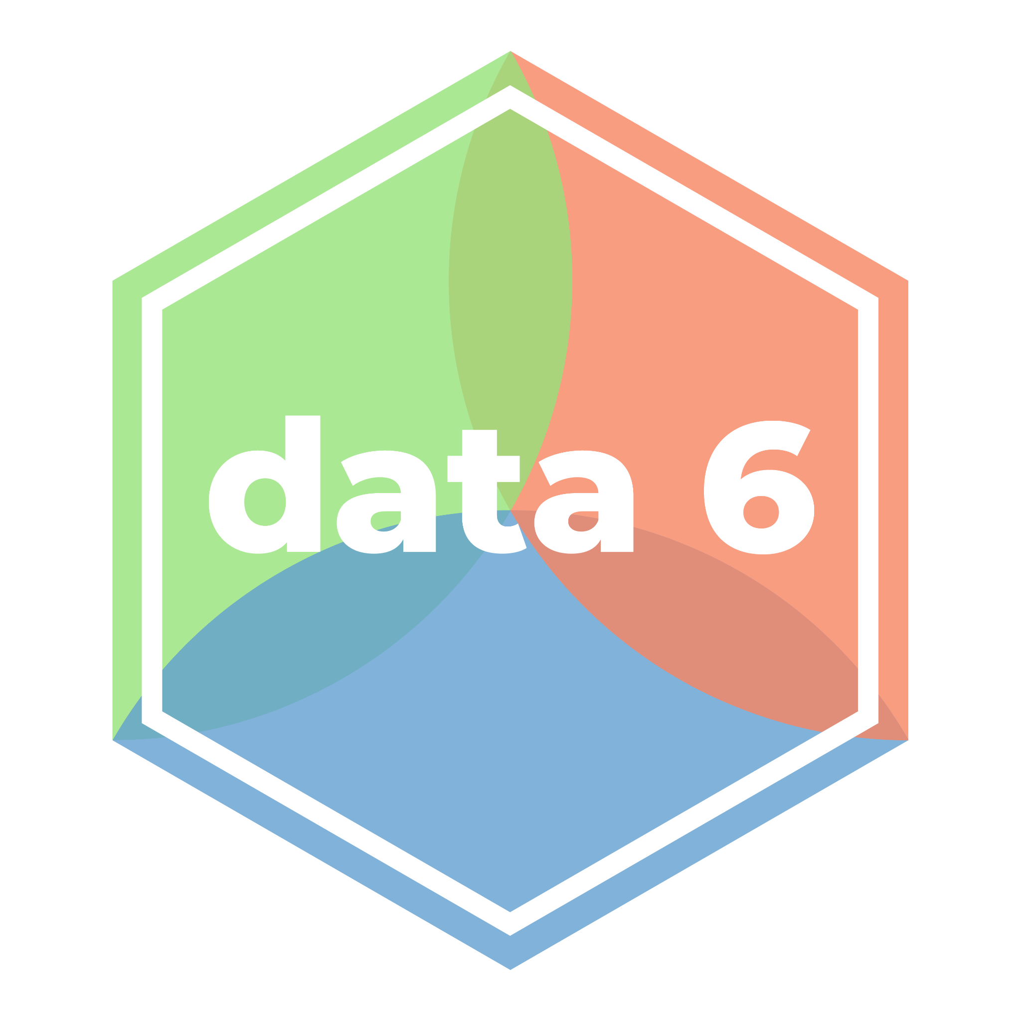
Taking and
Filtering Rows
LECTURE 15
Getting subsets of table rows to answer questions.
Spark 10, Spring 2024
Developed by students and faculty at UC Berkeley and Tuskegee University
data6.org/su23/syllabus/#acknowledgements-

Slide 2
Ice Breaker
Would you rather be able to teleport or fly?

Slide 3
Week N
Announcements!
Hope everyone had a great break!
No Homework Due this week!
Office Hours take place
(Suzanne) Mondays 4:30 - 5:20PM in ACS 366
(Adrien) Wednesdays 4:30 - 5:20PM in ACS 330B
(Jordan) Tuesdays & Thursdays 10-12am

Slide 4
Today’s Roadmap
Review: .iloc
Booleans
Boolean Filtering
Lecture N, Spark 10, Spring 2024

Slide 5
Review: .iloc
➤
1. Review: .iloc
2. Booleans
3. Boolean Filtering

Slide 6
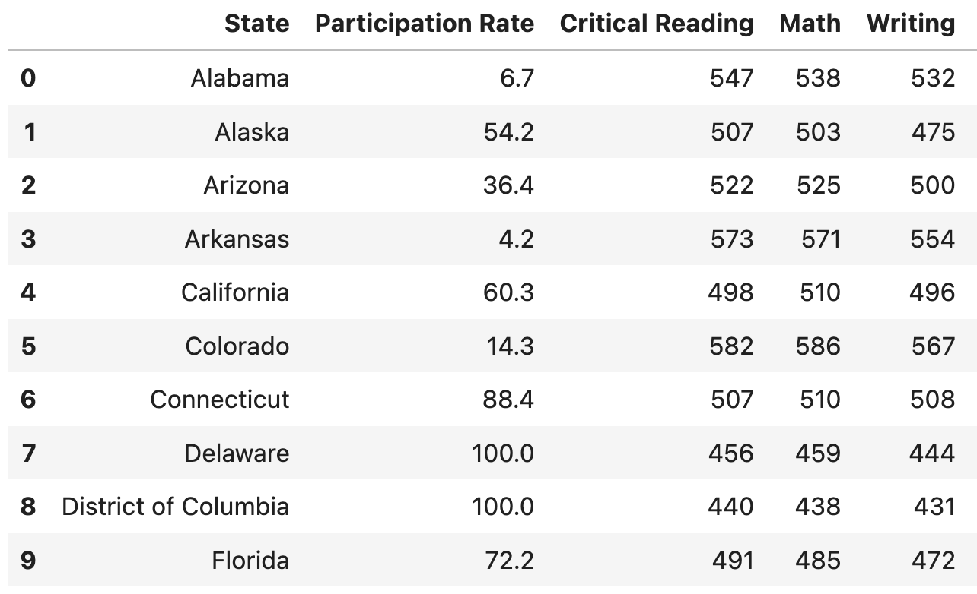
Row Index
Rows, like columns, have indexes. Like everything else in Python, rows are 0-indexed.
Row 0
Row 5

Slide 7
.iloc[]
The method
t.iloc[row_indices]
only the rows specified by the integer locations (i.e., i loc).
If row_indices is a single integer, it returns just one row – the row at index row_indices.
If row_indices is an array, it returns a table with all of the rows at positions specified by row_indices.
.iloc is often used in conjunction with NumPy array ranges!

Slide 8
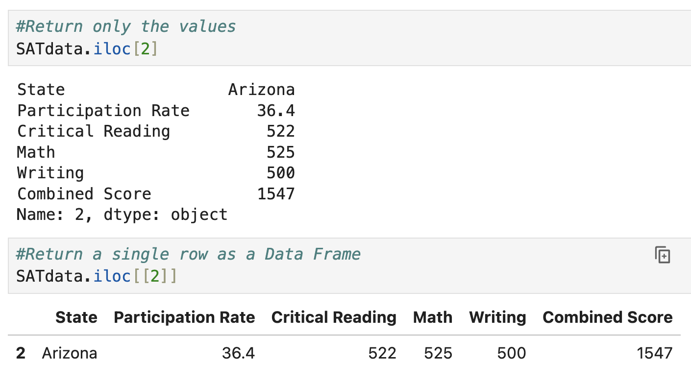
.iloc[]
When we have a single row, we have a couple of options.
t.iloc[Row]
Returns the values ONLY!
t.iloc[[Row]]
Returns a data Frame!

Slide 9
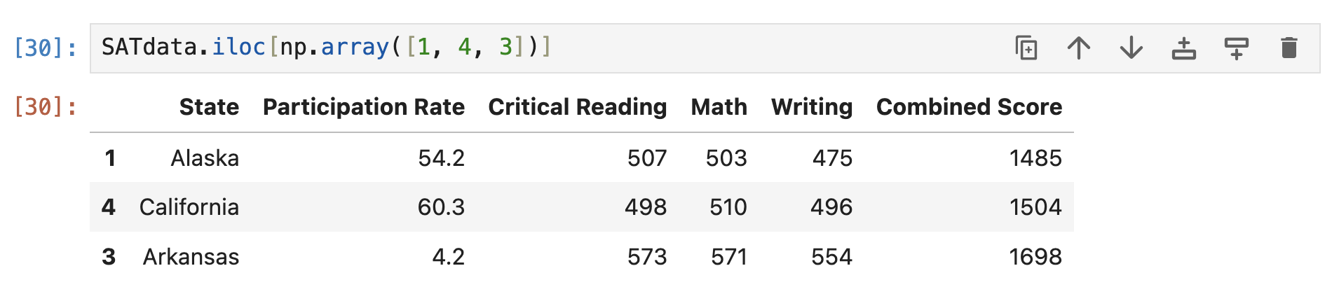
.iloc[] with Arrays
We can also use np.array to specify a number of rows to extract
t.iloc[np.array[([i,j,k,l,m])]

Slide 10
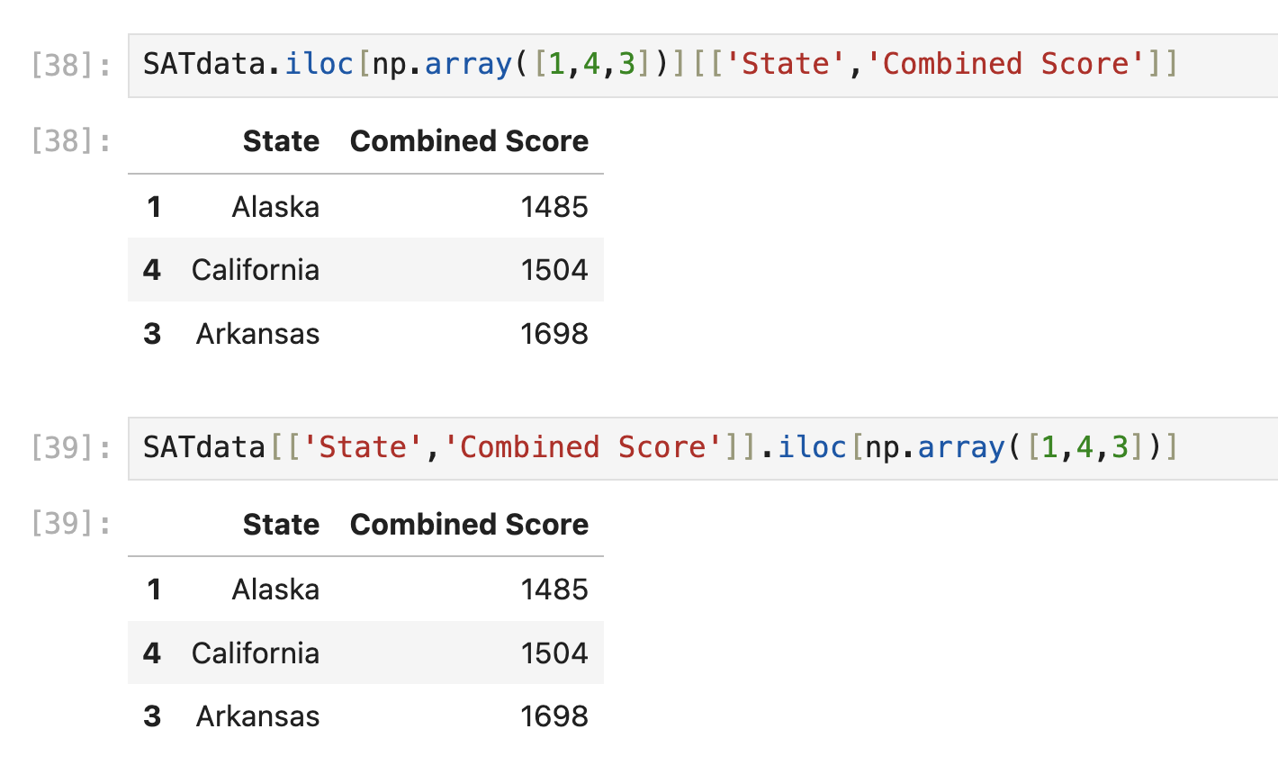
.iloc[] with Arrays
Incidentally, the .iloc method works on arrays too, not just tables.
That means you can reverse the order of .iloc and column and still get the same result.
⚠️ Be careful to use double square brackets for the columns [[]] to get the result as a data frame. And always check your results at each step when you have a long process.

Slide 11
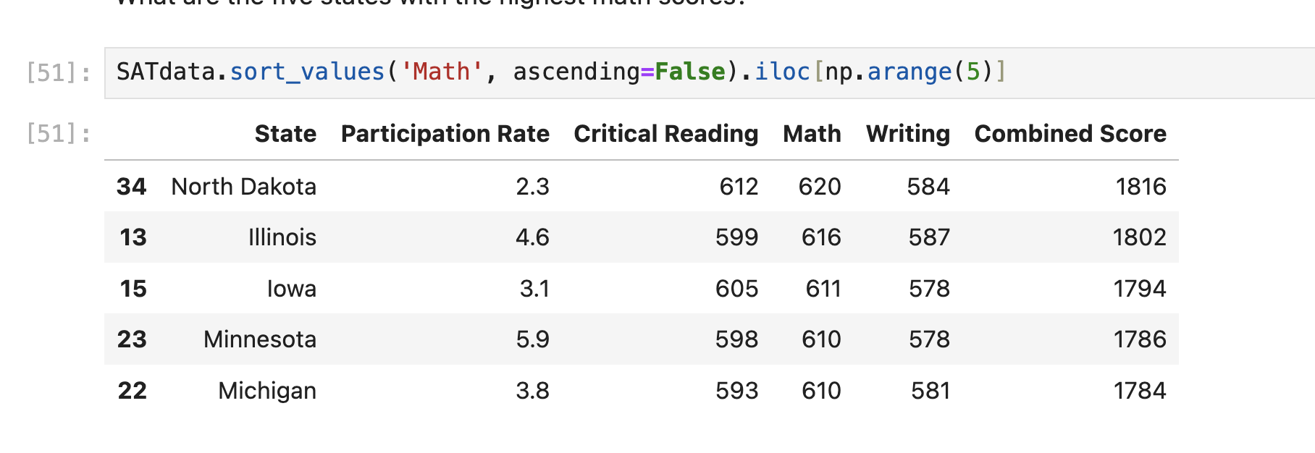
.iloc[] with Arrays
Recall that we can chain commands to construct more complex arrangements.
Suppose we want to get the states with the Top 5 Math scores.

Slide 12
Questions?

Slide 13
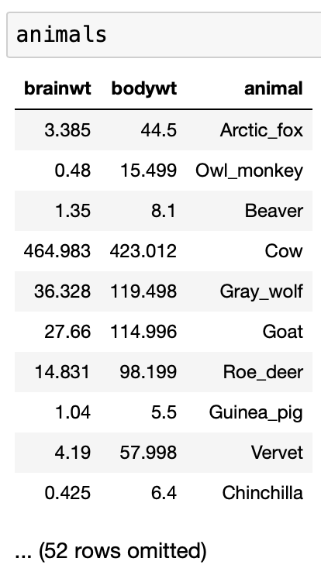
Quick Check 1
Suppose animals is the table shown to the right.
Fill in the blanks so that the result is an array containing the names of the five smallest animals by body weight, in increasing order.
animals.sort_values(____).iloc[_____]
Notes:
animals.sort_values('bodywt', ascending = True).iloc[np.arange(5)] # Replace the blanks with your answer

Slide 14
Booleans
1. Review: .iloc
2. Booleans
3. Boolean Filtering
➤

Slide 15
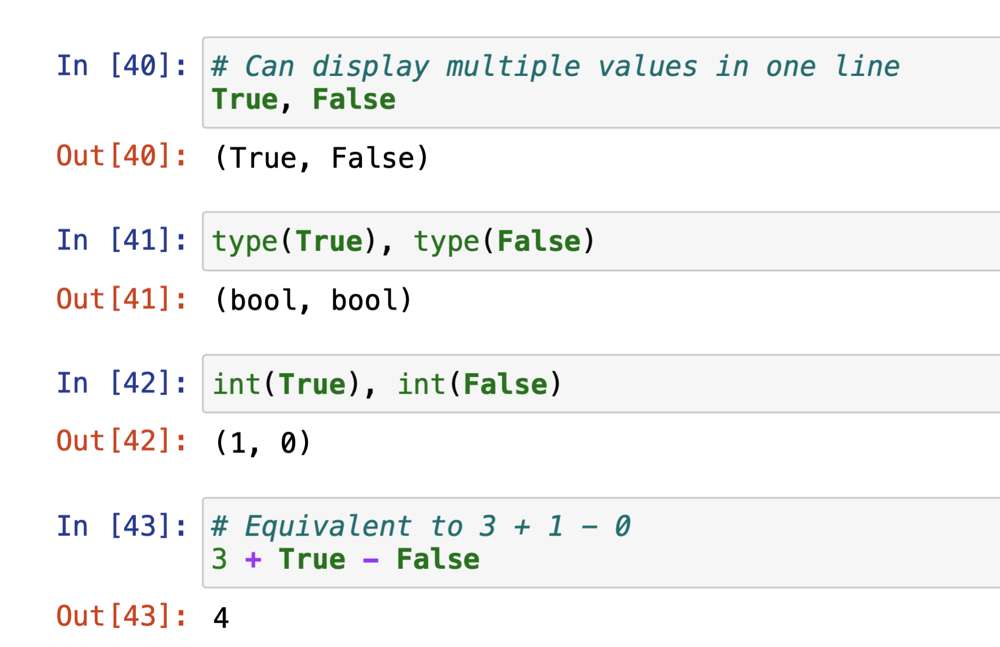
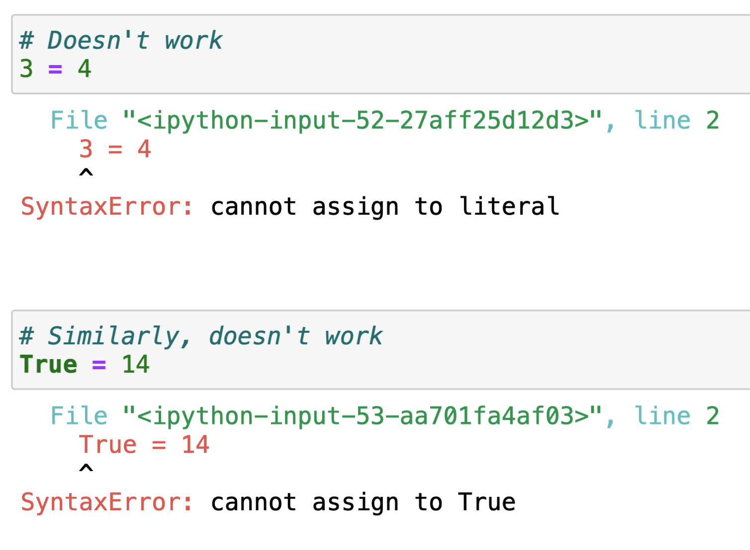
bool
The bool, or Boolean type, has only two values: True and False. No other values have this type.
True, and False are Python keywords.
They have special meanings and cannot be
used as names.
In this regard, they’re similar to values 3, -15.2, and "zebra".

Slide 16
Boolean Data
In data science, boolean values can be used represent a binary variable:
yes/no, on/off, high/low, etc.
Boolean statements/questions have only True or False answers.
Example:
5 is even
5 is odd.
This class is Spark 10
This class is Psyc 10

Slide 17
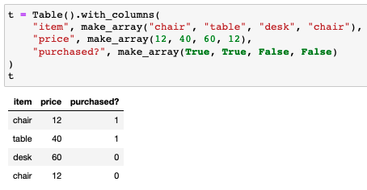
Using Boolean Values
True and False are technically numeric values: you can cast them to integers and floats, and use them in arithmetic expressions.
True is equivalent to 1.
False is equivalent to 0.
Like other data types, it can be stored in arrays.

Slide 18
Boolean Function: AND (&)
A | B | A & B
True | True | True
True | False | False
False | True | False
False | False | False
This table shows the result of applying the & (logical AND) operator to all possible combinations of boolean values for A and B. The result of A & B is True only when both A and B are True.

Slide 19
Boolean Function: AND (&)
There are many mathematical examples that can be given to illustrate the AND, but let’s do some examples outside of math/programming.
Going to the Beach: We will only go to the beach if it is warm and sunny. This decision requires both conditions to be true; if it's cold or cloudy, the decision is false.
Watching a Movie: We will watch a new movie tonight if it has good reviews and any of our friends want to join. Both conditions must be met for the plan to proceed.
Plant Watering: A gardener decides to water the plants if the soil is dry and there's no forecast for rain. This ensures the plants are watered only when necessary.

Slide 20
Boolean Function: OR (|)
A | B | A | B
True | True | True
True | False | True
False | True | True
False | False | False
This table shows the result of applying the | (logical OR) operator to all possible combinations of boolean values for A and B. The result of A | B is False only when both A and B are False.

Slide 21
Boolean Function: OR (|)
There are many mathematical examples that can be given to illustrate the OR, but let’s do some examples outside of math/programming.
Outdoor Exercise: I will go for a run outside if the weather is cool or the air quality is good. If either condition is true (it’s cool or the air quality is satisfactory), the run outside is a go.
Dinner Choice: We will eat at a restaurant tonight if we don't feel like cooking or if there’s a special occasion. The decision to dine out hinges on either circumstance being true.
Movie Night: We'll have a movie night at home if it's raining or if there’s nothing interesting happening in town. In this scenario, either condition being true makes movie night the chosen activity.

Slide 22
Questions?

Slide 23
Filtering Rows with Boolean Variables
1. Review: .iloc
2. Booleans
3. Boolean Filtering
➤

Slide 24
Review: Filtering Rows
Often times, we will have a table and will want to access only the rows where some condition is true. For example, given our SAT data, we may want all of the rows where…
The combined SAT score is above 1800 (remember, this data is on the old 2400 scale).
The state name is equal to “California”.
The state name contains “Dakota”.
The math SAT score is between 580 and 600.
Accessing a subset of our data is called filtering. We will use boolean variables to filter our data frame.
We will look specifically at applying filters for numerical values (>, <, between)
String values (is exactly, is contained in)

Slide 25
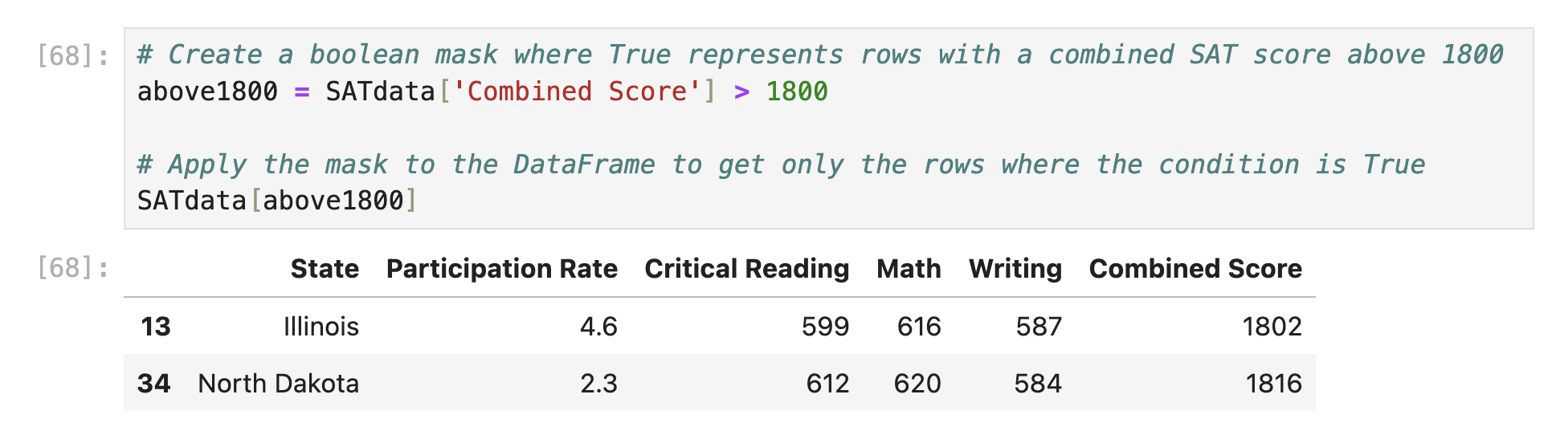
Numerically Filtering ( >, >=, <, <= )

Slide 26
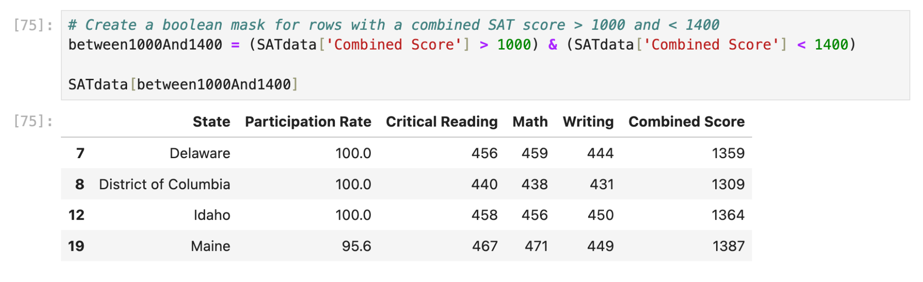
Boolean Filtering: Between Two Values
If we want to get rows where the Combined Score is between two values, we will use the AND operator. Here we want values above 1000 and less than 1400

Slide 27
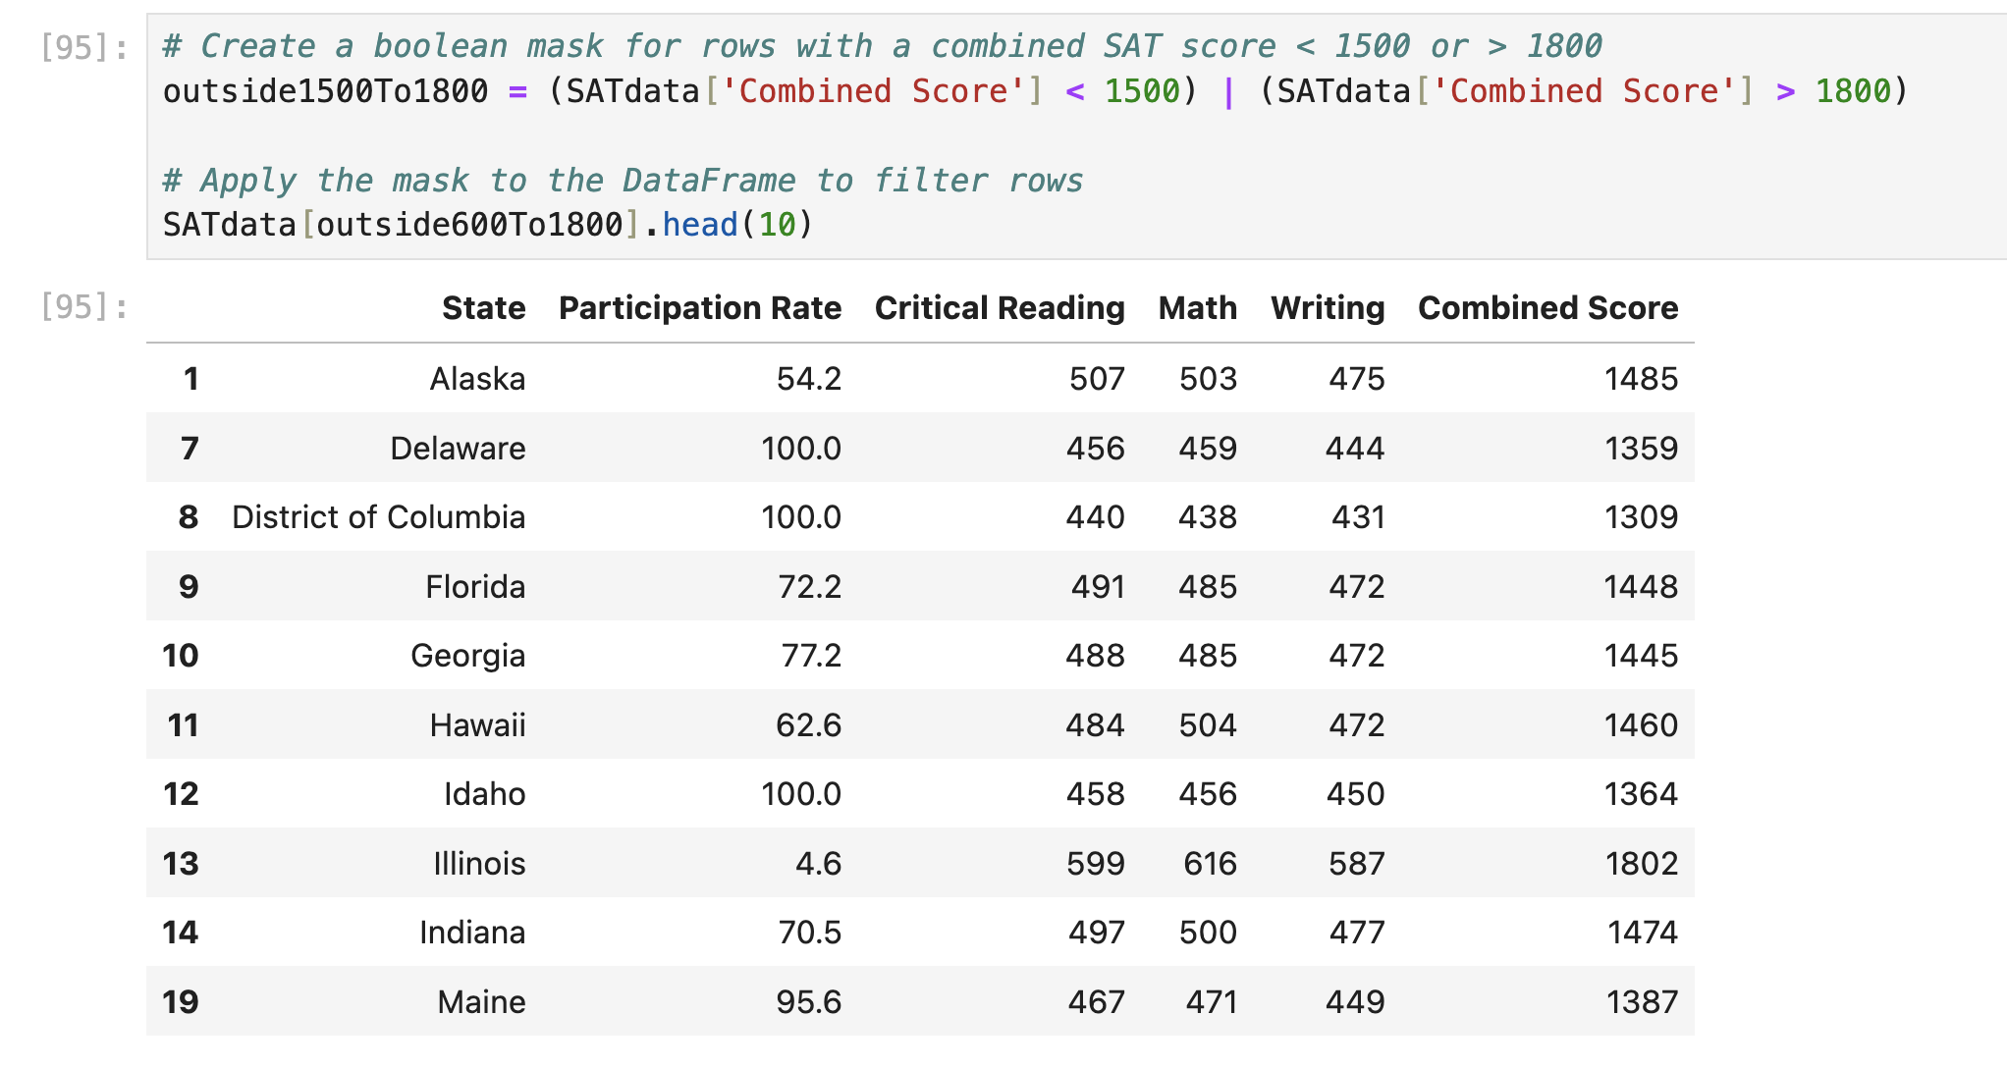
Boolean Filtering: Outside A Range
If we want to get rows where the Combined Score is between outside a range (below 1500 and greater than 1800) we use the OR operator.

Slide 28
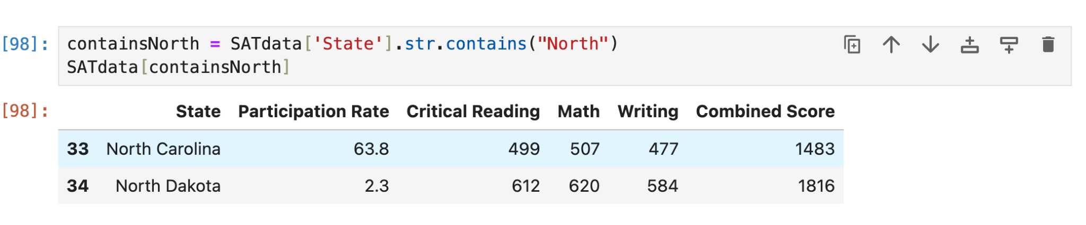
Boolean Filtering: String Contains
Boolean filtering can also be used with string operations! For example, do get all states that contain with word “North” we do the following:

Slide 29
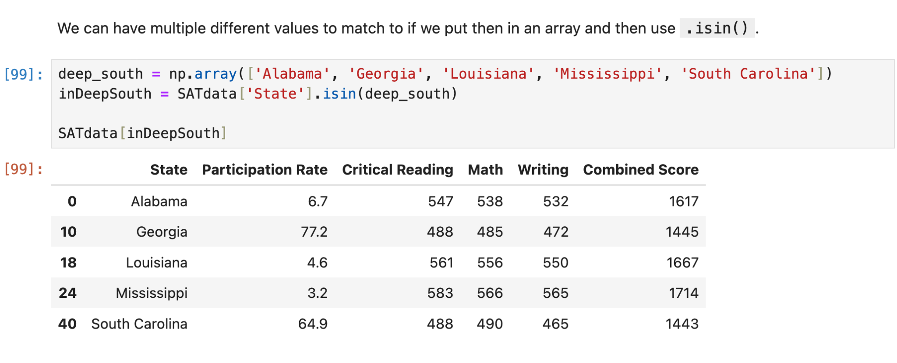
Boolean Filtering: String Contains
We can also use string operations like “==” for string equality and or
“Isin” to match a list of states.
Here is the output for states in the Deep South.

Slide 30
Questions?

Slide 31
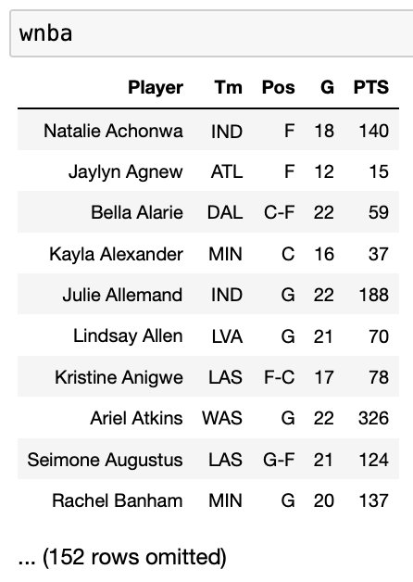
Quick Check 2
Suppose wnba is the table shown to the right.
Fill in the blanks so that the result is the average PTS scored last season by forwards (players whose Pos is “F”) who played 20 or more games.
booleanFilter = (----) & (----)
wnba[booleanFilter]['PTS'].mean()

Slide 32
In Conclusion…

Slide 33
Summary
Table Method | Behavior
t.sort(column_or_label, descending) | Returns a copy of t with the rows sorted according to column_or_label. If descending is not specified, the sorting is done in ascending order; to sort in descending order you must specify descending = True.
t.iloc() | Returns a copy of t with only the rows at the specified positions.
AND/OR | Useful for Boolean Filtering
contains() | String Operations
.isin() | String Operations

Slide 34
Week N
Announcements!
Hope everyone had a great break!
No Homework Due this week!
Office Hours take place
(Suzanne) Mondays 4:30 - 5:20PM in ACS 366
(Adrien) Wednesdays 4:30 - 5:20PM in ACS 330B
(Jordan) Tuesdays & Thursdays 10-12am

Slide 35
Recap
Next Time
.iloc
Booleans
Boolean Filtering
More table/data frame manipulations

