Slide 1

Joining and
Row Methods
LECTURE 16
Combining multiple sources of data.
Spark 10, Spring 2024
Developed by students and faculty at UC Berkeley and Tuskegee University
data6.org/su23/syllabus/#acknowledgements-

Slide 2
Icebreaker
What is your hottest take?
(most unpopular opinion)

Slide 3
Week 10
Announcements!
No Homework Due this week!
Office Hours take place
(Suzanne) Mondays 4:30 - 5:20PM in ACS 366
(Adrien) Wednesdays 4:30 - 5:20PM in ACS 330B
(Jordan) Tuesdays & Thursdays 10-12am

Slide 4
Today’s Roadmap
Joining Tables
Demo
Lecture 16, Spark 10, Spring 2024

Slide 5
Joining Tables
➤
1. Joining
2. Demo
3. The Row Data Type

Slide 6
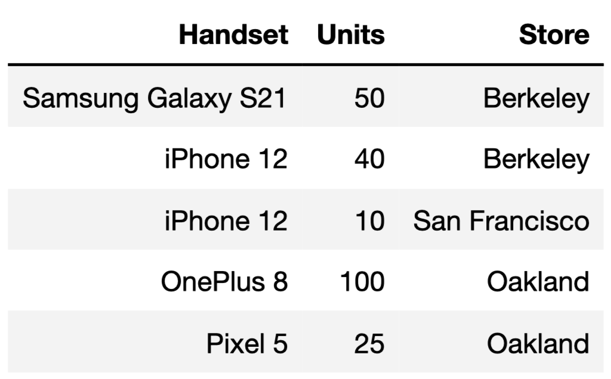
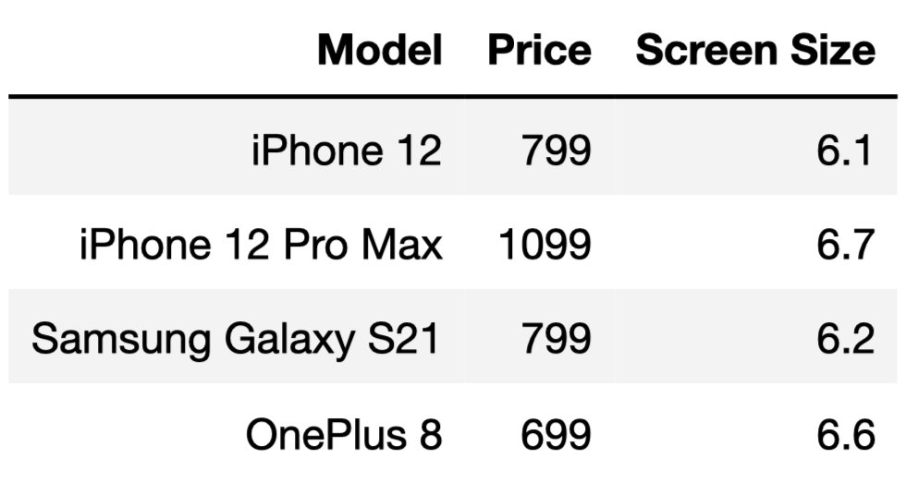
phones
inventory
Question: If I sold all of the phones in my inventory, what would my revenue be?

Slide 7
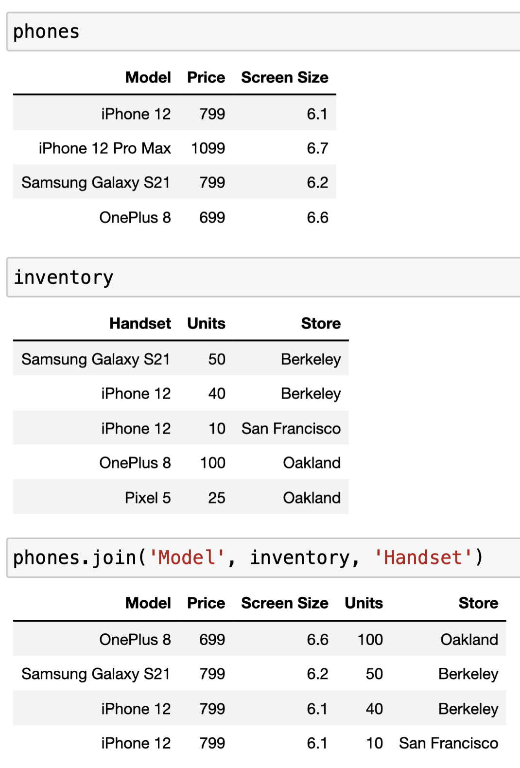
pd.merge()
The method
pd.merge(table1, table2, left_on = 'col1',right_on = 'col2')
combines table1 and table2 into a larger table, by looking for matches in 'col1' of table1 and 'col2' of table2 and combining matching rows.

Slide 8
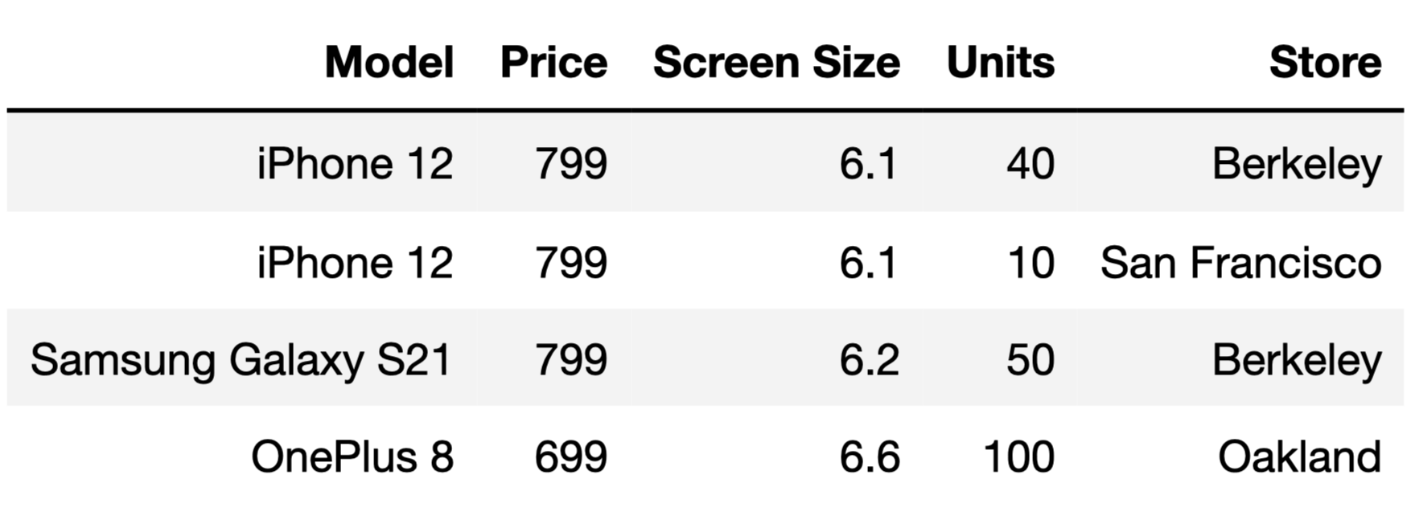
phones
inventory
pd.merge( phones, inventory, left_on ='Model', right_on = 'Handset')

Slide 9
phones
inventory
No matches!
pd.merge( phones, inventory, left_on ='Model', right_on = 'Handset')

Slide 10
phones
inventory
pd.merge( phones, inventory, left_on ='Model', right_on = 'Handset')

Slide 11
phones
inventory
pd.merge( phones, inventory, left_on ='Model', right_on = 'Handset')

Slide 12
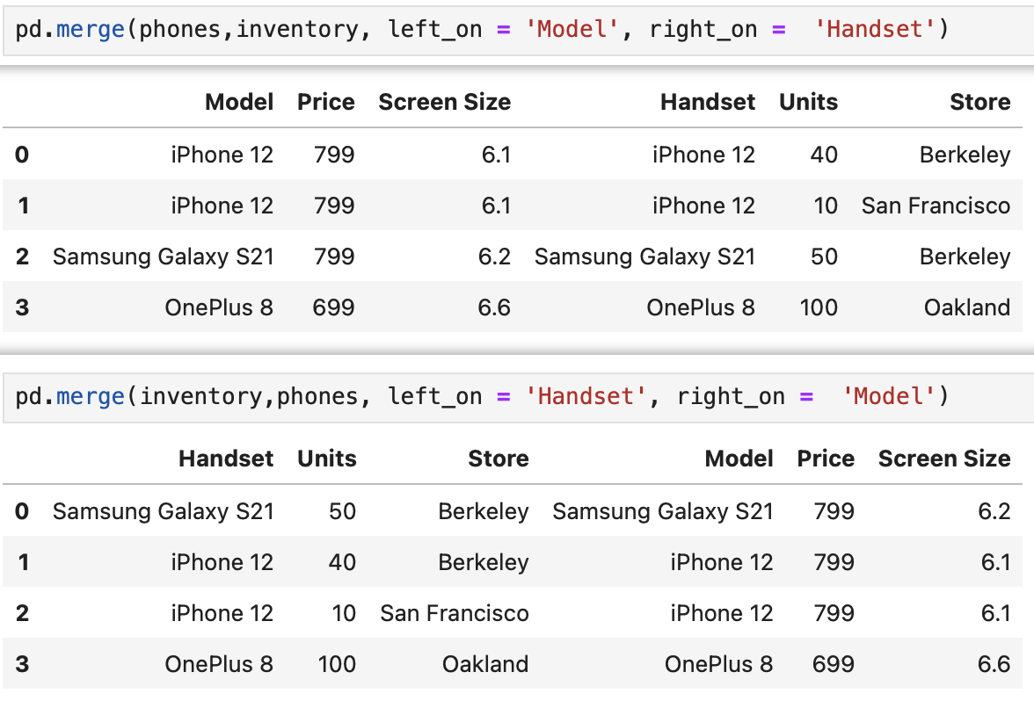
Some Considerations
The order that you join in can change the order of your columns, but doesn’t change the content of your table.

Slide 13
Questions?

Slide 14
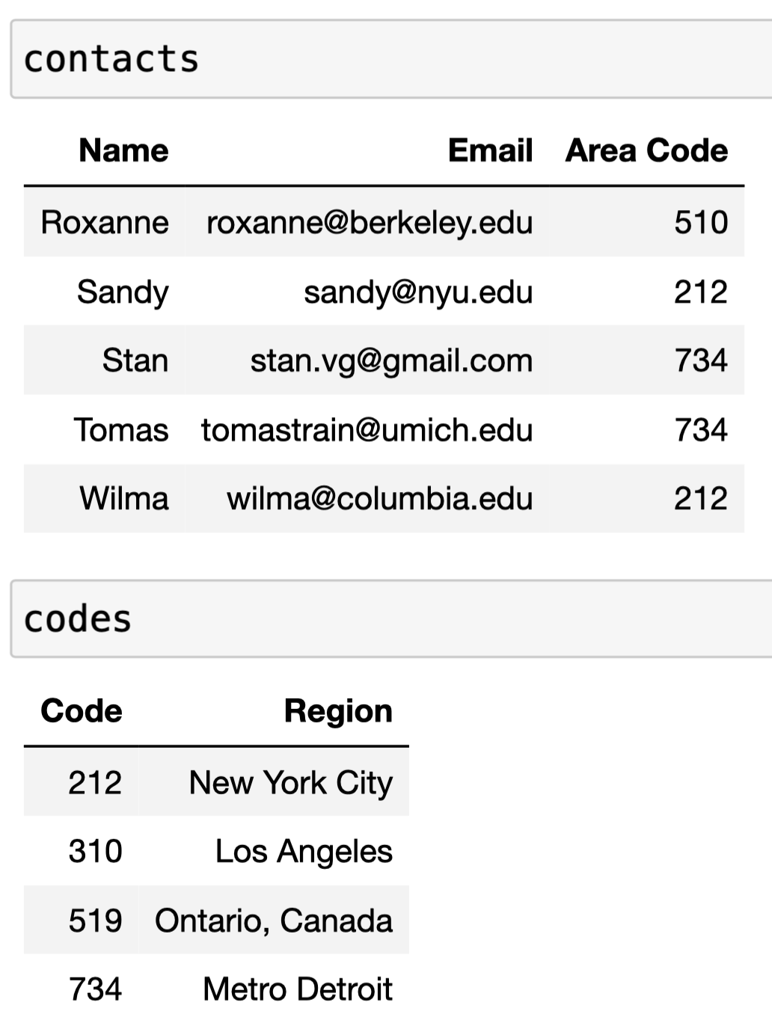
Quick Check 1
Answer on Ed!
Consider the tables contacts and codes.
Fill in the blanks to join the two tables in the way that feels most natural.
pd.merge(___,___,left_on=___,right_on=___)
How many rows and columns will be in the joined table?

Slide 15
Demo
1. Joining
2. Demo
3. The Row Data Type
➤

Slide 16
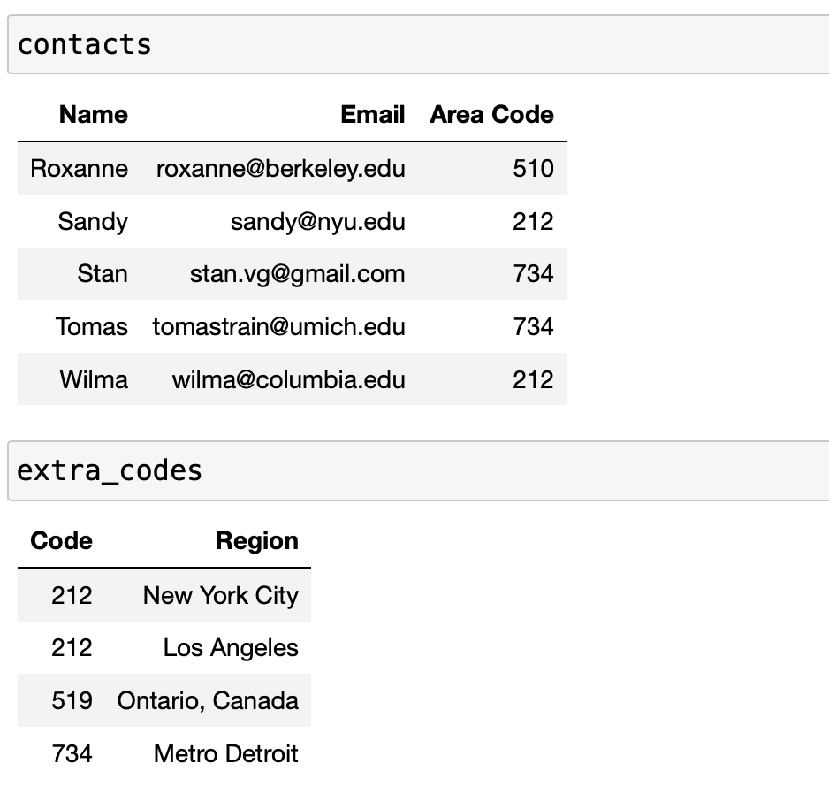
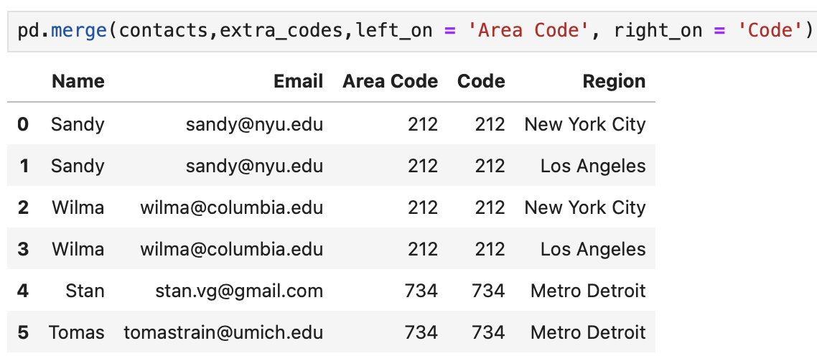
Followup
Beware: merging won’t always give you the result you’re looking for.
Here, it seems odd that we have multiple rows for Sandy with different regions. But that’s how merge works!

Slide 17
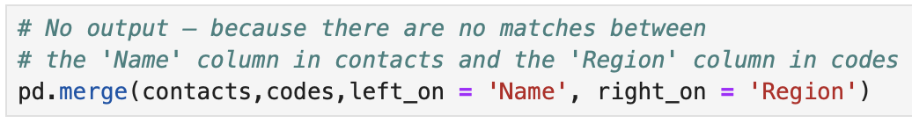
Disclaimer
Pandas doesn’t know what columns to merge on – we need to tell it.
It doesn’t know that it makes sense to join two tables by area code if you don’t tell it to.
Your role is important!
If you try and merge on columns that have no shared elements, the result will be empty.

Slide 18
The Row Data Type
➤
1. Joining
2. Demo
3. The Row Data Type

Slide 19
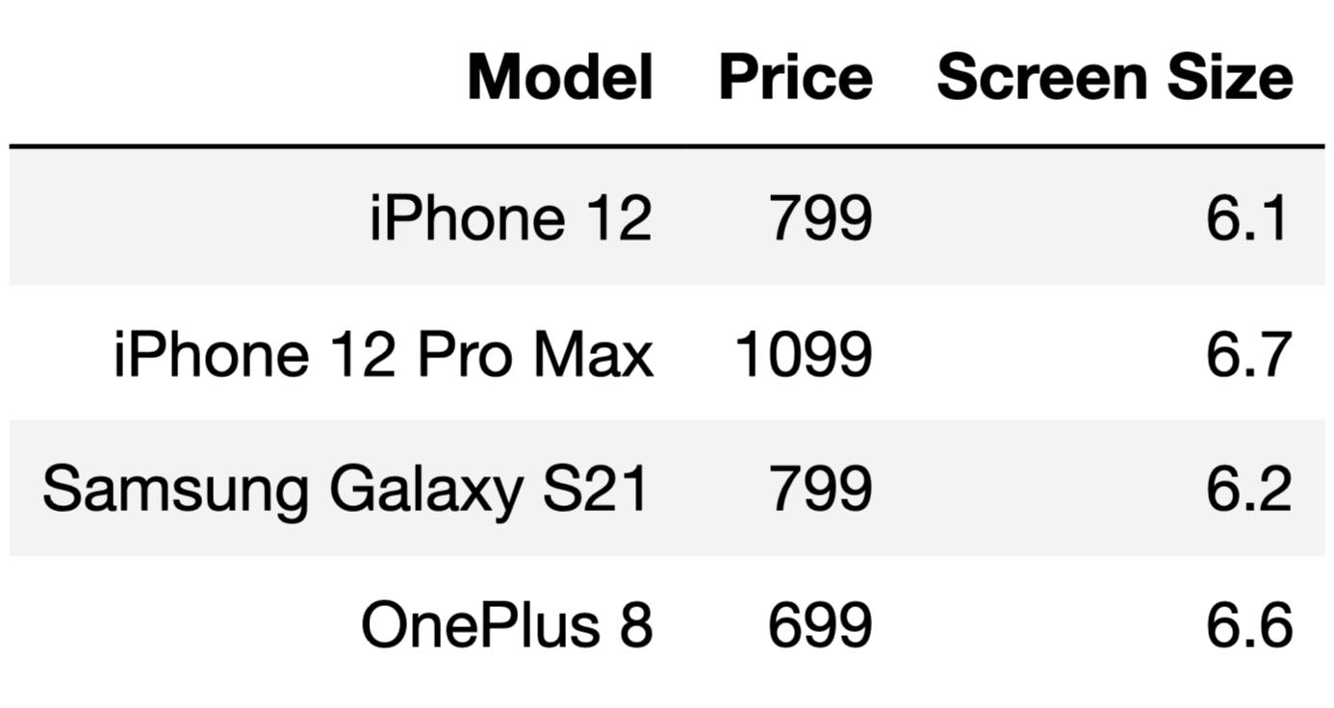
Rows vs. Columns
Each row contains strings, ints, and floats.
What is the data type of a single row?
Question: Are rows stored as arrays?
Answer: No – elements in arrays are stored as Series data types. These are like DataFrames, but are only one-dimensional. All entries in a series must all be of the same type, or Pandas will choose a default type.
So what are rows stored as, then?
Each column only contains one type (e.g. float).

Slide 20
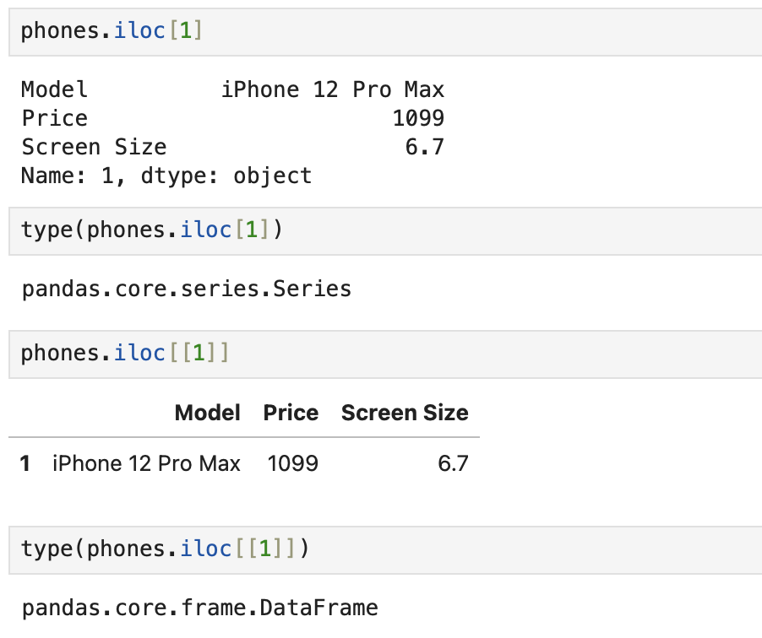
df.iloc[index]
The method
df.iloc[index]
returns a Series at the provided index.
df.iloc[[index]]
returns a DataFrame at the provided index.
Series cannot have elements of different types.
DataFrames can have elements of different types.

Slide 21
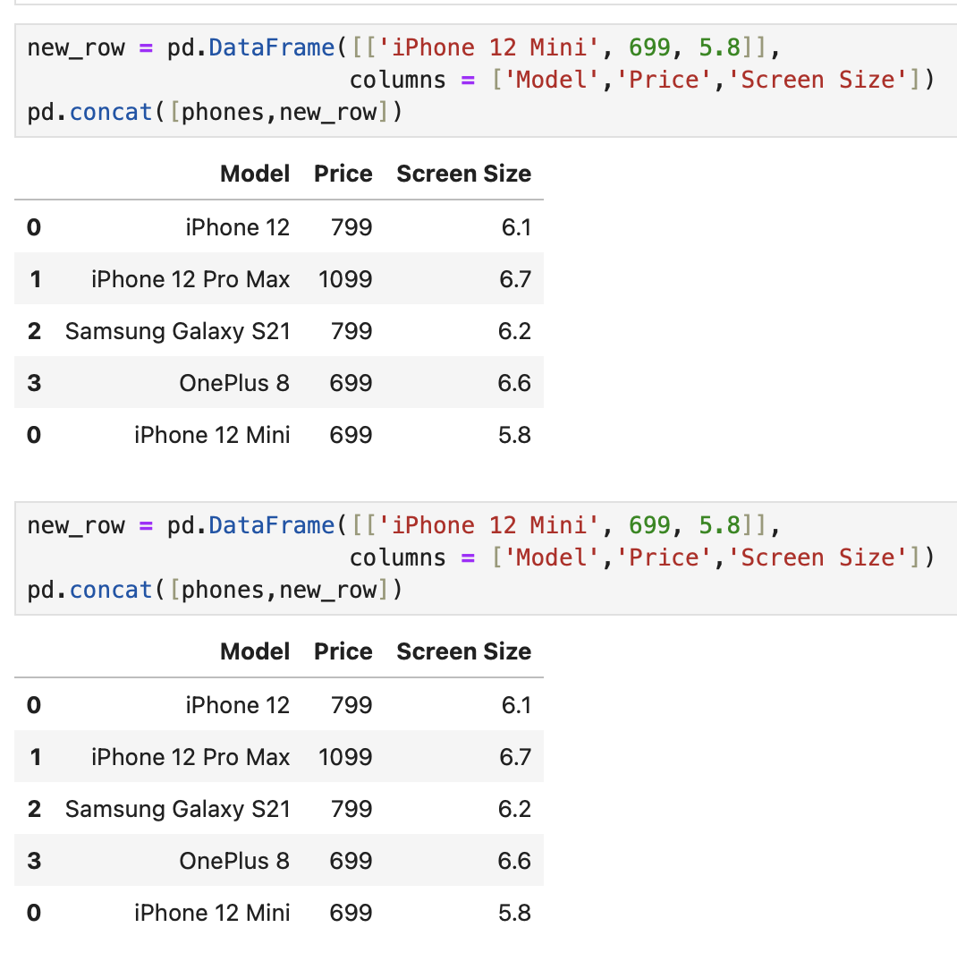
pd.concat()
The methods pd.concat returns a new table with additional rows.
If we want to add rows to df1, we first make a new table df2 with our rows. Then we call pd.concat([df1,df2]) to append them together.
We add rows far less frequently than we add columns, but these methods are still good to know.

Slide 22
Questions?

Slide 23
In Conclusion…

Slide 24
Summary
Method | Behavior
pd.merge(t1,t2,left_on='col1',right_on='col2') | Combines t1 and t2 by looking for matches in 'col1' of t1 and 'col2' of t2 and combining matching rows. Returns a new table.
pd.merge(t1, t2 ,on='column') | Shortcut to the above if 'column 1' and 'column 2' are equal (i.e. the labels of the join columns in both tables are equal).
df.iloc[index] | Returns the row of df at the specified index as a Series.
df.iloc[[index]] | Returns the row of df at the specified index as a DataFrame
pd.concat([df1,df2]) | Returns a copy of df1 appended with the rows of df2.

Slide 25
Recap
Next Time
Working with Rows
Joining Tables
More table/data frame manipulations

Slide 26
Week 10
Announcements!
No Homework Due this week!
Office Hours take place
(Suzanne) Mondays 4:30 - 5:20PM in ACS 366
(Adrien) Wednesdays 4:30 - 5:20PM in ACS 330B
(Jordan) Tuesdays & Thursdays 10-12am

