Slide 1

Applying
LECTURE 18
Writing functions to augment our tables.
Spark 10, Spring 2024
Developed by students and faculty at UC Berkeley and Tuskegee University
data6.org/su23/syllabus/#acknowledgements-

Slide 2
Week N
Announcements!
Homework 4
has been released
will be due on 05/19 @ 11:59 PM
Office Hours take place
(Suzanne) Mondays 4:30 - 5:20PM in ACS 366
(Adrien) Wednesdays 4:30 - 5:20PM in ACS 330B
(Jordan) Tuesdays & Thursdays 10-12am

Slide 3
Today’s Roadmap
Motivation
Applying with .apply
Masking with Boolean Arrays
Lecture 18, Spark 10 Spring 2024

Slide 4
Motivation
➤
1. Motivation
2. Applying with .apply
3. Masking with Boolean Arrays

Slide 5
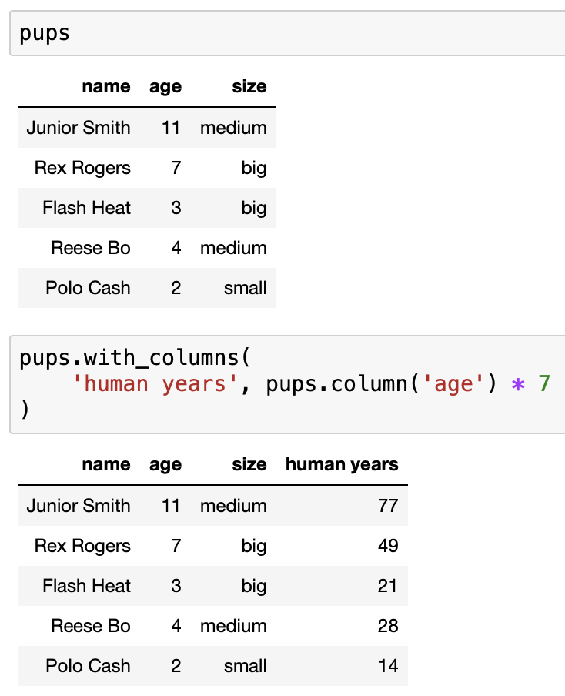
Array Operations
It’s easy to apply mathematical operations to every element of an array. Remember, columns are arrays.
An array with 11*7, 7*7, 3*7, 4*7, and 2*7.

Slide 6
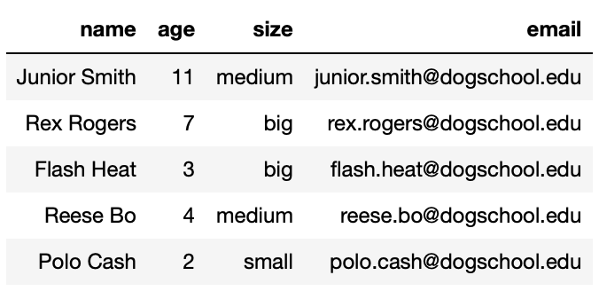
Other Functions
However, not all operations work nicely with arrays. For example, we may want to:
Take a dog’s first and last name and generate its email, first.last@dogschool.edu.
Factor in a dog’s size when computing its human age (larger dogs age faster).
We can write functions to do each of these things for one dog, but what about for all dogs?
???

Slide 7
Applying with .apply
1. Motivation
2. Applying with .apply
3. Masking with Boolean Arrays
➤

Slide 8
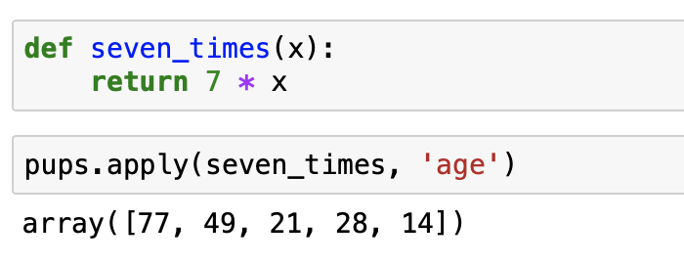
.apply()
The method
t.apply(function, column_or_columns)
applies function to every element in column_or_columns, and returns an array with the results.
If you only supply one column name, function should only take one argument.
If you supply X column names, function should take X arguments.
Not a good use of apply, since we could do this with just pups.column('age') * 7.

Slide 9
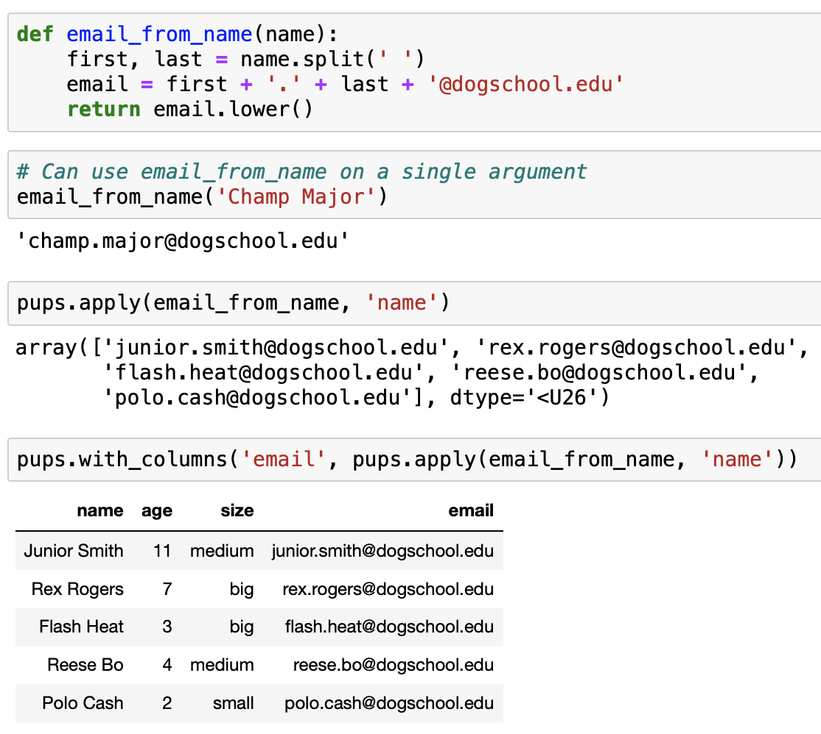
The function email_from_name takes in a single name and returns a single email.
The result of calling apply is an array.
To add the resulting array to pups, we use .with_columns.

Slide 10
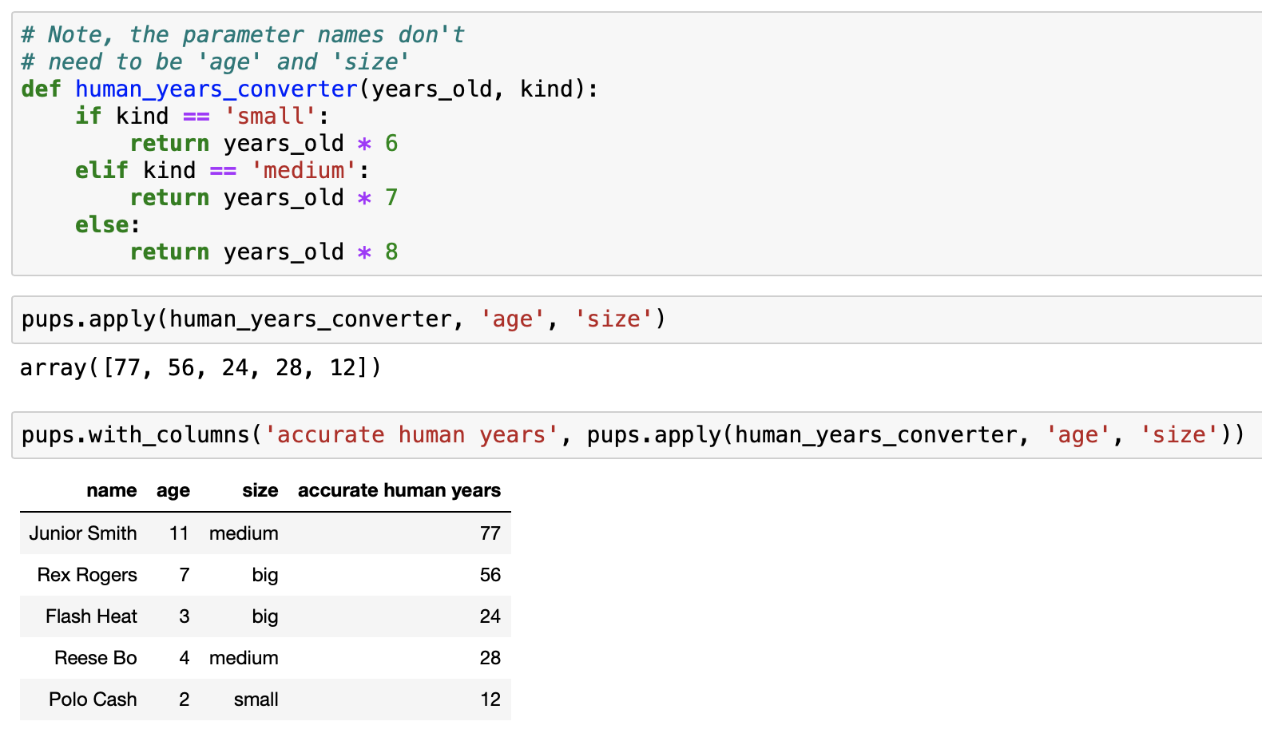
human_years_converter takes two arguments, so we need to specify two column names.

Slide 11
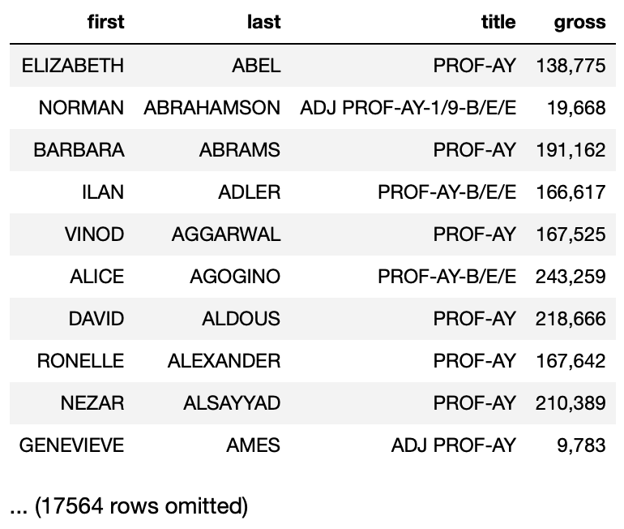
Quick Check 1
Suppose profs is the table shown below. The elements in the 'gross' column right now are strings. Fill in the blanks to replace the elements in the 'gross' column with integers. (Hint: use the fix_income function)
def fix_income(income):
return str(income.replace(',', ''))
fixed_income = profs.apply(_____, _____)
profs = profs.with_columns('gross', _____)
Answer on Ed!

Slide 12
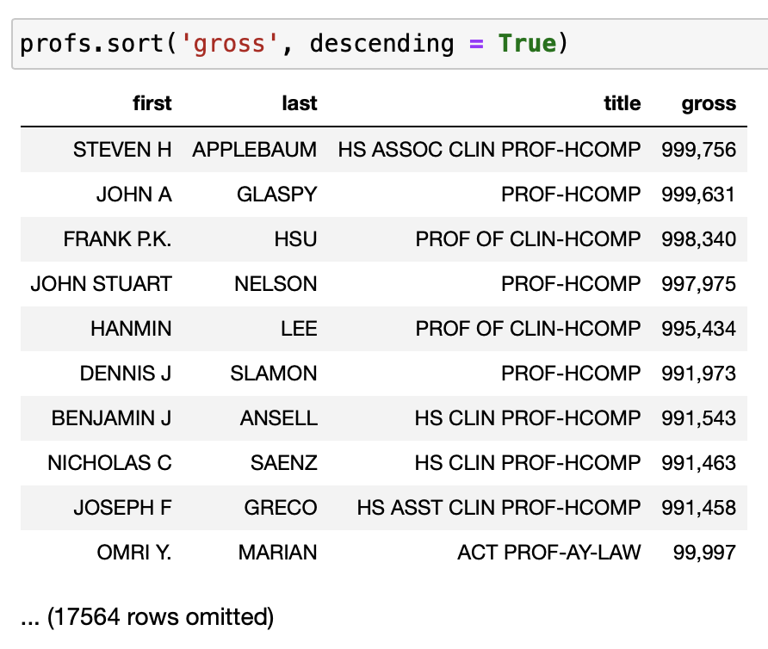
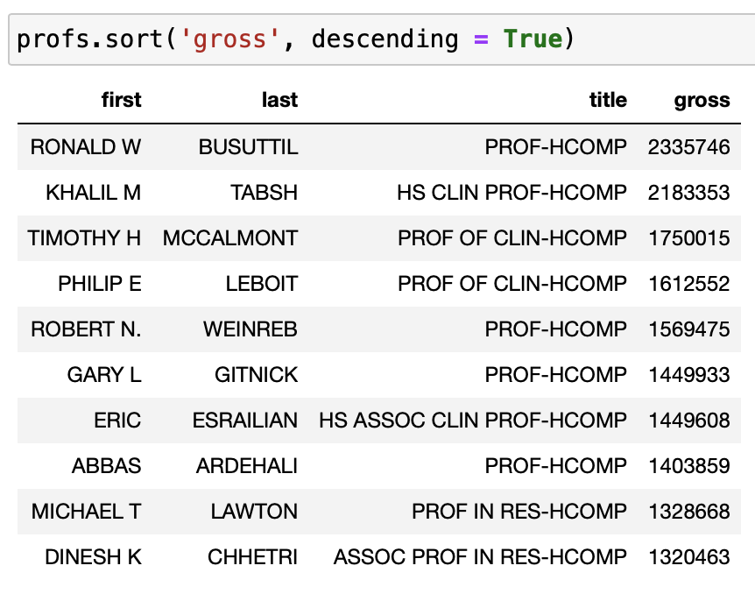
Data Cleaning
Data cleaning is the process of looking through data to fix inconsistencies. One such inconsistency is when the information in a column is stored as one type, but really should be stored as another – like in the Quick Check you just answered.
The real largest income is over 2.3 million, but the “dirty” version of the data doesn’t reflect that.
before fixing ‘gross’
after fixing ‘gross’

Slide 13
Masking with
Boolean Arrays
1. Motivation
2. Applying with .apply
3. Masking with Boolean Arrays
➤

Slide 14
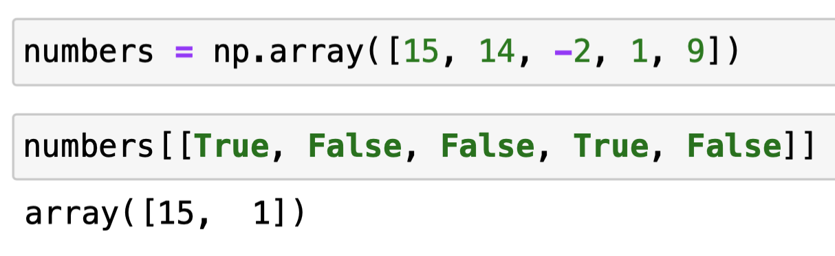
Masks and Arrays
Masking – also known as boolean indexing – is the process of indexing into an array or table with a array of booleans.
Only the elements at indexes 0 and 3.

Slide 15
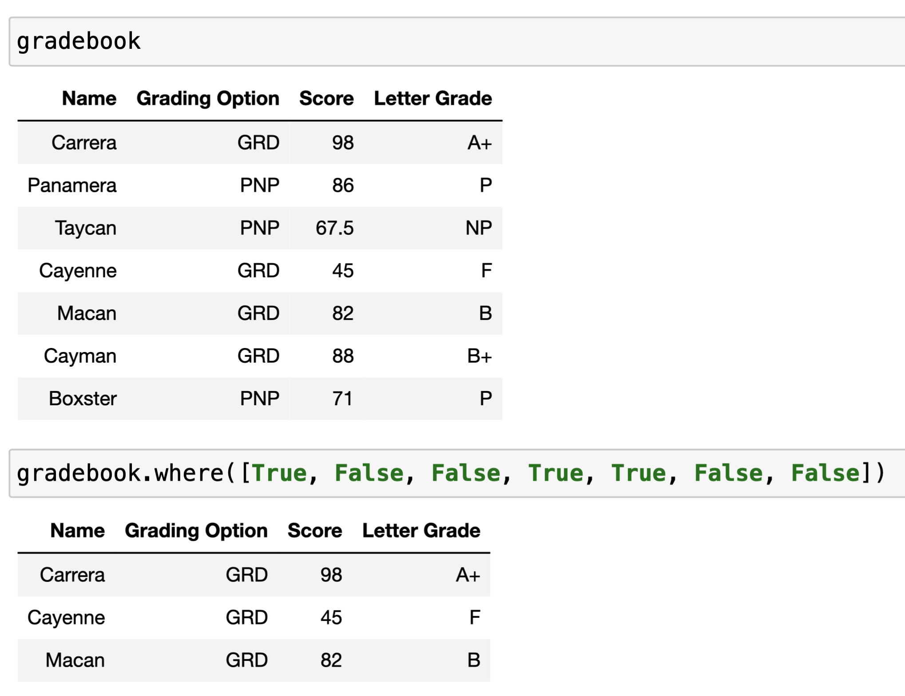
Masks with Tables
We can achieve the same behavior with tables – by using where with just a single argument.
Previously, where required two arguments.
Just one argument: a list of booleans.

Slide 16
.where()
where behaves slightly differently depending on if you give it one argument or two, but under the hood it is doing the same thing – returning a table with only the rows where some boolean condition is True.
t.where(column, pred) returns a new table with only the rows from t where column satisfies the predicate pred.
t.where(boolean_arr) returns a new table with only the rows from t where the corresponding value in boolean_arr is True.
Question: Why would we ever need the single-argument version of where? Isn’t it worse?
Answer: Single-argument where can do everything that where where can, and more!

Slide 17
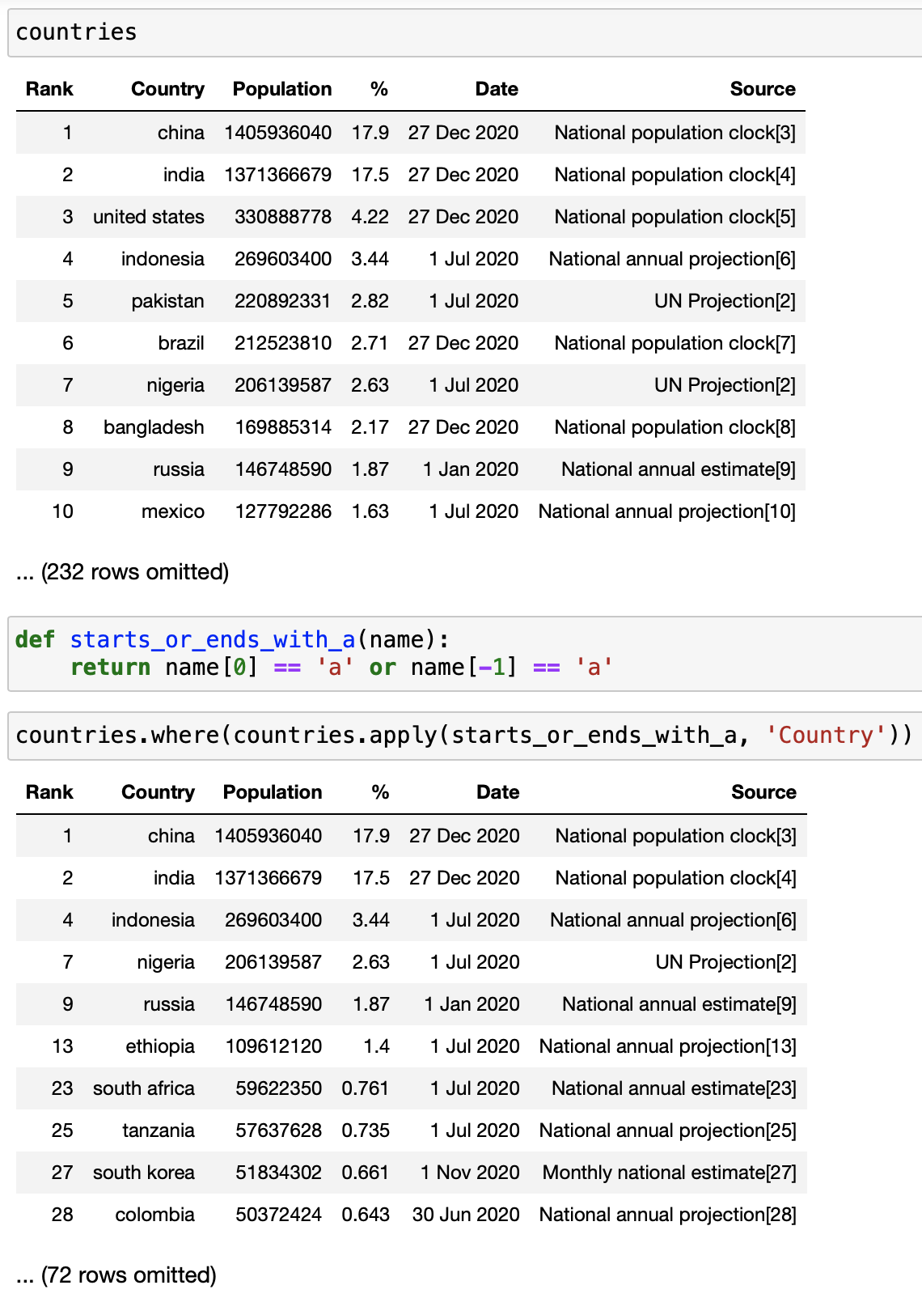
Example: Country Names
At the start of the semester, we looked at an example where we selected rows where a country’s name started or ended with an 'a'.
The are predicates we know about – are.equal_to, are.between, are.above, etc. – aren’t capable of this filtering.
But, we can write a function that returns a boolean, use it with apply to get a boolean array, then use the resulting array with where to perform the filtering.

Slide 18
In Conclusion…

Slide 19
Summary
Method | Behavior
t.apply(function, column_or_columns) | Returns an array with the result of applying function to every element in column_or_columns. The number of column names specified should be the same as the number of arguments that function takes in.
t.where(column, pred) | Returns a copy of t with only the rows from t where column satisfies the predicate pred. See earlier lecture slides for some common predicates.
t.where(boolean_arr) | Returns a copy of t with only the rows from t where the corresponding value in boolean_arr is True.

Slide 20
Recap
Next Time
Applying Functions to Columns
Masking with Boolean Arrays
Comparisons
Boolean Operators

Slide 21
Week N
Announcements!
Homework 4
has been released
will be due on 05/19 @ 11:59 PM
Office Hours take place
(Suzanne) Mondays 4:30 - 5:20PM in ACS 366
(Adrien) Wednesdays 4:30 - 5:20PM in ACS 330B
(Jordan) Tuesdays & Thursdays 10-12am

