Slide 1
LIGHTWEIGHT, ANONYMOUS & DECOUPLED
DISTRIBUTED AUTHENTICATION
FOR MULTIHOP IoT NETWORKS
Anup Kulkarni · M.Tech Thesis Defense · IIT Guwahati · June 2026

Slide 2
TABLE OF CONTENTS
01
02
03
04
MOTIVATION & BACKGROUND
PROPOSED SCHEME
IoT security landscape & gaps in existing schemes
PUF-based pseudonym auth for multihop IoT
SECURITY ANALYSIS
PERFORMANCE RESULTS
Formal ProVerif verification — 19 of 19 queries satisfied
COOJA simulation & RPi 4B hardware benchmarks

Slide 3
WHY IoT NEEDS NEW AUTHENTICATION
30 billion+ connected IoT devices projected by 2030
Smart meters · Medical implants · Industrial controllers
Devices are severely resource-constrained:
▸ Energy budget < 10 mJ/round (CR2032 / energy harvesting)
▸ Multihop RPL mesh — no fixed infrastructure or backbone
▸ Authentication Server must be selected dynamically by GW
What existing schemes miss:
▸ ID_D sent in plaintext → device tracking & profiling
▸ Missed update = state desync = lockout — no recovery path
▸ LAAKA / Zhou consume 42–55% more energy than our scheme

Slide 4
THE FOUR GAPS WE ADDRESS
01
02
03
04
IDENTITY EXPOSED
DESYNCHRONIZATION
RESOURCE OVERHEAD
CENTRALIZED AS
Real device ID sent over open channel — trackable & linkable
Missed update → auth failure → costly re-enrollment required
PKI / heavy crypto exceed constrained-device energy budgets
Fixed auth server = network bottleneck & single point of failure

Slide 5
02
PROPOSED SCHEME
PUF · Pseudonym Rotation · Dual-State Desync Recovery

Slide 6
PROTOCOL OVERVIEW
01
02
03
ENROLLMENT
AUTH & KEY EX
DATA COMM
PUF response R_D; one-time per device
Hash accumulator for group membership
Pseudonym: PID = H(ID_D ‖ m_curr)
SK = H(R_D ‖ m_curr ‖ ts₂)
PID_new = H(ID_D ‖ m_new)
Dual-state: (curr, old) updated
AES-CCM encrypted with SK
Desync recovery via (curr+old) lookup
No re-enrollment on missed update

Slide 7
NOVEL CONTRIBUTIONS
01
02
03
04
① PSEUDONYM ROTATION
② DUAL-STATE DESYNC
PID = H(ID_D ‖ m_curr) — real ID never on wire; sessions unlinkable
AS & GW store (curr,old) pair — missed update healed; no re-enroll
③ DECOUPLED AS
④ FORMAL PROOF
GW picks any capable node as AS — no dedicated infrastructure
19 / 19 ProVerif queries satisfied under full Dolev–Yao adversary

Slide 8
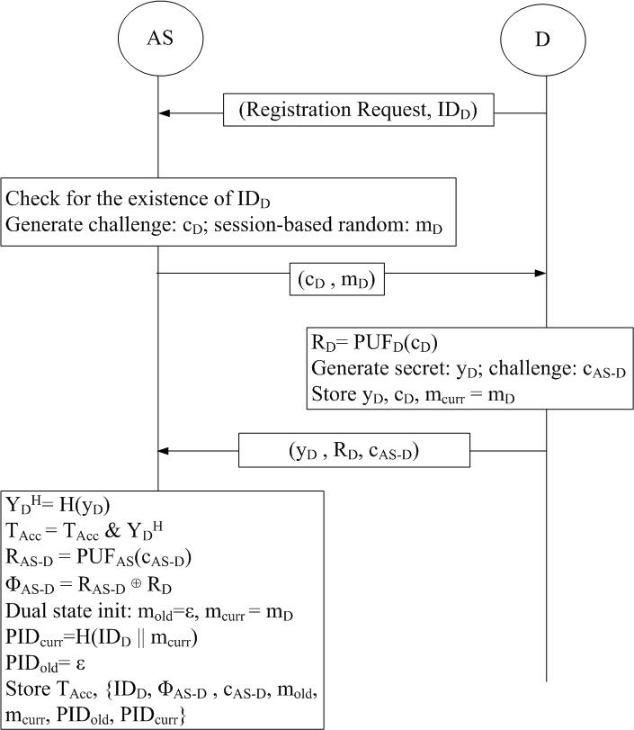
PHASE 1: ENROLLMENT
One-time setup: Device (D), GW, Auth Server (AS)
▸ D runs PUF(C_D) → secret R_D (never stored on device)
▸ AS stores: H(ID_D), C_D, hash accumulator A
▸ GW stores: ID_D → {PID_curr, PID_old}
▸ Initial PID₀ = H(ID_D ‖ m₀) registered at GW & AS
▸ A = ∏ H(R_Dᵢ) enables group-membership check
without revealing individual device identities
Key property: long-term secret lives only in PUF silicon

Slide 9
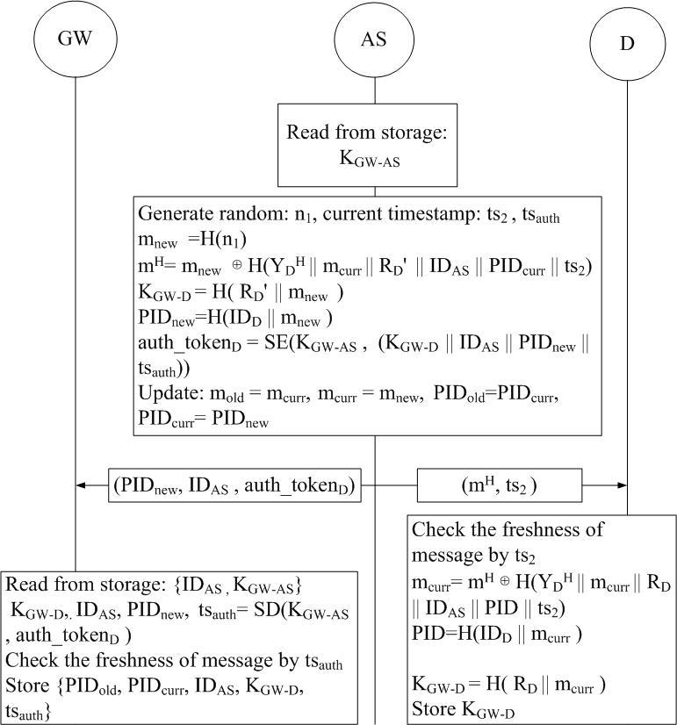
PHASES 2 & 3: AUTH + KEY EXCHANGE
Auth (Phase 2) — pseudonym shields real identity:
▸ D → GW: {PID_curr, ts₁, MAC₁} (ID_D never sent)
▸ AS verifies PID & group membership via accumulator A
Key Exchange (Phase 3) — forward-secret session key:
▸ SK = H(R_D ‖ m_curr ‖ ts₂) shared by D and AS
▸ State update: PID_old ← PID_curr, m_old ← m_curr
▸ New: PID_new = H(ID_D ‖ m_new)
Desync recovery — D misses Phase 3 ACK:
▸ Next round D sends PID_old; AS still accepts
▸ No lockout · No re-enrollment needed

Slide 10
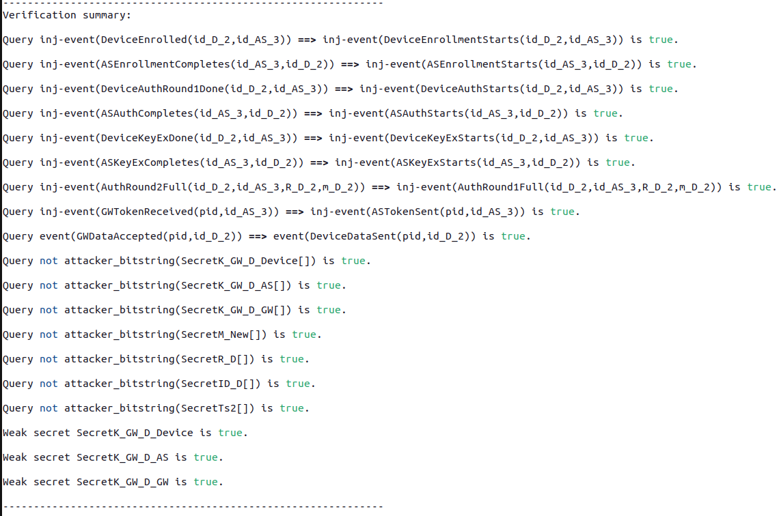
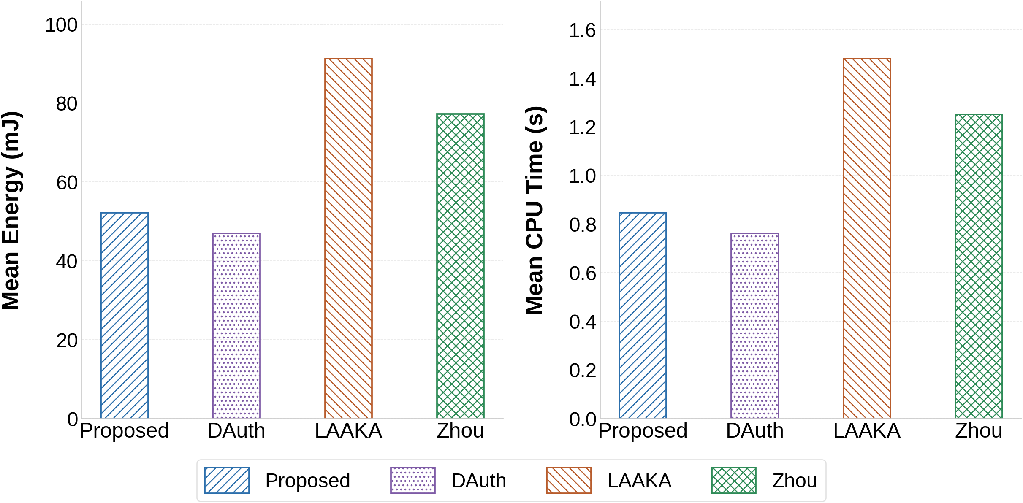
19 / 19 ProVerif Queries Satisfied
42.8% less energy vs LAAKA · 32.4% less vs Zhou · lowest overhead among 4 schemes

