Slide 1
Lightweight, Anonymous &
Decoupled Authentication
for Multihop IoT Networks
MTP Thesis Defense · Anup Kulkarni · IIT Guwahati · June 2026 Hello

Slide 2
Agenda
01
02
03
Background &
Motivation
Proposed
Protocol
Security &
Evaluation
IoT threat landscape & research gaps
4-phase PUF-based protocol with pseudonym rotation & desync recovery
ProVerif formal proofs + COOJA simulation + RPi 4B benchmarks

Slide 3
01
Background &
Motivation
Why do multihop IoT networks need rethinking?

Slide 4
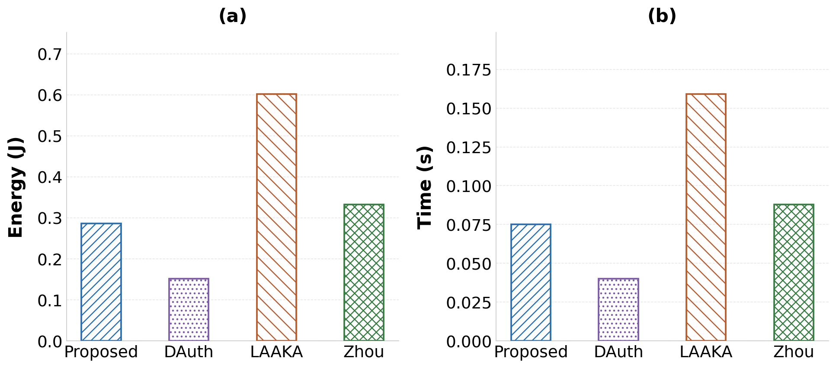
IoT Authentication:
A Critical Challenge
30B+ connected devices by 2030
Constrained nodes: battery-powered, <256KB RAM
Open channel → real ID linkable to location
LAAKA uses 4× energy of our scheme per round

Slide 5
Research Gaps We Address
1
Identity Exposure
Real device ID transmitted on open channel — enables location tracking & linkability
2
Desynchronization Vulnerability
Single-state nonce: one missed update forces costly full re-enrollment
3
Excessive Overhead
LAAKA: 0.60 J/round · Zhou: 0.33 J/round — infeasible on battery-powered IoT nodes

