Slide 1

MTP - 2
on
Lightweight, Anonymous, and Decoupled Distributed Authentication for Multihop IoT Networks
Anup Kulkarni
Roll No.: 224101017
M.Tech., Computer Science & Engineering
Indian Institute of Technology Guwahati, Assam
Guide: Prof. Manas Khatua
Co-investigator: Sreeparna Das

Slide 2
Table of Contents
Introduction
Literature Review
Research Gap & Motivation
Proposed Scheme
Security Analysis
Performance Evaluation
Conclusion & Future Work
References
2

Slide 3
IoT: Growth and Applications
Temperature Sensor
Key Statistics
AUTH SERVER
(Any capable node)
50 Billion+
connected IoT devices projected by 2030 (Ericsson)
Smart Camera
GATEWAY
(Border Router)
15.9 Billion
active IoT endpoints globally in 2023
Medical Device
INTERNET
/ Cloud
Smart Lock
4× Growth
in connected devices over the past decade
Industrial Node
80%+ Devices
are resource-constrained (CPU ≤ 100 MHz, RAM < 256 KB)
Application Domains: Smart Homes • Healthcare • Industrial Automation • Agriculture • Transportation
3

Slide 4
IoT Security Challenges
Resource Constraints
Open Wireless Channel
IoT devices have minimal CPU (≤100 MHz), RAM (<256 KB) and battery. Heavy cryptography is infeasible — schemes must be lightweight.
All messages are broadcast over shared wireless medium. Any nearby attacker can intercept, replay, or modify packets.
No Physical Security
Multihop Routing
Sensor nodes are deployed in uncontrolled environments (forests, hospitals, factories). Physical capture → secret extraction is a real threat.
A device is rarely one hop from the Authentication Server. Intermediate nodes relay messages — each hop is a potential attacker.
Identity Privacy
Scalability
Transmitting real device identity in plaintext enables tracking and profiling. Privacy regulations (GDPR) mandate identity protection.
Networks can contain thousands of nodes, many newly joining. Pre-distribution of shared keys does not scale — dynamic auth needed.
4

Slide 5
Why Authentication is Needed
✗ Without Authentication
✓ With Authentication
Device X
"I am Device X" (plaintext!)
Gateway
Device X
PID (pseudonym) + Proof [Encrypted]
Gateway
✓ Verified!
⚠ ATTACKER
Consequences:
Benefits:
• Malicious node sends fake ID → gains network access
• Only verified devices join → rogue nodes blocked
• Real device identity exposed → tracking possible
• Pseudonym (PID) used → real identity never exposed
• No replay protection → captured message reused
• Fresh nonce per session → replay attacks impossible
• No accountability → attacker cannot be identified
• Mutual authentication → both sides are verified
• MitM attack: attacker relays/alters all messages
• Desync recovery → no re-enrollment if packet lost
5

Slide 6
What Makes Authentication Hard in IoT?
Low Compute Power: Symmetric/asymmetric crypto at scale is expensive. A scheme must complete in milliseconds on a 100 MHz MCU.
1
No Stable Power Source: Battery-powered nodes survive on millijoules. Energy per authentication round directly impacts device lifetime.
2
Multihop Topology: Device is rarely one hop from the Authentication Server. The protocol must work across multiple intermediate relay nodes.
3
Identity Privacy Requirement: Real device ID must never travel on the open channel. Pseudonym rotation must be efficient and desync-resilient.
4
No Pre-shared Keys at Scale: With thousands of dynamically-joining nodes, key pre-distribution is impractical. PUF-based derivation is preferred.
5
6

Slide 7
Literature Review
Author (Year) | Scheme / Venue | Key Features | Limitations
Das & Khatua (2026) | DAuth COMSNETS 2026 | Decoupled AS selection, PUF-based secret derivation, hash accumulator for group membership, 4-phase protocol | No anonymity (real ID sent on channel); No desynchronisation recovery
Ali & Ahmed (2024) | LAAKA Comp. & Security | Anonymous auth for fog-driven IoT; ECC-based; lightweight claimed | Centralized fog node (not decoupled); High overhead on constrained nodes
X. Zhou et al. (2024) | Zhou IEEE IoT J. | Anonymity-preserving user auth for healthcare IoT; Includes revocation mechanism | Fixed/centralized auth server; No desync recovery; higher comm. cost
Wazid et al. (2021) | IIOT Auth IEEE Access | Three-factor auth for Industrial IoT; Biometric + smart card + password | Not suited for multihop; High computation on constrained sensor
Banerjee et al. (2022) | PUF-IoT IEEE IoT J. | PUF-based lightweight mutual auth; Resists physical attacks | No anonymity; no group membership; Fixed auth infrastructure
Proposed (This work) | Anup et al. MTP 2026 | Pseudonym rotation (PID), dual-state desync recovery, Decoupled AS, PUF-based, 4-phase, multihop | — (all identified gaps addressed)
7

Slide 8
Feature Comparison of Authentication Schemes
Security Feature | DAuth (Das 2026) | LAAKA (Ali 2024) | Zhou (2024) | Proposed (This Work)
Anonymity (PID rotation) | ✗ | ✓ | ✓ | ✓
Desync Recovery | ✗ | ✗ | ✗ | ✓
Decoupled Auth Server | ✓ | ✗ | ✗ | ✓
PUF-based (no key storage) | ✓ | ✗ | ✗ | ✓
Multihop Support | ✓ | ✗ | ✗ | ✓
Formal Verification | ✗ | ✗ | ✗ | ✓
Low Overhead (COOJA) | ✓ | ✗ | ✗ | ✓
8

Slide 9
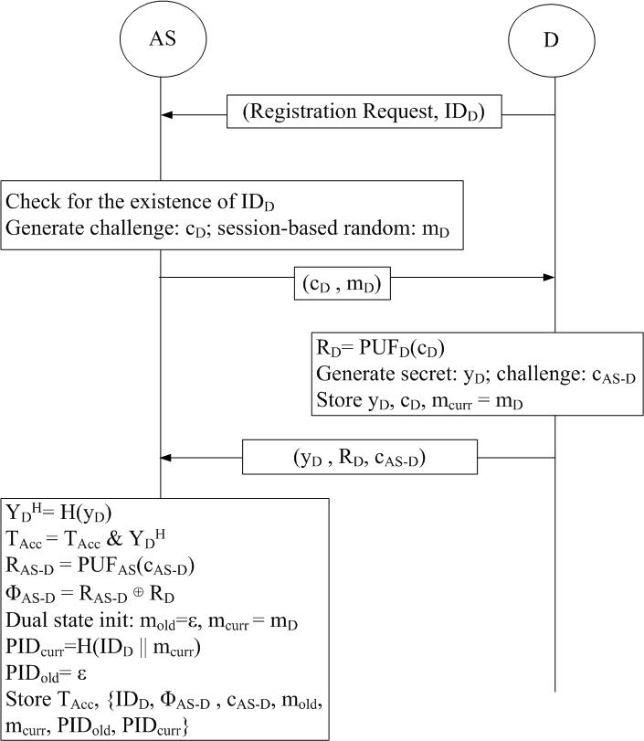
DAuth — The Base Scheme (Das & Khatua, COMSNETS 2026)
"Lightweight and Decoupled Distributed Authentication for IoT" — COMSNETS 2026
Enrollment Phase Diagram
Phase 1: Enrollment
Device registers with AS using PUF response R_D. AS stores a hash-based accumulator (no R_D stored).
Phase 2: Authentication
Device proves identity to GW-selected AS using PUF-derived tokens. Mutual authentication via challenge-response.
Phase 3: Key Exchange
Session key SK established between D and AS. GW facilitates but does not learn SK.
Phase 4: Data Communication
Encrypted data exchange using SK. GW acts as relay; AS verifies message authenticity.
⚠ Limitation of DAuth
Real device identity (ID_D) transmitted in plaintext. | No recovery if pseudonym state desyncs.
9

Slide 10
Comparison Schemes: LAAKA and Zhou et al.
LAAKA — Ali & Ahmed (2024)
Zhou et al. — Xin Zhou (2024)
Hala Ali & Irfan Ahmed (Virginia Commonwealth University) "LAAKA: Lightweight Anonymous Authentication and Key Agreement Scheme for Secure Fog-Driven IoT Systems" Computers & Security 140 (2024) 103770 [Elsevier]
Xin Zhou et al. "Security-Enhanced Lightweight and Anonymity-Preserving User Authentication Scheme for IoT-Based Healthcare" IEEE Internet of Things Journal, Vol. 11, No. 6 (2024)
Architecture: Fog-node-based; clients (IoT devices), fog nodes, cloud server
Architecture: Three-party: healthcare IoT device, gateway, remote server
Anonymity: Anonymous authentication via pseudonyms; ECC-based
Anonymity: Preserves user anonymity; dynamic pseudonym update
Key Exchange: Session key established between device and fog node
Security: Resistance to replay, impersonation, and offline dictionary attacks
Claimed: Lightweight and suitable for resource-constrained IoT
Claimed: Lightweight computation suitable for IoT healthcare setting
Gap → Centralized fog node; not decoupled. High overhead on 802.15.4 nodes.
Gap → Fixed/centralized auth server; no desync recovery; higher comm. overhead.
Note: Both LAAKA and Zhou provide anonymity, but neither offers decoupled AS selection, PUF-based key derivation, or desynchronisation recovery — gaps addressed in this work.
10

Slide 11
Summary of Literature Review
1
Lightweight is non-negotiable
Public-key/ECC schemes (LAAKA, Zhou) achieve anonymity but impose high computation and communication cost on resource-constrained 802.15.4 nodes.
2
Anonymity is increasingly required
Modern schemes (LAAKA, Zhou) hide user/device identity — but the base scheme DAuth still transmits the real identity ID_D in plaintext on the open channel.
3
Centralized auth servers limit scalability
LAAKA (fog node) and Zhou (remote server) fix the authenticator. DAuth decouples it — any capable node can serve as AS — improving multihop scalability.
4
Desynchronisation recovery is missing
No prior scheme recovers gracefully when a pseudonym-update packet is lost. A dropped packet forces costly re-enrollment.
11

Slide 12
Research Gap
Anonymity vs. Lightweight Trade-off: Existing anonymous schemes (LAAKA, Zhou) rely on heavy ECC/public-key operations. A scheme that is both anonymous AND lightweight for constrained multihop IoT is missing.
1
Identity Exposure in the Base Scheme: DAuth transmits the real device identity ID_D on the open channel, enabling tracking and profiling — no pseudonym mechanism.
2
No Desynchronisation Recovery: If a pseudonym/nonce-update packet is lost, prior schemes cannot re-synchronise without full re-enrollment, wasting energy.
3
Coupling of Authentication to Fixed Servers: LAAKA and Zhou fix the authenticator (fog/remote server). A decoupled, gateway-selected AS is needed for multihop scalability.
4
12

Slide 13
Motivation: The Eavesdropping Threat
"I am ID_D"
(plaintext!)
Our Solution: Pseudonym Rotation
Device D
Auth Server
Instead of sending ID_D, the device sends a rotating pseudonym:
PID = H( ID_D || m_curr )
⚠ EAVESDROPPER
captures ID_D
✓ Real identity ID_D never appears on the channel.
✓ PID refreshes after every successful key exchange.
Device Tracking: Same ID_D across sessions → movement & behaviour profiled
✓ Each session looks unlinkable to an eavesdropper.
✓ Dual-state recovery handles lost update packets.
Linkability: Attacker links all messages from the same device
Targeted Attacks: Known identity enables impersonation & selective jamming
Result: anonymity at near-zero extra cost on constrained nodes.
13

Slide 14
PROPOSED SCHEME
14

Slide 15
System Model and Threat Model
System Model
Threat Model (Dolev–Yao Adversary)
Device (D)
⚠ Full control of the open channel: intercept, inject, replay, modify, drop packets.
Resource-constrained IoT node. Holds a PUF; never stores long-term keys.
⚠ May capture and analyse all transmitted messages (eavesdropping).
Gateway (GW)
Border router. Selects an Authentication Server and relays multihop traffic.
⚠ May attempt impersonation of D, GW, or AS.
Auth Server (AS)
Any capable node chosen by GW (decoupled). Verifies device, never learns ID_D.
⚠ Cannot break cryptographic primitives (hash, PUF) or read secure enrollment.
Assumptions
⚠ Cannot physically clone the PUF.
• Device enrolls once with AS via a secure channel.
• PUF is unclonable and noise-tolerant.
• GW is honest-but-curious (must not learn ID_D or SK).
Goal: mutual authentication + session key + anonymity, secure under all the above.
15

Slide 16
Proposed Scheme: Overview
Phase 1
Phase 2
Phase 3
Phase 4
Enrollment
Authentication
Key Exchange
Data Comm.
One-time PUF registration
Mutual proof via PID + tokens
Establish SK + rotate PID
Encrypted data over SK
Four-phase structure, PUF-based derivation, decoupled AS and hash accumulator are retained from DAuth. Our novelty is in Phases 2–3:
1
2
3
Pseudonym Rotation
Dual-State Desync Recovery
Lightweight by Design
Real identity ID_D never sent. A rotating PID = H(ID_D || m_curr) is used and refreshed after each key exchange. GW never learns ID_D → full anonymity.
AS and GW store (m_curr, m_old, PID_curr, PID_old). A device arriving with PID_old after a lost packet is still recognised and re-synchronised — no re-enrollment.
Hash-only operations on the device. COOJA: 42.8% lower per-device energy than LAAKA and 32.4% than Zhou — lowest overhead among all four schemes.
16

Slide 17
Phase 1: Enrollment
PHASE 1
Enrollment Phase
One-time secure registration
Device D registers with AS over a secure channel — performed once at deployment.
PUF challenge–response
AS issues challenge c_D; device returns R_D = PUF(c_D). R_D is never stored.
Hash accumulator
AS stores group-membership accumulator and dual-state (m_curr, PID_curr) — not ID_D or R_D.
Initial pseudonym
First pseudonym PID = H(ID_D || m_curr) is computed and registered.
Key point: No long-term secret is stored on the device — PUF regenerates R_D on demand.
17

Slide 18
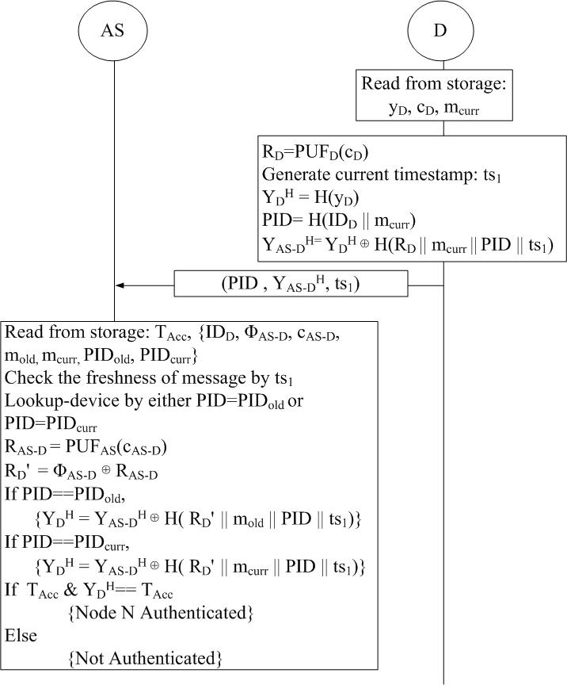
Phase 2: Authentication
PHASE 2
Authentication Phase
Device sends pseudonym
D transmits PID (not ID_D) plus a fresh nonce and timestamp ts_2 — anonymous on the channel.
GW selects an AS
Gateway picks any capable node as Authentication Server (decoupled) and relays the request.
Dual-state lookup
AS matches PID against PID_curr / PID_old — recovering identity context without ID_D exposure.
Mutual challenge–response
Two-round PUF-derived token exchange authenticates D and AS to each other.
Key point: PID + fresh nonce per session → replay and linkability attacks both fail.
18

Slide 19
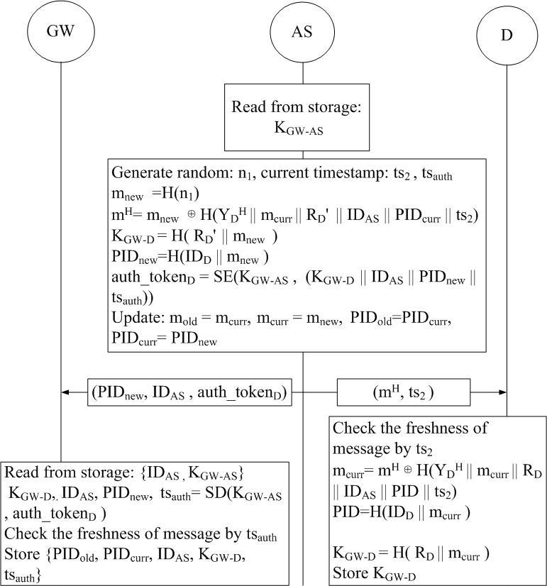
Phase 3: Key Exchange & Pseudonym Rotation
PHASE 3
Key Exchange Phase
Session key established
D and AS derive a shared session key SK. GW facilitates relay but never learns SK.
Fresh nonce m_new
A new nonce m_new is agreed; it is not derivable from prior state (forward secrecy).
Pseudonym refresh
PID is rotated: PID_new = H(ID_D || m_new). Old values shift into PID_old / m_old.
Dual-state update
Both AS and GW store (m_curr, m_old, PID_curr, PID_old) — enabling desync recovery.
Key point: Rotating PID after every exchange keeps successive sessions unlinkable.
19

Slide 20
Phase 4: Data Communication & Desync Recovery
Phase 4: Data Communication
Desynchronisation Recovery
Encrypted payloads
All application data is encrypted under the session key SK established in Phase 3.
Normal case
1
D updates to PID_new; AS’s PID_curr matches → authenticated instantly.
AS verifies authenticity
Each message carries a keyed tag; AS confirms integrity and freshness.
Packet lost
2
D never received the Phase-3 update → still holds PID_old.
GW as pure relay
Gateway forwards ciphertext across hops without learning SK or ID_D.
Dual-state rescue
3
AS also stored PID_old. It matches D’s stale PID → recognises the device.
Re-synchronised
4
AS re-issues the update; state converges. No re-enrollment, minimal overhead.
20

Slide 21
SECURITY ANALYSIS
21

Slide 22
Security Properties and Attack Resistance
Attack / Property | How the Proposed Scheme Defends
Replay Attack | ✓ Fresh nonce + timestamp ts_2 in every session; stale messages rejected by freshness check.
Man-in-the-Middle | ✓ Mutual two-round challenge–response binds both parties; relayed/altered messages fail token check.
Impersonation | ✓ Authentication tokens are PUF-derived; attacker cannot forge R_D without the physical device.
Eavesdropping / Tracking | ✓ Only the rotating pseudonym PID travels on the channel — real ID_D never exposed → unlinkable.
Desynchronisation | ✓ Dual-state (PID_curr, PID_old) at AS and GW recovers a device that missed an update packet.
Offline Guessing | ✓ No verifiable password/identity on the channel; hash one-wayness blocks dictionary attacks.
Physical Capture | ✓ No long-term secret stored; PUF response R_D regenerated on demand and never persisted.
Forward Secrecy | ✓ New nonce m_new not derivable from prior state; past sessions stay secure if current state leaks.
22

Slide 23
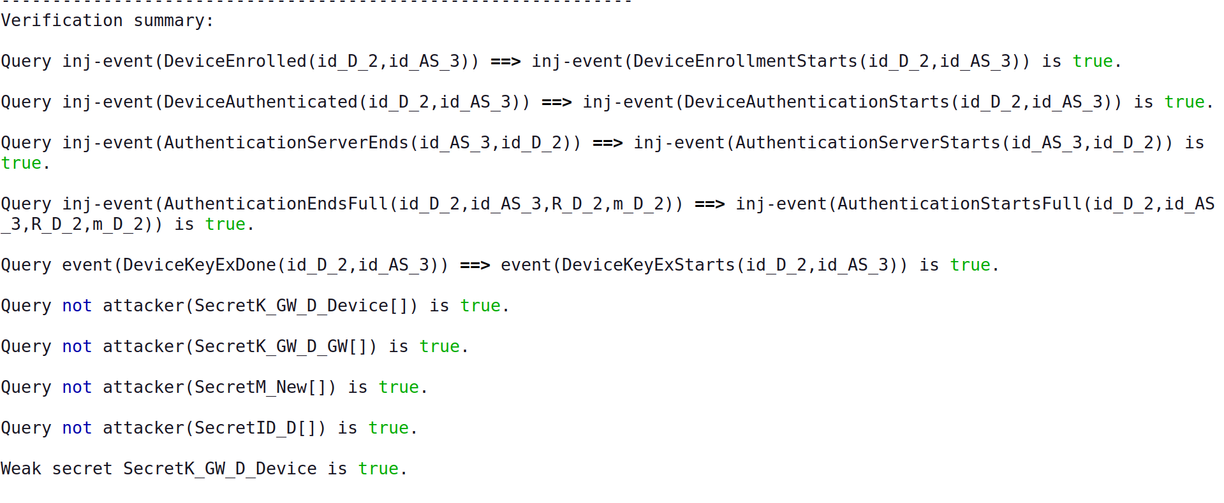
Formal Verification: ProVerif
✓ All 19 queries verified — result: true
Verified Properties
Dolev–Yao adversary model • ProVerif 2.x
Q1–Q9 Authentication
Enrollment & two-round auth correspondence; cross-round binding; token delivery.
Q10–Q12 Session Key Secrecy
SK remains secret from all three viewpoints — Device, AS, and Gateway.
Q13 Forward Secrecy
New nonce m_new is not derivable from old state.
Q14–Q16 Confidentiality
ProVerif verification output (excerpt)
PUF response R_D, real identity ID_D, and timestamp ts_2 stay secret.
Q17–Q19 Weak Secrecy
Resistance to offline dictionary / guessing attacks.
23

Slide 24
PERFORMANCE EVALUATION
24

Slide 25
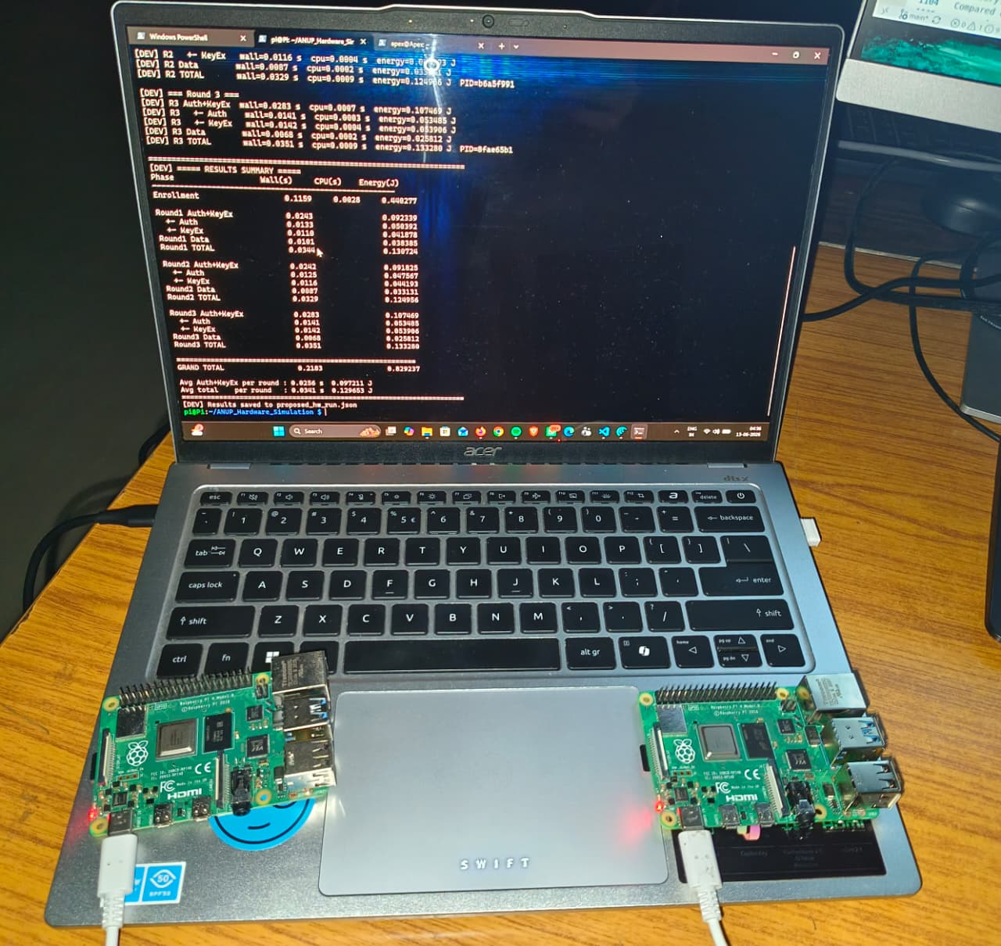
Experimental Setup
COOJA Network Simulation
Raspberry Pi 4B Hardware Testbed
Simulator: Contiki-NG COOJA, emulated Tmote Sky
Network size: Up to 100 motes (also N = 30, 50, 80, 120)
Routing: RPL-Lite, multihop
MAC / PHY: CSMA over IEEE 802.15.4
Seeds: 10 random seeds, results averaged
Metrics: Per-device energy (mJ) and CPU time (ms)
Apex = Device, Pi = AS, Laptop = Gateway
Schemes: Proposed, DAuth, LAAKA, Zhou
Power model: Energy = wall-clock time × 3800 mW (measured)
Procedure: 3 runs per scheme; 1 warm-up round discarded each
Measured: Auth + Key-Exchange per round, and Enrollment
25

Slide 26
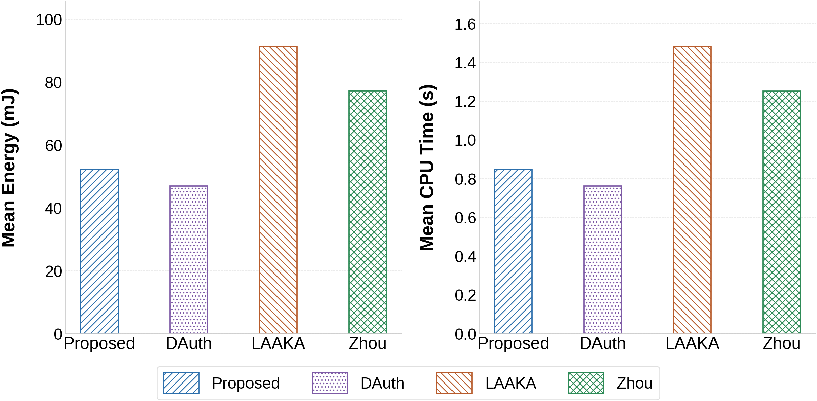
COOJA: Per-Device Mean Total Cost (100-mote)
Per-device mean energy (left panel) and CPU time (right panel), four schemes.
Proposed has the lowest overhead of any anonymity-preserving scheme.
42.8% lower per-device energy and CPU time than LAAKA; 32.4% lower than Zhou.
DAuth sits just below Proposed — the ~8% gap is the small price paid for PID anonymity.
Averaged over 10 seeds on a 100-mote RPL-Lite / 802.15.4 network.
26

Slide 27
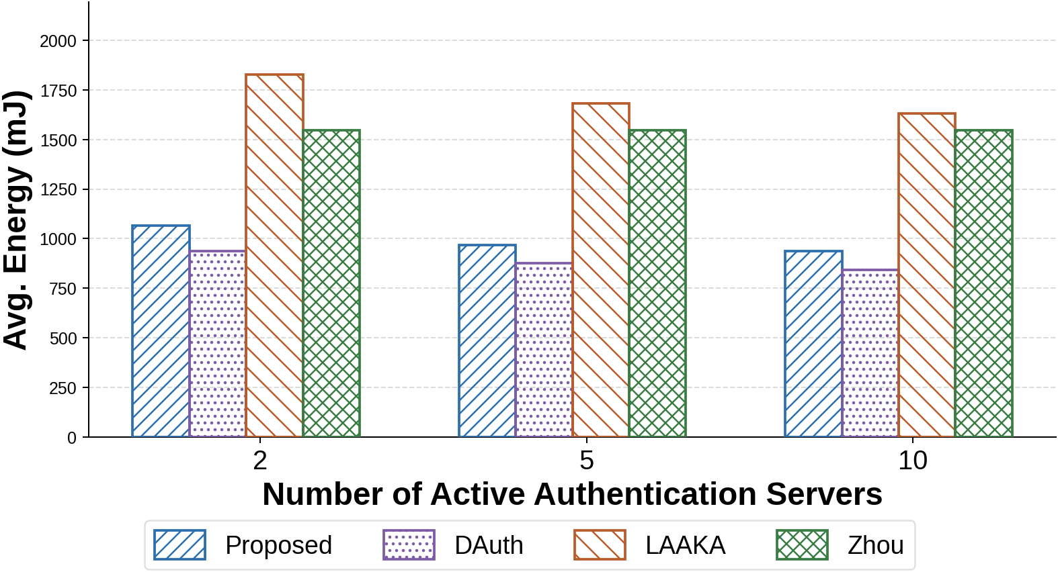
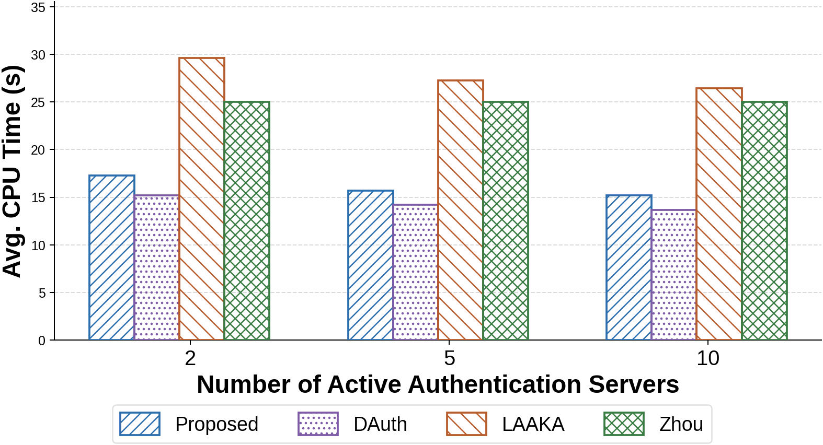
COOJA: Effect of Active AS Count
Total Energy vs Active AS Count
Total CPU Time vs Active AS Count
Energy scales gracefully as more nodes act as AS.
Decoupled AS spreads load — no single bottleneck.
Proposed stays below LAAKA and Zhou throughout.
CPU time follows the same favourable trend.
Hash-only device operations keep cost flat.
DAuth and Proposed track closely, both lowest.
27

Slide 28
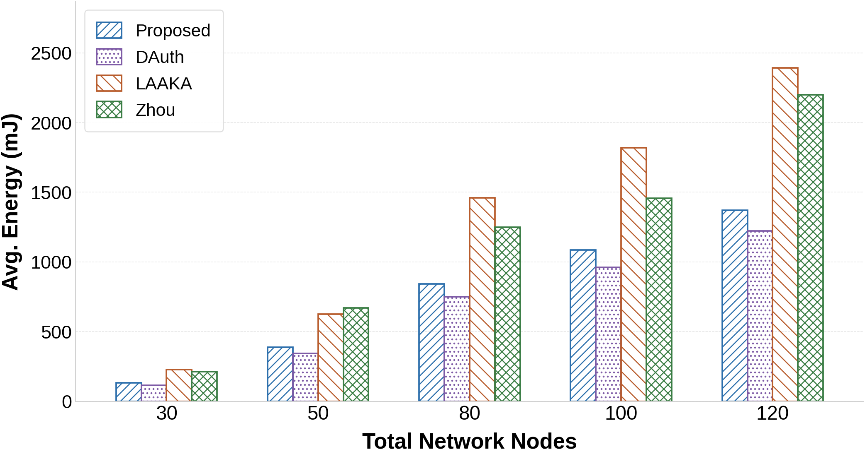
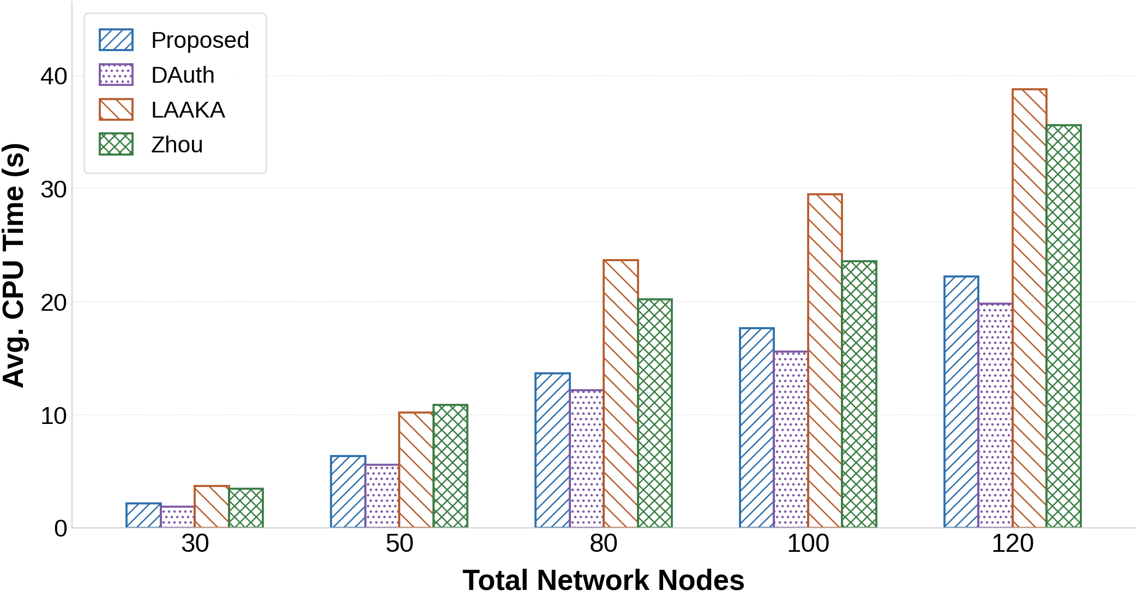
COOJA: Effect of Network Size
Total Energy vs Network Size
Total CPU Time vs Network Size
Advantage holds as the network grows.
N = 30, 50, 80, 100, 120 with 20% newly-joined devices.
Gap over LAAKA / Zhou widens with scale.
CPU cost grows slowly and stays lowest.
Lightweight design pays off at larger N.
Proposed ≈ DAuth, both far below LAAKA / Zhou.
28

Slide 29
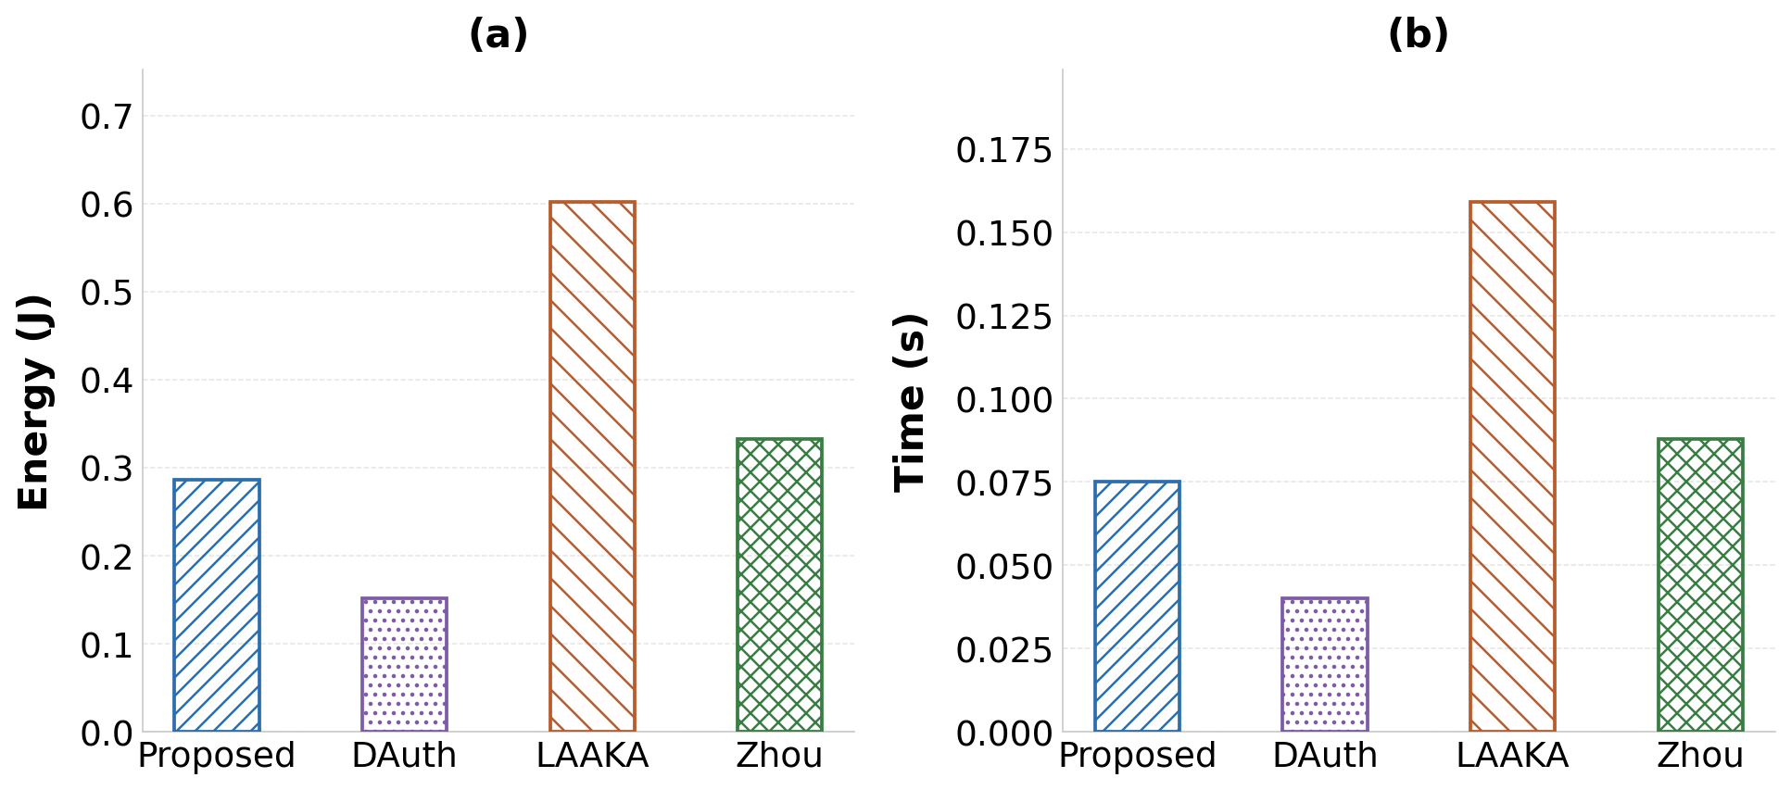
Hardware Results: Raspberry Pi 4B
Per-round energy and CPU time: Proposed vs DAuth vs LAAKA vs Zhou.
Per-round Auth + Key-Exchange cost on real RPi 4B hardware.
Order (energy): DAuth 0.152 J < Proposed 0.286 J < Zhou 0.333 J < LAAKA 0.602 J.
Proposed is the lightest anonymity-preserving scheme — about half the cost of LAAKA.
Energy = wall-clock time × 3800 mW; 3 runs per scheme, warm-up round discarded.
29

Slide 30
Conclusion
Anonymity added at near-zero cost: Pseudonym rotation (PID = H(ID_D || m_curr)) hides the real identity on the open channel while keeping device operations hash-only.
1
Robust desynchronisation recovery: Dual-state (PID_curr / PID_old) at AS and GW recovers devices that miss an update packet — no costly re-enrollment.
2
Decoupled & multihop-ready: Gateway-selected AS retained from DAuth; verified to scale across AS count and network size in COOJA.
3
Formally proven secure: ProVerif confirms all 19 queries (true) under the Dolev–Yao model — secrecy, authentication, anonymity, and forward secrecy.
4
Lowest overhead among four schemes: 42.8% / 32.4% lower energy than LAAKA / Zhou in COOJA; lightest anonymity-preserving scheme on RPi 4B hardware.
5
30

Slide 31
Future Work
Post-Quantum Hardening
Group & Handover Authentication
1
Replace remaining classical assumptions with lattice-based primitives while preserving the lightweight, hash-centric device profile.
2
Extend pseudonym rotation to batch/group authentication and seamless inter-gateway handover for mobile IoT devices.
Real-World Deployment
Adaptive AS Selection
3
Validate on a larger heterogeneous testbed (mixed MCUs) and integrate with standard IoT stacks (6LoWPAN / CoAP / DTLS).
4
Energy- and trust-aware gateway policy for choosing the Authentication Server to further balance network-wide load.
31

Slide 32
References
[1] S. Das and M. Khatua, "Lightweight and Decoupled Distributed Authentication for IoT," Proc. COMSNETS, 2026. (DAuth — base scheme)
[2] H. Ali and I. Ahmed, "LAAKA: Lightweight Anonymous Authentication and Key Agreement Scheme for Secure Fog-Driven IoT Systems," Computers & Security, vol. 140, 103770, 2024.
[3] X. Zhou et al., "Security-Enhanced Lightweight and Anonymity-Preserving User Authentication Scheme for IoT-Based Healthcare," IEEE Internet of Things J., vol. 11, no. 6, 2024.
[4] M. Wazid et al., "Design of Secure Three-Factor Authentication for Industrial IoT," IEEE Access, 2021.
[5] S. Banerjee et al., "PUF-Based Lightweight Mutual Authentication for IoT," IEEE Internet of Things J., 2022.
[6] B. Blanchet, "ProVerif: Automatic Cryptographic Protocol Verifier," ProVerif 2.x manual.
[7] Contiki-NG / COOJA Network Simulator, https://github.com/contiki-ng/contiki-ng.
32

Slide 33
Thank You
Questions & Discussion
Anup Kulkarni • Roll No. 224101017 • IIT Guwahati
33

