Slide 1
Knowledge Graph and Corpus Driven Segmentation and Answer Inference for Telegraphic Entity-seeking Queries EMNLP 2014
Mandar Joshi | Uma Sawant | Soumen Chakrabarti
IBM Research | IIT Bombay, Yahoo Labs | IIT Bombay
mandarj90@in.ibm.com | uma@cse.iitb.ac.in | soumen@cse.iitb.ac.in

Slide 2
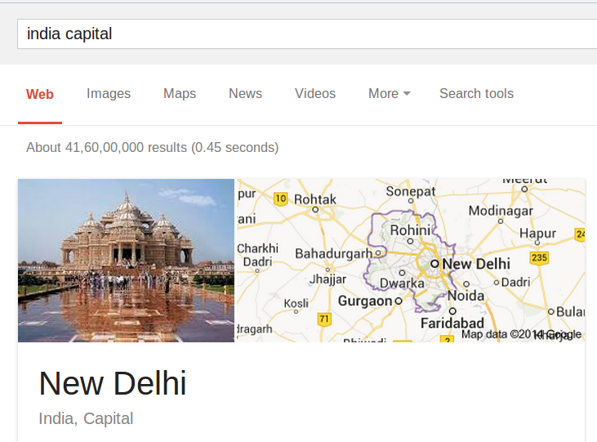
Entity-seeking Telegraphic Queries
Short
Unstructured (like natural language questions)
Expect entities as answers
Notes:
I will begin by characterizing the kind of queries we are interested in.
Our queries are short – typically 2 to 5 words long.
They are unstructured but do not adhere to a formal grammatical specification.
Lastly, they expect entities as answers.

Slide 3
Challenges
No reliable syntax clues
Free word order
No or rare capitalization, quoted phrases
Ambiguous
Multiple interpretations
aamir khan films
Aamir Khan - the Indian actor or British boxer
Films - appeared in, directed by, or about
Previous QA work
Convert to structured query
Execute on knowledge graph (KG)
Notes:
So what are the challenges in trying to interpret and answer these queries? First, we have no reliable syntax clues. As these are Web search style queries, they are free word order. We also do not have capitalization and quoted phrases. Second, as these queries are short and underspecified, ambiguity is a particularly serious problem. Consider this query “aamir khan films”. Here, “aamir khan” could be the Indian actor or the British boxer. Likewise, “films” could refer to films Aamir Khan appeared in, films directed by Aamir Khan or films about Aamir Khan. The point I am trying to drive home is that our input is particularly unhelpful.
Now previous work in QA provides some clues about how we can go about answering these questions. One popular paradigm is to convert the question to a structured query over the KG and execute the query to get back answer entities. In this work, we show that combining evidence from the KG and corpus yields better results.

Slide 4
Why do we need the corpus?
KG is high precision but incomplete
Work in progress
Triples can not represent all information
Structured – unstructured gap
Corpus provides recall
fastest odi century batsman
… Corey Anderson hits fastest ODI century. This was the first time two batsmen have hit hundreds in under 50 balls in the same ODI.
Notes:
But why do we need the corpus when we have a high precision KG? Because the KG is incomplete and lags behind the corpus. Additionally, it can be very difficult to answer queries exclusively from the corpus. Consider this query “fastest odi century batsman”. The intent here is to find the batsman with the fastest odi century in cricket. Answering this query from the KG alone is difficult – both from the point of view of interpretation as well as execution. On the other hand, if you pass on these tokens to a search engine, you will get back snippets that look like these. Now isolating the correct entity in the snippet can lead you to the answer. In other words, our data source has now changed to something like this.

Slide 5
Annotated Web with Knowledge Graph
Type: /cricket/cricket_player
Type: /people/profession
instanceOf
Entity: Corey_Anderson
instanceOf
/people/person/profession
Entity: Cricketer
mentionOf
… Corey Anderson hits fastest ODI century in mismatch ... was the first time two batsmen have hit hundreds in under 50 balls in the same ODI.
Annotated document
Notes:
We have a KG which has entities. Entities belong to types. Entities also have relation. In addition, we have a large Web corpus with entity mentions lnked to entities in Freebase.

Slide 6
Interpretation via Segmentation
Notes:
So how can be answer queries from this data source?

Slide 7
Signals from the Query
Queries seek answer entities (e₂)
Contain (query) entities (e₁) , target types (t₂), relations (r), and selectors (s).
query | e₁ | r | t₂ | s
washingtonfirst governor | washington | governor | governor | first
 | washington | - | governor | first
spider automobile company | spider | - | automobile company | -
 | automobile | company | company | spider
Assignment of tokens to columns for illustration only; not necessarily optimal
Notes:
Recall that we said that our queries are short and unstructured. But query tokens can still provide vital signals. For example, in the query, “washington first governor” Washington refers to an entity in the KG, “governor” tells us about the type of the answer entity, and “first” qualifies the answer entity. We do no want any governor; we want the first governor. Likewise, in the query, “spider automobile company”, spider refers to the entity Alfa Romeo Spider – a car model and “automobile company” acts as a type hint.
These examples are hint at a general framework for Web query interpretation.

Slide 8
Segmentation and Interpretation
Interpretation = Segmentation + Annotation
Segmentation of query tokens into 3 partitions
Query entity (E₁)
Relation and Type (T₂/R)
Selectors (S)
Multiple ways to annotate each partition
washington first governor
E₁ partition
S partition
T₂/R partition
1. Washington (State)
2. Washington_D.C. (City)
r: governorOf t2: us_state_governor
r: null t2: us_state_governor
Notes:
We define interpretation as segmentation + annotation. The idea is to segment query tokens into 3 partitions.
The query entity partition – this partition gives us the entity in the query
The relation/type partition. The token in this partition take on a dual role of acting as type as well as relation hints.
Selectors. These qualify the answer entity. We call them selectors because we can use them to more selectively probe the corpus.
Now there are multiple ways to segment query tokens and multiple ways to annotate each segment. For example, on of the possible partitions of the above query is this. The part in red refers to the E1 partition, the part in green is the selector partition and the part in blue is the type/relation partition. Notice how Washington could refer to the state as well as the city. Likewise, “governor” can be mapped to multiple combinations of types and relations.
We keep around all possible interpretations of the query to arrive at the answer entity..

Slide 9
Combining KG and Corpus Evidence
Segmentation
Z
Washington | first | governor
washington first | governor
Ψ_{T2}
Type language model
Ψ_{E1}
Entity language model
Ψ_{R}
Relation language model
Target type
Query entity
Selectors
Relation
T₂
R
E₁
S
us_state_governor
governor_general
governorOf
null
Washington (State)
null
first
washington first
Ψ_{T2, E2}
Entity Type Compatibility
Ψ_{E1, R, E2}
KG-assisted relation evidence potential
Ψ_{E1, R, E2, S}
Corpus-assisted entity-relation evidence potential
Elisha Peyre Ferry
E₂
Candidate entity
Notes:
For this, we use a graphical model which combines KG and corpus evidence. I will unroll the model part by part. First we have the segmentation node. This gives us mentions of entities, relations and types/ For example, here are two segmentations of the previous query.
Next, we have signals present in the query. This includes the query entity, target type, relation and selectors. To extract signals from the query, we use compatibility potentials. So we have a potential \Psi_T2 between the segmentation and target type which scores the type hint wrt a type. We have similar potentials for relation and query entity.
Now we want to reach the answer entity through these signals. For that we have the compatibility between the candidate entity and a target type. Then we have a potential that tells us whether the link e1-r-e2 is present in our knowledge graph. Finally we have the corpus potential which quantifies the evidence for e1-r-e2-s. As you can see, the idea is to combine all of this to reach the answer entity.
Now it might seem from this model that we are making some assumptions about the query – that it will contain an entity or a target type. But this is not the case. We allow any or all of these signals to be null. For example, in the second segmentation, there is no query entity, and so the nodes E1 and R are null. However, because of corpus support, it is possible to use these interpretations too and enables us to answer any kind of query,
Before discussing the design of potentials, I will take you through how our system ranks answer entities given the query.

Slide 10
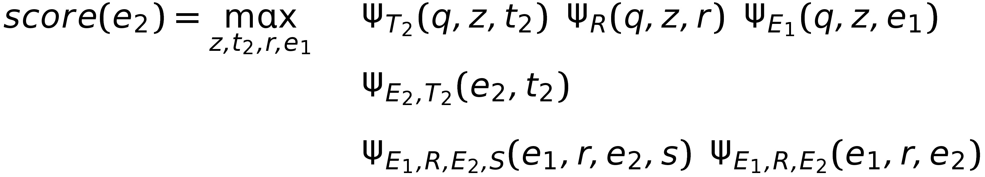
From query to Answer Entity
Generate interpretations
Retrieve snippets for each interpretation
Construct candidate answer entities (e₂) set
Top k from corpus based on snippet frequency
By KG links that are in interpretations set
Inference
query – signals compatibility
e2-t2 compatibility
evidence from KG and corpus
Notes:
The first step is to generate interpretations, i.e., generate a set of segmentations and annotate each segment. After this we retrieve a set of supporting snippets for each interpretation. Next we construct a set of candidate answer entities by using the KG and corpus. Finally, we score the candidates. The score of each candidate is defined as the score of the maximally supported interpretation. In case of the graphical model, this turns out to be the MAP given candidate e2.
\begin{align*}
score(e_2) & = \max_{z,t_2,r,e_1} && \Psi_{T_2}(q,z,t_2) \;\; \Psi_{R}(q,z,r) \; \; \Psi_{E_1}(q,z,e_1) \\
& && \Psi_{E_2,T_2}(e_2, t_2) \;\; \Psi_{E_1,R,E_2}(e_1, r, e_2) \;\; \Psi_{S}(q,z) \\[2.5mm]
& && \Psi_{E_1,R,E_2,S}(q,z,e_1,r,e_2) \\
\end{align*}

Slide 11
Relation and Type Models
Objective: To map relation (or type) mentions in query to Freebase relation (or types)
Relation Language Model (Ψ_{R})
Use annotated ClueWeb09 + Freebase triples
Locate Freebase relation endpoints in corpus
Extract dependency path words between entities
Maintain co-occurrence counts of <words, rel>
Assumption: Co-occurrence implies relation
Type Language Model (Ψ_{T2})
Smoothed Dirichlet language model using Freebase type names
Notes:
I will now discuss the design of potentials in this model. First up are type and relation language models. The idea is To map relation (or type) mentions in query to Freebase relation (or types).
To create a language model for a relation, we take all the triples of that relation from Freebase. We locate the sentences containing participating entities in our entity annotated corpus, pass them through a dependency parser, and get back the dependency path between the entities. We assume that the words in the path are relation hints. We maintain counts of these words and normalize to get back probabilities.
For the type language model, we use the smoothed Dirichlet language model. The idea is to create a microdocument for each type which contains words that describe the type using information from the KG. For example, the microdocument for the Freebase type /location/location will contain terms like location, city, town etc. With a microdocument for each type, we can create a smoothed Dirichlet language model

Slide 12
Corpus Potential
Estimates support to e₁-r-e₂-s in corpus
Snippet retrieval and scoring
Snippets scored using RankSVM
Partial list of features
#snippets with distance(e₂ , e₁ ) < k (k = 5, 10)
#snippets with distance(e₂ , r) < k (k = 3, 6)
#snippets with relation r = ⊥
#snippets with relation phrases as prepositions
#snippets covering fraction of query IDF > k (k = 0.2, 0.4, 0.6, 0.8)
Notes:
Then we have the corpus potential. The purpose is to estimate the support for e1-r-e2-s in the corpus. This is done through snippets built around each candidate e2. There are two issues here.
How do we efficiently retrieve snippets?
How do we quantify the evidence presented by a set of snippets?
For snippet retrieval, we used an inverted index index. The query gives us mentions of e1 and s. We need a textual representation for relation, r. Now the tokens in the relation partition provide us with one mention. For example, in the query, “hedy lamarr birthplace”, the token birthplace represents the relation between Hedy Lamarr and Vienna. But the corpus may express this relation in other way, e.g., “Hedy Lamar was born in Vienna”. To catch all these instances, we use the relation model which provides us with phrases popularly used to represent relations. So we pad the index query with phrases from our relation model.
To quantify evidence from the retrieved snippets, we need a model cognizant of the roles of e1, r, e2 and s. For this we use features like the textual distance between e1 and e2, the IDF fraction in the snippet and so on.

Slide 13
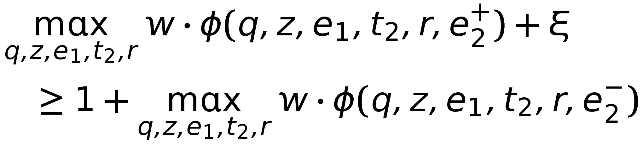
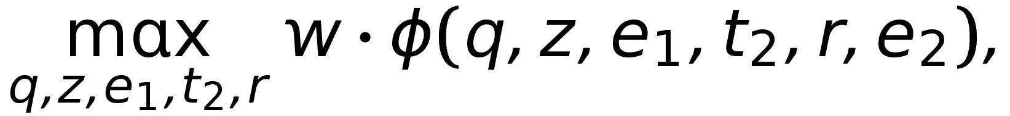
Latent Variable Discriminative Training (LVDT)
Constraints are formulated using the best scoring interpretation
Training
Inference
q, e₂ are observed; e₁, t₂, r and z are latent
Non-convex formulation
Notes:
Now it is reasonable to assume that some of our potentials are more effective than other. An interesting issue here is to see if we can train weights for these potentials. For this, we use LVDT. The details are in the paper but the gist of it is that we have a non-convex model where the query and answer entity e2 are observed and all other variables are latent.

Slide 14
Experiments

Slide 15
Test Bed
Freebase entity, type and relation knowledge graph
~29 million entities
14000 types
2000 selected relation
Annotated corpus
Clueweb09B Web corpus having 50 million pages
Google (FACC1), ~ 13 annotations per page
Text and Entity Index
Notes:
Our test bed consists of Freebase as the knowledge graph and Clueweb 09 as the annotated corpus. Freebase contains 29M entities, 14k types and 2000 relations. Clueweb contains 50M pages with FACC1 annotations. These are sparse high precision annotations.

Slide 16
Test Bed
Query sets
TREC-INEX: 700 entity search queries
WQT: Subset of ~800 queries from WebQuestions (WQ) natural language query set [1], manually converted to telegraphic form
Available at http://bit.ly/Spva49
TREC-INEX | WQT
Has type and/or relation hints | Has mostly relation hints
Answers from KG and corpus collected by volunteers | Answers from KG only collected by turkers.
Answer evidence from corpus (+ KG) | Answer evidence from KG
[1] Jonathan Berant, Andrew Chou, Roy Frostig, and Percy Liang. 2013. Semantic parsing on Freebase from question-answer pairs. In Empirical Methods in Natural Language Processing (EMNLP).
Notes:
For queries, we use two data sets. Both have been obtained by shortening NL questions. There are few differences between datasets. TREC-INEX has a balance of type and relation hints while WQT mostly has relation hints. Answers for questions in TREC-INEX were collected by volunteers who had access to both the KG and the corpus. WQT answers were collected by turkers who had access only to KG.

Slide 17
Synergy Between KG and Corpus
Corpus and knowledge graph help each other to deliver better performance
Notes:
Switched of corpus features or potentials. Then switched off graph features / potentials.

Slide 18
Query Template Comparison
Entity-relation-type-selector template provides yields better accuracy than type-selector template
[2] Uma Sawant and Soumen Chakrabarti. 2013. Learning joint query interpretation and response ranking. In WWW Conference, Brazil.

Slide 19
Comparison with Semantic Parsers

Slide 20
Qualitative Comparison
Benefits of collective inference
automobile company makes spider
Entity model fails to identify e₁ (Alfa Romeo Spider)
Recovery: automobile company makes spider
Limitations
Sparse corpus annotations
south africa political system
Few corpus annotations for e₂: Constitutional Republic
Can’t find appropriate t₂ (/../form_of_government) and r (/location/country/form_of_government)
e₁: Automobile
t₂: /../organization r : /business/industry/companies

Slide 21
Summary
Query interpretation is rewarding, but non-trivial
Segmentation based models work well for telegraphic queries
Entity-relation-type-selector template better than type-selector template
Knowledge graph and corpus provide complementary benefits

Slide 22
References
S&C: Uma Sawant and Soumen Chakrabarti. 2013. Learning joint query interpretation and response ranking. In WWW Conference, Brazil.
Sempre: Jonathan Berant, Andrew Chou, Roy Frostig, and Percy Liang. 2013. Semantic parsing on Freebase from question-answer pairs. In Empirical Methods in Natural Language Processing (EMNLP).
Jacana: Xuchen Yao and Benjamin Van Durme. 2014. Information extraction over structured data: Question answering with Freebase. In ACL Conference. ACL.

Slide 23
Data
TREC-INEX and WQT
Short URL http://bit.ly/Spva49
Long URL https://docs.google.com/spreadsheets/d/1AbKBdFOIXum_NwXeWub0SdeG-y8Ub4_ub8qTjAw4Qug/edit#gid=0
Project page
http://www.cse.iitb.ac.in/~soumen/doc/CSAW/

Slide 24

Thank you! Questions?

