Slide 1
What is Reproducibility and Why do we care?
REU Site: Advancing Data Science in the Public Interest
6/05/2026

Slide 2
What is Research?

Slide 3
How do we know whether something no one has done before is correct?

Slide 4
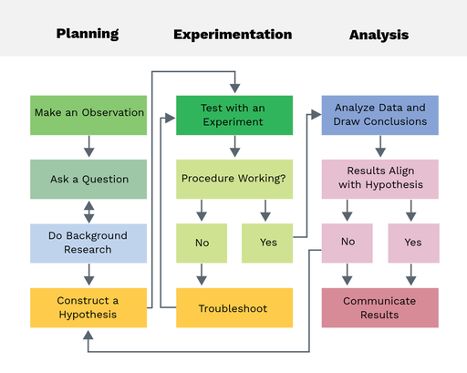
Iterate
https://theory.labster.com/scientific_method/

Slide 5
Replication “crisis” Increasing rates of non-replicability in scientific studies
The crisis is especially prevalent in social sciences
Replication means to reproduce the findings of a study with new data.
Replication is a fundamental tenet of science, including social science.
Replicating studies with new independent data is expensive, rarely published in high-impact journals

Slide 6
Studies on Reproducibility
Johnson VE, Payne RD, Wang T, Asher A, Mandal S. On the Reproducibility of Psychological Science. J Am Stat Assoc. 2017; 112(517): 1-10. doi: 10.1080/01621459.2016.1240079.
A. Brodeur, D. Valenta, A. Marcoci, J.P. Aparicio, D. Mikola, B. Barbarioli, R. Alexander, L. Deer, T. Stafford, L. Vilhuber, G. Bensch, F. Motoki, M. Abdelhady, Y. Abdelmoula, G.A. Baki, T. Aguirre, S. Aiyer, S. Akhtar, F. Akhtar, M.R. Albada, M. Altman, D. Angenendt, Z. Arjmandi Lari, J.A. De León Tejada, D.R. Arana, I. Asanov, A. Noha, R. Ashong, T. Auer, F.J. Bahamonde-Birke, B.J. Baker, S.M. Bartram, D. Bao, L. Batinovic, T. Batistoni, M. Beeder, L. Beland, C. Gero Bienz, C.B. Aryanto, C. Bolibaugh, C. Bonander, R. Bravo, E. Bronnikov, S. Bruns, N. Buliskeria, S. Caicedo-Silva, A. Calef, J. Sebastian Cano Arias, G. A. Castillo Alvarez, S. Caulker, S. Cepenas, A. Chatton, Z. Chen, N. Chioma Ewurum, A. Ciocîrlan, F.J. Clouth, J. Collins, N. Cook, C. Cornejo, J. Craveiro, J. Créchet, J. Cui, N. Chalil Vayalabron, C. Czymara, C.D. Bermúdez Jaramillo, H. Datta, L. Denoo, A. Dhaliwal, N. Dhameja, E. Djemai, E. Dujeancourt, U. Dündar, T. Duprey, Y. Eissa, Y. El Fassi, I. El Fassi, K. Ellis, A. Elminejad, M. Elsherif, A. Emirmahmutoglu, G. Etingin-Frati, E. Eze, J.F. Dollbaum, J. Feld, A. Felipe Rengifo Jaramillo, G. Fenig, V. Fernandes, L. Fiala, L. Fink, M. Firouzjaeiangalougah, S. Fish, J. Fitzgerald, R. Forshaw, A. Fortier-Chouinard, L. Fréget, J. Frese, J. Gabani, S. Gallegos, M.C. Gamill, A. Gáspár, R. Gauriot, E. Gavrilova, D. Geraldes, G.G. Cantone, G. Gibson, D. Goldschmitt, A. Gourdon-Kanhukamwe, A. Gregor de Varda, I. Grigoryeva, A. Gugushvili, A.H.A. Fletcher, F. Habermann, M. Hablicsek, J. Haddad, J.D. Hall, O. Hammar, M. Hassouneh, C.I. Hausladen, S.C.F. Hendrikse, M. Hepplewhite, A.T.Y. Ho, S. Hogan-Hennessy, E. Howley, G. Huang, H. Hulstaert, Z.G. Ilchovska, P. Jaimes Santamaria, N. Jakobsson, J. Jansson, E. Jarosz, H. Jebeli, Y. Jiang, H. Junaid, R. Kalluraya, S. Karim, E. Kelly, E. Kimel, S. Kingsuwankul, V. Klotzbücher, D. Krähmer, P. Krūminas, N. Kruus, E. Kujansuu, C.F. Kurz, S. Küster, B. Lee-Whiting, F. Lewandowski, T. Li, R. Li, D. Liu, J. Liu, H. Lo, K. Loter, F. Macedo Dias, C.R. Madan, N. Mäder, M. Mandas, C. Mantilla, J. Marcus, D. Marino Fages, X. Martin, R. McWay, D. Medina-Gaspar, S. Meng, L. Meng, S. Merz, A.P. Miller, T. Mirabel, D.D. Mishra, S. Mishra, B.W. Moges, M. Mohandes Mojarrad, M. Mohnen, L. Morin, L. Muehlenbachs, G. Mullin, A. Musulan, S. Muzzì, J.A.C. Myers, F. Neubauer, T. Nguyen, A. Niazi, A. Nordstrom, B. Nowak, D. O’Habib, T. Ölkers, J. Ong, V. Orozco Castiblanco, Ö. Özak, A.I. Ozkes, M. Paaso, S. Pandey, V. Papazoglou, R. Penheiro, L. Pham, U. Phieler, P. Pütz, Q. Qi, J. Qiu, M.T. Rein, D.A. Reinstein, J. Repo, N. Rudolf, S. Saha, O. Saka, C. Saponaro, G. Sator, M. Schoenmakers, R. Seri, M. Shah, P. Sibille, C. Siemroth, V. Skavysh, B. Slater, W. Song, S. Staubli, T. Steindl, N.S. Waongo, P. Stott, S. Strobel, R. Sudhaharan, P. Sun, S.D. Swain, O. Talavera, H.M. Tantiangco, G. Tarasenko, B. Tarlinton, M. Tarraf, K. Teoh, R. Thériault, B. Thompson, T. Tian, W. Tian, E. Tolani, N. Borgen, S. Topstad Borgen, J. Torralba, C. Velez-Ospina, M.W. Mak, L. Wallrich, Z. Wang, L. Ward, M.D. Webb, D. Webb, B.S. Weber, C. Weber, W. Weng, C. Westheide, T. Wilkinson, K. Wong, M. Wroński, Z. Wu, Q. Wu, V.Y. Wu, B. Xiao, F. Xu, C. Xu, P. Yadav, Y. Yang Chou, L. Yap, M. Yazbeck, B. Yao, Z. Zagrodzka, T. Zahra, M. Zaneva, X. Zhang, Z. Zhao, H. Zhong, A. Zirgulis, J. Zou, F. Zoutman, & C. Zozoungbo, AI-assisted teams outperform AI-led teams but not human-only teams in assessing research reproducibility in quantitative social science, Proc. Natl. Acad. Sci. U.S.A. 123 (22) e2524747123, https://doi.org/10.1073/pnas.2524747123 (2026).

Slide 7
Why is that happening?
Fraud
Poorly conducted science
Mistakes
Poor description of methods
No documentation of decisions that seemed unimportant
It does happen, but rare
Includes non-representative samples, not properly accounting for
variability in units of analysis, p-hacking
Humans make mistakes
Until recently, not much focus on this
Same as above
Using principles of reproducibility can reduce the last three!

Slide 8
Ioannidis (2005) “Corollaries”
The smaller the studies conducted in a scientific field, the less likely the research findings are to be true.
The smaller the effect sizes in a scientific field, the less likely the research findings are to be true.
The greater the number and the lesser the selection of tested relationships in a scientific field, the less likely the research findings are to be true.
The greater the flexibility in designs, definitions, outcomes, and analytical modes in a scientific field, the less likely the research findings are to be true.
The greater the financial and other interests and prejudices in a scientific field, the less likely the research findings are to be true.
The hotter a scientific field (with more scientific teams involved), the less likely the research findings are to be true.

Slide 9
Reproducible research
Assess the validity and rigor of scientific results
Others can reproduce the results given only
Original data
Code
Documentation
Minimizes cost of collecting brand new data
Minimal acceptable standard for publishable research

Slide 10
“doing reproducible research” in practice
Leave breadcrumbs
Use a system and tools for organization
Use a system for sharing results that is accessible and updatable by all collaborators

Slide 11
Reproducible Research Benefits
You
Memory
Modification
Science
Build on your work
Easy follow-up
Consumers
Learn from your work
Builds trust
Reconfiguration
Citation
Verification
Consistency of results
Increased consistency

Slide 12
Three Stages of Computational Research
Data Gathering
Data Analysis
Presenting results

Slide 13
Three Stages of Computational Research
Back up files. Keep the originals!
Name files in an informative manner. UseCamelCase_or_underscores
Use line .csv or .txt files
Multi-dimensional relational formats (e.g., json)
If you scraped it, keep the code!
Data Gathering
Data Analysis
Presenting results

Slide 14
Three Stages of Computational Research
“tidy” formats
Metadata
Use modular code
Consistent naming conventions
Produce tables and graphics directly from code
There is no such thing as too many comments.
Data Gathering
Data Analysis
Presenting results

Slide 15
Three Stages of Computational Research
Make all code & results accessible to your mentor on a publicly available site
Weekly journal of activities
A little organization on the front end makes presentations easier!
Include presentation code
Data Gathering
Data Analysis
Presenting results

Slide 16
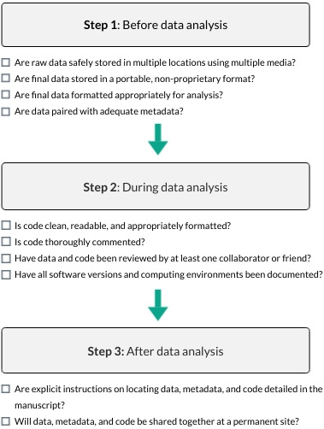
A Beginner's Guide to Conducting Reproducible Research (Alston and Rick 2021)
Notes:
A 10‐point checklist to guide researchers toward greater reproducibility in their research. Researchers should give careful thought before, during, and after analysis to ensure reproducibility of their work.
IF THIS IMAGE HAS BEEN PROVIDED BY OR IS OWNED BY A THIRD PARTY, AS INDICATED IN THE CAPTION LINE, THEN FURTHER PERMISSION MAY BE NEEDED BEFORE ANY FURTHER USE. PLEASE CONTACT WILEY'S PERMISSIONS DEPARTMENT ON PERMISSIONS@WILEY.COM OR USE THE RIGHTSLINK SERVICE BY CLICKING ON THE 'REQUEST PERMISSIONS' LINK ACCOMPANYING THIS ARTICLE. WILEY OR AUTHOR OWNED IMAGES MAY BE USED FOR NON-COMMERCIAL PURPOSES, SUBJECT TO PROPER CITATION OF THE ARTICLE, AUTHOR, AND PUBLISHER.

Slide 17
Documenting Decisions
In the code notebook
In the methods section of a paper
We still haven’t answered the most important question:
What are the downstream
consequences of this decision?

Slide 18
Some Experimental Design Decisions
Type of design
Completely randomized or blocked?
How many populations?
How many variables collected on each?
Range of effect
Minimum and maximum value of the effect
How many levels of the effect?
Who (or what) are the populations?
Duration of study
Inclusion criteria
Sample size
Effect size
Significance level
Power
What response to measure ?
How to measure that response?
Appropriate test statistic

Slide 19
Variable choice, the p-value, differing results If the variable choice isn’t documented, be suspicious
Number and range of levels changes effect size
Time to stop misusing p-values
Variability in neuroimaging studies
Hack your way to scientific glory

Slide 20
A is for Analysis Choice
How many clusters?
What similarity/dissimilarity measure?
What algorithm?
Researcher degrees of freedom

Slide 21

Particularly a problem for high dimensional data
Curse of dimensionality

Slide 22
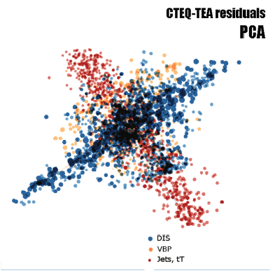
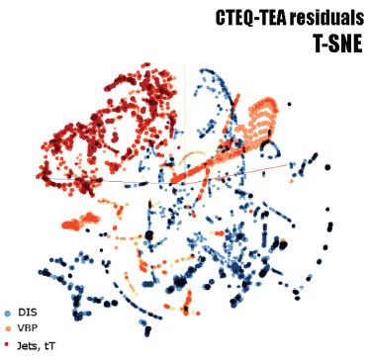
Geometry of multivariate probability distributions is weird
Curse of dimensionality
Unimodal distributions are far less likely
Big-data paradox (Xiao-Li Meng, Harvard University)
An extreme example
The Bigger the Data, the surer we fool ourselves
Projections of 28-dimensional vectors describing data points in a big-data analysis of the inner structure of protons. From B.-T. Wang et al., Phys.Rev.D 98 (2018) 9, 094030

Slide 23
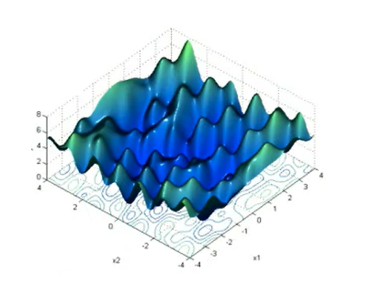
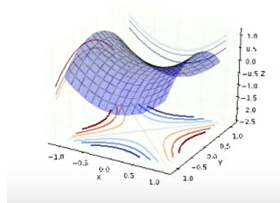
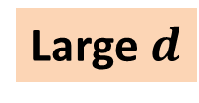
Large $d$
With many parameters, probability distributions often behave as landscapes dominated by saddle points.
These saddle points have practically the same value of the probability or loss function.
Looking for an exact global maximum becomes impractical. Numerically, maximization does not converge.
Credibility intervals are determined by the full set of equivalent saddle points rather than by a neighborhood of the global maximum.

Slide 24
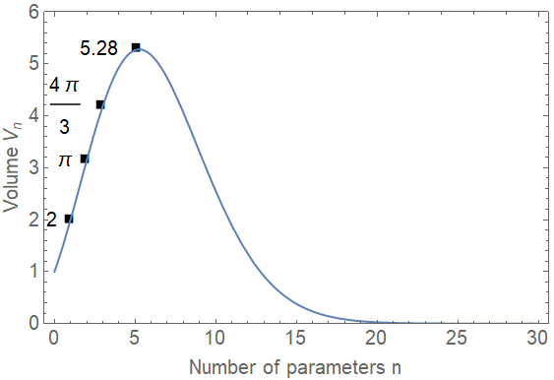
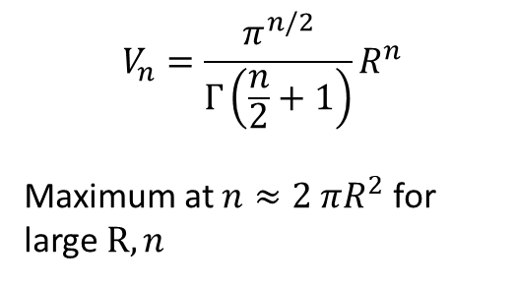
Volume of a unit ball in n dimensions
$$V_{n}=\frac{π^{n/2}}{Γ\left(\frac{n}{2}+1\right)}R^{n}$$
Maximum at $n≈2 πR^{2}$ for large $R,n$
0.0009
The Curse of Dimensionality!
Identified by Richard E. Bellman in 1961

Slide 25


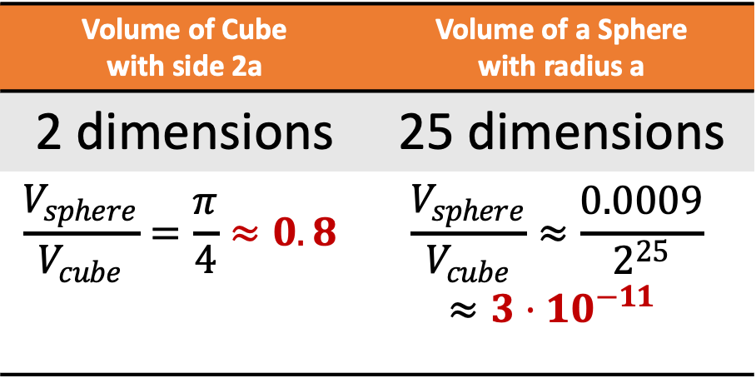

Compare
Volume of Cube with side 2a | Volume of a Sphere with radius a
2 dimensions | 25 dimensions
$$\frac{V_{sphere}}{V_{cube}}=\frac{π}{4}≈0.8$$ | $$\frac{V_{sphere}}{V_{cube}}≈\frac{0.0009}{2^{25}}$$ $$≈3⋅{10}^{−11}$$
$$2a$$
$$2a$$
Image: sand painting, SMU-in-Taos

Slide 26
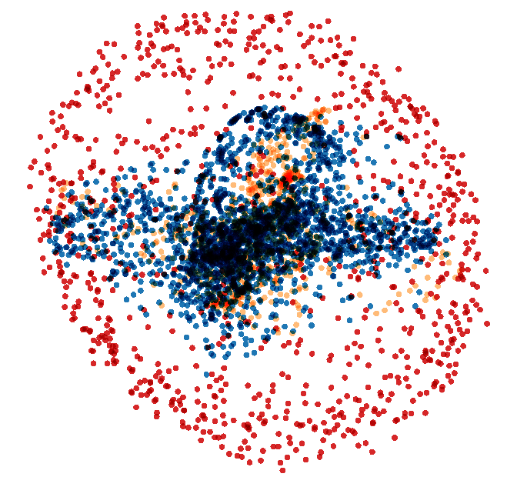
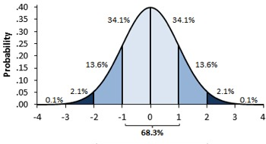

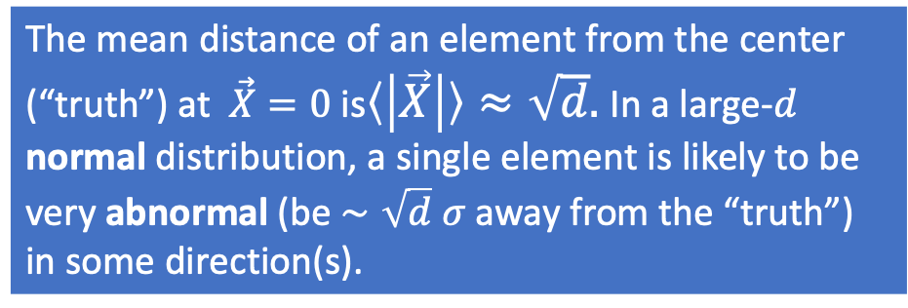
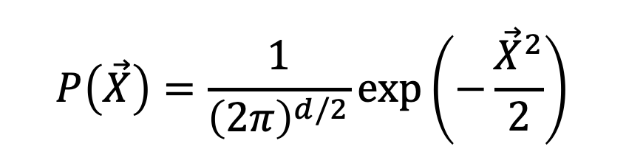
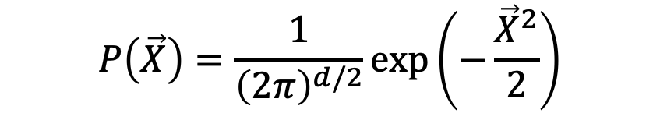
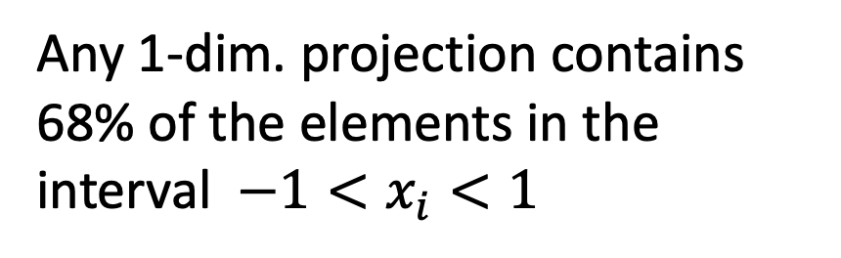
Standard Normal distributions
$$P\left(\vec{X}\right)=\frac{1}{{\left(2π\right)}^{d/2}}\exp\left(−\frac{{\vec{X}}^{2}}{2}\right)$$
$$P\left(\vec{X}\right)=\frac{1}{{\left(2π\right)}^{d/2}}\exp\left(−\frac{{\vec{X}}^{2}}{2}\right)$$
$$\vec{X}$$
The mean distance of an element from the center (“truth”) at $\vec{X}=0$ is$〈\left|\vec{X}\right|〉≈\sqrt{d}.$In a large-$d$ normal distribution, a single element is likely to be very abnormal (be $∼\sqrt{d} σ$ away from the “truth”) in some direction(s).
Any 1-dim. projection contains 68% of the elements in the interval $−1<x_{i}<1$

Slide 27
Lessons from the Big Data Paradox
Data quality is far more important than data quantity.
Compensating for quality with quantity is a doomed game.
It is far more important to reduce sampling and non-response biases than non-response rates.
Invest in small but very high quality surveys than large surveys with uncontrolled/unknown quality.

Slide 28
Lessons from the Big Data Paradox (cont’d)
When combining datasets, relatively tiny but higher quality ones should be given far more weights than suggested by their sizes.
For population inferences, “bigness” of ”Big Data” should be measured by their relative size, not absolute size.
Probability sampling is an extremely powerful tool for ensuring data quality, but it is not the only strategy.

Slide 29
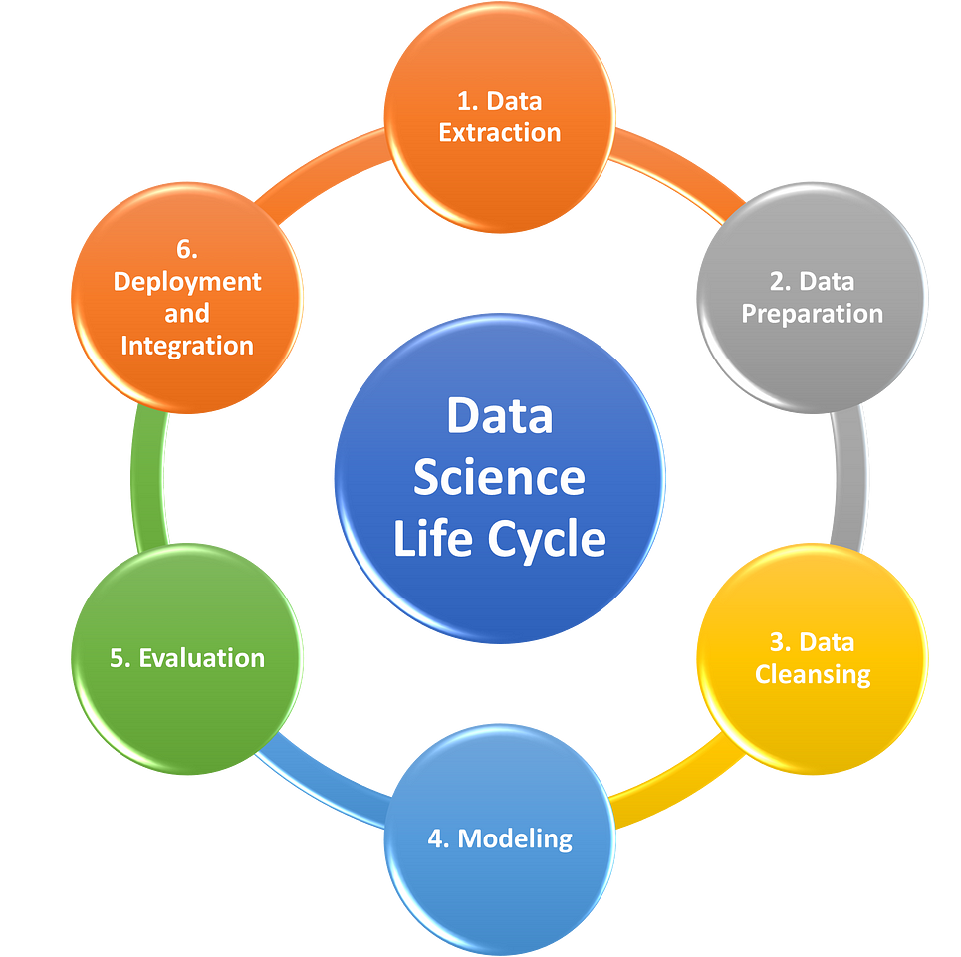
The A Solution?
Would the conclusion be the same if you had made a different, equally reasonable, choice in parameter values or analysis strategy?
Veridical Data Science (paper & book)
Spans the data science life cycle

Slide 30
Don’t Hide – Document! Use PCS
Predictability: demonstrate computationally that results reemerge in relevant future data and are in line with domain knowledge (reality check)
Computability: document the reasons that certain algorithmic restrictions were deemed appropriate and the impact they may have on conclusions
Stability: Assess the trustworthiness of your results by examining a range of sources of uncertainty using a series of stability explorations throughout the DSLC
Actively embrace imperfections within our data and analyses

Slide 31
PCS Spans the DSLC

Slide 32

Thank you!
Questions?

