Slide 1


SAP Vulnerability Disclosure

Slide 2

Francisco Leon Gil
Pentester for more than 11 years
@arphanetx

Slide 3


Slide 4
SAP Stuff…
“…is a bundle of business applications that provide integration of information and processes, collaboration …” (wikipedia definition)
Many, many, many modules
High complexity
Netweaver support these languages :
.Net
Java
IBM WebSphere
…remember the complexity?

Slide 5
Netweaver History
1st version 2003 and commercial release 2004
2nd version 7.0 or Netweaver 2004s - Oct. 25, 2005
3rd version 7.3 21 de Nov. 2001
Netweaver Module:
Enterprise portal

Slide 7

What I mean…
SAP is full of servlets
Default permissions for users are wicked/weird
Even Developers say “read the manual (RTFM) but the manual is huge” (like Zague xD)

Slide 8
Why a full disclosure?
The white hat way:
Contact the vendor
Give them 3 months
Be ethical

Slide 9


Slide 10
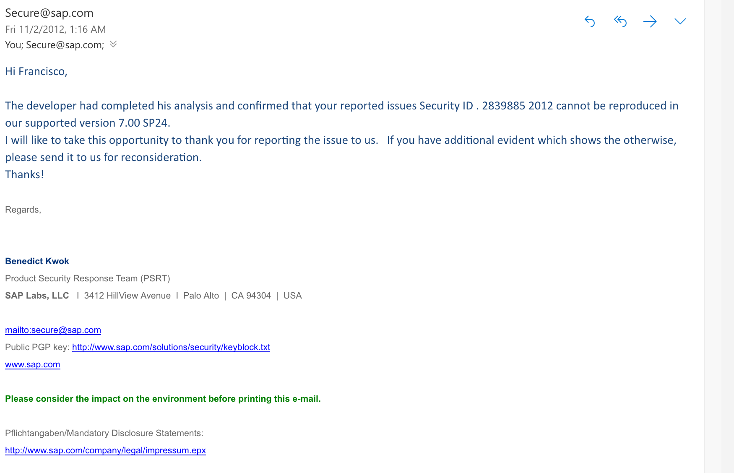

Slide 11

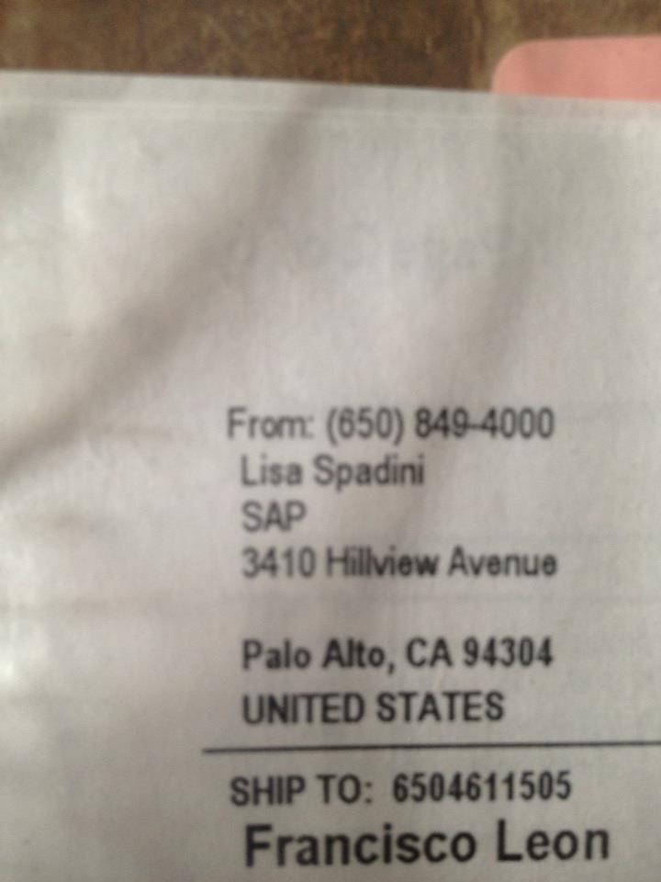
What I got…?

Slide 12


Slide 13
so let's do eeet…
This vulnerability is based on lack of security permissions
Usually user anonymous is used to let users read or download content from portal
Module navigation in the KM reads any folder with the variable Uri=
Almost all the links generated from SAP have all the path for the folders or modules
The KM (Knowledge Management) is known to deliver many features and rarely secured.

Slide 14


Slide 15
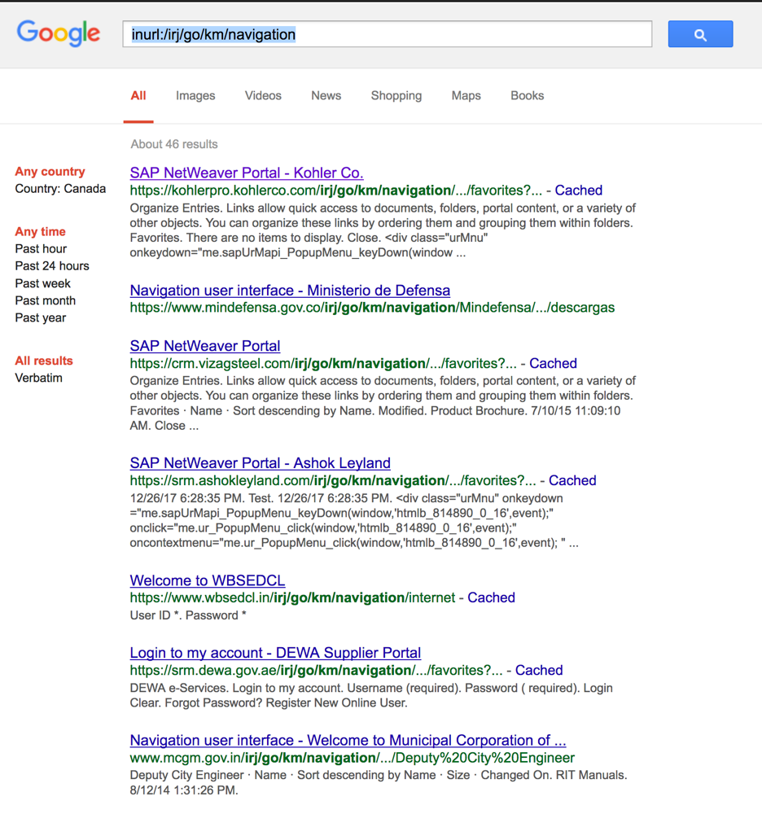
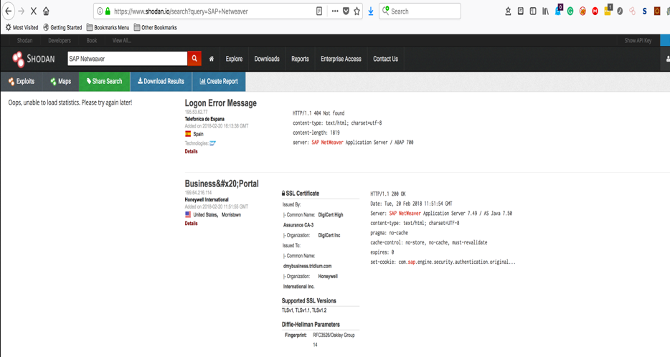
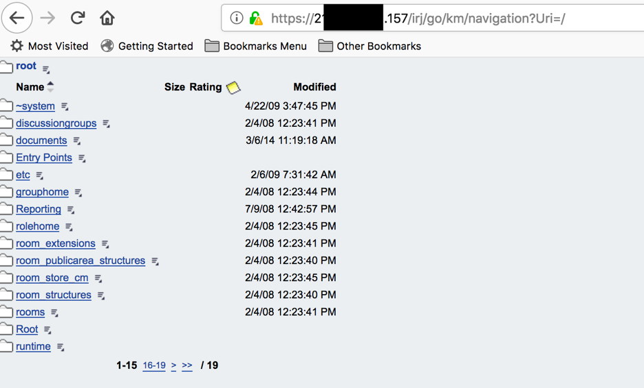

Slide 16

Let's take a little bite…

Slide 17
DEMO TIME!!

Slide 18

Q&A

Slide 19


