Slide 1

DevOps Configuration Management Tools
Presented By:
2251053 Avirup Das
2251188 Arpita Nath
2251198 Abhijit Ghosh
2251243 Rahit Saha
Presented On 10/03/2025

Slide 2
Topics to BE COVERED HERE…
Introduction to DevOps
Infrastructure as Code Vs Configuration as Code
What is Configuration Management Tool
Importance of Configuration Management in Devops
Popular DevOps Configuration Management Tools
Configuration Management As Code
Chef-Architecture or Process
Ansible-Architecture or Process
Use Cases
Conclusion

Slide 3
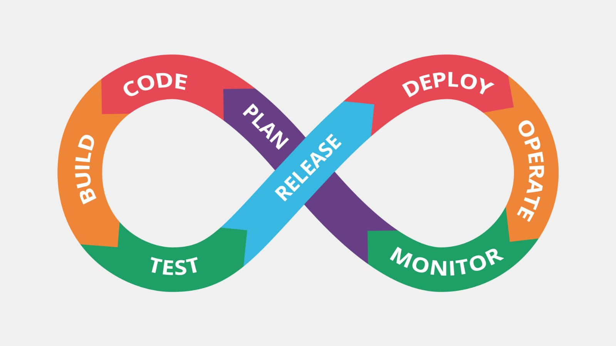
Introduction to DevOps
DevOps combines development and operations
Focuses on automation, collaboration, and continuous integration/continuous deployment (CI/CD)
Enhances software development lifecycle (SDLC)

Slide 4
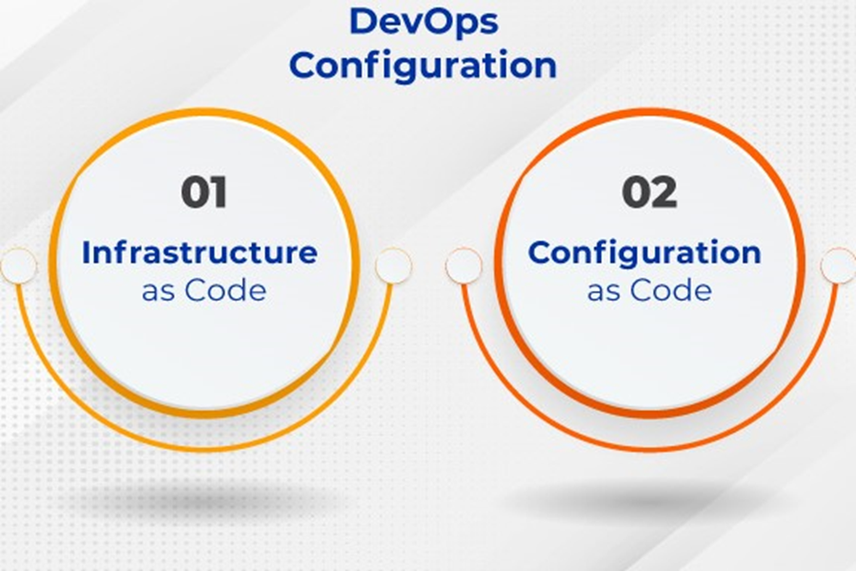
Infrastructure as Code Vs Configuration as Code
Purpose
Scope
Action
Tools

Slide 5
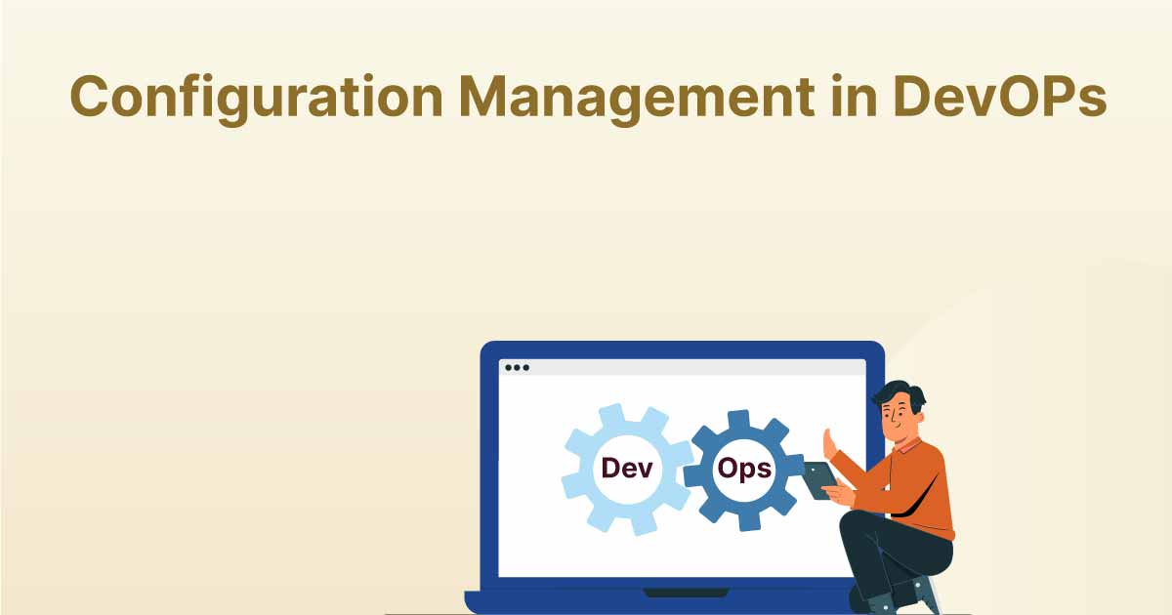
What is Configuration Management?
Configuration Management is a process that helps manage and track changes to software, hardware, and infrastructure.

Slide 6
Importance of Configuration Management in DevOps
Version Control
Infrastructure as Code (IaC)
Automated Provisioning
Application Configuration
Automated Deployment
Environment Management

Slide 7
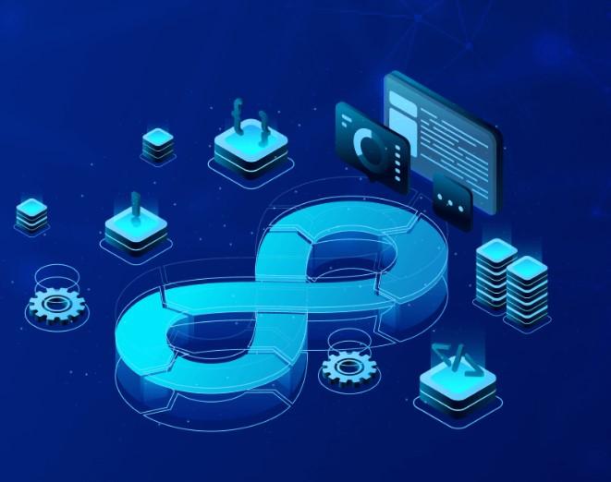
Popular DevOps Configuration Management Tools
Ansible
Puppet
Chef
Salt Stack

Slide 8
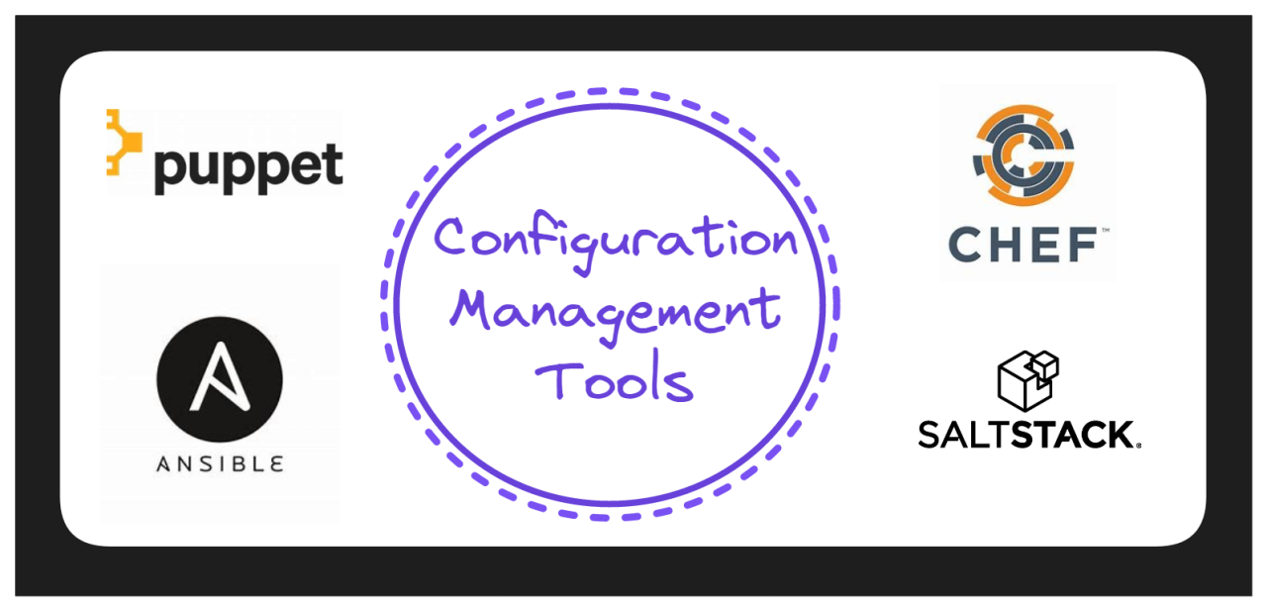
Configuration Management as Code
Pull Based - Chef , puppet
Push Based - Ansible, Salt Stack

Slide 9
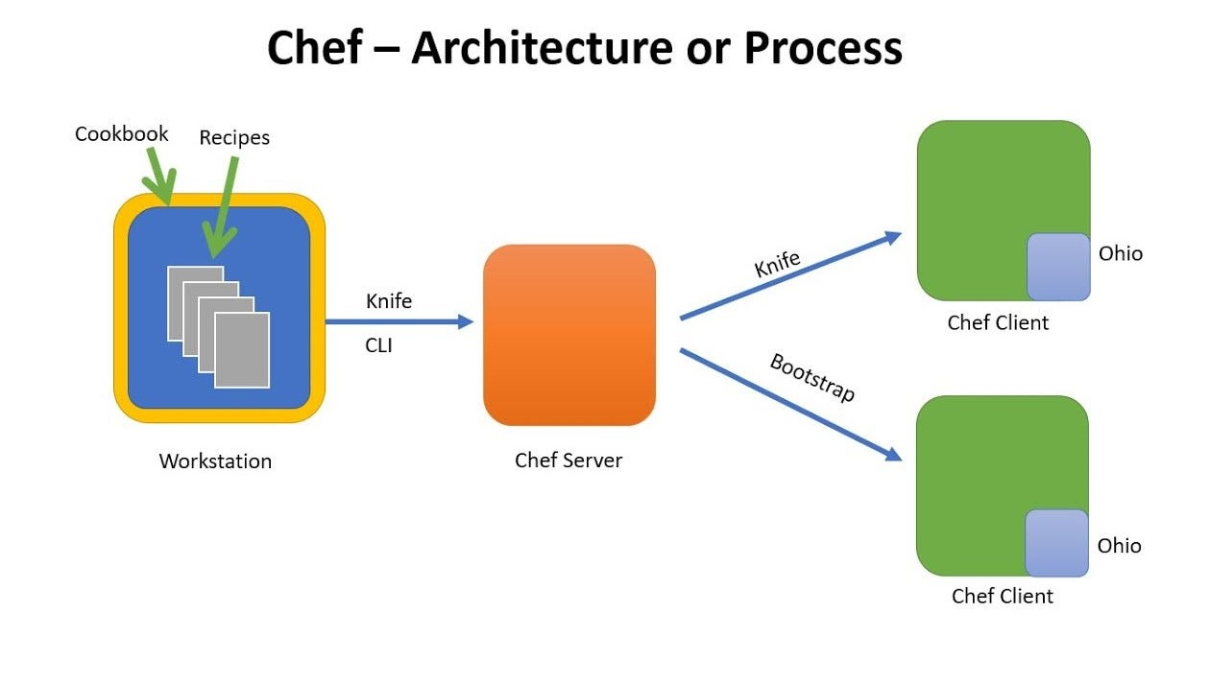
Chef - Architecture or Process

Slide 10
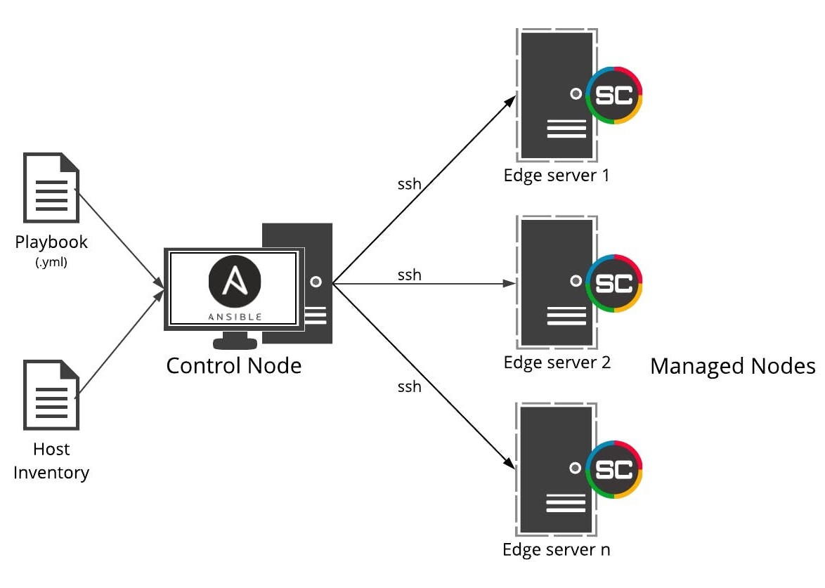
Ansible - Architecture or Process

Slide 11
Use Cases
Push-Based Configuration
Emergency Security Patches & Critical Updates.
Rapid Deployments in DevOps(CI/CD Pipelines).
Managing Small-to-Medium Scale Infrastructure.
One-Time or Ad-Hoc Configuration Changes.
Pull-based Configuration
Large-Scale Cloud Infrastructure(AWS, Azure, Google Cloud).
Continuous Compliance & Security Policy Enforcement
Auto-Scaling and Dynamic Infrastructure
Managing Remote and Occasionally Connected Servers.

Slide 12
Conclusion
Configuration management is key to DevOps success
Choosing the right tool depends on infrastructure needs
Automation reduces time and improves efficiency

Slide 13
Thank You!!! Happy to have any questions??

