Slide 1
Developer Task Report
Generated on 10-Oct-2026

Slide 2
Ava
Task Summary
Task | Sprint | Status | Start | End | Hours
Build ticketing API | Sprint 12 | Done | 01-Jun-2026 | 02-Jun-2026 | 0.0
QA follow-up | Sprint 12 | In-progress | 02-Jun-2026 | - | 0.0
Narrative
Status summary for Ava (auto-generated)
Progress: 1 of 2 tasks done (50%).
Completed: 1 | In progress: 1 | To do: 0 | Blocked: 0
Total hours logged: 0.0

Slide 3
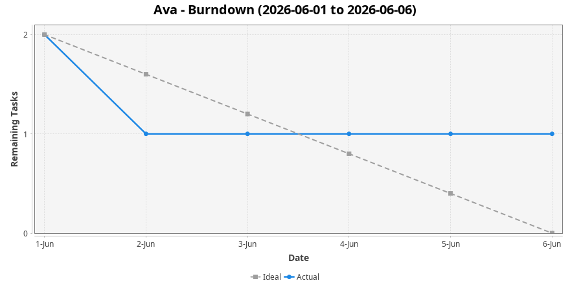
Ava - Burndown

Slide 4
Ben
Task Summary
Task | Sprint | Status | Start | End | Hours
Write integration tests | Sprint 12 | Blocked | 03-Jun-2026 | - | 0.0
Fix dashboard bug | Sprint 12 | To Do | 05-Jun-2026 | - | 0.0
Narrative
Status summary for Ben (auto-generated)
Progress: 0 of 2 tasks done (0%).
Completed: 0 | In progress: 0 | To do: 1 | Blocked: 1
Total hours logged: 0.0
Attention: 1 blocked task(s) need follow-up.

Slide 5
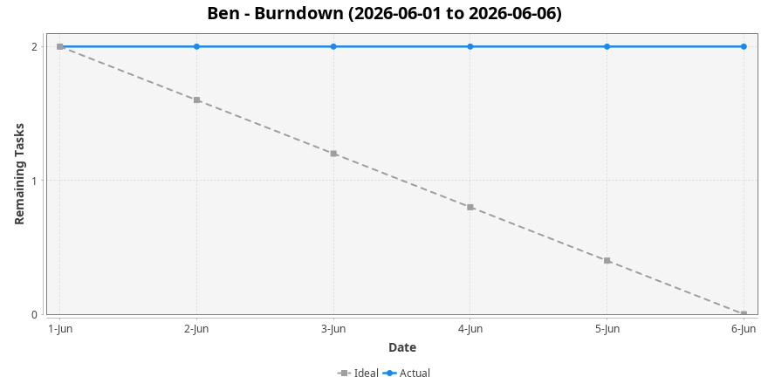
Ben - Burndown

Slide 6
Carla
Task Summary
Task | Sprint | Status | Start | End | Hours
Deploy report service | Sprint 12 | Done | 01-Jun-2026 | 06-Jun-2026 | 0.0
Narrative
Status summary for Carla (auto-generated)
Progress: 1 of 1 tasks done (100%).
Completed: 1 | In progress: 0 | To do: 0 | Blocked: 0
Total hours logged: 0.0

Slide 7
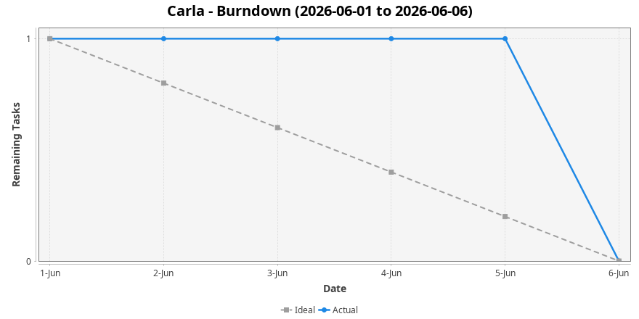
Carla - Burndown

