Slide 1
Divide-And-Conquer Sorting
Small instance.
  n <= 1 elements.
  n <= 10 elements.
  Let us use n <= 1 for now.
Large instance.
  Divide into k >= 2 smaller instances.
  k = 2, 3, 4, … ?
  What does each smaller instance look like?
  Sort smaller instances recursively.
  How do you combine the sorted smaller instances?

Slide 2
Insertion Sort
a[0]
a[n-2]
a[n-1]
k = 2
First n - 1 elements (a[0:n-2]) define one of the smaller instances; last element (a[n-1]) defines the second smaller instance.
a[0:n-2] is sorted recursively.
a[n-1] is a small instance.
Notes:
Insertion sort divides a large instance into two smaller instances. These smaller instances are of a very different size: n-1 vs 1.

Slide 3
Insertion Sort
a[0]
a[n-2]
a[n-1]
Combining is done by inserting a[n-1] into the sorted a[0:n-2] .
Complexity is O(n²).
Usually implemented nonrecursively.
(you can also go from the other direction)

Slide 4
Selection Sort
a[0]
a[n-2]
a[n-1]
k = 2
To divide a large instance into two smaller instances, first find the largest element.
The largest element defines one of the smaller instances; the remaining n-1 elements define the second smaller instance.

Slide 5
Selection Sort
a[0]
a[n-2]
a[n-1]
The second smaller instance is sorted recursively.
Append the first smaller instance (largest element) to the right end of the sorted smaller instance.
Complexity is O(n²).
Usually implemented nonrecursively.

Slide 6
Bubble Sort
Bubble sort may also be viewed as a k = 2 divide-and-conquer sorting method.
Insertion sort, selection sort and bubble sort divide a large instance into one smaller instance of size n - 1 and another one of size 1.
All three sort methods take O(n²) time.

Slide 7
Divide And Conquer
Divide-and-conquer algorithms generally have best complexity when a large instance is divided into smaller instances of approximately the same size.
When k = 2 and n = 24, divide into two smaller instances of size 12 each.
When k = 2 and n = 25, divide into two smaller instances of size 13 and 12, respectively.

Slide 8
Merge Sort
k = 2
First ceil(n/2) elements define one of the smaller instances; remaining floor(n/2) elements define the second smaller instance.
Each of the two smaller instances is sorted recursively.
The sorted smaller instances are combined using a process called merge.
Complexity is O(n log n).
Usually implemented nonrecursively.

Slide 9
Merge Two Sorted Lists
A = (2, 5, 6)
B = (1, 3, 8, 9, 10)
C = ()
Compare smallest elements of A and B and merge smaller into C.
A = (2, 5, 6)
B = (3, 8, 9, 10)
C = (1)

Slide 10
Merge Two Sorted Lists
A = (5, 6)
B = (3, 8, 9, 10)
C = (1, 2)
A = (5, 6)
B = (8, 9, 10)
C = (1, 2, 3)
A = (6)
B = (8, 9, 10)
C = (1, 2, 3, 5)

Slide 11
Merge Two Sorted Lists
A = ()
B = (8, 9, 10)
C = (1, 2, 3, 5, 6)
When one of A and B becomes empty, append the other list to C.
O(1) time needed to move an element into C.
Total time is O(n + m), where n and m are, respectively, the number of elements initially in A and B.

Slide 12
Merge Sort
[8, 3, 13, 6, 2, 14, 5, 9, 10, 1, 7, 12, 4]
[8, 3, 13, 6, 2, 14, 5]
[9, 10, 1, 7, 12, 4]
[8, 3, 13, 6]
[2, 14, 5]
[9, 10, 1]
[7, 12, 4]
[8, 3]
[13, 6]
[2, 14]
[5]
[9, 10]
[1]
[7, 12]
[4]
[8]
[3]
[13]
[6]
[2]
[14]
[9]
[10]
[7]
[12]

Slide 13
Merge Sort
[1, 2, 3, 4, 5, 6, 7, 8, 9, 10, 12, 13,14]
[2, 3, 5, 6, 8, 13, 14]
[1, 4, 7, 9, 10,12]
[3, 6, 8, 13]
[2, 5, 14]
[1, 9, 10]
[4, 7, 12]
[3, 8]
[6, 13]
[2, 14]
[5]
[9, 10]
[1]
[7, 12]
[4]
[8]
[3]
[13]
[6]
[2]
[14]
[9]
[10]
[7]
[12]

Slide 14
Time Complexity
Let t(n) be the time required to sort n elements.
t(0) = t(1) = c, where c is a constant.
When n > 1,
  t(n) = t(ceil(n/2)) + t(floor(n/2)) + dn,
  where d is a constant.
To solve the recurrence, assume n is a power of 2 and use repeated substitution.
t(n) = O(n log n).

Slide 15
Merge Sort
Downward pass over the recursion tree.
  Divide large instances into small ones.
Upward pass over the recursion tree.
  Merge pairs of sorted lists.
Number of leaf nodes is n.
Number of nonleaf nodes is n-1.

Slide 16
Time Complexity
Downward pass.
  O(1) time at each node.
  O(n) total time at all nodes.
Upward pass.
  O(n) time merging at each level that has a nonleaf node.
  Number of levels is O(log n).
  Total time is O(n log n).

Slide 17
Nonrecursive Version
Eliminate downward pass.
Start with sorted lists of size 1 and do pairwise merging of these sorted lists as in the upward pass.

Slide 18
Nonrecursive Merge Sort
[8]
[3]
[13]
[6]
[2]
[14]
[5]
[9]
[10]
[1]
[7]
[12]
[4]
[3, 8]
[6, 13]
[2, 14]
[5, 9]
[1, 10]
[7, 12]
[4]
[3, 6, 8, 13]
[2, 5, 9, 14]
[1, 7, 10, 12]
[4]
[2, 3, 5, 6, 8, 9, 13, 14]
[1, 4, 7, 10, 12]
[1, 2, 3, 4, 5, 6, 7, 8, 9, 10, 12, 13, 14]

Slide 19
Complexity
Sorted segment size is 1, 2, 4, 8, …
Number of merge passes is ceil(log₂n).
Each merge pass takes O(n) time.
Total time is O(n log n).
Need O(n) additional space for the merge.
Merge sort is slower than insertion sort when n <= 15 (approximately). So define a small instance to be an instance with n <= 15.
Sort small instances using insertion sort.
Start with segment size = 15.

Slide 20
Natural Merge Sort
Initial sorted segments are the naturally ocurring sorted segments in the input.
Input = [8, 9, 10, 2, 5, 7, 9, 11, 13, 15, 6, 12, 14].
Initial segments are:
  [8, 9, 10] [2, 5, 7, 9, 11, 13, 15] [6, 12, 14]
2 (instead of 4) merge passes suffice.
Segment boundaries have a[i] > a[i+1].

Slide 21
Quick Sort
Small instance has n <= 1. Every small instance is a sorted instance.
To sort a large instance, select a pivot element from out of the n elements.
Partition the n elements into 3 groups left, middle and right.
The middle group contains only the pivot element.
All elements in the left group are <= pivot.
All elements in the right group are >= pivot.
Sort left and right groups recursively.
Answer is sorted left group, followed by middle group followed by sorted right group.

Slide 22
Example
6
2
8
5
11
10
4
1
9
7
3
Use 6 as the pivot.
2
5
4
1
3
6
7
9
10
11
8
Sort left and right groups recursively.

Slide 23
Choice Of Pivot
Pivot is leftmost element in list that is to be sorted.
  When sorting a[6:20], use a[6] as the pivot.
Randomly select one of the elements to be sorted as the pivot.
  When sorting a[6:20], generate a random number r in the range [6, 20]. Use a[r] as the pivot.

Slide 24
Choice Of Pivot
Median-of-Three rule. From the leftmost, middle, and rightmost elements of the list to be sorted, select the one with median key as the pivot.
  When sorting a[6:20], examine a[6], a[13] { ((6+20)/2)}, and a[20]. Select the element with median (i.e., middle) key.
  If a[6].key = 30, a[13].key = 2, and a[20].key = 10, a[20] becomes the pivot.
  If a[6].key = 3, a[13].key = 2, and a[20].key = 10, a[6] becomes the pivot.

Slide 25
Choice Of Pivot
  If a[6].key = 30, a[13].key = 25, and a[20].key = 10, a[13] becomes the pivot.
When the pivot is picked at random or when the median-of-three rule is used, we can use the quick sort code provided we first swap the leftmost element and the chosen pivot.
swap
pivot

Slide 26
Partitioning Into Three Groups
Sort a = [6, 2, 8, 5, 11, 10, 4, 1, 9, 7, 3].
Leftmost element (6) is the pivot.
When another array b is available:
  Scan a from left to right (omit the pivot in this scan), placing elements <= pivot at the left end of b and the remaining elements at the right end of b.
  The pivot is placed at the remaining position of the b.

Slide 27
Partitioning Example Using Additional Array
a
6
2
8
5
11
10
4
1
9
7
3
b
2
5
4
1
3
6
7
9
10
11
8
Sort left and right groups recursively.

Slide 28
In-place Partitioning
Find leftmost element (bigElement) > pivot.
Find rightmost element (smallElement) < pivot.
Swap bigElement and smallElement provided bigElement is to the left of smallElement.
Repeat.

Slide 29
In-Place Partitioning Example
a
6
6
2
8
8
5
11
10
4
1
9
7
3
3
a
6
6
2
3
5
11
11
10
4
1
1
9
7
8
a
6
6
2
3
5
1
10
10
4
4
11
9
7
8
a
6
6
2
3
5
1
4
4
10
10
11
9
7
8
bigElement is not to left of smallElement, terminate process. Swap pivot and smallElement.
a
4
2
3
5
1
4
6
6
10
11
9
7
8

Slide 30
Complexity
O(n) time to partition an array of n elements.
Let t(n) be the time needed to sort n elements.
t(0) = t(1) = c, where c is a constant.
When t > 1,
  t(n) = t(|left|) + t(|right|) + dn,
  where d is a constant.
t(n) is maximum when either |left| = 0 or |right| = 0 following each partitioning.

Slide 31
Complexity
This happens, for example, when the pivot is always the smallest element.
For the worst-case time,
  t(n) = t(n-1) + dn, n > 1
Use repeated substitution to get t(n) = O(n²).
The best case arises when |left| and |right| are equal (or differ by 1) following each partitioning.
For the best case, the recurrence is the same as for merge sort.

Slide 32
Complexity Of Quick Sort
So the best-case complexity is O(n log n).
Average complexity is also O(n log n).
To help get partitions with almost equal size, change in-place swap rule to:
  Find leftmost element (bigElement) >= pivot.
  Find rightmost element (smallElement) <= pivot.
  Swap bigElement and smallElement provided bigElement is to the left of smallElement.
O(n) space is needed for the recursion stack.

Slide 33
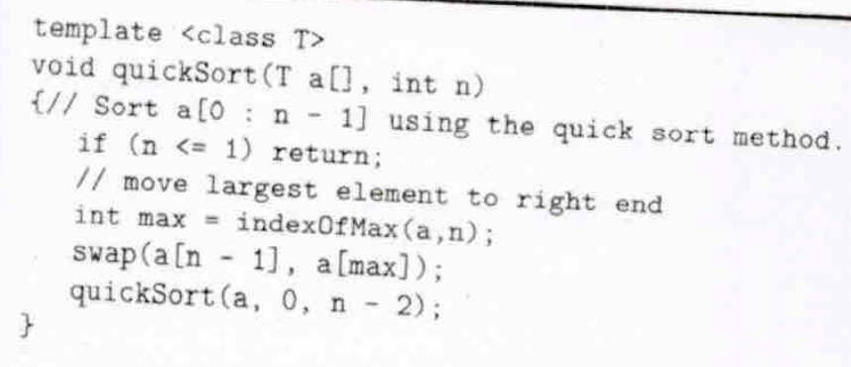

Slide 34
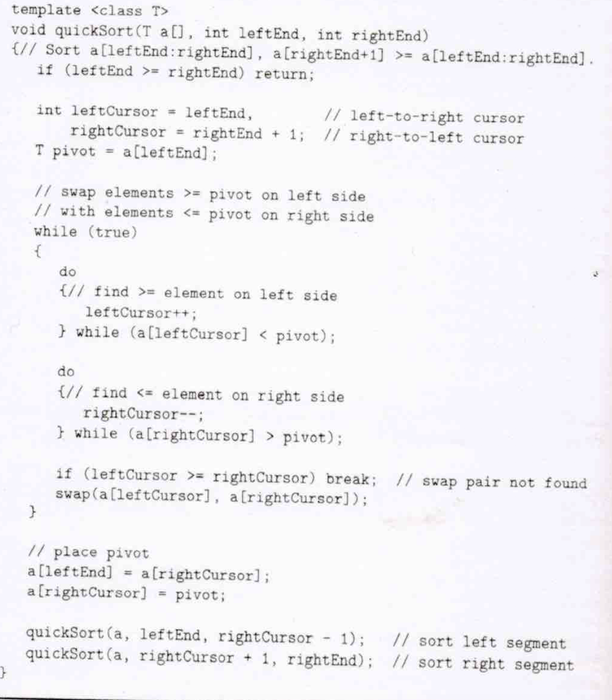

Slide 35
Space Efficiency
May be reduced to O(log n) by using Stack to simulate recursion

Slide 36
Average complexity
Average Complexity Θ (n log n)
--

Slide 37
Complexity Of Quick Sort
To improve performance, define a small instance to be one with n <= 15 (say) and sort small instances using insertion sort.

Slide 38
Notes
When the median of the three rule is applied, quicksort takes O(n log n) when the input list is in sorted order
Also, the case when one of the two partitions is eliminated ( except when we have duplicates)

Slide 39
C++ STL sort Function
Quick sort.
  Switch to heap sort when number of subdiviions exceed some constant times log₂n.
  Switch to insertion sort when segment size becomes small.

Slide 40
C++ STL stable_sort Function
Merge sort is stable (relative order of elements with equal keys is not changed).
Quick sort is not stable.
STL’s stable_sort is a merge sort that switches to insertion sort when segment size is small.

Slide 41
Closest Pair of Points
You are given n points (xi,yi) and are to find two that are nearest. Use Eucledian distance.
D & C
  Divide into roughly equal parts in A and B
    Find closed pairs in A & B
    Find closest pairs such that one is in A and One is in B
    From the closest three pairs find the one with least distance

Slide 42
Multiplication of Matrices
Matrix Multiplication by partitioning
Strassen’s Alg

Slide 43
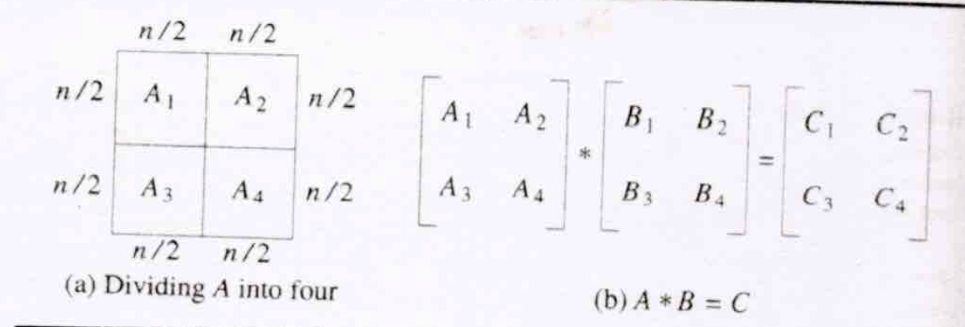
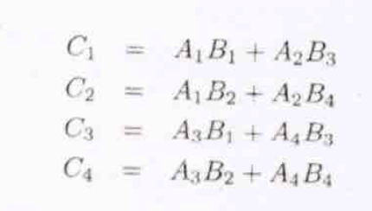

Slide 44
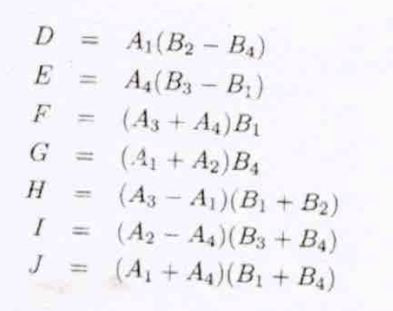
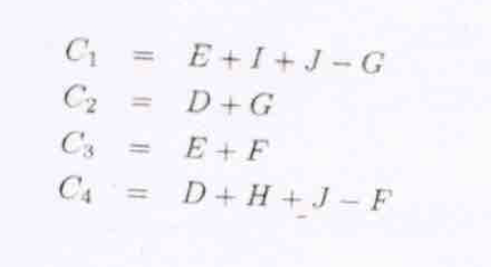

Slide 45
