Slide 1
Identification of Human Activities from Accelerometer Readings

Slide 2
Contents
Overview
Workflow
Data Dictionary
Exploratory Data Analysis
Feature Engineering
Evaluation Metrics
Models
Challenges

Slide 3
Overview
Problem Statement: Identifying and Classifying a number of simple human activities which are defined as Human Motion Primitives (HMP) using tri-axial accelerometer data obtained while performing the activities.
Engineering features to capture micro movements within activities.
Build Predictive models and evaluate them.

Slide 4
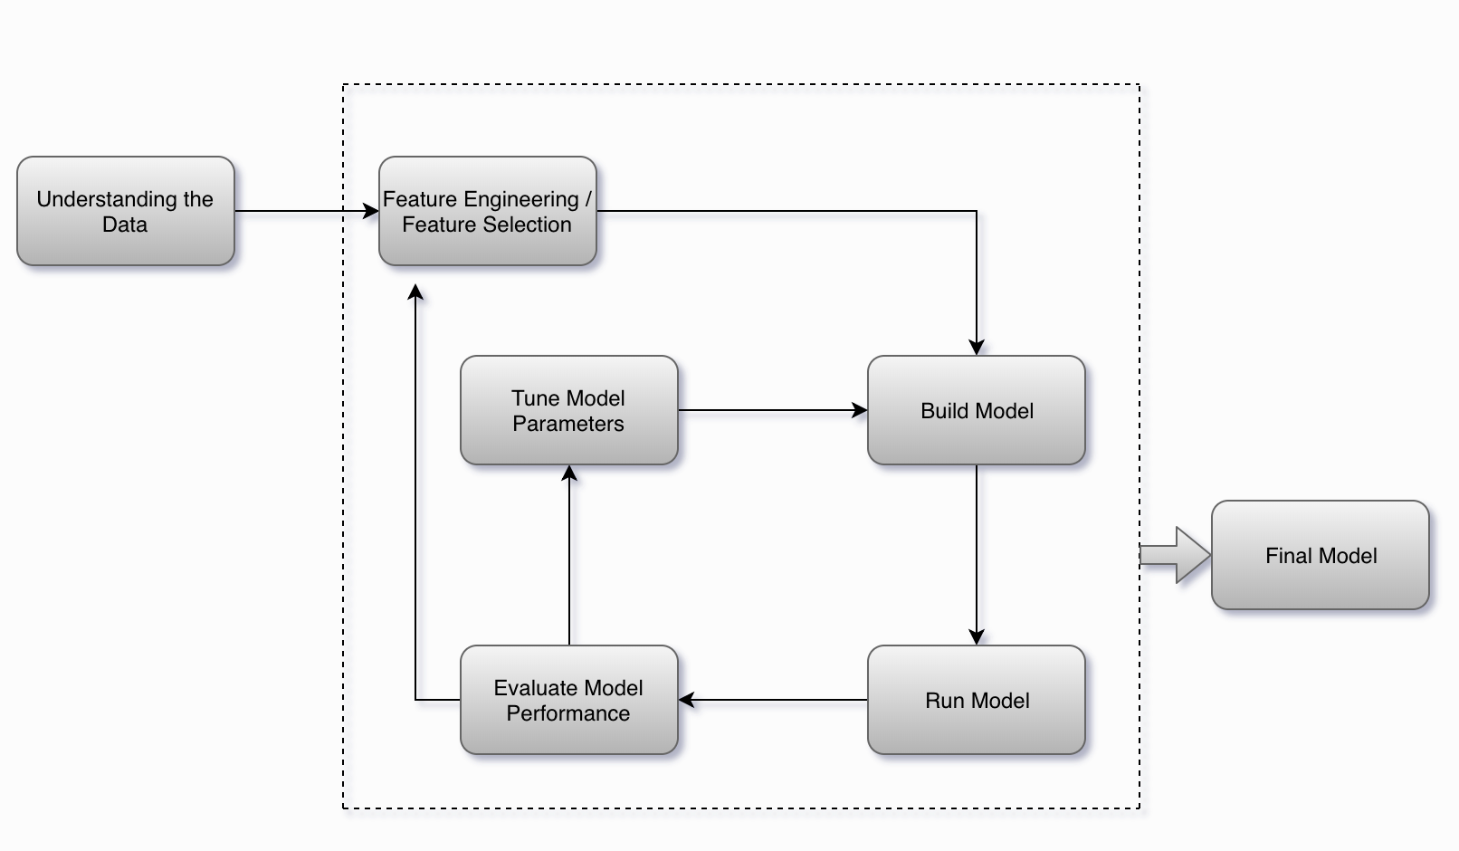
Workflow

Slide 5
Data Dictionary
Source: UCI Repository
https://archive.ics.uci.edu/ml/datasets/Dataset+for+ADL+Recognition+with+Wrist-worn+Accelerometer
16 volunteers, Total Activities recorded – 14
Brush_teeth (12 elements) | Getup_bed (101 elements)
Climb_stairs (102 elements) | Liedown_bed (28 elements)
Comb_hair (31 elements) | Pour_water (100 elements)
Descend_stairs (42 elements) | Sitdown_chair (100 elements)
Drink_glass (100 elements) | Standup_chair (102 elements)
Eat_meat (5 elements) | Use_telephone (13 elements)
Eat_soup (3 elements) | Walk (100 elements)

Slide 6
Data Dictionary
Each file in the dataset corresponds to a volunteer performing an activity for a specific time period. For example, the file Accelerometer-2011-03-24-10-24-39-climb_stairs-f1.txt
Each raw file consists of three tab separated columns of data, each corresponding to acceleration readings [0,63] from an accelerometer attached to the right wrist of the user along three axes:
x axis: pointing toward the hand
y axis: pointing toward the left
z axis: perpendicular to the plane of the hand

Slide 7
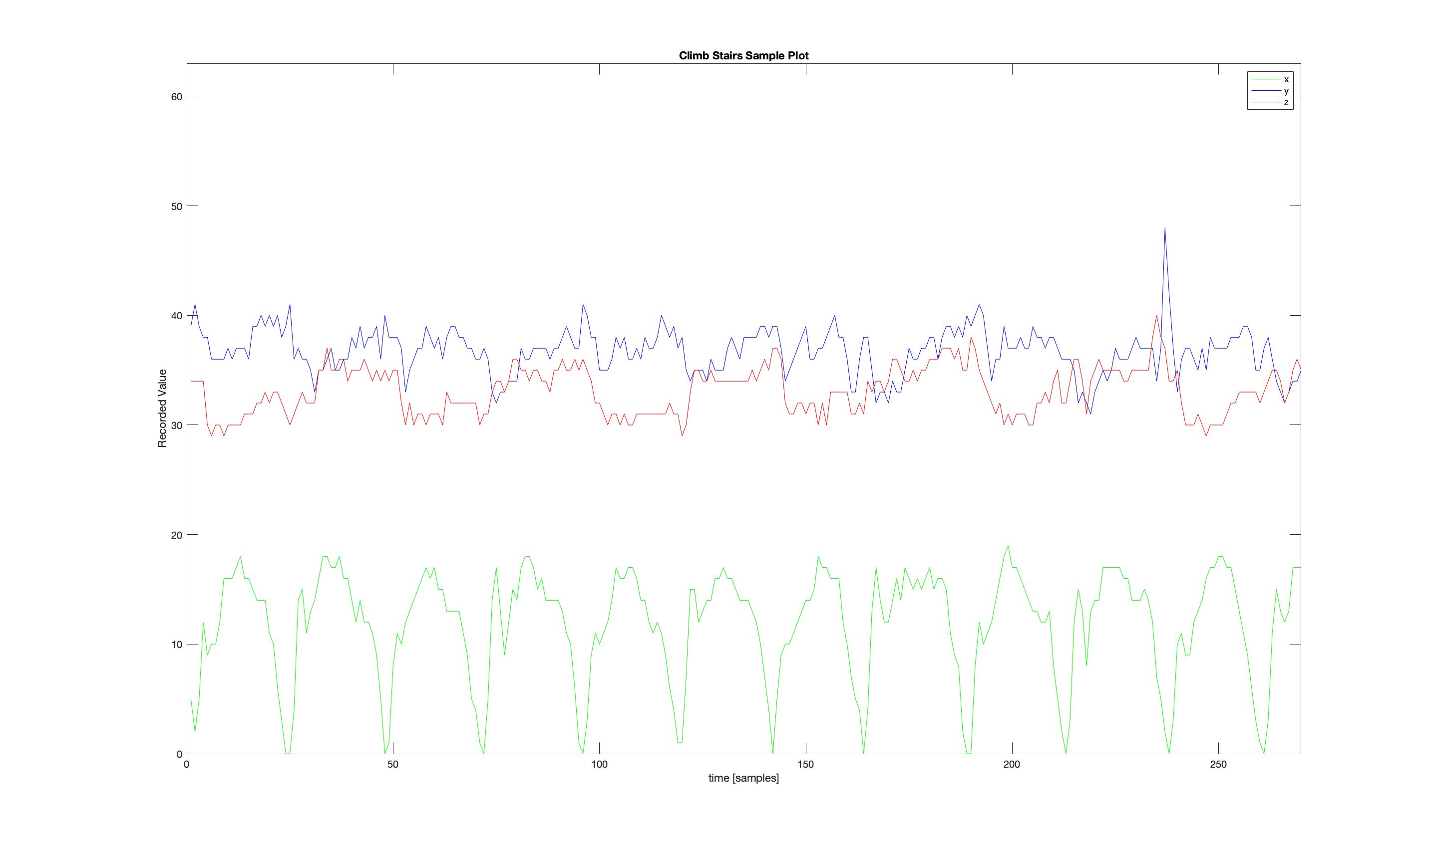
Exploratory Data Analysis

Slide 8
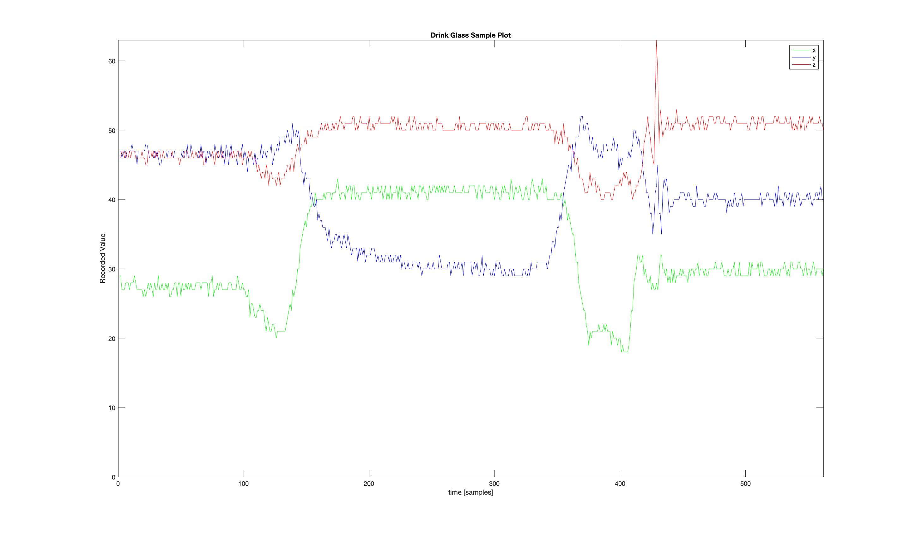
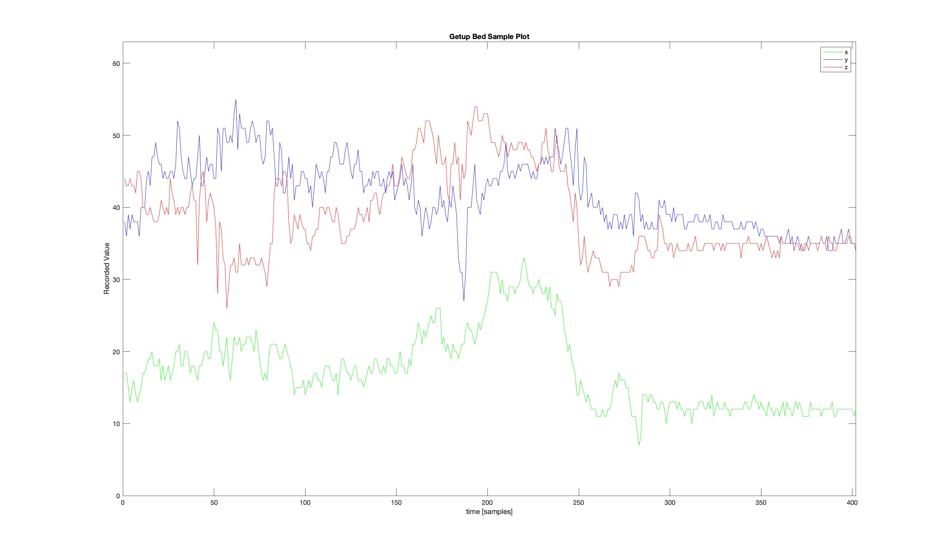

Slide 9
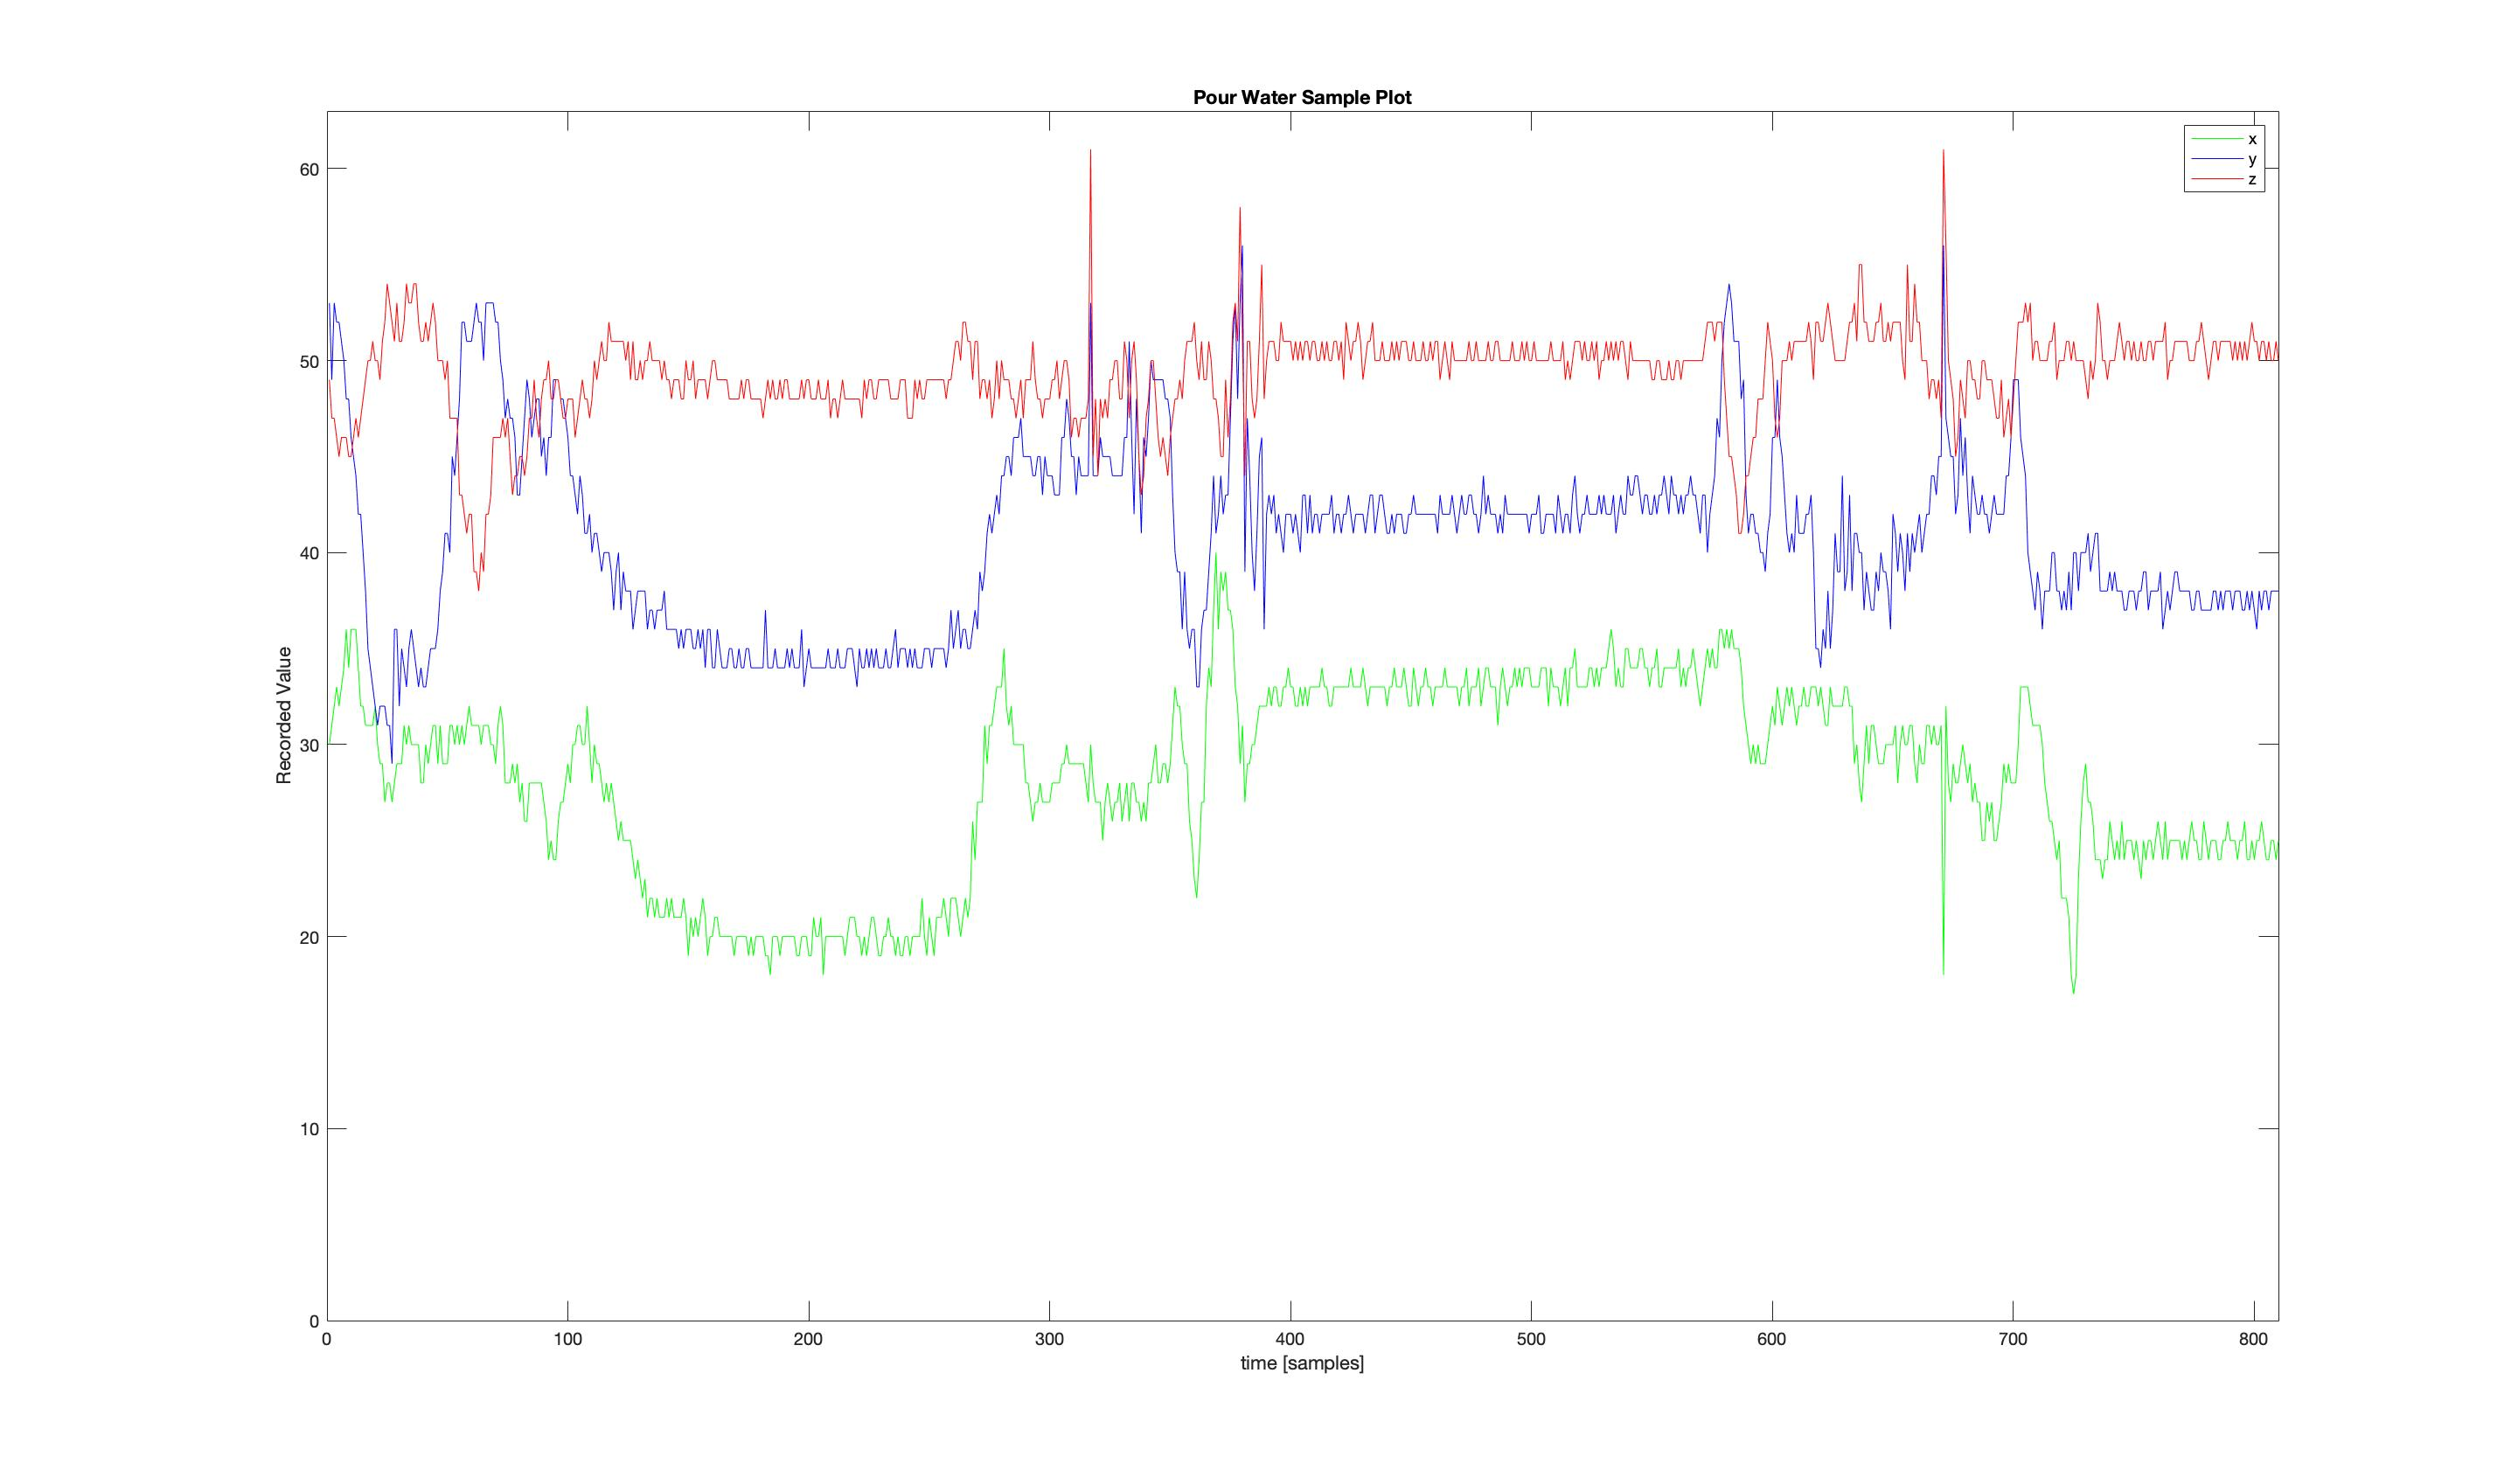
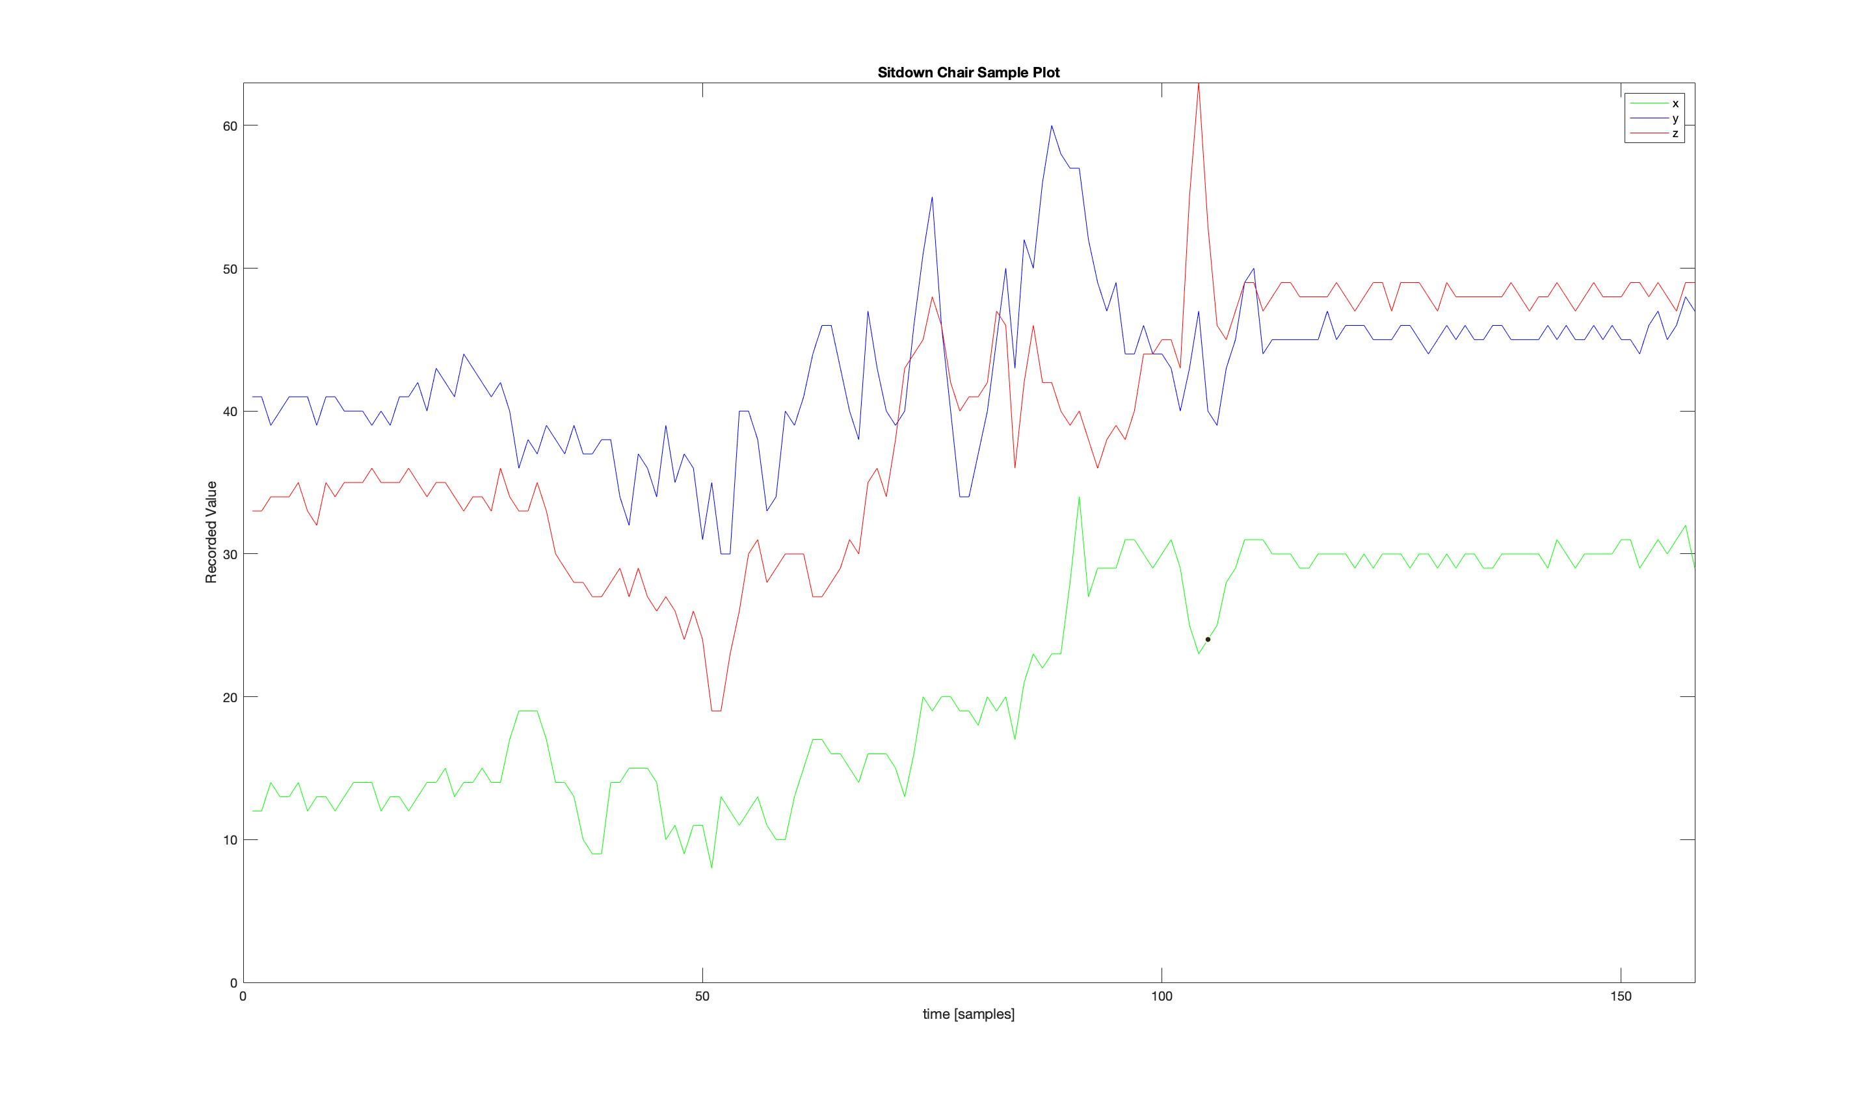

Slide 10
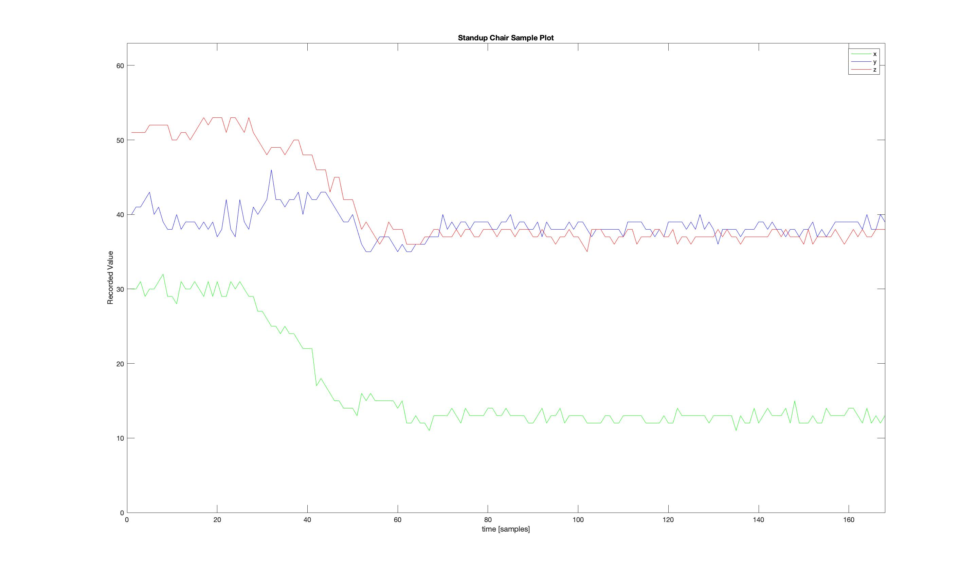
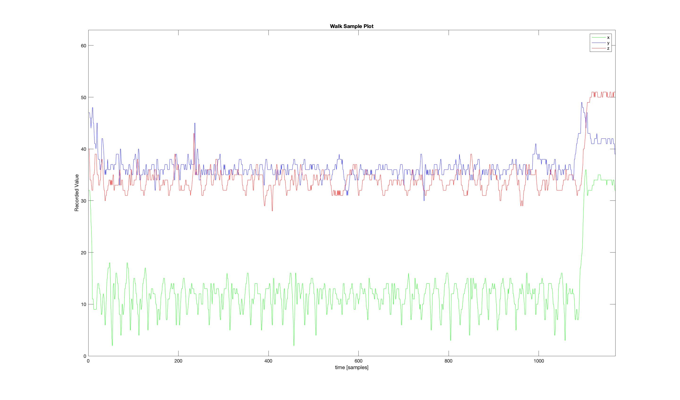

Slide 11

Feature Engineering
New Features created (using R) (23)
Mean, Median and Variance of signals (x, y and z) (9)
Correlation and covariances among signals (6)
Peak Amplitudes of signals (3)
Spectral energy for an activity (1)
Other features (2)
Feature Name | Feature Description
vol | Volunteer ID
meanx | Mean of x recordings
meany | Mean of y recordings
meanz | Mean of z recordings
medianx | Median of x recordings
mediany | Median of y recordings
medianz | Median of z recordings
varx | variance of x
vary | variance of y
varz | variance of z
corxy | correlation of x and y
corxz | correlation of x and z
coryz | correlation of y and z
varxy | covariances of x and y
varxz | covariances of x and z
varyz | covariances of y and z
fftxmax | Peak amplitude of signal x
fftymax | Peak amplitude of signal y
fftzmax | Peak amplitude of signal z
specenergy | Spectral energy contained in signals
xbtwnzandy | Percentage of samples where x between z and y
xless10 | Percentage of samples with x less than 10
HMPactivity | Activity performed by volunteer

Slide 12
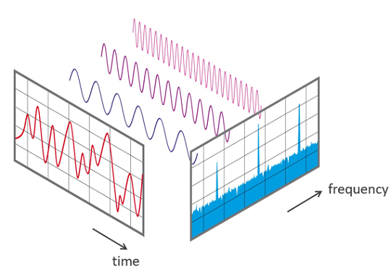
Peak Amplitude of Signal
Computed using Fast Fourier Transform of signals
fftxmax=max(abs(Mod(fft(dat$x_acc))))

Slide 13
Spectral Energy
Total energy contained within the signals for an activity
Parseval’s Theorem
https://en.wikipedia.org/wiki/Parseval%27s_theorem
specenergy=(sum(Mod(fftx))/length(fftx))+(sum(Mod(ffty))/length(ffty))+(sum(Mod(fftz))/length(fftz))

Slide 14
Other Features
xbtwnzandy – Percentage of samples that has x between z and y, this is for classifying the Drink_glass activity.
xbtwnzandy=mean((dat$z_acc > dat$x_acc & dat$y_acc < dat$x_acc))
xless10: Percentage of samples with x less than 10
Climb_stairs, Sitdown_chair, Standup_chair – xless20
Climb_stairs, Getup_bed – xless10
xless10=sum(dat$x_acc<10)/nrow(dat)

Slide 15
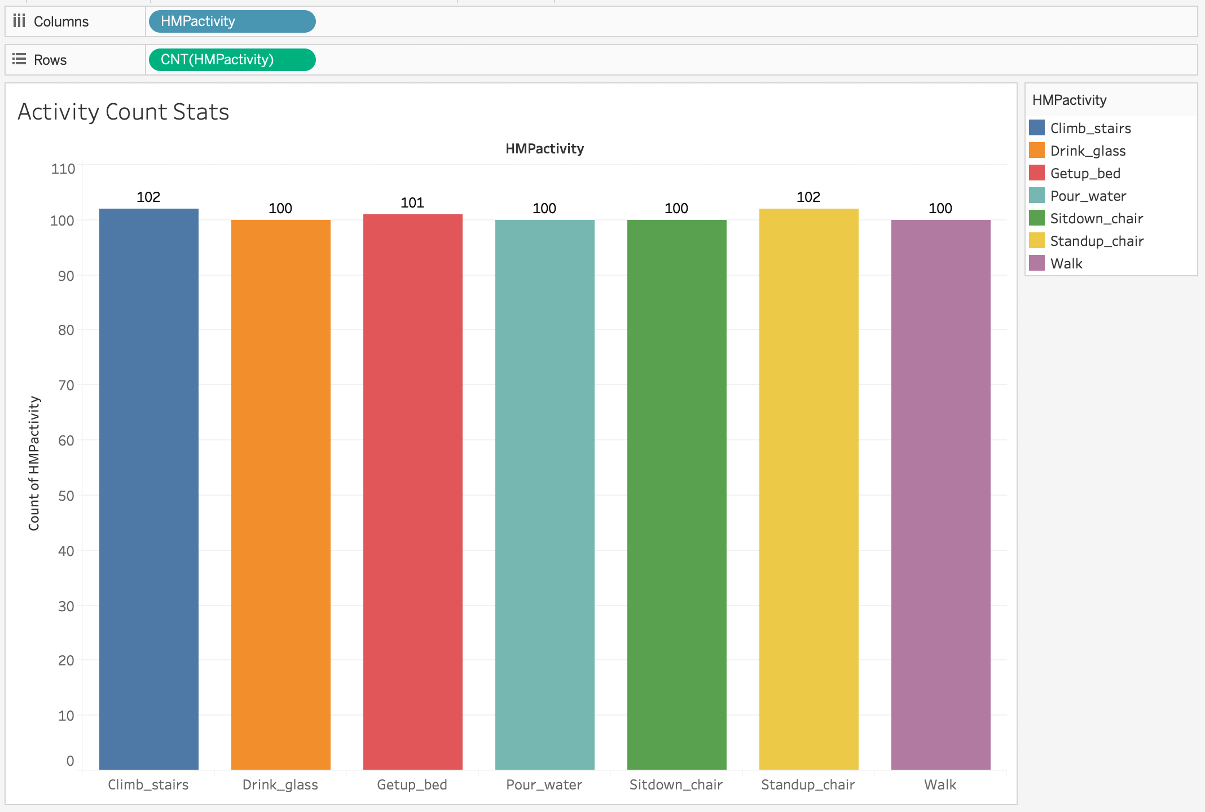
Evaluation Metrics
Baseline Accuracy
Class that has most number of observations – Climb_stairs / Standup_chair
No. of Records in Climb_stairs – 102
Total No. of Records – 705
Baseline Accuracy = 102/705 = 14.47%
Any Model that has accuracy more than this baseline is a useful model.
Misclassification rate

Slide 16
Models
Data Split (Train-60%, Validation-20%, Test-20%)
Decision Tree
Gradient Boosting
Random Forest
Also built SVM (both Linear and Poly) Models using Python
Built the below Models (using SAS E-Miner) without feature Selection, with feature Selection and with PCA

Slide 17
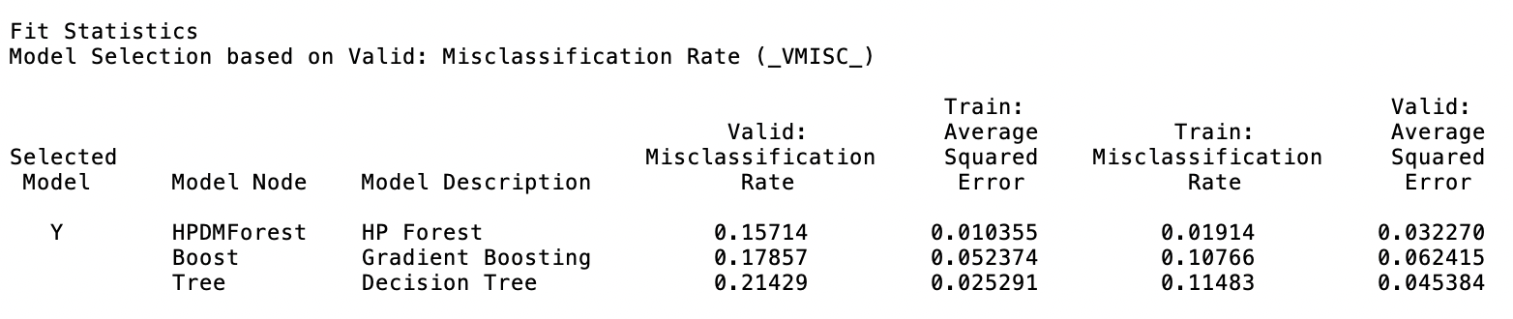
Without Feature Selection

Slide 18
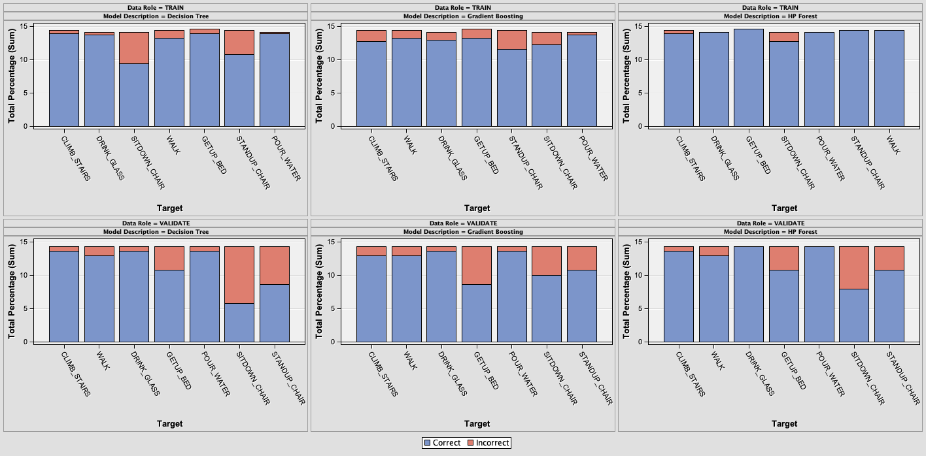
Classification Chart

Slide 19
With Feature Selection
Name | USE | ROLE | Level | REASON
HMPACTIVITY | D | TARGET | NOMINAL
CORXY | Y | INPUT | INTERVAL
CORXZ | Y | INPUT | INTERVAL
CORYZ | Y | INPUT | INTERVAL
FFTXMAX | Y | INPUT | INTERVAL
FFTYMAX | Y | INPUT | INTERVAL
FFTZMAX | Y | INPUT | INTERVAL
MEANX | Y | INPUT | INTERVAL
MEANY | Y | INPUT | INTERVAL
MEANZ | Y | INPUT | INTERVAL
MEDIANX | Y | INPUT | INTERVAL
MEDIANY | Y | INPUT | INTERVAL
MEDIANZ | Y | INPUT | INTERVAL
SPECENERGY | Y | INPUT | INTERVAL
VARX | Y | INPUT | INTERVAL
VARY | Y | INPUT | INTERVAL
VARYZ | Y | INPUT | INTERVAL
VARZ | Y | INPUT | INTERVAL
XLESS10 | Y | INPUT | INTERVAL
VOL | D | REJECTED | NOMINAL
VAR1 | D | REJECTED | NOMINAL
VARXY | N | REJECTED | INTERVAL | Variable Importance in Decision Tree
VARXZ | N | REJECTED | INTERVAL | Variable Importance in Decision Tree
XBTWNZANDY | N | REJECTED | INTERVAL | Variable Importance in Decision Tree
Used Variable importance
in a decision tree
Features Rejected are
VARXY
VARXZ
XBTWNZANDY

Slide 20
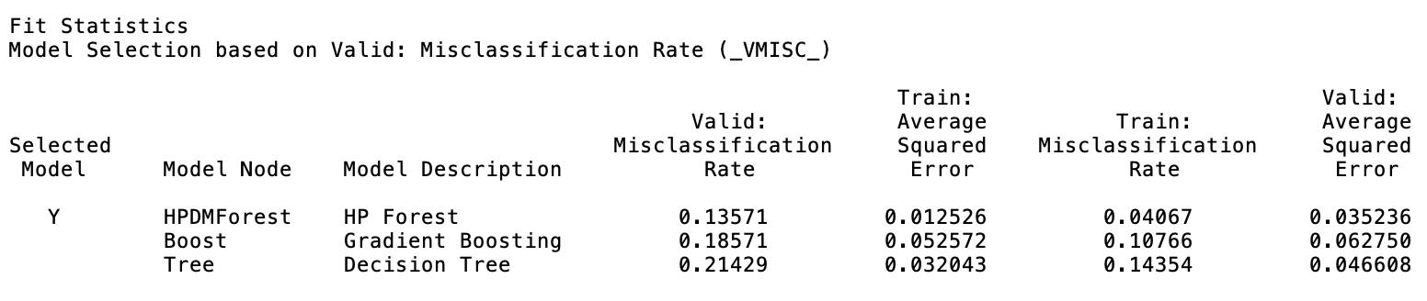
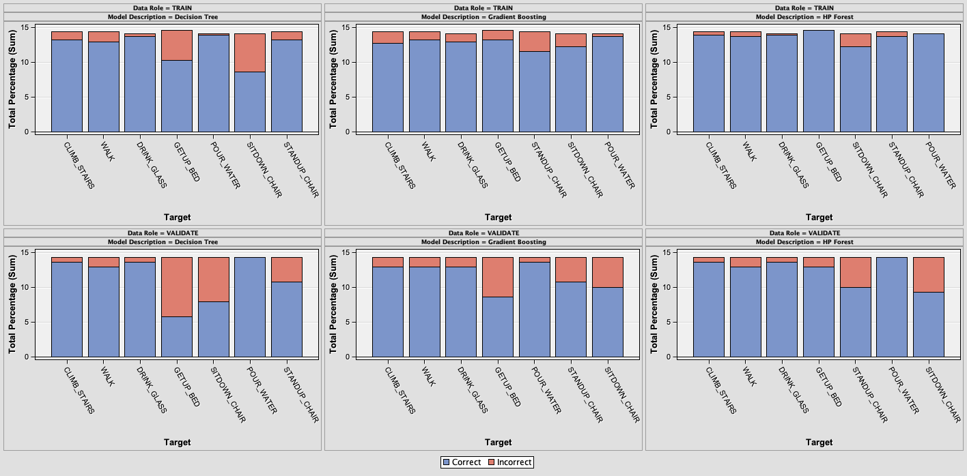

Slide 21
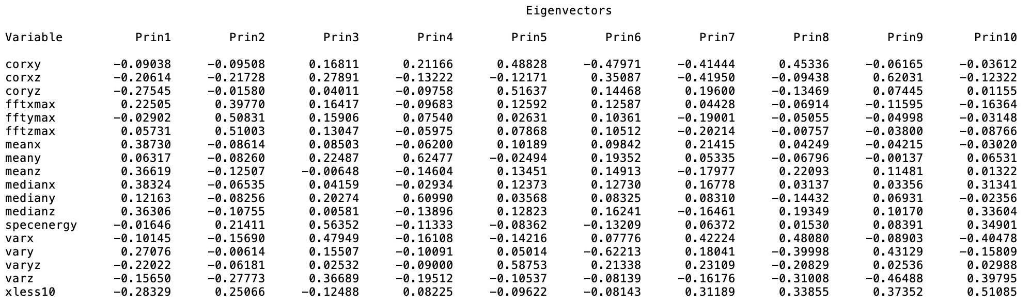
With PCA (Principal Component Analysis)
To convert a set of correlated variables into a set of linearly uncorrelated variables.

Slide 22
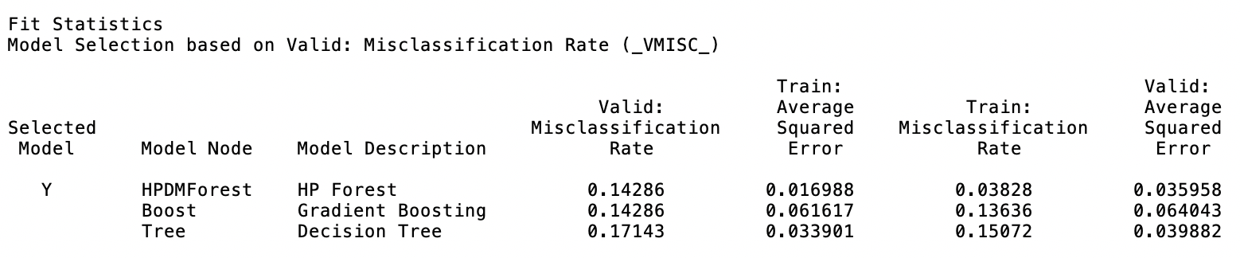
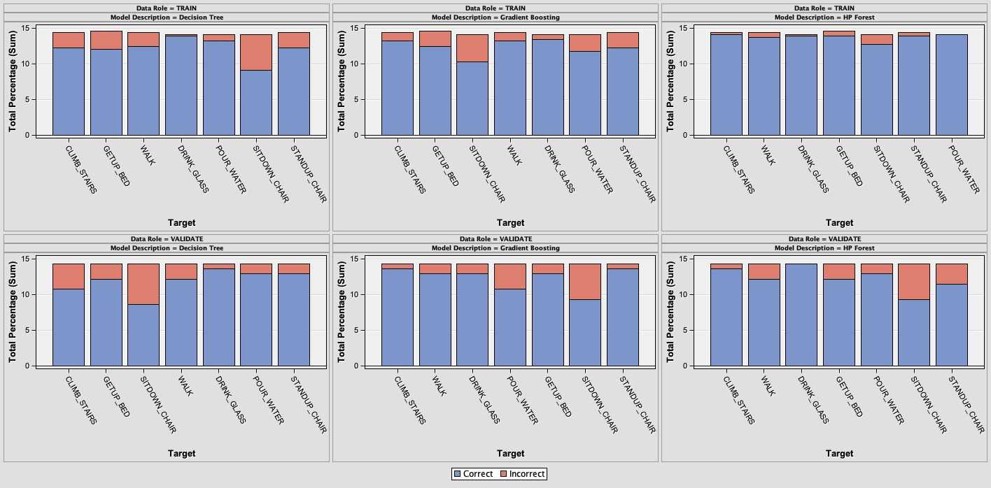

Slide 23
SVM Models (Linear and Poly)
Multi-Class Classification in SVM happens in 2 ways:
One-Vs-One Classification
One-Vs-Rest Classification
As we used SVC (Support Vector Classifier), it uses One-Vs-One Multiclass reduction.
Built Models with Linear and Poly (degree 2) Kernels

Slide 24
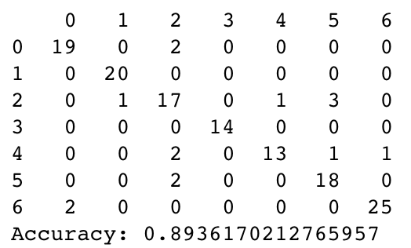
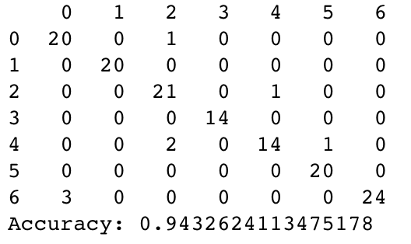
SVM with Linear Kernel
SVM with Poly Kernel with degree 2
0 – Climb Stairs | 4 – Sitdown Chair
1 – Drink Glass | 5 – Standup Chair
2 – Getup Bed | 6 – Walk
3 – Pour Water

Slide 25
Challenges
Feature Engineering
Feature Selection

Slide 26
Thank You

