Slide 1


E-Commerce Analytics Dashboard
Business Performance Analysis | Power BI · SQL · MySQL · Power Query · DAX
PREPARED BY
REVIEW TYPE
PERIOD
DATE
Arpit Kumar
Quarterly Business Review (QBR)
2015 – 2020
June 2026
₹61.1 Cr
6,02,807
113K
27%
9.4 Days
44
Total Revenue
Total Orders
Unique Customers
Return Rate
Avg Delivery
Unique Products
CONFIDENTIAL — Amazon Internal Business Review
Notes:
Open with business context. Highlight total revenue of ₹61.1 Cr across 2015-2020. Emphasize this is an internal QBR presentation using Power BI, SQL, and DAX analytics.
1

Slide 2
Dataset Overview
Data Sources · Schema · Cleaning Summary
113K+
6,02,807
44
5+
2015–2020
3
Customers
Orders
Unique Products
Categories
Date Range
Table Attributes
(Customer)
DATA RELATIONSHIP MODEL
DATA CLEANING SUMMARY
CUSTOMERS
─────────────
CustomerID (PK)
Customer Age
Customer Gender
ORDERS
────────────
OrderID (PK)
CustomerID (FK)
Product
Product Category
Sale Price
Order Quantity
Order Date
Delivery Date
Status / Reason
Delivery Type
Shipping Fee
Revenue
Null Values
Replaced blank 'Reason' fields with 'Not Applicable'; removed critical nulls
1 : Many
Duplicates
Removed duplicate records based on OrderID
Data Types
Converted dates, quantities, and currency to correct types
Calc Columns
Added Revenue, Delivery Days, Age Group, Needs Improvement
Relationship
Established 1:Many link between Customers[CustomerID] and Orders[CustomerID]
DAX Measures
Built 12+ measures: Total Revenue, Return Rate, Avg Rating, Customer Satisfaction, etc.
Notes:
Highlight that the Customers table has 3 attributes and the Orders table is the fact table. The 1:Many relationship enables RELATED() DAX to bring in customer demographics.
4

Slide 3
Business Context
Why This Analysis Matters
BUSINESS PROBLEM
ANALYTICAL SCOPE
  Amazon's e-commerce operations generate millions of data points daily across orders, products, customers, and deliveries — yet critical decisions were being made without a unified analytical view.
  Sales performance varied significantly by category, region, and delivery type, with no real-time visibility into return rates, customer satisfaction, or revenue trends.
  Leadership required a data-driven platform to monitor KPIs, identify underperforming segments, and prioritize operational improvements.
▸ 6 years of transactional data (2015–2020)
▸ 113K+ customers across multiple geographies
▸ 44 unique products across 5+ categories
▸ Revenue, returns, delivery & customer metrics
SUCCESS METRICS
Revenue Growth
YoY & MoM trends identified
Return Rate Reduction
From 27% baseline
Delivery Optimization
Target < 7 days average
Customer Retention
Loyalty tier framework
Notes:
Emphasize the business need for a centralized analytics platform. The absence of unified visibility across revenue, returns, delivery, and customers was limiting decision quality and speed.
2

Slide 4
Analytical Objectives
Business Questions · KPIs · Expected Outcomes
📊 Revenue Performance
👥 Customer Intelligence
📦 Product Analytics
KPI:
Total Revenue, MoM Growth, YoY Trend
KPI:
Unique Customers, High-Value Segments
KPI:
Top Products, Category Revenue, Return Rate
Outcome:
Outcome:
Outcome:
Identify peak months & growth drivers
Build loyalty tier framework
Flag underperforming SKUs
🚚 Delivery Operations
⭐ Customer Satisfaction
🗺️ Regional Performance
KPI:
Avg Delivery Days by Type
KPI:
Avg Rating, Return Reasons
KPI:
Revenue by Location
Outcome:
Outcome:
Outcome:
Correlate delays with low ratings
Reduce 27% return rate
Optimize regional marketing spend
Notes:
Walk leadership through the 6 core analytical questions this dashboard answers. Each objective maps directly to an operational business decision.
3

Slide 5
Methodology & Data Pipeline
End-to-End Analytics Workflow
Raw Data
Power Query
Data Cleaning
Data Modeling
SQL Analysis
DAX Measures
Interactive
Dashboard
Orders &
Customer CSVs
Type fixes,
null handling,
duplicates removed
Calculated columns:
Revenue, Delivery Days,
Age Group
1:Many relationship
Customers → Orders
Date table
MySQL queries:
Top customers, MoM growth,
rolling averages
12+ measures:
Total Revenue,
Return Rate, KPIs
3 pages:
Revenue · Customer
· Product
TOOLS & TECHNOLOGIES
● Power BI Desktop
End-to-end analytics platform for modeling, DAX, and interactive dashboards
● MySQL / SQL
Composite customer scoring, MoM growth analysis, rolling 3-month revenue averages
● Power Query (M)
ETL pipeline: data loading, type correction, column transformations
● DAX
12+ business measures: SUMX, CALCULATE, DISTINCTCOUNT, SAMEPERIODLASTYEAR, DATEADD
Notes:
Walk the audience through the end-to-end pipeline. Emphasize that Power Query handles ETL before data loads into the model, making refreshes reproducible and automated.
5

Slide 6
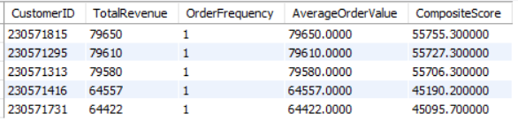
SQL Analysis I — Identifying High-Value Customers
Composite Scoring: Revenue 50% · Frequency 30% · Avg Order Value 20%
❓Which customers deliver the highest business value and should be prioritized for retention initiatives?
SQL QUERY — COMPOSITE CUSTOMER SCORE
SQL OUTPUT
WITH CustomerMetrics AS (
SELECT CustomerID,
SUM(Sale_Price * Order_Quantity)
AS TotalRevenue,
COUNT(DISTINCT OrderID)
AS OrderFrequency,
AVG(Sale_Price * Order_Quantity)
AS AvgOrderValue
FROM Orders
GROUP BY CustomerID
)
SELECT CustomerID,
TotalRevenue * 0.50 +
OrderFrequency * 0.30 +
AvgOrderValue * 0.20
AS CompositeScore
FROM CustomerMetrics
ORDER BY CompositeScore DESC
LIMIT 5;
📌 Key Findings
⚡ Action
  The top customer generated ₹79,650 in revenue.
  The Top 5 customers achieved the highest composite scores, primarily driven by high revenue and average order value.
  All Top 5 customers placed a single high-value order, suggesting that high-value purchases in this dataset are primarily one-time transactions.
  Launch a premium loyalty program targeting customers with the highest composite scores.
  Encourage repeat purchases through personalized recommendations and exclusive promotional offers.
  Track Customer Lifetime Value (CLV) and repeat purchase behavior to evaluate long-term customer retention.
Notes:
The composite score weights revenue at 50% to prioritize the highest-spend customers. Since all customers have 1 order in this dataset, composite score mirrors revenue. Real-world implementation should normalize across repeat buyers.
6

Slide 7
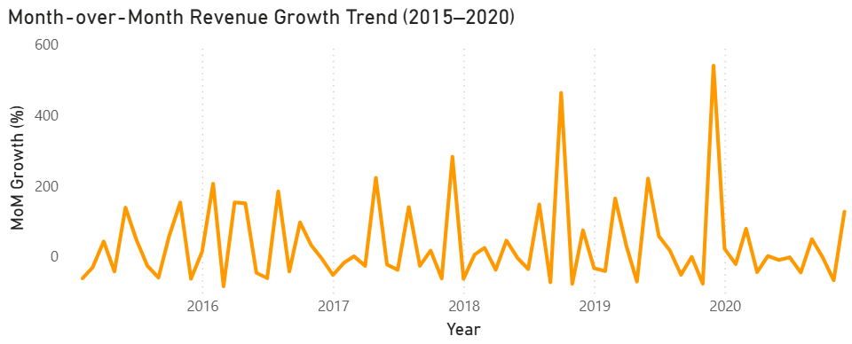
SQL Analysis II — Month-Over-Month Revenue Growth
LAG() Window Function · 2015–2020 Seasonality Analysis
❓ What are the seasonal revenue patterns and which months need promotional support to stabilize growth?
SQL Approach — Month-over-Month Revenue Analysis
WITH MonthlyRev AS (
SELECT
YEAR(OrderDate) AS OrderYear,
MONTH(OrderDate) AS OrderMonth,
SUM(Sale_Price * Order_Qty)
AS TotalRevenue
FROM Orders
GROUP BY YEAR(OrderDate), MONTH(OrderDate)
)
SELECT OrderYear, OrderMonth,
TotalRevenue,
LAG(TotalRevenue) OVER
(ORDER BY OrderYear, OrderMonth)
AS PrevMonthRevenue,
ROUND((TotalRevenue - LAG(TotalRevenue)
OVER(ORDER BY OrderYear, OrderMonth))
/ LAG(TotalRevenue) OVER
(ORDER BY OrderYear, OrderMonth) * 100, 2)
AS MoM_Growth_Pct
FROM MonthlyRev
ORDER BY OrderYear, OrderMonth;
Highest Growth
2nd Highest
Steepest Drop
Pattern
+540%
+463%
-77%
Cyclical
Dec 2019 — festive/year-end
Oct 2018 — seasonal spike
Nov 2018 — post-peak decline
Strong seasonality detected
📌 Key Findings
⚡ Action
  Revenue displayed strong seasonality across 2015–2020, with recurring month-over-month fluctuations.
  December 2019 recorded the highest MoM growth (+540%), while October 2018 showed the second-highest growth (+463%), indicating successful seasonal demand.
  November 2018 experienced the steepest decline (−77%), highlighting a significant post-peak slowdown.
  Replicate high-performing December and October campaigns to maximize revenue during future peak seasons.
  Increase promotional activities and inventory planning ahead of historically weak months to reduce post-peak revenue declines.
  Continuously monitor MoM revenue trends to improve demand forecasting, campaign timing, and inventory optimization.
Notes:
The LAG() window function is the key SQL technique here. December 2019's 540% growth was likely driven by festive promotions. Negative months indicate the importance of post-peak demand management.
7

Slide 8
Rolling Revenue Analysis | Category Growth | Investment Prioritization
Rolling Average | YoY Growth Analysis
❓Which categories show sustained growth and where should inventory/marketing investment be concentrated?
SQL Approach — Rolling Revenue & Category Growth Analysis
Executive KPI Summary
Phones & Tablet
Phones & Tablet
WITH MonthlyRevenue AS (
SELECT
YEAR(OrderDate) AS OrderYear, MONTH(OrderDate) AS OrderMonth,
`Product Category`,SUM(`Sale Price` * `Order Quantity`) AS MonthlyRevenue
FROM Orders
GROUP BY YEAR(OrderDate), MONTH(OrderDate),`Product Category`)
SELECT OrderYear,OrderMonth,`Product Category`,MonthlyRevenue,
ROUND(
AVG(MonthlyRevenue) OVER (
PARTITION BY `Product Category`
ORDER BY OrderYear, OrderMonth
ROWS BETWEEN 2 PRECEDING AND CURRENT ROW
),
2
) AS Rolling_3_Month_Avg_Revenue
FROM MonthlyRevenue
ORDER BY `Product Category`,OrderYear,OrderMonth;
Avg: ₹32,690
Sales Increase: +199,105
Peak Monthly Revenue: ₹84,051 (Dec'17)
Year: 2020 vs Previous Year
Top Performing Category
Highest YoY Growth
Electronics
Avg: ₹15,639
Peak: ₹37,252 (Jan'20)
Second Best Performer
📌 Key Findings
⚡ Action
  Phones & Tablets achieved the highest 3-month rolling average revenue (₹32,690), demonstrating sustained customer demand.
  Phones & Tablets also recorded the strongest year-over-year sales increase (+₹199,105), reinforcing their position as the highest-growth category.
  Electronics ranked as the second-best performing category, indicating strong potential for continued investment and cross-category growth.
  Prioritize inventory allocation and marketing investment for Phones & Tablets to maximize revenue growth.
  Expand promotional campaigns for Electronics to strengthen its contribution and diversify revenue sources.
  Use rolling revenue trends and YoY category performance to guide inventory planning, demand forecasting, and marketing decisions.
Notes:
Phones & Tablet is Amazon's revenue engine — ₹32K rolling average vs. ₹10-15K for other categories. The 2020 surge of +₹199K in a single year signals strong market expansion. Fashion & Health are ripe for promotional investment.
8

Slide 9
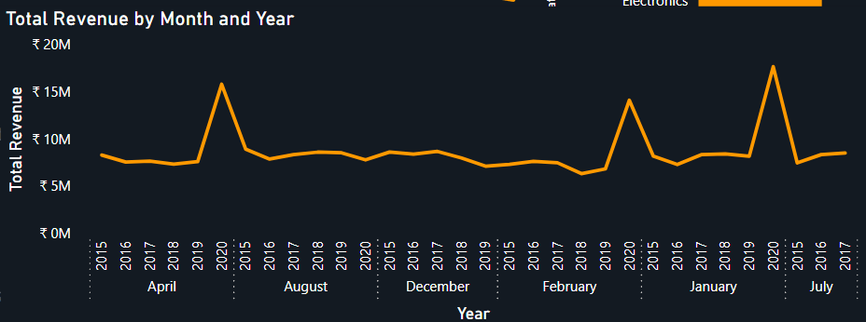
Dashboard Analysis I — Revenue Performance
Total Revenue · Annual Trend · Category Breakdown · MoM Seasonality
₹61.1 Cr
6,02,807
₹10.1 Cr
+540%
Total Revenue
Total Orders
Highest Revenue Year
2020
Highest MoM Growth
2015–2020
Across 6 years
Revenue: ₹10.1 Cr
Dec 2019
📌 Key Findings
⚡ Action
  ₹61.1 Cr revenue was generated during 2015–2020, with 2020 recording the highest annual revenue (₹10.1 Cr).
  Revenue shows strong seasonality, with December 2019 achieving the highest MoM growth (+540%).
  Phones & Tablets remained the top-performing category, contributing approximately 35% of total revenue.
  Increase inventory and marketing investment before seasonal demand peaks, especially for Phones & Tablets.
  Replicate high-performing December promotional strategies during other seasonal campaigns to maximize revenue.
  Continuously monitor MoM revenue trends to improve demand forecasting and optimize inventory planning.
Notes:
Highlight the 2020 inflection point. Revenue was flat for 5 years before a step-change in 2020. Phones & Tablet dominate. February is the most under-indexed month — ideal for flash sales and promotions.
9

Slide 10
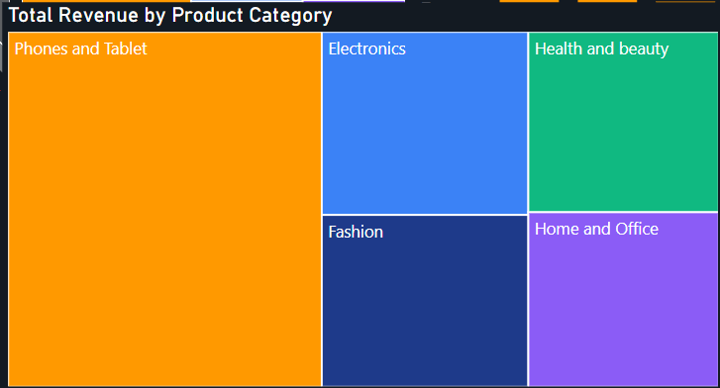
Dashboard Analysis I — Revenue Performance
Total Revenue · Annual Trend · Category Breakdown · MoM Seasonality
₹61.1 Cr
6,02,807
₹10.1 Cr
+540%
Total Revenue
Total Orders
Highest Revenue Year
2020
Highest MoM Growth
2015–2020
Across 6 years
Revenue: ₹10.1 Cr
Dec 2019
📌 Key Findings
⚡ Action
  Total revenue reached ₹61.1 Cr during 2015–2020, with 2020 generating the highest annual revenue (₹10.1 Cr).
  Phones & Tablets contributed approximately 35% of total revenue, making it the highest-performing product category.
  Revenue is concentrated across a few major categories, with Electronics and Health & Beauty emerging as the next strongest revenue contributors.
  Prioritize inventory and marketing investment for Phones & Tablets to maximize revenue growth.
  Strengthen promotions for Electronics and Health & Beauty to diversify revenue across high-performing categories.
  Monitor category-wise revenue contribution regularly to optimize inventory planning and product portfolio decisions.
Notes:
Highlight the 2020 inflection point. Revenue was flat for 5 years before a step-change in 2020. Phones & Tablet dominate. February is the most under-indexed month — ideal for flash sales and promotions.
9

Slide 11
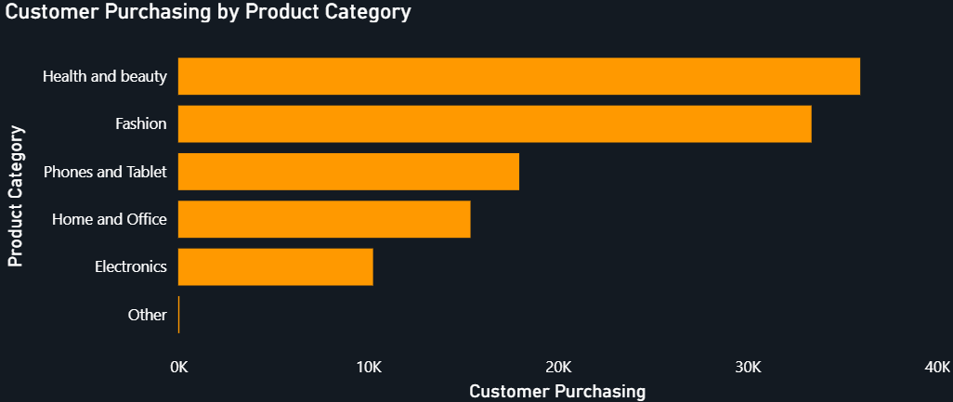
Dashboard Analysis II — Customer Intelligence
Unique Customers · Demographics · Category Engagement · Loyalty Tiers
113K
22,305
25–45
193
Total Customers
Highest Customer Acquisition (2020)
Core Age Segment
High-Value Customers
2015–2020
+27% vs. 2019
Majority demographic
Premium Customer Segment
📌 Key Findings
⚡ Action
  The customer base reached 113K, with customer acquisition peaking at 22,305 in 2020.
  The 25–45 age group is the largest customer segment, making it the primary target for acquisition and retention strategies.
  Health & Beauty and Fashion recorded the highest customer purchasing activity, while only 193 customers qualify as high-value customers.
  Launch a Platinum loyalty program to retain the 193 high-value customers and increase repeat purchases.
  Personalize campaigns for the 25–45 age segment to improve customer engagement and lifetime value.
  Cross-sell premium products to customers purchasing from Health & Beauty and Fashion to increase average order value.
Notes:
2020 customer acquisition surge (+27%) is the standout. Health & Beauty and Fashion drive the highest customer volume despite lower average order values. The Platinum tier targets 193 high-value customers identified in SQL analysis.
10

Slide 12
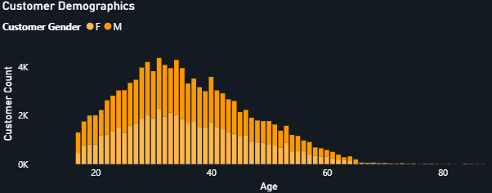
Dashboard Analysis II — Customer Intelligence
Unique Customers · Demographics · Category Engagement · Loyalty Tiers
113K
22,305
25–45
193
Total Customers
Highest Customer Acquisition (2020)
Core Age Segment
High-Value Customers
2015–2020
+27% vs. 2019
Majority demographic
Premium Customer Segment
📌 Key Findings
⚡ Action
  The customer base reached 113K, with customer acquisition peaking at 22,305 in 2020.
  The 25–45 age group represents the largest customer segment, making it the primary target for acquisition and retention.
  Only 193 customers qualify as high-value customers, highlighting a significant opportunity to improve customer lifetime value (CLV).
  Launch a Platinum loyalty program to retain the 193 high-value customers and encourage repeat purchases.
  Personalize marketing campaigns for the 25–45 age segment to improve engagement and conversion.
  Develop retention initiatives to convert one-time buyers into repeat customers, increasing long-term customer value.
Notes:
2020 customer acquisition surge (+27%) is the standout. Health & Beauty and Fashion drive the highest customer volume despite lower average order values. The Platinum tier targets 193 high-value customers identified in SQL analysis.
10

Slide 13
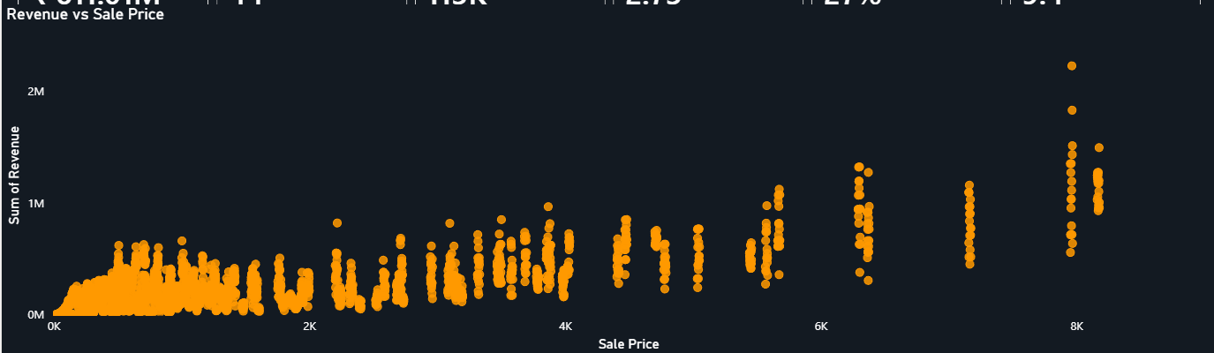
Dashboard Analysis III — Product Performance
Top Products · Return Rate · Rating Correlation · Products Needing Attention
❓Which products require immediate attention to improve customer satisfaction, reduce return rates, and maximize revenue?
44
27%
2.73
9.4 Days
Unique Products
Return Rate
Avg Rating
Avg Delivery Time
DISTINCTCOUNT DAX
1 in 4 orders returned
Out of 5.0 scale
Delivered orders only
📌 Key Findings
⚡ Action
  The product portfolio includes 44 unique products, with an average customer rating of 2.73/5 and an overall 27% return rate.
  Higher-priced products generally generate higher revenue, but products within similar price ranges show significant variation in revenue performance.
  The combination of low ratings (2.73/5) and high return rates (27%) indicates opportunities to improve product quality and customer satisfaction.
  Prioritize quality improvements for high-revenue products with high return rates to protect profitability.
  Improve product descriptions, images, and specifications to reduce customer expectation gaps and minimize returns.
  Optimize pricing and product positioning by analyzing revenue performance across different price ranges and focusing on high-performing products.
Notes:
The 27% return rate is the biggest operational risk. Top products by revenue also have the worst return rates (33-34%). Quality control and accurate descriptions are the primary levers for improvement.
11

Slide 14
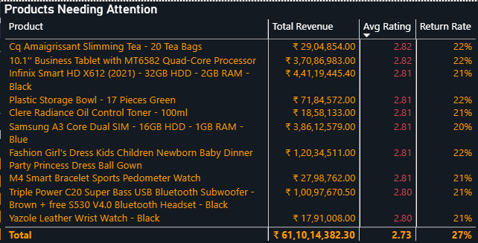
Dashboard Analysis III — Product Performance
Top Products · Return Rate · Rating Correlation · Products Needing Attention
❓Which products require immediate attention to improve customer satisfaction, reduce return rates, and maximize revenue?
44
27%
2.73
9.4 Days
Unique Products
Return Rate
Avg Rating
Avg Delivery Time
DISTINCTCOUNT DAX
1 in 4 orders returned
Out of 5.0 scale
Delivered orders only
📌 Key Findings
⚡ Action
  The product catalog contains 44 unique products, with an average customer rating of 2.73/5 and an overall 27% return rate, indicating room for quality improvement.
  Several high-revenue products have ratings below 3.0 and return rates between 20–33%, highlighting products that require immediate attention.
  A small group of products contributes disproportionately to returns, representing the greatest opportunity to improve customer satisfaction and profitability.
  Prioritize quality audits for high-revenue products with return rates above 20% to reduce customer dissatisfaction.
  Improve product descriptions, images, and specifications to minimize expectation mismatches and avoid preventable returns.
  Continuously monitor ratings and return rates through dashboard alerts to identify products requiring corrective action.
Notes:
The 27% return rate is the biggest operational risk. Top products by revenue also have the worst return rates (33-34%). Quality control and accurate descriptions are the primary levers for improvement.
11

Slide 15
Business Recommendations & Action Plan
Priority Actions Across Sales · Pricing · Inventory · Customer · Operations · Marketing
🚚 Operations
CRITICAL IMPACT
💰 Sales
HIGH IMPACT
📦 Inventory
HIGH IMPACT
▸ Reduce overseas delivery time from 15 → <10 days through local fulfillment
▸ Launch flash sales in February, consistently lowest revenue month
▸ Pre-position stock in local warehouses for Health & Beauty and Fashion before peak months
▸ Strengthen pre-dispatch QC for the top 3 products (33–34% returns).
▸ Replicate high-performing December campaigns that delivered +540% MoM revenue growth.
▸ Use the 3-month rolling average to improve demand forecasting and inventory planning.
👥 Customer
CRITICAL IMPACT
🏷️ Pricing
MEDIUM IMPACT
📢 Marketing
MEDIUM IMPACT
▸ Enroll the 193 identified high-value customers into a Platinum loyalty tier
▸ Introduce EMI/payment options for high-ticket Phones & Tablet items
▸ Increase digital marketing spend in Greater Accra & Ashanti (highest revenue regions)
▸ Deploy personalized recommendations for 25–45 age group (core segment)
▸ Offer targeted discounts on high-priced, low-selling products
▸ Launch region-specific offers in Western & Weija to capture untapped demand
Notes:
Prioritize CRITICAL actions first: customer loyalty enrollment and operational QC for returns. HIGH items (sales promotions, inventory positioning) should be in next quarter's plan.
12

Slide 16
Expected Business Impact
Projected Improvements from Implementing Recommendations
📈 Revenue Growth
📉 Return Rate
⭐ Customer Satisfaction
CURRENT:
₹61.1 Cr (6-year total)
CURRENT:
27% (baseline)
CURRENT:
Avg Rating: 2.73 / 5
TARGET:
10-15% YoY growth
TARGET:
Target < 18%
TARGET:
Target: 3.5+ / 5
Driver: Seasonal campaigns, promotional optimization, and targeted marketing.
Driver: Quality assurance, improved product information, and fulfillment accuracy.
Driver: Delivery speed + product quality improvements
🚚 Delivery Performance
🤝 Customer Retention
⚡ Decision Speed
CURRENT:
Avg 9.4 days | 15 days abroad
CURRENT:
Single-order customers dominant
CURRENT:
Ad hoc reporting
TARGET:
Target < 7 days
TARGET:
Loyalty tier adoption 15%+
TARGET:
Real-time KPI monitoring
Driver: Local fulfillment expansion and logistics optimization.
Driver: 4-tier loyalty program: Bronze → Platinum
Driver: Interactive dashboards, automated reporting, and real-time KPI monitoring.
Projected targets based on the successful implementation of the recommended business initiatives.
Notes:
Present these as directional targets based on industry benchmarks. The 27% return rate reduction to 18% would directly recover lost revenue equivalent to ~9% of total orders.
13

Slide 17
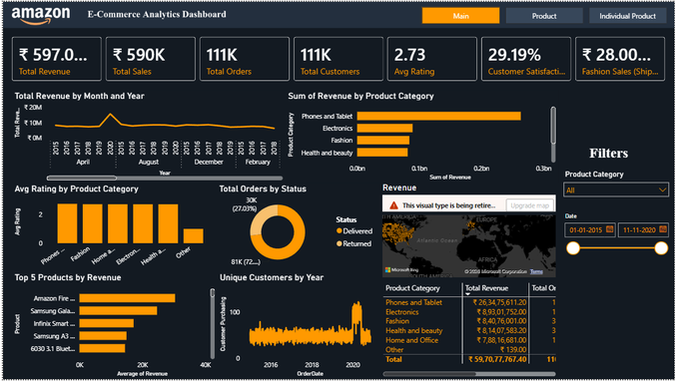
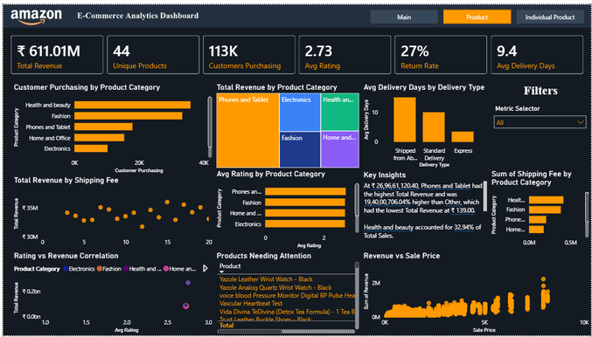
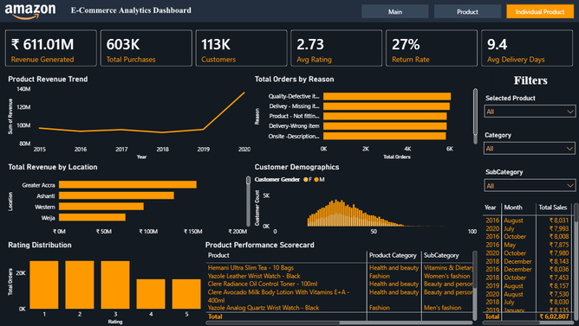
Power BI Dashboard Walkthrough
3 Interactive Pages · KPIs · Drill-Through · Dynamic Metric Selector
Executive Dashboard Overview
INTERACTIVE FEATURES FOR LEADERSHIP
🎛 Dynamic Metric Selector
Switch between Revenue, Orders, Customers, and Ratings using a single dynamic visual, reducing dashboard clutter and improving analysis flexibility.
🔍 Drill-Through
Navigate instantly from summary KPIs to product-level analysis for faster root-cause investigation.
📅 Year & Category Slicers
Interactively analyze business performance by Year and Product Category using dynamic slicers.
⚡ Real-Time KPI Cards
Executive KPI cards update instantly with every filter selection, providing real-time business insights.
📊 DAX Time Intelligence
Built using DAX Time Intelligence to enable Year-over-Year and Month-over-Month performance comparisons.
Notes:
Walk leadership through the drill-through and slicer functionality live. The Dynamic Metric Selector (Field Parameter) is the key innovation — it allows real-time switching between KPIs without building separate visuals.
14

Slide 18
EXECUTIVE SUMMARY
Amazon E-Commerce Analytics Dashboard | 2015–2020
🔎 Top Findings
⚠️ Key Risks
🚀 Strategic Opportunities
▸ Revenue reached ₹61.1 Cr (2015–2020), with 2020 recording the highest annual revenue (+26% YoY).
▸ 27% return rate driven by quality defects, wrong items, and description mismatches
▸ 193 high-value customers (> ₹6,615 revenue) under-engaged — enroll in Platinum loyalty tier
▸ Phones & Tablets contributed 35% of total revenue, remaining the highest-performing category.
▸ Top 3 revenue products all carry 21–34% return rates — profitability at risk
▸ February consistently lowest revenue month — high ROI opportunity for promotional campaigns
▸ 27% return rate is the single largest operational and revenue risk
▸ Average rating of 2.73/5 indicates systemic customer satisfaction issues
▸ Electronics category growing — cross-selling with Phones & Tablet can amplify revenue
▸ December drives the highest MoM growth (+540% in 2019), festive demand is the growth lever
▸ 'Shipped from Abroad' avg delivery of 15 days significantly above customer expectations
▸ Fashion & Health and Beauty have highest customer volume but lower revenue — pricing power exists
▸ Customer acquisition grew 27% in 2020, indicating strong market expansion.
▸ Revenue remained relatively stable during 2015–2019 before a sharp increase in 2020, indicating reliance on a single growth year.
▸ Greater Accra and Ashanti are revenue leaders — geographic expansion playbook ready
Top 3 Actions:
1. Launch Platinum loyalty tier for 193 high-value customers
2. Reduce return rate from 27% via QC + description improvements
3. Deploy Feb promotional campaign to reverse lowest-month pattern
"Data-driven decision-making transforms operational data into sustainable business growth and competitive advantage."
Notes:
Close with confidence. The three priority actions are: (1) Loyalty tier rollout for 193 platinum customers, (2) Quality control improvements to reduce 27% return rate, and (3) February promotional campaign. These three together have the highest short-term revenue impact.
15

