Slide 1
NLP Chatbot for Discharge Summaries ------- [MED 277 project]
Presented by:
Harsh Lal, Soheil karimi, Ali Alattar & Thomas Liu

Slide 2
Introduction
One of the most important goals in healthcare is improving the quality of health and service rendered by healthcare industry.
Growing demand for ease of access to healthcare information for patients and providers.
Healthcare, provider notes contain a large amount of information and is difficult to comprehend easily.
NLP-based methods can help extract information and answer questions based on this data.

Slide 3
Problem Definition
We propose a NLP chatbot that provides an easy way for patient to analyze and get information from from their clinical notes.
Input: Free-text discharge summaries from MIMIC-III, and Question regarding the discharge summary.
Output: Answer to the question, which is extracted from the discharge summary based on topic modeling and matching.

Slide 4
Dataset
MIMIC-III (Medical Information Mart for Intensive Care) Critical Care Database for the analysis.
Information from ICU discharges from Beth Israel Deaconess Medical center 2001-2010
It has a total of 2,083,180 rows in total.
We filtered dataset using category, “Discharge Summary”.
There were about 59,562 data points after filtering.

Slide 5
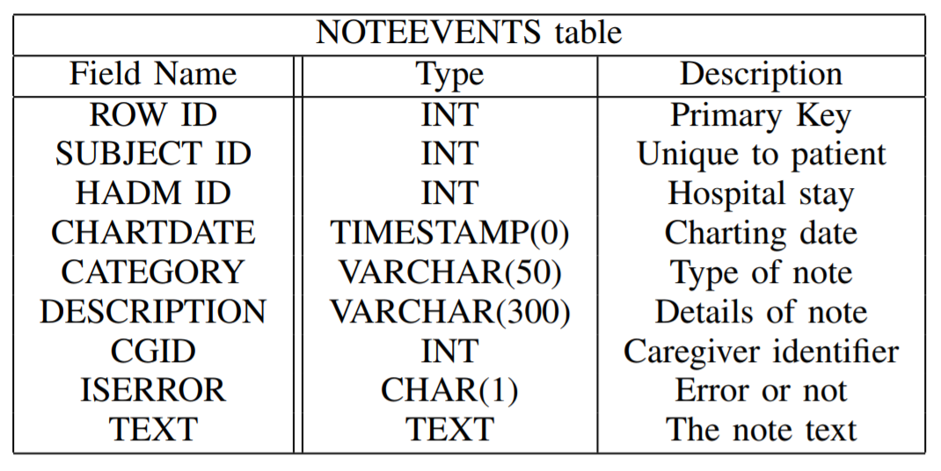
Dataset

Slide 6
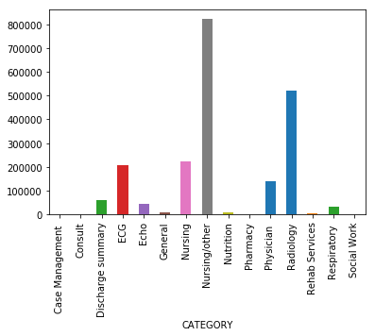
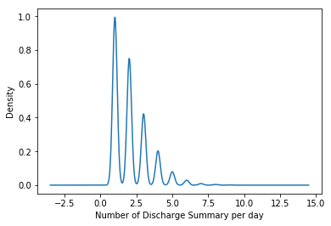
Dataset

Slide 7
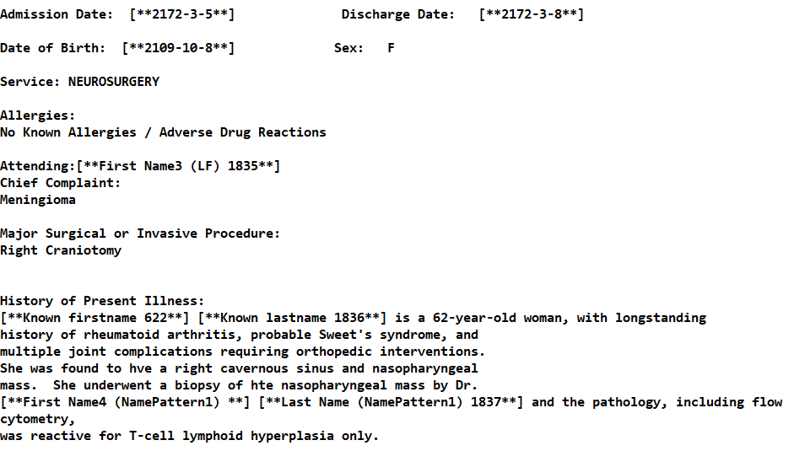
Example of a Discharge Summary

Slide 8
Text Preprocessing
Cleaning, transformation, normalization, & feature extraction
Removal of numbers, special characters, extra spaces, and stop words
Case agnostic processing: converting all text to same case
Stemming: reducing words to their word stem or base
Lemmatization: reducing words to root form in English

Slide 9
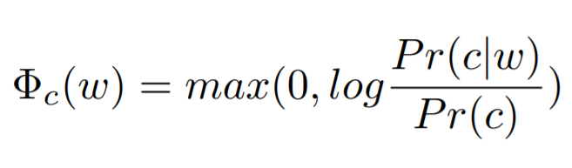
Word Embeddings
Creation of N-gram topic embeddings.
Extracted the 1000 most common words to use as context C.
For each topic, looked at a window of size W=4, ie, 2 previous and 2 words after the topic and counted them if they exist in C.
This gives an embedding of 1000 dimensions, which was further compressed using PCA.

Slide 10
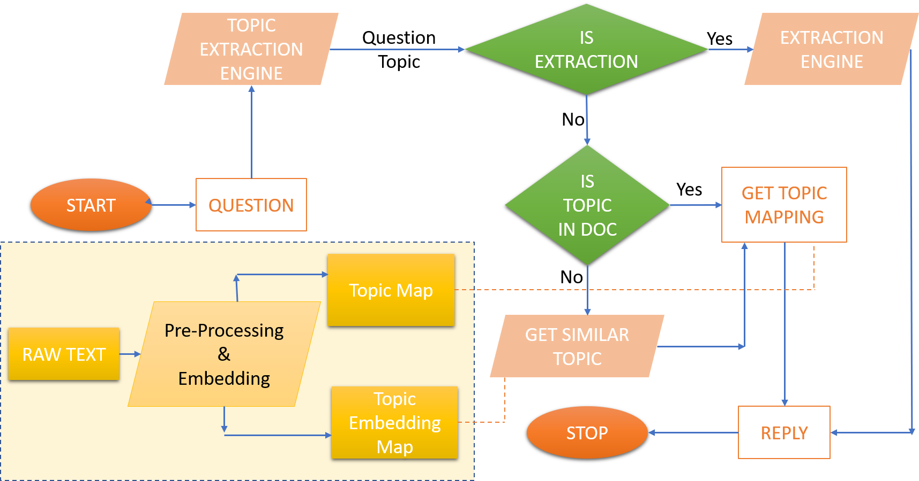
NLP Chatbot

Slide 11
Topic Modelling
Latent Dirichlet Modeling (LDA) of processed data for topic modeling to generate topic map
Document Topic Modeling - We split the specified discharge summary into sentences, extract topic from each sentence and save a dictionary of topic to sentence matching as “Topic Map”.
Corpus Topic Modeling - We use Document topic modelling described above and collect topics for all the sentences in entire corpus. We then generate embedding for each of topic from entire corpus and save it “Topic Embedding Map”

Slide 12
Types of Question
Instruction Question - These are special defined commands or instructions that are used to invoke specific functionality. Ex. “summary” prints out discharge summary.
Extraction Question - These are the questions whose answers can be directly extracted from the discharge summaries. Ex. What is my date of birth?
Direct topic Question - For this type of questions we try finding the topic of the question in the discharge summary document. We look for an exact match of topics in “Topic Map”.
Indirect topic Question - Here we look for similarity between the question topic, and all other topics present in the entire corpus (all the discharge summaries for all the patients available). We use cosine similarity to measure similarity between the topics.
The Questions follow the hierarchy shown above, meaning any question os first tested for Instruction Question, then Extraction Question and so on.

Slide 13
NLP Chatbot
Chatbot workflow:
Question(Q) Topic extraction using LDA.
Check the type of Question(Q) against defined types.
If the question is an instruction then execute it.
Otherwise answer either using direct information extraction using regular expressions, or
Use sentences with same or similar topic to answer the question.

Slide 14
Conclusion
NLP chatbot based on topic modelling does good job of retrieving sentences with similar topics.
Chatbot provides functionality of specific information extraction and executing specialized instructions (maybe third party)
The answering mechanism is pretty fast once the chatbot is initialized
Chatbot has large scope for improve but we have demonstrated reasonable performance feasibility.

Slide 15
Future Scope
Variable window size for mixture modeling while creating embeddings.
Make use of features other than context words for information extraction (e.g. date, time of admission)
Add normal conversation functionality, experiment with additional topic modeling techniques and features based on parse structure
Additional interoperability with other systems.

