Slide 1
Healthcare Analytics Pipeline for MediCare Hospital
An End-to-End Scalable Data Engineering & Analytics Platform
Capstone Project
Group Number: 3
Submitted By
Name Roll Number
Ankita Dwivedi G25AI1011
Arpit Sharma G25AI1012
Astosh Ranjan G25AI1013
Bharat Sharma G25AI1014
Damini Khatri G25AI1015
Post Graduate Diploma in Data Engineering (PGDDE)
Indian Institute of Technology Jodhpur
July 2026

Slide 2
Problem Statement
• Healthcare data is generated from multiple sources.
• Manual processing is slow and inefficient.
• Data is often fragmented across systems.
• Real-time analytics and reporting are difficult.
• Need for an automated and scalable solution.
Objective
• Build an end-to-end Healthcare Analytics Pipeline. • Automate data ingestion, processing and analytics. • Generate business insights using dashboards and machine learning. • Enable scalable healthcare analytics by leveraging cloud services.
Project Resources
• GitHub Repository:
https://github.com/arpit-systems/healthcare-analytics-pipeline
• Final Project Report:
https://drive.google.com/file/d/1gJPl8zC-l_vYn_bC0B9SGhOb3Uhrsf_k/view?usp=sharing

Slide 3
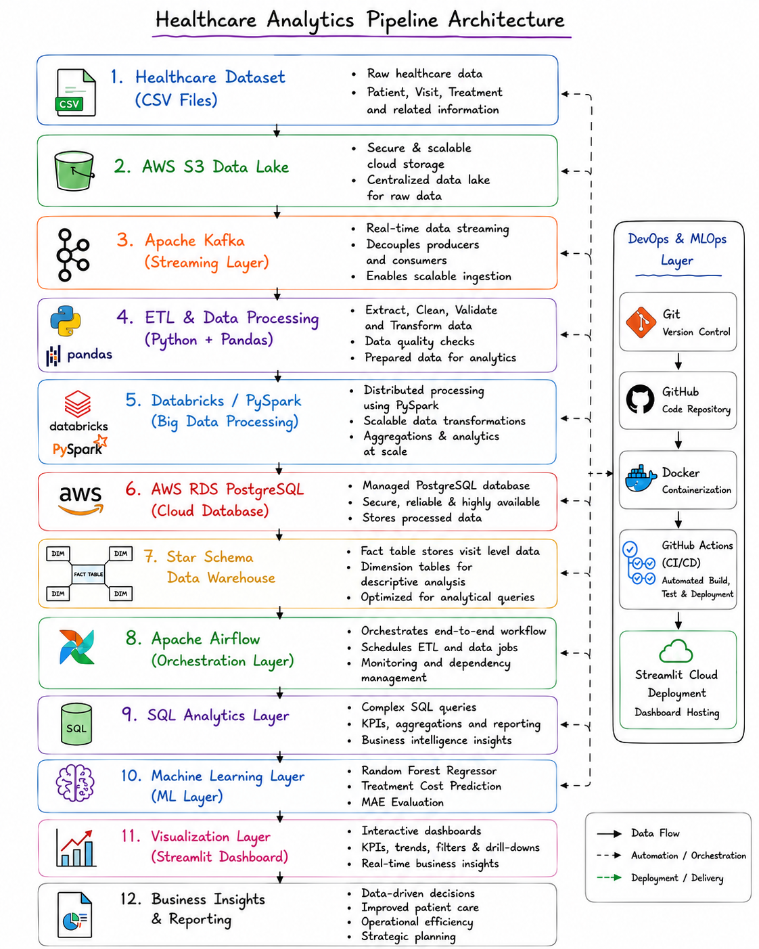
Project Architecture
• Integrated Healthcare Data Engineering Architecture
• Real-time streaming capability using Apache Kafka
• Databricks-powered PySpark processing
• Automated workflow orchestration using Airflow
• Star Schema Data Warehouse for analytics
• Machine Learning based predictive analytics
• CI/CD automation using GitHub Actions
• Interactive Streamlit dashboard for reporting

Slide 4
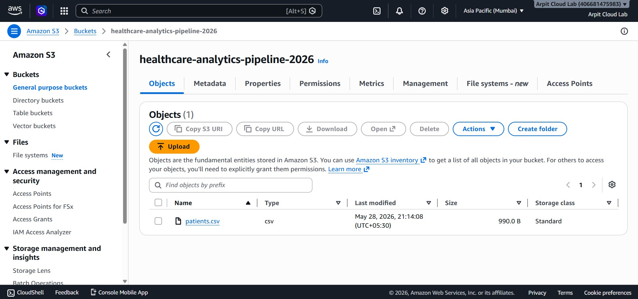
Data Collection & AWS S3
• Healthcare dataset containing 5000 records.
• Data stored in AWS S3 cloud storage.
• Centralized and scalable storage solution.
• Source layer of the analytics pipeline.

Slide 5
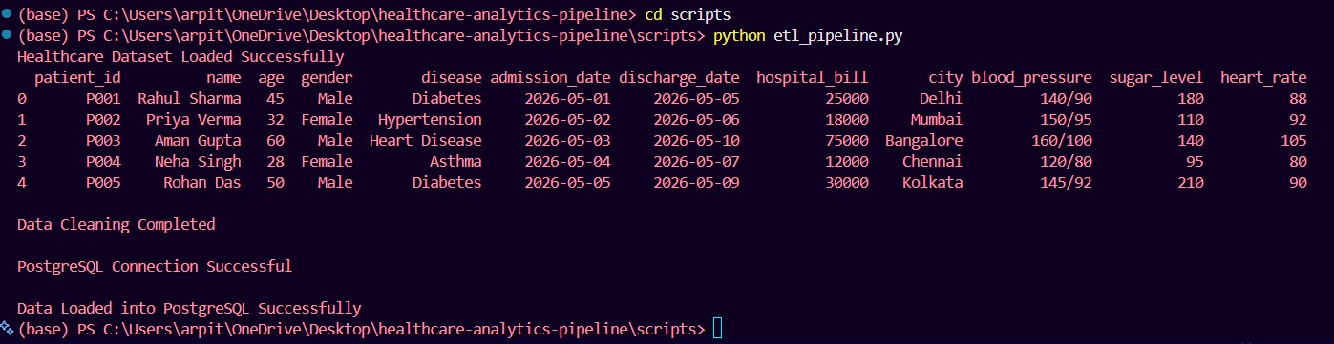
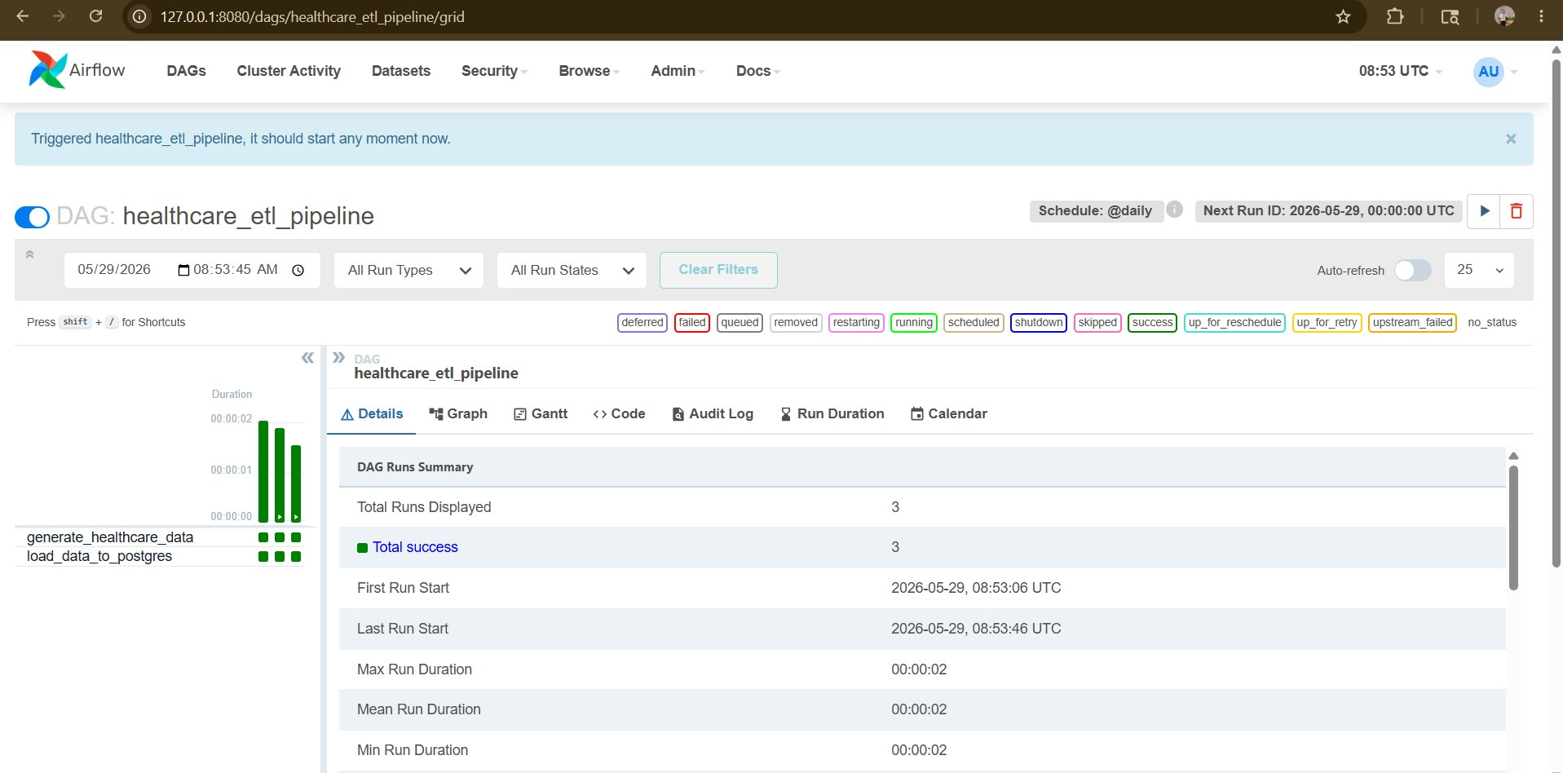
ETL Pipeline, Airflow & Kafka
• Extracted healthcare data from source files.
• Performed data cleaning and transformation.
• Loaded processed data into PostgreSQL.
• Automated workflow using Apache Airflow
DAGs.

Slide 6
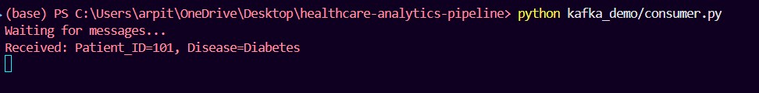
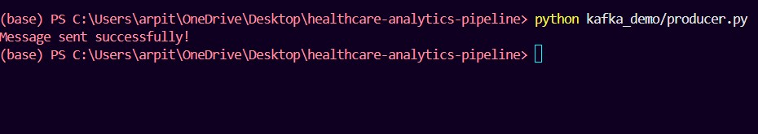
• Apache Kafka Producer-Consumer
implementation
• Real-time healthcare message
streaming demonstration

Slide 7
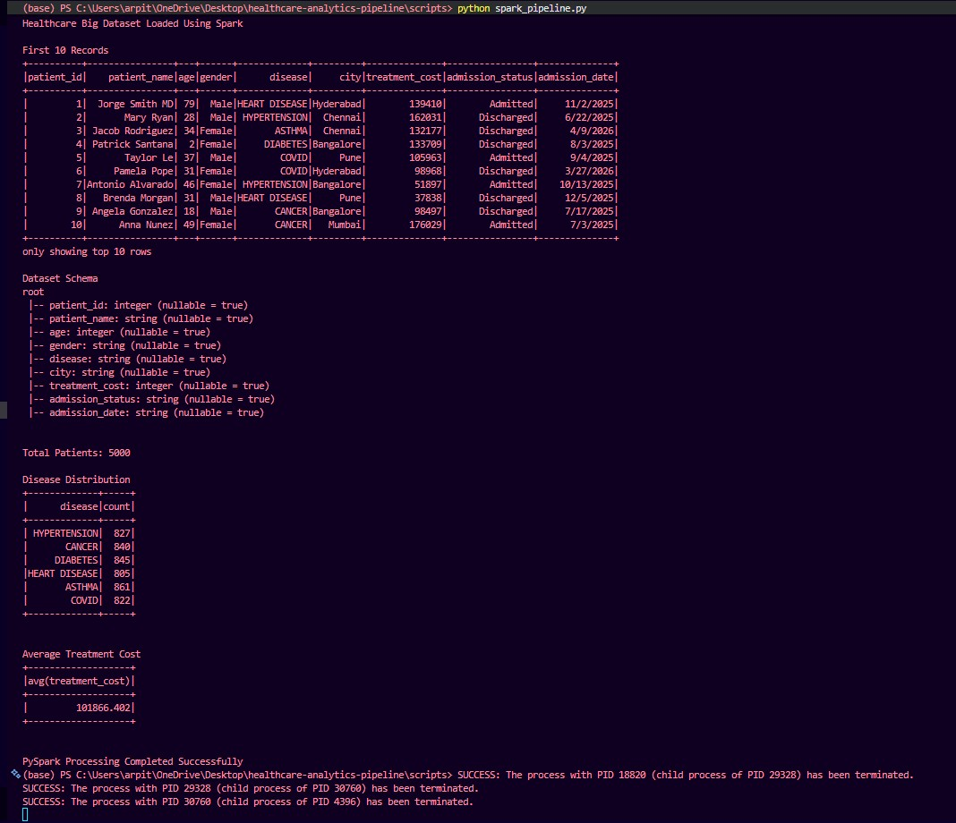
Big Data Processing
using PySpark &
Databricks
• Processed 5000 healthcare records.
• Generated disease distribution
analytics.
• Calculated treatment cost statistics.
• Enabled scalable big data processing.
• PySpark workflows validated using Databricks notebooks

Slide 8
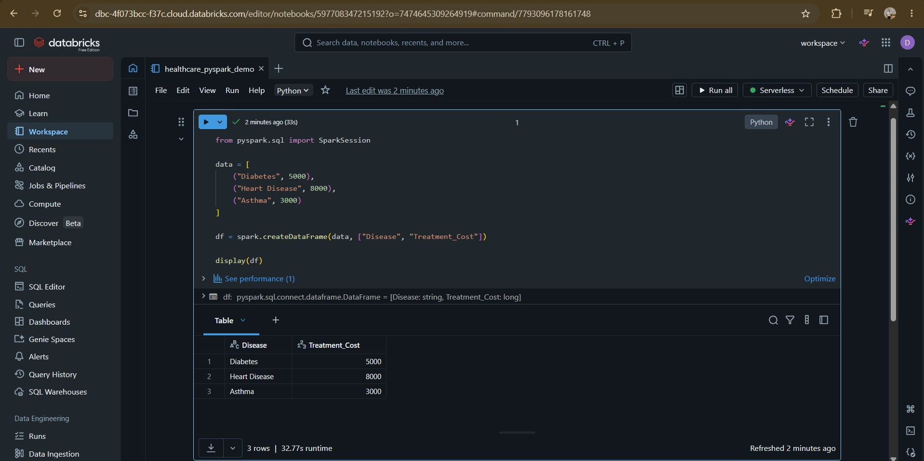
Figure: Databricks Notebook Executing PySpark Processing

Slide 9
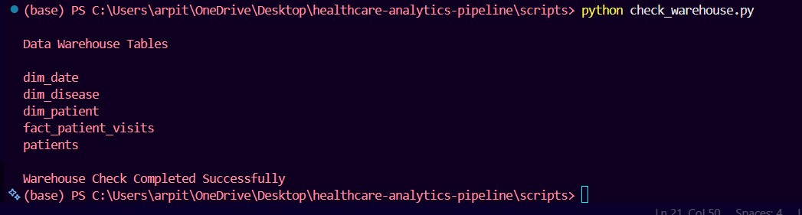
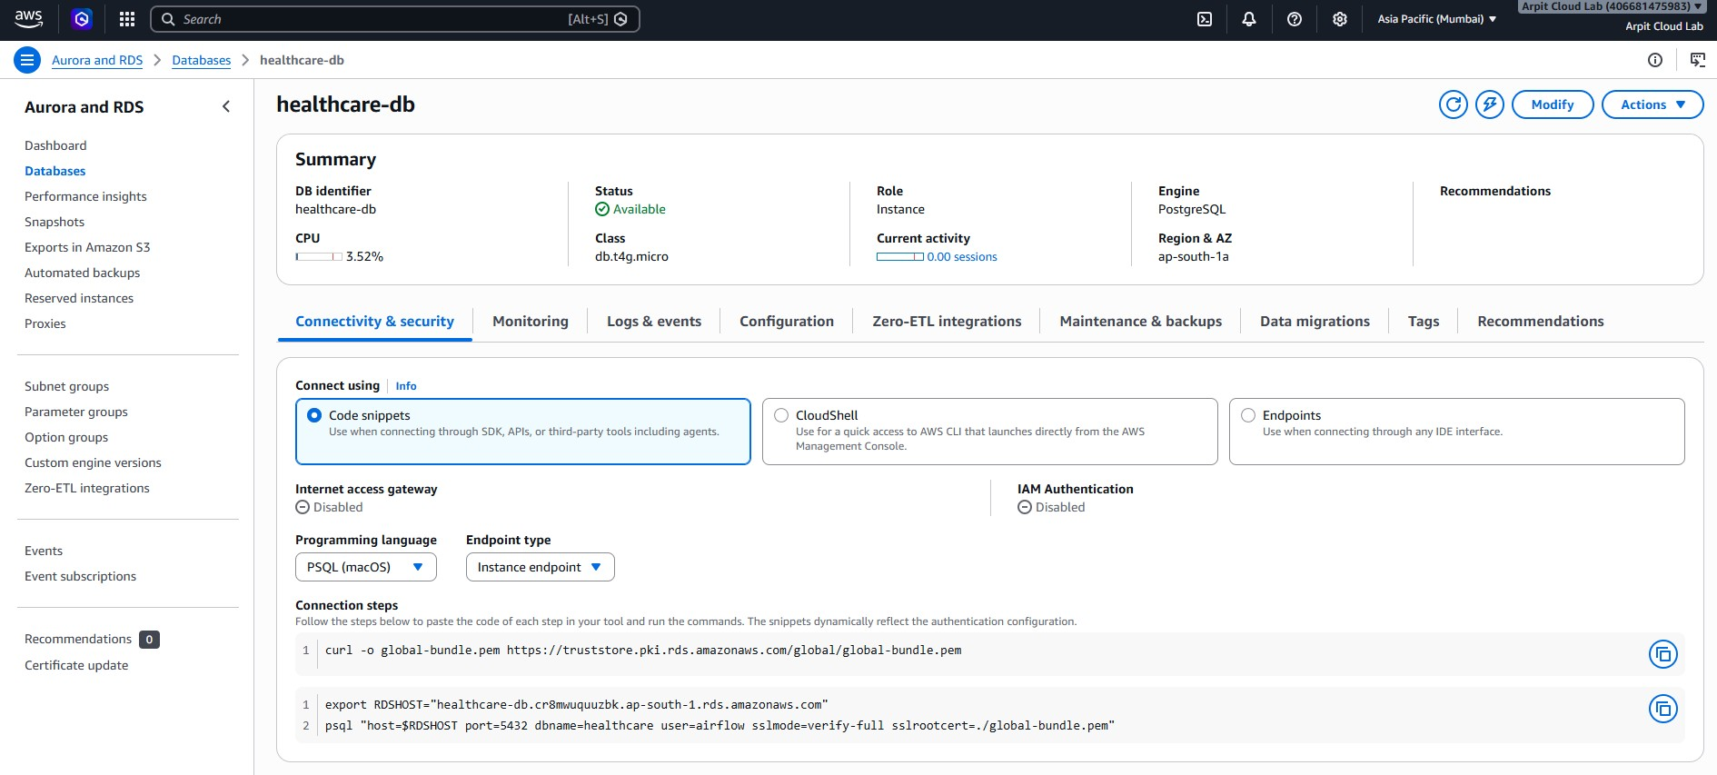
AWS RDS &
Data Warehouse
• PostgreSQL deployed on AWS RDS.
• Star Schema data warehouse created.
• Dimension tables for analytical reporting.
• Fact table stores patient visit information.

Slide 10
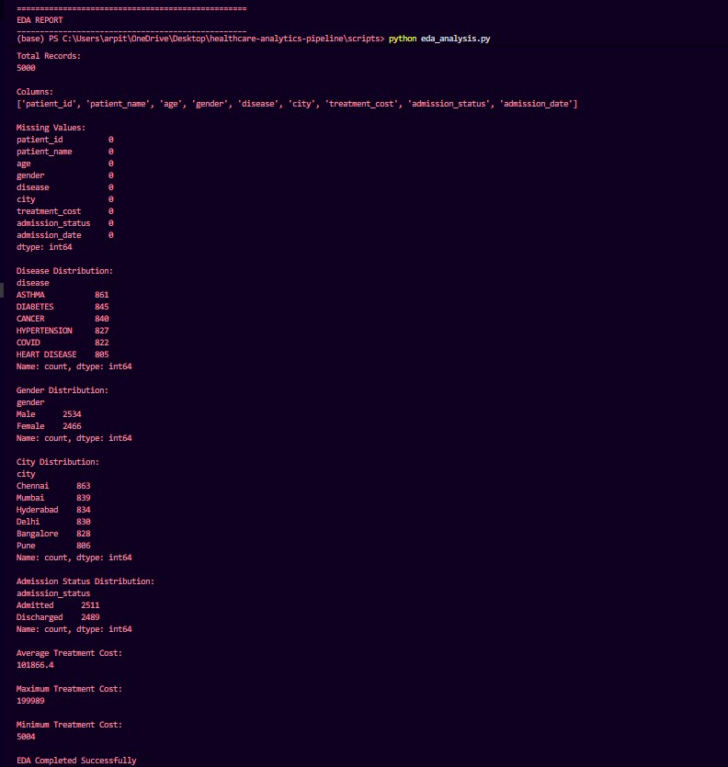
Exploratory Data Analysis
• Disease distribution analysis.
• Gender and city-wise analysis.
• Admission status analysis.
• Treatment cost statistics.
• Generated healthcare insights.

Slide 11
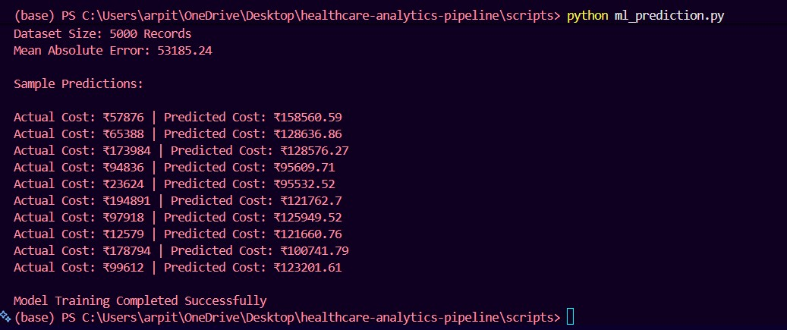
• Random Forest Regressor implemented.
• Treatment cost prediction performed.
• Model trained on healthcare dataset.
• Performance evaluated using MAE.
Machine Learning Model

Slide 12
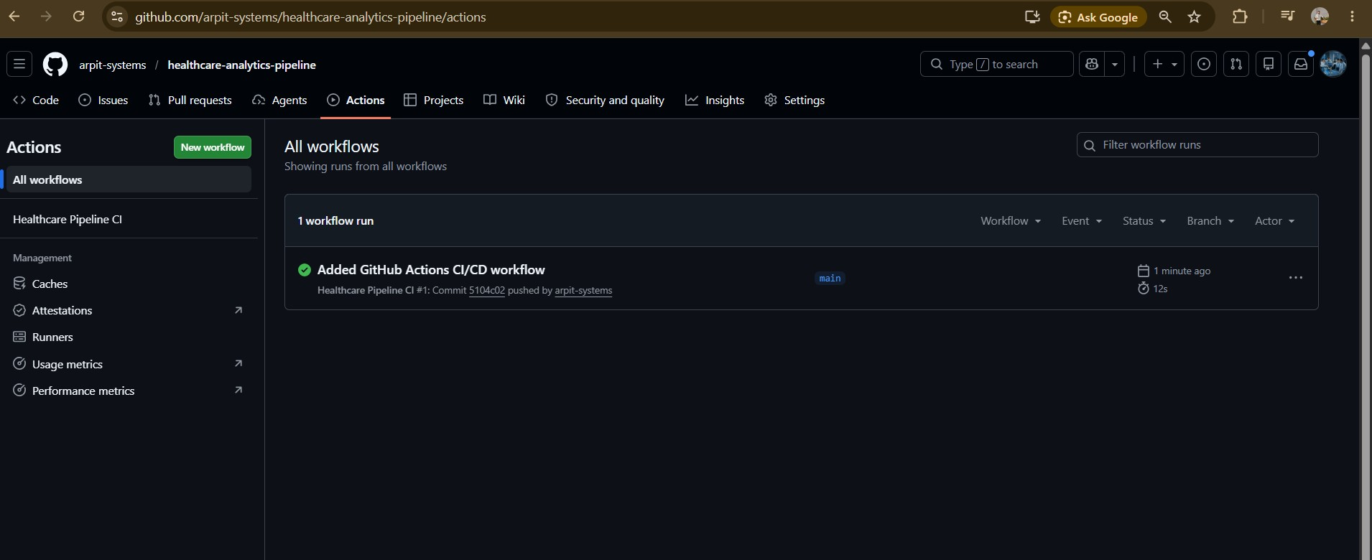
• GitHub Actions workflow implemented
• Automated code validation and execution
• Continuous Integration (CI) pipeline
• Automatic workflow execution on
code updates
• Improved deployment and maintenance
readiness
CI/CD Automation using
GitHub Actions

Slide 13
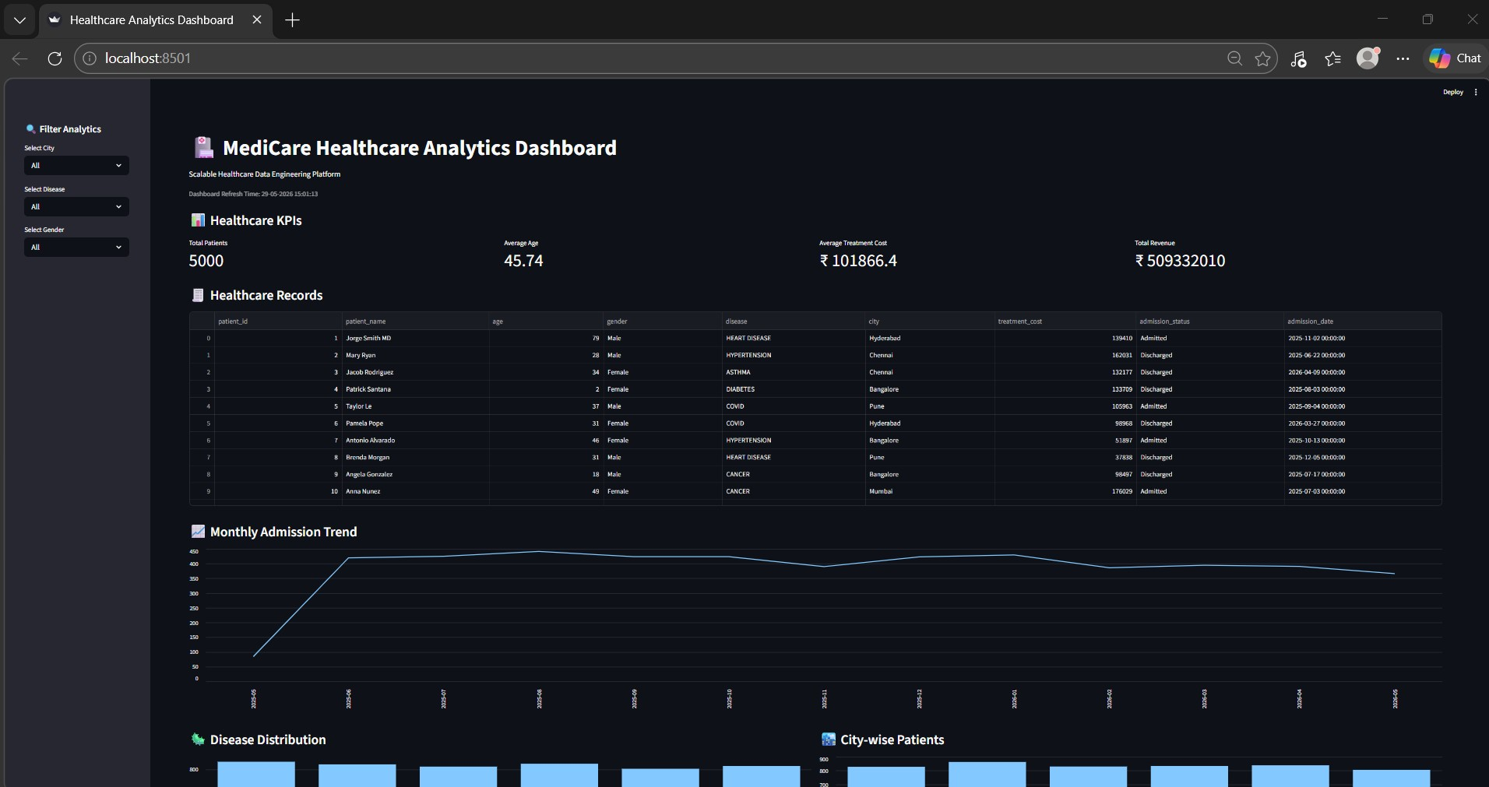
Interactive Dashboard
• Healthcare KPIs and metrics
• Revenue and cost analysis
• Patient trend visualization
• Interactive filtering and reporting
• Live dashboard deployed on
Streamlit Cloud
Live Dashboard URL:
https://medicare-healthcare-dashboard.streamlit.app

Slide 14
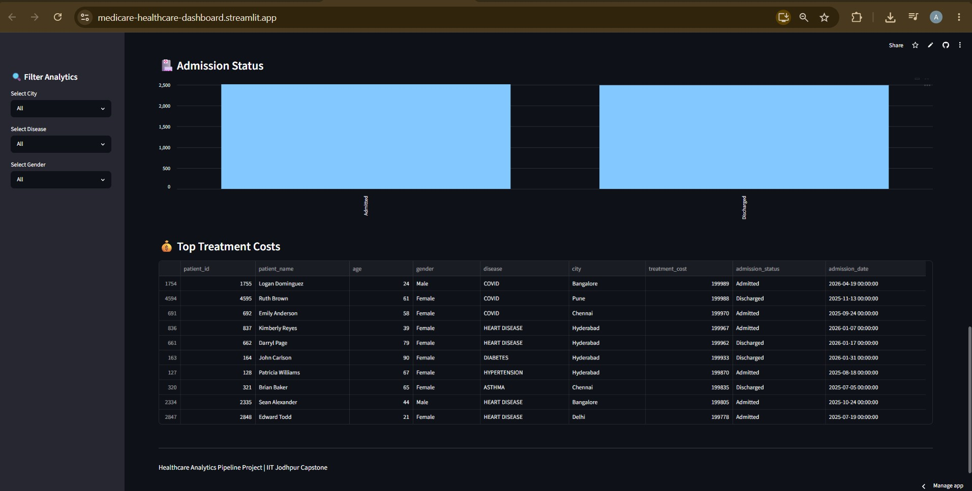
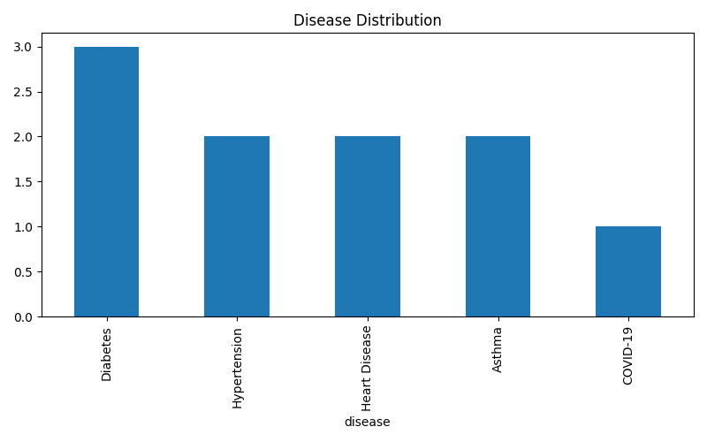
Key Results Achieved
Processed 5000+ healthcare records through an end-to-end analytics pipeline.
Built a healthcare data engineering and analytics platform using AWS S3, PostgreSQL,
Airflow, PySpark, and Databricks.
Implemented real-time healthcare data streaming using Apache Kafka.
Developed an interactive Streamlit dashboard with dynamic filtering and KPI visualization.
Generated disease distribution, treatment cost, admission trends, and patient analytics.
Integrated Machine Learning (Random Forest) for predictive healthcare analytics.
Implemented GitHub Actions CI/CD automation for workflow validation and
deployment readiness.

Slide 15
Conclusion
Built a complete Healthcare Analytics Pipeline.
Integrated AWS S3, Apache Kafka, Databricks, Airflow, PySpark and PostgreSQL.
Designed a Star Schema Data Warehouse.
Developed an Interactive Streamlit Dashboard.
Implemented Machine Learning based Analytics.
Implemented GitHub Actions based CI/CD workflow.
Future Scope
Snowflake Data Warehouse Integration.
Kubernetes-based Container Orchestration.
Production-grade Apache Kafka Streaming.
Integration with Hospital Information Systems.
Advanced Predictive Analytics & Real-time Alerts.
Thank You!

