Slide 1




Project – Predict the City Taxi Trip Duration

Slide 2





Challenge
Business Goal: To improve the efficiency of electronic taxi dispatching systems it is important to be able to predict how long a driver will have his taxi occupied. If a dispatcher knew approximately when a taxi driver would be ending their current ride, they would be better able to identify which driver to assign to each pickup request.
ML Goal: To build a model that predicts the total ride duration of taxi trips in New York City
Data: The taxi trip records include fields capturing pick-up and drop-off dates/times, pick-up and drop-off locations, trip distances, itemized fares, rate types, payment types, and driver-reported passenger counts. The data used in the attached datasets were collected and provided to the NYC Taxi and Limousine Commission (TLC) by technology providers authorized under the Taxicab & Livery Passenger Enhancement Programs (TPEP/LPEP).

Slide 3



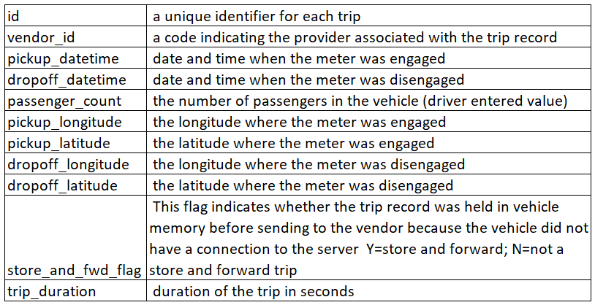
About Data

Slide 4


Data Pre-Processing
1
2
3
4
5
6
Add the Year, Month , Hours, Minutes and Days as the features to the dataframe
Add a feature to the dataframe which checks if it is day time or night time
Calculate the Distance travelled with the help of latitudes and longtitudes of the pickup and dropoff locations
check for outliers
Check for highly correlated values
Check for duplicated values

Slide 5


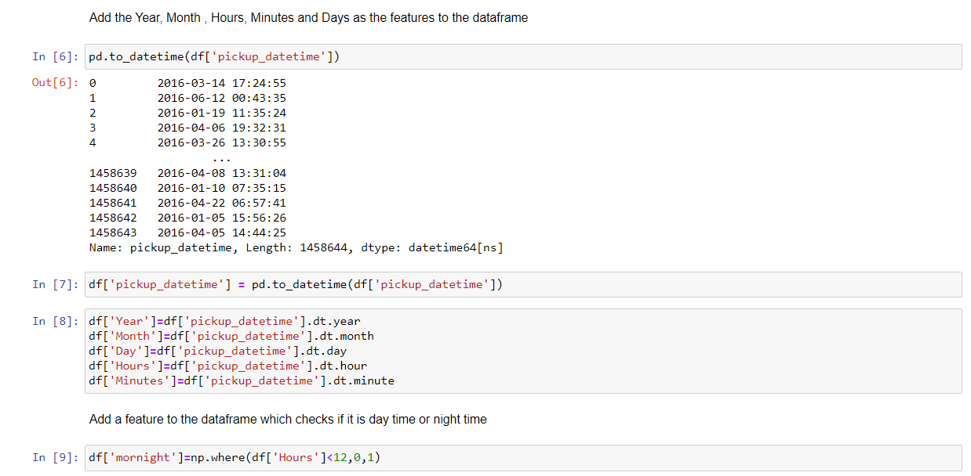


Slide 6
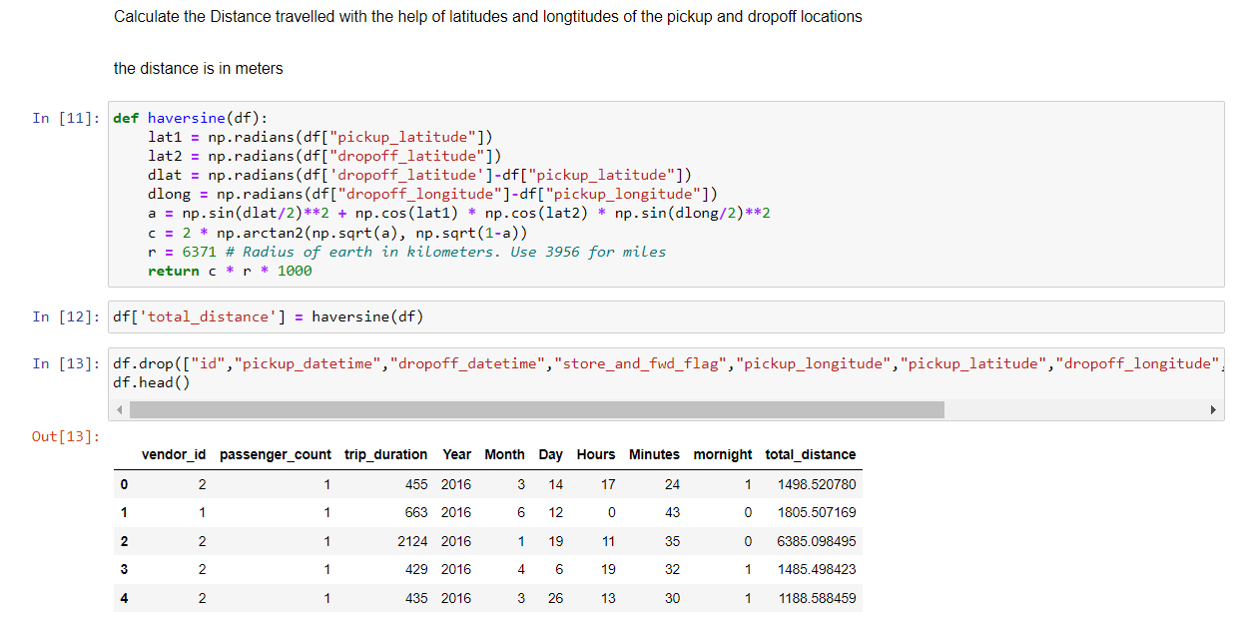

Slide 7
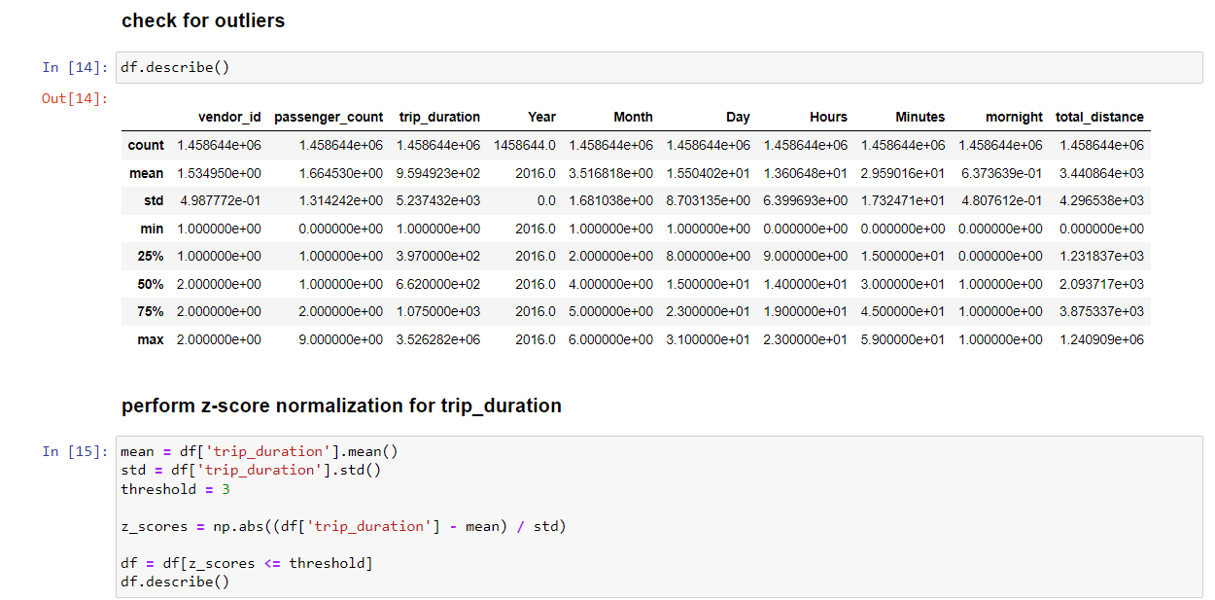

Slide 8
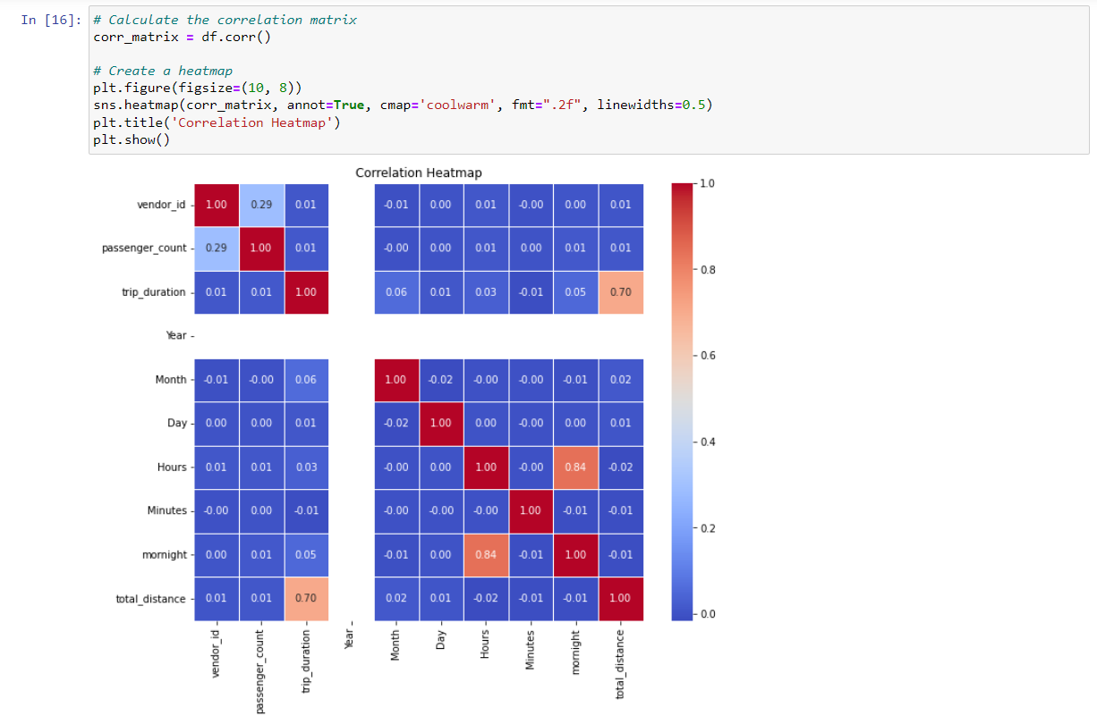

Slide 9
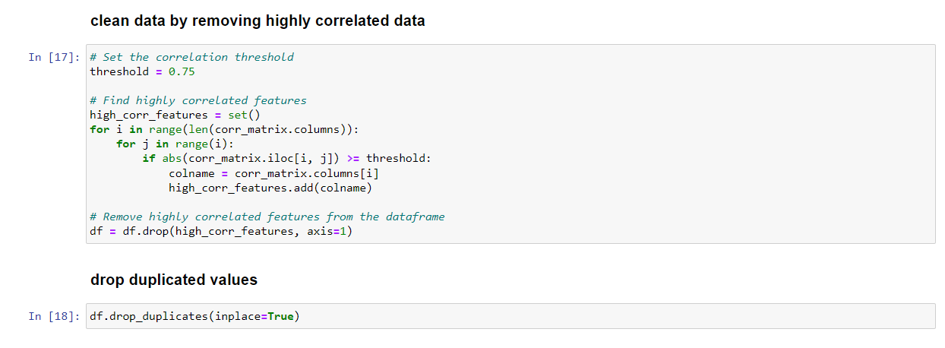

Slide 10

Train and Test Model
Linear Regression Model
Ridge Model
Lasso Model
LightGBM Model

Slide 11
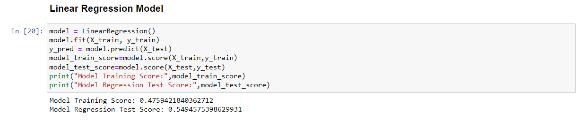

Slide 12
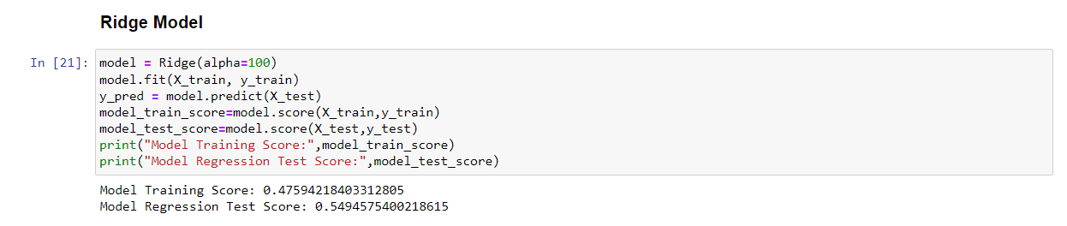

Slide 13
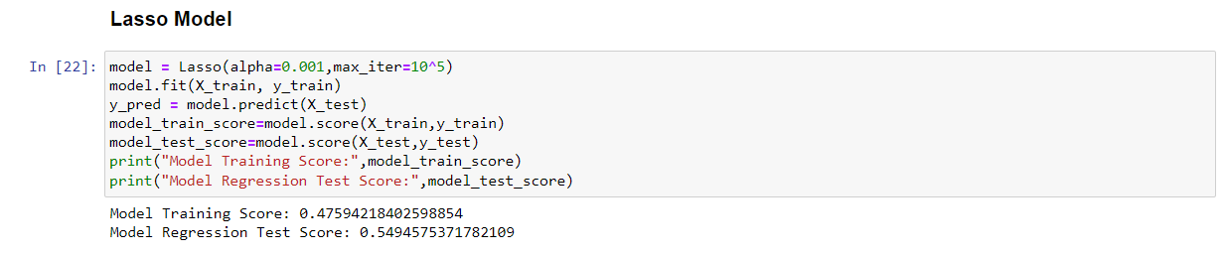

Slide 14
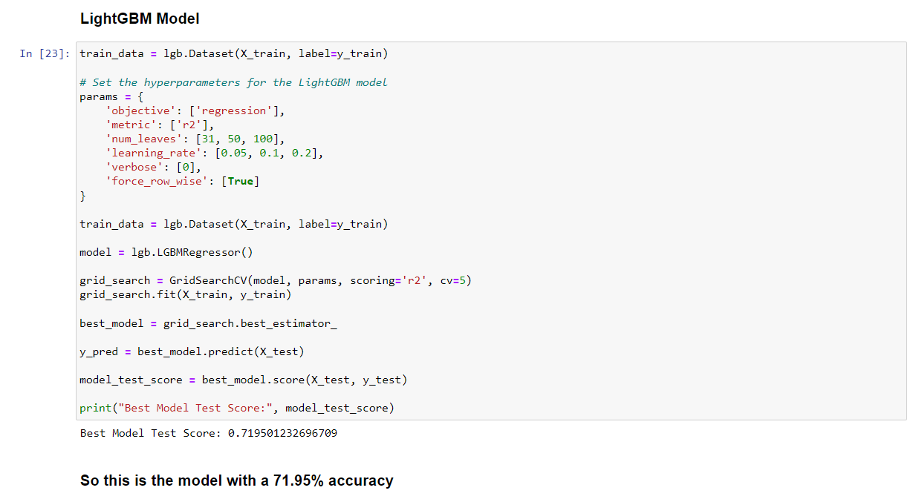

Slide 15

Conclusion
In conclusion, we have successfully developed a robust machine learning model that accurately predicts the trip duration of a taxi. By leveraging various features such as vendor ID, passenger count, pickup and dropoff coordinates, and other relevant factors, our model demonstrates strong performance in estimating the time it takes for a taxi ride.
Overall, our model showcases the potential of machine learning in the transportation industry and opens up avenues for further research and development in this field.

Slide 16

I would like to express my sincere gratitude to everyone who contributed to the success of this project.
First and foremost, I would like to thank capabl team for their guidance, support, and valuable insights throughout the project. Their expertise and encouragement were instrumental in shaping the direction of this research.
This project would not have been possible without the collective effort and support from the capabl team
Acknowledgements

Slide 17
Thank You
Project Created by ARPIT JAISWAL
Github link- https://github.com/arpit00000/Taxi-Trip_duration_prediction_model.git

